Slide 1
Reading Data in Web Pages
A very common application of PHP is to have an HTML form gather information from a website's visitor and then use PHP to do process that information.
Data can be entered in to the forms through
Textbox
Password
Text area
Radio buttons
Check boxes
Drop down
List box
The entered data collect from the php
Reading Data in Web Pages
UPES

Slide 2
The PHP $_GET and $_POST variables are used to retrieve information from forms, like user input.
The most important thing to notice when dealing with HTML forms and PHP is that any form element in an HTML page will automatically be available to your PHP scripts.
The example below contains an HTML form with two text input fields and a submit button.
Reading Data in Web Pages
UPES

Slide 3
Text fields are one line areas that allow the user to input text.
The name setting adds an internal name to the field so the program that handles the form can identify the fields.
The value setting defines what will appear in the box as the default value.
Reading Data in Web Pages
UPES

Slide 4
When a visitor clicks a submit button, the form is sent to the address specified in the action setting of the <form> tag.
The name setting adds an internal name to the button so the program that handles the form doesn't confuse the button with the other fields.
The value setting defines what is written on the button.
Reading Data in Web Pages
UPES

Slide 5
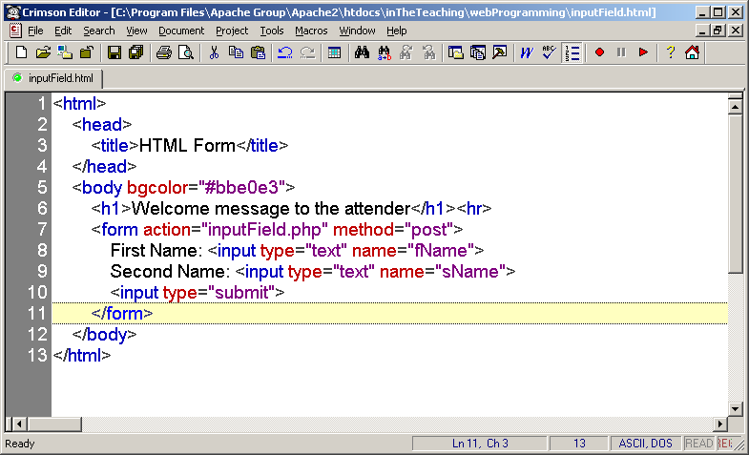
Reading Data in Web Pages
UPES

Slide 6
When a user fills out the form above and click on the submit button, the form data is sent to a PHP file, called “inputField.php":
" inputField.php" looks like this:
Reading Data in Web Pages
UPES

Slide 7
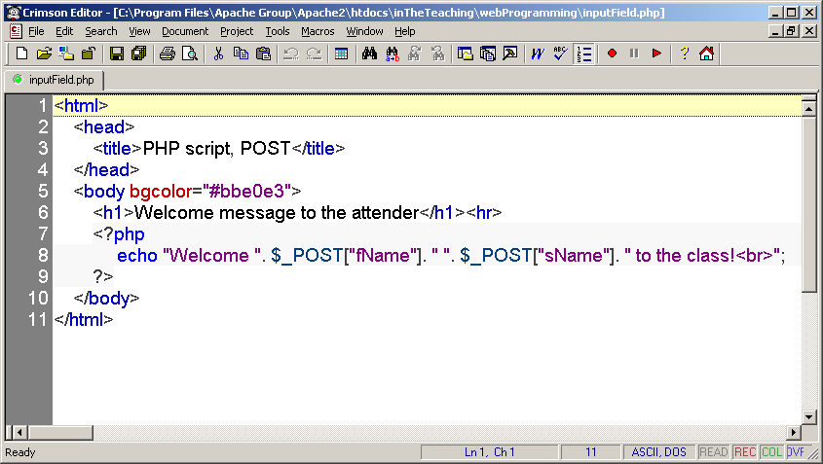
Reading Data in Web Pages
UPES

Slide 8
Be sure to take notice the names of the form data names, as they represent the keys in the "$_POST" associative array.
Next the output could be something like this:
Reading Data in Web Pages
UPES

Slide 9
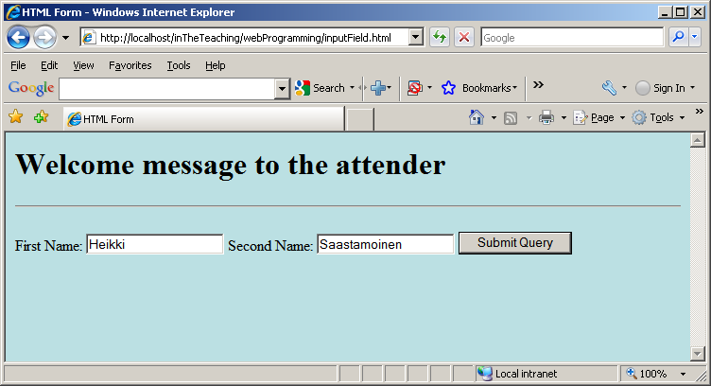
Reading Data in Web Pages
UPES

Slide 10
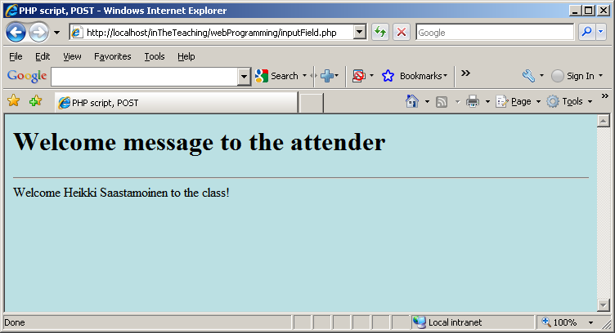
Reading Data in Web Pages
UPES

Slide 11
The built-in $_POST function is used to collect values from a form sent with method="post".
Information sent from a form with the POST method is invisible to others and has no limits on the amount of information to send.
Note: However, there is an 8 Mb max size for the POST method, by default (can be changed by setting the post_max_size in the php.ini file).
When the user clicked the "Submit" button in the previous example, the URL looked like this:
http://localhost/inTheTeaching/webProgramming/inputField.phpThe.
“inputField.php" file was able to use the $_POST function to collect form data (the names of the form fields will automatically be the keys in the $_POST array).
Reading Data in Web Pages
UPES

Slide 12
Another way to get this information would be to create two new variables and set them equal to the values that have been "posted“:
Reading Data in Web Pages
UPES

Slide 13
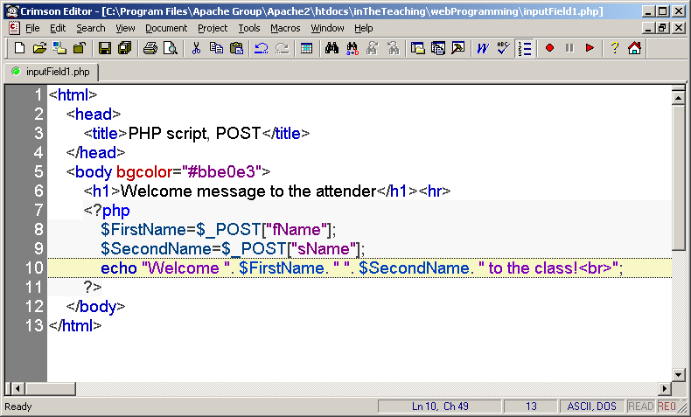
Reading Data in Web Pages
UPES

Slide 14
When to use method="post"?
Information sent from a form with the POST method is invisible to others and has no limits on the amount of information to send.
However, because the variables are not displayed in the URL, it is not possible to bookmark the page.
Reading Data in Web Pages
UPES

Slide 15
The built-in $_GET function is used to collect values from a form sent with method="get".
Information sent from a form with the GET method is visible to everyone (it will be displayed in the browser's address bar) and has limits on the amount of information to send (max. 100 characters).
The get method passes the variables along to the “inputField2.php" web page by appending them onto the end of the URL.
Reading Data in Web Pages
UPES

Slide 16
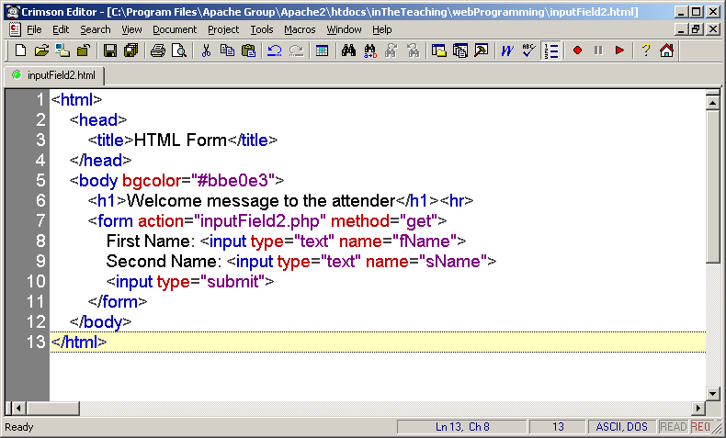
Reading Data in Web Pages
UPES

Slide 17
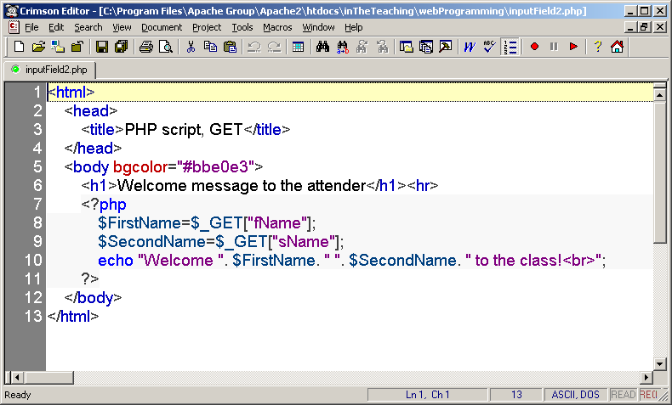
Reading Data in Web Pages
UPES

Slide 18

Reading Data in Web Pages
UPES

Slide 19

Reading Data in Web Pages
UPES

Slide 20
When the user clicked the "Submit" button, the URL sent to the server looked something like this:
http://localhost/inTheTeaching/webProgramming/inputField2.php?fName=Kirsi&sName=Taivalantti.
The question mark "?" tells the browser that the following items are variables.
The “inputField.php" file was able to use the $_GET function to collect form data (the names of the form fields will automatically be the keys in the $_GET array).
Reading Data in Web Pages
UPES

Slide 21
When to use method="get"?
When using method="get" in HTML forms, all variable names and values are displayed in the URL.
Note: Because of the above behavior this method should not be used when sending passwords or other sensitive information!
However, because the variables are displayed in the URL, it is possible to bookmark the page. This can be useful in some cases.
Note: The get method is not suitable for large variable values; the value cannot exceed 100 characters.
Reading Data in Web Pages
UPES

Slide 22
The PHP $_REQUEST Function
The PHP built-in $_REQUEST function contains the contents of both $_GET, $_POST, and $_COOKIE.
The $_REQUEST function can be used to collect form data sent with both the GET and POST methods.
Reading Data in Web Pages
UPES

Slide 23
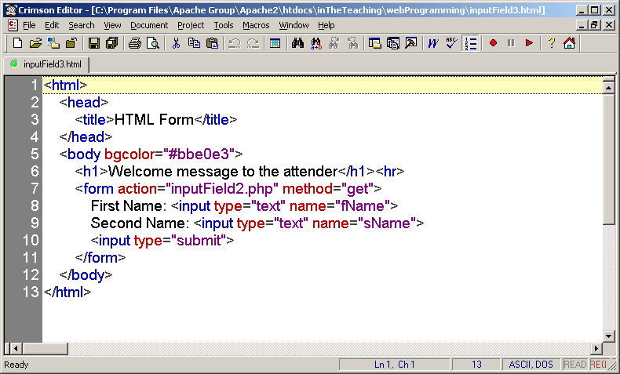
Reading Data in Web Pages
UPES

Slide 24
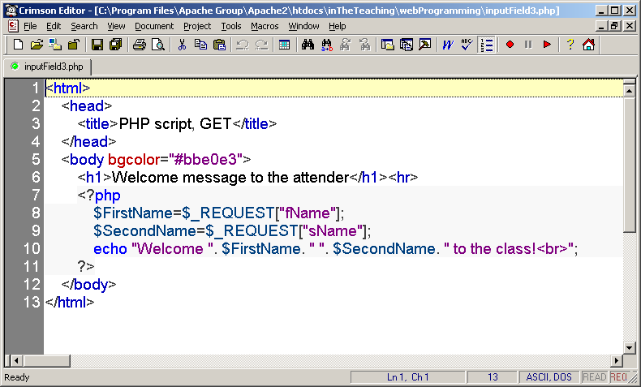
Reading Data in Web Pages
UPES

Slide 25

Reading Data in Web Pages
UPES

Slide 26

Reading Data in Web Pages
UPES

Slide 27
Next example deals with Drop-Down Menu, only one item can be selected.
The name setting adds an internal name to the field so the program that handles the form can identify the fields.
The value setting defines what will be submitted if the item is selected. This is not always the same as what it says in the menu.
name = value information will be sent to the script (if the value attribute is used – otherwise the text displayed in the menu will be transmitted):
Reading Data in Web Pages
UPES

Slide 28
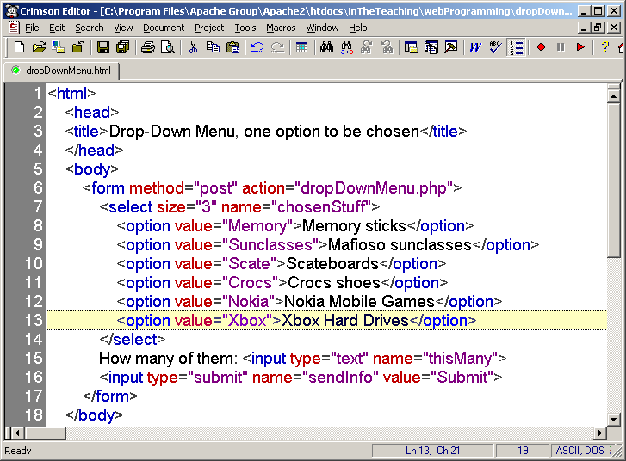
Reading Data in Web Pages
UPES

Slide 29
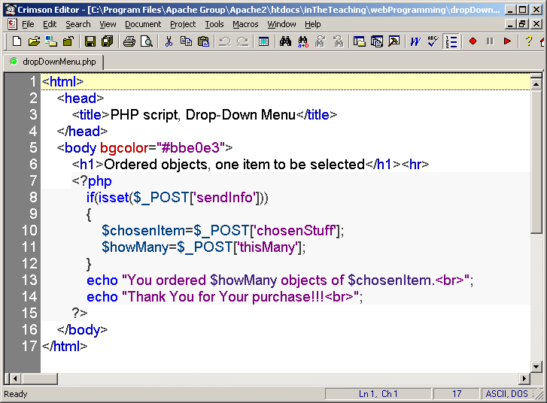
Reading Data in Web Pages
UPES

Slide 30
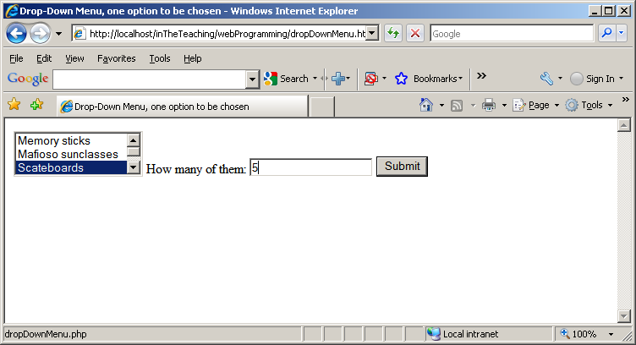
Reading Data in Web Pages
UPES

Slide 31
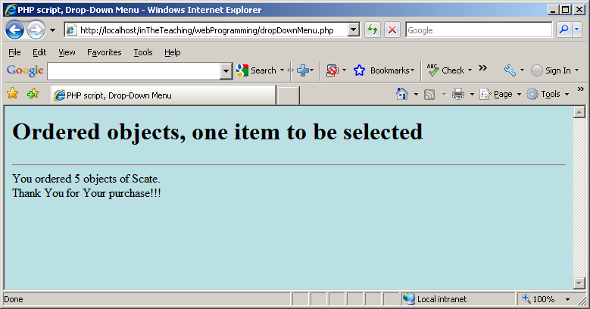
Reading Data in Web Pages
UPES

Slide 32
Again an example with Drop-Down Menu, now several items can be selected.
The multiple setting will allow for multiple selections if present.
Here we must give the control the name of an array, not just a name.
Reading Data in Web Pages
UPES

Slide 33
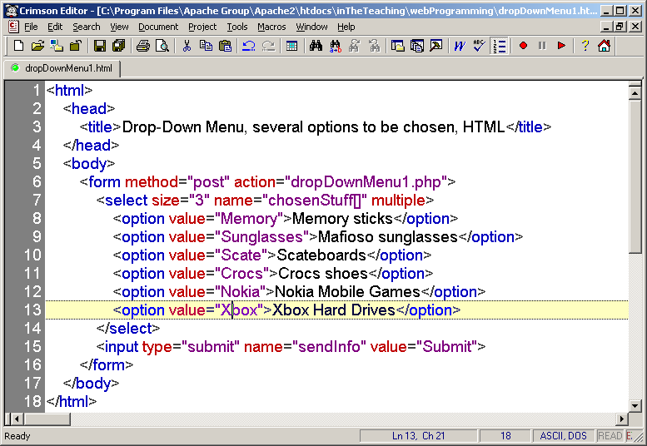
Reading Data in Web Pages
UPES

Slide 34
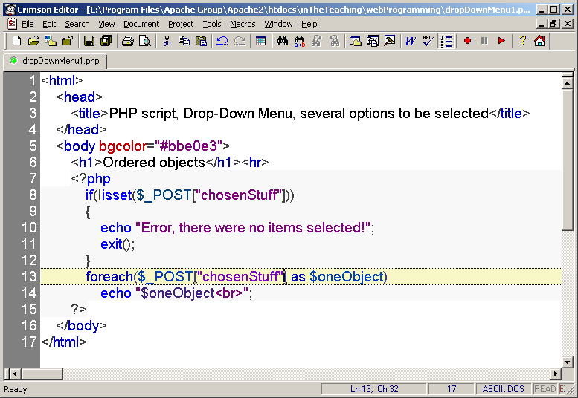
Reading Data in Web Pages
UPES

Slide 35
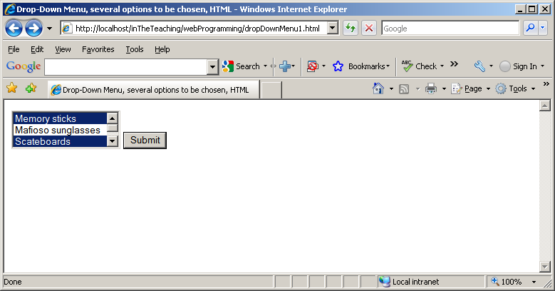
Reading Data in Web Pages
UPES

Slide 36
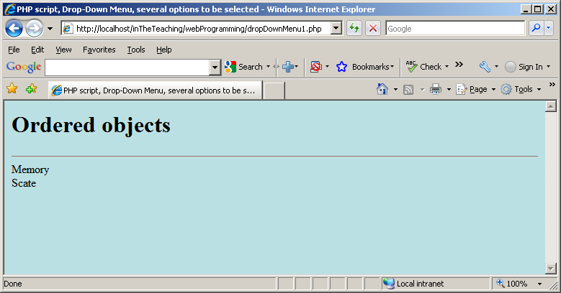
Reading Data in Web Pages
UPES

Slide 37
Radio buttons are used when you want to let the visitor select one - and just one - option from a set of alternatives. If more options are to be allowed at the same time you should use check boxes instead.
The name setting tells which group of radio buttons the field belongs to. When you select one button, all other buttons in the same group are unselected.
If you couldn't define which group the current button belongs to, you could only have one group of radio buttons on each page.
The value setting defines what will be submitted if checked.
Reading Data in Web Pages
UPES

Slide 38
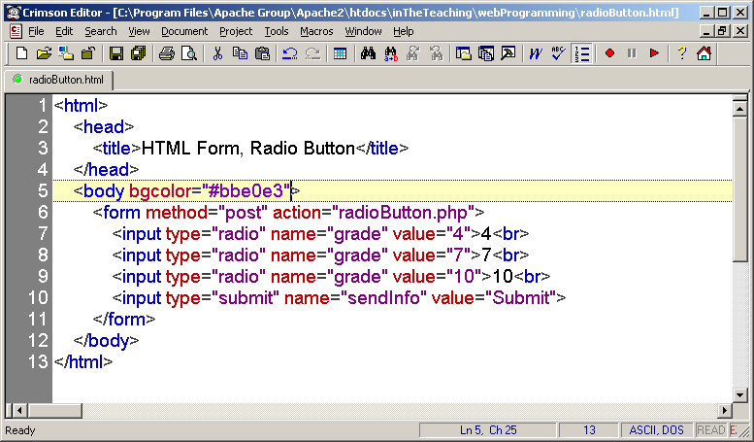
Reading Data in Web Pages
UPES

Slide 39
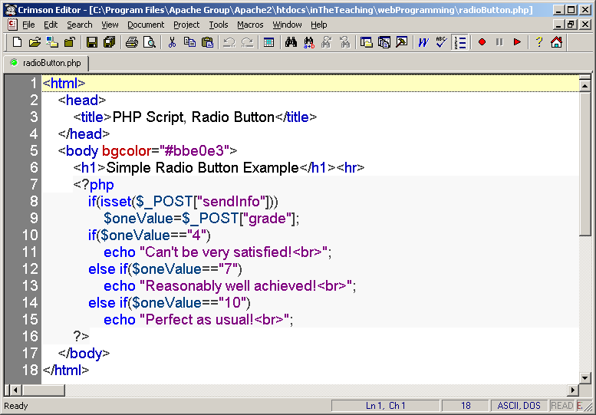
Reading Data in Web Pages
UPES

Slide 40
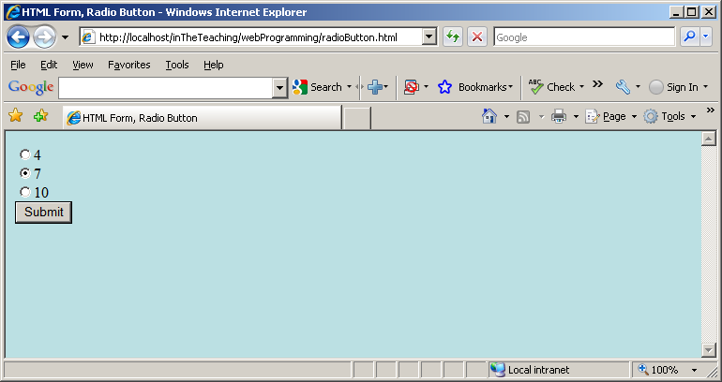
Reading Data in Web Pages
UPES

Slide 41
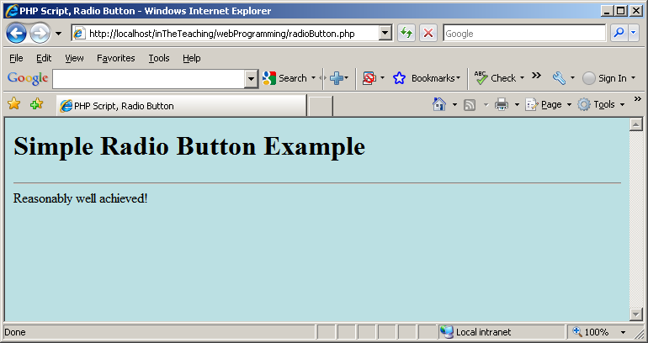
Reading Data in Web Pages
UPES

Slide 42
Next example is only slightly modified compared to the previous one:
Reading Data in Web Pages
UPES

Slide 43
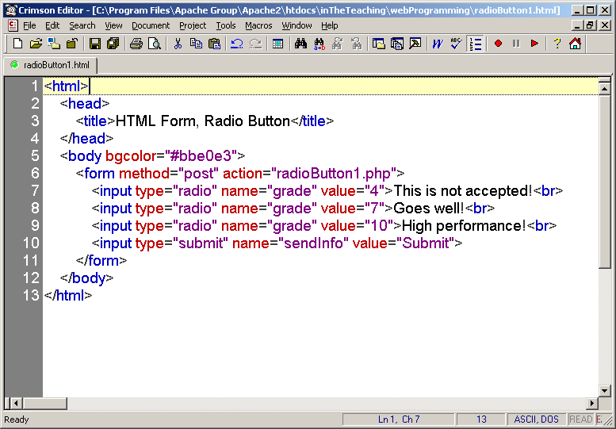
Reading Data in Web Pages
UPES

Slide 44
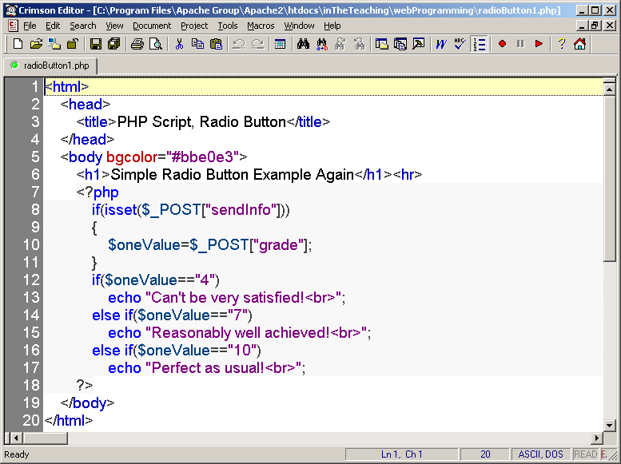
Reading Data in Web Pages
UPES

Slide 45
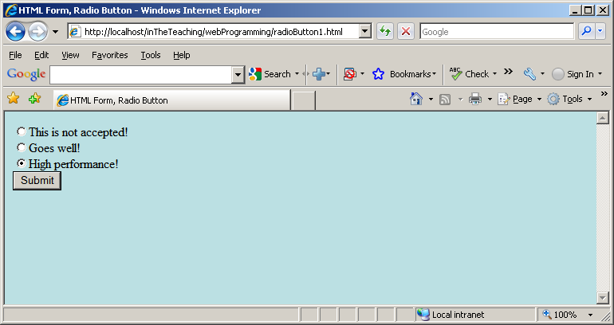
Reading Data in Web Pages
UPES

Slide 46
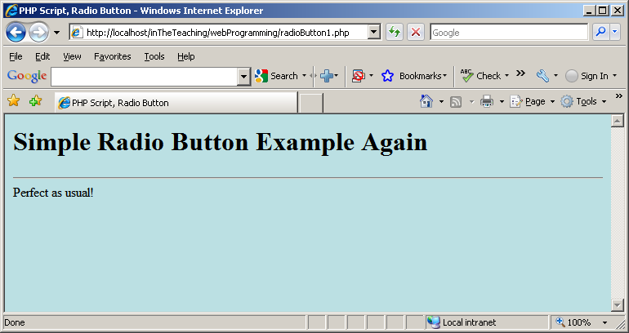
Reading Data in Web Pages
UPES

Slide 47
Check boxes are used when you want to let the visitor select one or more options from a set of alternatives.
The name setting adds an internal name to the field so the program that handles the form can identify the fields.
The value setting defines what will be submitted if checked.
Reading Data in Web Pages
UPES

Slide 48
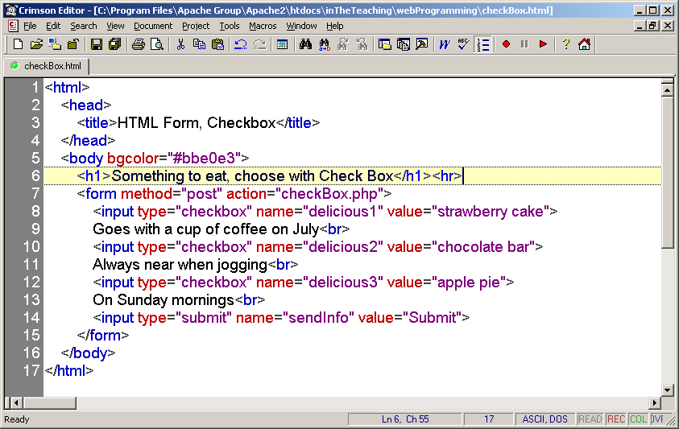
Reading Data in Web Pages
UPES

Slide 49
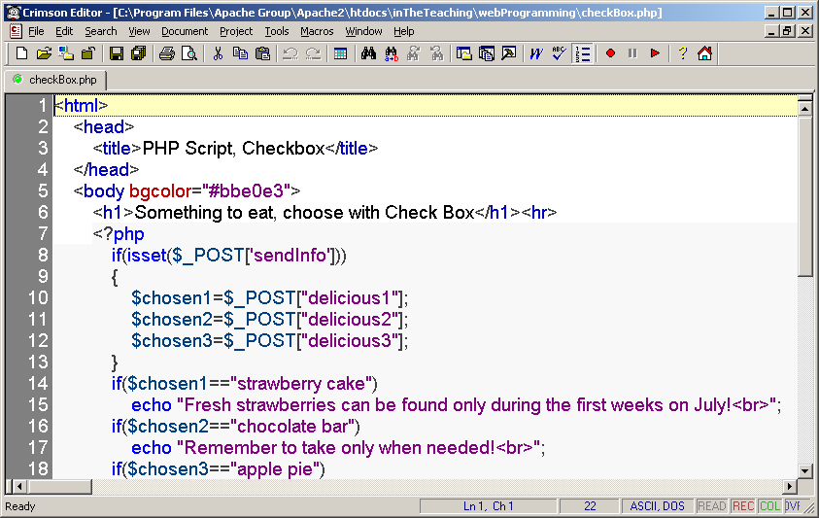
Reading Data in Web Pages
UPES

Slide 50
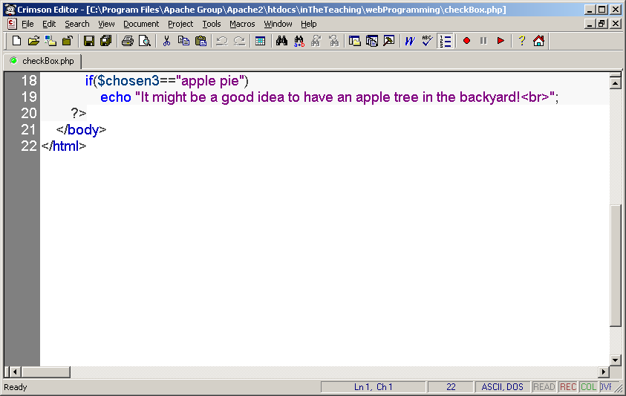
Reading Data in Web Pages
UPES

Slide 51
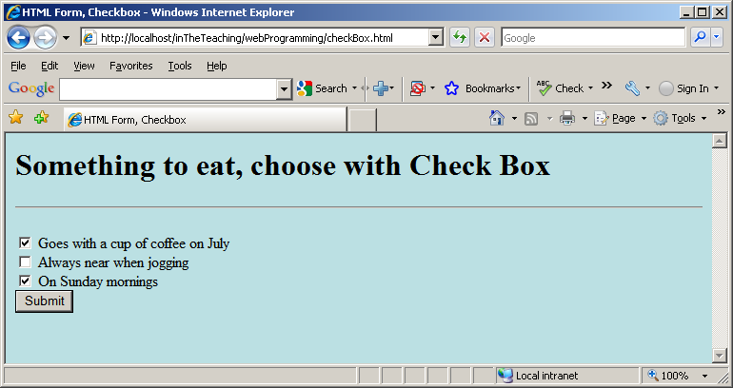
Reading Data in Web Pages
UPES

Slide 52
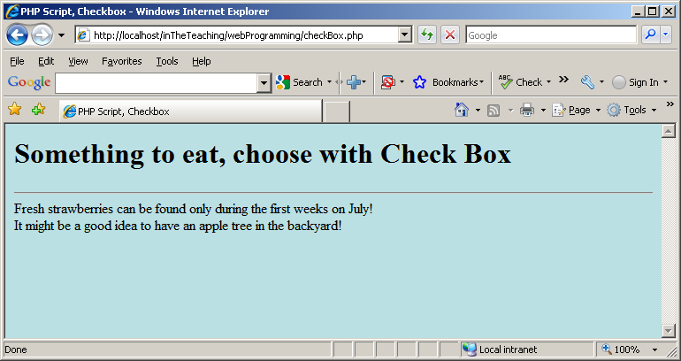
Reading Data in Web Pages
UPES

Slide 53
A minor modification to the previous one, let us give the name setting the name of an array:
Reading Data in Web Pages
UPES

Slide 54
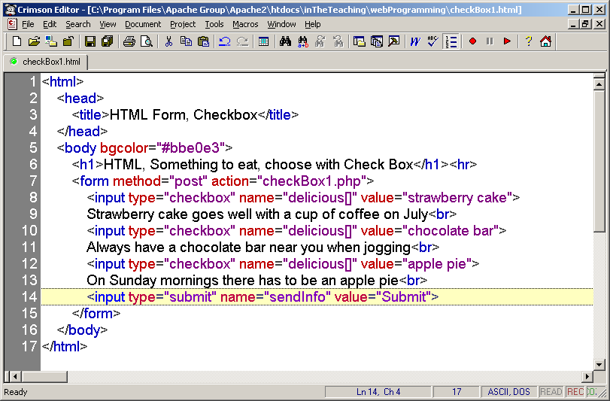
Reading Data in Web Pages
UPES

Slide 55
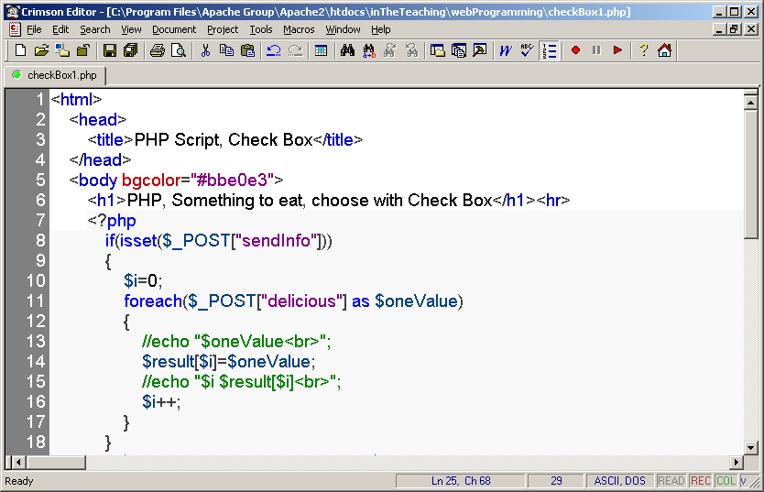
Reading Data in Web Pages
UPES

Slide 56
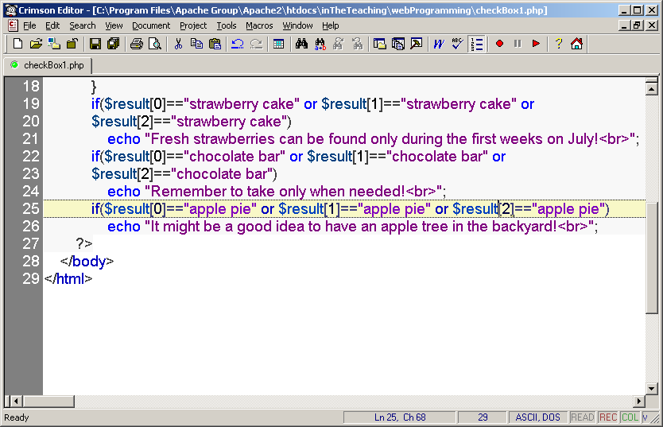
Reading Data in Web Pages
UPES

Slide 57
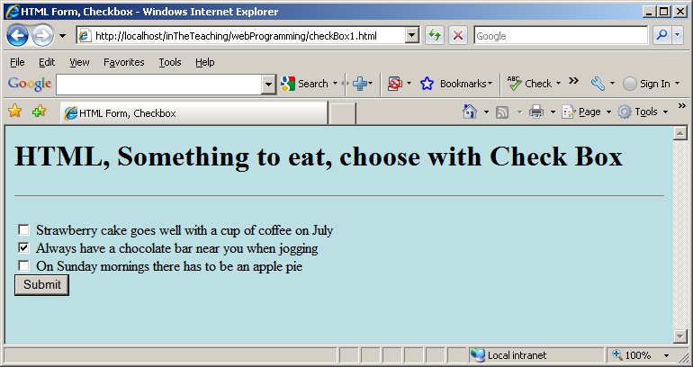
Reading Data in Web Pages
UPES

Slide 58
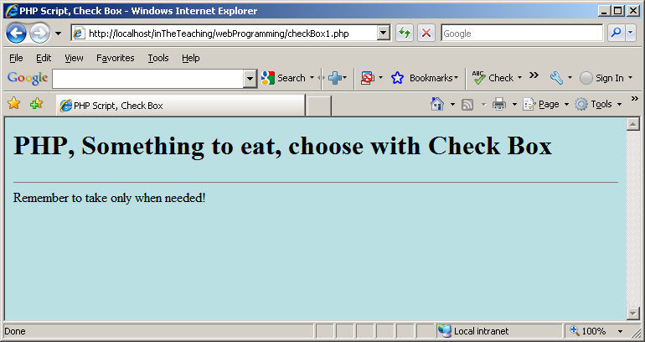
Reading Data in Web Pages
UPES

Slide 59
Text areas are text fields that can span several lines.
Unlike most other form fields, text areas are not defined with an <input> tag.
Instead you enter a <textarea> tag where you want the text area to start and a closing </textarea> tag where you want the area to end.
Everything written between these tags will be presented in the text area box.
The name setting adds an internal name to the field so the program that handles the form can identify the fields.
Reading Data in Web Pages
UPES

Slide 60
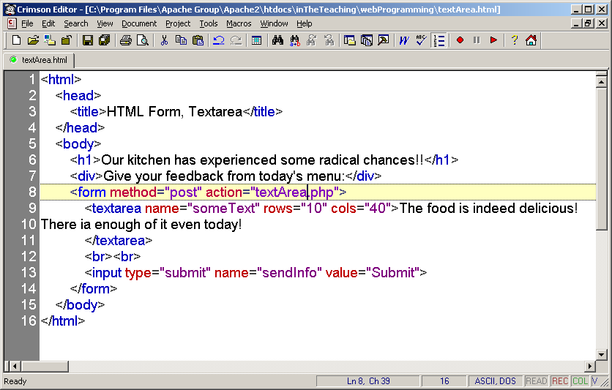
Reading Data in Web Pages
UPES

Slide 61
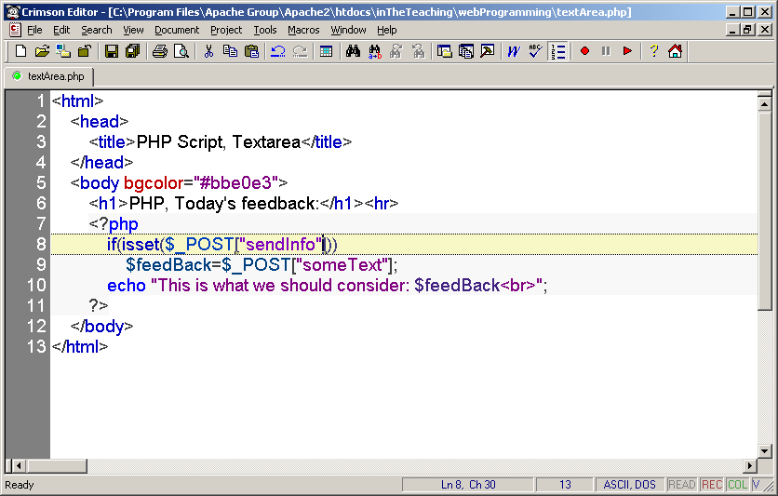
Reading Data in Web Pages
UPES

Slide 62
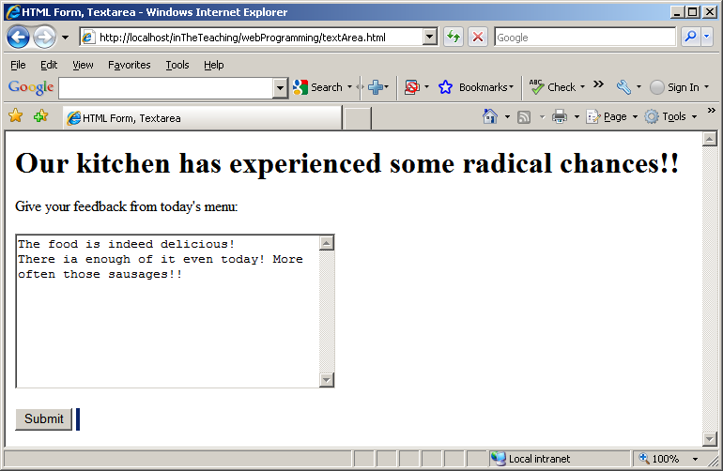
Reading Data in Web Pages
UPES

Slide 63
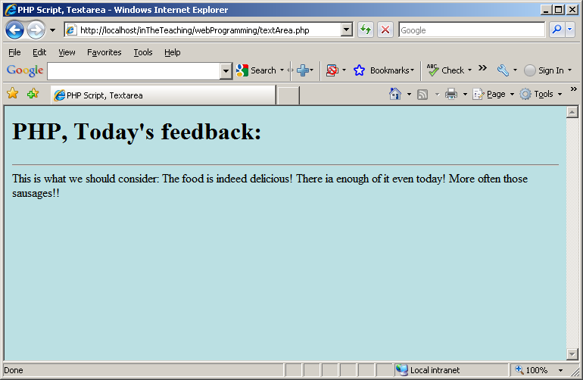
Reading Data in Web Pages
UPES

Slide 64
Password fields are similar to text fields.
The difference is that what is entered into a password field shows up as dots on the screen. This is, of course, to prevent others from reading the password on the screen.
The name setting adds an internal name to the field so the program that handles the form can identify the fields.
Reading Data in Web Pages
UPES

Slide 65
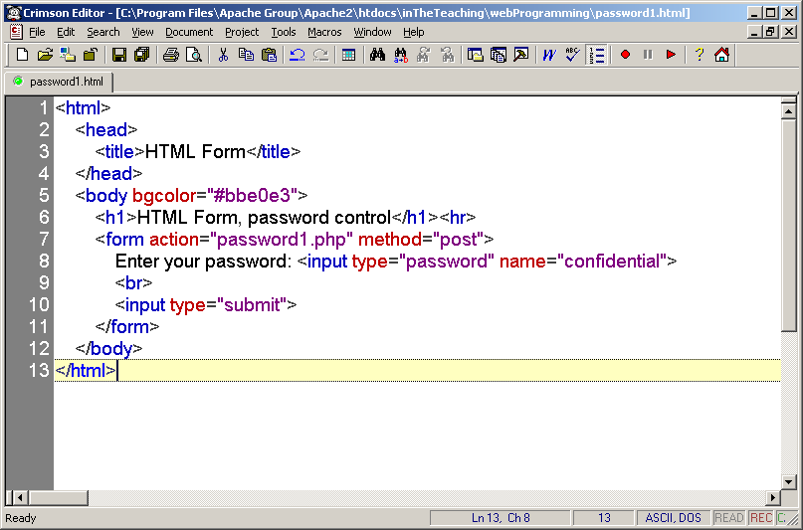
Reading Data in Web Pages
UPES

Slide 66
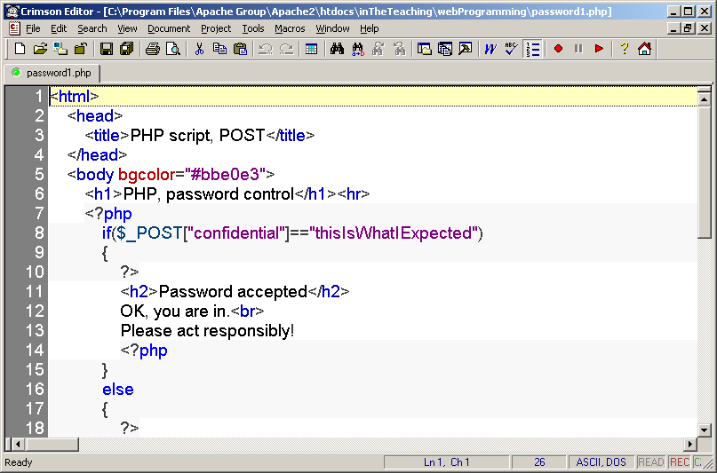
Reading Data in Web Pages
UPES

Slide 67
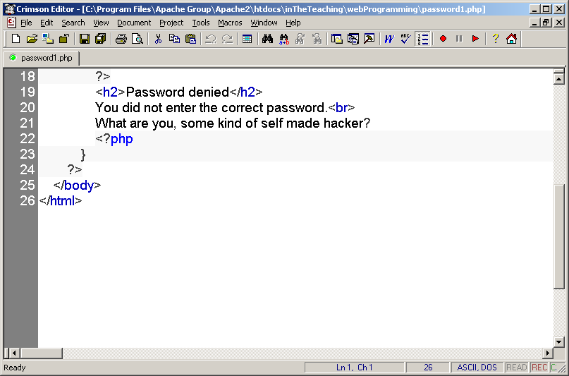
Reading Data in Web Pages
UPES

Slide 68
The previous example checks the given password against the password, which is “thisIsWhatIExpected” in this case, and if it matches, display a welcome page to the user.
On the other hand, if password the user entered is not right, you can display an error page – note how the password1.php script mixes HTML and PHP.
Reading Data in Web Pages
UPES

Slide 69
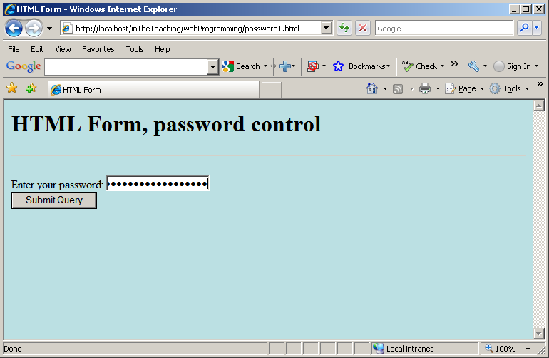
Reading Data in Web Pages
UPES

Slide 70
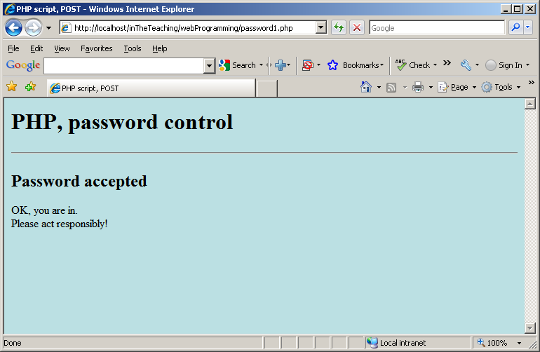
Reading Data in Web Pages
UPES

Slide 71
If you do not enter the right password:
Reading Data in Web Pages
UPES

Slide 72
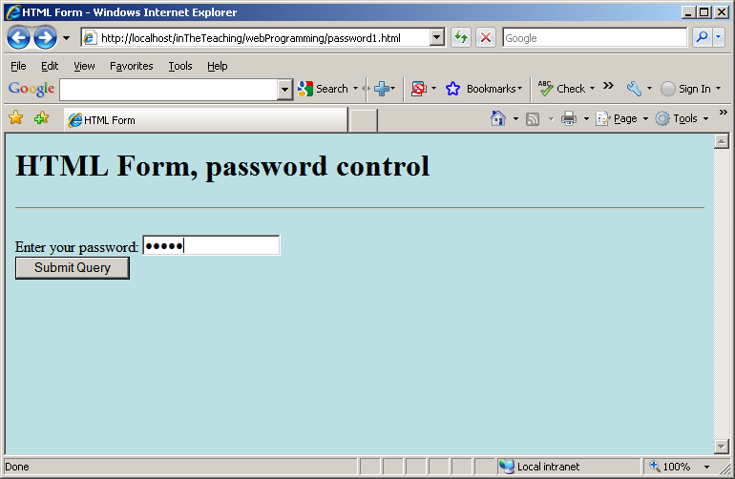
Reading Data in Web Pages
UPES

Slide 73
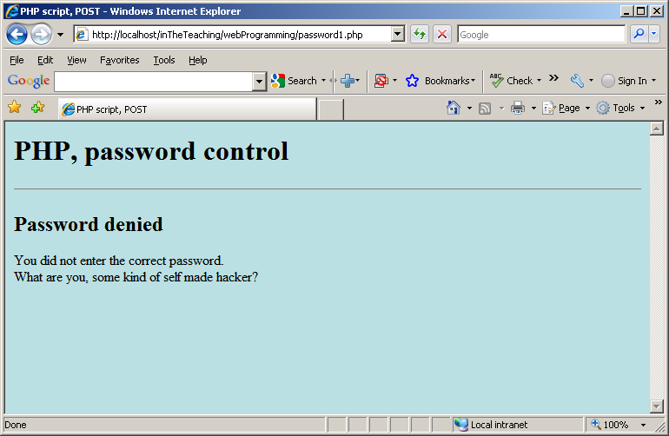
Reading Data in Web Pages
UPES

Slide 74
Hidden fields are similar to text fields, with one very important difference!
The difference is that the hidden field does not show on the page. Therefore the visitor can't type anything into a hidden field, which leads to the purpose of the field: to submit information that is not entered by the visitor.
The name setting adds an internal name to the field so the program that handles the form can identify the fields.
The value setting defines what will be sent once the form is submitted.
Reading Data in Web Pages
UPES

Slide 75
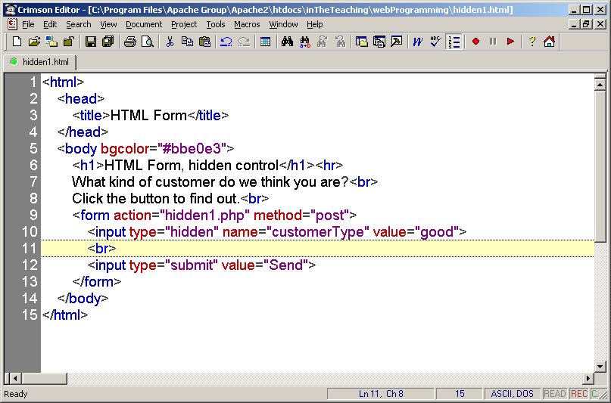
Reading Data in Web Pages
UPES

Slide 76
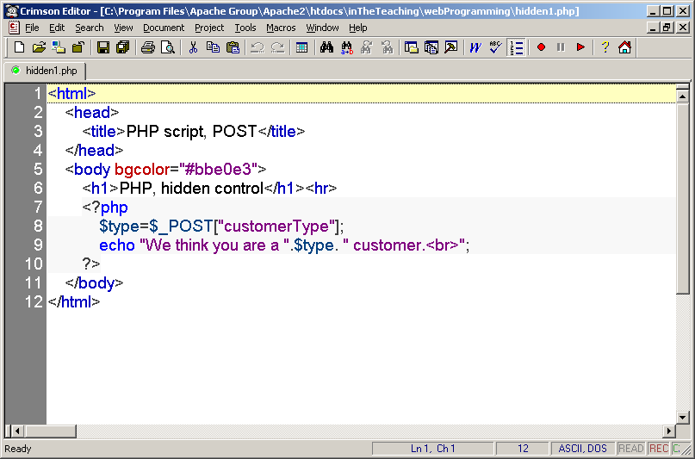
Reading Data in Web Pages
UPES

Slide 77
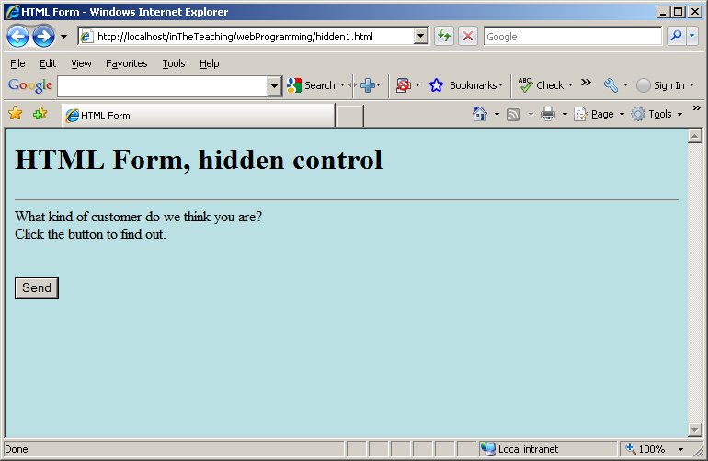
Reading Data in Web Pages
UPES

Slide 78
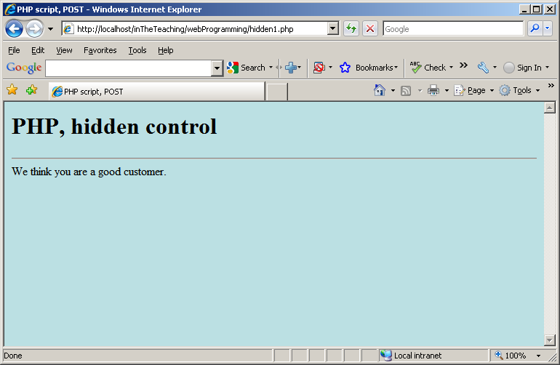
Reading Data in Web Pages
UPES

Slide 79
Putting it all in one page
So far, the applications we have developed have relied on an HTML start page that connects to a PHP page.
However, it can all be handled with one PHP page.
Next is an example, which asks the name of the user.
The name will be stored in the $_REQUEST array under the name “myName”.
That means that if data is waiting for you in the $_REQUEST array under the name “myName”, you should display that data. If data is not waiting for you, you should display the welcome page that asks for the name.
Reading Data in Web Pages
UPES

Slide 80
You can check if data is waiting for you with the PHP isset() function, which returns TRUE if an array element exists
Reading Data in Web Pages
UPES

Slide 81

Reading Data in Web Pages
UPES

Slide 82

Reading Data in Web Pages
UPES

Slide 83

Reading Data in Web Pages
UPES

Slide 84

Reading Data in Web Pages
UPES

