Slide 1
Outline
1
Introduction Memory
Memory Hierarchy
Memory Management System
Main Memory
2
3
4
5
6
Unit 4 - Memory Organization

Slide 2
Memory
The memory that communicates directly with CPU is called main memory.
Devices that provides backup storage are called auxiliary memory.
Only program and data currently needed by the processor resides in main memory.
All other information is stored in auxiliary memory and transferred to main memory when needed.
Unit 4 - Memory Organization

Slide 3
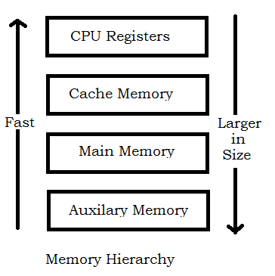
Memory Hierarchy
Unit 4 - Memory Organization

Slide 4
CPU Register - also known as Internal Processor Memory. The data or instruction which has to be executed are kept in these registers.
The Cache Memory is employed in computer system to compensate for the speed differential between main memory access time and processor logic.
The cache is used for storing segments of programs currently being executed in the CPU and temporary data frequently needed in the present calculations.
By making program and data available at a rapid rate, it is possible to increase the performance rate of the computer.
Unit 4 - Memory Organization

Slide 5
Memory Management System
Many operating system are designed to enable the CPU to process a number of independent programs concurrently - known as multiprogramming.
Sometimes a program are too long to be accommodated in total space available in main memory. A program with its data normally resides in auxiliary memory.
When the program or a segment of program is to be executed, it is transfered to main memory to be executed by the CPU.
The part of the computer system that supervise the flow of information between auxiliary memory and main memory is called the memory management system.
Unit 4 - Memory Organization

Slide 6
Main Memory
The principal technology used for main memory is based on
semiconductor integrated circuit.
The Integrated circuit chips are available in two possible operating modes:
› Static
› Dynamic
The Static RAM consists essentially of internal flip-flop that store the binary information.
The dynamic RAM stores the binary information in form of electronic charges that are applied to capacitors.
The stored charge on the capacitor tend to discharge with time and the capacitors must be periodically recharged by refreshing the dynamic memory.
The static RAM is easier to use and has shorter read and write cycles and used in cache.
The dynamic RAMs are used for implementing the main memory.
Unit 4 - Memory Organization

Slide 7
Direct Mapping
The n-bit memory address is divided into two Fields: k-bits for the index field and n-k bits for the tag field.
The direct mapping cache organization uses the n-bit address to access the main memory and the k-bit index to access the cache.
Each word in cache consists of the data word and its associated tag.
When a new word is first brought into the cache, the tag bits are stored alongside the data bits.
When the CPU generates a memory request, the index field is used for the address to access the cache.
The tag field of the CPU address is compared with the tag in the word read from cache.
If the two tags match, there is a hit and the required word is read from cache otherwise it is read from main memory.
Unit 4 - Memory Organization

Slide 8
Virtual Memory
In a memory hierarchy system, program and data are first stored in auxiliary memory.
Portion of a program or data are brought into main memory as they are needed by the CPU.
Virtual Memory is a concept used in some large computer systems that permit the user to construct programs as though a large memory space were available, equal to the totality of auxiliary memory.
A virtual memory system provides a mechanism for translating program-generated addresses into correct main memory locations.
An address used by a programmer will be called a virtual address, and set of such addresses the address space.
An address in main memory is called a location or physical address and the set of such addresses is called memory space.
Unit 4 - Memory Organization

Slide 9
THANK YOU
Unit 4 - Memory Organization

