Slide 1
Conventional Matrix Multiplication
Let A & B are two n by n matrices.
Let C=AB will also be n by n matrix.
(I, j)-th element of matrix C is formed by taking the elements in the i-th row of A and the j-th column of B and multiplying them.
This requires n multiplications.
As the matrix C has n² number of elements, the resulting matrix multiplication will require n³ number of multiplication operations.
So time complexity of matrix multiplication by traditional approach is Θ(n³)

Slide 2
Conventional Matrix Multiplication
Let A is a matrix of order n × m, B is a matrix of order m × p, if C = AB for then C is an n × p matrix. Its algorithm is as follows:
Algorithm MM(A, B,C)
{
For i from 1 to n
{
For j from 1 to p
{
C_{ij} = 0;
For k from 1 to m
{
C_{ij} ← C_{ij} + A_{ik} × B_{kj};
}
}
}
Return C
}
So time complexity of
matrix multiplication by traditional approach is Θ (npm)

Slide 3
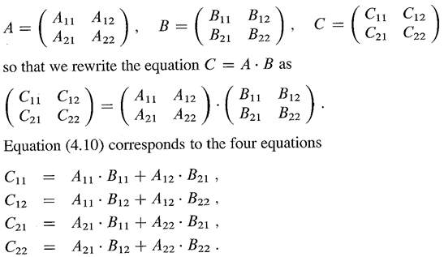
Matrix Multiplication – Divide & Conquer
We assume that n is a power of 2 i.e. n=2^{k}. If it is not, then add additional rows and columns of zero to make n power of 2.
Divide the matrix A and B in to four sub matrices of order n/2 by n/2.
This procedure of division of matrices in to submatrices will go on till sub matrices will become of order 2 by 2.

Slide 4
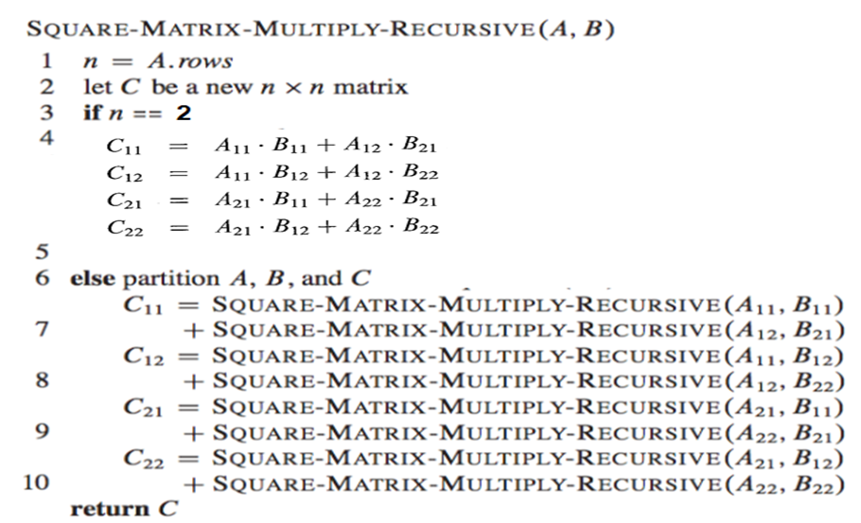
Matrix Multiplication – Divide & Conquer

Slide 5

Matrix Multiplication – Divide & Conquer
Multiplying two n-by-n matrices involves 8 multiplications and 4 additions operations which is a constant.
Total number of recursive calls are 8 with size n/2 and addition of two matrices of order n by n requires Θ(n²). So time complexity of matrix multiplication using divide and conquer approach is
here b and c are constants.
If we simplify the above recurrence using master theorem method then T(n)= O(n³)
So this results in no improvement over conventional matrix multiplication method. However, it requires extra memory in terms of stack due to recursive implementation of algorithm.
So conventional method of matrix multiplication is better than divide and conquer based method of matrix multiplication in terms of space and same in terms of time.

Slide 6

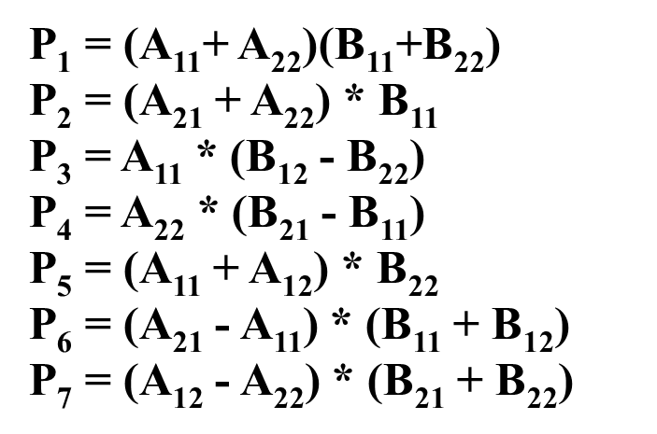
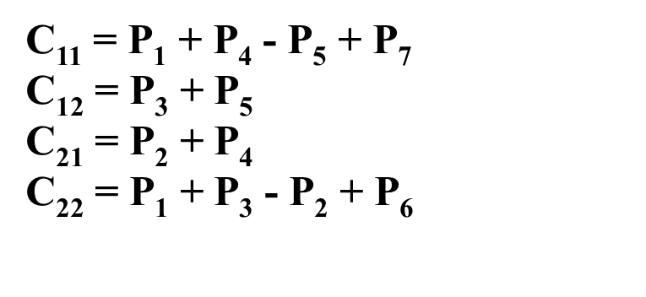
Matrix Multiplication – Strassen Method
Strassen showed that two 2x2 matrix multiplication can be accomplished in 7 multiplication and 18 additions or subtractions.
This reduction can be achieved by merging Strassen method with divide and conquer approach.

Slide 7
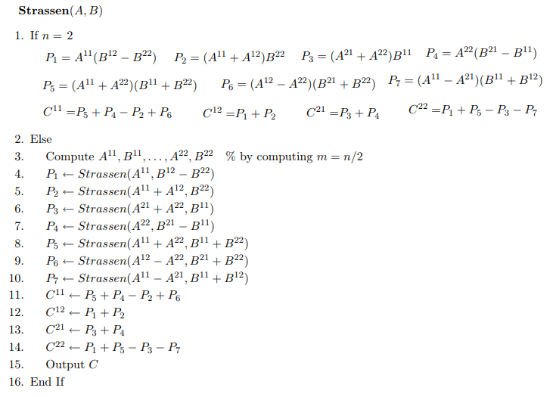
Matrix Multiplication – Strassen Method

Slide 8

Matrix Multiplication – Strassen Method
The recurrence corresponding to divide and conquer using Strassen method is
f
And its solution is O(n^{2.81})

