Slide 1
MECHANISM AND POLICY
DOMAIN OF PROTECTION
ACCESS MATRIX.
SECURITY AUTHENTICATION

Slide 2
Goals of Protection
Principles of Protection
Domain of Protection
Access Matrix
Implementation of Access Matrix
Access Control

Slide 3
Objectives
Discuss the goals and principles of protection in a modern computer system
Explain how protection domains combined with an access matrix are used to specify the resources a process may access
Examine capability and language-based protection systems

Slide 4
Goals of Protection
Operating system consists of a collection of objects, hardware or software
Each object has a unique name and can be accessed through a well-defined set of operations.
Protection problem - ensure that each object is accessed correctly and only by those processes that are allowed to do so.

Slide 5
Principles of Protection
Guiding principle – principle of least privilege
  Programs, users and systems should be given just enough privileges to perform their tasks

Slide 6
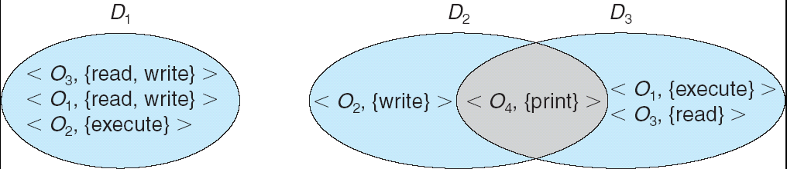
Domain Structure
Access-right = <object-name, rights-set>
where rights-set is a subset of all valid operations that can be performed on the object.
Domain = set of access-rights

Slide 7
Domain Implementation (UNIX)
System consists of 2 domains:
  User
  Supervisor
UNIX
  Domain = user-id
  Domain switch accomplished via file system.
    Each file has associated with it a domain bit (setuid bit).
    When file is executed and setuid = on, then user-id is set to owner of the file being executed. When execution completes user-id is reset.

Slide 8
Ways to realize a domain
Each user is a domain
  Set of objects that can be accessed depend on identity of user
  Domain switch occurs when????
  When one user logs out and other logs in
A process may be a domain
  Set of objects that can be accessed depends upon domain
  Domain switching occurs when???
  When one process sends message to other
A procedure may be a domain
  Set of objects that can be accessed correspond to local variables defined within the procedure
  Domain Switching occurs when????
  When a procedure call is made

Slide 9
Access Matrix
View protection as a matrix (access matrix)
Rows represent domains
Columns represent objects
Access(i, j) is the set of operations that a process executing in Domain_{i} can invoke on Object_{j}

Slide 10
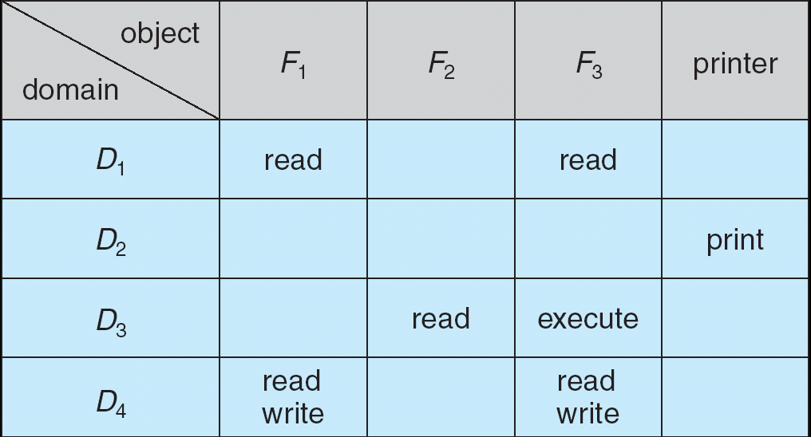
Access Matrix

Slide 11
Use of Access Matrix
If a process in Domain D_{i} tries to do “op” on object O_{j}, then “op” must be in the access matrix.
Can be expanded to dynamic protection.
  Operations to add, delete access rights.
  Special access rights:
    owner of O_{i}
    copy op from O_{i} to O_{j}
    control – D_{i} can modify D_{j} access rights
    transfer – switch from domain D_{i} to D_{j}

Slide 12
Use of Access Matrix (Cont.)
Access matrix design separates mechanism from policy.
  Mechanism
    Operating system provides access-matrix + rules.
    If ensures that the matrix is only manipulated by authorized agents and that rules are strictly enforced.
  Policy
    User dictates policy.
    Who can access what object and in what mode.

Slide 13
Implementation of Access Matrix
Each column = Access-control list for one object
Defines who can perform what operation.
Domain 1 = Read, Write
Domain 2 = Read
Domain 3 = Read

Each Row = Capability List (like a key)
Fore each domain, what operations allowed on what objects.
      Object 1 – Read
      Object 4 – Read, Write, Execute
      Object 5 – Read, Write, Delete, Copy

Slide 14
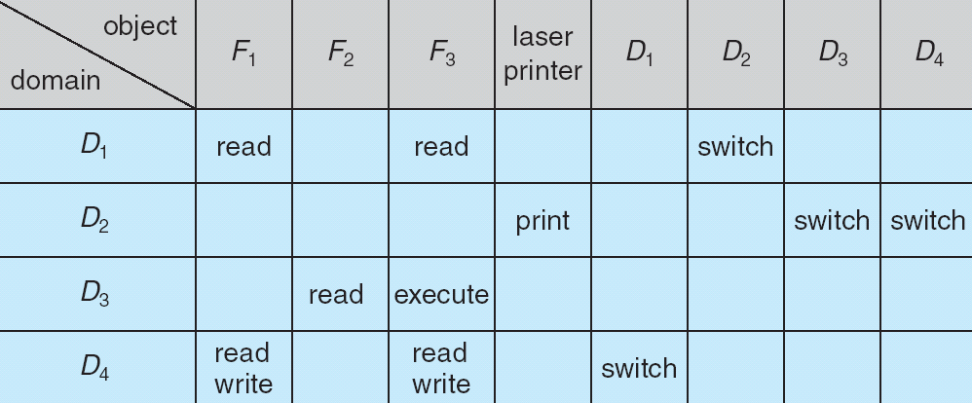
Access Matrix of Figure A With Domains as Objects
Figure B

Slide 15
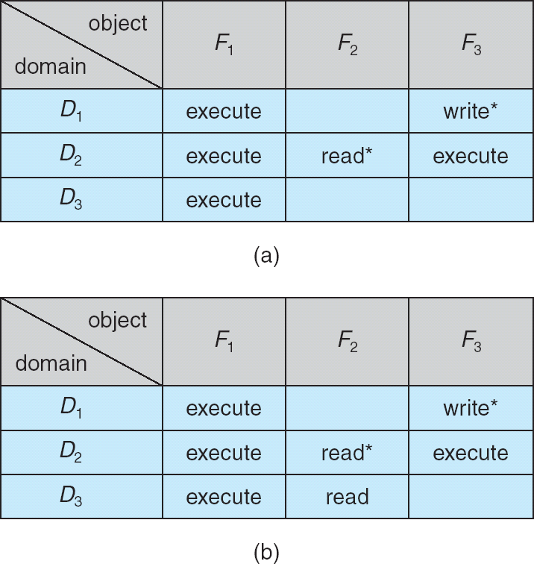
Access Matrix with Copy Rights

Slide 16
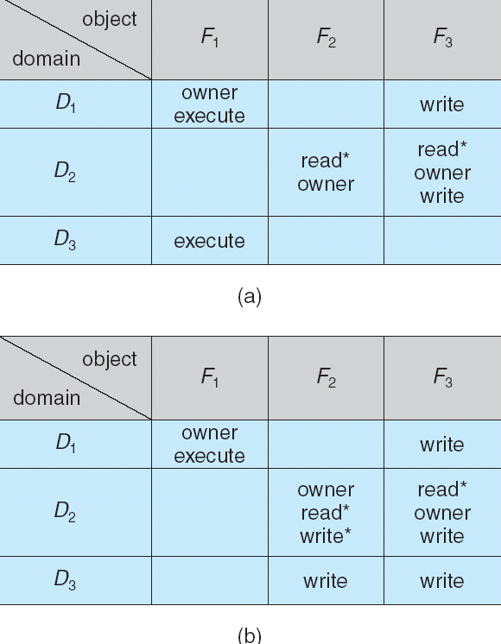
Access Matrix With Owner Rights

Slide 17
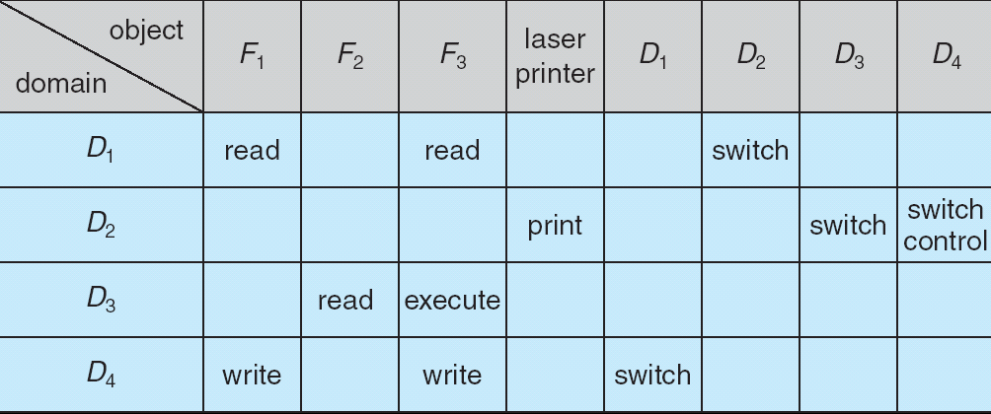
Modified Access Matrix of Figure B

