Slide 1



Unit 3
Business Process Management Overview
1
© 2013 IBM Corporation

Slide 2
Learning Objectives
Process Designer for creating process applications
Core elements to create a BPD in Process Designer
Translation of workflow steps into business process activities
Nested processes
Gateways to control the process flow
Validate process model – simulation
2

Slide 3
Overview of process modeling
A process is the major unit of logic in IBM Business Process Manager
It is the storehouse of all the components of a process definition, including services, activities and gateways; timer, message, and exception events; sequence lines, rules, and variables
Process components help you to define the process workflow for end users, creating logic inside a process and integrating with other applications and data sources
To understand what happens inside a process at run time, it is necessary to understand the components that make up a process at design time.
3

Slide 4
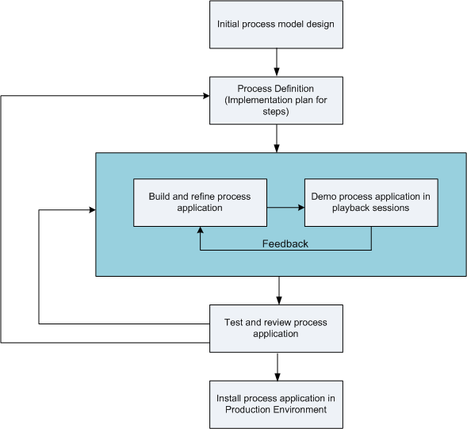
Business process management overview
4

Slide 5
Reusing items in Process Designer
Process Designer enables process developers to reuse existing items both within and across process applications
If we have services already existing which includes Coaches, other shared items that you and other developers need, you can access and reuse those items by including them in a toolkit
From the process application, add a dependency to the toolkit in which the shared items reside. This enables you to pick one of the existing services when choosing the implementation for an activity
The items in the toolkit can also be used by other developers working in different process applications.
5

Slide 6
Using the Designer in IBM Process Designer
7© 2013 IBM Corporation
© 2013 IBM Corporation
Innovation Centre for Education

Slide 7
Process development with the Process Centre
IBM® Process Center serves as a central repository for all project assets created in Process Designer
When multiple Process Designer clients connect to the Process Center, users can share items, such as processes and services, and can also see changes made by other users as they happen
The Process Center can also be used as a repository for assets created in IBM Integration Designer
There is a hierarchy available in the Process Center repository which is designed to help you manage your projects

Slide 8
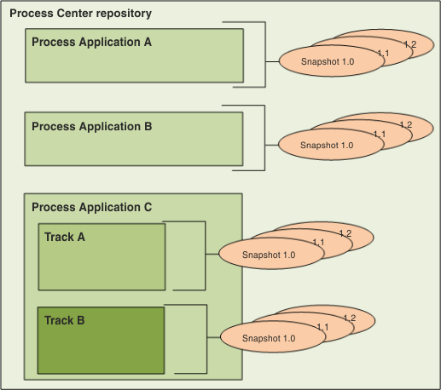
Process Center repository

Slide 9
Artifacts in process center repository
Process Applications | Containers for the process models and supporting implementations that BPM analysts and developers create in the Designer in IBM Process Designer
Tracks | Optional subdivisions in a process application based on team tasks or process application versions. When enabled, tracks allow parallel development to occur. Administrators determine if additional tracks are necessary and, thus, enabled for each process application

Slide 10
Artifacts in process center repository
Snapshots | Record the state of the items within a process application or track at a specific point in time Usually snapshots represent a milestone or are used for playbacks or installations You can compare snapshots and revert to previous snapshots If an administrator enables tracks for a process application, a snapshot is used as the basis for a new track

Slide 11
Process applications :
An overview
A process application, stored in the repository is a container for process models and their supporting implementations
Once the artifacts have been created, they are put together into a process application and a snapshot is taken
Testing, installing and administering the process application snapshot can be done

Slide 12
Process applications artifacts
One or more process models, also called Business Process Definitions (BPDs)
The services required to implement activities or integrate with other systems
Service Component Architecture (SCA) modules
Toolkits
IBM® Integration Designer libraries
One or more workspaces
An IBM Business Monitor model for monitoring business performance
Any other items required to run the process

Slide 13
Running and debugging processes
With the help of the Inspector, individual developers can run processes and services on the Process Center Server or remote runtime Process Server
The Inspector in IBM® Process Designer is important for an iterative approach to process development
Using the Inspector, an entire development team can demonstrate current process design and implementation in playback sessions
Playback sessions are useful in capturing important information from different stakeholders in a process, such as management, end users and business analysts.

Slide 14
Deploying and managing process applications
The process application life cycle takes care of deploying and undeploying snapshots, managing snapshot states and versioning considerations
When developing processes you can make best use of the iterative approach supported by the tools within the Process Designer
Processes evolve in time, initially from a development state, to testing, and then on to production

Slide 15
Deploying and managing process applications
Processes might continue to evolve even in production stage due to changing needs
Being prepared for the ongoing life cycle of processes is essential and will help to design effectively from the very beginning
A typical Business Process Manager configuration includes three environments to support the development and eventual deployment of processes

Slide 16
Environments cont..
Development | Design your process models and implement the steps in those models using the Designer Demonstrate your development progress using Inspector Use playback sessions quickly evaluate and refine your prototype By using the Process Center Console, deploy your process applications in test and production environments.

Slide 17
Environments cont..
Test | Deploy process applications on the Process Server in your test environment to implement formal quality assurance tests Using the Inspector you can verify and resolve issues
Production | Once all issues reported from formal testing are resolved, use the Process Center Console to deploy your process applications on the Process Server in your production environment Using the Inspector you can investigate and resolve any issues reported in your production environment

Slide 18
Process Designer and Process Center tasks
© 2013 IBM Corporation

Slide 19
Modeling processes
A process is the major unit of logic in IBM® Business Process Manager
It contains all the components of a Business Process Definition (BPD)
Modeling a good process that matches your requirements is the core of Process Designer
A process is made of process components that help you to define the process workflow for users, create logic and integrate other applications and data sources
In order to understand what occurs inside a process at run time, it is essential to understand the components that make up a process at design time

Slide 20
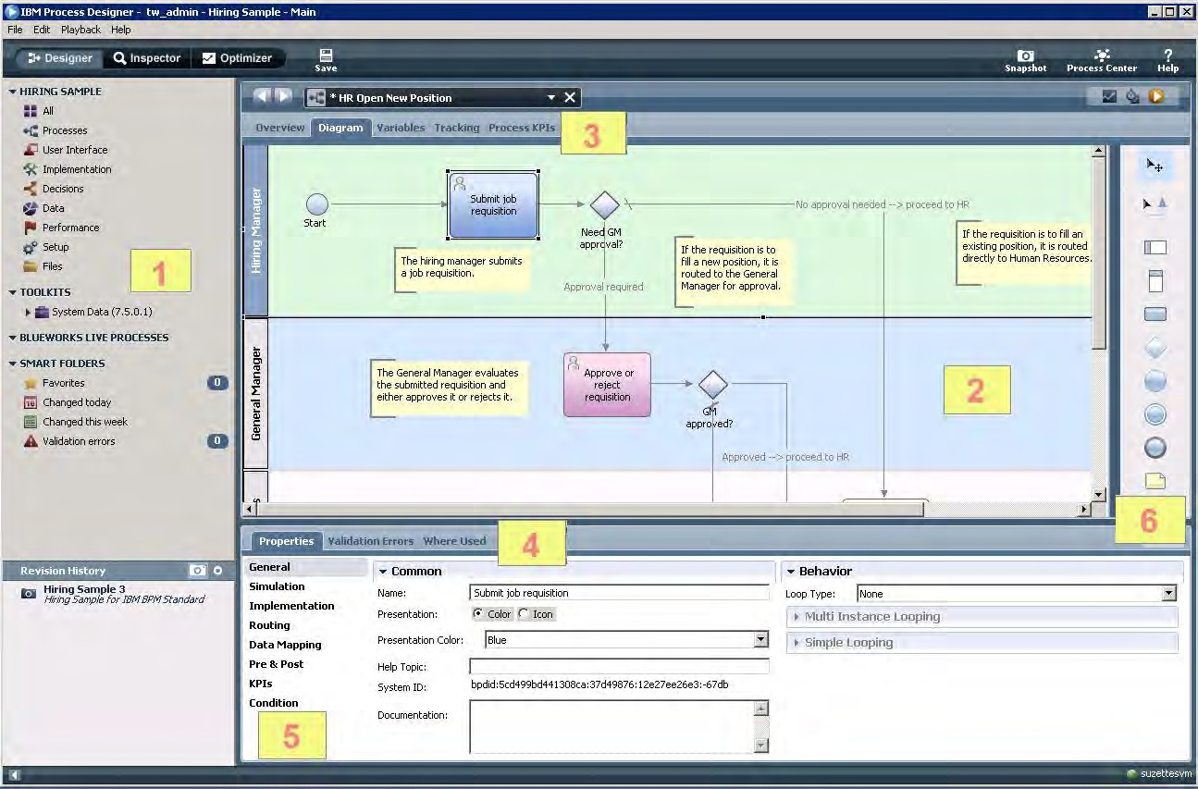
IBM Process Designer

Slide 21
Designer
Parts of
1 | Library | Gives access to the library items for the current process application New library items can be created and existing ones edited as described in Managing library items in the Designer view
2 | Main canvas | Provides the area where you can model your process using the components from the palette
3 | Tabs to control display in main canvas area | The tab selected determines the tool displayed in the main canvas area if you select the Variables tab, the Designer provides a dialog for creating and managing variables for the current process

Slide 22
Designer cont…
Parts of
4 | Properties tab | Displays the properties of the component currently selected in the diagram
5 | Options to control display in properties area | selected option determines the properties shown for the currently selected component in the diagram
6 | Palette | Provides components that you can use to model your process All the available components are described in the following section By dragging a component from the palette to the diagram you can use the properties to control the implementation of the component

Slide 23



Understanding process components
Component icon | Component name | Description
 | Selection Tool | Helps you to select and move components on the diagram
 | Sequence Flow | Aids you to connect process components to establish the order in which the steps in the process occur.
 | Lanes | Add lanes to your process diagram to hold the activities and events that take place during process execution.

Slide 24


Process components cont…
 | Milestone | Add milestones to your process diagram to demonstrate the phases of process execution
 | Start Event | Use to model the start of a process. To manually start the process, you can select None as the implementation in the properties
 | Activity | Use to model the steps in your process, choosing the implementation most appropriate for each particular step
 | Gateway | Gateways control the divergence and convergence of sequence lines, determining branching and merging of the paths that a runtime process can take

Slide 25



Process components cont…
 | Intermediate Event | Intermediate events can be attached to activities within your BPDs or they can be included in the process flow, connected with sequence lines
 | End Event | Use to end process execution
 | Note | Use to add information about the overall process or each step in the process to the diagram. Adding notes helps other developers understand your design

Slide 26
The general modeling process steps :-
Creating a business process definition
In order to model a process, a BPD needs to be created
A BPD is a reusable model of a process, describing what is common to all runtime instances of that process model
Building services
Business objects and variables
Modeling events
Using external implementations
Integrating with other systems
Configuring conditional activities

Slide 27
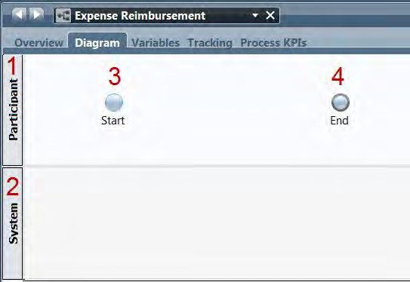
Process Designer

Slide 28
Process Designer cont…
NO | DEFAULT NAME | DESCRIPTION
1 | Participant lane | It is a default lane for user tasks. The name can be changed by selecting the lane and editing its properties
2 | System lane | It is a default lane for system tasks. The name can be changed by selecting the lane and editing its properties
3 | Start event | Each BPD will automatically include a start event
4 | End event | Each BPD will automatically include an end event

Slide 29
Understanding task types
Implementation option | Description
User Task | If an activity has to be started or completed by a user (human performer), this implementation option must be selected
System Task | Select this implementation option if an activity is to be completed by an automated system or service
Decision Task | The Decision Task implementation option must be chosen when you want a decision or condition in a business rule to decide which process implementation is called

Slide 30
Understanding task types
Implementation option | Description
Script | If you intend to create a script to execute an activity, choose the Script implementation option. A Script activity runs a Java™ script when executed
Sub process | Sub process is an alternative for encapsulating logically related steps within a parent process
Linked Process | You can execute an activity using a linked process. Linked processes offer a way to encapsulate logically related steps within a process while retaining the high-level view of the parent process

Slide 31
Understanding task types
Implementation option | Description
Event Subprocess | Event subprocess is a specialized subprocess that permits you to easily model event handling logic for a process or subprocess
None | This option is selected if you are not ready to associate an implementation. This option allows you to create a temporary placeholder activity in your process diagram till an implementation is available

Slide 32

Understanding service components
Component icon
Description
Helps you to select and move components on the diagram
Helps you to connect service components to ascertain the order in which the steps in the service occur.
Used to run an external Web service. This component helps you to supply a WSDL URI and then use any of the available services.

Slide 33



Understanding service components
Component icon | Description
 | Used to call methods from a Java class. These methods can be used to complete tasks like reading or writing files or sending SMTP mail.
 | Used to execute the interfaces for your Human services so that end users can participate in a business process.
 | Used to implement the interfaces for your Human services so that users can participate in a business process.

Slide 34



Understanding service components
Component icon | Description
 | Used when you want to write JavaScript to run on the Process Server in the service context. The Server Script component is helpful for parsing through variables and executing programmatic commands.
 | Used to build conditions for your Decision services.
 | Used to include decision services available on an ILOG JRules Rule Execution Server.
 | Use the Business Action Language (BAL) Rule component to create business rules using natural language technology

Slide 35




Understanding service components
Component icon | Description
 | Used to bind blocks of formatted text (for example, HTML, XML, or XSLT) directly to a service variable. This gets rid of the need to store large blocks of text in default values for variables
 | Used to change the priority, due date, status, or other aspects of a task.
 | Used to stop processing without changing the status of a task.
 | Used to model a point in the process execution where only one of several paths could be followed based on a condition.
100

Slide 36


Understanding service components
Component icon | Description
 | Used to add information about the overall service or each step in the service to the diagram. Adding notes enables other developers understand your design.
 | Used to throw an error on purpose and stop processing
 | Use to call an Undercover Agent (UCA) from your service.
 | Used to listen for errors from the service component to which it is attached.

Slide 37


Understanding service components
Component icon | Description
 | Used to indicate a point in a service at which you want IBM Business Process Manager to get the runtime data for reporting purposes
 | Used to incorporate other services in your current service. Nested services are generally defined to carry out specific, repeatable functions such as exception handling routines, integration with outside systems, or data manipulation. Nested services are frequently used in multiple process applications and likely reside in a toolkit.

Slide 38
Designing process interactions for business users
Configuring a role-based business user interface
Developing flexible and efficient process applications
Setting up collaboration features for business users
Enabling task management
Generating names for process instances

Slide 39
Enabling processes for tracking and reporting
Tracking IBM Business Process Manager performance data
Sending tracking definitions to Performance Data Warehouse
Defining reports in Process Designer (deprecated)

Slide 40
Running and debugging processes with the
Managing process instances
Stepping through a process
Debugging a process
Resolving errors
Inspector reference

Slide 41
Checkpoint
Process Designer for creating process applications
Core elements to create a BPD in Process Designer
Translation of workflow steps into business process activities
Gateways to control the process flow
Process model simulation

