Slide 1
Dynamic Programming II
Many of the slides are from Prof. Plaisted’s resources at University of North Carolina at Chapel Hill

Slide 2
Dynamic Programming
Similar to divide-and-conquer, it breaks problems down into smaller problems that are solved recursively.
In contrast, DP is applicable when the sub-problems are not independent, i.e. when sub-problems share sub-sub-problems. It solves every sub-sub-problem just once and save the results in a table to avoid duplicated computation.

Slide 3
Elements of DP Algorithms
Sub-structure: decompose problem into smaller sub-problems. Express the solution of the original problem in terms of solutions for smaller problems.
Table-structure: Store the answers to the sub-problem in a table, because sub-problem solutions may be used many times.
Bottom-up computation: combine solutions on smaller sub-problems to solve larger sub-problems, and eventually arrive at a solution to the complete problem.

Slide 4
Applicability to Optimization Problems
Optimal sub-structure (principle of optimality): for the global problem to be solved optimally, each sub-problem should be solved optimally. This is often violated due to sub-problem overlaps. Often by being “less optimal” on one problem, we may make a big savings on another sub-problem.
Small number of sub-problems: Many NP-hard problems can be formulated as DP problems, but these formulations are not efficient, because the number of sub-problems is exponentially large. Ideally, the number of sub-problems should be at most a polynomial number.

Slide 5
Optimized Chain Operations
Determine the optimal sequence for performing a series of operations. (the general class of the problem is important in compiler design for code optimization & in databases for query optimization)
For example: given a series of matrices: A₁…A_{n} , we can “parenthesize” this expression however we like, since matrix multiplication is associative (but not commutative).
Multiply a p x q matrix A times a q x r matrix B, the result will be a p x r matrix C. (# of columns of A must be equal to # of rows of B.)

Slide 6
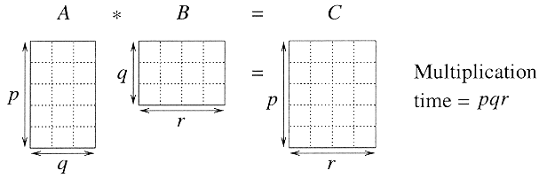
Matrix Multiplication
In particular for 1 ≤ i ≤ p and 1 ≤ j ≤ r,
C[i, j] = ∑_{k = 1 to q} A[i, k] B[k, j]
Observe that there are pr total entries in C and each takes O(q) time to compute, thus the total time to multiply 2 matrices is pqr.

Slide 7
Chain Matrix Multiplication
Given a sequence of matrices A₁ A₂…A_{n} , and dimensions p₀ p₁…p_{n} where A_{i} is of dimension p_{i-1} x p_{i} , determine multiplication sequence that minimizes the number of operations.
This algorithm does not perform the multiplication, it just figures out the best order in which to perform the multiplication.

Slide 8
Example: CMM
Consider 3 matrices: A₁ be 5 x 4, A₂ be 4 x 6, and A₃ be 6 x 2.
Mult[((A₁ A₂)A₃)] = (5x4x6) + (5x6x2) = 180
Mult[(A₁ (A₂A₃ ))] = (4x6x2) + (5x4x2) = 88
Even for this small example, considerable savings can be achieved by reordering the evaluation sequence.

Slide 9
Naive Algorithm
If we have just 1 item, then there is only one way to parenthesize. If we have n items, then there are n-1 places where you could break the list with the outermost pair of parentheses, namely just after the first item, just after the 2nd item, etc. and just after the (n-1)th item.
When we split just after the kth item, we create two sub-lists to be parenthesized, one with k items and the other with n-k items. Then we consider all ways of parenthesizing these. If there are L ways to parenthesize the left sub-list, R ways to parenthesize the right sub-list, then the total possibilities is L∗R.

Slide 10
Cost of Naive Algorithm
The number of different ways of parenthesizing n items is
P(n) = 1, if n = 1
P(n) = ∑_{k = 1 to n-1} P(k)P(n-k), if n ≥ 2
This is related to Catalan numbers (which in turn is related to the number of different binary trees on n nodes). Specifically P(n) = C(n-1).
C(n) = (1/(n+1)) C(2n, n) ∈ Ω(4^{n} / n^{3/2})
where C(2n, n) stands for the number of various ways to choose n items out of 2n items total.

Slide 11
DP Solution (I)
Let A_{i…j} be the product of matrices i through j. A_{i…j} is a p_{i-1} x p_{j} matrix. At the highest level, we are multiplying two matrices together. That is, for any k, 1 ≤ k ≤ n-1,
A_{1…n} = (A_{1…k})(A_{k+1…n})
The problem of determining the optimal sequence of multiplication is broken up into 2 parts:
  : How do we decide where to split the chain (what k)?
  A : Consider all possible values of k.
  : How do we parenthesize the subchains A_{1…k} & A_{k+1…n}?
  A : Solve by recursively applying the same scheme.
  NOTE: this problem satisfies the “principle of optimality”.
Next, we store the solutions to the sub-problems in a table and build the table in a bottom-up manner.

Slide 12
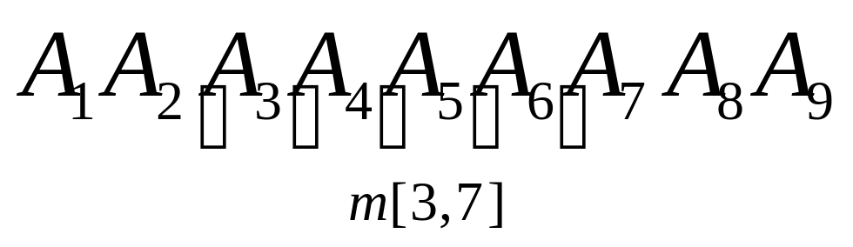
DP Solution (II)
For 1 ≤ i ≤ j ≤ n, let m[i, j] denote the minimum number of multiplications needed to compute A_{i…j} .
Example: Minimum number of multiplies for A_{3…7}
In terms of p_{i} , the product A_{3…7} has
dimensions ____.

Slide 13
DP Solution (III)
The optimal cost can be described be as follows:
  i = j ⇒ the sequence contains only 1 matrix, so m[i, j] = 0.
  i < j ⇒ This can be split by considering each k, i ≤ k < j,
  as A_{i…k} (p_{i-1} x p_{k} ) times A_{k+1…j} (p_{k} x p_{j}).
This suggests the following recursive rule for computing m[i, j]:
m[i, i] = 0
m[i, j] = min_{i ≤ k < j} (m[i, k] + m[k+1, j] + p_{i-1}p_{k}p_{j} ) for i < j

Slide 14
Computing m[i, j]
For a specific k,
(A_{i} …A_{k})( A_{k+1} … A_{j})
=
m[i, j] = min_{i ≤ k < j} (m[i, k] + m[k+1, j] + p_{i-1}p_{k}p_{j} )

Slide 15
Computing m[i, j]
For a specific k,
(A_{i} …A_{k})( A_{k+1} … A_{j})
= A_{i…k}( A_{k+1} … A_{j}) (m[i, k] mults)
m[i, j] = min_{i ≤ k < j} (m[i, k] + m[k+1, j] + p_{i-1}p_{k}p_{j} )

Slide 16
Computing m[i, j]
For a specific k,
(A_{i} …A_{k})( A_{k+1} … A_{j})
= A_{i…k}( A_{k+1} … A_{j}) (m[i, k] mults)
= A_{i…k} A_{k+1…j} (m[k+1, j] mults)
m[i, j] = min_{i ≤ k < j} (m[i, k] + m[k+1, j] + p_{i-1}p_{k}p_{j} )

Slide 17
Computing m[i, j]
For a specific k,
(A_{i} …A_{k})( A_{k+1} … A_{j})
= A_{i…k}( A_{k+1} … A_{j}) (m[i, k] mults)
= A_{i…k} A_{k+1…j} (m[k+1, j] mults)
= A_{i…j} (p_{i-1} p_{k} p_{j} mults)
m[i, j] = min_{i ≤ k < j} (m[i, k] + m[k+1, j] + p_{i-1}p_{k}p_{j} )

Slide 18
Computing m[i, j]
For a specific k,
(A_{i} …A_{k})( A_{k+1} … A_{j})
= A_{i…k}( A_{k+1} … A_{j}) (m[i, k] mults)
= A_{i…k} A_{k+1…j} (m[k+1, j] mults)
= A_{i…j} (p_{i-1} p_{k} p_{j} mults)
For solution, evaluate for all k and take minimum.
m[i, j] = min_{i ≤ k < j} (m[i, k] + m[k+1, j] + p_{i-1}p_{k}p_{j} )

Slide 19
Matrix-Chain-Order(p)
1. n ← length[p] - 1
2. for i ← 1 to n // initialization: O(n) time
3. do m[i, i] ← 0
4. for L ← 2 to n // L = length of sub-chain
5. do for i ← 1 to n - L+1
6. do j ← i + L - 1
7. m[i, j] ← ∞
8. for k ← i to j - 1
9. do q ← m[i, k] + m[k+1, j] + p_{i-1} p_{k} p_{j}
10. if q < m[i, j]
11. then m[i, j] ← q
12. s[i, j] ← k
13. return m and s

Slide 20
Analysis
The array s[i, j] is used to extract the actual sequence (see next).
There are 3 nested loops and each can iterate at most n times, so the total running time is Θ(n³).

Slide 21
Extracting Optimum Sequence
Leave a split marker indicating where the best split is (i.e. the value of k leading to minimum values of m[i, j]). We maintain a parallel array s[i, j] in which we store the value of k providing the optimal split.
If s[i, j] = k, the best way to multiply the sub-chain A_{i…j} is to first multiply the sub-chain A_{i…k} and then the sub-chain A_{k+1…j} , and finally multiply them together. Intuitively s[i, j] tells us what multiplication to perform last. We only need to store s[i, j] if we have at least 2 matrices & j > i.

Slide 22
Mult (A, i, j)
1. if (j > i)
2. then k = s[i, j]
3. X = Mult(A, i, k) // X = A[i]...A[k]
4. Y = Mult(A, k+1, j) // Y = A[k+1]...A[j]
5. return X*Y // Multiply X*Y
6. else return A[i] // Return ith matrix

Slide 23
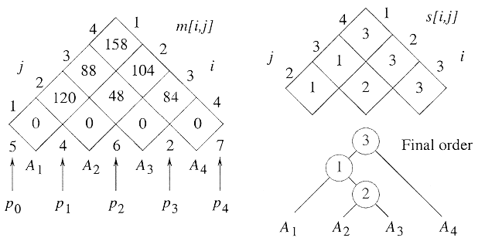
Example: DP for CMM
The initial set of dimensions are <5, 4, 6, 2, 7>: we are multiplying A₁ (5x4) times A₂ (4x6) times A₃ (6x2) times A₄ (2x7). Optimal sequence is (A₁ (A₂A₃ )) A₄.

Slide 24
Finding a Recursive Solution
Figure out the “top-level” choice you have to make (e.g., where to split the list of matrices)
List the options for that decision
Each option should require smaller sub-problems to be solved
Recursive function is the minimum (or max) over all the options
m[i, j] = min_{i ≤ k < j} (m[i, k] + m[k+1, j] + p_{i-1}p_{k}p_{j} )

Slide 25
Steps in DP: Step 1
Think what decision is the “last piece in the puzzle”
  Where to place the outermost parentheses in a matrix chain multiplication
  (A₁) (A₂ A₃ A₄)
  (A₁ A₂) (A₃ A₄)
  (A₁ A₂ A₃) (A₄)

Slide 26
DP Step 2
Ask what subproblem(s) would have to be solved to figure out how good your choice is
  How to multiply the two groups of matrices, e.g., this one (A₁) (trivial) and this one (A₂ A₃ A₄)

Slide 27
DP Step 3
Write down a formula for the “goodness” of the best choice
m[i, j] = min_{i ≤ k < j} (m[i, k] + m[k+1, j] + p_{i-1}p_{k}p_{j} )

Slide 28
DP Step 4
Arrange subproblems in order from small to large and solve each one, keeping track of the solutions for use when needed
Need 2 tables
  One tells you value of the solution to each subproblem
  Other tells you last option you chose for the solution to each subproblem

Slide 29
Matrix-Chain-Order(p)
1. n ← length[p] - 1
2. for i ← 1 to n // initialization: O(n) time
3. do m[i, i] ← 0
4. for L ← 2 to n // L = length of sub-chain
5. do for i ← 1 to n - L+1
6. do j ← i + L - 1
7. m[i, j] ← ∞
8. for k ← i to j - 1
9. do q ← m[i, k] + m[k+1, j] + p_{i-1} p_{k} p_{j}
10. if q < m[i, j]
11. then m[i, j] ← q
12. s[i, j] ← k
13. return m and s

Slide 30
Assembly-Line Scheduling
Two parallel assembly lines in a factory, lines 1 and 2
Each line has n stations S_{i,1}…S_{i,n}
For each j, S_{1, j} does the same thing as S_{2, j} , but it may take a different amount of assembly time a_{i, j}
Transferring away from line i after stage j costs t_{i, j}
Also entry time e_{i} and exit time x_{i} at beginning and end

Slide 31
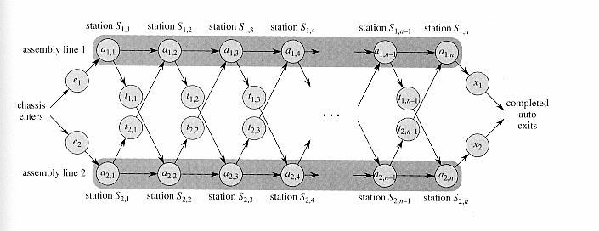
Assembly Lines

Slide 32
Finding Subproblem
Pick some convenient stage of the process
  Say, just before the last station
What’s the next decision to make?
  Whether the last station should be S_{1,n} or S_{2,n}
What do you need to know to decide which option is better?
  What the fastest times are for S_{1,n} & S_{2,n}

Slide 33
Recursive Formula for Subproblem
=min ( ,
Fastest time through prev station (same line)
Fastest time to any given station
Fastest time through prev station (other line)
)
+
Time it takes to switch lines

Slide 34
Recursive Formula (II)
Let f_{i} [ j] denote the fastest possible time to get the chassis through S _{i, j}
Have the following formulas:
f₁[ 1] = e₁ + a_{1,1}
f₁[ j] = min( f₁[ j-1] + a_{1, j}, f₂ [ j-1]+t_{2, j-1}+ a_{1, j} )
Total time:
f * = min( f₁[n] + x₁, f₂ [ n]+x₂)

Slide 35
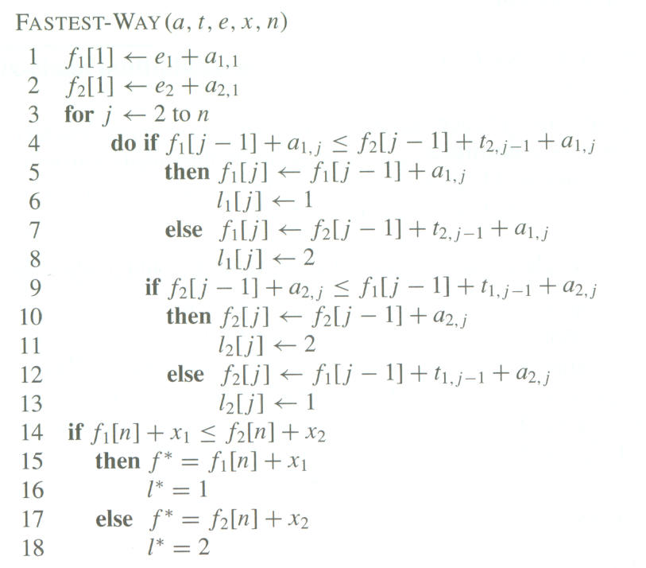

Slide 36
Analysis
Only loop is lines 3-13 which iterate n-1 times: Algorithm is O(n).
The array l records which line is used for each station number

Slide 37
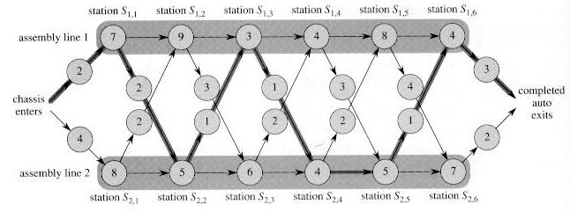
Example

Slide 38
Polygons
A polygon is a piecewise linear closed curve in the plane. We form a cycle by joining line segments end to end. The line segments are called the sides of the polygon and the endpoints are called the vertices.
A polygon is simple if it does not cross itself, i.e. if the edges do not intersect one another except for two consecutive edges sharing a common vertex. A simple polygon defines a region consisting of points it encloses. The points strictly within this region are in the interior of this region, the points strictly on the outside are in its exterior, and the polygon itself is the boundary of this region.

Slide 39
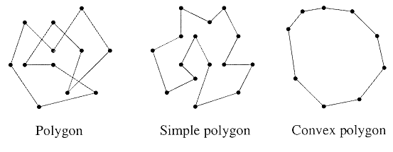
Convex Polygons
A simple polygon is said to be convex if given any two points on its boundary, the line segment between them lies entirely in the union of the polygon and its interior.
Convexity can also be defined by the interior angles. The interior angles of vertices of a convex polygon are at most 180 degrees.

Slide 40
Triangulations
Given a convex polygon, assume that its vertices are labeled in counterclockwise order P=<v₀,…,v_{n-1}>. Assume that indexing of vertices is done modulo n, so v₀ = v_{n}. This polygon has n sides, (v_{i-1} ,v_{i} ).
Given two nonadjacent v_{j} , where i < j, the line segment (v_{i} ,v_{j} ) is a chord. (If the polygon is simple but not convex, a segment must also lie entirely in the interior of P for it to be a chord.) Any chord subdivides the polygon into two polygons.
A triangulation of a convex polygon is a maximal set T of chords. Every chord that is not in T intersects the interior of some chord in T. Such a set of chords subdivides interior of a polygon into set of triangles.

Slide 41
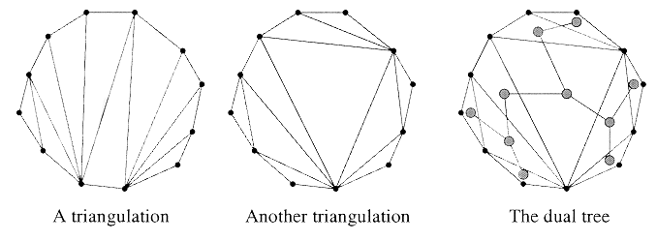
Example: Polygon Triangulation
Dual graph of the triangulation is a graph whose vertices are
the triangles, and in which two vertices share an edge if the
triangles share a common chord. NOTE: the dual graph is a
free tree. In general, there are many possible triangulations.

Slide 42
Minimum-Weight Convex Polygon Triangulation
The number of possible triangulations is exponential in n, the number of sides. The “best” triangulation depends on the applications.
Our problem: Given a convex polygon, determine the triangulation that minimizes the sum of the perimeters of its triangles.
Given three distinct vertices, v_{i} , v_{j} and v_{k} , we define the weight of the associated triangle by the weight function
w(v_{i} , v_{j} , v_{k}) = |v_{i} v_{j} | + |v_{j} v_{k} | + |v_{k} v_{i} |,
where |v_{i} v_{j} | denotes length of the line segment (v_{i ,}v_{j} ).

Slide 43
Correspondence to Binary Trees
In MCM, the associated binary tree is the evaluation tree for the multiplication, where the leaves of the tree correspond to the matrices, and each node of the tree is associated with a product of a sequence of two or more matrices.
Consider an (n+1)-sided convex polygon, P=<v₀,…,v_{n}> and fix one side of the polygon, (v₀ ,v_{n}). Consider a rooted binary tree whose root node is the triangle containing side (v₀ ,v_{n}), whose internal nodes are the nodes of the dual tree, and whose leaves correspond to the remaining sides of the tree. The partitioning of a polygon into triangles is equivalent to a binary tree with n-1 leaves, and vice versa.

Slide 44
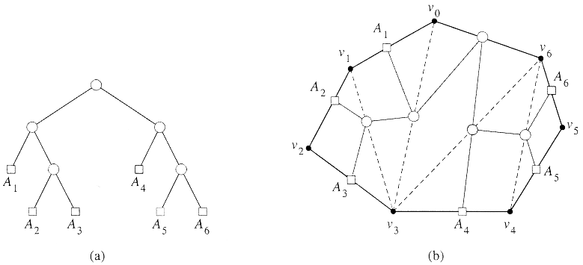
Binary Tree for Triangulation
The associated binary tree has n leaves, and hence n-1 internal nodes. Since each internal node other than the root has one edge entering it, there are n-2 edges between the internal nodes.

Slide 45
Lemma
A triangulation of a simple polygon has n-2 triangles and n-3 chords.
(Proof) The result follows directly from the previous figure. Each internal node corresponds to one triangle and each edge between internal nodes corresponds to one chord of triangulation. If we consider an n-vertex polygon, then we’ll have n-1 leaves, and thus n-2 internal nodes (triangles) and n-3 edges (chords).

Slide 46
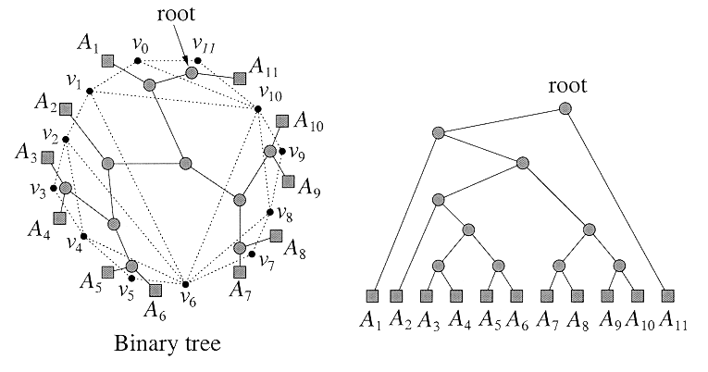
Another Example of Binary Tree for Triangulation

Slide 47
DP Solution (I)
For 1 ≤ i ≤ j ≤ n, let t[i, j] denote the minimum weight triangulation for the subpolygon <v_{i-1}, v_{i} ,…, v_{j}>.
We start with v_{i-1} rather than v_{i}, to keep the structure as similar as possible to the matrix chain multiplication problem.
v₅
v₄
v₃
Min. weight
triangulation
= t[2, 5]
v₆
v₂
v₀
v₁

Slide 48
DP Solution (II)
Observe: if we can compute t[i, j] for all i and j (1 ≤ i ≤ j ≤ n), then the weight of minimum weight triangulation of the entire polygon will be t[1, n].
For the basis case, the weight of the trivial 2-sided polygon is zero, implying that t[i, i] = 0 (line (v_{i-1}, v_{i})).

Slide 49
DP Solution (III)
In general, to compute t[i, j], consider the subpolygon <v_{i-1}, v_{i} ,…, v_{j}>, where i ≤ j. One of the chords of this polygon is the side (v_{i-1}, v_{j}). We may split this subpolygon by introducting a triangle whose base is this chord, and whose third vertex is any vertex v_{k}, where i ≤ k ≤ j-1. This subdivides the polygon into 2 subpolygons <v_{i-1},...v_{k}> & <v_{k+1},... v_{j}>, whose minimum weights are t[i, k] and t[k+1, j].
We have following recursive rule for computing t[i, j]:
t[i, i] = 0
t[i, j] = min_{i ≤ k ≤ j-1} (t[i, k] + t[k+1, j] + w(v_{i-1}v_{k}v_{j} )) for i < k

Slide 50
Weighted-Polygon-Triangulation(V)
1. n ← length[V] - 1 // V = <v₀ ,v₁ ,…,v_{n}>
2. for i ← 1 to n // initialization: O(n) time
3. do t[i, i] ← 0
4. for L ← 2 to n // L = length of sub-chain
5. do for i ← 1 to n-L+1
6. do j ← i + L - 1
7. t[i, j] ← ∞
8. for k ← i to j - 1
9. do q ← t[i, k] + t[k+1, j] + w(v_{i-1} , v_{k} , v_{j})
10. if q < t[i, j]
11. then t[i, j] ← q
12. s[i, j] ← k
13. return t and s

