Slide 1
Flip-Flops

Slide 2
Objectives of Lecture
The objectives of this lecture are:
to discuss the difference between combinational and sequential logic as well as the difference between asynchronous and synchronous circuits and to show why the operation of synchronous circuits is more predictable, given propagation delays.
to explain the operation of the common latches and flip-flops
SR or set–reset latch, which may also be called a SR flip-flop
D or data flip-flip
T or toggle flip-flop
JK flip-flop
to describe clocking and the differences between positive edge and negative edge triggering and discuss the type of control inputs — active high and active low; asynchronous, jam or direct.

Slide 3
Combinational Logic
The outputs depend only on the state of the inputs all of the time. Any change in the state of one of the inputs will ripple through the circuit immediately.
Examples of combinational logic are NAND and NOR gates, Inverters, and Buffers. These four logic gates form the basis of almost all combinational logic circuits as well as flip flops.
Circuits that change the state of the output in this manner are also known as asynchronous circuits.
However, not all asynchronous circuits are combinational logic circuits.

Slide 4
Sequential Logic
Has memory; the circuit stores the result of the previous set of inputs. The current output depends on inputs in the past as well as present inputs.
The basic element in sequential logic is the bistable latch or flip-flop, which acts as a memory element for one bit of data.

Slide 5
Clocked Circuits
Most flip-flops are clocked so that the output change state based upon the state of the inputs at precisely determined times.
Usage varies — in this course, ‘flip-flops’ will be used for clocked circuits and ‘latches’ for circuits that are asynchronous.
A common clock used in many flip-flips in one circuit ensures that all parts of a digital system change state at the same time. This is called a synchronous system

Slide 6
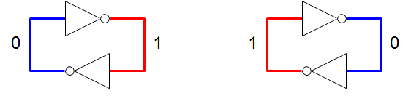
Bistable Circuit
At the heart of a bistable circuit is a pair of inverters connected in a loop — with feedback, in other words. It has two stable states.
Without some control, there isn’t a way to force the bistable circuit into one or the other state.

Slide 7
Bistable Circuits
The bistable circuit is used as a ‘bus keeper’ to hold a node at a definite 1 or 0. It is also the heart of a ‘static random access memory’ (SRAM) cell.
Similar operation occurs for any ring composed of an even number of invertors.
What would happen if 3 inverters (or larger odd number) are connected in series?
This type of circuit is called a ring oscillator.
Check this out in the laboratory or in PSpice!

Slide 8
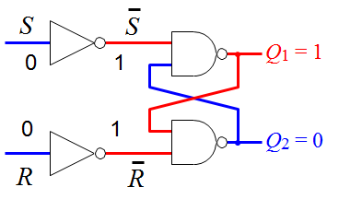
Core of a Flip-Flop: The set–reset or SR Latch
Acts as a simple memory with two stable states at the two output when S = R = 0
Q1 and Q2 are the outputs of the S-R latch.
When Q1 is known as Q and Q2 is also called Q’ or (spoken as Q bar), meaning that its value is not Q or the opposite of Q.

Slide 9
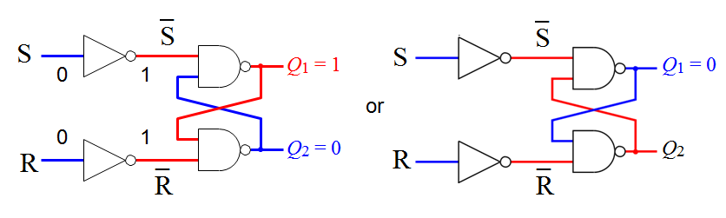
S-R Latch
Acts as a simple memory with two stable states when S = R = 0:
The latch
holds (stores) when S = R = 0
is set (to 1) by bringing S = 1 with R = 0
is reset (to 0) or cleared by bringing R = 1 with S = 0
The condition S = R = 1 must be avoided because it leads to an
indeterminate condition, where the output can not be predicted at any one point in time. This can cause a race condition to occur when the inputs change to S = R = 0.

Slide 10
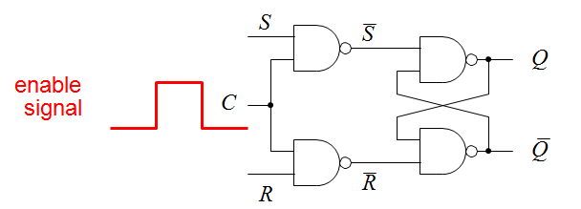
SR Latch with Enable
The S and R inputs only effect the output states when the enable input C is high.
This controls when the latch responds to its inputs.
The latch holds (stores) its value while the enable input is low — latches it!
Any changes in the inputs during the time when enable is high will affect the output immediately: the circuit is said to be transparent.
This circuit still has a major problem: the stored value is indeterminate if S = R = 1 when the clock goes low

Slide 11
Logic Table
SR Latch
SR Latch with Enable
S | R | Q
0 | 0 | Last Q
0 | 1 | 0
1 | 0 | 1
1 | 1
S | R | E | Q
0 | 0 | 1 | Last Q
0 | 1 | 1 | 0
1 | 0 | 1 | 1
1 | 1 | 1
X | X | 0 | Last Q

Slide 12
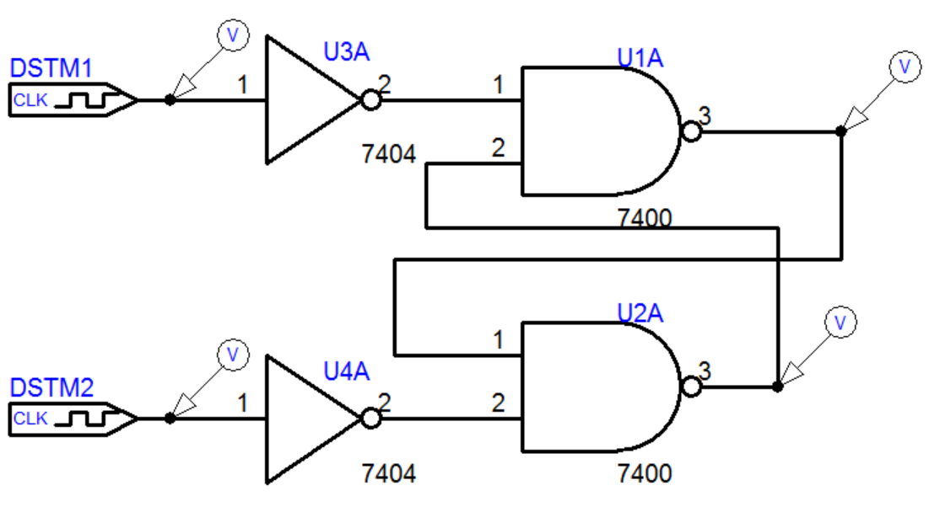
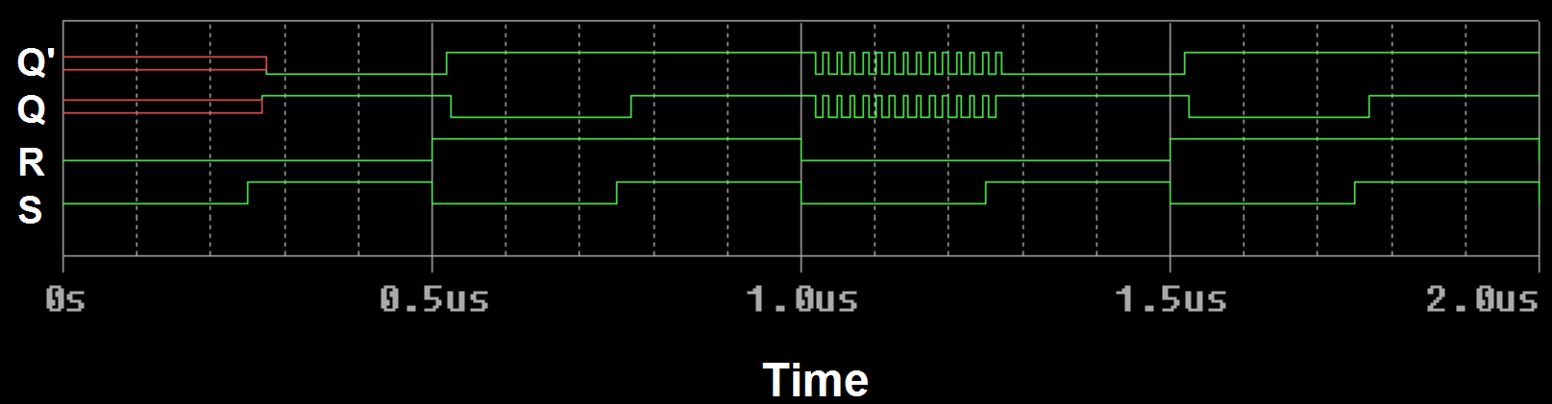
Timing Diagram

Slide 13

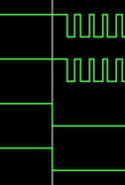
Timing Diagram
No Initial Condition
Propagation Delay Time
Indeterminate Condition, Q = Q’
Followed by a Race Condition
Notes:
Left: Simulation started with S = R = 0, but no last Q had been defined. Propagation delay time can be seen as Q and Q’ change 21.5ns after S and R change.
Right: Q and Q’ are both equal to 1 when S = R=1. This results in a race condition when the input changes to S = R = 0. Again, the propagation delay time can be seen in the period of the oscillations.

Slide 14
Task
The two NAND gates form a SR latch.
SR latches can be made using OR, NOR, or AND gates. Can you design one and work out the logic table for its operation?
Depending on the design and which output is called Q, the race condition occurs when S = R = 0 and the last Q state occurs when S = R = 1.
Can you predict the logic table before you have constructed the circuit and simulated/measured output for the four sets of input states?

Slide 15
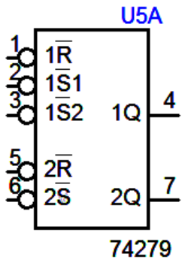
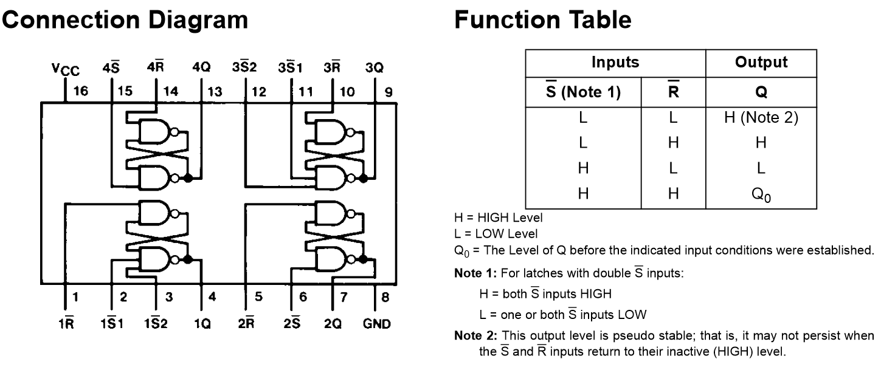
74279
Note that there is dual SR bar latch in PSpice (2 in 1 part).
It may appear that the undefined operation has been designed out of its operation when you use this part in a simulation. However, the datasheet indicates that the race condition may show up.

Slide 16
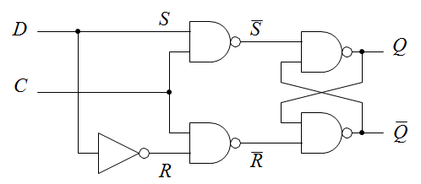
D Flip-Flop
The problem with S = R = 1 can be avoided using a common input D as shown above so that .
The output of the latch now:
follows the D input while C = 1 (transparent)
holds its value while C = 0 (Q = last Q when C went low) no matter what happens at the input
This circuit is often called a transparent latch. It can be bought as an integrated circuit, usually with several latches in a package.
The input C may be called control, clock, gate, or enable.

Slide 17
Timing Diagrams
 | D Q C Q
D
C output follows input
output remains constant: input ‘latched’
Q
 | D Q C Q
D
C' output follows input
output remains constant: input ‘latched’
Q

Slide 18
Transparent Latches
Transparent latches have important applications in digital electronics.
However, the stability of the output can be an issue in noisy environments.
It is more convenient if the behaviour depends on the inputs only at a particular time, which led to the invention of edge-triggered flip-flops.
Transparent latches are sometimes called ‘level-sensitive’ flip-flops to distinguish them from edge-sensitive devices. Yet another name is ‘half flip-flop’.

Slide 19
Edge-Triggered Flip-Flops
These circuits respond to their inputs on either the rising or falling edge of the clock — a precise point in time rather than an interval.
Positive edge triggered Negative edge triggered
rising edge of clock
falling edge of clock
D
Q
D
Q
additional of a circle means that there is negative edge triggering
wedge shows positive
edge triggering
Q Q
Older flip-flops may be ‘pulse-triggered’, which require a clock pulse that goes from 0→1→0 or a ‘master–slave’ types but these are now obsolete.

Slide 20
Excitation Tables
Logic tables show the state of the output(s) of a logic circuit as a function of its inputs at the same time.
Since, clocked digital systems have memory, their behaviour depends on inputs in the past as well as the present values of the inputs.
Thus, flip-flops cannot be described by simple truth tables. Instead, we use
excitation or transition tables. These show:
output before the clock transition — often labelled Qn
inputs at the clock transition — such as S and R
occasionally the type of clock transition – positive/negative edge-triggered
the resulting output after the clock transition — often labelled Qn+1
It is important to remember that Qn and Qn+1 describe the same signal but at different times. The notation can vary, e.g. Q0 and Q instead.

Slide 21
D Flip-Flop
D | _{C} | Q_{n} | Qn+1 | description
0 |  | 0 | 0 | Clear (reset)
0 |  | 1 | 0
1 |  | 0 | 1 | Set
1 |  | 1 | 1
 | D Q Q
input at clock
output before clock
output after clock
Q_{n+1} = D
A D flip-flop simply stores the value on its D input at the clock transition. The previous value stored, Qn, has no effect, unlike other flip-flops.
It therefore acts as a simple memory or ‘latch’.
The most widely used flip-flops: simple to build and design with.
A register comprises several D flip-flops, one for each bit to be stored.

Slide 22
Timing Diagram: Edge-Triggered FF
 | D Q Q
C
D
Q
The input D can change at any time because it comes from other parts of the system — it is not necessarily synchronized to the clock (it may be from a switch on the front panel, for instance). However, the flip-flop only changes its output when the clock pulse rises.

Slide 23
Toggle (T) Flip-Flop
 | T Q Q
T | Q_{n} | Qn+1 | description
0 | 0 | 0 | hold
0 | 1 | 1
1 | 0 | 1 | toggle
1 | 1 | 0
Q_{n+1} = T ≈ Q_{n} = T ◊ Q_{n} + T ◊ Q_{n}
Note that the output depends on the previous value stored, Qn.
This type of flip-flop is rarely bought as a ‘dedicated’ device — you can easily make a T from a D flip-flop.
Aside: it is not possible to put a specific value into a T flip-flop – it can only toggle or hold.

Slide 24
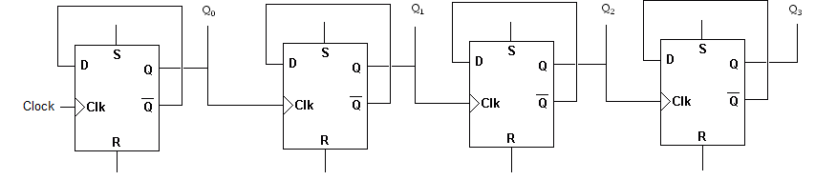
What does this circuit do?
Assume that the initial state of Q₀, Q₁, Q₂, and Q₃ are all logical zeros.
Determine how Q₀ changes as the clock pulse goes from 0 →1 →0 →1.
After how many clock pulses will Q₁ change state from ‘0’ to ‘1’?
After how many clock pulses will Q₂ change state from ‘0’ to ‘1’?
After how many clock pulses will Q₃ change state from ‘0’ to ‘1’?

Slide 25
S-R Latch
S | R | C | Q_{n} | Qn+1 | description
0 | 0 |  | 0 | 0 | hold
0 | 0 |  | 1 | 1
0 | 1 |  | 0 | 0 | clear (reset)
0 | 1 |  | 1 | 0
1 | 0 |  | 0 | 1 | set
1 | 0 |  | 1 | 1
1 | 1 |  | 0 | ? | indeterminate
1 | 1 |  | 1 | ? | — avoid
S Q
C
R Q
inputs
at
clock transition
output before clock
output after clock

Slide 26
JK Flip-Flop
J | K | Q_{n} | Qn+1 | description
0 | 0 | 0 | 0 | hold
0 | 0 | 1 | 1
0 | 1 | 0 | 0 | clear (reset)
0 | 1 | 1 | 0
1 | 0 | 0 | 1 | set
1 | 0 | 1 | 1
1 | 1 | 0 | 1 | toggle
1 | 1 | 1 | 0
J Q
K
Q
Q_{n+1} = J ◊ Q_{n} + K ◊ Q_{n}
The excitation table for a JK flip-flop is similar to SR flip-flop but doesn’t have the problem of S = R = 1. It can perform all the operations of the simpler types of flip-flop. However, the design of the circuit internal to the flip-flop makes it more expensive to manufacture than a number of other flip-flops so JK flip-flops are now rarely used.

Slide 27
Timing Diagram: JK Flip-Flop
C
J
K
Q
hold
set
hold
clear
toggle
set (no effect)
Suggestion: Determine the Q output for a negative edge triggered JK flip-flop
with the inputs shown above, assuming that Q starts at logic 0.

Slide 28
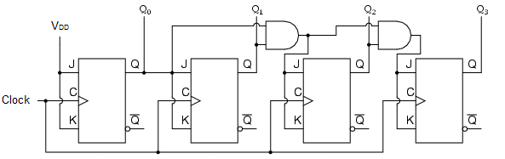
Same Operation as Circuit on Slide 24
Task: Prove this to yourself.

Slide 29
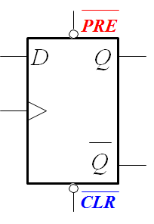
Control Pins
Flip-flops and more complicated circuits often have inputs, such as clear, preset, enable, and load. The state of the control pins has priority of the D and Clock inputs when determining the state of the output.
Clear (CLR) resets the flip-flop output to 0 — the most common control input
Preset (PRE) sets the flip-flop output to 1
More complicated circuits such as counters may have additional control inputs for up/down, count/hold, load, etc. Microprocessors usually have a reset pin.

Slide 30
Active Low Controls
Control inputs are often active low, shown by a bar over the label or a circle for negation (or both as in the component below).
Active low inputs should be:
kept high for normal operation
changed to low to preset or clear the device.
The reason for making these active low is historical.
Check the data sheet to be sure!

Slide 31
Asynchronous Control
Another feature of control inputs is that they are often asynchronous. This means that they take effect immediately and do not wait for a clock transition.
Compare
D takes effect only at a clock transition (positive edge)
clear and preset act immediately to ‘overrule’ D
Asynchronous inputs are sometimes called direct or jam inputs.
Always check the data sheet because some control inputs are synchronous!

Slide 32
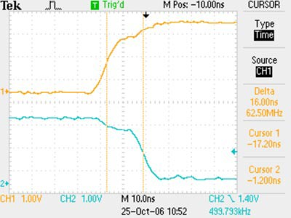
Propagation Delay
We have seen that most modern logic devices are triggered on either the rising or falling edge of the clock. The output does not respond instantly, but only after a time called the propagation delay, tpd.
Here is an example for a D flip-flop that was measured in a UoG lab class.
74HC74
flip-flop at 3 V
propagation
delay, tpd
(about 16 ns)

Slide 33
Limitations on Circuit: t_{pd}
The propagation delay is important for several reasons:
It limits the speed at which circuits can be clocked (20 or 30 MHz for the ‘HC’ family of components, used in the laboratory)
Signals that pass through different numbers of components receive different delays, as in a ripple counter. Time must be allowed for all outputs to settle down before the system attempts to change state again.
The delay helps to keep digital circuits with feedback stable (this applies to virtually all practical circuits).
Each logic gate responds to its at the clock transition.
Because of t_{pd}, the outputs change after the propagation delay.
This affects the inputs that are connected to outputs.
However, these gates are no longer acting on their inputs until the next clock transition arrives.

Slide 34
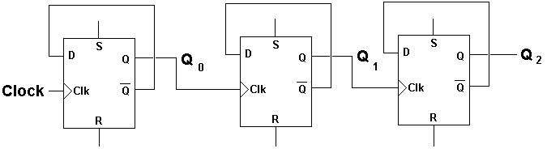
Would this circuit work?
What would happen if t_{pd} is longer than the period of the clock?
What would happen if t_{pd} is about equal to the clock’s period?

Slide 35
Lecture Review Questions
What is the fundamental difference between combinational and sequential logic?
What inputs should you put on a SR flip-flop to set it (to 1)?
Why must S = R = 1 be avoided?
Why do sequential logic circuits need a clock?
What is meant by the term edge-triggered flip-flop?
Describe the operation of a type D flip-flop. For what are they used? Describe the operation of a JK flip-flop with J = K = 1.
Why do some flip-flops have control inputs? In what ways do they differ from the normal inputs, such as J and K?
What is the propagation delay? Why is it important?

