Slide 1
INTRODUCTION
PHP is now officially known as PHP: Hypertext Preprocessor.
It is a server-side scripting language usually written in an HTML context
HTML elements in the script are left alone, but PHP code is interpreted and executed.
PHP code in a script can query databases, create images, read and write files, talk to remote servers— the possibilities are endless.
The output from PHP code is combined with the HTML in the script and the result sent to the user

Slide 2
How Did PHP Evolve?
The first version of PHP was created by Rasmus Lerdorf in 1994 as a set of Web publishing macros.
These were released as the Personal Home Page Tools and later rewritten and extended to include a package called the Form Interpreter (PHP/FI).
PHP3 was an effective rewrite of PHP, with an entirely new parser created by Zeev Suraski and Andi Gutmans, as well as differences in syntax and new features. This release established PHP as one of the most exciting server scripting languages available , and the growth in usage was enormous.

Slide 3
PHP's support for Apache and MySQL further secured its popularity. Apache is now the most-used Web server in the world, and PHP3 can be compiled as an Apache module. MySQL is a powerful free SQL database, and PHP provides a comprehensive set of functions for working with it. The combination of Apache, MySQL, and PHP is all but unbeatable.
PHP4 introduces numerous new features that will make the programmer's life more interesting.
A new foreach statement
the Boolean data type.
A particularly useful feature of PHP3 was the capability to name form elements as if they were elements in an array. The elements' names and values are then made available to the code in array form. This feature has been extended to support multidimensional arrays.

Slide 4
Support for object-oriented programming was somewhat rudimentary in PHP. This is significantly extended in PHP4; for example, it is now possible to call an overridden method from a child class.
PHP4 now provides native support for user sessions, using both cookies and the query string.
A new comparison operator (===) has been introduced that tests for equivalence of type as well as equivalence of value.
New associative arrays containing server and environmental variables have been made available, as well as a variable that holds information about uploaded files.
PHP4 now provides built-in support for both Java and XML.

Slide 5
Why Choose PHP?
Speed of Development
Because PHP allows you to separate HTML code from scripted elements, you will notice a significant decrease in development time on many projects.
PHP Is Open Source
To many people, "open source" simply means free, which is, of course, a benefit in itself. To quote from the official PHP site at http://www.php.net/:
Performance
Because of the powerful Zend engine, PHP4 compares well with ASP in benchmark tests, beating it in some tests. Compiled PHP leaves ASP far behind.
Portability
PHP is designed to run on many operating systems and to cooperate with many servers and databases

Slide 6
A First PHP Script
<? php
print ("Hello Web!“);
?>
Combining HTML and PHP
1: <html>
2: <head>
3: <title>Listing 3.2 A PHP script including HTML</title>
4: </head>
5: <body>
6: <b>
7: <?php
8: print "hello world";
9: ?>
10: </b>
11: </body>
12: </html>

Slide 7
Adding Comments to PHP Code
A comment is text in a script that is ignored by the interpreter. Comments can be used to make code more readable, or to annotate a script.
Single line comments begin with two forward slashes (/ /) or a single hash sign (#).
Multiline comments begin with a forward slash followed by an asterisk (/*) and end with an asterisk followed by a forward slash (*/).

Slide 8
Variables
A variable is a special container that you can define to "hold" a value.
A variable consists of a name that you can choose, preceded by a dollar ($) sign. The variable name can include letters, numbers, and the underscore character (_).
$a;
$a_longish_variable_name;
$2453;
$sleepyZZZZ;
EXAMPLES
$num1 = 8;
$num2 = 23;
print $num1;
is equivalent to
print 8;

Slide 9
Dynamic Variables
you create a variable with a dollar sign followed by a variable name.
$user = "bob";
is equivalent to
$holder="user";
$$holder = "bob";
you must wrap the string you want to use for the variable name in braces:
${"user"} = "bob";
$user ="bob";
print $user;
is equivalent to
$user ="bob";
$holder="user";
print $$holder; it is prints the bob

Slide 10
$user="bob";
$holder="user";
print "$$holder"; it prints the $user
$user="bob";
$holder="user";
print "${$holder}"; it prints the bob

Slide 11
Dynamically Setting and Accessing Variables
1: <html>
2: <head>
3: <title> Dynamically setting and accessing variables</title>
4: </head>
5: <body>
6: <?php
7: $holder = "user";
8: $$holder = "bob";
9:
10: // could have been:
11: // $user = "bob";
12: // ${"user"} = "bob";
13:
14: print "$user<br>"; // prints "bob"
15: print $$holder; // prints "bob"
16: print "<br>";
17: print "${$holder}<br>"; // prints "bob"
18: print "${'user'}<br>"; // prints "bob"
19: ?>
20: </body>
21: </html>

Slide 12
References to Variables
1: <html>
2: <head>
3: <title>Listing 4.2 Variables are assigned by value</title>
4: </head>
5: <body>
6: <?php
7: $aVariable = 42;
8: $anotherVariable = $aVariable;
9: // a copy of the contents of $aVariable is placed in $anotherVariable
10: $aVariable = 325;
11: print $anotherVariable; // prints 42
12: ?>
13: </body>
14: </html>

Slide 13
Assigning a Variable by Reference
1: <html>
2: <head>
3: <title>Listing 4.3 Assigning a variable by reference</title>
4: </head>
5: <body>
6: <?php
7: $aVariable = 42;
8: $anotherVariable = &$aVariable;
9: // a copy of the contents of $aVariable is placed in $anotherVariable
10: $aVariable= 325;
11: print $anotherVariable; // prints 325
12: ?>
13: </body>
14: </html>

Slide 14
Printing some HTML
<html>
<head>
<title> displaying text from PHP</title>
</head>
<body>
<h1>display text from php</h1>
Here ‘s what PHP has to say:
<br>
<?php
echo “<i>welcome </i> <br>”
echo“<u> to</u> <br>”
echo “<b>PHP </b>.”;
?>
</body>
</html>

Slide 15
Data Types
PHP4 is loosely typed, which means that it will calculate data types as data is assigned to each variable. This is a mixed blessing.
On the one hand, it means that variables can be used flexibly, holding a string at one point and an integer at another.
On the other hand, this can lead to confusion in larger scripts if you expect a variable to hold one data type when in fact it holds something
Type Example Description
Integer 5 A whole number
Double 3.234 A floating-point number
String "hello“ A collection of characters
Boolean true One of the special values true or false
Object
Array

Slide 16
Testing the Type of a Variable
1: <html>
2: <head>
3: <title>Listing 4.3 Testing the type of a variable</title>
4: </head>
5: <body>
6: <?php
7: $testing = 5;
8: print gettype( $testing );
9: print "<br>";
10: $testing = "five";
11: print gettype( $testing );
12: print("<br>");
13: $testing = 5.0;

Slide 17
14: print gettype( $testing );
15: print("<br>");
16: $testing = true;
17: print gettype( $testing );
18: print "<br>";
19: ?>
20: </body>
21: </html>

Slide 18
Changing Type with settype()
1: <html>
2: <head>
3: <title>Listing 4.5 Changing the type of a variable with settype()</title>
4: </head>
5: <body>
6: <?php
7: $undecided = 3.14;
8: print gettype( $undecided ); // double
9: print " -- $undecided<br>"; // 3.14
10: settype( $undecided, string );
11: print gettype( $undecided ); // string

Slide 19
12: print " -- $undecided<br>"; // 3.14
13: settype( $undecided, integer );
14: print gettype( $undecided ); // integer
15: print " -- $undecided<br>"; // 3
16: settype( $undecided, double );
17: print gettype( $undecided ); // double
18: print " -- $undecided<br>"; // 3.0
19: settype( $undecided, boolean );
20: print gettype( $undecided ); // boolean
21: print " -- $undecided<br>";
22: ?>
23: </body>
24: </html>

Slide 20
Changing Type by Casting
By placing the name of a data type in brackets in front of a variable, you create a copy of that variable's value converted to the data type specified
The principal difference between settype() and a cast is the fact that casting produces a copy , leaving the original variable untouched.

Slide 21
1: <html>
2: <head>
3: <title>Listing 4.6 Casting a variable</title>
4: </head>
5: <body>
6: <?php
7: $undecided = 3.14;
8: $holder = ( double ) $undecided;
9: print gettype( $holder ) ; // double
10: print " -- $holder<br>"; // 3.14
11: $holder = ( string ) $undecided;
12: print gettype( $holder ); // string
13: print " -- $holder<br>"; // 3.14

Slide 22
14: $holder = ( integer ) $undecided;
15: print gettype( $holder ); // integer
16: print " -- $holder<br>"; // 3
17: $holder = ( double ) $undecided;
18: print gettype( $holder ); // double
19: print " -- $holder<br>"; // 3.14
20: $holder = ( boolean ) $undecided;
21: print gettype( $holder ); // boolean
22: print " -- $holder<br>"; // 1
23: ?>
24: </body>
25: </html>

Slide 23
constant
<html>
<head>
<title> Defining constants</title>
</head>
<body>
<?php
define(“PI”,3.14);
echo “the value of pi is”, PI,”<br>”;
?>
</body>
</html>

Slide 24
Operators and Expressions
An operator is a symbol or series of symbols that, when used in conjunction with values, performs an action and usually produces a new value.
An operand is a value used in conjunction with an operator. There are usually two operands to one operator.
The combination of operands with an operator to manufacture a result is called an Expression or
An expression is any combination of functions, values, and operators that resolve to a value. As a rule of thumb, if you can use it as if it were a value, it is an expression.

Slide 25
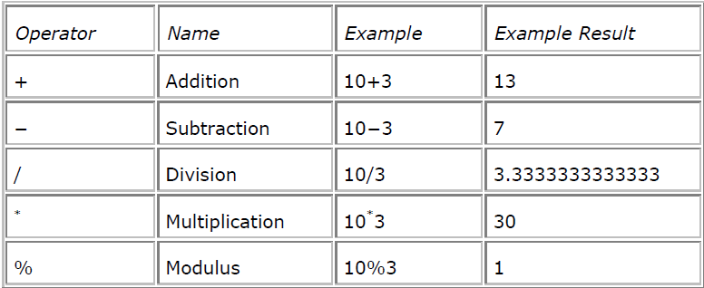
Arithmetic Operators
<?php
echo "7+2=",7+2;
echo "7-2=",7-2;
echo "7*2=",7*2;
echo "7/2=",7/2;
echo "7%2=",7%2;
?>

Slide 26
Math operators
<?php
echo tan(deg2rad(45)),"<br>";
echo pow(4,3)."<br>";
echo floor(3.14159)."<br>";
echo dechex(16)."<br>";
echo rad2deg(atan(1))."<br>";
?>

Slide 27
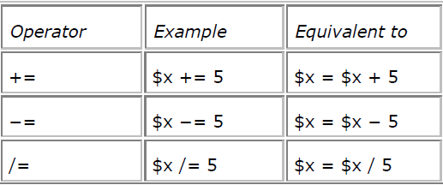
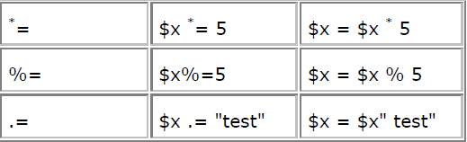
Assignment operators
$name ="matt";
$x = 4;
$x += 4; // $x now equals 8

Slide 28
Incrementing and Decrementing
<?php
$a=$b=$c=$d=1;
echo "\$a=\$b=\$c=\$d=1 <br>";
echo "\$a++ gives ",$a++,"<br>";
echo "\$a=",$a;
echo "<br> ++\$b gives ",++$b,"<br>";
echo " \$c-- gives ",$c--,"<br>";
echo "now \$c= ",$c,"<br>";
echo "--\$d gives",--$d,"<br>";
?>

Slide 29
PHP string operators
concatenation operator ,.,
Assignment operator .=.
<?php
$a="no";
echo "\$a=",$a,"<br>";
echo "\$b=\$a.\"worries\"<br>";
$b=$a."worries";
echo "now \$b=",$b,"<br>";
echo "\$b.=\"at all.\"<br>";
$b.="at all.";
echo "now \$b=",$b,"<br>";
?>

Slide 30
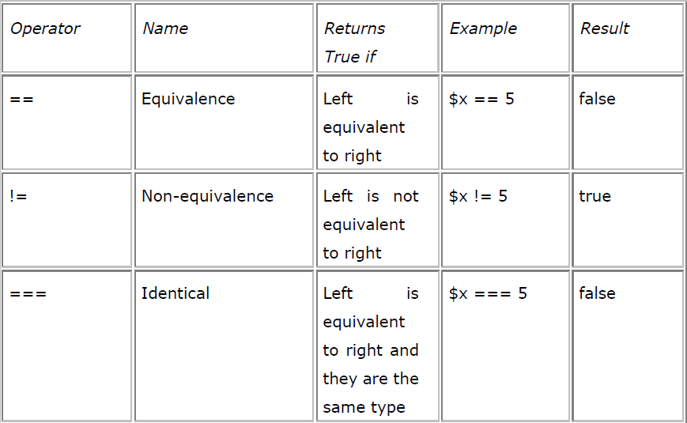
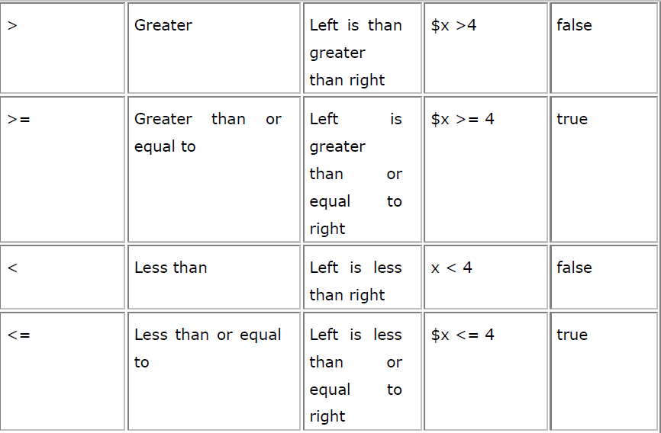
Comparison Operators

Slide 31
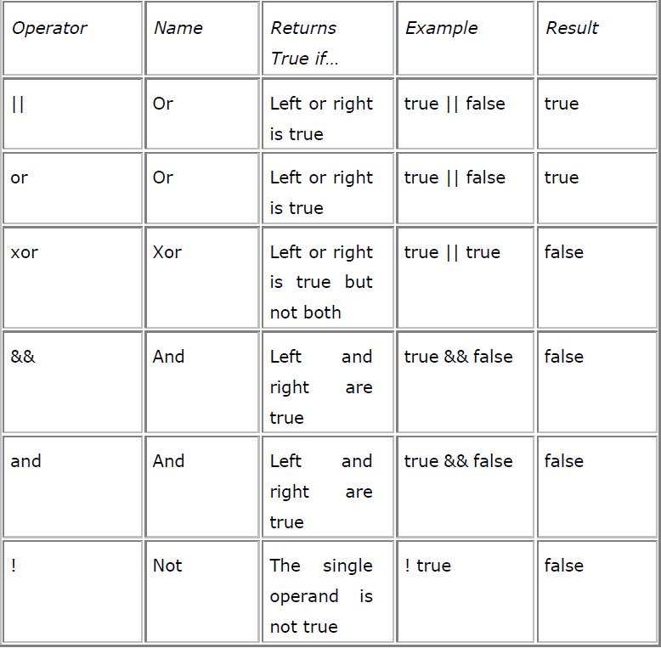
Logical operator

Slide 32
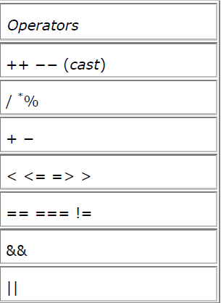
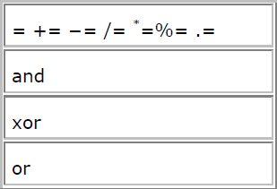
Operator Precedence

Slide 33
Using the if statement
if ( expression )
{
// code to execute if the expression evaluates to true
}
1: <html>
2: <head>
3: <title>Listing 5.1</title>
4: </head>
5: <body>
6: <?php
7: $mood = "happy";
8: if ( $mood == "happy" )
9: {
10: print "Hooray, I'm in a good mood";
11: }
12: ?>
13: </body>
14: </html>

Slide 34
Using the else Clause with the if Statement
if ( expression )
{
// code to execute if the expression evaluates to true
}
else
{
// code to execute in all other cases
}

Slide 35
1: <html>
2: <head>
3: <title>Listing 5.2</title>
4: </head>
5: <body>
6: <?php
7: $mood = "sad";
8: if ( $mood == "happy" )
9: {
10: print "Hooray, I'm in a good mood";
11: }
12: else
13: {
14: print "Not happy but $mood";
15: }
16: ?>
17: </body>
18: </html>

Slide 36
Using the elseif Clause with the if Statement
if ( expression )
{
// code to execute if the expression evaluates to true
}
elseif ( another expression )
{
// code to execute if the previous expression failed
// and this one evaluates to true
else
{
// code to execute in all other cases
}

Slide 37
1: <html>
2: <head>
3: <title>Listing 5.3</title>
4: </head>
5: <body>
6: <?php
7: $mood = "sad";
8: if ( $mood == "happy" )
9: {
10: print "Hooray, I'm in a good mood";
11: }
12: elseif ( $mood == "sad" )
13: {
14: print "Awww. Don't be down!";
15: }
16: else
17: {
18: print "Neither happy nor sad but $mood";
19: }
20: ?>
21: </body>
22:</html>

Slide 38
The switch Statement
switch ( expression )
{
case result1:
// execute this if expression results in result1
break;
case result2:
// execute this if expression results in result2
break;
default:
// execute this if no break statement
// has been encountered hitherto
}

Slide 39
1: <html>
2: <head>
3: <title>Listing 5.4</title>
4: </head>
5: <body>
6: <?php
7: $mood = "sad";
8: switch ( $mood )
9: {
10: case "happy":
11: print "Hooray, I'm in a good mood";
12: break;
13: case "sad":
14: print "Awww. Don't be down!";
15: break;
16: default:
17: print "Neither happy nor sad but $mood";
18: }
19: ?>
20: </body>
21: </html>

Slide 40
Using the ? or ternary Operator
( expression )?
returned_if_expression_is_true :
returned_if_expression_is _false;
<?php
$mood = "sad";
$text = ( $mood=="happy" )?"Hooray, I'm in a good mood": "Not happy but $mood";
print "$text";
?>

Slide 41
Loops
while ( expression )
{ // do something }
<?php
$counter = 1;
while ( $counter <= 12 )
{
print "$counter times 2 is ".($counter*2)."<br>";
$counter++;
}
?>

Slide 42
The do..while Statement
do { // code to be executed }
while ( expression );
<?php
$num = 1;
do
{
print "Execution number: $num<br>\n";
$num++;
}
while ( $num > 200 && $num < 400 );
?>

Slide 43
The for Statement
for ( variable assignment; test expression; variable increment ) {
// code to be executed
}
<?php
for ( $counter=1; $counter<=12; $counter++ )
{
print "$counter times 2 is ".($counter*2)."<br>";
}
?>

Slide 44
Breaking Out of Loops with the break Statement or terminating Loops early
<?php
$counter = − 4;
for ( ; $counter <= 10; $counter++ )
{
if ( $counter == 0 )
break;
$temp = 4000/$counter;
print "4000 divided by $counter is... $temp<br>";
}
?>

Slide 45
Skipping an Iteration with the continue Statement
<?php
$counter = − 4;
for ( ; $counter <= 10; $counter++ )
{
if ( $counter == 0 )
continue;
$temp = 4000/$counter;
print "4000 divided by $counter is... $temp<br>";
}
?>

Slide 46
Nesting Loops
<html>
<head>
<title>Listing 5.12</title>
</head>
<body>
<?php
print "<table border=3>\n";
for ( $y=1; $y<=12; $y++ ) {
print "<tr>\n";
for ( $x=1; $x<=12; $x++ ) {
print "\t<td>";
print ($x*$y);
print "</td>\n"; }
print "</tr>\n"; }
print "</table>";
?>
</body>
</html>

Slide 47
Using foreach loop
foreach(collection_expression as $value)
foreach(collection_expression as $key=>$value)
<?php
$arr=array("sri","kanth","M.Tech");
foreach($arr as $key=> $value){
echo "current details:$key=>$value<br>";
}
?>

Slide 48
PHP Alternate syntax
PHP also supports an alternative syntax for if ,while,for,foreach and switch.
Incase the form of the alternative syntax changes the opening curly brace to a colon(:) and closing brace to endif;endswitch;endwhile;endfor;endforeach
<?php
$temp=61;
switch($temp==61):
case 61:
echo "hi";
break;
case 62:
echo "hello";
break;
default: echo"bad option";
endswitch;
?>

