Slide 1
DIVIDE & CONQUER
Recursive in structure
Divide the problem into sub-problems that are similar to the original but smaller in size
Conquer the sub-problems by solving them recursively. If they are small enough, just solve them in a straightforward manner.
Combine the solutions to create a solution to the original problem

Slide 2
Merge Sort
Sorting Problem: Sort a sequence of n elements into non-decreasing order.
Divide: Divide the n-element sequence to be sorted into two subsequences of n/2 elements each
Conquer: Sort the two subsequences recursively using merge sort.
Combine: Merge the two sorted subsequences to produce the sorted answer.
Used when we have large data set.
Worst and average case time complexity if O(nlgn)
Requires double memory space

Slide 3
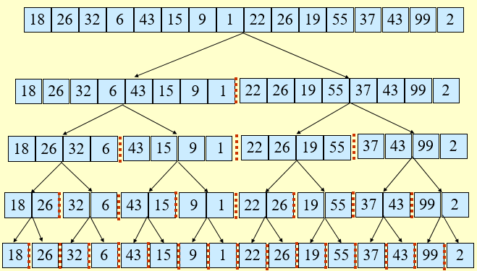
Merge Sort - Example

Slide 4
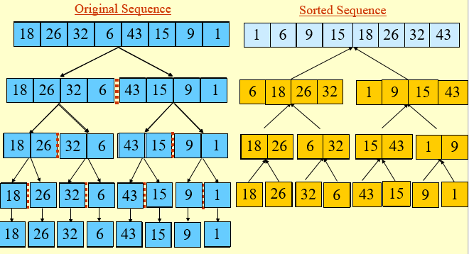
Merge Sort - Example

Slide 5
Merge Sort - Algorithm
INPUT: a sequence of n numbers stored in array A
OUTPUT: an ordered sequence of n numbers
MergeSort (A, low, high) // sort A[low..high] by divide & conquer
{
if (low < high) then
{
mid ← ⎣(low+high)/2⎦
MergeSort (A, low, mid)
MergeSort (A, mid+1, high)
Merge (A, low, mid, high) // merges A[low..mid] with A[mid+1..high]
}
}

Slide 6
Merge( A, low, mid, high)
h ← low;
i ← low;
j ← mid+1;
While((h ≤mid)and(j ≤high))
{
if (a[h] ≤a[j])
{
b[i]=a[h];
h=h+1;
}
else
{
b[i]=a[j];
j=j+1;
}
i=i+1;
}
If(h ≥ mid) then
{
for k=j to high do
{
b[i]=a[k];
i=i+1;
}
}
else
{
for k=h to mid do
{
b[i]=a[k];
i=i+1;
}
}
for k=low to high do
a[k]=b[k];

Slide 7
Merge Sort - Analysis
Running time T(n) of Merge Sort:
Divide: computing the middle takes Θ(1)
Conquer: solving 2 sub problems takes 2T(n/2)
Combine: merging n elements takes Θ(n)
Total:
T(n) = Θ(1) if n = 1
T(n) = 2T(n/2) + Θ(n) if n > 1
T(n) = O(n lg n)

