Slide 1
Working with the Database in PHP

Slide 2
Contents
Intro to DBMS
Creating MYSQL database
Connecting to the database server
Insertion and deletion of records
Reading and Displaying the Table data on Web Page
PHP functions related to database handling

Slide 3
Introduction to DBMS
Purpose of Database Systems
View of Data
Data Models
Data Definition Language
Data Manipulation Language
Transaction Management
Storage Management
Database Administrator
Database Users
Overall System Structure

Slide 4
Database Management System (DMBS)
Data means collection of facts
Collection of interrelated data or
A database management system stores data, in such a way which is easier to retrieve, manipulate and helps to produce information
Set of programs to access the data
DMBS contains information about a particular enterprise
DBMS provides an environment that it both convenient and efficient to use

Slide 5
Purpose of Database Systems
In the early days, database applications were built on top of file systems
Data redundancy and inconsistency
Difficulty in accessing data
Data isolation – multiple files and formats
Integrity problems
Atomicity of updates
Concurrent access by multiple users
Security problems

Slide 6
Problems with file system
Drawbacks of using file systems to store data:
Data redundancy and inconsistency
✔ Multiple file formats, duplication of information in different files
Difficulty in accessing data
✔ Need to write a new program to carry out each new task
Data isolation — multiple files and formats
Integrity problems
✔ Integrity constraints (e.g. account balance > 0) become part of program code
✔ Hard to add new constraints or change existing ones

Slide 7
Atomicity of updates
✔ Failures may leave database in an inconsistent state with partial
updates carried out
✔ E.g. transfer of funds from one account to another should either
complete or not happen at all
Concurrent access by multiple users
✔ Concurrent accessed needed for performance
✔ Uncontrolled concurrent accesses can lead to inconsistencies
E.g. two people reading a balance and updating it at the same
time
Security problems
Database systems offer solutions to all the above problems

Slide 8
View of Data
An architecture for a database system
View level
View 1
View 2
…
View n
Logical
level
Physical
level

Slide 9
Levels of Abstraction
Physical level: describes how a record (e.g. customer) is stored.
Logical level: describes data stored in database, and the relationships among the data.
type customer = record
name: string;
street: string;
city: integer;
end;
View level: application programs hide details of data types. Views can also hide information (e.g. salary) for security purposes.

Slide 10
Instances and Schemas
Similar to types and variables in programming languages
Schema – the logical structure of the database (e.g., set of customers and accounts and the relationship between them)
Instance – the actual content of the database at a particular point in time

Slide 11
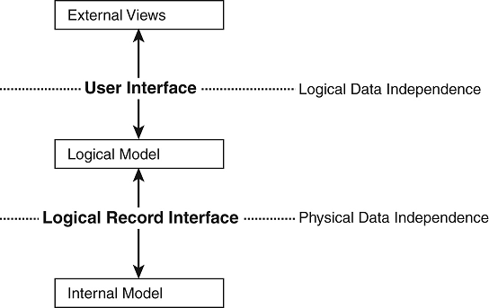
Data Independence
Ability to modify a schema definition in one level without affecting a schema definition in the other levels.
The interfaces between the various levels and components should be well defined so that changes in some parts do not seriously influence others.
Two levels of data independence
Physical data independence
Logical data independence

Slide 12
Data Models
A collection of tools for describing:
Data
Data relationships
Data semantics
Data constraints
Object-based logical models
Entity-relationship model
Object-oriented model
Semantic model
Functional model
Record-based logical models
Relational model (e.g., SQL/DS, DB2)
Network model
Hierarchical model (e.g., IMS)

Slide 13
Entity-Relationship Model
Example of entity-relationship model
social-security
customer-street
account-number
customer-city
customer-name
balance
depositor
customer
account

Slide 14
Relational Model
Example of tabular data in the relational model:

Slide 15
Data Definition Language (DDL)
Specification notation for defining the database schema
DDL compiler generates a set of tables stored in a data dictionary
Data dictionary contains metadata (data about data)
Data storage and definition language – special type of DDL in which the storage structure and access methods used by the database system are specified
Operation performed under DDL are:
Create
Alter
Drop

Slide 16
Data Manipulation Language (DML)
Language for accessing and manipulating the data organized by the appropriate data model
Two classes of languages
Procedural – user specifies what data is required and how to get those data
Nonprocedural – user specifies what data is required without specifying how to get those data
Operations
Delete
Insert
Merge
Select
update

Slide 17
Transaction Management
A transaction is a collection of operations that performs a single logical function in a database application.
Transaction-management component ensures that the database remains in a consistent (correct) state despite system failures (e.g. power failures and operating system crashes) and transaction failures.
Concurrency-control manager controls the interaction among the concurrent transactions, to ensure the consistency of the database.
COMMIT ROLLBACK SAVEPOINT SET TRANSACTION

Slide 18
Storage Management
A storage manager is a program module that provides the interface between the low-level data stored in the database and the application programs and queries submitted to the system.
The storage manager is responsible for the following tasks:
Interaction with the file manager
Efficient storing, retrieving, and updating of data

Slide 19
Database Administrator
Coordinates all the activities of the database system; the database administrator has a good understanding of the enterprise’s information resources and needs:
Database administrator’s duties include:
Schema definition
Storage structure and access method definition
Schema and physical organization modification
Granting user authority to access the database
Specifying integrity constraints
Acting as liaison with users
Monitoring performance and responding to changes in requirements

Slide 20
Database Users
Users are differentiated by the way they expect to interact with the system.
Application programmers: interact with system through DML calls.
Specialized users: write specialized database applications that do not fit into the traditional data processing framework
Sophisticated users: form requests in a database query language.
Naive users: invoke one of the permanent application programs that have been written previously

Slide 21
Overall System Structure
indices
Statistical data
disk storage
Data files
Data dictionary

Slide 22
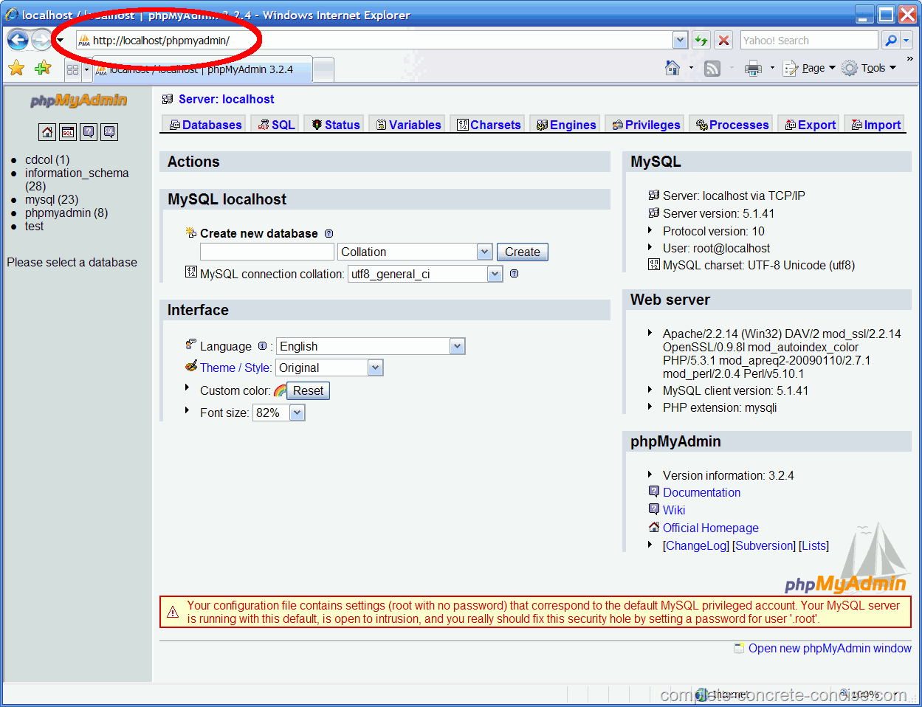
Creating MYSQL database
Open your browser and enter http://localhost/phpmyadmin. This will bring you to the MySQL setup page:

Slide 23
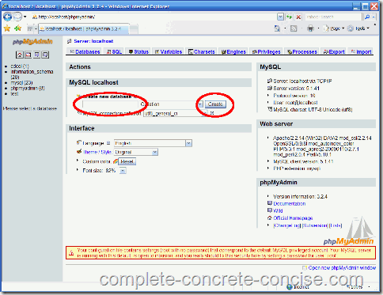
Cont..
Enter a name for the database, then click on the Create button.

Slide 24
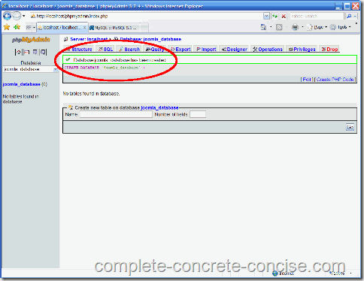
Cont..
Ensure the database was successfully created:

Slide 25
Connecting to the database server
Open a Connection to the MySQL Server:
Before we can access data in a database, we must open a connection to the MySQL server.
In PHP, this is done with the mysqli_connect() function.
Syntax:
mysqli_connect(host,username,password,dbname);
Note: There are more available parameters, but the ones listed below are the most important.
Parameter | Description
host | Optional. Either a host name or an IP address
username | Optional. The MySQL user name
password | Optional. The password to log in with
dbname | Optional. The default database to be used when performing queries

Slide 26
Cont.. For establish the connection
In the following example we store the connection in a variable ($con) for later use in the script:
<?php // Create connection $con=mysqli_connect("example.com","peter","abc123","my_db"); // Check connection if (mysqli_connect_errno($con)) { echo "Failed to connect to MySQL: " . mysqli_connect_error(); } ?>

Slide 27
Close a Connection
The connection will be closed automatically when the script ends. To close the connection before, use the mysqli_close() function:
<?php $con=mysqli_connect("example.com","peter","abc123","my_db"); // Check connection if (mysqli_connect_errno()) { echo "Failed to connect to MySQL: " . mysqli_connect_error(); } mysqli_close($con); ?>

Slide 28
Insertion and deletion of records: insertion
to insert the values into existing table in your database.
Step1: steps for connect to database through php coding,
<?php
$dbhostname = 'localhost';
$dbusername = 'testuser';
$dbpassword = 'testpassword';
$conn = mysql_connect($dbhostname, $dbusername, $dbpassword);
if(! $conn ) {
die('Could not connect: ' . mysql_error()); }
echo 'MySQL Connected successfully'."<BR>";
mysql_select_db("testdb") or die(mysql_error());
echo "Connected to Database"."<BR>";
cont.………………………

Slide 29
Step2: way to insert the data into existing table on your database
$sql_statemanet = 'INSERT INTO tblstaff '.
'(employee_name,employee_add, employee_joined, employee_sal) '.
'VALUES ( "Mike", "dummy address", NOW() ,5000 )';
//mysql_select_db('test_db');
$rec_insert = mysql_query( $sql_statemanet);
if(! $rec_insert ) {
die('Could not enter data: ' . mysql_error());
}
echo "Entered data successfully\n";
mysql_close($conn);
?>

Slide 30
Update data using mysql_query()
Step1 is common for every query.
Step2: for updating table through php coding
$emp_salary = 7000;
$emp_id = 3;
$sql_statemanet = "UPDATE tblstaff ".
"SET employee_sal = $emp_salary ".
"WHERE ID = $emp_id" ;
//mysql_select_db('test_db');
$rec_update = mysql_query( $sql_statemanet);
if(! $rec_update )
{
die('Could not update data: ' . mysql_error());
}
echo "Record updated successfully\n";
mysql_close($conn);
?>

Slide 31
Select data using mysql_query() and displaying by mysql_fetch_array()
Step1: as usual
Step2: for selecting table data from coding
$sql_statemanet = "select * from tblstaff";
$rec_select = mysql_query( $sql_statemanet);
if(! $rec_select )
{
die('Could not retrieve data: ' . mysql_error());
}
//Displaying fetched records to HTML table
echo "<table border='1'>";
echo "<tr> <th>Employee Name</th> <th>Employee Salary</th> </tr>";
// Using mysql_fetch_array() to get the next row until end of table rows

Slide 32
Cont..
while($row = mysql_fetch_array( $rec_select )) {
// Print out the contents of each row into a table
echo "<tr><td>";
echo $row['employee_name'];
echo "</td><td>";
echo $row['employee_sal'];
echo "</td></tr>";
}
mysql_close($conn);
?>

Slide 33
Reading and Displaying the Table data on Web Page
<html>
<head>
<title>Search data</title>
</head>
<body>
<table>
<tr>
<td align="center">EMPLOYEES DATA</td>
</tr>
<tr>
<td>
<table border="1">
<tr>
<td>NAME</td>
<td>EMPLOYEES<br>NUMBER</td>
<td>ADDRESS</td>
</tr>

Slide 34
Cont..
<?php
//the example of searching data
with the sequence based on the field name
//search.php
mysql_connect("localhost","root","admin");//database connection
mysql_select_db("employees");
$order = "SELECT * FROM data_employees ORDER BY name";
//order to search data
//declare in the order variable
$result = mysql_query($order);
//order executes the result is saved
//in the variable of $result
while($data = mysql_fetch_row($result)){
echo("<tr><td>$data[1]</td><td>$data[0]</td><td>$data[2]</td></tr>");
}
?>
</table>
</td>
</tr>
</table>
</body>
</html>

Slide 35
PHP functions related to database handling
mysql_affected_rows — Get number of affected rows in previous MySQL operation
Mysql_change_user change the logged in user
mysql_client_encoding — Returns the name of the character set
mysql_close — Close MySQL connection
mysql_connect — Open a connection to a MySQL Server
mysql_create_db — Create a MySQL database
mysql_data_seek — Move internal result pointer
mysql_db_name — Retrieves database name from the call to mysql_list_dbs
mysql_db_query — Selects a database and executes a query on it
mysql_drop_db — Drop (delete) a MySQL database
mysql_errno — Returns the numerical value of the error message from previous MySQL operation
mysql_error — Returns the text of the error message from previous MySQL operation

Slide 36
Cont..
mysql_escape_string — Escapes a string for use in a mysql_query
mysql_fetch_array — Fetch a result row as an associative array, a numeric array, or both
mysql_fetch_assoc — Fetch a result row as an associative array
mysql_fetch_field — Get column information from a result and return as an object
mysql_fetch_lengths — Get the length of each output in a result
mysql_fetch_object — Fetch a result row as an object
mysql_fetch_row — Get a result row as an enumerated array
mysql_field_flags — Get the flags associated with the specified field in a result
mysql_field_len — Returns the length of the specified field
mysql_field_name — Get the name of the specified field in a result
mysql_field_seek — Set result pointer to a specified field offset
mysql_field_table — Get name of the table the specified field is in
mysql_field_type — Get the type of the specified field in a result

Slide 37
Cont..
mysql_free_result — Free result memory
mysql_get_client_info — Get MySQL client info
mysql_get_host_info — Get MySQL host info
mysql_get_proto_info — Get MySQL protocol info
mysql_get_server_info — Get MySQL server info
mysql_info — Get information about the most recent query
mysql_insert_id — Get the ID generated in the last query
mysql_list_dbs — List databases available on a MySQL server
mysql_list_fields — List MySQL table fields
mysql_list_processes — List MySQL processes
mysql_list_tables — List tables in a MySQL database
mysql_num_fields — Get number of fields in result
mysql_num_rows — Get number of rows in result
mysql_pconnect — Open a persistent connection to a MySQL server
mysql_ping — Ping a server connection or reconnect if there is no connection

Slide 38
Cont..
mysql_query — Send a MySQL query
mysql_real_escape_string — Escapes special characters in a string for use in an SQL statement
mysql_result — Get result data
mysql_select_db — Select a MySQL database
mysql_set_charset — Sets the client character set
mysql_stat — Get current system status
mysql_tablename — Get table name of field
mysql_thread_id — Return the current thread ID
mysql_unbuffered_query — Send an SQL query to MySQL without fetching and buffering the result rows.

