Slide 1
CHAPTER 3: PROCESSES
Session 6,7,8

Slide 2
Chapter 3: Processes
Process Concept
Process Scheduling
Operations on Processes
Cooperating Processes
Interprocess Communication
Communication in Client-Server Systems

Slide 3
Process Concept
An operating system executes a variety of programs:
  Batch system – jobs
  Time-shared systems – user programs or tasks
Textbook uses the terms job and process almost interchangeably
Process – a program in execution; process execution must progress in sequential fashion
A process includes:
  program counter
  stack
  data section
  Heap!!!

Slide 4

Process in Memory

Slide 5

Diagram of Process State
Operating System Concepts

Slide 6
Process States
As a process executes, it changes state
  new: The process is being created
  running: Instructions are being executed
  waiting: The process is waiting for some event to occur
  ready: The process is waiting to be assigned to a processor
  terminated: The process has finished execution

Slide 7
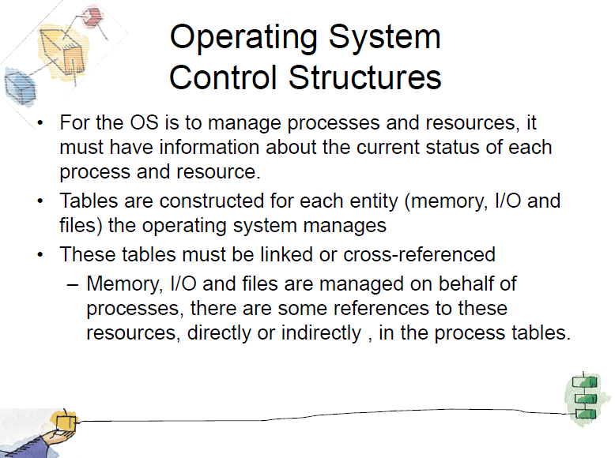

Slide 8
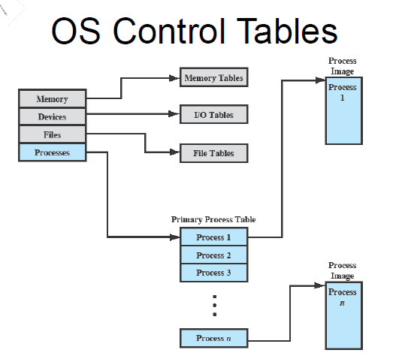

Slide 9
Process Control Block (PCB)
Information associated with each process
Process state
Program counter
CPU registers
CPU scheduling information
Memory-management information
Accounting information
I/O status information

Slide 10

Process Control Block (PCB)

Slide 11
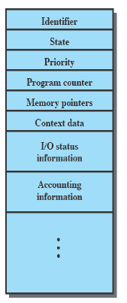
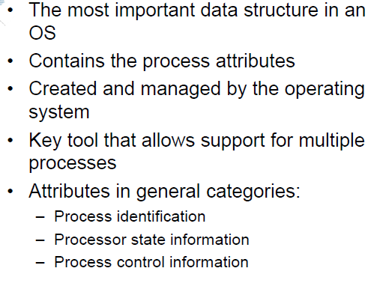
PCB

Slide 12

CPU Switch From Process to Process

Slide 13
Process Scheduling Queues
Job queue – set of all processes in the system
Ready queue – set of all processes residing in main memory, ready and waiting to execute
Device queues – set of processes waiting for an I/O device
Processes migrate among the various queues

Slide 14

Ready Queue And Various I/O Device Queues

Slide 15

Representation of Process Scheduling

Slide 16

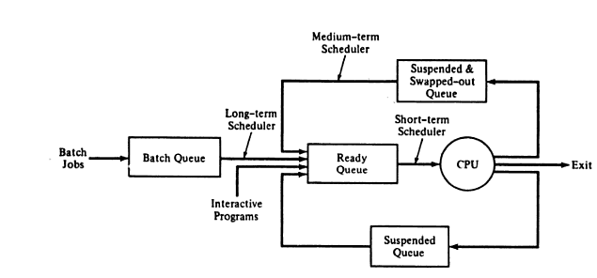
Types of Schedulers

Slide 17
Schedulers
Long-term scheduler (or job scheduler) – selects which processes should be brought into the ready queue
Short-term scheduler (or CPU scheduler) – selects which process should be executed next and allocates CPU

Slide 18

Addition of Medium Term Scheduling
Significance: 7-state transition diagram

Slide 19
Schedulers (Cont.)
Short-term scheduler is invoked very frequently (milliseconds) ⇒ (must be fast)
Long-term scheduler is invoked very infrequently (seconds, minutes) ⇒ (may be slow)
The long-term scheduler controls the degree of multiprogramming
Processes can be described as either:
  I/O-bound process – spends more time doing I/O than computations, many short CPU bursts
  CPU-bound process – spends more time doing computations; few very long CPU bursts

Slide 20
Context Switch
When CPU switches to another process, the system must save the state of the old process and load the saved state for the new process
Context-switch time is overhead; the system does no useful work while switching
Time dependent on hardware support

Slide 21
Process Creation
Parent process create children processes, which, in turn create other processes, forming a tree of processes
Resource sharing
  Parent and children share all resources
  Children share subset of parent’s resources
  Parent and child share no resources
Execution
  Parent and children execute concurrently
  Parent waits until children terminate

Slide 22
Process Creation (Cont.)
Address space
  Child duplicate of parent
  Child has a program loaded into it
UNIX examples
  fork system call creates new process
  exec system call used after a fork to replace the process’ memory space with a new program

Slide 23

Process Creation

Slide 24
C Program Forking Separate Process
int main()
{
pid_t pid;
/* fork another process */
pid = fork();
if (pid < 0) { /* error occurred */
fprintf(stderr, "Fork Failed");
exit(-1);
}
else if (pid == 0) { /* child process */
execlp("/bin/ls", "ls", NULL);
}
else { /* parent process */
/* parent will wait for the child to complete */
wait (NULL);
printf ("Child Complete");
exit(0);
}
}
//http://www.linfo.org/pid.html

Slide 25

A tree of processes on a typical Solaris

Slide 26
Process Termination
Process executes last statement and asks the operating system to delete it (exit)
  Output data from child to parent (via wait)
  Process’ resources are deallocated by operating system
Parent may terminate execution of children processes (abort)
  Child has exceeded allocated resources
  Task assigned to child is no longer required
  If parent is exiting
    Some operating system do not allow child to continue if its parent terminates
      All children terminated - cascading termination

Slide 27
Cooperating Processes
Independent process cannot affect or be affected by the execution of another process
Cooperating process can affect or be affected by the execution of another process
Advantages of process cooperation
  Information sharing
  Computation speed-up
  Modularity
  Convenience

Slide 28
Producer-Consumer Problem
Paradigm for cooperating processes, producer process produces information that is consumed by a consumer process.
Producer and Consumer can run concurrently if we make available buffer for items that can be produced by producer and consumed by consumer.
Producer and consumer need to synchronize.
  unbounded-buffer places no practical limit on the size of the buffer
  bounded-buffer assumes that there is a fixed buffer size , i.e. Producer must wait if buffers are full and consumer must wait if buffers are empty.

Slide 29
Bounded-Buffer – Shared-Memory Solution
      #define BUFFER_SIZE 10
      typedef struct {
      . . .
      } item;
      item buffer[BUFFER_SIZE];
      int in = 0;
      int out = 0;
      item nextconsumed,nextproduced;
      //Insert Method
while (true) {
/* Produce an item */
while (((in = (in + 1) % BUFFER _SIZE ) == out)
; /* do nothing -- no free buffers */
buffer[in] = nextproduced;
in = (in + 1) % BUFFER SIZE;
}
//Remove method
while (true) {
while (in == out)
; // do nothing -- nothing to consume
// remove an item from the buffer
nextconsumed = buffer[out];
out = (out + 1) % BUFFER SIZE;
return item;
}

Slide 30
Interprocess Communication (IPC)
Mechanism for processes to communicate and to synchronize their actions
Message system – processes communicate with each other without resorting to shared variables ie without sharing address space.
IPC facility provides two operations:
  send(message) – message size fixed or variable
  receive(message)
If P and Q wish to communicate, they need to:
  establish a communication link between them
  exchange messages via send/receive
Implementation of communication link
  physical (e.g., shared memory, hardware bus)
  logical (e.g., logical properties)

Slide 31
Implementation Questions
How are links established?
Can a link be associated with more than two processes?
How many links can there be between every pair of communicating processes?
What is the capacity of a link?
Is the size of a message that the link can accommodate fixed or variable?
Is a link unidirectional or bi-directional?

Slide 32

Communications Models

Slide 33
Direct Communication
Processes must name each other explicitly:
  send (P, message) – send a message to process P
  receive(Q, message) – receive a message from process Q
Properties of communication link
  Links are established automatically
  A link is associated with exactly one pair of communicating processes
  Between each pair there exists exactly one link
  The link may be unidirectional, but is usually bi-directional

Slide 34
Indirect Communication
Messages are directed and received from mailboxes (also referred to as ports)
  Each mailbox has a unique id
  Processes can communicate only if they share a mailbox
Properties of communication link
  Link established only if processes share a common mailbox
  A link may be associated with many processes
  Each pair of processes may share several communication links
  Link may be unidirectional or bi-directional

Slide 35
Indirect Communication
Operations
  create a new mailbox
  send and receive messages through mailbox
  destroy a mailbox
Primitives are defined as:
send(A, message) – send a message to mailbox A
receive(A, message) – receive a message from mailbox A

Slide 36
Indirect Communication
Mailbox sharing
  P₁, P₂, and P₃ share mailbox A
  P₁, sends; P₂ and P₃ receive
  Who gets the message?
Solutions
  Allow a link to be associated with at most two processes
  Allow only one process at a time to execute a receive operation
  Allow the system to select arbitrarily the receiver. Sender is notified who the receiver was.

Slide 37
Synchronization
Message passing may be either blocking or non-blocking.
Blocking is considered synchronous
  Blocking send has the sender block until the message is received
  Blocking receive has the receiver block until a message is available
Non-blocking is considered asynchronous
  Non-blocking send has the sender send the message and continue
  Non-blocking receive has the receiver receive a valid message or null

Slide 38
Buffering
Queue of messages attached to the link; implemented in one of three ways
  Zero capacity – 0 messages
  Sender must wait for receiver (rendezvous)
  Bounded capacity – finite length of n messages
  Sender must wait if link full
  3. Unbounded capacity – infinite length ,Sender never waits

Slide 39
Client-Server Communication
Sockets
Remote Procedure Calls
Remote Method Invocation (Java)

Slide 40
Sockets
A socket is defined as an endpoint for communication
Concatenation of IP address and port
The socket 161.25.19.8:1625 refers to port 1625 on host 161.25.19.8
Communication consists between a pair of sockets

Slide 41

Socket Communication

Slide 42
Remote Procedure Calls
Remote procedure call (RPC) abstracts procedure calls between processes on networked systems.
Stubs – client-side proxy for the actual procedure on the server.
The client-side stub locates the server and marshalls the parameters.
The server-side stub receives this message, unpacks the marshalled parameters, and peforms the procedure on the server.

Slide 43
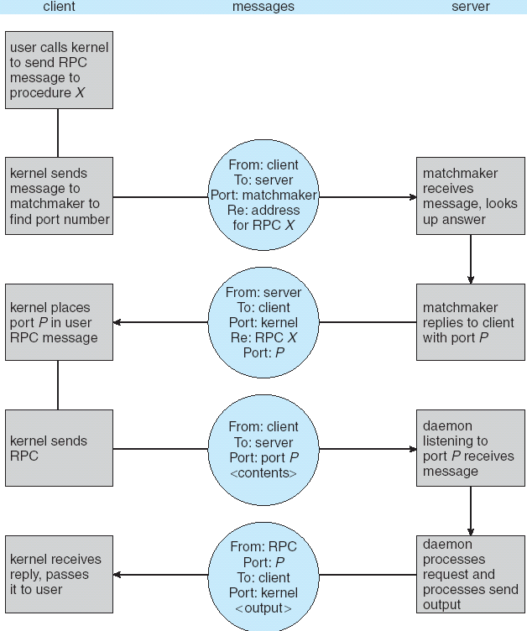
Execution of RPC

Slide 44

Remote Method Invocation
Remote Method Invocation (RMI) is a Java mechanism similar to RPCs.
RMI allows a Java program on one machine to invoke a method on a remote object.

Slide 45
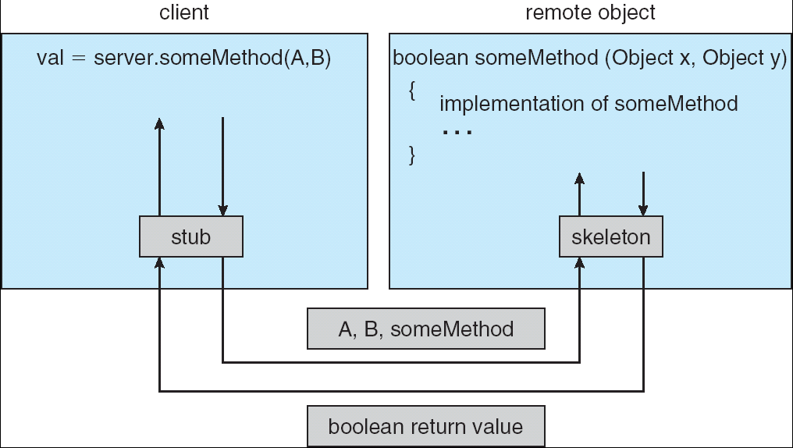
Marshalling Parameters

Slide 46
Credits
Operating System Concepts-8th Edition by Silberschatz , Galvin and Gagne.
Operating Systems-Internals and Design Principles-4th Edition by William Stallings
And lots of Readings myself!!! ☺
Thanks
Queries @ mkapoor@ddn.upes.ac.in

Slide 47
END OF CHAPTER 3

