Slide 1
SCHOOL OF ENGINEERING & TECHNOLOGY
DEPARTMENT OF COMPUTER SCIENCE AND ENGINEERING
Introduction to Java
Presented By:
Pushpendra K. Rajput
Assistant Professor,
Department of Computer Science & Engineering

Slide 2
SCHOOL OF ENGINEERING & TECHNOLOGY
DEPARTMENT OF COMPUTER SCIENCE AND ENGINEERING
Outline
Arrays

Slide 3
Arrays - Introduction
Array is a list of finite number n of homogeneous data elements such that:
The elements of the array are referenced respectively by an index set of n consecutive numbers.
The element of the array are stored respectively in successive memory location.
The number n of elements is called the length or size.

Slide 4
Graphical Representation
Position is called a index or superscript. Base index = 0.
Let DATA be a 6-element array of integers such that
DATA[0]=247, DATA[1]=56, DATA[2]=492,
DATA[3]=135, DATA[4]=87, DATA[5]=156
DATA
1
2
3
4
5
6
247
56
492
135
87
156
INDEX

Slide 5
SCHOOL OF ENGINEERING & TECHNOLOGY
DEPARTMENT OF COMPUTER SCIENCE AND ENGINEERING
Graphical Representation
Position is called a index or superscript. Base index = 0.
Let DATA be a 6-element array of integers such that
DATA[0]=247, DATA[1]=56, DATA[2]=492,
DATA[3]=135, DATA[4]=87, DATA[5]=156
DATA
0
1
2
3
4
5
247
56
492
135
87
156
VALUE

Slide 6
SCHOOL OF ENGINEERING & TECHNOLOGY
DEPARTMENT OF COMPUTER SCIENCE AND ENGINEERING
Declaration of Arrays
Like any other variables, arrays must declared and created before they can be used. Creation of arrays involve three steps:
Declare the array
Create storage area in primary memory.
Put values into the array (i.e., Memory location)
Declaration of Arrays:
Form 1:
Type arrayname[];
Form 2:
Type [] arrayname;
Examples:
int[] students;
int students[];
Note: we don’t specify the size of arrays in the declaration.

Slide 7
Creation of Arrays
After declaring arrays, we need to allocate memory for storage array items.
In Java, this is carried out by using “new” operator, as follows:
Arrayname = new type[size];
Examples:
students = new int[7];
students
0
1
2
3
4
5
6
Declaring and defining in the same statement:
int[] students=new students[10];

Slide 8
Initialisation of Arrays
Once arrays are created, they need to be initialised with some values before access their content. A general form of initialisation is:
Arrayname [index/subscript] = value;
Example:
students[0] = 50;
students[1] = 40;
Array index starts with 0 and ends with n-1
Trying to access an array beyond its
boundaries will generate an error message.
students[7] = 100;
students
0
1
2
3
4
5
6
50

Slide 9
SCHOOL OF ENGINEERING & TECHNOLOGY
DEPARTMENT OF COMPUTER SCIENCE AND ENGINEERING
Initialisation of Arrays
Once arrays are created, they need to be initialised with some values before access their content. A general form of initialisation is:
Arrayname [index/subscript] = value;
Example:
students[0] = 50;
students[1] = 40;
Array index starts with 0 and ends with n-1
Trying to access an array beyond its
boundaries will generate an error message.
students[7] = 100;
students
0
1
2
3
4
5
6
50
40

Slide 10
Explicit initialization
Arrays can also be initialised like standard variables at the time of their declaration.
Type arrayname[] = {list of values};
Example:
int[] students = {55, 69, 70, 30, 80, 90, 45};
Creates and initializes the array of integers of length 7.
In this case it is not necessary to use the new operator.
students
0
1
2
3
4
5
6
55
69
70
30
80
90
45

Slide 11
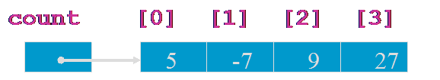
Processing Array Elements
Access individual elements of an array using:
the name (handle) of the array
a number (index or subscript) that tells which of the element of the array
What value is stored in count[2]?
count[2] = 9

Slide 12
Array Length
Refer to array length using length
A data member of array object
arrayname.length
for(int k=0; k<students.length;k++)
Example:
long[] primes = new long[20];
System.out.println(primes.length);
Output: 20
→ If number of elements in the array are changed, JAVA will automatically change the length attribute!

Slide 13
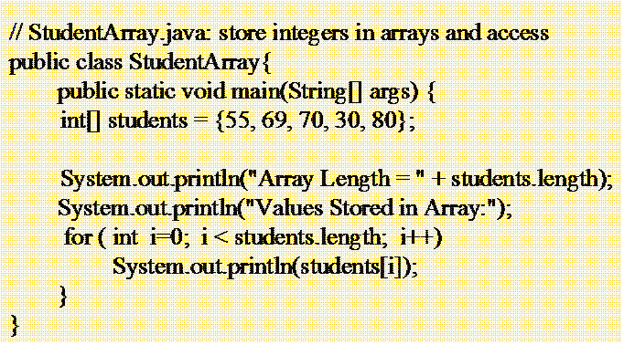
SCHOOL OF ENGINEERING & TECHNOLOGY
DEPARTMENT OF COMPUTER SCIENCE AND ENGINEERING
Processing Array Elements using loop
Often a for( ) loop is used to process each of the elements of the array in turn.
The loop control variable, i, is used as the index to access array components

Slide 14
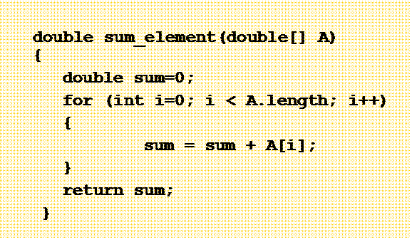
SCHOOL OF ENGINEERING & TECHNOLOGY
DEPARTMENT OF COMPUTER SCIENCE AND ENGINEERING
Array as Parameters
Methods can accept arrays via parameters
Use square brackets [ ] in the parameter declaration:

Slide 15
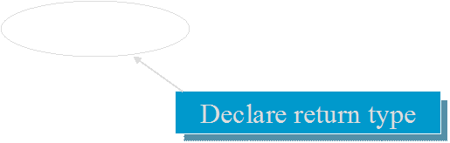
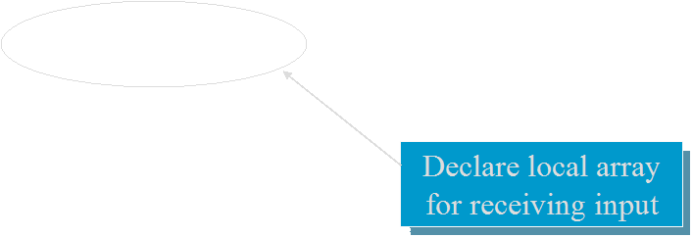

SCHOOL OF ENGINEERING & TECHNOLOGY
DEPARTMENT OF COMPUTER SCIENCE AND ENGINEERING
Returning Array
A method may return an array as its result
double [] readArray(int n)
{
double result[] = new double[n]; for (i = 0; i < n; i++) {
result[i] = i;
} return result;
}

Slide 16
SCHOOL OF ENGINEERING & TECHNOLOGY
DEPARTMENT OF COMPUTER SCIENCE AND ENGINEERING
Two Dimensional Arrays
Two dimensional arrays allows us to store data that are recorded in table.
int[][] student=new int[4][4];
4 arrays each having 4 elements
First index: specifies array (row)
Second Index: specifies element in that array (column)
0 | 1 | 2 | 3
0
1
2
3
10 | 20 | 85 | 45
56 | 58 | 25 | 58
45 | 85 | 65 | 78
65 | 14 | 28 | 56

Slide 17
Two Dimensional Arrays
Requires two indices
int[][] student=new int[4][4];
What is the value of student[2][3]?
student
Student[2][3] = 78
0 | 1 | 2 | 3
0
1
2
3
10 | 20 | 85 | 45
56 | 58 | 25 | 58
45 | 85 | 65 | 78
65 | 14 | 28 | 56

Slide 18
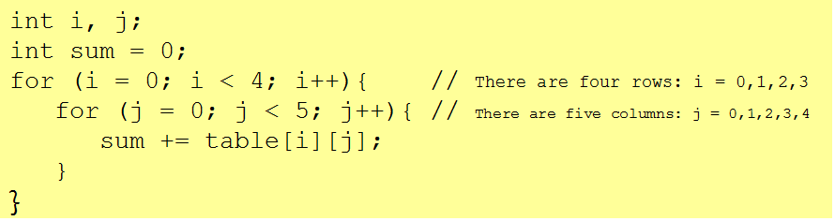
Accessing 2D Array Elements
Sum the Elements
Here is code that sums all the numbers in table.
The outer loop iterates four times and moves down the rows.
Each time through the outer loop, the inner loop iterates five times and moves across a different row.

Slide 19
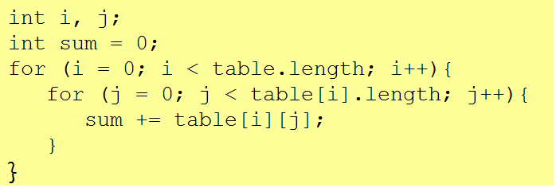
Accessing Rows and Columns
The previous code can be rewritten without using the numbers 4 and 5.
The value table.length equals the number of rows,
table[i].length is the number of columns in row i.
table[0].length = 5, table[1].length = 5,………..

Slide 20
Declaration and Instantiation of 2D Array
Declaring and instantiating two-dimensional arrays are accomplished by extending the processes used for one-dimensional arrays:
Declaration:
int myArray [][];
Creation or Instantiation:
myArray = new int[4][3]; // OR
int myArray [][] = new int[4][3];
Initialisation:
- Single Value;
myArray[0][0] = 10;
- Multiple values:
int table[2][3] = {{10, 15, 30}, {14, 30, 33}};
int table[][] = {{10, 15, 30}, {14, 30, 33}};

Slide 21
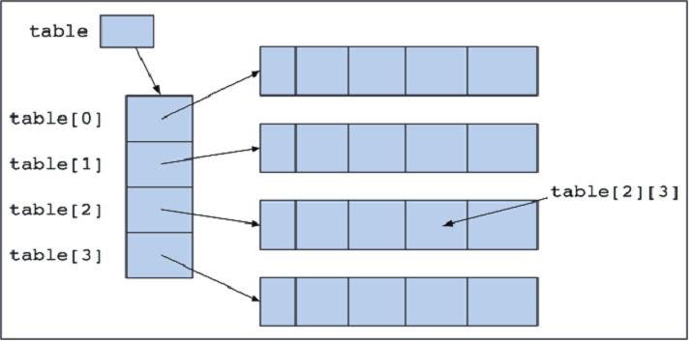
2D Array as “Array of Arrays”
int table [][] = new int[4][5];
The variable table references an array of four elements.
Each of these elements in turn references an array of five integers.
[0] | [1] | [2] | [3] | [4]

Slide 22
Variable Size Arrays
Java treats multidimensional arrays as “arrays of arrays”. It is possible to declare a 2D arrays as follows:
int a[][] = new int [3][];
[0]
[1]
[2]
a[0]= new int [2];
[0] | [1]
a[1]= new int [3];
[0] | [1] | [2]
a[2]= new int [4];
[0] | [1] | [1] | [3]

Slide 23
Multidimensional Arrays
Example: A farmer has 10 farms of beans each in 5 countries, and each farm has 30 fields!
Three-dimensional array:
long[][][] beans=new long[5][10][30];
//beans[country][farm][fields]

Slide 24
Varying length in Multidimensional Arrays
Same features apply to multi-dimensional arrays as those of 2 dimensional arrays
long beans=new long[3][][]; //3 countries
beans[0]=new long[4][]; //First country has 4 farms
beans[0][4]=new long[10];//Each farm in first country has 10 fields

Slide 25
Exercise-1
WAP in Java that create an array and simple print the element of the array. (Array Traversing).
WAP in Java that implements following three methods:
boolean Search( int [] A, int Key): it takes an array A and a Key as input and returns true if Key is in the array else return false.
int Position(int [] A, int Key): it takes an array A and a Key as input and returns the position of Key in the array.
int [] Sort(int [] A): it takes an array A and returns another array. The output array has same element as in input array but in ascending order.
WAP in Java that takes an two dimensional array as input parameter to a method and returns one dimensional array. Each element of the output array is the sum of the element of corresponding row in input array.
WAP in Java to add, multiply, and subtract two Matrices. The decision of operation should be made based on user’s choice.

Slide 26
SCHOOL OF ENGINEERING & TECHNOLOGY
DEPARTMENT OF COMPUTER SCIENCE AND ENGINEERING
Thank You!

