Slide 1

Overview
  Objects and Databases in 1986
  Trends with Objects and Databases
  POSTGRES Data/Query Model & Fast Path
  POSTGRES Rules and Storage
  POSTGRES v2.1 Implementation
  Future of Objects and Databases
Notes:
-Way back in 1986, the connection between objects and databases was new and being explored.
-In this paper, the author has basically described the turmoil of objects and databases and emergence of 4 main database systems.

Slide 2


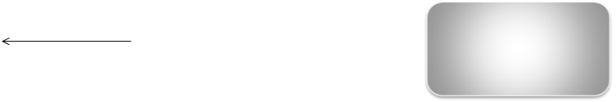


Back in 1986….
  Connection between objects and databases was new and getting explored.
Persistent Programming Languages
Extended Relational
Database Systems
New Era of Objects
  Object Oriented Database Systems.
  Database system toolkits.
Notes:
-Traditional database readers were extending the relational data model to incorporate new and more complex types of data.
-> Extended Relational DB
-Programmers were adding persistence to the languages -> PPL
-OODB repidly gaining momentum
-One camp agreed that combination of OODB and RDD would suffice the real world requirement.
-other opined that building domain specific database wud be better-> Database system toolkit.

Slide 3
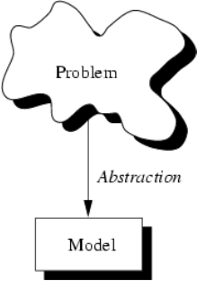
Why Extended Relational Databases?
  Motivation: Storage and Querying of complex Data-types
  Example: Probabilistic Databases
      Location of ACL Conference in 2012 is either Europe or USA, each with probability 0.5.
      Representation? {USA/0.5,Europe/0.5}
      ({Paris,Vienna}/0.5 , {Michigan, California}/0.5)
  Solution: Abstract Data-types.
Notes:
- Research on the extended relational database had been in progress since several years
Properties of ADT’s
Exports a type and a set of operations called functions.
Type should be registered with the Database system.
Once registered, ADT’s can be accessed like any other built in data-type.
Provides Encapsulation of data and methods of an object.
ADT- Ingres Effort pioneered the approach of using ADT functions in a query and dynamically loading it.
Postgres came in as a follow-on of Ingres and enhanced Query Optimization using ADT.
More on Postgres later....

Slide 4
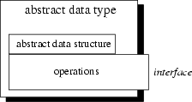
What are ADT's?
  User defined Abstract Data-types,
    Register with Database - System aware of its size and functions.
    Benefits -
      Encapsulation of data and methods of an object
      Re usability
      Flexibility.
Notes:
Encapsulation - Because each user-defined data type exist as a complete entity, including the data definitions, default values, and value constraints, this entity ensures uniformity and consistency.
Reusability - As a hierarchy of common data structures are assembled, these can be re-used within many definitions, saving coding time and insuring uniformity.
Flexibility - The ability to create real-world data representations of data allows the database object designer to model the real world as it exists.

Slide 5
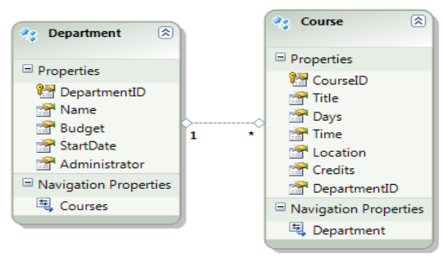
Impedance Mismatch still persists....
  Arises at the boundary when Programming Language meets the Relational Database.
  Eg: Data Model for Departmental statistics.
Notes:
None of the tables contain complete information.
Need of translating data between Relational tables and objects
Programmer is responsible to write explicit code to retrieve data from the database and store it back to it.
set of technical and conceptual difficulties when RDBMS is accessed by the programming language.

Slide 6
Persistent Programming Languages
  Motivation: Reduce the impedance mismatch
  How? - Allow objects to be created and stored in
  a database, and used directly from a programming language
    No need of SQL to query data.
    No Need of explicit format type changes.
    Allow objects to be manipulated in-memory.
  Drawbacks?-
    Easy to make programming errors
    Complexity of languages make Optimization difficult.
Notes:
Adding features to a Programming language to make its data persistent and program executions atomic.
Allow data to be directed manipulated from the programming language
Applications which just need to manage their permanent data, would prefer this.
Reduce the impedance mismatch that arises at the boundary when the programming language meets the Database.
Consider a CAD application.
Work in this area focused on Orthogonality, persistence models , garbage collection, maintenance of Persistent data-structures.

Slide 7
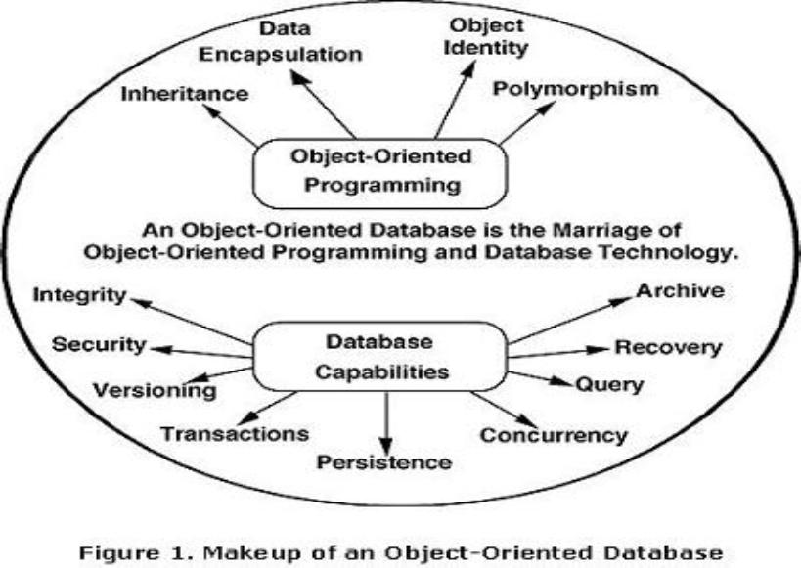
Object Oriented Database Systems
  Motivation: Reduce impedance mismatch, support for querying and indexing and addressing version management.
  .
Notes:
Support for Encapsulation, inheritance, extensible type system, persistence, concurrency, recovery, version management.
Standardization of Specifications for Data-Model, Query-Language.
Client Server Architectures for Data-Caching and recovery.
Version and configuration management models also proposed.
Consider a computer aided design application in which the user can save and load complex engineering drawings into memory.
With an object oriented database, the software calls a database function to load the illustration, but objects are not created in memory until they are needed: instead, they are stored in the database, and only references are loaded into memory
OODB Query Language: QUEL and SQL.

Slide 8
Object Oriented Database Systems
  Drawbacks-
    No uniform agreement on the any OODB paradigm.
    Differences in several OODB products as no standard. [Only O2 supports all standards of OQL]
    Behind with respect to Relational DB -> View facility not provided, Schema Evolution is a pain.
    Robustness, scalability and Fault-tolerance not as good as Relational DB.

Slide 9
Database System Toolkits/Components
  Motivation: To build a Domain-Specialized Database system.
  Difference in Query Languages, access methods, storage organizations and transaction mechanisms.
  Eg: Geographic Information Systems manages the Geographic Data.
Notes:
Documents to be managed in a document oriented DB and Geographic data in a GIS.
difference in Query language, sementics was a drawback.
Three projects : EXODUS,GENESIS and DASDBS.
Argument that no Database system would be able to meet the functional requirements of future applications.

Slide 10
Overview
  Objects and Databases in 1986
  Trends with Objects and Databases
  POSTGRES Data/Query Model & Fast Path
  POSTGRES Rules and Storage
  POSTGRES v2.1 Implementation
  Future of Objects and Databases

Slide 11
What was the conclusion?
  Four Database Systems since 1986. Outcome?
    Losers
      Database System Tool-kits
      Persistent Programming languages
    Survivors
      Object Oriented Databases.
      Extended Relations Databases
Notes:
1]We had 4 problems and 4 solutions ack in 1986.. whats the conclusion of this mystery?
Who were the losers ??
2]

Slide 12
Casualty 1 - Database System Tool-kits.
    Too much Expertise required
    Inflexible and incomplete in terms of database design.
    Query Optimizer was general but inefficient to use, left details of Logical Query rewrites and predicates to the implementer.
    Very less control over buffering, concurrency and recovery.
Notes:
EXODUS provided
-client/server storage manager
- but most wanted to use their own servers and EXODUS's client/server model introduced a additional level of indirection
-Positive Point- EXODUS triggered a research in OODB direction.

Slide 13
Casualty 2 - Persistent Programming Languages
  No commercial implementation of a pure persistent programming language.
  Why not a complete disaster?
    Impact on the research of many of OODB's products.
    Persistence Models, Pointer Swizzling Mechanisms[?] and garbage collection schemes relate to OODB concepts.
Notes:
Pointer Swizzling mechanism:
Relation of objects stored on disk and memory
-converting physical OID into logical in memory OID
-Lookup table which maps the logical to physical OID. slow
-storing memory pointers in the place of
referenced OIDs, and vice versa when the object is
written back to disk.

Slide 14
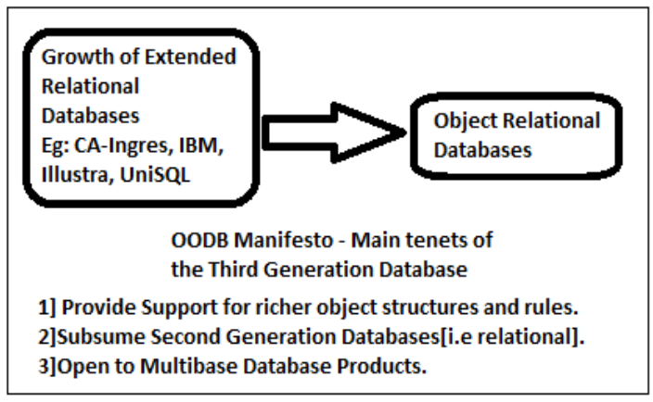
Extended Relational Databases.
  In parallel with OODB, extended relational DB also matured. [CA-Ingres, IBM, Illustra]
Notes:
Also laid out certain rules as to how
-inheritance
-functions and encapsulation
-rules/triggers
-query based interface
- updataable views

Slide 15
Object Relational Databases.
  ORDB have relational model and a Query language built from there.
  Support ADT's and Row types.
  Set Types
  Shortcomings- No agreement on ORDB paradigms.
Notes:
ADT's described earlier, used for extending datatypes to text, images ,videos etc.
Row Types- enable the Rows to enjoy Object Properties and can contain reference value attributes
Multivalued attribute support [Eg: Set]
Inheritance
Object client wrappers-
Generate classes that act as proxies for the underlying database
permit programmers to interact with the DB in more natural way.
pointer swizzling mechanism to map the physical database data to programming objects..

Slide 16
Overview
  Objects and Databases in 1986
  Trends with Objects and Databases
  POSTGRES Data/Query Model & Fast Path
  POSTGRES Rules and Storage
  POSTGRES v2.1 Implementation
  Future of Objects and Databases

Slide 17









Postgres Motivation
Factors Motivating towards Postgres
ADT’s to support Bitmaps, Videos, text etc
Support for Data, object and Knowledge Management
Object and Rule management
Supports No-overwrite Storage manager and Time Travel
Notes:
History
Version 1 of Postgres, coded in C, was written on top of Ingres released in 1989
Object Management- storing non traditional datatypes like bitmaps, icons, text etc
-knowlege- ability to force a collection of rules that are a part of applications eg: integrity
-Example of newspaper.

Slide 18
Postgres Data Model & Query Language
  Design Criteria
  Postgres Data Model
  Postgres Functions
  Postgres Query Language
  Fast Path

Slide 19


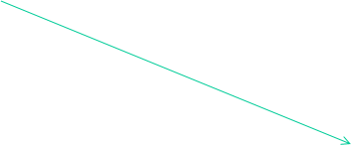



Design Criteria
Three Design Criteria
  Orientation towards Database access from Query Language.
  Orientation towards Multilingual access
  [ Neutral and can tightly couple with any Language]
  Smaller Number of Concepts
  [Constructs like classes, Inheritance, types and functions.]
Notes:
Orientation towards Database access from Query Language.
Set Oriented Query Language, POSTQUEL.
Primary goal was to include a query language, Optimizer with a run-time system.
Postgres assigns a OID to each record.
Indexes can be defined on the OID.
Fast Path allows user to package a collection of direct calls to Postgres internals via a function.
Orientation towards Multilingual access
Postgres is Programming language neutral and can tightly couple with the compiler of any programming language.
Smaller Number of Concepts
Constructs like classes, Inheritance, types and functions.
Keeps it simple!

Slide 20


Postgres Data Model
  Classes - Collection of instances of objects.
  Eg: Create EMP (name= C12, salary = float, age = int)
  Inheritance
      Eg:Create salesman (quota=float ) inherits EMP.
  Types of Classes- Real Classes, Derived Classes, Versioned classes
EMP
Name=C12
Salary=Float
Age=int
Salesman
Quota = float
Notes:
Classes - Collection of instances of objects.
Each instance has a same collection of attributes.
Each attribute is defined by a type.
Multiple inheritance is allowed. [In case of ambiguity due to inheriting same attribute, Postgres chose not to create the class]
Types of Classes
Real Classes:
Base class whose instances are stored in the database.
Derived class:
Analogous to a View or a Virtual Class whose contents are materialized only at runtime.
Versioned Class:
To store historical/ archived information.

Slide 21


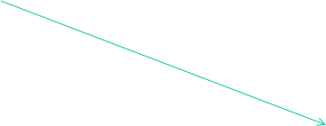



Postgres Data-Model
Postgres Data-types
  Base Types – ADT
  Eg: Create DEPT
  (dname= c10,
  manager=c12,
  floorspace= polygon,
  mailstop= point)
Replace DEPT(mailstop="(10,10)", where DEPT.name="shoe")
  Arrays of Base Types
  Create EMP(name=c12, salary=float[12], age=int)
  Composite Datatypes.
Two Types: Nested Definition, Set Definition
  create EMP( name=c12, salary=float, age=int, manager=EMP, corworkers=EMP)
add to EMP (hobbies=set)
Notes:
Postgres Types-Base Types
Abstract Data type:
Postgres does not restrict the collection of base types.
Postgres supports ADT, whereby any user can construct arbitrary new base type.
Eg: Create DEPT (dname= c10, manager=c12, floorspace= polygon, mailstop= point)
Replace DEPT(mailstop="(10,10)", where DEPT.name="shoe")
The first two types are built in , however Polygon and mailstop is an ADT.
Postgres Types-Arrays of Base Types
Arrays are supported using the standard bracket.
If in the Eg, we say each Employee recieves different salary per month,
create EMP(name=c12, salary=float[12], age=int)
Postgres Types-Composite Types
Allow the user to construct a complex object.
Attributes contain instances as a part or whole of their value.
Path Expressions- EMP.manager.age

Slide 22






Postgres Functions
  Operators
    Operators are functions with one or more operands
Eg: retrieve(DEPT.dname) where DEPT.floorspace AGT "(0,0),(1,1),(2,2)“
    Flexibility to write new operator- Creator can define how B+-tree can be created.
    Postgres requires the user to write 13 C functions which perform the record level operations.
    Liberty of optimization by writing multidimensional access methods.
  C – Functions
Eg: retrieve (EMP.name) where overpaid(EMP)
    Overpaid returns a boolean.
    Flexibility of invoking like an attribute.
Eg: retrieve (EMP.name) where EMP.overpaid
    Drawbacks-Optimization is left to the User.
  PostQuel Functions
    Set of commands in a Postgres query can be packaged together to define a Postquel function.
Eg: define function high-pay returns EMP as retrieve (EMP.all) where EMP.sal>50000
    Postquel functions can have parameters accessed by the $ sign.
Eg: define function high-pay(C12) returns EMP as retrieve (EMP.name) where EMP.sal>50000 and EMP.name=$1
Postgres Functions
Notes:
C -functions
Arbitrary C procedures whose arguments are base or composite types.
Dynamically loaded when invoked

Slide 23








Postgres Query Language
  Nested Queries
    To find dept that occupies the entire
    floor.
    Eg:
    retrieve (DEPT.dname ) where DEPT.floor not in {D.floor from D in DEPT where D.dname!= DEPT.dname}
  Transitive Closure
  Eg: To find all ancestors of Joe
  parent (older,younger)
retrieve * into ans (parent.older) from a into ans where parent.younger='Joe' or parent.younger=a.older.
  Inheritance
retrieve (E.name )from E in EMP* where E.age>40.
The * indicates that query should be run over all derived classes of EMP.
Postgres Query Language
  Time Travel
  Stores archives and historical data.
Eg: retrieve (*) from EMP(T)
Notes:
C -functions
Arbitrary C procedures whose arguments are base or composite types.
Dynamically loaded when invoked

Slide 24
Fast Path
  Motivation : To provide direct access to low level functions without checking for validation.
    Construction of a parse tree for a Specialized Query.
  Require User to access any Postgres function and directly call the parser, optimizer, executor or any access methods.
  Eg: Sensor Database
Notes:
Provides direct access to low level functions without checking for validation.

Slide 25
















Fast Path
  Temp. Sensor Database
  Query to retrieve the average temperature of all cities in a
  particular state.
  User can access the Query optimizer to add the function as-
  Avg (T1,T2,T3,…)= (T1+T2+T3+… )/ N
  Now the Query to retrieve avg temp is ->
  Retrieve Temp into T from TS where Temp=Avg(TS1,TS2,TS3,….)
Block1
T1
Ann Arbor
MI
Block2
T2
Region
Detroit
Block1
T3
Ohio
T4
Block2
Ada
Block1
T5
Notes:
Provides direct access to low level functions without checking for validation.

Slide 26
Overview
  Objects and Databases in 1986
  Trends with Objects and Databases
  POSTGRES Data/Query Model & Fast Path
  POSTGRES Rules and Storage
  POSTGRES v2.1 Implementation
  Future of Objects and Databases

Slide 27
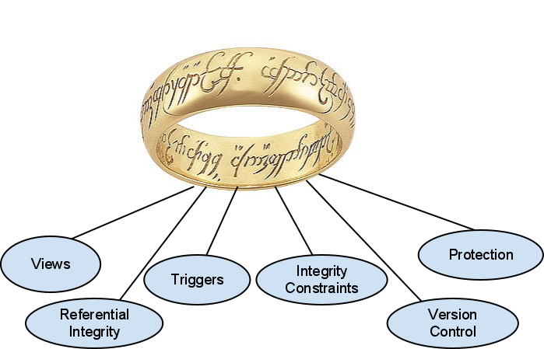
POSTGRES Rules System
Motivation:
  One System to RULE them all!
Notes:
ABOUT
Knowledge management system
Generic framework
MOTIVATION
Reproduce commercial systems
Centralize data rules into one spot
Tasks it is used for:
View management
(virtual tables/classes)
Triggers
Integrity constraints
e.g. make sure salary > 10000
Referential Integrity
e.g. only manager can be team leader
Protection
Version Control

Slide 28
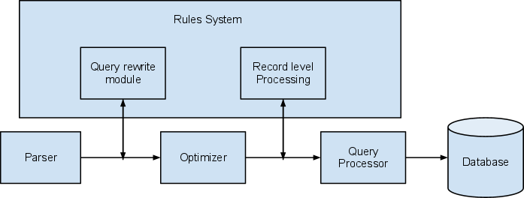
POSTGRES Rules System
Implementation of rules
Notes:
Query rewrite module
Exists between parser and optimizer,
converts user commands to alternate form prior to optimization.
example:
reading from view
Record level processing
called when individual records are
accessed,
deleted,
inserted
modified
example:
triggers

Slide 29
POSTGRES Rules System
Inner-workings:
  Rules defined in POSTQUEL
  Rule Chaining
    Since rules can trigger other rules, or can involve derived forms, chaining is required.
  Semantics of rules
    Immediate vs. deferral
    Same vs. separate transaction
Notes:
In v2.1, rules are implemented with POSTQUEL, which is an extension of QUEL, a query language like SQL developed for INGRES
Forward-chaining
Example: Joe/Fred salary update rule combined with a trigger to increment raise counters
Backward-chaining
Example: Salary update, but salary is a derived rule-based value, so process goes has to do derive value before trigger takes effect
Immediate vs. deferral
Some rules need activating immediately while others should wait till a user's transaction completes.
Same vs. separate transaction
Some rules need to run in the same transaction, others need to run in a separate transaction

Slide 30
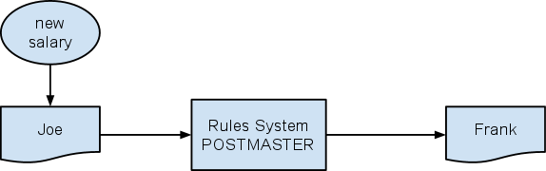
POSTGRES Rules System
Example of use: Triggers
  Enforcing employees have same salary
Notes:
Triggers:
Enforcing one employee (Joe) has same salary as another (Fred)
Could be done at application level, but would require application to see all updates to salary field.
More efficient DB to fire check as salary is updated

Slide 31
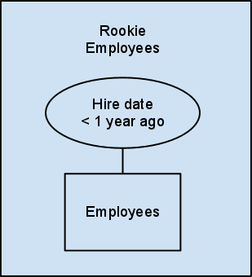
POSTGRES Rules System
Application example: Views
  User-level syntax is compiled into one or more rules
  POSTGRES takes more general approach to updates than traditional RDBMS's
Notes:
Updating
Default update rules
as long as no ambiguity
app designer can create own update semantics

Slide 32
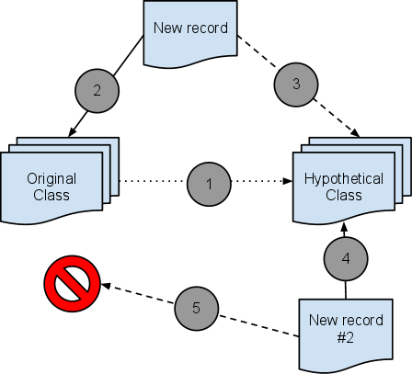
POSTGRES Rules System
Application example: Versions
  Similar to branching in Source Control
Notes:
Application example: Versioning
User-level syntax is compiled into one or more rules
Allows for retrieval of past versions of an object via retrieval rule that is created when the version is created

Slide 33

POSTGRES Storage System
Motivation:
  Be different!
Notes:
Avoid copying INGRES
Write-ahead logging
something better?
No-overwrite storage system

Slide 34
POSTGRES Storage System
The old storage manager: "write-ahead logging"
  Used to ensure atomicity and durability
  Before changes are applied, they are written to a log
Notes:
Advantages:
if system crashes, easy to pickup where left off and restart any transactions that half completed
widely accepted practice
Disadvantages:
slow to recover from crash;
no new academic contribution by using it

Slide 35
POSTGRES Storage System
The new storage manager: "no-overwrite"
  No transaction log used, so only one write to disk
  Old record remains in database
Notes:
Advantages:
less writes to disk mean faster performance;
instant crash recovery;
allows for easy versioning of records
Disadvantages:
run-time system needs to distinguish archive records from current record;
does random I/O to disk when committing data pages, where write-ahead does sequential

Slide 36
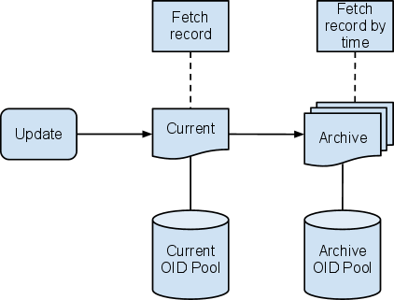
POSTGRES Storage System
Time Travel (a.k.a. Versioning)
Notes:
POSTGRES maintains two sets of records (current and archive)
Each has its own indexes
An asynchronous demon "vacuum cleaner" moves the older records to the archive

Slide 37
Overview
  Objects and Databases in 1986
  Trends with Objects and Databases
  POSTGRES Data/Query Model & Fast Path
  POSTGRES Rules and Storage
  POSTGRES v2.1 Implementation
  Future of Objects and Databases

Slide 38
POSTGRES Implementation (v2.1)
Four areas different from RDBMS:
  Process structure
  Extendability
  Dynamic loading
  Rule wake-up
Notes:
Similarities to existing relational DBMS's
Parser
Query Optimizer
Execution Engine
Process structure
Runs a separate process for each active user
Each process shares code, buffer pool, lock table
Reasoning: to get system up and running ASAP
Extendability
Accomplished by making the parser, optimizer and execution engine table-driven
allows for accommodating a large number of types, operators, and functions
Dynamic loading
Loads functions/operators dynamically as they are needed
Downside: dynamic loader needs implementing for each hardware platform
Rule wake-up
Rules system adds significant complexity on design
Example:
User 1 adds rule to notify his app when salary adjusted for Joe
User 2 gives Joe a raise
POSTGRES process applying raise notices the rule, then notifies the special "POSTMASTER" process
POSTMASTER notifies User 1

Slide 39
POSTGRES Performance (v2.1)
Summary of Tests
  At time of paper (June 1991), POSTGRES v2.1 was running on 125 sites
  Use the Wisconsin benchmark and an engineering benchmark
  Systems compared with:
    UC Berkeley version of INGRES
    Commercial version of INGRES from ASK
    Cattell's in-house system
    Commercial OODB
    Commercial RDBMS

Slide 40
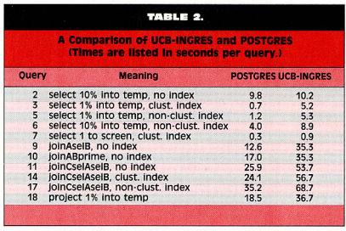
POSTGRES Performance (v2.1)
Summary of Results
Notes:
Wisconsin Benchmark:
2x performance of UCB-INGRES
3/5th performance of commercial INGRES

Slide 41
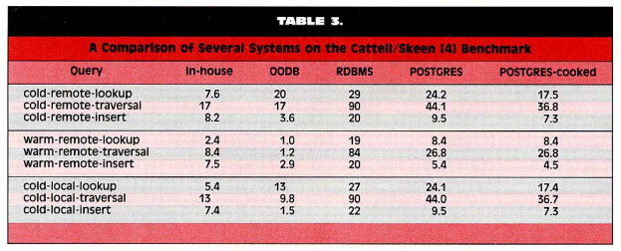
POSTGRES Performance (v2.1)
Notes:
Engineering Benchmark:
Significantly outperforms commercial RDBMS
Half the performance of in-house and OODB

Slide 42
Overview
  Objects and Databases in 1986
  Trends with Objects and Databases
  POSTGRES Data/Query Model & Fast Path
  POSTGRES Rules and Storage
  POSTGRES v2.1 Implementation
  Future of Objects and Databases

Slide 43
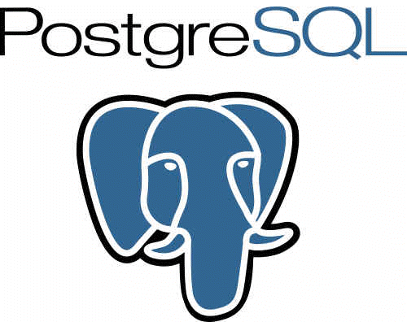
POSTGRES Future (1996 to present)
  Postgres95 -- replaced POSTQUEL with SQL
  Spun off into Open Source project, PostgreSQL as v6.0
  Implemented many standard DBMS features
  Up to v9.1 with (K-nearest-neighbor indexing, etc.)
Notes:
DBMS features:
improved built-in types
speed (20-40% performance; 80% quicker startup)
security
full-text indexing
joins
Write-Ahead Log

Slide 44
Future of Objects and Databases
"Predictions for 2006"
  Fully integrated solution
  Server functionality & performance
  Client integration
  Legacy data sources
  Standardization
Notes:
Fully integrated solution for OR-DBMS
Yes, PostgreSQL
Server functionality & performanceClient integration
OR-DBMS on par with RDMBS
Yes, PostgreSQL seems comparable
Legacy data sources
not sure on this one (middleware between ORdMBS and disparate data sources)
Standardization
﻿SQL 1999
SQL 2003
SQL 2008
Object-Databases
db4o - open source, still used
Informix (aka Illustra) bought y IBM, integrated into DB2) -- doesn't seem like active "feature" anymore though

