Slide 1

Concepts for
Object-Oriented Databases
Copyright © 2004 Pearson Education, Inc.

Slide 2
Chapter Outline
20.1 Overview of O-O Concepts
20.2 O-O Identity, Object Structure and Type Constructors
20.3 Encapsulation of Operations, Methods and Persistence
20.4 Type and Class Hierarchies and Inheritance
20.5 Complex Objects
20.6 Other O-O Concepts
20.7 Summary & Current Status
Chapter 20-<number>

Slide 3
Introduction
Traditional Data Models : Hierarchical, Network (since mid-60’s), Relational (since 1970 and commercially since 1982)
Object Oriented (OO) Data Models since mid-90’s
Reasons for creation of Object Oriented Databases
  Need for more complex applications
  Need for additional data modeling features
  Increased use of object-oriented programming languages
Commercial OO Database products – several in the 1990’s, but did not make much impact on mainstream data management
Chapter 20-<number>

Slide 4
History of OO Models and Systems
Languages: Simula (1960’s), Smalltalk (1970’s), C++ (late 1980’s), Java (1990’s)
Experimental Systems: Orion at MCC, IRIS at H-P labs, Open-OODB at T.I., ODE at ATT Bell labs, Postgres - Montage - Illustra at UC/B, Encore/Observer at Brown
Commercial OO Database products: Ontos, Gemstone, O2 ( -> Ardent), Objectivity, Objectstore ( -> Excelon), Versant, Poet, Jasmine (Fujitsu – GM)
Chapter 20-<number>

Slide 5
20.1 Overview of Object-Oriented Concepts(1)
MAIN CLAIM: OO databases try to maintain a direct correspondence between real-world and database objects so that objects do not lose their integrity and identity and can easily be identified and operated upon
Object: Two components: state (value) and behavior (operations). Similar to program variable in programming language, except that it will typically have a complex data structure as well as specific operations defined by the programmer
Chapter 20-<number>

Slide 6
Overview of Object-Oriented Concepts (2)
In OO databases, objects may have an object structure of arbitrary complexity in order to contain all of the necessary information that describes the object.
In contrast, in traditional database systems, information about a complex object is often scattered over many relations or records, leading to loss of direct correspondence between a real-world object and its database representation.
Chapter 20-<number>

Slide 7
Overview of Object-Oriented Concepts (3)
The internal structure of an object in OOPLs includes the specification of instance variables, which hold the values that define the internal state of the object.
An instance variable is similar to the concept of an attribute, except that instance variables may be encapsulated within the object and thus are not necessarily visible to external users
Chapter 20-<number>

Slide 8
Overview of Object-Oriented Concepts (4)
Some OO models insist that all operations a user can apply to an object must be predefined. This forces a complete encapsulation of objects.
To encourage encapsulation, an operation is defined in two parts:
  signature or interface of the operation, specifies the operation name and arguments (or parameters).
  method or body, specifies the implementation of the operation.
Chapter 20-<number>

Slide 9
Overview of Object-Oriented Concepts (5)
Operations can be invoked by passing a message to an object, which includes the operation name and the parameters. The object then executes the method for that operation.
This encapsulation permits modification of the internal structure of an object, as well as the implementation of its operations, without the need to disturb the external programs that invoke these operations
Chapter 20-<number>

Slide 10
Overview of Object-Oriented Concepts (6)
Some OO systems provide capabilities for dealing with multiple versions of the same object (a feature that is essential in design and engineering applications).
  For example, an old version of an object that represents a tested and verified design should be retained until the new version is tested and verified:
  very crucial for designs in manufacturing process control, architecture , software systems …..
Chapter 20-<number>

Slide 11
Overview of Object-Oriented Concepts (7)
Operator polymorphism: It refers to an operation’s ability to be applied to different types of objects; in such a situation, an operation name may refer to several distinct implementations, depending on the type of objects it is applied to.
This feature is also called operator overloading
Chapter 20-<number>

Slide 12
20.2 Object Identity, Object Structure, and Type Constructors (1)
Unique Identity: An OO database system provides a unique identity to each independent object stored in the database. This unique identity is typically implemented via a unique, system-generated object identifier, or OID
The main property required of an OID is that it be immutable; that is, the OID value of a particular object should not change. This preserves the identity of the real-world object being represented.
Chapter 20-<number>

Slide 13
Object Identity, Object Structure, and Type Constructors (2)
Type Constructors: In OO databases, the state (current value) of a complex object may be constructed from other objects (or other values) by using certain type constructors.
The three most basic constructors are atom, tuple, and set. Other commonly used constructors include list, bag, and array. The atom constructor is used to represent all basic atomic values, such as integers, real numbers, character strings, Booleans, and any other basic data types that the system supports directly.
Chapter 20-<number>

Slide 14
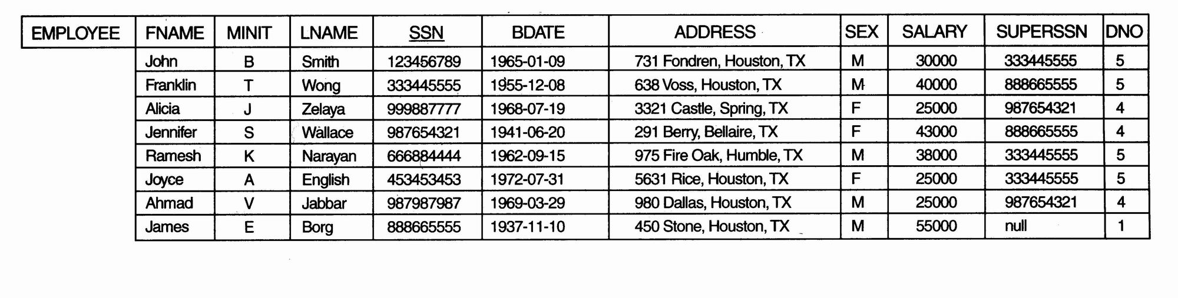
Object Identity, Object Structure, and Type Constructors (3)
Example 1, one possible relational database state corresponding to COMPANY schema
Chapter 20-<number>

Slide 15
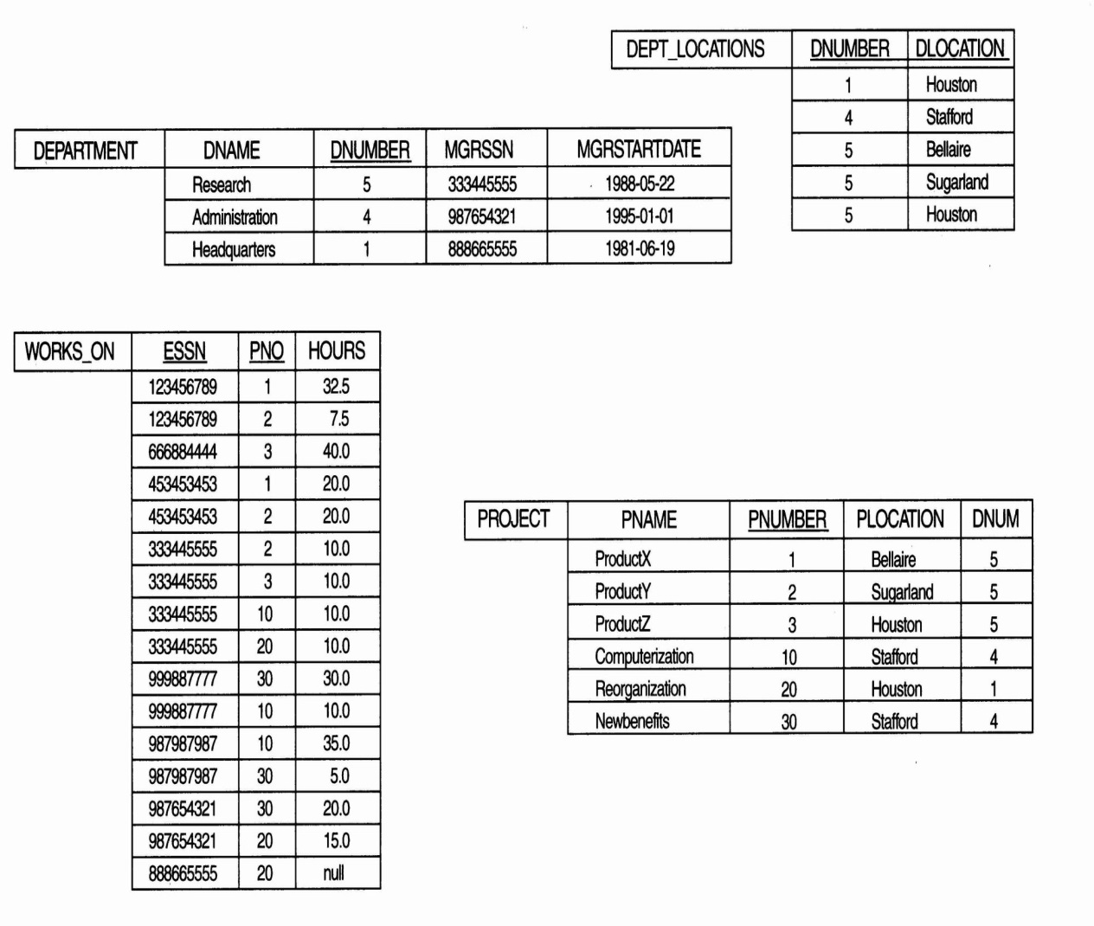
Object Identity, Object Structure, and Type Constructors (4)
Example 1 (cont.):
Chapter 20-<number>

Slide 16
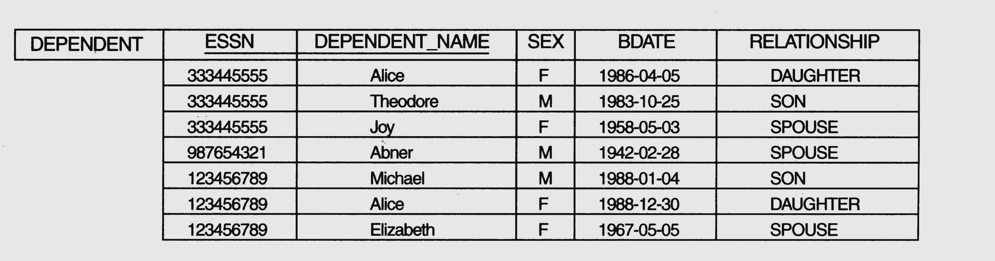
Object Identity, Object Structure, and Type Constructors (5)
Example 1 (cont.)
Chapter 20-<number>

Slide 17
Object Identity, Object Structure, and Type Constructors (6)
Example 1 (cont.)
We use i₁, i₂, i₃, . . . to stand for unique system-generated object identifiers. Consider the following objects:
o₁ = (i₁, atom, ‘Houston’)
o₂ = (i₂, atom, ‘Bellaire’)
o₃ = (i₃, atom, ‘Sugarland’)
o₄ = (i₄, atom, 5)
o₅ = (i₅, atom, ‘Research’)
o₆ = (i₆, atom, ‘1988-05-22’)
o₇ = (i₇, set, {i₁, i₂, i₃})
Chapter 20-<number>

Slide 18
Object Identity, Object Structure, and Type Constructors (7)
Example 1(cont.)
o₈ = (i₈, tuple, <dname:i₅, dnumber:i₄, mgr:i₉, locations:i₇, employees:i₁₀, projects:i₁₁>)
o₉ = (i₉, tuple, <manager:i₁₂, manager_start_date:i₆>)
o₁₀ = (i₁₀, set, {i₁₂, i₁₃, i₁₄})
o₁₁ = (i₁₁, set {i₁₅, i₁₆, i₁₇})
o₁₂ = (i₁₂, tuple, <fname:i₁₈, minit:i₁₉, lname:i₂₀, ssn:i₂₁, . . ., salary:i₂₆, supervi­sor:i₂₇, dept:i₈>)
. . .
Chapter 20-<number>

Slide 19
Object Identity, Object Structure, and Type Constructors (8)
Example 1 (cont.)
    The first six objects listed in this example represent atomic values. Object seven is a set-valued object that represents the set of locations for department 5; the set refers to the atomic objects with values {‘Houston’, ‘Bellaire’, ‘Sugarland’}. Object 8 is a tuple-valued object that represents department 5 itself, and has the attributes DNAME, DNUMBER, MGR, LOCATIONS, and so on.
Chapter 20-<number>

Slide 20
Object Identity, Object Structure, and Type Constructors (9)
  Example 2:
  This example illustrates the difference between the two definitions for comparing object states for equality.
  o₁ = (i₁, tuple, <a₁:i₄, a₂:i₆>)
  o₂ = (i₂, tuple, <a₁:i₅, a₂:i₆>)
  o₃ = (i₃, tuple, <a₁:i₄, a₂:i₆>)
  o₄ = (i₄, atom, 10)
  o₅ = (i₅, atom, 10)
  o₆ = (i₆, atom, 20)
Chapter 20-<number>

Slide 21
Object Identity, Object Structure, and Type Constructors (10)
  Example 2 (cont.):
  In this example, The objects o₁ and o₂ have equal states, since their states at the atomic level are the same but the values are reached through distinct objects o₄ and o₅.
  However, the states of objects o₁ and o₃ are identical, even though the objects themselves are not because they have distinct OIDs. Similarly, although the states of o₄ and o₅ are identical, the actual objects o₄ and o₅ are equal but not identical, because they have distinct OIDs.
Chapter 20-<number>

Slide 22
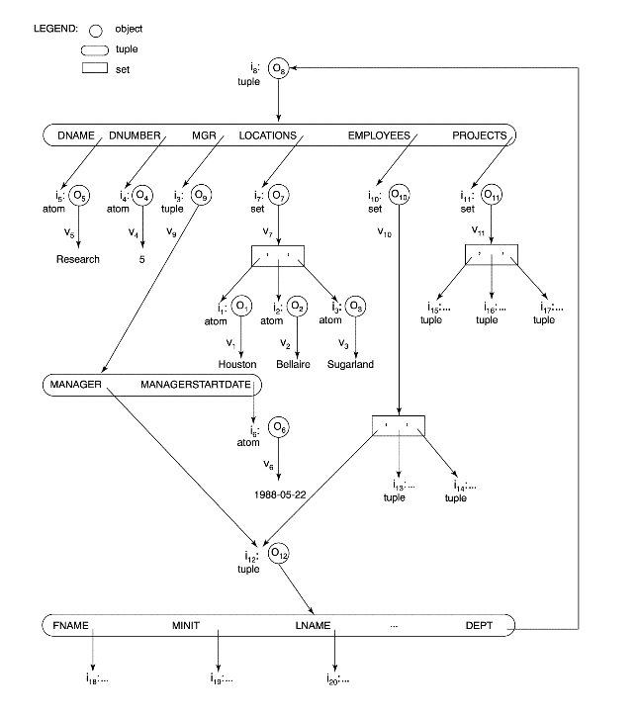
Object Identity, Object Structure, and Type Constructors (11)
Figure 20.1 Representation of a DEPARTMENT complex object as a graph
Chapter 20-<number>

Slide 23
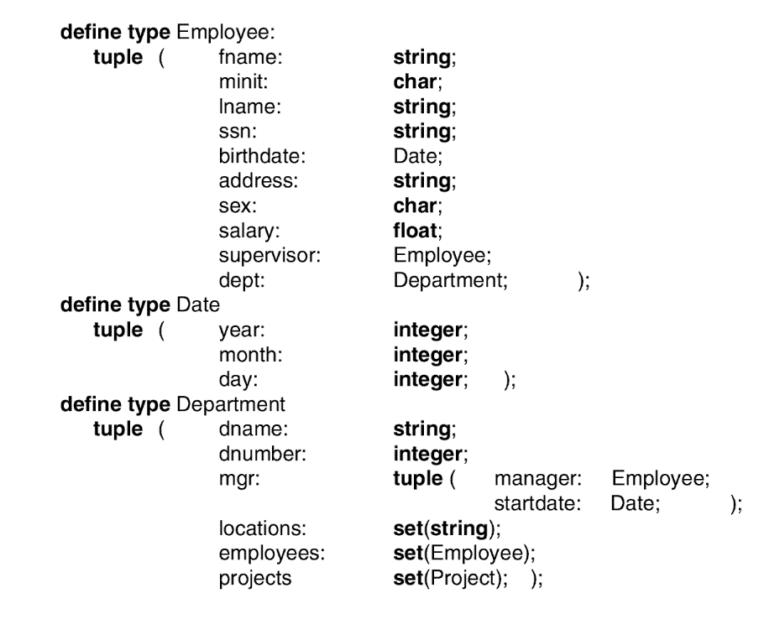
Object Identity, Object Structure, and Type Constructors (12)
Figure 20.2 Specifying the object types Employee, date, and Department using type constructors
Chapter 20-<number>

Slide 24
20.3 Encapsulation of Operations, Methods, and Persistence (1)
Encapsulation
One of the main characteristics of OO languages and systems
Related to the concepts of abstract data types and information hiding in programming languages
Chapter 20-<number>

Slide 25
Encapsulation of Operations, Methods, and Persistence (2)
Specifying Object Behavior via Class Operations:
The main idea is to define the behavior of a type of object based on the operations that can be externally applied to objects of that type.
In general, the implementation of an operation can be specified in a general-purpose programming language that provides flexibility and power in defining the operations.
Chapter 20-<number>

Slide 26
Encapsulation of Operations, Methods, and Persistence (3)
Specifying Object Behavior via Class Operations (cont.):
For database applications, the requirement that all objects be completely encapsulated is too stringent.
One way of relaxing this requirement is to divide the structure of an object into visible and hidden attributes (instance variables).
Chapter 20-<number>

Slide 27
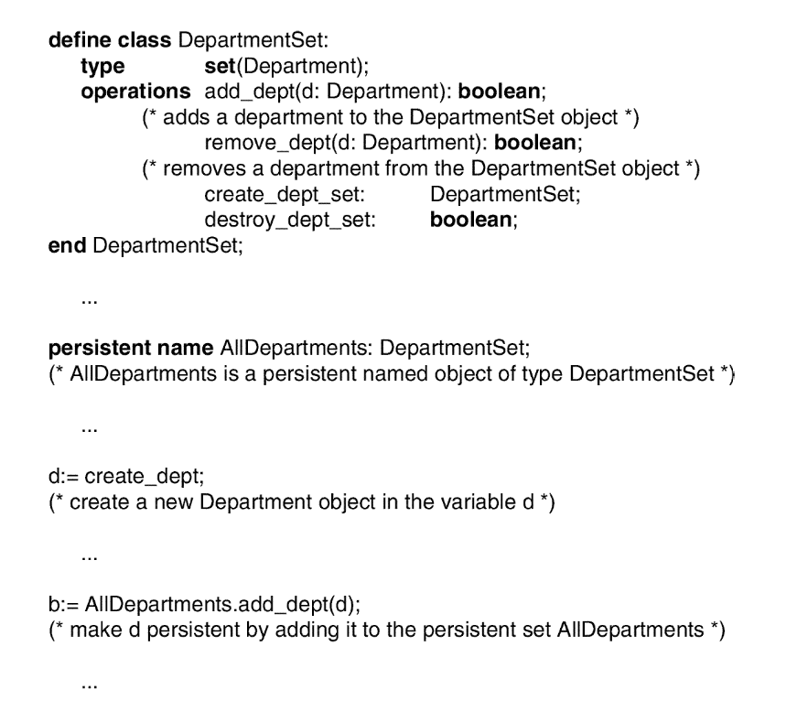
Encapsulation of Operations, Methods, and Persistence (4)
Figure 20.3 Adding operations to definitions of Employee and Department
Chapter 20-<number>

Slide 28
Encapsulation of Operations, Methods, and Persistence (5)
Specifying Object Persistence via Naming and Reachability:
Naming Mechanism: Assign an object a unique persistent name through which it can be retrieved by this and other programs.
Reachability Mechanism: Make the object reachable from some persistent object.
An object B is said to be reachable from an object A if a sequence of references in the object graph lead from object A to object B.
Chapter 20-<number>

Slide 29
Encapsulation of Operations, Methods, and Persistence (6)
Specifying Object Persistence via Naming and Reachability (cont.):
In traditional database models such as relational model or EER model, all objects are assumed to be persistent.
In OO approach, a class declaration specifies only the type and operations for a class of objects. The user must separately define a persistent object of type set (DepartmentSet) or list (DepartmentList) whose value is the collection of references to all persistent DEPARTMENT objects
Chapter 20-<number>

Slide 30
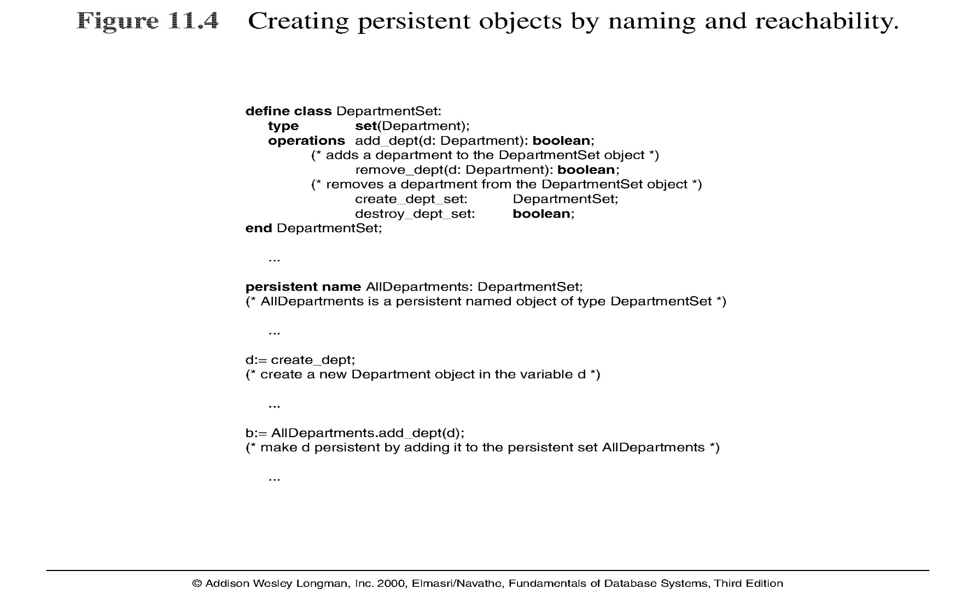
Encapsulation of Operations, Methods, and Persistence (7)
Note: The above figure is now called Figure 20.4 in Edition 4
Chapter 20-<number>

Slide 31
20.4 Type and Class Hierarchies and Inheritance (1)
Type (class) Hierarchy
A type in its simplest form can be defined by giving it a type name and then listing the names of its visible (public) functions
When specifying a type in this section, we use the following format, which does not specify arguments of functions, to simplify the discussion:
TYPE_NAME: function, function, . . . , function
Example:
PERSON: Name, Address, Birthdate, Age, SSN
Chapter 20-<number>

Slide 32
Type and Class Hierarchies and Inheritance (2)
Subtype: when the designer or user must create a new type that is similar but not identical to an already defined type
Supertype: It inherits all the functions of the subtype
Chapter 20-<number>

Slide 33
Type and Class Hierarchies and Inheritance (3)
Example (1):
EMPLOYEE: Name, Address, Birthdate, Age, SSN, Salary, HireDate, Seniority
STUDENT: Name, Address, Birthdate, Age, SSN, Major, GPA
OR:
EMPLOYEE subtype-of PERSON: Salary, HireDate, Seniority
STUDENT subtype-of PERSON: Major, GPA
Chapter 20-<number>

Slide 34
Type and Class Hierarchies and Inheritance (4)
Example (2):
Consider a type that describes objects in plane geometry, which may be defined as follows:
  GEOMETRY_OBJECT: Shape, Area, ReferencePoint
Chapter 20-<number>

Slide 35
Type and Class Hierarchies and Inheritance (5)
Example (2) (cont.):
Now suppose that we want to define a number of subtypes for the GEOMETRY_OBJECT type, as follows:
  RECTANGLE subtype-of GEOMETRY_OBJECT: Width, Height
  TRIANGLE subtype-of GEOMETRY_OBJECT:
  Side1, Side2, Angle
  CIRCLE subtype-of GEOMETRY_OBJECT: Radius
Chapter 20-<number>

Slide 36
Type and Class Hierarchies and Inheritance (6)
Example (2) (cont.):
An alternative way of declaring these three subtypes is to specify the value of the Shape attribute as a condition that must be satisfied for objects of each subtype:
  RECTANGLE subtype-of GEOMETRY_OBJECT (Shape=‘rectangle’): Width, Height
  TRIANGLE subtype-of GEOMETRY_OBJECT (Shape=‘triangle’): Side1, Side2, Angle
  CIRCLE subtype-of GEOMETRY_OBJECT (Shape=‘circle’): Radius
Chapter 20-<number>

Slide 37
Type and Class Hierarchies and Inheritance (7)
Extents: In most OO databases, the collection of objects in an extent has the same type or class. However, since the majority of OO databases support types, we assume that extents are collections of objects of the same type for the remainder of this section.
Persistent Collection: It holds a collection of objects that is stored permanently in the database and hence can be accessed and shared by multiple programs
Chapter 20-<number>

Slide 38
Type and Class Hierarchies and Inheritance (8)
Transient Collection: It exists temporarily during the execution of a program but is not kept when the program terminates
Chapter 20-<number>

Slide 39
20.5 Complex Objects (1)
Unstructured complex object: It is provided by a DBMS and permits the storage and retrieval of large objects that are needed by the database application.
Typical examples of such objects are bitmap images and long text strings (such as documents); they are also known as binary large objects, or BLOBs for short.
This has been the standard way by which Relational DBMSs have dealt with supporting complex objects, leaving the operations on those objects outside the RDBMS.
Chapter 20-<number>

Slide 40
Complex Objects (2)
Structured complex object: It differs from an unstructured complex object in that the object’s structure is defined by repeated application of the type constructors provided by the OODBMS. Hence, the object structure is defined and known to the OODBMS. The OODBMS also defines methods or operations on it.
Chapter 20-<number>

Slide 41
20.6 Other Objected-Oriented Concepts (1)
Polymorphism (Operator Overloading):
This concept allows the same operator name or symbol to be bound to two or more different implementations of the operator, depending on the type of objects to which the operator is applied
Chapter 20-<number>

Slide 42
Other Objected-Oriented Concepts (2)
Multiple Inheritance and Selective Inheritance
Multiple inheritance in a type hierarchy occurs when a certain subtype T is a subtype of two (or more) types and hence inherits the functions (attributes and methods) of both supertypes.
For example, we may create a subtype ENGINEERING_MANAGER that is a subtype of both MANAGER and ENGINEER. This leads to the creation of a type lattice rather than a type hierarchy.
Chapter 20-<number>

Slide 43
Other Objected-Oriented Concepts (3)
Versions and Configurations
Many database applications that use OO systems require the existence of several versions of the same object
There may be more than two versions of an object.
Chapter 20-<number>

Slide 44
Other Objected-Oriented Concepts (4)
Configuration: A configuration of the complex object is a collection consisting of one version of each module arranged in such a way that the module versions in the configuration are compatible and together form a valid version of the complex object.
Chapter 20-<number>

Slide 45
20.7 Summary (1)
Object identity: Objects have unique identities that are independent of their attribute values.
Type constructors: Complex object structures can be constructed by recursively applying a set of basic constructors, such as tuple, set, list, and bag.
Encapsulation of operations: Both the object structure and the operations that can be applied to objects are included in the object class definitions.
Chapter 20-<number>

Slide 46
Summary (2)
Programming language compatibility: Both persistent and transient objects are handled uniformly. Objects are made persistent by being attached to a persistent collection.
Type hierarchies and inheritance: Object types can be specified by using a type hierarchy, which allows the inheritance of both attributes and methods of previously defined types.
Chapter 20-<number>

Slide 47
Summary (3)
Extents: All persistent objects of a particular type can be stored in an extent. Extents corresponding to a type hierarchy have set/subset constraints enforced on them.
Support for complex objects: Both structured and unstructured complex objects can be stored and manipulated.
Polymorphism and operator overloading: Operations and method names can be overloaded to apply to different object types with different implementations.
Chapter 20-<number>

Slide 48
Summary (4)
Versioning: Some OO systems provide support for maintaining several versions of the same object.
Chapter 20-<number>

Slide 49
Current Status
OODB market not growing much per se. Currently around $250M as opposed to the relational DB revenue upwards of $50B.
O-O ideas are being used in a large number of applications, without explicitly using the OODB platform to store data.
Growth: O-O tools for modeling and analysis, O-O Programming Languages like Java and C++
Compromise Solution Proposed: Object Relational DB Management (Informix Universal Server, Oracle 10i, IBM’s UDB, DB2/II …)
Chapter 20-<number>

