Slide 1
B.TECH CSE with Specialization in Big Data
Big Data Storage
The File System Namespace
Notes:
Notes to the Facilitator:
Introduce the module to the participants and tell them that you will be talking about the File System Namespace in this module.
Notes to the Participants:
You will be discussing File System Namespace in this module.

Slide 2

Module Learning Objectives
Module 1: The File System Namespace
At the end of this module, you will be able to:
Understand the basics of data storage.
Explain Traditional File system and its components.
Describe how a file system is structured.
Describe Files and Directories.
Enumerate the disadvantages of traditional file systems.
Notes:
Notes to the Facilitator:
List out the module objectives.
Reiterate each objective.
Notes to the Participants:
At the end of the module, you will be able to:
Understand the basics of data storage.
Explain Traditional File system and its components.
Describe how a file system is structured.
Describe Files and Directories.
Enumerate the disadvantages of traditional file systems.

Slide 3
Module Topics
Module 1: The File System Namespace
Let us take a quick look at the topics we will cover in this module:
Introduction to Data Storage
Traditional file systems.
File system hierarchy.
Limitations of traditional file systems.
Notes:
Notes to the Facilitator:
Talk about the topics you will cover in this module.
Notes to the Participants:
You will learn about the following topics:
Introduction to data storage.
Traditional file systems.
File system hierarchy.
Limitations of traditional file systems.

Slide 4
1. Introduction to Data Storage
Module 1: The File System Namespace
Imagine the volume of data generated by individuals and enterprises on a day-to-day basis. Ever wondered where all this is stored?
Data is stored in a physical or virtual medium using different mechanisms.
The term ‘storage’ refers to devices and data connected to the system through input/output (I/O) operations.
Storage may be done in primary or secondary storage devices. These devices are called storage media.
Categories of data storage.
File storage
Block storage
Object storage
Notes:
Notes to the Facilitator:
Give an introduction to Data Storage to the participants.
Notes to the Participants:
Data, irrespective of its size, is stored in physical devices or on the cloud using different mechanisms. Data storage refers to the use of recording media to retain data using computers or other devices. Data storage refers to the ways in which data is stored in a digital format and retrieved later. Computers, laptops, tablets, smartphones, and other devices all store data, but the technologies and methods used for data storage vary greatly.
The most prevalent forms of data storage are file storage, block storage, and object storage, with each being ideal for different purposes.
Storage media:
Storage media refers to the substrate on which data is stored. We’ll learn about the different types of storage in the forthcoming section.
Types of data storage:
File storage - Data is stored typically in files and folders (directories), and file systems are an inexpensive and simply constructed, traditional way of data storage. Data is generally stored on hard drives and means that the files look exactly the same to the hard drive as they do to the user.
Block storage - Data is stored in evenly-sized blocks. Blocks are more expensive and complex, on the other hand are less scalable This type of storage ideal for data that must be frequently accessed and edited.
Object storage - Data is stored as objects with metadata and unique identifiers. A less expensive form of data storage. Object storage is only ideal for data that doesn’t need to be edited.

Slide 5
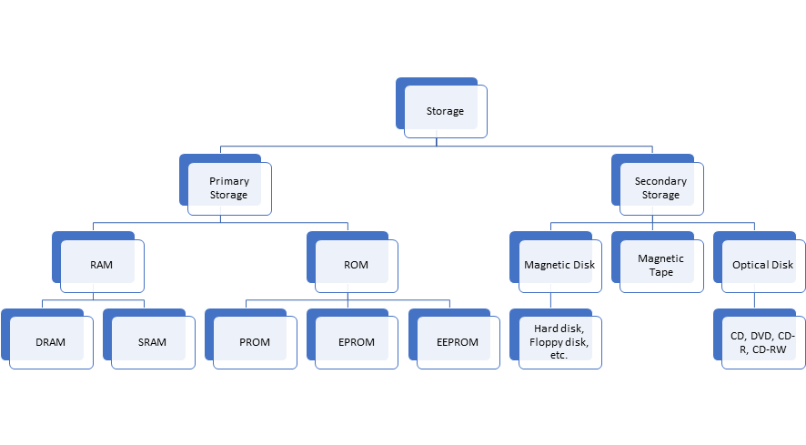
1.1. Types of Data Storage Media
Module 1: The File System Namespace
Notes:
Notes to the facilitator:
Explain about the two different types of data storage media.
Notes to the participants:
There are two types of storage media.
Primary or internal storage
Primary storage also refers to volatile storage, which is the main memory of the computer. This includes Random Access Memory (RAM) and Read Only Memory (ROM). Primary memory is the internal memory that can be accessed directly by the processor, and data access is generally faster. Primary storage is used to store data that is likely to be in active use.
Secondary or external storage
Secondary storage is also referred to as non-volatile storage. It is the memory that is not accessible to the CPU of a computer. Secondary storage requires the use of the computer’s input/output channels. Secondary storage is an external storage that refers to the different ways in which a computer can store program and data. Secondary storage is usually slower than primary storage but it has a higher storage capacity. Some of the secondary storage systems are magnetic disk, Tape drive and optical disk such as CD, DVD, etc.

Slide 6
1.2. Traditional Storage Devices
Module 1: The File System Namespace
Tape Drive
Used for Archival storage
Very high access time
Hard Disk Drives
General purpose storage device
Moderate access time with good IOPS
Greater storage capacity
Solid State Drives
Used for high input/output intensive operations
Very less access time with outstanding IOPS and data transfer rate
Cost is quite high
Notes:
Notes to the Facilitator:
Explain the different types of storage devices and how they have evolved over the time.
Notes to the Participants:
Before looking at the file systems, let’s learn about the traditional storage devices.
Tape drive – Storage device that makes use of magnetic tape as a medium for storage. Reads and writes data on a Magnetic tape may go up to 360 MB/s, which is for compressed data. Tape drives have become obsolete these days.
Hard Disk Drive – Hard disk drives are generally cheaper and became the predominant secondary storage medium, even till the modern era of servers and personal computers. Reads and writes data on a rotating magnetic disk (platter).
Solid State Drive – Solid state drives are used as permanent storage for systems that require faster storage access. These drives offer 10X speed, as compared to magnetic disk drives. Solid state drives are more expensive than RAM, but are cheaper than magnetic disk drives. Reads and writes data to integrated circuit assemblies, and the speed may go up to 1 GB/s

Slide 7
What did you Grasp?
Module 1: The File System Namespace
Which of the following storage devices is used for highly intensive I/O operations?
Tape drive
Hard disk drive
Solid state drive
CPU
Notes:
Notes to the Facilitator:
Answer:
1. C. Solid state drive

Slide 8
2. The File System Namespace – an Introduction
Module 1: The File System Namespace
File system – a way to organize, store, retrieve, and manage information on a permanent storage medium. The file systems have the structure and logic rules to manage the collection of information and their names.
Being an integral part of all operating systems, file systems manage the permanent storage.
A file system serves the purpose of the whole storage and it is also a part of an isolated storage segment – a disk partition.
In a nutshell, a file system is a structured way of representing data and a set of metadata describing the stored data.
Notes:
Notes to the Facilitator:
Explain- what is a file system and its need. Elaborate how the file system is linked with the OS to serve files and their metadata.
Notes to the Participants:
The primary functionality of a file system is to store a named piece of data and to retrieve the data later using the name given to it. The File systems have to be designed with the following goals in mind: storage, retrieval, location and manipulation of information.
There are multiple ways to write a file system, which is based on the needs of the project. A File system designed for one system may not be suitable for another project.
The most common type of file systems are ext3, ext4, XFS in Linux and FAT, FAT32, NTFS in Windows Operating Systems. Every file system has its own way of managing the space allocated to the files and structure of the file’s metadata. The Operating system interacts with the API of the file system API to store and retrieve the required files.
We’ll now learn about the components of a file system.

Slide 9
2.1. File Systems
Module 1: The File System Namespace
File systems are a traditional way of storing and retrieving data.
File systems are closely tied to the operating system using them.
Often called a ‘two-dimensional flat file system’ and records do not have any structured relationship among them.
Each file is independent of one another and maintains its own metadata.
As the systems become complex, the traditional file systems offer little flexibility, present many limitations and become difficult to maintain.
/(root File System
Directories
File Systems
/bin
/dev
/etc
/lib
/bin
/bin
/bin
/bin
Notes:
Notes to the Facilitator:
Explain what a file system is, what it manages and what abstractions it provides to the rest of the operating system.
Notes to the Participants:
You might be roughly familiar with the concepts of Data Storage, files, directories (folders) and so on, because of the direct knowledge acquired from the use of computers. We might not have thought about the systems or processes that run inside the systems.
The main purpose of computing systems is to create, manipulate, store and retrieve data. A file system provides the machinery to support all this. As we saw earlier, the File Systems organize, store and manage information on a permanent storage medium such as the disk, and they are an integral part of the operating system.
The permanent storage can be managed by multiple types of approaches. On one hand, the simple file systems impose many restrictions that cause inconvenience to the users and the usage of file systems thus becomes difficult. On the other hand, there are persistent object stores and object-oriented databases that abstract the permanent storage completely from users, so that they don’t even need to be aware of it.
There is no single ‘correct’ way to write a File System. To understand which file system will be suitable for a particular operating system, we need to understand the needs of the problem along with the other constraints of the project. For example, file system for a high-end mainframe computer requires extremely fast throughput in many areas, but it might be very less user-friendly. Techniques enabling high transactions per second should be focused here, over implementing user-friendly features.

Slide 10
2.2. File System Terminologies
Module 1: The File System Namespace
Disk
Block
Partition
Volume
Superblock
Metadata
Journaling
I-node
Extent
Attribute
Notes:
Notes to the Facilitator:
Introduce the various terminologies associated with file systems to the participants, and explain each one of them in detail.
Notes to the Participants:
Understand the various terminologies associated with filesystems. Each of these will be explained in detail in the forthcoming sections.
Disk – A permanent storage medium of a certain size. Composed of sector or block size, a minimum unit that a disk can read or write.
Block – The smallest unit writable by a disk or file system. A file system block is always the same size as or larger (in integer multiples) than the disk block size.
Partition – A subset of all blocks on a disk. A disk can have several partitions.
Volume – A Collection of blocks on a storage medium, ie, a disk. That is, a volume may be all of the blocks on a single disk, some portion of the total number of blocks on a disk, or it may even span multiple disks and be all the blocks on several disks. The term “volume” is used to refer to a disk or partition that has been initialized with a file system.
Superblock – The area of a volume where a file system stores its critical volume-wide information. A superblock usually contains information such as how large a volume is, the name of a volume, and so on.
Metadata – A general term referring to information that is about a file, but not directly part of it. For example, the size of a file is very important information about a file, but it is not part of the data in the file.
Journaling – A method of ensuring the correctness of file system metadata even in the presence of power failures or unexpected reboots.
I-node – The place where a file system stores all the necessary metadata about a file. The i-node also provides the connection to the contents of the file and any other data associated with the file. The term “i-node” is historical and originated in Unix. An i-node is also known as a file control block (FCB) or file record.
Extent – An extent is a contiguous area of storage reserved for a file in a file system, represented as a range of block numbers. A file can consist of zero or more extents; one file fragment requires one extent.
Attribute – File attributes are settings associated with computer files that grant or deny certain rights to how a user or the operating system can access that file. For example, IBM compatible computers running MS-DOS or Microsoft Windows have capabilities of having read, archive, system, and hidden attributes..

Slide 11
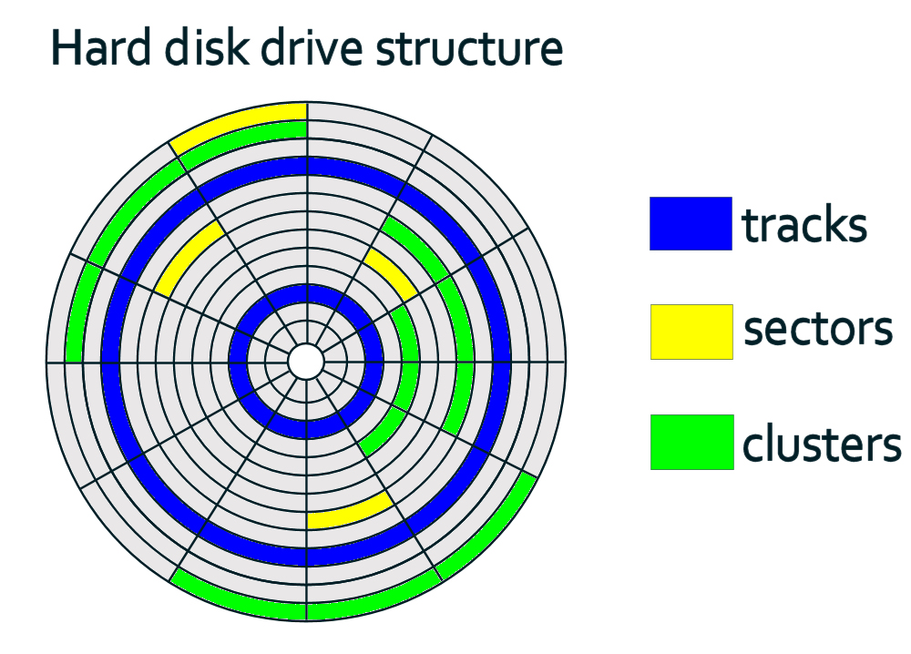
2.2.1. Disk
Module 1: The File System Namespace
A physical storage device that is able to hold the digital data permanently. Ex: Hard disk drive (HDD), Compact disk (CD), Solid State Drives (SSD), Tape drives, EEPROM, etc.
Hard Disk Drive Structure
Notes:
Notes to the Facilitator:
Explain how the disk is connected to the file system.
Notes to the Participants:
A physical storage device that is able to hold the digital data permanently. Eg: Hard disk drive (HDD), Compact disk (CD), Solid State Drives (SSD), Tape drives, EEPROM, etc.
For the operating systems to store and retrieve data from the disk, they need to be formatted with a specific file system that provides an abstraction of how the data is read.
Some File Systems are specific to the type of storage device. Eg: CDFS for CD drive provides write once read many operations.
A disk has the following components:
Sector: The smallest physical storage unit on a disk. In Windows size of each sector is 512 (bytes).
Track: A physical division of data in a disk drive
Cluster: Group of one or more contiguous sectors
Volume: Logical partitioning of a disk, consisting of one or more clusters. Volume consists of files, system information and unallocated space that can be allocated to files.

Slide 12
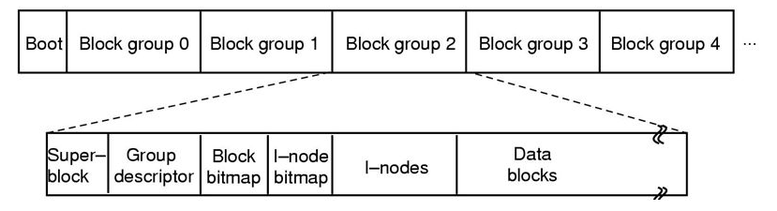
2.2.2. Block
Module 1: The File System Namespace
Overall layout of the disk looks like this.
The initial portion is the Boot Block.
On a diskette, there is one block group. A diskette has a Boot Block followed by the structure in the lower bar.
Notes:
Notes to the Facilitator:
Explain how the blocks are arranged in disks and the file system.
Notes to the Participants:
Block is a sequence of bytes or bits that is writable by a disk or filesystem.
The Data buffer in the disk usually stores the blocked data and it is read or written as a whole block at a time.
The block size in a filesystem can be a multiple of the block size of the actual disk.
Since data is written in blocks instead of bits (0s & 1s), there will be unused space in blocks causing space inefficiency. Disk defragmentation will remove the unused space by filling the data from the neighboring block.
The file system normally abstracts the block storage for use by various applications

Slide 13
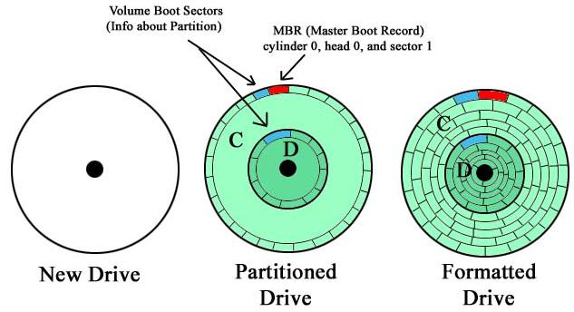
2.2.3. Partition and Volume
Module 1: The File System Namespace
New partition can be created in any disk with empty space. A partition is a portion of the disk and behaves like physically separate drive.
Formatted partitions are called volumes
Volume Boot Sectors
(info about Partition)
MBR (Master Boot Record)
Cylinder 0, head 0, and sector 1
New Drive
Partitioned Drive
Formatted Drive
Notes:
Notes to the Facilitator:
Explain the significance of partitioning and the whole process from a raw disk to a set of fully formatted volume.
Notes to the Participants:
Look at the picture and understand how a disk drive is partitioned to create new volumes.
Partitions are separate regions created on a disk so that operating system can manage information in each regions separately.
Partitioning is the first step to be done before storing any files or directories on the disk.
Each partition can be formatted with any type of filesystem so that the operating system will be able use file systems API for storing and retrieving data. A formatted partition is called as volume.
Isolating the files with partitions will make them safe even if other partitions get corrupted.
By partitioning, the file system namespace gets distributed thus allowing better control and performance but at the same time, more space will be used for the file system since each partition has one.

Slide 14
2.2.4. Superblock
Module 1: The File System Namespace
There is one superblock per filesystem.
Contains the following information:
Size of the file system
The number of free blocks in the filesystem
Size of the logical file block
List of the free data blocks available for file allocation
Index of the next free block on the list
The size of the i-node list
The number of free i-nodes on the system
The list of free i-nodes on the filesysrtem
The index of the next free i-node on the list
Boot Block
Super Block
inode List
Block List
Disk blocks
Bitmap
Free
Used
Free
Free
Used
Free
1 0 1 1 0 1
Notes:
Notes to the Facilitator:
Explain the importance of superblock and elaborate its role in mounting the filesystem.
Notes to the Participants:
Superblock is a place in a formatted partition where the filesystem’s critical information such as the size, the name, the log area and the indices of the partition.
In addition to that, it also has the empty and filled blocks, the size and the location of i-node table and the disk block map.
To access any file, the access to superblock is mandatory and without that filesystem cannot be mounted at all.
In Linux, a copy of mounted filesystems’ superblock will be maintained in the memory.
File Allocation Table (FAT) is the superblock equivalent on Microsoft Windows file system.

Slide 15
2.2.5. Journaling
Module 1: The File System Namespace
A mechanism in filesystem to ensure the correctness of on-disk data structures. It is also referred as logging.
All filesystem changes are recorded in an append-only log file.
Log written sequentially, in large chunks at a time, means efficient disk utilization and high performance.
In case of a crash, log only needs to be examined. Quicker recovery and higher reliability.
Improvement in write performance.
File system
1. write journal logs
write
3. delete journal logs
File system
2. Make changes to actual file system
Notes:
Notes to the Facilitator:
Explain the need to track the operations on a disk block and how the journaling helps to do it.
Notes to the Participants:
A disk can only guarantee an operation on a single disk block. i.e. whether the write to the block succeeded or failed. Hence it is not possible to partially write to a block. In most cases, a file will be stored across multiple blocks.
Transaction – an atomic event of multiple modifications on a block during one operation.
Journaling is a mechanism in filesystem to ensure the correctness of on-disk data structures. It is also referred as logging.
If there is a failure while modifying the data structure, then the system has traverse across all the blocks to repair the damage by previous halt which is a lengthy process.
It keeps the track of all operations made and whether they are successful or not. So it offers guaranteed consistency and speedy recovery.
It works by creating a transaction, buffering the transaction to the memory and the log to the disk, finally updating the log with success status once the transaction is actually made to the on-disk data structure.
As all transactions are written to a single log, the log must be locked during transactions that forces the filesystem to run in a single-threaded model.

Slide 16
2.2.6. Metadata and i-node
The relationship of direct, indirect, and double-indirect blocks.
Module 1: The File System Namespace
I-Node
Metadata provides specific information about a file.
I-node contains the descriptive information about the file.
I-node also contains pointers to the first few data blocks of the file.
If the file is large, the indirect pointer contains a pointer to the block of pointers to the file fragment.
The figure explains the relationship of direct, indirect and double indirect blocks.
Direct block 1
Data
(block 579)
Direct block 2
…
Data
(block 348)
Direct block 12
Data
(block 972)
Indirect block
Data block 3
Data
(block 629)
Data block 4
...
Data
(block 1943)
Data block N
Data
(block 481)
Double
indirect block
Double
indirect block 1
Data block N+1
Data block N+2
……..
Data
(block 99)
Double
indirect block 2
…
Data
(block 179)
Data block 1
…
Data
(block 77)
Notes:
Notes to the Facilitator:
Reiterate the points on the slide. Explain the direct, indirect and double indirect blocks.
Notes to the Participants:
A metadata is some additional information about a file such as the file’s name, size, date created, etc.
i-node is the place in the filesystem where the metadata of the files are stored.
The i-node number is the address of the file i.e. the location of the exact data on the disk.
The POSIX standard provides a list of attributes to be in the i-node. Some of them are File mode, User ID, Group ID, Device ID, size, number of blocks, etc.
Direct block - points the locations of the data blocks directly.
Indirect block - points to a block on disk and the block’s content provides the block address of the real data.
Double indirect block - points to a block that contains the addresses of indirect blocks.

Slide 17
2.2.7. Extents and Attributes
Module 1: The File System Namespace
Extent is a contiguous area of storage reserved for a file.
Extents solve many indirection issues.
In extent-based systems, data blocks are of variable sizes.
Attributes are the file-specific information maintained by the OS.
This includes data like file size, creation time, modification date, etc.
Attributes vary a lot across different OS’s.
Data
Extent
Extent
Extent-based
Data
Extent
Data
Notes:
Notes to the Facilitator:
Explain the extent and its use over direct and indirect blocks. Provide more examples on available attributes on frequently used files.
Notes to the Participants:
Under the concept of extents and attributes in a file system
Extent is a technique to map the address of data blocks as a range of contiguous list i.e. an extent list will have a starting position of a block and the length up to which the block should extend.
Extent list is usually larger than a simple block address and though it is more compact, it may still require use of direct and indirect blocks.
For instance, if the disk is heavy fragmented, then the extent list can’t cover much and hence indirect blocks becomes a necessity.
Attribute is a name and a value of type number, string or even binary. They are stored in attribute directory of the file’s i-node.
Attributes facilitate in storing additional information on files that helps in identification or querying files based on the attributes. Example: pixels of an image file, contact information of an office file, etc.
Some examples for file attributes:
Name - only information kept in human-readable form
Identifier - a unique tag (number) identifies the file within a system
Type - needed for systems that support different types
Location - pointer to file location on device
Size - current file size
Protection - controls actions on files like read, write, execute
Time, data and user identification - data for protection, security and usage monitoring

Slide 18

Group Discussion
Module 1: The File System Namespace
Notes:
Notes to facilitator:
Form different groups of students. Each group should talk about one of the terminologies of file systems.
Notes to participants:
We’ve so far seen about the important concepts associated with file systems. Form different groups and each group should talk about one concept in detail along with analogies or examples to show your understanding.

Slide 19
3. Files
Module 1: The File System Namespace
The Files are named pieces of data, which can later be retrieved using the name given to it.
A File is the most basic level of functionality in a file system.
A File is where the information is stored permanently.
In its simplest form, a file stores a single piece of information, such as a bit of text, a graphic image, a database, or any collection of bytes a user wishes to store permanently.
The size of Files may range from a few bytes to the entire capacity of the volume.
A file system should be able to hold tens of thousands to millions of files.
Notes:
Notes to the Facilitator:
Explain the example given in the participant notes and reiterate the points discussed in the slide.
Notes to the Participants:
Imagine you have 10 l of water, 1 l of juice and ½ l milk.
These are three different things. We need a space to store them. If all the three items are stored in a single container, the content will become useless since it will be spoilt and it will become impossible to separate them. So we need different containers for each type.
Likewise, we store the data of an image, a text and an ‘Office File’ separately in their own files so that each one of them can be retrieved separately when required.
The File System provides the API that allows us to store our files in the storage.
It can use the name of the file alone as the key to identifying the files uniquely. But it isn’t sufficient since we can have the same name for multiple files. So the file system uses the combination of the location and the name of the file as a unique key to fetch our files.

Slide 20
3.1. File Metadata
Module 1: The File System Namespace
The file’s name itself is a metadata that is not in the bytes that make up the file
There are other parts of metadata as well such as author, size, type, time, etc.
Generally most of the filesystem store this metadata in the File Control Block (FCB) popularly known as i-node.
The i-node directly indicates the number of files that can be stored under the filesystem. Usually there will an i-node for every 2 to 8 KB of space.
File system
I-node 1:
Profile.jpg, 2 MB, user1, etc
I-node 2:
Sample.mp4, 1 GB, user1, etc
I-node 3:
echo, 1 KB, system, etc
Image content
Video content
Shell content
Notes:
Notes to the Facilitator:
Explain the example given in the Participants Notes and reiterate the points discussed in the slide.
Notes to the Participants:
(Continuing the analogy from the last slide)
Now we need to label them with details like the container’s capacity, the type of content inside the container, the owner of the container, the last accessed time, etc.
By doing so, we can easily get the required containers if they are huge in numbers.
The File System does this with the metadata stored in its own namespace as i-nodes. It allows us to do queries on the i-nodes to filter the files by their metadata attributes.
Remember, everything is a file in Linux.

Slide 21
3.2. Directories
Module 1: The File System Namespace
Directory or Folder is a special file that acts as a container that organizes files by name.
The Primary purpose is to manage a list of files and to connect the name in the directory with the associated file (i.e., i-node).
A Directory contains a list of names, a handle associated with each name refers to the contents. It stores both the name and the i-node number of the file.
File system
abc.txt’s content
i-node xx:
Name: My Docs
Size: 1 KB
Type: Directory
Location: 250-1500
Directory File:
i-node: xx Name: abc.txt
i-node: yy Name: abc.txt
xyz.txt’s content
Notes:
Notes to the Facilitator:
Explain the concept of Directory with real- world examples.
Notes to the Participants:
A Directory is a file that has a mapping of the i-nodes and the names of the files under them. Since the directory is a file by itself, it has an i-node for it. Directories have all the properties of a regular file like name, location, time modified, etc. A directory can use a different kind of data structure to have this mapping. It depends on the type of file system used. The data structures include hash tables, binary trees, radix sorting schemes, ordered or unordered lists, etc.

Slide 22
3.3. Some Basic Filesystem Operations
Module 1: The File System Namespace
Some file systems can do additional operations:
Initialization
Mounting
Unmounting
Creating Files & Directories
Reading, Writing, Renaming and deleting files
Reading and writing File’s metadata
Symbolic Links & Hard Links
Indexing & Logging
Quotas and Access Control Lists
Notes:
Notes to the Facilitator:
Elaborate all the Filesystem operations listed in the slide.
Notes to the Participants:
Initialization – Formatting a partition to a specific file system
Mounting – Mounting the formatted partition on an empty directory under root directory
Unmounting – Unmounting the mounted partition
Creating Files & Directories – Creating new files or folders under another directory
Reading – Retrieving the file’s content by doing a lookup with the file’s name
Writing – Writing the input given to the space on the partition identified by some i-node
Renaming and deleting files – Modifying the file’s name in the inode or deleting the file itself
Reading and writing File’s metadata – Modifying the files’ metadata attributes such as the owner, time modified, etc.
Symbolic Links & Hard Links – Creating shortcuts for a file or a directory
Indexing & Logging – Maintaining a track of all the files/directories and the actions made on them.
Quotas & Access Control Lists – Limit permissions and space for the system users on a specific file or a partition

Slide 23
3.4. File System Hierarchy
Module 1: The File System Namespace
Hierarchy refers to the organization of files and directories in a file system.
Example file system hierarchy
File and empty directory within a directory
Directories with files within a directory
Individual file
File in a directory
dir1
dir1
dir1
file1
subdir1
subdir1
subdir2
file1
file1
file1
file2
Notes:
Notes to the Facilitator:
Explain the hierarchy, using the example given in the slide and with some more live examples.
Notes to the Participants:
The File System provides a very flexible hierarchy for storing and organizing files under them.
A directory can contain another directory as well as a file. More than that, It can contain the symbolic link of another directory or a file. This provides a very convenient way to organize and manage our files, especially when there are thousands of files in our file system.

Slide 24
4. Common File Systems
Module 1: The File System Namespace
Windows
File Allocation Table (FAT)
New Technology File System (NTFS)
Resilient File System (ReFS)
MacOS
Hierarchical File System Plus (HFS+)
Apple File System (APFS)
Linux
ext* family (ext2, ext3 and ext4)
ReiserFs
XFS
Journaled File System (JFS)
Unix
Unix File System (UFS)/Fas File System (FFS)
Notes:
Notes to the Facilitator:
Explain different file systems used on different operating systems.
Notes to the Participants:
Though all the operating systems support many type of file systems, it is uncertain that they will support all the file system types.
For instance, FAT file system of Windows is supported by Linux, whereas, the ext4 is not supported by Windows. Likewise, HFS and APFS are mostly supported on operating systems other than MAC.

Slide 25
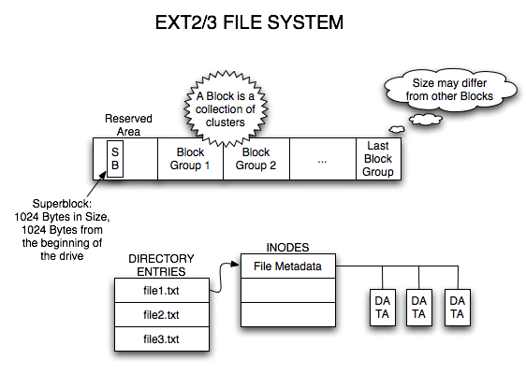
4.1. Linux ext2
Module 1: The File System Namespace
EXT2/3 FILE SYSTEM
Member of Extended file systems (ext*) family designed for Linux kernel.
Originally developed as a replacement for the ext file system in 1993.
First commercial grade file system for the Linux OS.
Ext2 is the default file system in several Linux distributions.
Notes:
Notes to the Facilitator:
Explain Linux ext2 in detail.
Notes to the Participants:
A very fast implementation of a classic unix file system.
Does not support Access Control List and offers superior speed by relaxing its consistency.
It simply divides the disk into fixed-size block groups and each group has its own superblock, bitmap, i-node map and table
Since it performs almost all operations in memory, it provides a greater IO rate than other systems and obviously it is not absolutely consistent.
The order of operations are not maintained when they are flushed to the disk from the cache.
It may not be the feasible for all applications but it is definitely the fastest file system around.

Slide 26
4.2. Linux ext3
Module 1: The File System Namespace
Ext3 or third extended file system is a journaled file system commonly used by the linux kernel
An ext3 file system is the addition of the following features to ext2 - a journal, online file system growth and H-Tree indexing for larger directories.
Ext3 system is devoid of modern features like dynamic i-node allocation and extents.
The maximum number of blocks for ext3 is 2.
The size of a block can vary, which affects the maximum number of files and maximum size of the file system.
Notes:
Notes to the Facilitator:
Explain the features of Linux ext3 in detail.
Notes to the Participants:
Compared with previous version, the main difference is that it allows three types of journaling available such as Journal, Ordered and Writeback.
Since journaling has a dedicated section in filesystem, the possibility of file system corruption is less.
It is possible to convert a ext2 file system to the ext3 file system easily.
The maximum individual file size can be in the range of 16 GB to 2 TB.
The overall file system size can be in the range of 2 TB to 32 TB.

Slide 27
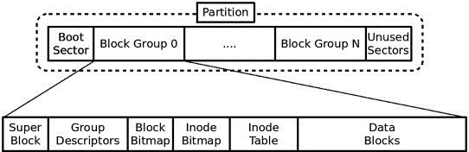
4.3. Linux ext4
Module 1: The File System Namespace
Fourth extended file system (ext4) for Linux, compatible with both ext2 and ext3.
Supports huge individual file data and overall file system size
Allows unlimited number of subdirectories compared to ext3.
Notes:
Notes to the Facilitator:
Explain Linux ext4 in detail.
Notes to the Participants:
This superior version of ext3 can support huge individual file size and overall file system size.
Maximum size of the individual file can be in the range of 16 GB to 16 TB.
Maximum size of the ext4 file system can be 1 EB (exabyte) i.e. 1024^2 TB
The file directories can contain a maximum of 64,000 subdirectories unlike ext3 file system (32,000 directories)
Additionally the journaling feature can be turned off in this file system.
The ext3 filesystem can be directly mounted as an ext4 filesystem without upgrading.

Slide 28
4.4. Macintosh HFS
Module 1: The File System Namespace
HFS is a proprietary file system developed by Apple in 1985 for Mac OS.
It was the primary file system for Mac OS until version 8.1, when HFS was replaced by HFS plus.
HFS is used to create a directory when a hard disk is formatted for MacOS.
Directory will expand when files and other directories are added to it.
Macintosh Hierarchical File System
2
11
21
21
35
43
Notes:
Notes to the Facilitator:
Explain Macintosh HFS in detail.
Notes to the Participants:
It is one of the first file system that supports GUI (Graphical User Interface) and it doesn’t resemble almost anything in other file systems.
It doesn’t have i-nodes, explicit directories and its way of mapping the blocks to a file is uncommon.
The Block bitmap records the free and allocated blocks and HFS utilizes B* tree to store the file system structure.
A file or directory has a record and a thread structure associated with them that contains the metadata of the them.
Since it is highly single threaded and all information is stored in a single file, it fails in key areas of performance and scalability.

Slide 29
4.5. Irix XFS
Module 1: The File System Namespace
/
First developed by Silicon Graphics (now SGI) in 1993 for use on IRIX OS.
It was released as open source in 2000.
It is a high performance journaling file system.
Useful for handling large files and smooth data transfers.
/bin
/etc
/usr
/var
/d2
/d3
/proj 1
/proj 2
/proj 3
/proj 4
Partition
7
Partition
7
Partition
0
Disk 1
Disk 2
Disk 3
Notes:
Notes to the Facilitator:
Explain Irix XFS in detail.
Notes to the Participants:
It is a sophisticated file system that supports journaling, 64-bit files and highly parallel operations.
Though it supports all traditional abstractions, it fails their implementations.
It divides large sized chunks called allocation groups that maintains a pair of B+trees to free space information.
Since same information is maintained in different forms, it can cause inconsistencies if they are out of sync.
Unlike others, it doesn’t pre-allocate i-node. Instead each groups will be provided with i-nodes on as-needed basis.
It supports greater parallel I/O and single writer/multiple reader access to files.

Slide 30
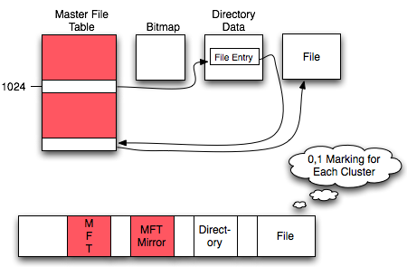
4.6. Windows NTFS
Module 1: The File System Namespace
NTFS FILE SYSTEM
New Technology File System (NTFS) is the modern file system used by Windows OS.
First used in consumer versions of Windows with Windows XP.
Has theoretically huge file sizes and partition limits.
System drive is first formatted with NTFS at the time of Windows installation.
Notes:
Notes to the Facilitator:
Explain Windows NTFS in detail.
Notes to the Participants:
It is a journaled 64-bit file system that supports multiple file attributes with file compression built-in to the file system.
Master File Table (MFT) is the main data structure that contains i-nodes for all files and the interesting part is MFT itself is a file in the filesystem.
By storing all metadata as file, it allows filesystem structure to grow dynamically and this makes it very powerful because volume can be expanded by simply adding more storage to the system.
Like XFS, it stores directories in XFS, duplicates the data that will end in inconsistencies if they are out of sync.
The downside is that it cannot index or query on the file attributes.

Slide 31
4.7. VMware VMFS
Module 1: The File System Namespace
host
A
host
B
host
C
Virtual Machine File System (VMFS) is a distributed cluster file system any type of storage to be attached and used with VMware’s server virtualization suite called vSphere.
In this file system, individual virtual machines are locked.
Multiple servers can read/write the same file system simultaneously
There are different versions of this file system based on the server release versions.
VM1
VM2
VM3
VMFS volume
disk1
virtual disk files
disk2
disk3
Notes:
Notes to the Facilitator:
Explain VMware VMFS in detail.
Notes to the Participants:
It is a cluster file system that supports storage virtualization for multiple installations of virtual machines.
Multiple instances of ESXi server can run and share the same VMFS in parallel.
It supports distributed infrastructure of virtualization by using a variety of VMware services and can optimize VM’s IO with adjustable disk, file & block sizes.
On server failure, it can recover quickly and reliably with Distributed journaling.
Maximum filesystem size is 64 TB and limits files to 2^18 blocks.

Slide 32
4.8. Sun Microsystem NFS
Module 1: The File System Namespace
Sun-NFS Structure
A distributed file system developed by Sun Microsystems in 1984.
Mostly used with Unix OS
Developed with major goals like simple crash recovery and high performance
Originally designed for diskless client-server architecture.
Built based on Virtual File System (VFS)
Client
Server
System call interface
Virtual file system
Virtual file system
Local operating system
NFS client
NFS server
Local operating system
Local disk
Message to server
Message from client
Local disk
Notes:
Notes to the Facilitator:
Explain Sun Microsystem NFS in detail.
Notes to the Participants:
It is a distributed file system that allows a client to access the filesystem of a remote machine much like a local filesystem.
It supports 64 bit file sizes and the file size greater than 2 GB can be handled.
It is built on Open Network Computing Remote Procedure Call (ONC RPC) system.
NFS requests are idempotent since performing the operation multiple times is equivalent to the effect of performing the operation a single time.
It supports asynchronous writes on the server file system that ends in improved write performance.
It can work on both TCP and UDP connection.

Slide 33

4.9. Apache Hadoop HDFS
Module 1: The File System Namespace
HDFS Architecture
Hadoop Distributed File System (HDFS) is a highly distributed and reliable storage system.
Stores less number of large files, rather than more number of small files.
Stores large files running on a cluster of commodity hardware.
Follows a master-slave architecture.
HDFS supports traditional hierarchical file organization.
Notes:
Notes to the Facilitator:
Explain the architecture of Hadoop HDFS and the important concepts of HDFS.
Notes to the Participants:
HDFS is a highly fault tolerant distributed file system that provides high throughput access to the application data. It typically stores data in the range of gigabytes to terabytes and achieves reliability by replicating data across multiple hosts. It is not fully POSIX-compliant and has increased performance for data throughput. HDFS uses Remote Procedure Calls (RPC) on a TCP connection to connect and replicate with other nodes. As a downside, it is not suitable for systems requiring concurrent write operations since it is designed for mostly immutable files.
The major assumptions and goals behind the development of HDFS are as follows:
Hardware Failure
Streaming Data Access
Large Data Sets
Simple Coherency Model
Moving Computation is Cheaper than Moving Data
Portability Across Heterogeneous Hardware and Software Platforms

Slide 34
5. Limitations of Traditional File Systems
Module 1: The File System Namespace
Data
Redundancy
Data Inconsistency
Lack of Data Integration
Program Dependence
Limited Data Sharing
Data Dependence
Inadequate Data Manipulation Capability
Poor Data Control
Security Issues
Notes:
Notes to the Facilitator:
Explain the limitations of traditional file systems to the participants. Explain each of the points mentioned above in detail and tell them that databases are a better alternative to file systems, as they help overcome these limitations.
Notes to the Participants:
File systems do have certain limitations. The following section will give an overview of the limitations of file systems. Databases are a very good alternative to file systems, as they help in overcoming the limitations of traditional file systems.
Inadequate Data Manipulation Capability – No strong relationship between data in different files, hence a limited data manipulation capability.
Security Issues – Application programs are added in a traditional file system in an ad hoc manner, and implementing security systems and access control rights become an issue.
Poor Data Control – Because of the decentralized nature of traditional file systems, data control becomes an issue. As a result of this, the data field might have a different meaning in a different context or same meaning for different fields.
Limited Data Sharing – In traditional file systems, applications have their own private files and users might face difficulty in data sharing outside their own applications. As a consequence, developers have to write complex programs to obtain data from several incompatible files.
Data Dependence – Applications/programs in file systems are data dependent. Application requirements control file organization, its physical location and data retrieval
Program Dependence – Reports produced by file systems are program dependent, any change in format or structure of data needs the program to be modified.
Lack of Data Integration – Need to access data contained in multiple files for a single query, due to independent nature. Complex programs need to be developed for querying data from each file or users will be forced to collect information manually.
Data Inconsistency – Redundancy leads to inconsistency, if same data present in different files is not updated in the individual files. Quality of information contained in the data file is compromised and causes reliability issues.
Data Redundancy –In traditional file systems, there is a datafile for every single application, and same data to be recorded and stored in different files. There is a need for additional storage space, extra time and money, and additional efforts are required to keep all files up to-date. As a consequence, duplication and redundancy of data happens.
Need for Excessive Programming – There exists a very high interdependence between program and data in a file system. This results in a situation where excessive programming efforts are needed to develop a new application program. Whenever a new application is developed, new file formats have to be designed and described before writing the file access logic for each new file.
Databases are considered to be a better alternative to file systems. We’ll learn more about NoSQL databases in the next module.

Slide 35

In a nutshell, we learnt:
Module 1: The File System Namespace
Disk is a storage of certain size with the smallest writable units called blocks.
Blocks are segmented into regions called partitions and made ready for use known as Volumes by formatting to a file system.
Journaling tracks the operations and helps in speedy recovery after crash.
Each file is a group of blocks on the disk with an i-node pointing to the file’s address along with additional metadata and attributes.
A directory is a special type of file that contains the location of other files on disk.
Notes:
Notes to the Facilitator:
Summarize the key featured in this module.
Reiterate the key features of the module.
Notes to the Participants:
Take note of the key features of the module.

Slide 36
In a nutshell, we learnt (Contd.)
Module 1: The File System Namespace
Most commonly used file systems are ext4 in Linux, NTFS in windows and HFS in Mac operating systems.
These traditional file systems are not distributed in nature and hence not suitable for applications having high throughput requirements.

Slide 37
Next Module 2: NoSQL Database Approach

