Slide 1
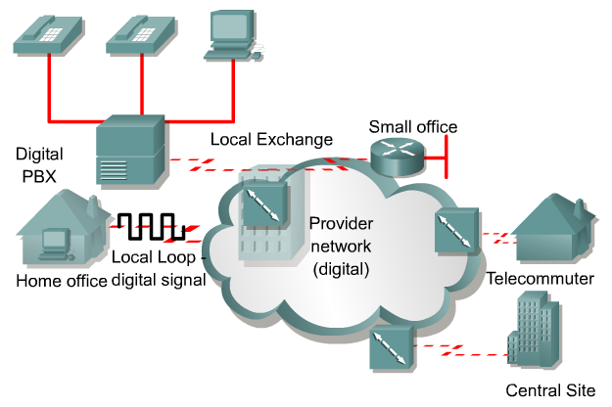
Introducing ISDN
Telephone companies developed ISDN (Integrated Services Digital Network) as part of an effort to standardize subscriber services.
This included the User-Network Interface (UNI), better known as the local loop.
The ISDN standards define the hardware and call setup schemes for end-to-end digital connectivity.
These standards help achieve the goal of worldwide connectivity by ensuring that ISDN networks easily communicate with one another.
In an ISDN network, the digitizing function is done at the user site rather than the telephone company.
Rick Graziani graziani@cabrillo.edu

Slide 2
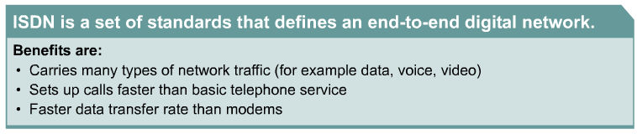
Introducing ISDN
Unlike POTS, ISDN is digital from end to end.
With asynchronous connections (POTS) the local loop is analog and requires PCM (Pulse Code Modulation) - explained later.
Benefits of ISDN include:
  Carries a variety of user traffic signals, including data, voice, and video
  Offers much faster call setup than modem connections
  B channels provide a faster data transfer rate than modems
  B channels are suitable for negotiated Point-to-Point Protocol (PPP) links
Rick Graziani graziani@cabrillo.edu

Slide 3
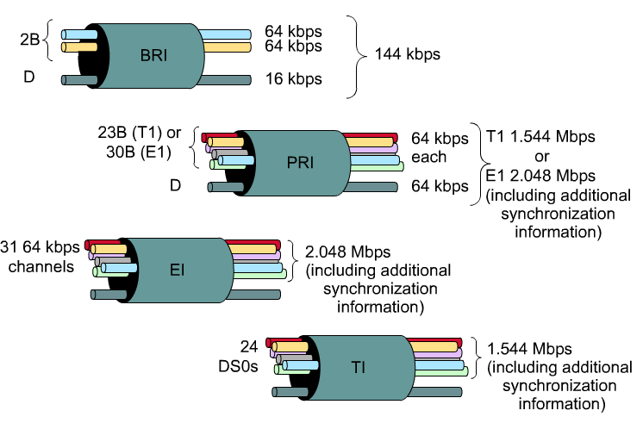

ISDN Advantages
ISDN also provides more bandwidth than a traditional 56 kbps dialup connection.
ISDN uses bearer channels, also called B channels, as clear data paths.
Each B channel provides 64 kbps of bandwidth.
An ISDN connection with two B channels would provide a total usable bandwidth of 128 kbps.
Each ISDN B channel can make a separate serial connection to any other site in the ISDN network.
ISDN lines can be used in conjunction with PPP encapsulation.
Rick Graziani graziani@cabrillo.edu

Slide 4
ISDN Disadvantages
BRI is slower than DSL and cable
More expensive than DSL and cable
Bottom line: ISDN, in its current form, is no longer a “first-choice” technology.
Rick Graziani graziani@cabrillo.edu

Slide 5
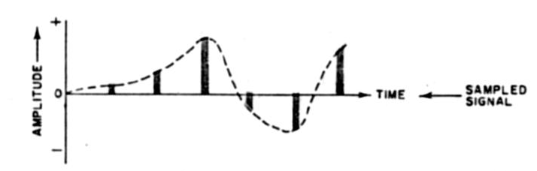
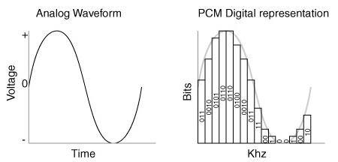
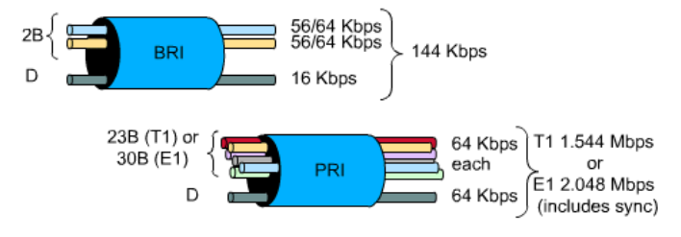
Why 64Kbps channels and what is PCM?
CCNP:
This will be explained in a later presentation on T1.
For now, 64,000 bps is what’s required to carry a single phone call over a link (an analog call which has been digitized).
PCM (Pulse Code Modulation) is how the analog signal is translated to digital and visa versa.
Rick Graziani graziani@cabrillo.edu

Slide 6
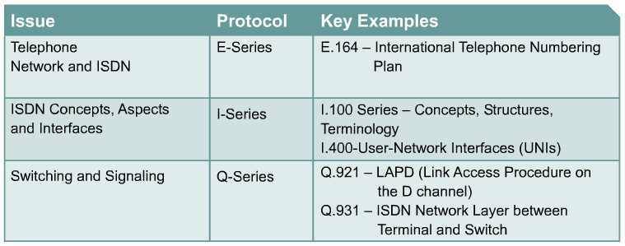
ISDN standards and access methods
Short Term Memory
ITU-T groups and organizes the ISDN protocols according to the following general topic areas:
E Protocols – Recommend telephone network standards for ISDN. For example, international addressing for ISDN.
I Protocols – Deal with concepts, terminology, and general methods.
Q Protocols – Cover how switching and signaling should operate. The term signaling in this context means the process of establishing an ISDN call.
Rick Graziani graziani@cabrillo.edu

Slide 7
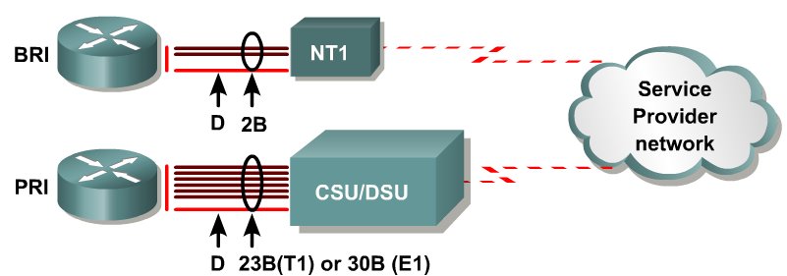
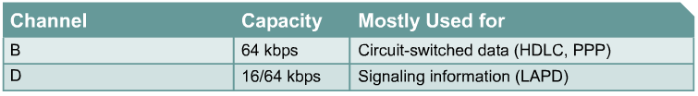
ISDN standards and access methods
ISDN standards define two main channel types
The bearer channel, or B channel, is defined as a clear digital path of 64 kbps
The second channel type is called a delta channel, or D channel.
  There can either be 16 kbps for the Basic Rate Interface (BRI) or 64 kbps for the Primary Rate Interface (PRI).
Rick Graziani graziani@cabrillo.edu

Slide 8
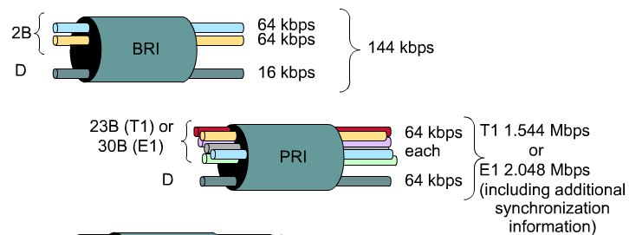
ISDN standards and access methods
ISDN is widely available in two flavors:
  BRI: Basic Rate Interface
    2 64 Kbps Bearer Channels,16 Kbps Delta Channel (for control information), 48 Kbps for framing and synchronization
    2B + 1D (2B+D)
    192 Kbps = 128+16+48
  PRI: Primary Rate Interface
    23B + 1D (T1), the D channel is 64-kbps
    30B + 1D (E1), European E1
    1.544 Mbps (North America) or 2.048 Mbps (E1)
Rick Graziani graziani@cabrillo.edu

Slide 9
B Channels
The B channels can be used for relatively high-speed data transport.
In this mode, the information is carried in frame format, using either HDLC or PPP as the Layer 2 protocol.
PPP is more robust than HDLC because it provides a mechanism for authentication and negotiation of compatible link and protocol configuration.
Rick Graziani graziani@cabrillo.edu

Slide 10
D Channel
When a TCP connection is established, there is an exchange of information called the connection setup.
  This information is exchanged over the path on which the data will eventually be transmitted.
  Both the control information and the data share the same pathway.
  This is called in-band signaling.
ISDN however, uses a separate channel for control information, the D channel.
  This is called out-of-band signaling.
The D channel carries signaling messages, such as call setup and teardown, to control calls on B channels.
Traffic over the D channel employs the Link Access Procedure on the D Channel (LAPD) protocol.
LAPD is a data link layer protocol based on HDLC.
Rick Graziani graziani@cabrillo.edu

Slide 11
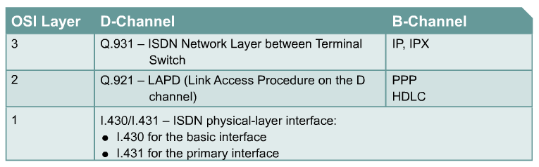
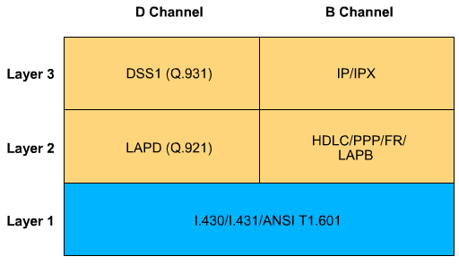
ISDN 3-layer model and protocols
Short Term Memory
Layer 3 Q.931 Layer 2 Q.921
I like the “older” chart.
ISDN utilizes a suite of ITU-T standards spanning the physical, data link, and network layers of the OSI reference model.
The ISDN BRI and PRI physical layer specifications are defined in ITU-T I.430 and I.431, respectively.
The ISDN data link specification is based on LAPD and is formally specified in the following, ITU-T Q.920, ITU-T Q.921, ITU-T Q.922, ITU-T Q.923
The ISDN network layer is defined in ITU-T Q.930, also known as I.450 and ITU-T Q.931, also known as I.451.
These standards specify user-to-user, circuit-switched, and packet-switched connections.
Rick Graziani graziani@cabrillo.edu

Slide 12
BRI Physical Layer
BRI service is provided over a local copper loop that traditionally carries analog phone service.
While there is only one physical path for a BRI, there are three separate information paths, 2B+D.
Information from the three channels is multiplexed into the one physical path.
ISDN physical layer, or Layer 1, frame formats differ depending on whether the frame is outbound or inbound.
Rick Graziani graziani@cabrillo.edu

Slide 13
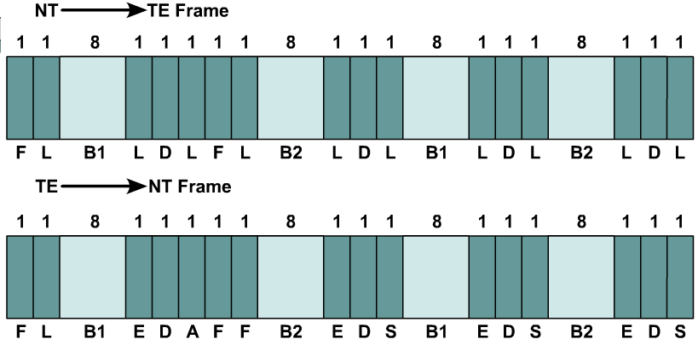
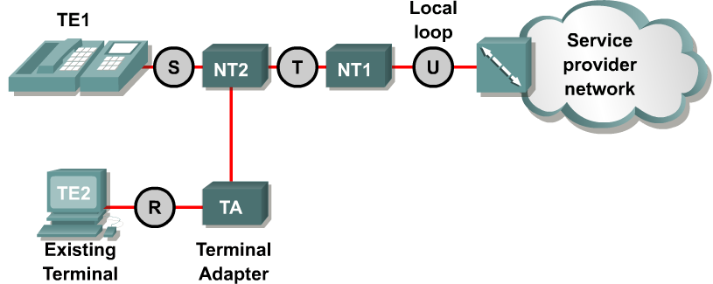
BRI Physical Layer
Short Term Memory
These Reference Points will be discussed in a moment, but this is where they get TE and NT from.
If the frame is outbound, it is sent from the terminal to the network.
  Outbound frames use the TE frame format.
If the frame is inbound, it is sent from the network to the terminal.
  Inbound frames use the NT frame format.
Rick Graziani graziani@cabrillo.edu

Slide 14
BRI Physical Layer
4,000 frames per second
64k (16*4,000) - B1 channel
64k (16*4,000) - B2 channel
16k (4*4,000) - D channel
48k (12*4,000) – Framing/Overhead
------------------------------------------------
192 kbps BRI Total
144 kbps = B1 + B2 + D (2B+D)
B1, B2, D and Framing Bits
ISDN BRI frames contain 48 bits.
Four thousand of these frames are transmitted every second, 4,000 x 48 = 192,000 bps.
  Each B channel, B1 and B2, have a capacity of 2(8*4000) = 64 kbps, 128 kbps for both B channels (B1 and B2)
  The D channel has a capacity of 4*4000 = 16 kbps (D)
  Framing and overhead 12*4,000 = 48,000 kbps. (F, L, E, A, S)
Rick Graziani graziani@cabrillo.edu

Slide 15
BRI Physical Layer
4,000 frames per second
Short Term Memory
The overhead bits of an ISDN physical layer frame are used as follows:
Framing bit – Provides synchronization
Load balancing bit – Adjusts the average bit value
Echo of previous D channel bits – Used for contention resolution when several terminals on a passive bus contend for a channel
Activation bit – Activates devices
Spare bit – Unassigned
Rick Graziani graziani@cabrillo.edu

Slide 16
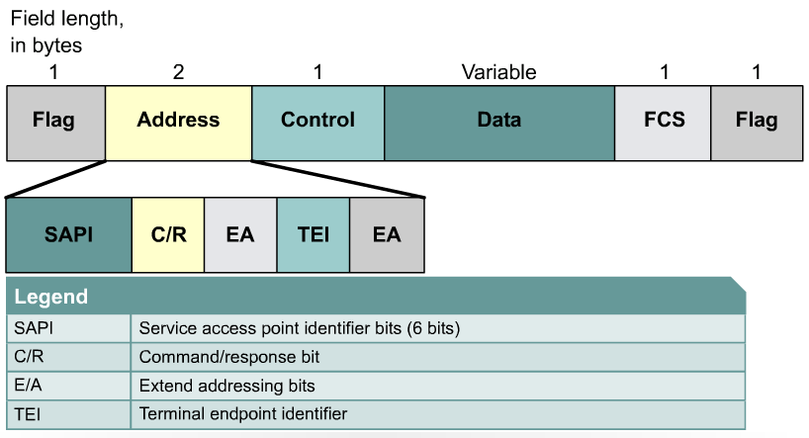
ISDN Data Link Layer
Short Term Memory
The LAPD flag and control fields are identical to those of HDLC.
The LAPD address field is 2 bytes long.
Service access point identifier (SAPI), which identifies the portal at which LAPD services are provided to Layer 3.
The command/response bit (C/R), indicates whether the frame contains a command or a response.
The second byte contains the terminal endpoint identifier (TEI).
  Each piece of terminal equipment on the customer premises needs a unique identifier.
  The TEI may be statically assigned at installation, or the switch may dynamically assign it when the equipment is started up.
  Statically assigned TEIs range from 0 to 63.
  Dynamically assigned TEIs range from 64 to 126.
  A TEI of 127, or all 1s, indicates a broadcast.
Rick Graziani graziani@cabrillo.edu

Slide 17
ISDN Data Link Layer
Router#show isdn status
Global ISDN Switchtype = basic-ni
ISDN BRI0 interface
dsl 0, interface ISDN Switchtype = basic-ni
Layer 1 Status:
ACTIVE
Layer 2 Status:
TEI = 64, Ces = 1, SAPI = 0, State = MULTIPLE_FRAME_ESTABLISHED
TEI = 65, Ces = 2, SAPI = 0, State = MULTIPLE_FRAME_ESTABLISHED
Spid Status:
TEI 64, ces = 1, state = 5(init)
spid1 configured, spid1 sent, spid1 valid
TEI 65, ces = 2, state = 5(init)
spid2 configured, spid2 sent, spid2 valid
Layer 3 Status:
1 Active Layer 3 Call(s)
Where you see this information.
Rick Graziani graziani@cabrillo.edu

Slide 18
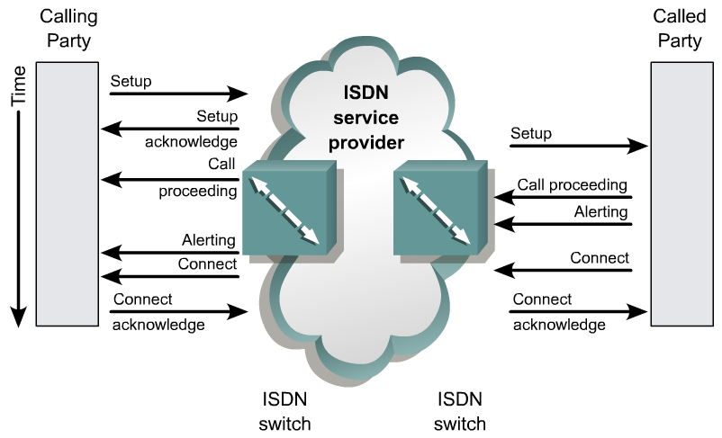
Call Setup
Not an end-to-end function but processed by the switch.
Depending upon the switch type, you may or may not get all of the steps show above.
Short Term Memory
To establish an ISDN call, the D channel is used between the router and the ISDN switch to control functions such as call setup, signaling, and termination.
Signal System 7 (SS7) signaling is used between the switches within the service provider network.
These functions are implemented in the Q.931 protocol.
The Q.931 standard recommends a network layer connection between the terminal endpoint and the local ISDN switch, but it does not impose an end-to-end recommendation.
Rick Graziani graziani@cabrillo.edu

Slide 19
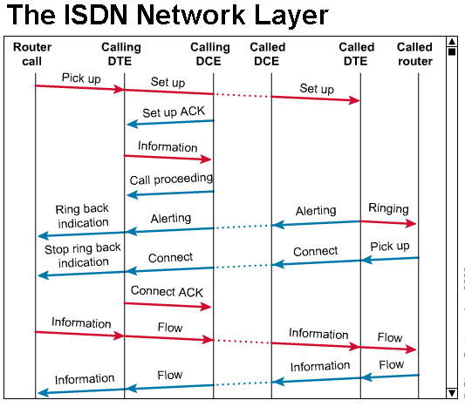
Call Setup – In detail
The following information discusses “some” of these steps.
FYI
Rick Graziani graziani@cabrillo.edu

Slide 20
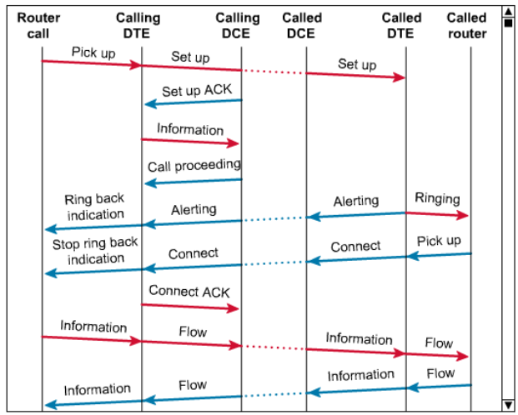
Call Setup
FYI
The D channel is used to send the called number to the local ISDN switch.
The local switch uses the SS7 signaling protocol to set up a path and pass the called number to the remote ISDN switch.
The remote ISDN switch signals the destination over the D channel.
Rick Graziani graziani@cabrillo.edu

Slide 21
Call Setup
FYI
The destination ISDN NT-1 device sends the remote ISDN switch a call-connect message.
The remote ISDN switch uses SS7 to send a call-connect message to the local switch.
The local ISDN switch connects one B channel end-to-end, leaving the other B channel available for a new conversation or data transfer. Both B channels can be used simultaneously.
Rick Graziani graziani@cabrillo.edu

Slide 22
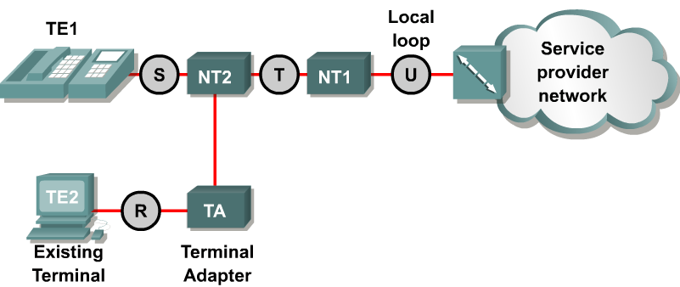
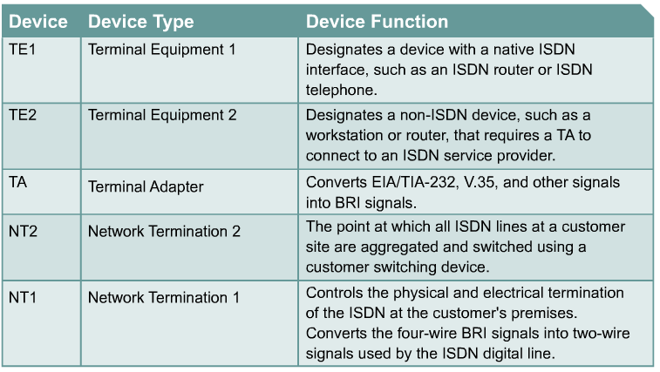
ISDN reference points
Short Term Memory
Rick Graziani graziani@cabrillo.edu

Slide 23
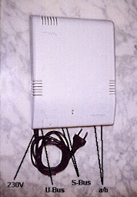
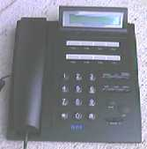
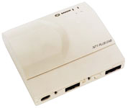

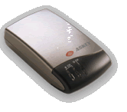
ISDN reference points
Short Term Memory
Rick Graziani graziani@cabrillo.edu

Slide 24
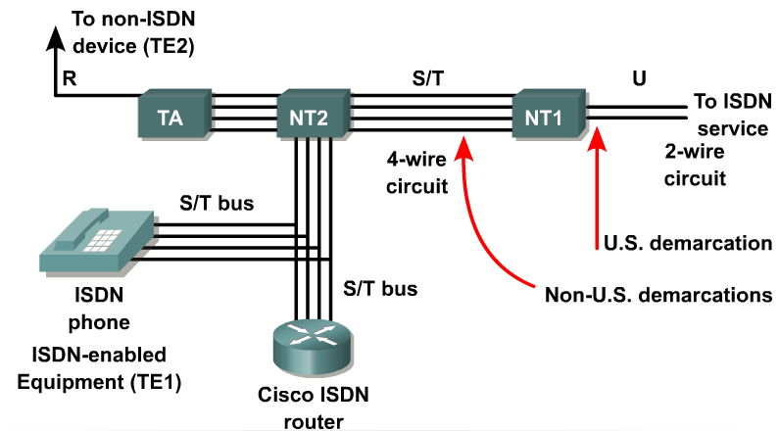
ISDN Interfaces
Short Term Memory
To connect devices that perform specific functions, the interface between the two devices needs to be well defined.
R – References the connection between a non-ISDN compatible device Terminal Equipment type 2 (TE2) and a Terminal Adapter (TA), for example an RS-232 serial interface.
S – References the points that connect into the customer switching device Network Termination type 2 (NT2) and enables calls between the various types of customer premises equipment.
T – Electrically identical to the S interface, it references the outbound connection from the NT2 to the ISDN network or Network Termination type 1 (NT1).
U – References the connection between the NT1 and the ISDN network owned by the telephone company.
Rick Graziani graziani@cabrillo.edu

Slide 25
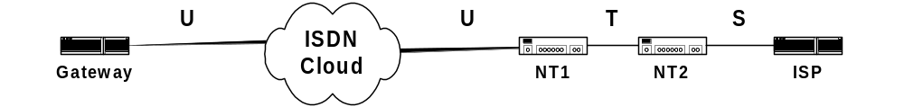
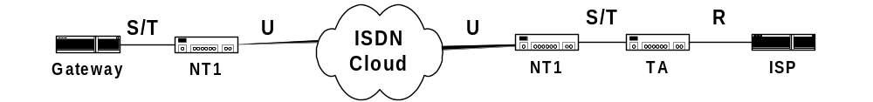
ISDN reference points
CAUTION: Some routers contain NT1’s. Never connect a router with a U interface into a NT1. It will most likely ruin the interface. Know what type of interface your router has!
Because the S and T references are electrically similar, some interfaces are labeled S/T interfaces. Although they perform different functions, the port is electrically the same and can be used for either function.
Rick Graziani graziani@cabrillo.edu

Slide 26
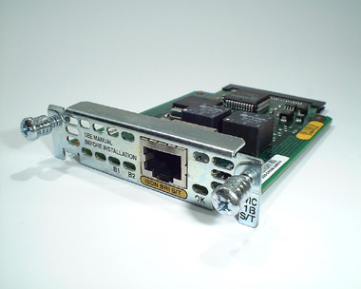
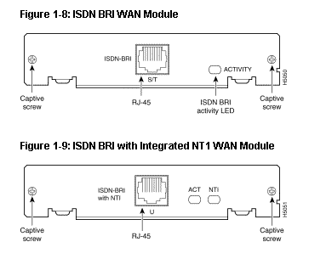
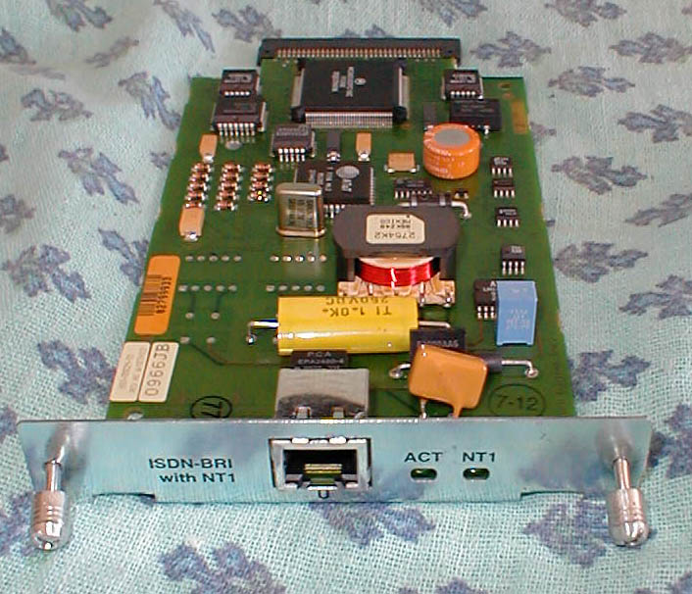
Cisco Interfaces
S/T interface requires an NT1 connection.
In the United States, the customer is required to provide the NT1.
In Europe and various other countries, the telephone company provides the NT1 function and presents an S/T interface to the customer.
Rick Graziani graziani@cabrillo.edu

Slide 27
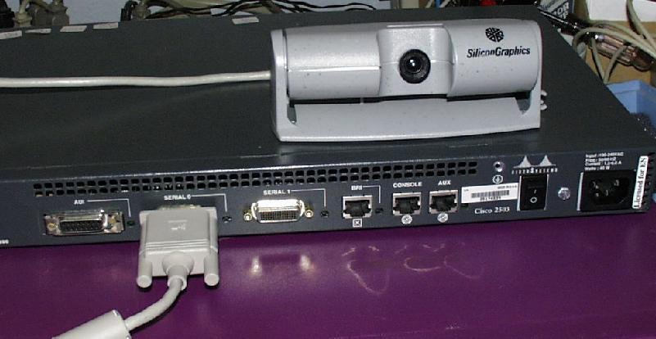
BRI S/T Interface – Cisco 2503
Rick Graziani graziani@cabrillo.edu

Slide 28
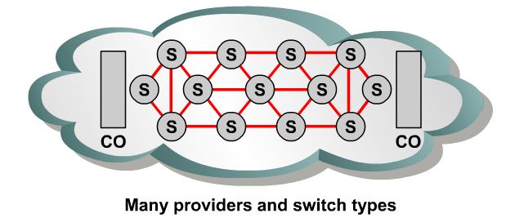

ISDN switch types
Routers must be configured to identify the type of switch with which they will communicate.
Available ISDN switch types vary, depending in part on the country in which the switch is being used.
As a consequence of various implementations of Q.931, the D channel signaling protocol used on ISDN switches varies from vendor to vendor.
Before the router can be connected to an ISDN service, it must be configured for the switch type used at the CO.
This information must be specified during router configuration.
Rick Graziani graziani@cabrillo.edu

Slide 29
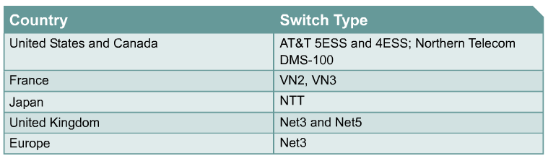
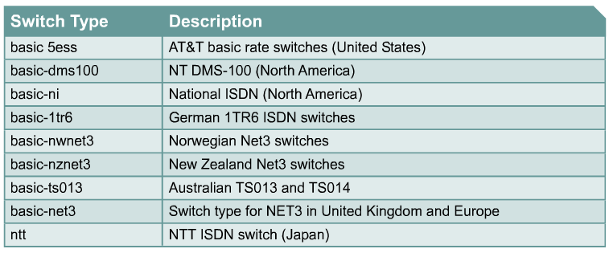
ISDN switch types
Switch types used for router configuration.
Rick Graziani graziani@cabrillo.edu

Slide 30
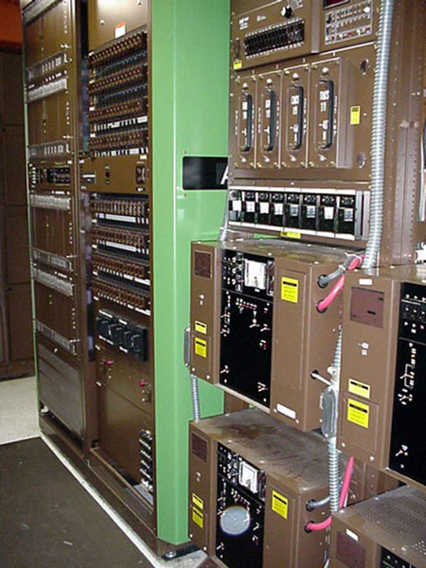
SPIDs
Nortel DMS-100 Switch
In addition to knowing the switch type the service provider is using, it may also be necessary to know what service profile identifiers (SPIDs) are assigned by the telco.
A SPID is a number provided by the ISDN carrier to identify the line configuration of the BRI service.
SPIDs allow multiple ISDN devices, such as voice and data equipment, to share the local loop.
SPIDs are required by DMS-100 and National ISDN-1 switches.
SPIDs are used only in North America and Japan.
In many cases when configuring a router, the SPIDs will need to be entered.
Rick Graziani graziani@cabrillo.edu

Slide 31
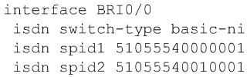
SPIDs
SPIDs are a series of characters that usually resemble telephone numbers.
SPIDs identify each B channel to the switch at the central office.
If SPIDs are necessary, but are not configured correctly, the initialization will fail, and the ISDN services cannot be used.
Rick Graziani graziani@cabrillo.edu

Slide 32
Configuring ISDN – Switch Type
Router(config)#isdn switch-type switch-type
Router(config-if)#isdn switch-type switch-type
The command isdn switch-type switch-type can be configured at the global or interface command mode to specify the provider ISDN switch.
Configuring the isdn switch-type command in the global configuration mode sets the ISDN switch type identically for all ISDN interfaces.
Individual interfaces may be configured, after the global configuration command, to reflect an alternate switch type.
Rick Graziani graziani@cabrillo.edu

Slide 33
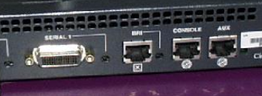
Configuring ISDN interface
Router(config)#interface bri number
Router(config-if)#
If the router is a TE2 device, which does not have a native BRI, it must use an external ISDN terminal adapter.
On a TE2 router, configure the appropriate serial interface to send the ISDN traffic to the TA.
Terminal Adapter
Rick Graziani graziani@cabrillo.edu

Slide 34
Configuring ISDN – Encapsulation (Optional)
Router(config-if)#encapsulation [ppp | lapb | hdlc | x25 | cpp]
A method of datagram encapsulation is needed for data to be transported when dial-on-demand routing (DDR) or a user creates an end-to-end path over ISDN.
The most common Layer 2 encapsulation protocol is PPP.
Available encapsulations for ISDN include the following:
  PPP
  HDLC (default)
  Frame Relay
  LAPB
  Combinet Proprietary Protocol (CPP)
Rick Graziani graziani@cabrillo.edu

Slide 35
Configuring ISDN – Optional SPIDs
Router(config-if)#isdn spid1 spid-number [ldn]
Router(config-if)#isdn spid2 spid-number [ldn]
DMS-100 and National ISDN-1 switches support only two SPIDs per BRI.
One SPID is supported for each B channel.
If both B channels will be used for data only, configure the router for both SPIDs, one for each B channel.
Data and voice cannot run over the same B channel simultaneously.
The absence or presence of a channel SPID in the configuration of the router dictates whether the second B channel can be used for data or voice.
To keep SPID numbers simple, most telephone companies use part of the ISDN phone number in the SPID naming system.
Therefore, SPIDs are often the ISDN phone number with some optional numbers.
For example, the SPID for the phone number 888-555-1212 could be 888555121200.
Rick Graziani graziani@cabrillo.edu

Slide 36
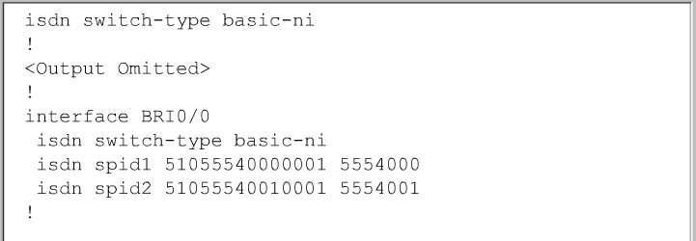
Configuring ISDN – Optional SPIDs
Router(config-if)#isdn spid1 spid-number [ldn]
Router(config-if)#isdn spid2 spid-number [ldn]
Not a complete configuration…
The optional ldn argument defines a local dial directory number.
On most switches, the number must match the called party information coming in from the ISDN switch.
SPIDs are specified in interface configuration mode.
Rick Graziani graziani@cabrillo.edu

Slide 37
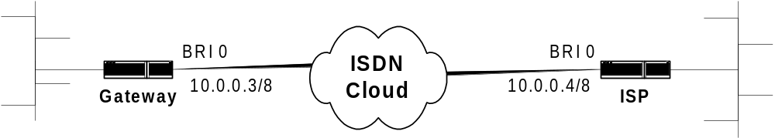


Gateway(config)#isdn switch-type basic-dms100
Gateway(config)#interface bri 0
Gateway(config-if)#ip add 10.0.0.3 255.0.0.0
Gateway(config-if)#isdn spid1 08443 213
Gateway(config-if)#isdn spid2 08132 344
SPID required
Default encapsulation HDLC
ISP(config)#isdn switch-type basic-5ess
ISP(config)#interface bri 0
ISP(config-if)#ip add 10.0.0.4 255.0.0.0
No SPID required
Default encapsulation HDLC
Rick Graziani graziani@cabrillo.edu

Slide 38
Gateway(config)#username ISP password class
Gateway(config)#isdn switch-type basic-dms100
Gateway(config)#interface bri 0
Gateway(config-if)#ip add 10.0.0.3 255.0.0.0
Gateway(config-if)#encapsulation ppp
Gateway(config-if)#ppp authen chap
Gateway(config-if)#isdn spid1 08443 213
Gateway(config-if)#isdn spid2 08132 344
Using PPP with CHAP
ISP(config)#username Gateway password class
ISP(config)#isdn switch-type basic-5ess
ISP(config)#interface bri 0
ISP(config-if)#ip add 10.0.0.4 255.0.0.0
ISP(config-if)#encapsulation ppp
ISP(config-if)#ppp authen chap
Using PPP with CHAP
Rick Graziani graziani@cabrillo.edu

Slide 39
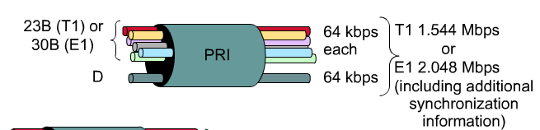
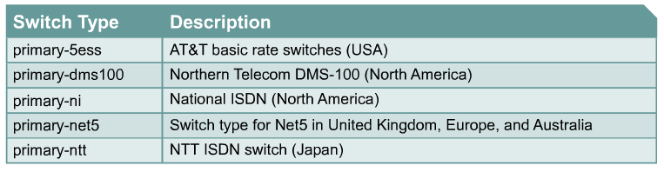
Configuring ISDN PRI – Switch Type
Router(config)#isdn switch-type switch-type
Router(config-if)#isdn switch-type switch-type
Use the isdn switch-type command to specify the ISDN switch used by the provider to which the PRI connects.
As with BRI, this command can be issued globally or in interface configuration mode.
Rick Graziani graziani@cabrillo.edu

Slide 40
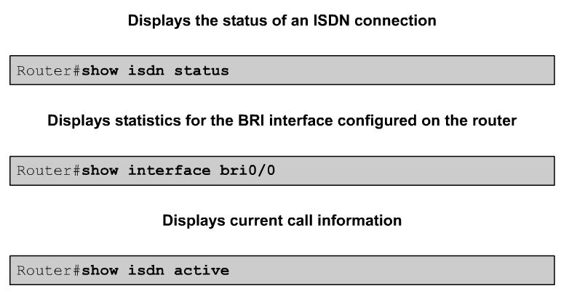
Verifying ISDN configuration
Rick Graziani graziani@cabrillo.edu

Slide 41
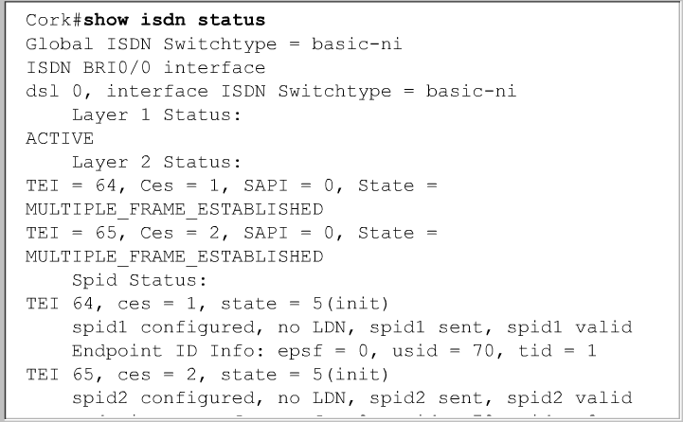
Show isdn status
To confirm BRI operations, use the show isdn status command to inspect the status of the BRI interfaces.
This command can be used after configuring the ISDN BRI to verify that the TE1, or router, is communicating correctly with the ISDN switch.
In output TEIs have been successfully negotiated and ISDN Layer 3 is ready to make or receive calls.
Rick Graziani graziani@cabrillo.edu

Slide 42
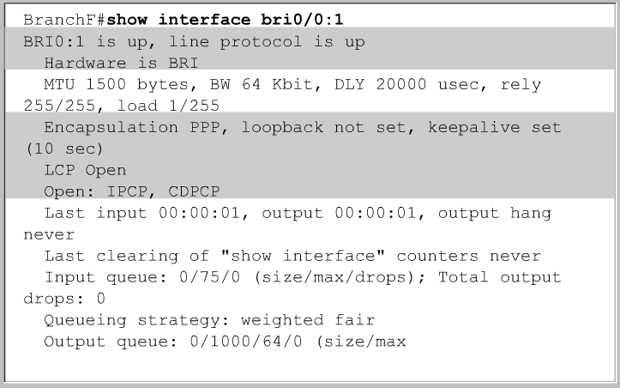
Show interface bri
The show interface bri0/0 displays statistics for the BRI interface configured on the router.
Channel specific information is displayed by putting the channel number at the end of the command.
In this case, the show interface bri0/0:1 command shows the following:
  The B channel is using PPP encapsulation.
  LCP has negotiated and is open.
  There are two NCPs running, IPCP and Cisco Discovery Protocol Control Protocol (CDPCP).
Rick Graziani graziani@cabrillo.edu

Slide 43
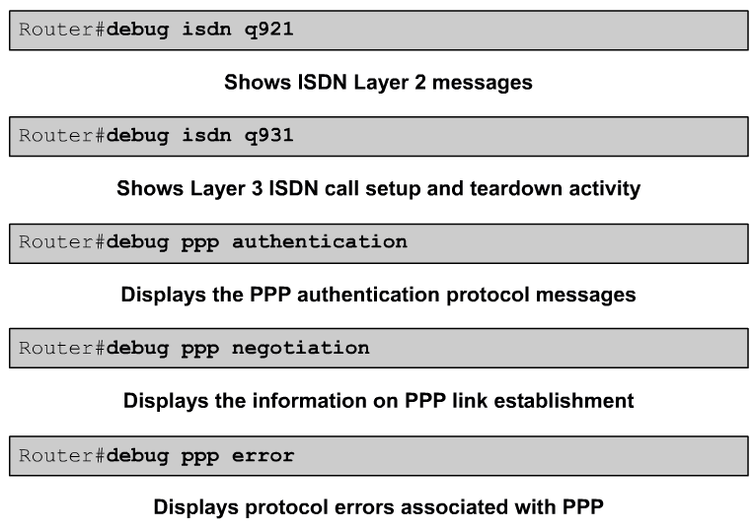
Troubleshooting the ISDN configuration
Rick Graziani graziani@cabrillo.edu

Slide 44
DDR – Dial-on-Demand Routing

Slide 45
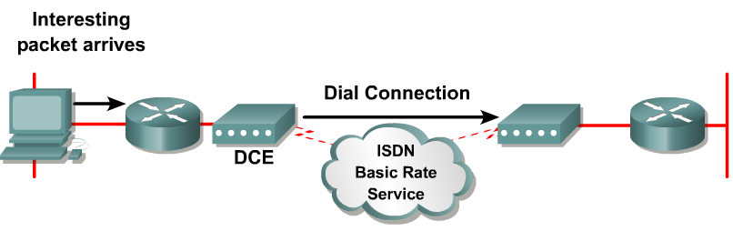
DDR operation
Dial-on-demand routing (DDR) is triggered when traffic that matches a predefined set of criteria is queued to be sent out a DDR-enabled interface.
The traffic that causes a DDR call to be placed is referred to as interesting traffic.
Once the router has transmitted the interesting traffic, the call is terminated.
Rick Graziani graziani@cabrillo.edu

Slide 46
Legacy DDR – Dialer Maps

Slide 47
3
Use dialer map to access next hop router
4
Dialer map in use? If so, send traffic. If not call remote router.
2
Exit inter DDR? If so, traffic interesting? If not, stop here.
5
Transmit both interesting and non-interesting traffic.
1
Routing Table
Exit inter
6
After a specific amount of time, the idle timer disconnects link when no interesting traffic is seen.
1
2
3
4 5 6
The router receives traffic, performs a routing table lookup to determine if there is a route to the destination, and identifies the outbound interface.
If the outbound interface is configured for DDR, the router does a lookup to determine if the traffic is interesting.
The router identifies the dialing information necessary to make the call using a dialer map to access the next-hop router.
The router then checks to see if the dialer map is in use. If the interface is currently connected to the desired remote destination, the traffic is sent. If the interface is not currently connected to the remote destination, the router sends call-setup information through the BRI using the D channel.
After the link is enabled, the router transmits both interesting and uninteresting traffic. Uninteresting traffic can include data and routing updates.
The idle timer starts and runs as long as no interesting traffic is seen during the idle timeout period and disconnects the call based on the idler timer configuration.
Rick Graziani graziani@cabrillo.edu

Slide 48
3
Use dialer map to access next hop router
4
Dialer map in use? If so, send traffic. If not call remote router.
2
Exit inter DDR? If so, traffic interesting? If not, stop here.
5
Transmit both interesting and non-interesting traffic.
1
Routing Table
Exit inter
6
After a specific amount of time, the idle timer disconnects link when no interesting traffic is seen.
1
2
3
4 5 6
The idle timer setting specifies the length of time the router should remain connected if no interesting traffic has been sent.
Once a DDR connection is established, any traffic to that destination will be permitted.
However, only interesting traffic resets the idle timer.
Note: You should configure routing protocols as uninteresting in the interesting traffic definition to prevent periodic routing updates and hellos from resetting the idle timeout.
Rick Graziani graziani@cabrillo.edu

Slide 49
Configuring DDR
3
Use dialer map to access next hop router
4
Dialer map in use? If so, send traffic. If not call remote router.
2
Exit inter DDR? If so, traffic interesting? If not, stop here.
5
Transmit both interesting and non-interesting traffic.
1
Routing Table
Exit inter
6
After a specific amount of time, the idle timer disconnects link when no interesting traffic is seen.
1
2
3
4 5 6
To configure legacy DDR perform the following steps:
Define static routes
Specify interesting traffic
Configure the dialer information
Rick Graziani graziani@cabrillo.edu

Slide 50
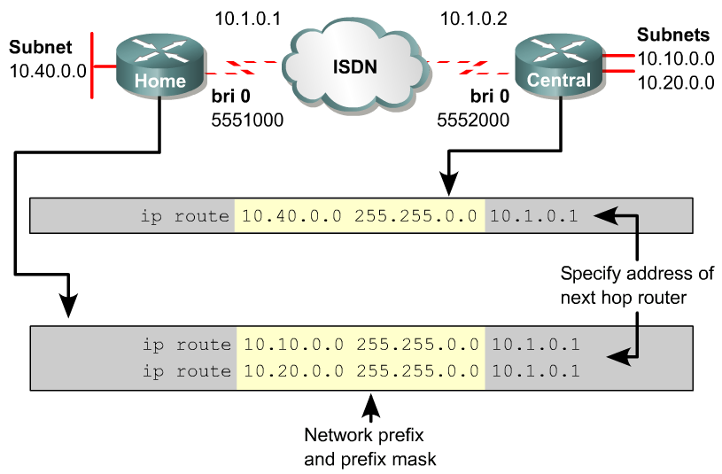
Step 1 - Defining static routes for DDR
10.1.0.2
To forward traffic, routers need to know what route to use for a given destination.
Rick Graziani graziani@cabrillo.edu

Slide 51
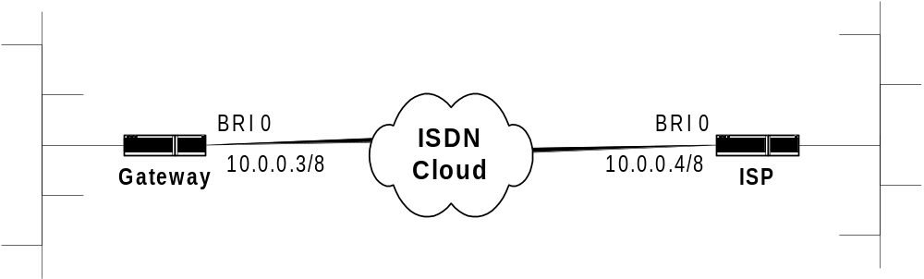
Non-interesting traffic and dynamic routing
172.16.1.0/24
172.16.4.0/24
172.16.2.0/24
172.16.3.0/24
Dynamic Routing
If your DDR interface is on the same network in which you are running dynamic routing protocol, and you do not want your routing updates to be sent over your DDR link, then use the passive-interface command .
ISP(config)# router igrp 100
ISP(config-router)# network 172.16.0.0
ISP(config-router)# passive-interface bri0
Rick Graziani graziani@cabrillo.edu

Slide 52
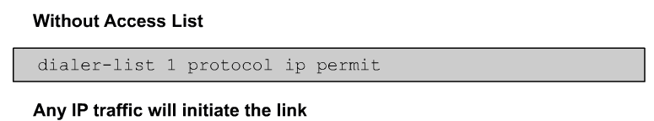
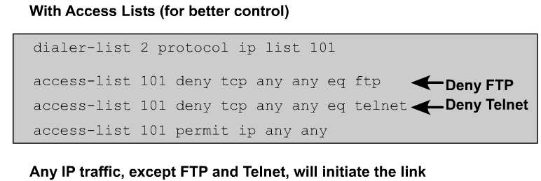
Step 2 – Specifying Interesting Traffic
DDR calls are triggered by interesting traffic. This traffic can be defined as any of the following:
  IP traffic of a particular protocol type
  Packets with a particular source address or destination
  Other criteria as defined by the network administrator
Rick Graziani graziani@cabrillo.edu

Slide 53
Step 2 – Specifying Interesting Traffic
Router(config)#dialer-list dialer-group-num protocol protocol-name {permit | deny | list access-list-number}
Router(config-if)#dialer-group group-number
Router(config-if)#dialer map protocol next-hop-address [name hostname] [speed 56 | 64] [broadcast] dial-string
A dialer list is used to specify the interesting traffic for this DDR interface and needs to be associated with the DDR interface.
This is done using the dialer-group command on the interface.
The dialer-group-num is an integer between 1 and 10 that identifies the dialer list to the router.
The correct dialing information for the remote DDR interface needs to be specified. This is done using the dialer map command.
The dialer map command maps the remote protocol address to a telephone number.
Rick Graziani graziani@cabrillo.edu

Slide 54
A quick word on Dialer Maps
Router(config)#dialer-list dialer-group-num protocol protocol-name {permit | deny | list access-list-number}
Router(config-if)#dialer-group group-number
Router(config-if)#dialer map protocol next-hop-address [name hostname] [speed 56 | 64] [broadcast] dial-string
Cisco IOS commands often contain the word "map".
This word is used in the command to statically map Layer 2 addresses to Layer 3 addresses.
  For example, the command frame-relay map is used to define a Layer 3 next-hop-address to its Layer 2 address, DLCI number.
With a dialer-map statement, a Layer 3 address, IP in this module, is linked to a dialup Layer 2 address.
In this case, the dialup Layer 2 address is a phone number.
Let’s put it all together…
Rick Graziani graziani@cabrillo.edu

Slide 55
EXAMPLE: Without access lists, all IP traffic will initiate the link
Router(config)# username ISP pass class
Router(config)# isdn switch-type basic-dms100
Router(config)# dialer-list 1 protocol ip permit
Router(config)# interface bri 0
Router(config-if)# ip add 10.0.0.3 255.0.0.0
Router(config-if)# encapsulation ppp
Router(config-if)# ppp authen chap
Router(config-if)# dialer-group 1
Router(config-if)# dialer map ip 10.0.0.4 name ISP 5554000
Router(config-if)# isdn spid1 51055512340001 5551234
Router(config-if)# isdn spid2 51055512350001 5551235
3
1
Remote IP address and number to dial
2
4, 5
5
Routing Table lookup of incoming traffic determines bri 0 is the exit interface.
Dialer-group command specifies that the traffic must be determined to be interesting before the call is initiated (assuming link is not currently up.)
Traffic is determined whether or not to be interesting.
If interesting, dialer map is used to find next hope router.
If dialer map is not currently in use initiate the call. If it is in use, send all traffic.
Rick Graziani graziani@cabrillo.edu

Slide 56
EXAMPLE: With access lists, telnet and FTP traffic will not initiate the link
Router(config)# username ISP pass class
Router(config)# isdn switch-type basic-5ess
Router(config)# dialer-list 1 protocol ip list 101
Router(config)# access-list 101 deny tcp any any eq telnet
Router(config)# access-list 101 deny tcp any any eq ftp
Router(config)# access-list 101 permit ip any any
Router(config)# interface bri 0
Router(config-if)# ip add 10.0.0.3 255.0.0.0
Router(config-if)# encapsulation ppp
Router(config-if)# ppp authen chap
Router(config-if)# dialer-group 1
Router(config-if)# dialer map ip 10.0.0.4 name ISP 5554000
3
1
Remote IP address and number to dial
2
4, 5
Routing Table lookup of incoming traffic determines bri 0 is the exit interface.
Dialer-group command specifies that the traffic must be determined to be interesting before the call is initiated (assuming link is not currently up.)
Traffic is determined whether or not to be interesting.
If interesting, dialer map is used to find next hope router.
If dialer map is not currently in use initiate the call. If it is in use, send all traffic.
Rick Graziani graziani@cabrillo.edu

Slide 57
EXAMPLE: With access lists, telnet and FTP traffic will not initiate the link
Router(config)# username ISP pass class
Router(config)# isdn switch-type basic-5ess
Router(config)# dialer-list 1 protocol ip list 101
Router(config)# access-list 101 deny tcp any any eq telnet
Router(config)# access-list 101 deny tcp any any eq ftp
Router(config)# access-list 101 permit ip any any
Router(config)# interface bri 0
Router(config-if)# ip add 10.0.0.3 255.0.0.0
Router(config-if)# encapsulation ppp
Router(config-if)# ppp authen chap
Router(config-if)# dialer-group 1
Router(config-if)# dialer map ip 10.0.0.4 name ISP 5554000
3
Remote name Used for CHAP
1
2
4, 5
When setting up DDR between more than two sites, it is very important to use PPP authentication.
Also, be sure to use the name keyword with the dialer-map command.
Dialer maps for inbound calls are maps between protocol addresses and authenticated user names.
Rick Graziani graziani@cabrillo.edu

Slide 58

Dialer idle-timeout
Router(config-if)#dialer idle-timeout seconds
The dialer idle-timeout seconds command may be used to specify the number of idle seconds before a call is disconnected.
The seconds represent the number of seconds until a call is disconnected after the last interesting packet is sent.
The default is 120.
Rick Graziani graziani@cabrillo.edu

Slide 59
PPP and dialer maps
NOTE: If using dialer map statements with PPP, you must use PPP with authentication for router to accept the call.
Problem: Connecting two routers via an asynchronous connection, modems, using PPP encapsulation, no authentication, and with dialer map statements at both ends. The router (with a dialer map statement) will dial out, but the remote router (also with a dialer map statement) will not create a connection. The answering modem does answer, but after a few seconds the line is deactivated. By removing the dialer-group from the interface of the remote router, the router will accept the call, but cannot be the one to initiate a call.
Environment: IOS: 12.05(T), Routers: 1720 and 2621, Modems: Hayes Accura V.90
Solution: You must add PPP with authentication for this to work! Used PPP with CHAP and life was good again! Also works with PAP. If dialer map statements are used at both ends, and you want either router to initiate the call, (and of course the remote router to answer), you must use PPP with authentication. Both routers can now initiate and answer calls from the other router. Other workaround: If you want the routers to dial each other without mapping ip address to phone numbers and chat-scripts, you can use the dialer string command.
Notes:
There are weird combinations that I did get to work, with a dialer map at one end and a dialer string at the other, but at some point I need to get a life.
This is also true when using ISDN with dialer map statements.
- Rick
Rick Graziani graziani@cabrillo.edu

Slide 60
Dialer String command
Router(config-if)#dialer string dial-string [class class-name]
If dialing only one site, use an unconditional dialer string command that always dials the one phone number regardless of the traffic destination.
This command is an alternate command to the dialer map command.
It is used in scenarios in which the name of the answering router might not be known.
In particular, this command appears in the ISP example configurations because many times the ISP router name either is unknown or may vary between a number of possible routers in a pool.
Rick Graziani graziani@cabrillo.edu

Slide 61
Dialer Profiles
Some of this can be difficult to understand at first.
The examples at the end of this section will help you understand
dialer profiles.
Some information from CCNP 2 has been added to help clarify
dialer profiles and to provide more examples.
In CCNP 2 Rotary Groups (legacy DDR) is discussed which may
help with understanding the transition from dialer maps to dialer
profiles.
See my CCNP 2 presentation on Ch. 5 Dialer Profiles for more
information.

Slide 62

Legacy DDR
Legacy DDR - configuring DDR by the application of dialer commands directly on the physical interface, BRI0, Async0, or by the use of rotary groups.
Legacy DDR is powerful and comprehensive.
However, the limitations of legacy DDR can inhibit scalability.
For instance, legacy DDR is based on static binding of a physical interface to one per-destination call specification.
Rick Graziani graziani@cabrillo.edu

Slide 63

Legacy DDR with a single destination
For example, DDR BRI0 can have only one Internet Protocol (IP) address, one encapsulation type, and one set of dialer timers.
Legacy DDR configuration uses dialer map statements.
Dialer map statements are convenient when one physical interface is responsible for calling one destination.
BRI can only dial a host named RTB, and can only use Point-to-Point Protocol (PPP) with a dialer idle-timeout of 30 seconds when connected.
Rick Graziani graziani@cabrillo.edu

Slide 64

Legacy DDR – dialer maps
Legacy DDR is limited because the configuration is applied directly to a physical interface.
Since the IP address is applied directly to the interface, then only DDR interfaces configured in that specific subnet can establish a DDR connection with that interface.
This means that there is a one-to-one correspondence between the two DDR interfaces at each end of the link.
Rick Graziani graziani@cabrillo.edu

Slide 65




Legacy DDR with multiple destinations
Specific call parameters must be defined under three separate physical interfaces, each of them connected to a separate line.
This scenario might result in a waste of resources and money.
A router with three dialup WAN interfaces would be needed, in addition to the cost of the three lines that might be used for only a few minutes daily.
Rick Graziani graziani@cabrillo.edu

Slide 66


Using Dialer Profiles with multiple destinations
A more efficient solution is a mechanism called DDR with dialer profiles.
With dialer profiles the physical interfaces are not locked into permanent configurations.
Call parameters are on an as-needed basis.
When the call is finished, the physical interface is freed of the previous logical configuration and is ready to service another calling destination using a different dialing profile.
More later…
Rick Graziani graziani@cabrillo.edu

Slide 67
Using Dialer Profiles with multiple destinations
With Dialer Profiles
Without Dialer Profiles
With Dialer Profiles the interface is not locked into a specific use with a permanent configuration.
Rick Graziani graziani@cabrillo.edu

Slide 68

Dialer Profiles
Dialer profiles remove the configuration from the interface receiving or making calls and only bind the configuration to the interface on a per-call basis.
Dialer profiles allow physical interfaces to dynamically take on different characteristics based on incoming or outgoing call requirements.
Using dialer profiles, the following tasks may be performed:
  Configure B channels of an ISDN interface with different IP subnets.
  Use different encapsulations on the B channels of an ISDN interface.
  Set different DDR parameters for the B channels of an ISDN interface.
  Eliminate the waste of ISDN B channels by letting ISDN BRIs belong to multiple dialer pools.
Rick Graziani graziani@cabrillo.edu

Slide 69

Dialer Profile Elements
A dialer profile consists of the following elements:
  Dialer interface – A logical entity that uses a per-destination dialer profile.
  Dialer pool – Each dialer interface references a dialer pool, which is a group of one or more physical interfaces associated with a dialer profile.
  Physical interfaces – Interfaces in a dialer pool are configured for encapsulation parameters and to identify the dialer pools to which the interface belongs. PPP authentication, encapsulation type, and multilink PPP are all configured on the physical interface.
Rick Graziani graziani@cabrillo.edu

Slide 70
The Dialer Interface
inter bri 0
dialer pool-member 1
interface Dialer0
ip address 21.1.1.1 255.0.0.0
encapsulation lapb dce multi
dialer remote-name RU1
dialer idle-timeout 300
dialer string 60036
dialer-group 1
dialer pool 1
interface Dialer1
ip address 22.1.1.1 255.0.0.0
encapsulation ppp
dialer remote-name RU2
dialer string 60043
dialer-group 1
ppp authentication chap
dialer pool 1
The dialer interface is a mechanism in which physical interfaces are not locked with permanent configurations, but the mechanism assumes call parameters on an as-needed basis.
Using the dialer interface allows you to specify one set of dialer maps that can apply to multiple physical lines.
The dialer interface is not a physical interface.
When a physical interface is being used for dialing, it inherits the parameters configured for the dialer interface.
Dialer interfaces provide flexibility through dialer profiles.
Rick Graziani graziani@cabrillo.edu

Slide 71

Dialer interfaces
Multiple dialer interfaces may be configured on a router.
Each dialer interface is the complete configuration for a destination. The interface dialer command creates a dialer interface and enters interface configuration mode.
To configure the dialer interface, perform the following tasks:
Configure one or more dialer interfaces with all the basic DDR commands:
  IP address
  Encapsulation type and authentication
  Idle-timer
  Dialer-group for interesting traffic
Configure a dialer string and dialer remote-name to specify the remote router name and phone number to dial it. The dialer pool associates this logical interface with a pool of physical interfaces.
Configure the physical interfaces and assign them to a dialer pool using the dialer pool-member command.
Rick Graziani graziani@cabrillo.edu

Slide 72


Dialer pool-member
dialer poo1 2
An interface can be assigned to multiple dialer pools by using multiple dialer pool-member commands.
If more than one physical interface exists in the pool, use the priority option of the dialer pool-member command to set the priority of the interface within a dialer pool.
If multiple calls need to be placed and only one interface is available, then the dialer pool with the highest priority is the one that dials out.
Rick Graziani graziani@cabrillo.edu

Slide 73

Rick Graziani graziani@cabrillo.edu

Slide 74

2
Rick Graziani graziani@cabrillo.edu

Slide 75
Dialer Profiles Config
RTA(config)#interface bri0/0
RTA(config-if)#isdn spid1 51055512340001 5551234
RTA(config-if)#isdn spid2 51055512350001 5551235
RTA(config-if)#encapsulation ppp
RTA(config-if)#ppp authentication chap
RTA(config-if)#dialer pool-member 1
RTA(config)#interface dialer 0
RTA(config-if)#dialer pool 1
RTA(config-if)#ip address 10.1.1.1 255.255.255.0
RTA(config-if)#encapsulation ppp
RTA(config-if)#ppp authentication chap
RTA(config-if)#dialer-group 1
RTA(config-if)#dialer remote-name RTB
RTA(config-if)#dialer string 5554000
RTA(config-if)#dialer string 5554001
Before IOS 12.0.(7)T, you must configure encapsulation options on both physical and logical interfaces.
No Dialer Map!
Rick Graziani graziani@cabrillo.edu

Slide 76





Placing calls with dialer profiles
If there is no dialer map, how does the router know which dialer profile to use when placing a call?
Rick Graziani graziani@cabrillo.edu

Slide 77






Placing calls with dialer profiles
If Central2 receives interesting traffic destined for the 10.0.0.0 network, it will check the routing table.
The routing table indicates that the next-hop IP address for the 10.0.0.0 network is 1.1.1.2.
“Of the three configured dialer profiles, only interface Dialer1 is configured with an IP address, 1.1.1.1, which is in the same subnet as 1.1.1.2.” Not the complete story, next slide.
Therefore, interface Dialer1 is bound to the first available interface in dialer pool 1 and the call is made to 5551111.
Rick Graziani graziani@cabrillo.edu

Slide 78
Placing calls with dialer profiles
The routing table finds 10.0.0.0/8 which has an intermediate address of 1.1.1.2.
The routing table needs to resolve this to an exit interface.
The routing table process looks up 1.1.1.2 finding the 1.0.0.0/24 network.
1.0.0.0/24 has an exit interface of Dialer1.
Interface dialer1 is used as the dialer.
Rick Graziani graziani@cabrillo.edu

Slide 79


Placing calls with dialer profiles
The same process is repeated when Central2 receives interesting traffic destined for 30.1.15.4.
After checking the routing table, Central2 finds that the next hop to the 30.0.0.0/8 network is 3.3.3.1.
“Central2 then scans the configured dialer profiles. Central2 finds that interface Dialer3 is configured with an IP address on the same subnet as the next hop.” Not the complete story.
In this case, interface Dialer3 is bound to an interface in dialer pool 1, so that the call can be made to 5553333.
Rick Graziani graziani@cabrillo.edu

Slide 80
Placing calls with dialer profiles
The routing table finds 30.0.0.0/8 which has an intermediate address of 3.3.3.1.
The routing table needs to resolve this to an exit interface.
The routing table process looks up 3.3.3.1 finding the 3.0.0.0/24 network.
3.0.0.0/24 has an exit interface of Dialer3.
Interface dialer3 is used as the dialer.
Rick Graziani graziani@cabrillo.edu

Slide 81

Receiving calls with dialer profiles
How does the router know which dialer profile to use when receiving a call?
Rick Graziani graziani@cabrillo.edu

Slide 82

Receiving calls with dialer profiles
If an interface in Central2 dialer pool 1 receives a call, it can bind to any of the three dialer profiles
Rick Graziani graziani@cabrillo.edu

Slide 83
Receiving calls with dialer profiles
RTB
?
When RTB places a call to Central2, it dials a phone number that establishes a call with the BRI0 dialing pool at Central2.
At this point, Central2 does not know which dialer profile to bind to BRI0.
Because RTB is using PPP with CHAP, Central2's BRI0 needs to support this in order for the call to proceed.
That is why dialer pool members, or physical interfaces, must have features such as, encapsulation, PPP authentication, and multilink PPP (MLP) already configured in order to use.
Rick Graziani graziani@cabrillo.edu

Slide 84
Receiving calls with dialer profiles
RTB
As part of the PPP Link Control Protocol (LCP) link establishment process, RTB sends its username to Central2.
Central2 learns that a host called RTB is calling in, and looks for a dialer profile that includes the dialer remote-name RTB command.
In this case, Central2 finds that interface Dialer2 is configured with the RTB hostname.
Therefore, Central2 binds interface Dialer2 to BRI0 and the call continues.
Rick Graziani graziani@cabrillo.edu

Slide 85
Receiving calls with dialer profiles
RTB
While it is very common to configure dialer profiles with PPP and CHAP, it is not required.
See curriculum for other options.
To complete the call, the bind occurs and the physical interface is configured for PPP encapsulation and authentication (CHAP and PAP).
The call will be disconnected if the CHAP or PAP name presented does not match what is configured in the dialer remote-name command on the dialer profile that was bound to the call.
Must match incoming CHAP name.
Rick Graziani graziani@cabrillo.edu

Slide 86

Dialer Profile and an Incoming Call
Rick Graziani graziani@cabrillo.edu

Slide 87

Dialer Profile and an Outgoing Call
As discussed earlier, it actually resolves the address to the exit interface.
Rick Graziani graziani@cabrillo.edu

Slide 88

Dialer Profiles - outgoing
RTB(config)#interface dialer 0
RTB(config-if)#ip address 10.1.1.2 255.255.255.0
RTB(config-if)#dialer pool 1
RTB(config-if)#encapsulation ppp
RTB(config-if)#ppp authentication chap
RTB(config-if)#dialer remote-name RTA
RTB(config-if)#dialer-group 5
RTB(config-if)#dialer string 5551234
RTB(config-if)#dialer string 5551235
RTB(config)#interface dialer 1
RTB(config-if)#ip address 172.16.0.2 255.255.255.0
RTB(config-if)#dialer pool 1
RTB(config-if)#encapsulation ppp
RTB(config-if)#ppp authentication chap
RTB(config-if)#ppp chap hostname JULIET
RTB(config-if)#dialer remote-name ROMEO
RTB(config-if)#dialer-group 5
RTB(config-if)#dialer string 5555678
RTB(config-if)#dialer string 5555679
Ping 10.1.1.1
Without a dialer map, which maps an IP to a phone number (dialer string), how does the router know which dialer interface to bind to the BRI?
Use interface dialer 0, it’s on the same subnet!
Rick Graziani graziani@cabrillo.edu

Slide 89
Dialer Profiles
Physical Interfaces
dialer pool-member pool-number priority
When dialing out, if more than one interface is a member of the same dialer pool, the dialer interface will use whichever interface has the lowest priority value (which is the highest priority) will be tried first.
inter bri 0
dialer pool-member 10 2 (the winner!)
inter bri 1
dialer pool-member 10 50
inter dialer 1
dialer pool 10
Rick Graziani graziani@cabrillo.edu

Slide 90
Sample Config
enable password cisco
username RTB password 0 cisco
isdn switch-type basic-ni
!
interface BRI0
no ip address
no ip directed-broadcast
encapsulation ppp
dialer pool-member 1
isdn switch-type basic-ni
isdn spid1 51055512340001 5551234
isdn spid2 51055512350001 5551235
ppp authentication chap
interface Dialer0
ip address 10.1.1.1 255.255.255.0
encapsulation ppp
dialer remote-name RTB
dialer string 5554000
dialer string 5554001
dialer load-threshold 1 either
dialer pool 1
dialer-group 1
ppp authentication chap
ppp multilink
!
ip route 192.168.1.0 255.255.255.0 10.1.1.2
dialer-list 1 protocol ip permit
Rick Graziani graziani@cabrillo.edu

Slide 91
Dialer Profiles
NOTE: Prior to IOS 12.0(7)T
Because the binding of the physical interface to the dialer interface only happens after the incoming call has been identified, you must define the layer 2 encapsulation and authentication on both the physical interface and the dialer interface.
The layer 2 encapsulations and authentications must match.
IOS 12.0(7)T introduces Dynamic Multiple Encapsulations feature, only the layer 2 encapsulation and authentication on the dialer interface is used.
Go to Cisco’s web site for more information on this feature.
Rick Graziani graziani@cabrillo.edu

Slide 92

Verifying DDR configuration
The show dialer interface [BRI] command displays information in the same format as the legacy DDR statistics on incoming and outgoing calls.
The message “Dialer state is data link layer up” suggests that the dialer came up properly and interface BRI 0/0:1 is bound to the profile dialer1.
Rick Graziani graziani@cabrillo.edu

Slide 93

Verifying DDR configuration
The show isdn active command displays information about the current active ISDN calls.
In this output, the ISDN call is outgoing to a remote router named Seattle.
Rick Graziani graziani@cabrillo.edu

Slide 94

Verifying DDR configuration
The show isdn status command displays information about the three layers of the BRI interface.
In this output, ISDN Layer 1 is active, ISDN Layer 2 is established with SPID1 and SPID2 validated, and there is one active connection on Layer 3.
Rick Graziani graziani@cabrillo.edu

Slide 95
Show interface bri and spoofing
DDR interfaces must spoof, that is, pretend to be “up and up,” so that they stay in the routing table.
By default, a router removes any routes point to down interfaces from its routing table
phoenix#show inter bri 0
BRI0 is up, line protocol is up (spoofing)
Hardware is PQUICC BRI with U interface
Internet address is 10.1.1.2/24
MTU 1500 bytes, BW 64 Kbit, DLY 20000 usec,
reliability 255/255, txload 1/255, rxload 1/255
Encapsulation PPP, loopback not set. . . . .
Rick Graziani graziani@cabrillo.edu

Slide 96


Troubleshooting the DDR configuration
The debug isdn q921 command is useful for viewing Layer 2 ISDN call setup exchanges
0x05 indicates a call setup message
0x02 indicates a call proceeding message
0x07 indicates a call connect message
0x0F indicates a connect acknowledgment (ack) message
Rick Graziani graziani@cabrillo.edu

Slide 97

Troubleshooting the DDR configuration
The debug isdn q931 command is useful for observing call setup exchanges for both outgoing and incoming calls.
Rick Graziani graziani@cabrillo.edu

Slide 98

Troubleshooting the DDR configuration
The debug isdn q931 command is useful for observing call setup exchanges for both outgoing and incoming calls.
Rick Graziani graziani@cabrillo.edu

Slide 99

Troubleshooting the DDR configuration
The debug dialer [events | packets] command is useful for troubleshooting DDR connectivity.
The debug dialer events command sends a message to the console indicating when a DDR link has connected and what traffic caused it to connect.
Rick Graziani graziani@cabrillo.edu

Slide 100

Troubleshooting the DDR configuration
If a router is not connecting when it should, then it is possible that an ISDN problem is the cause, as opposed to a DDR problem.
The remote router may be incorrectly configured, or there could be a problem with the ISDN carrier network.
Use the isdn call interface command to force the local router to attempt to dial into the remote router.
The clear interface bri command clears currently established connections on the interface and resets the interface with the ISDN switch.
This command forces the router to renegotiate its SPIDs with the ISDN switch, and is sometimes necessary after making changes to the isdn spid1 and isdn spid2 commands on an interface.
Rick Graziani graziani@cabrillo.edu

Slide 101
Ch. 4 – ISDN and DDR
CCNA 4 version 3.0
Rick Graziani

