Slide 1
FRAME RELAY
Frame Relay is a virtual-circuit wide-area network that was designed in response to demands for a new type of WAN in the late 1980s and early 1990s.
Topics discussed in this section:
Architecture
Frame Relay Layers
Extended Address
FRADs
VOFR
LMI

Slide 2
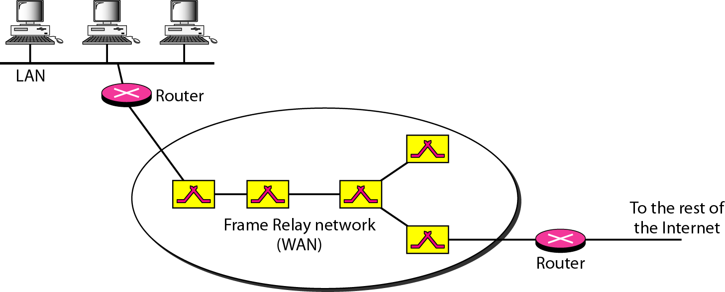
Figure Frame Relay network

Slide 3

Note
VCIs in Frame Relay are called DLCIs.

Slide 4
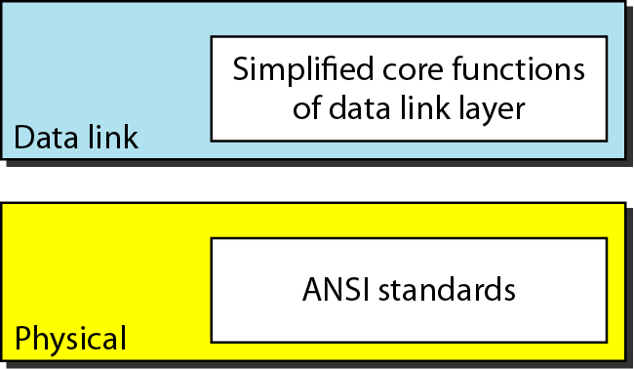
Figure Frame Relay layers

Slide 5
Note
Frame Relay operates only at the physical and data link layers.

Slide 6
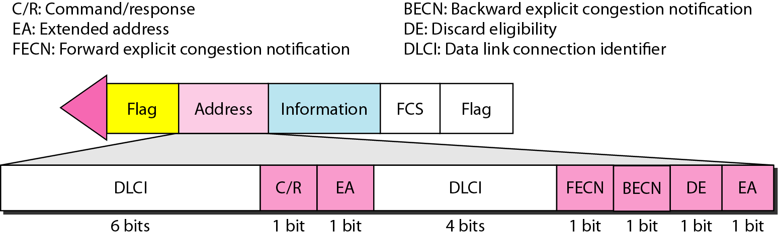
Figure Frame Relay frame format

Slide 7
Note
Frame Relay does not provide flow or error control; they must be provided
by the upper-layer protocols.

Slide 8
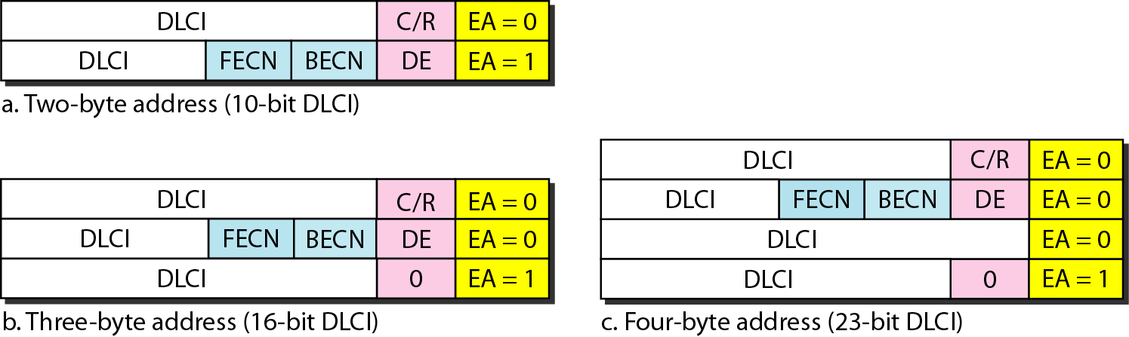
Figure Three address formats

Slide 9
Integrated Services Digital Network
ISDN
Services
History
Subscriber Access
Layers
BISDN

Slide 10
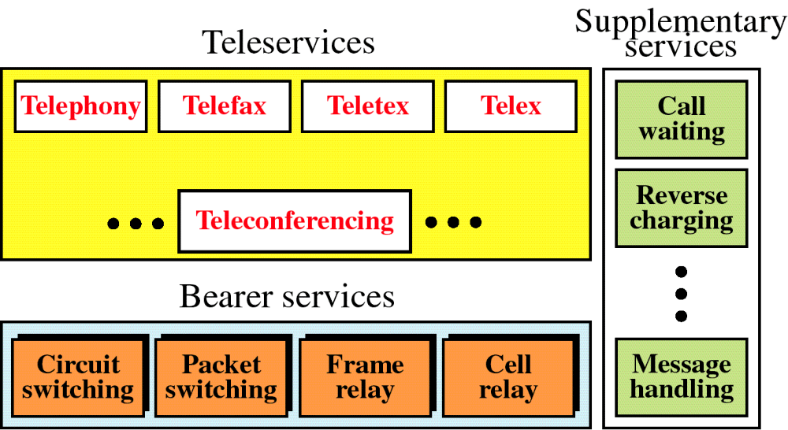
Figure
ISDN Services

Slide 11
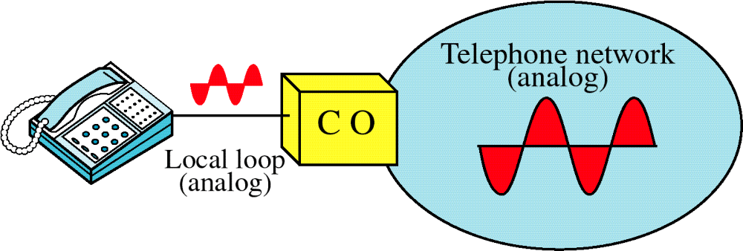
Figure
Voice over Analog Network

Slide 12
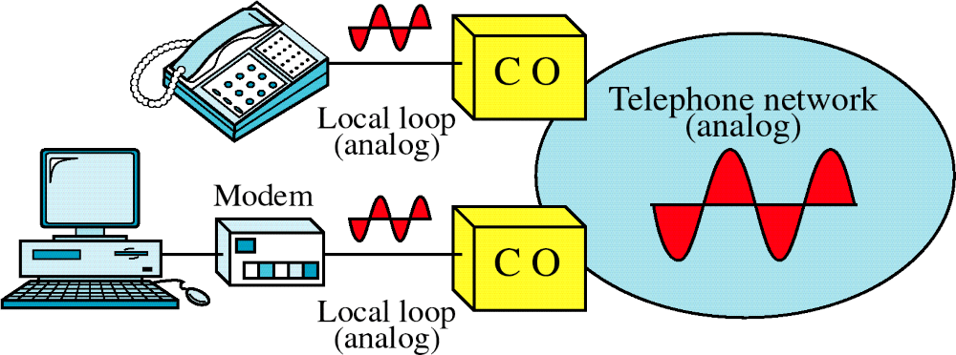
Figure
Voice and Data over Analog Network

Slide 13
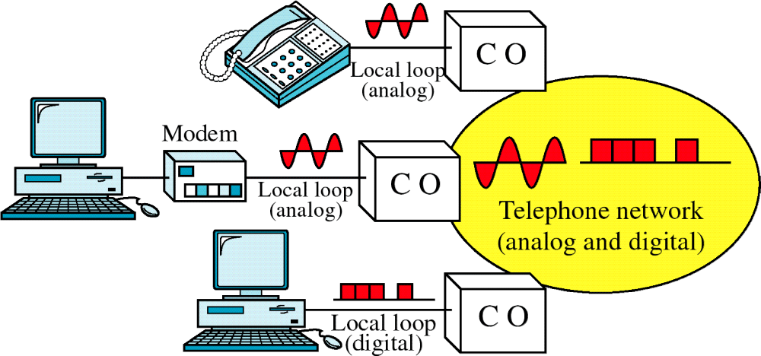
Analog and Digital Services

Slide 14
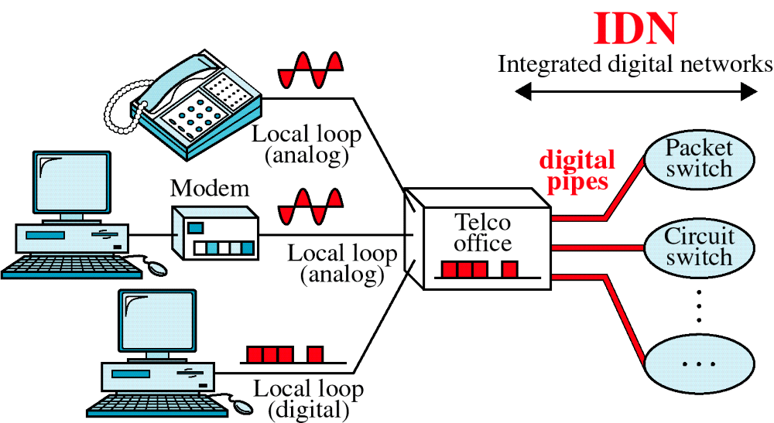
Integrated Digital Network

Slide 15
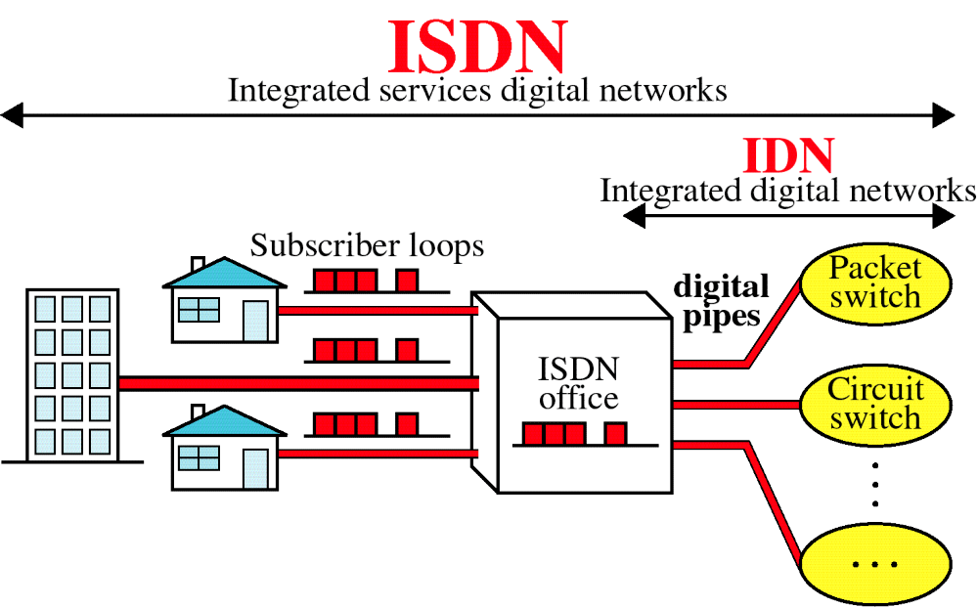
Integrated Services Digital Network

Slide 16
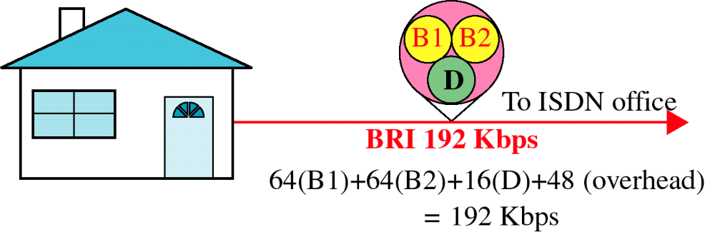
Basic Rate Interface

Slide 17
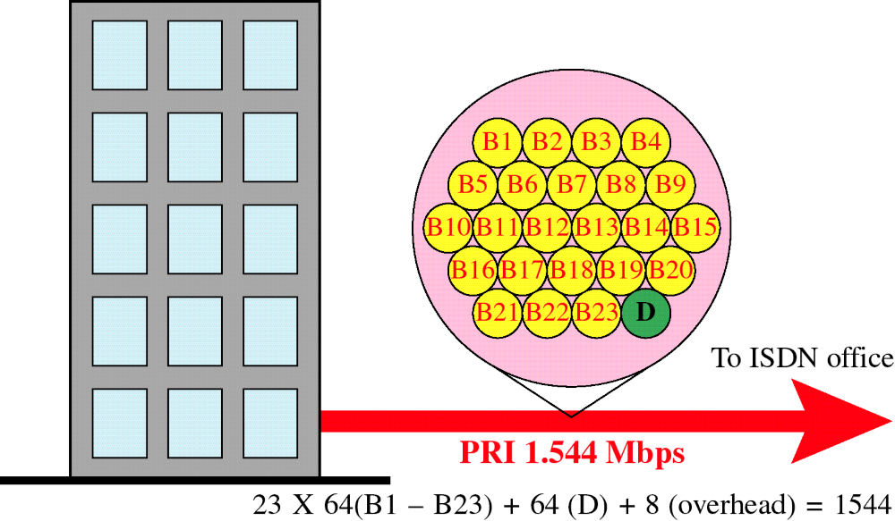
Primary Rate Interface

Slide 18
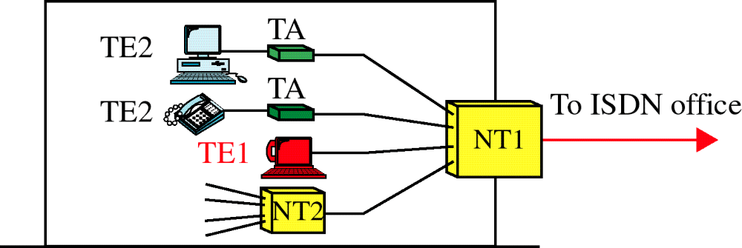
Functional Grouping

Slide 19
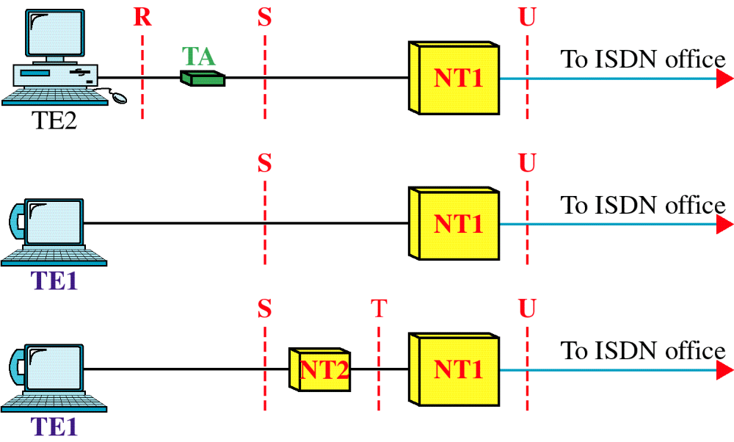
Reference Points

Slide 20
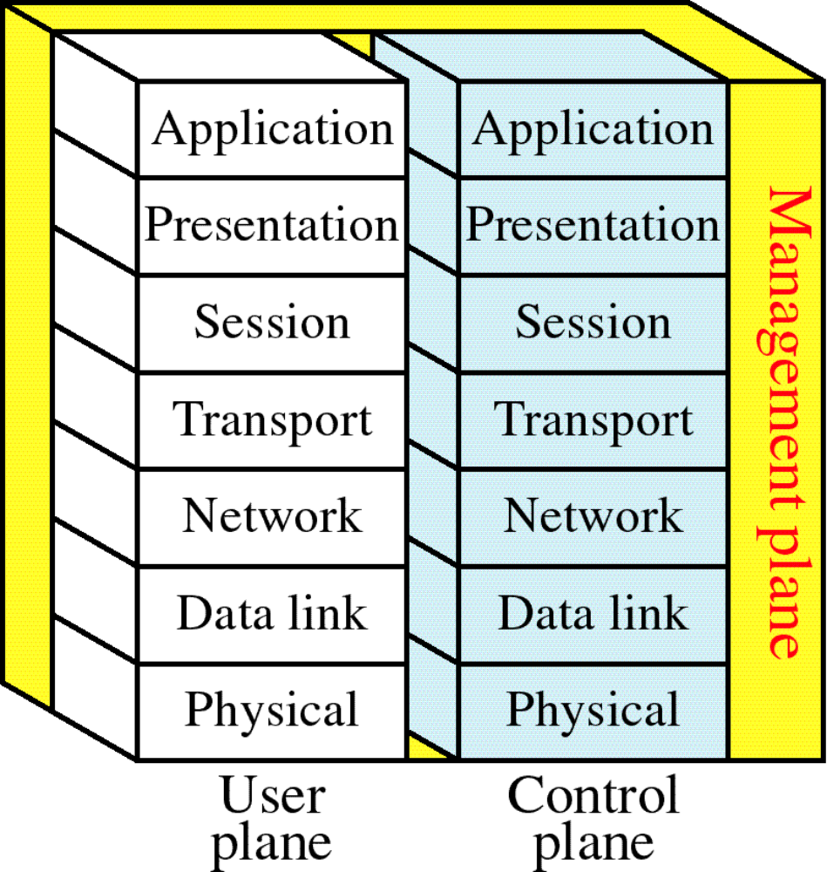
ISDN Layers

Slide 21
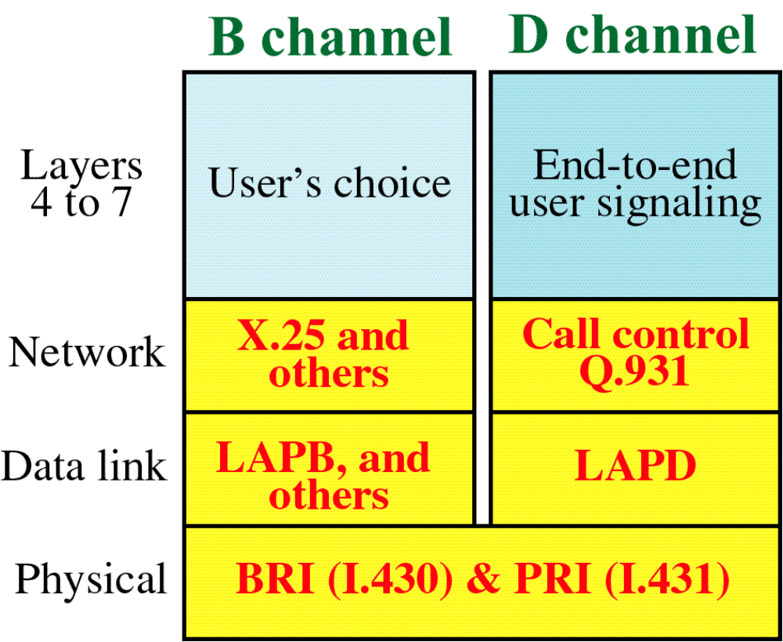
ISDN Layers for B and D Channels

Slide 22
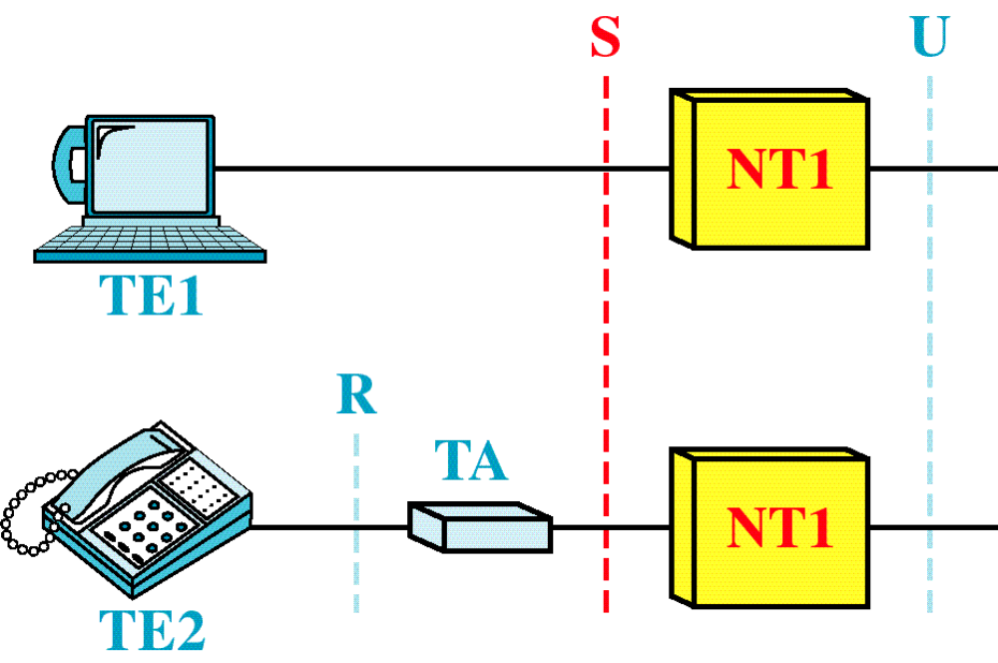
BRI Interfaces

Slide 23
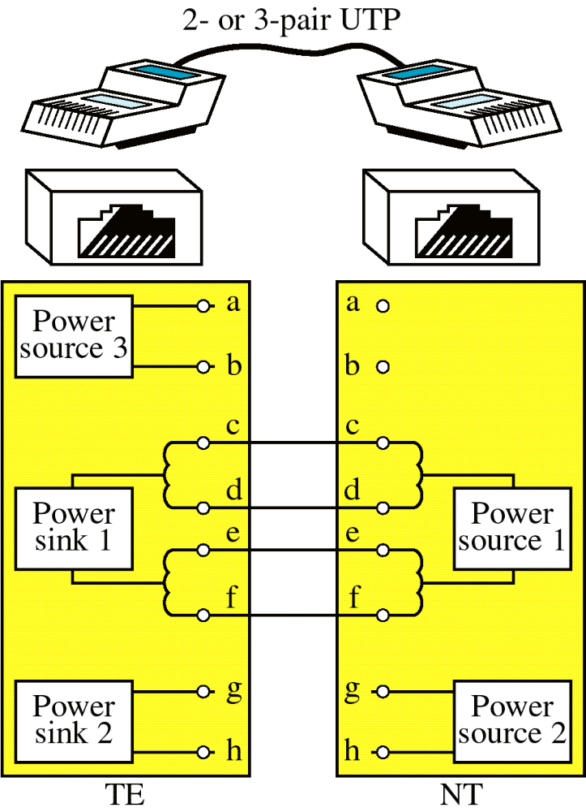
S Interface

Slide 24
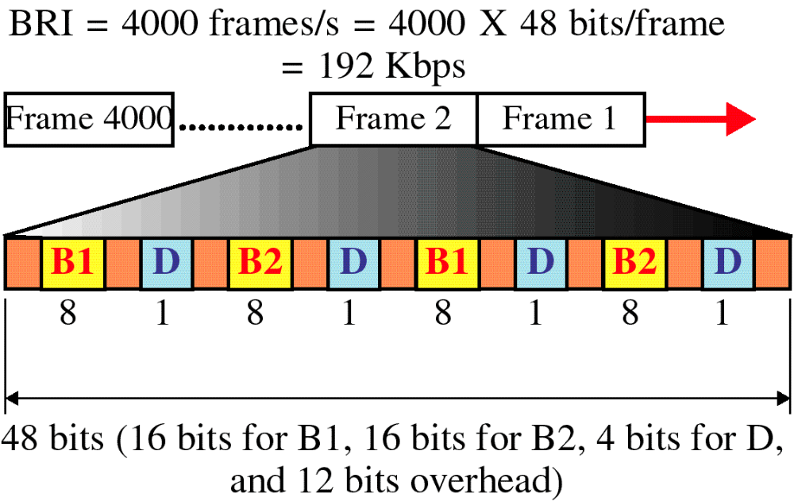
BRI Frame

Slide 25
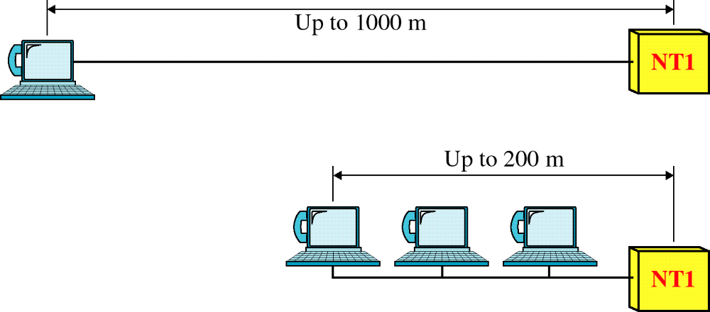
BRI Topology

Slide 26
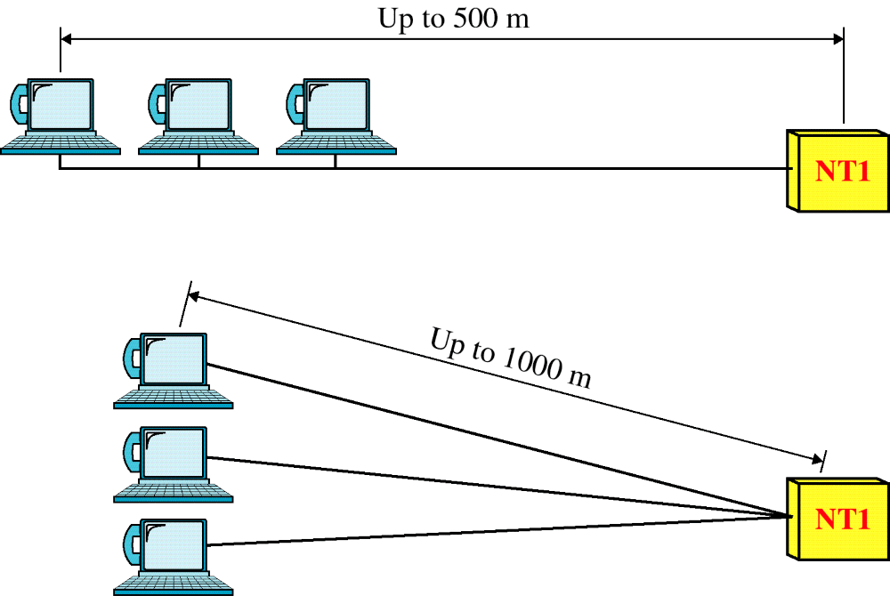
BRI Topology

Slide 27
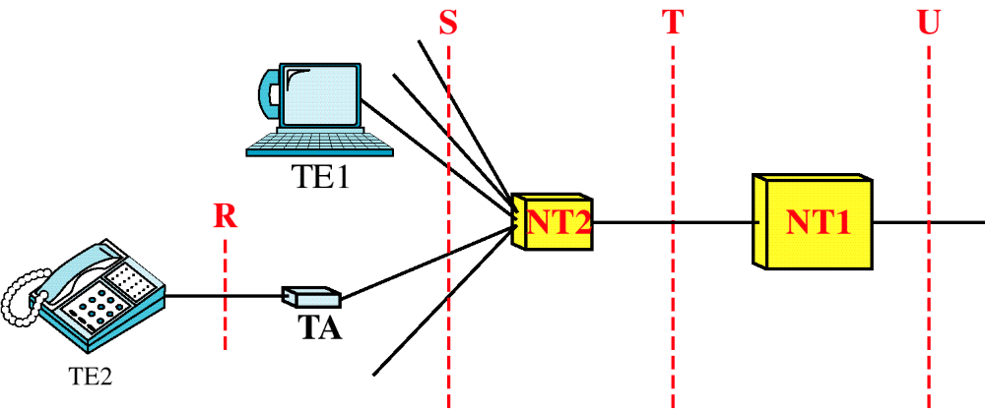
PRI Interfaces

Slide 28
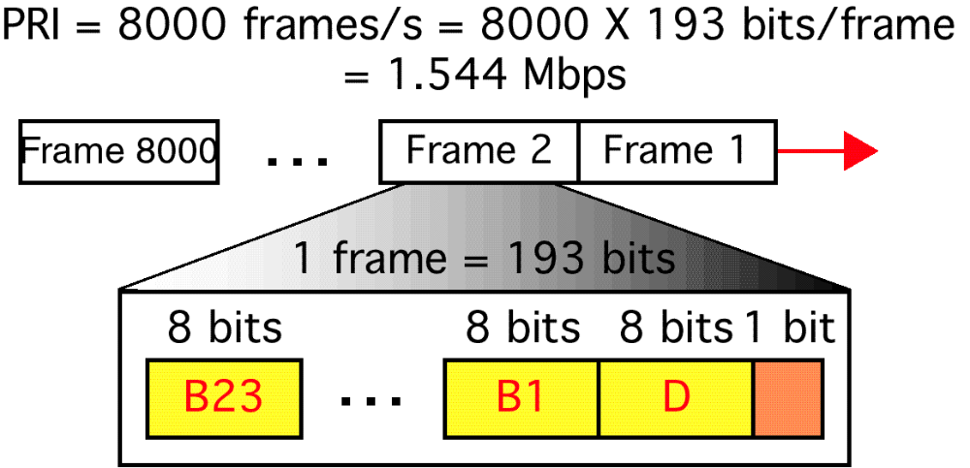
PRI Frame

Slide 29
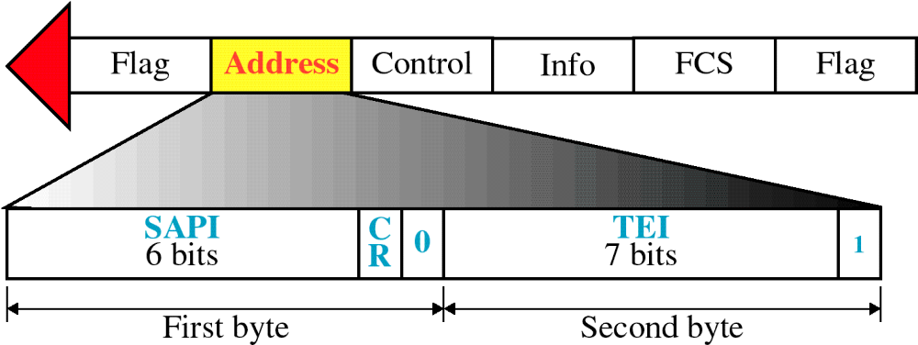
LAPD Address Field

Slide 30
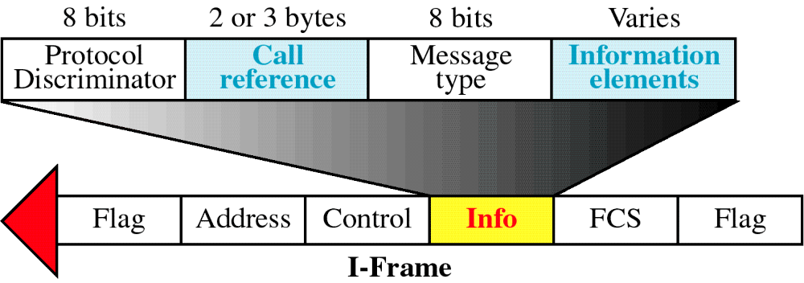
Network Layer Packet Format

Slide 31
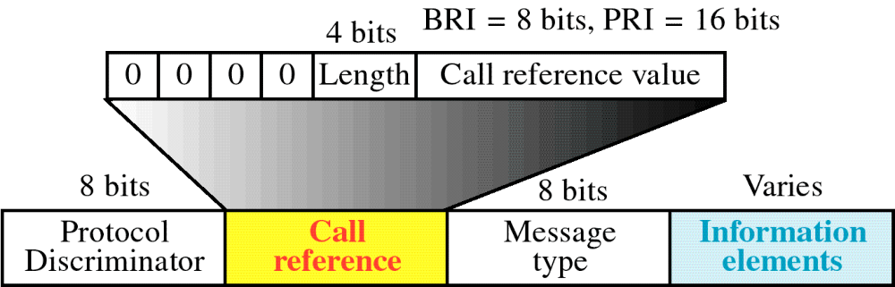
Call Reference Field

Slide 32
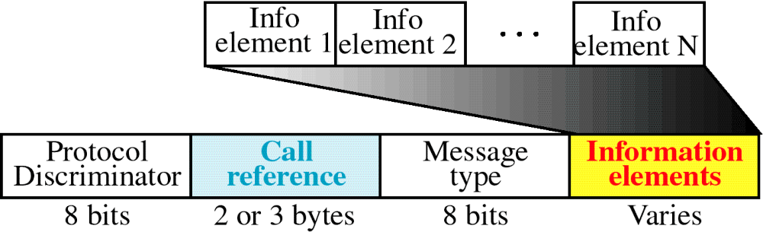
Information Elements

Slide 33
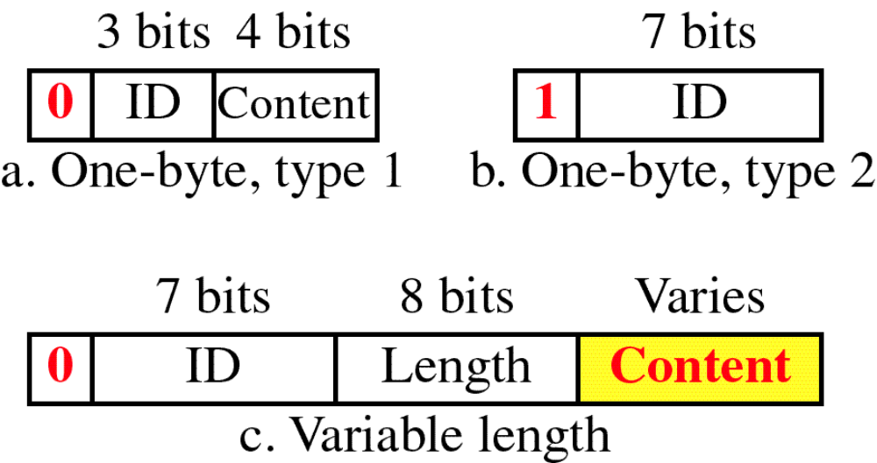
Information Element Types

Slide 34
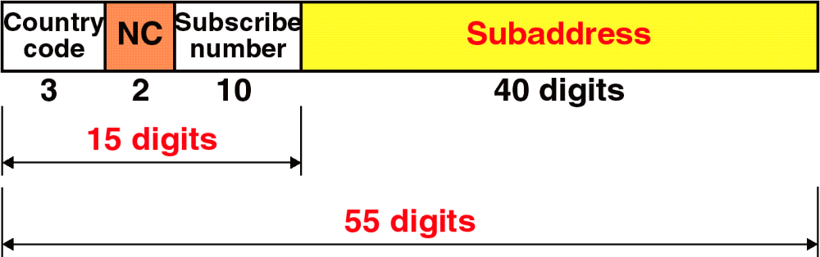
Addressing in ISDN

Slide 35
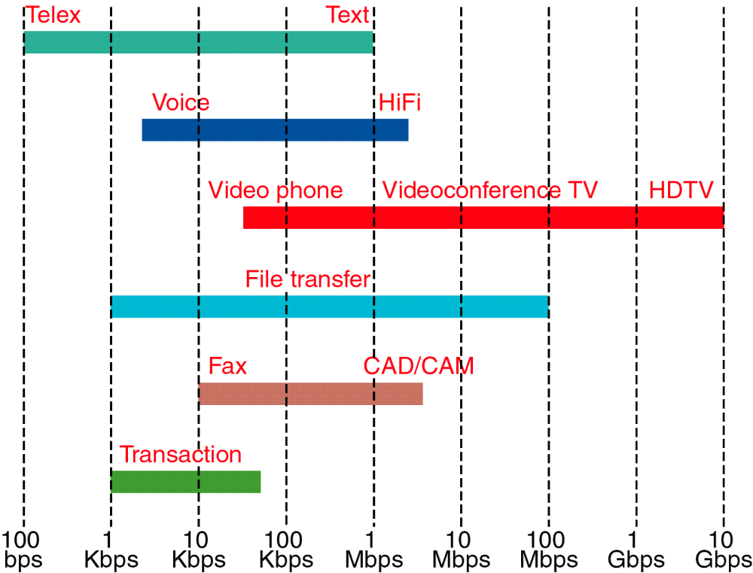
Bit Rates for Different Applications

Slide 36
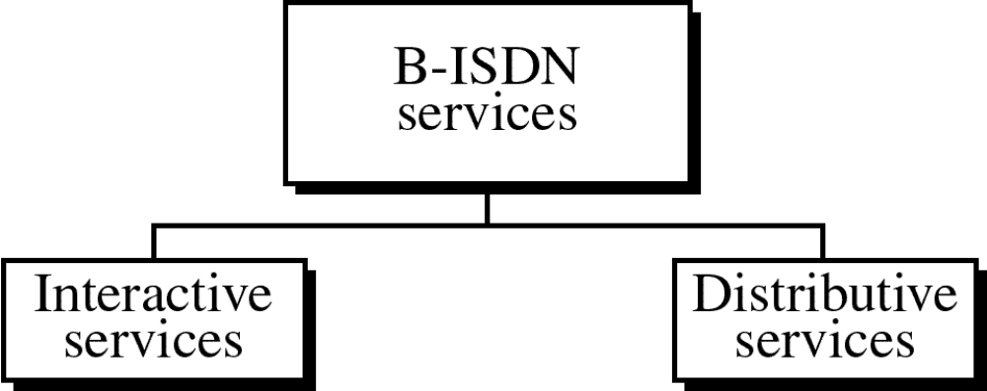

Slide 37
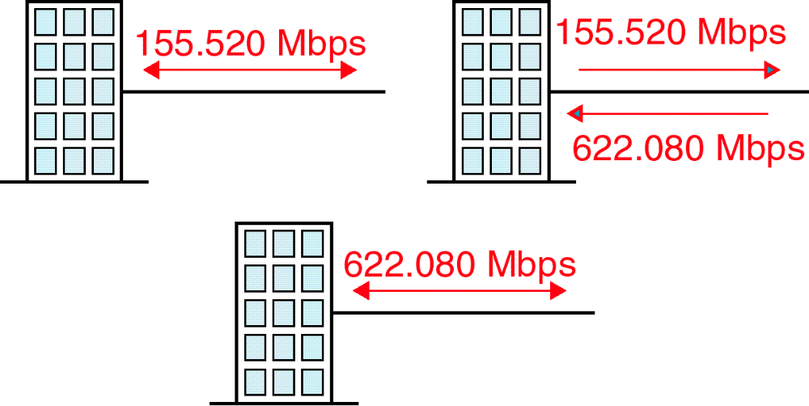
B-ISDN Access Methods

Slide 38
STANDARD ETHERNET
The original Ethernet was created in 1976 at Xerox’s Palo Alto Research Center (PARC). Since then, it has gone through four generations. We briefly discuss the Standard (or traditional) Ethernet in this section.

Slide 39

Figure Ethernet evolution through four generations

Slide 40
FAST ETHERNET
Fast Ethernet was designed to compete with LAN protocols such as FDDI or Fiber Channel. IEEE created Fast Ethernet under the name 802.3u. Fast Ethernet is backward-compatible with Standard Ethernet, but it can transmit data 10 times faster at a rate of 100 Mbps.

Slide 41

Figure Fast Ethernet topology

Slide 42

Figure Fast Ethernet implementations

Slide 43

Figure Encoding for Fast Ethernet implementation

Slide 44

Table Summary of Fast Ethernet implementations

