Slide 1
The Data Link Layer

Slide 2
Data Link Layer Design Issues
Services Provided to the Network Layer
Framing
Error Control
Flow Control

Slide 3
Functions of the Data Link Layer
Provide service interface to the network layer
Dealing with transmission errors
Regulating data flow
  Slow receivers not swamped by fast senders

Slide 4
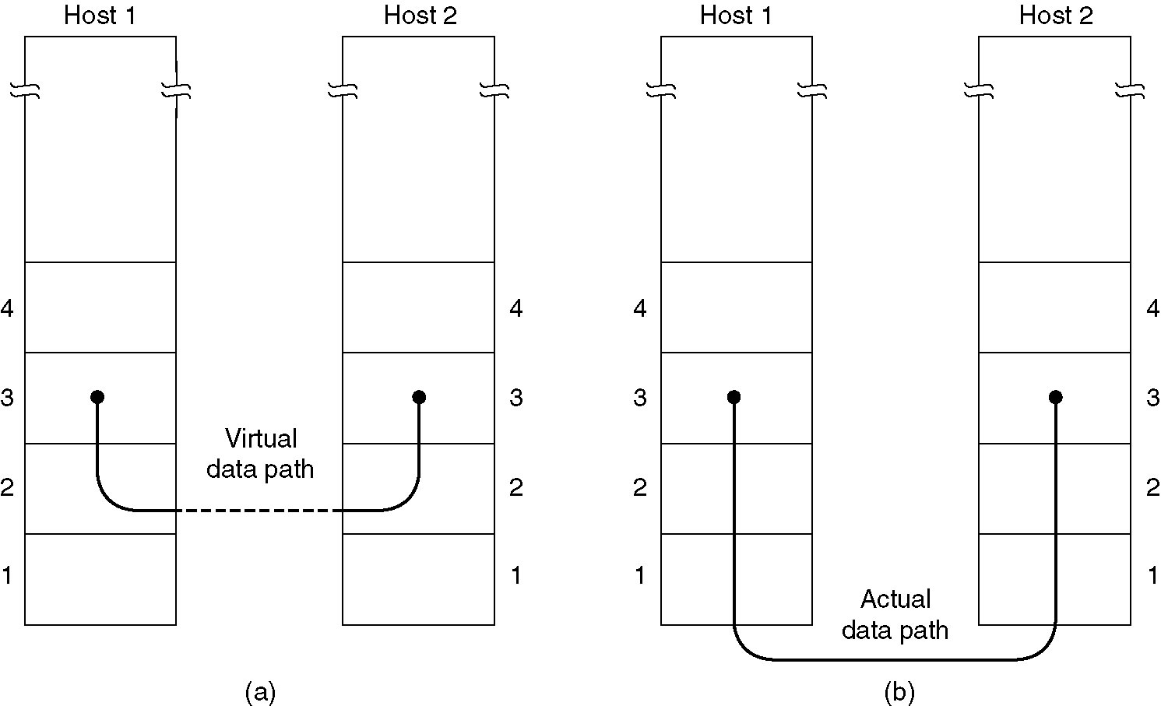
Services Provided to Network Layer
(a) Virtual communication.
(b) Actual communication.

Slide 5
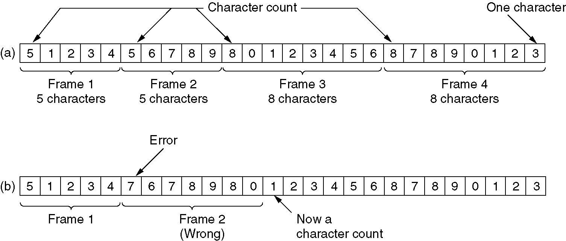
Framing
A character stream. (a) Without errors. (b) With one error.

Slide 6
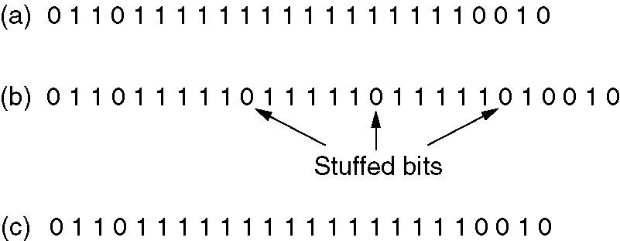
Framing (3)
Bit stuffing
(a) The original data.
(b) The data as they appear on the line.
(c) The data as they are stored in receiver’s memory after destuffing.

Slide 7
Error Detection
and
Correction

Slide 8
Data can be corrupted during transmission. For reliable communication, errors must be detected and corrected.

Slide 9
Types of Error
Single-Bit Error
Burst Error

Slide 10
In a single-bit error, only one bit in the data unit has changed.

Slide 11
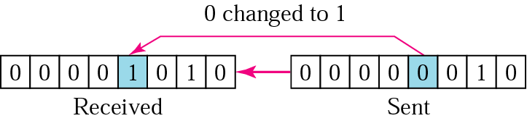
Single-bit error

Slide 12
A burst error means that 2 or more bits in the data unit have changed.

Slide 13
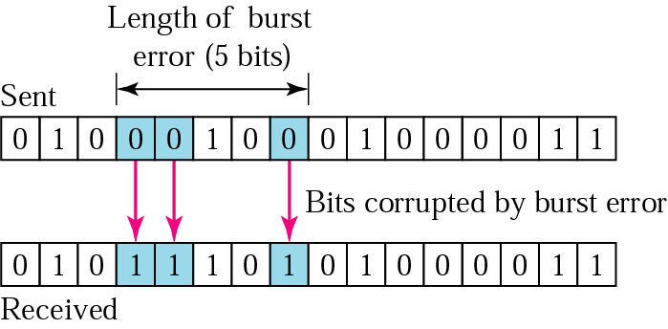
Burst error of length 5

Slide 14
Error detection uses the concept of redundancy, which means adding extra bits for detecting errors at the destination.

Slide 15
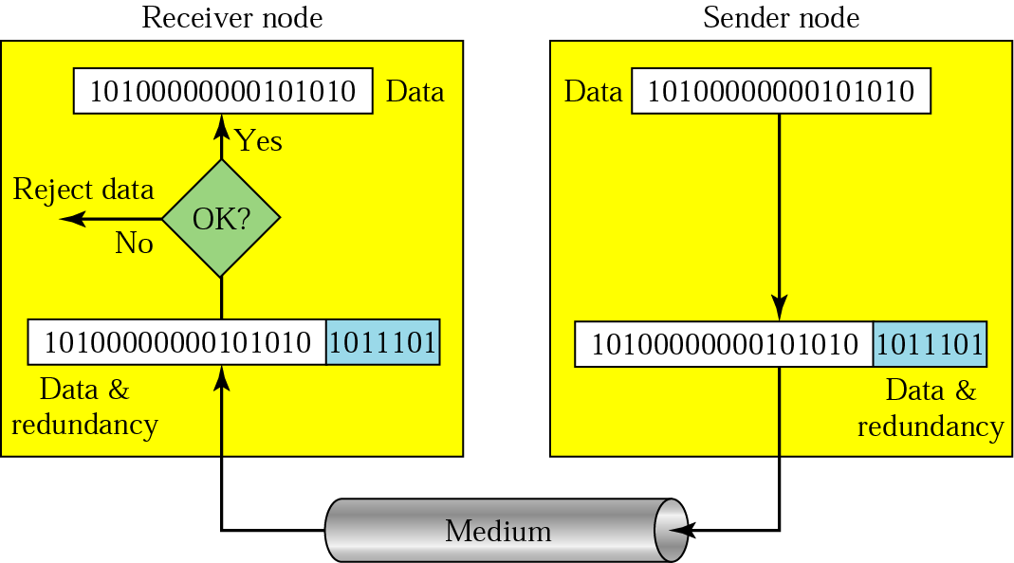
Redundancy

Slide 16
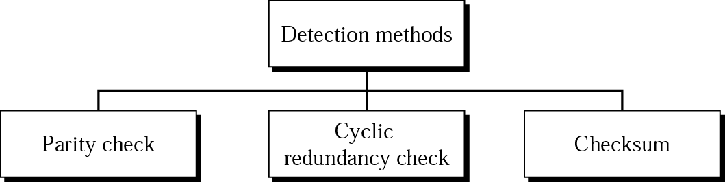
Detection methods

Slide 17
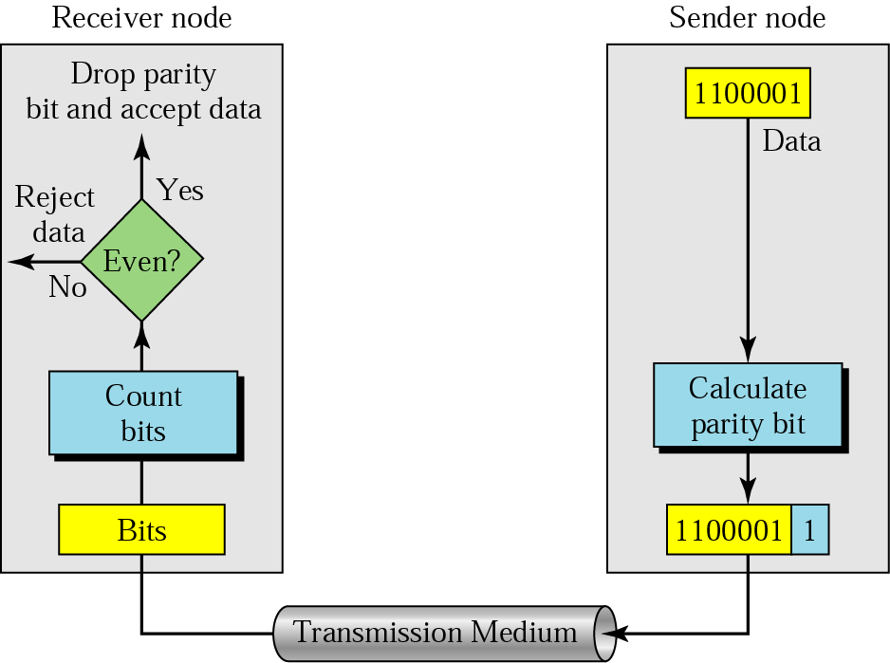
Even-parity concept

Slide 18
In parity check, a parity bit is added to every data unit so that the total number of 1s is even
(or odd for odd-parity).

Slide 19
Example 1
Suppose the sender wants to send the word world. In ASCII the five characters are coded as
1110111 1101111 1110010 1101100 1100100
The following shows the actual bits sent
11101110 11011110 11100100 11011000 11001001

Slide 20
Example 2
Now suppose the word world in Example 1 is received by the receiver without being corrupted in transmission.
11101110 11011110 11100100 11011000 11001001
The receiver counts the 1s in each character and comes up with even numbers (6, 6, 4, 4, 4). The data are accepted.

Slide 21
Example 3
Now suppose the word world in Example 1 is corrupted during transmission.
11111110 11011110 11101100 11011000 11001001
The receiver counts the 1s in each character and comes up with even and odd numbers (7, 6, 5, 4, 4). The receiver knows that the data are corrupted, discards them, and asks for retransmission.

Slide 22
Simple parity check can detect all single-bit errors. It can detect burst errors only if the total number of errors in each data unit is odd.

Slide 23
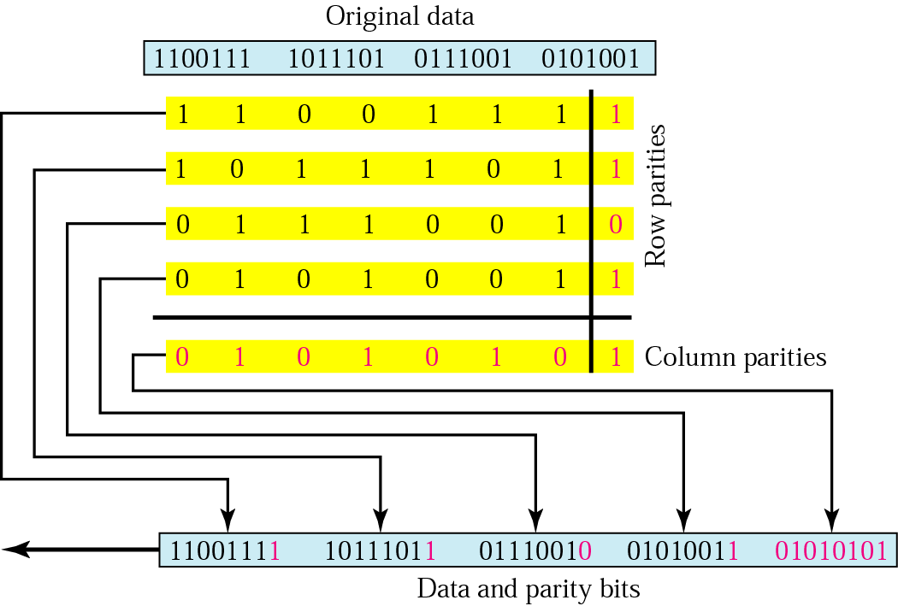
Two-dimensional parity

Slide 24
Example 4
Suppose the following block is sent:
10101001 00111001 11011101 11100111 10101010
However, it is hit by a burst noise of length 8, and some bits are corrupted.
10100011 10001001 11011101 11100111 10101010
When the receiver checks the parity bits, some of the bits do not follow the even-parity rule and the whole block is discarded.
10100011 10001001 11011101 11100111 10101010

Slide 25
In two-dimensional parity check, a block of bits is divided into rows and a redundant row of bits is added to the whole block.

Slide 26
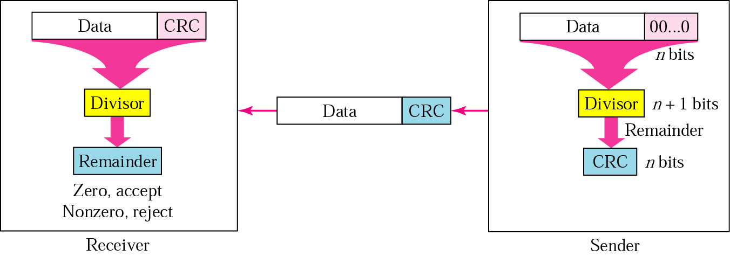
CRC generator and checker

Slide 27
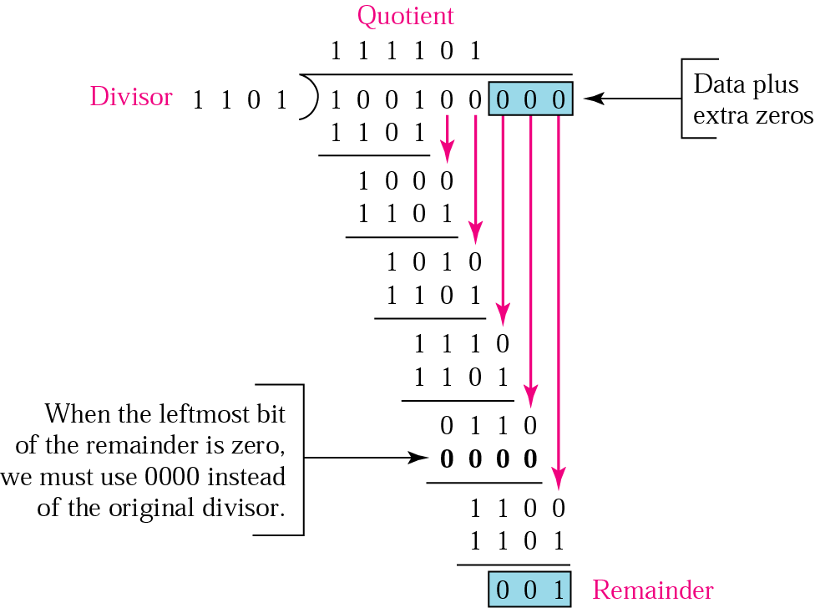
Binary division in a CRC generator

Slide 28
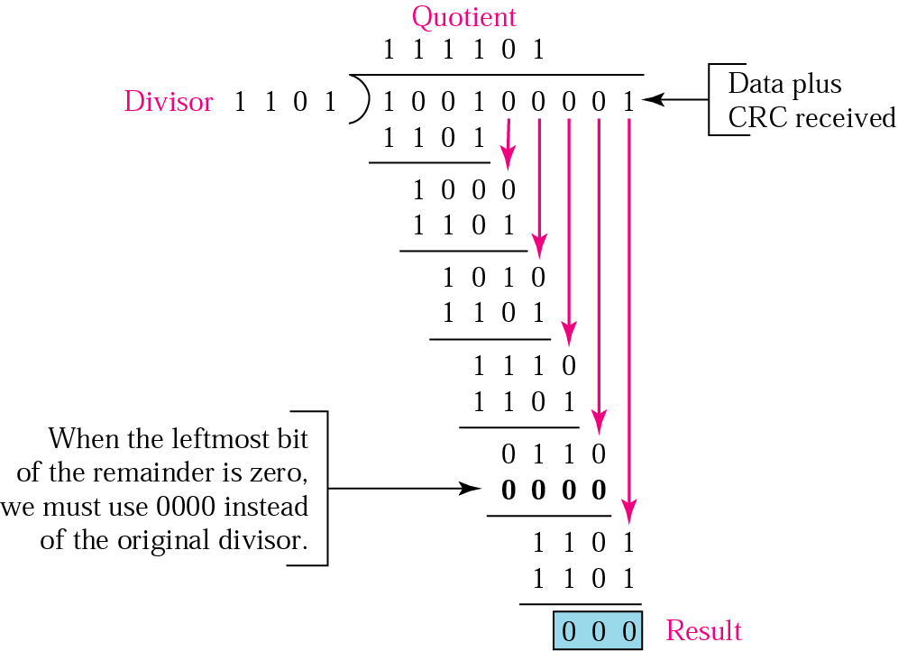
Binary division in CRC checker

Slide 29
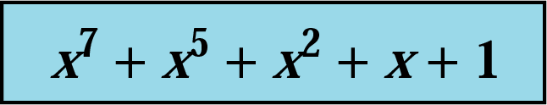
A polynomial

Slide 30
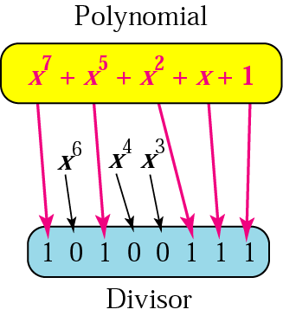
A polynomial representing a divisor

Slide 31
Standard polynomials
Name | Polynomial | Application
CRC-8 | x⁸ + x² + x + 1 | ATM header
CRC-10 | x¹⁰ + x⁹ + x⁵ + x⁴ + x ² + 1 | ATM AAL
ITU-16 | x¹⁶ + x¹² + x⁵ + 1 | HDLC
ITU-32 | x³² + x²⁶ + x²³ + x²² + x¹⁶ + x¹² + x¹¹ + x¹⁰ + x⁸ + x⁷ + x⁵ + x⁴ + x² + x + 1 | LANs

Slide 32
Example
The CRC-12
x¹² + x¹¹ + x³ + x + 1
which has a degree of 12, will detect all burst errors affecting an odd number of bits, will detect all burst errors with a length less than or equal to 12, and will detect, 99.97 percent of the time, burst errors with a length of 12 or more.

Slide 33
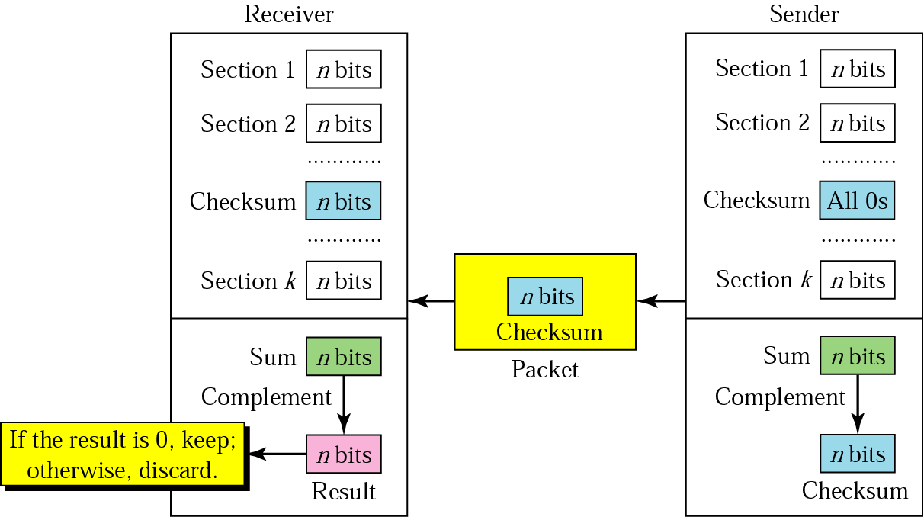
Checksum

Slide 34
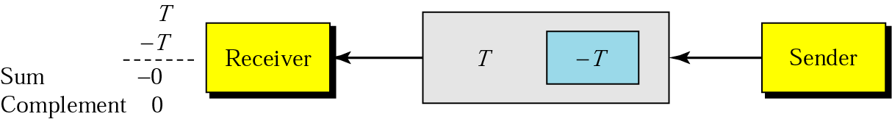
Data unit and checksum

Slide 35
The sender follows these steps:
The unit is divided into k sections, each of n bits.
All sections are added using one’s complement to get the sum.
The sum is complemented and becomes the checksum.
The checksum is sent with the data.

Slide 36
The receiver follows these steps:
The unit is divided into k sections, each of n bits.
All sections are added using one’s complement to get the sum.
The sum is complemented.
If the result is zero, the data are accepted: otherwise, rejected.

Slide 37
Example
Suppose the following block of 16 bits is to be sent using a checksum of 8 bits.
10101001 00111001
The numbers are added using one’s complement
10101001
00111001
------------
Sum 11100010
Checksum 00011101
The pattern sent is 10101001 00111001 00011101

Slide 38
Example
Now suppose the receiver receives the pattern sent in pevious Example and there is no error.
10101001 00111001 00011101
When the receiver adds the three sections, it will get all 1s, which, after complementing, is all 0s and shows that there is no error.
10101001
00111001
00011101
Sum 11111111
Complement 00000000 means that the pattern is OK.

Slide 39
Example
Now suppose there is a burst error of length 5 that affects 4 bits.
10101111 11111001 00011101
When the receiver adds the three sections, it gets
10101111
11111001
00011101
Partial Sum 1 11000101
Carry 1
Sum 11000110
Complement 00111001 the pattern is corrupted.

Slide 40
Correction
Retransmission
Single Bit Error Correction

Slide 41
Data and redundancy bits
Number of data bits m | Number of redundancy bits r | Total bits m + r
1 | 2 | 3
2 | 3 | 5
3 | 3 | 6
4 | 3 | 7
5 | 4 | 9
6 | 4 | 10
7 | 4 | 11

Slide 42
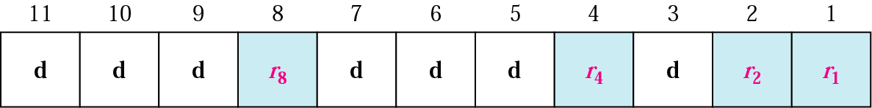
Positions of redundancy bits in Hamming code

Slide 43
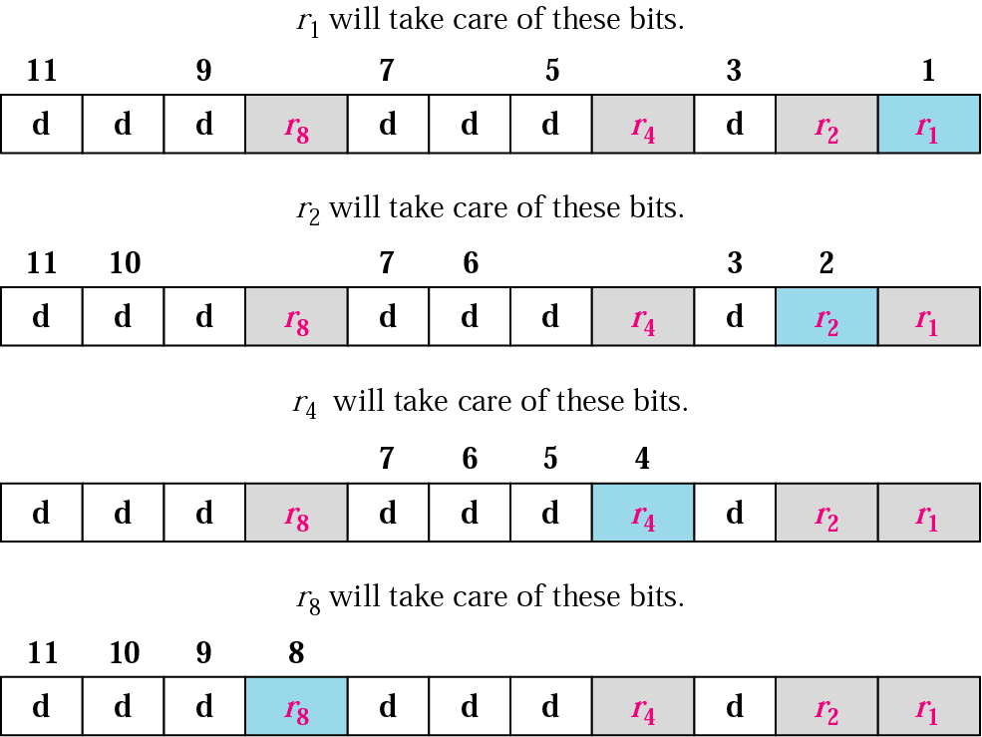
Redundancy bits calculation

Slide 44
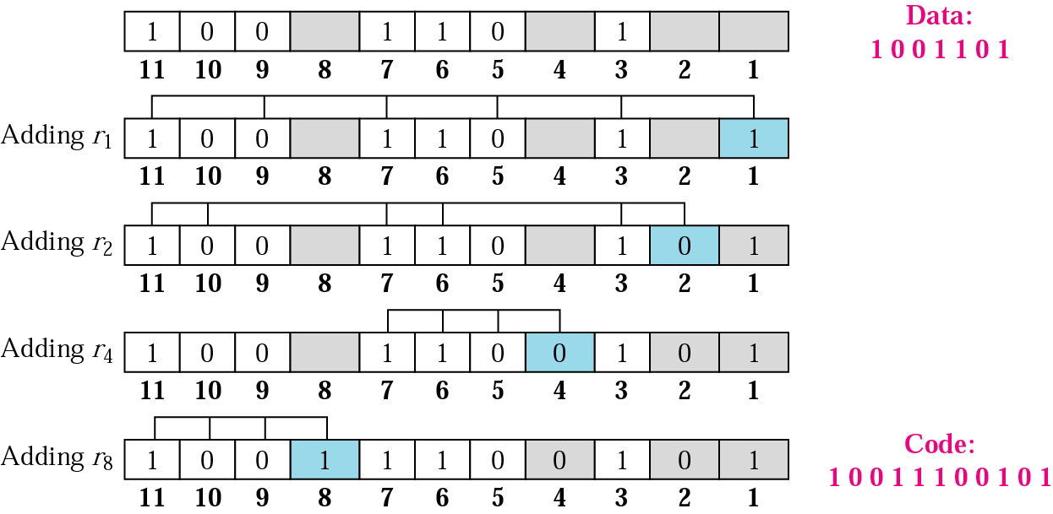
Example of redundancy bit calculation

Slide 45
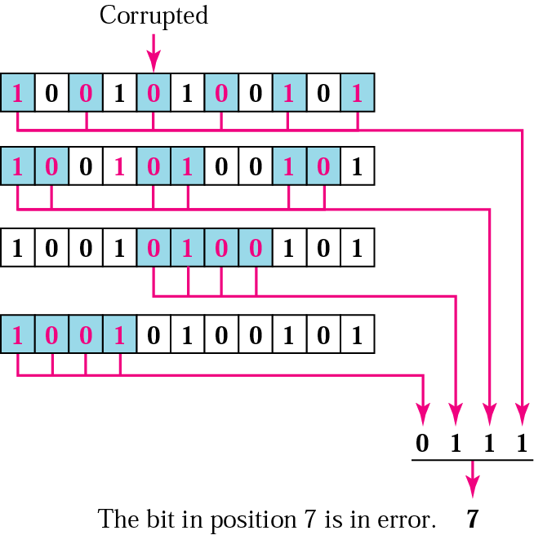
Error detection using Hamming code

Slide 46
Elementary Data Link Protocols
An Unrestricted Simplex Protocol
A Simplex Stop-and-Wait Protocol

Slide 47
Sliding Window Protocols
A One-Bit Sliding Window Protocol
A Protocol Using Go Back N
A Protocol Using Selective Repeat

