Slide 1
FLOW AND ERROR CONTROL
The most important responsibilities of the data link layer are flow control and error control. Collectively, these functions are known as data link control.
Topics discussed in this section:
Flow Control
Error Control
11.<number>

Slide 2

Note
Flow control refers to a set of procedures used to restrict the amount of data
that the sender can send before
waiting for acknowledgment.
11.<number>

Slide 3
Note
Error control in the data link layer is based on automatic repeat request, which is the retransmission of data.
11.<number>

Slide 4

Figure Taxonomy of protocols discussed
11.<number>

Slide 5
NOISELESS CHANNELS
Let us first assume we have an ideal channel in which no frames are lost, duplicated, or corrupted. We introduce two protocols for this type of channel.
Topics discussed in this section:
Simplest Protocol
Stop-and-Wait Protocol
11.<number>

Slide 6

Figure The design of the simplest protocol with no flow or error control
11.<number>

Slide 7
Example 1
Figure next shows an example of communication using this protocol. It is very simple. The sender sends a sequence of frames without even thinking about the receiver. To send three frames, three events occur at the sender site and three events at the receiver site. Note that the data frames are shown by tilted boxes; the height of the box defines the transmission time difference between
the first bit and the last bit in the frame.
11.<number>

Slide 8

Figure Flow diagram for Example 1
11.<number>

Slide 9

Figure Design of Stop-and-Wait Protocol
11.<number>

Slide 10
Example 2
Figure next shows an example of communication using this protocol. It is still very simple. The sender sends one frame and waits for feedback from the receiver. When the ACK arrives, the sender sends the next frame. Note that sending two frames in the protocol involves the sender in four events and the receiver in two events.
11.<number>

Slide 11

Figure Flow diagram for Example 2
11.<number>

Slide 12
NOISY CHANNELS
Although the Stop-and-Wait Protocol gives us an idea of how to add flow control to its predecessor, noiseless channels are nonexistent. We discuss three protocols in this section that use error control.
Topics discussed in this section:
Stop-and-Wait Automatic Repeat Request
Go-Back-N Automatic Repeat Request
Selective Repeat Automatic Repeat Request
11.<number>

Slide 13
Note
Error correction in Stop-and-Wait ARQ is done by keeping a copy of the sent frame and retransmitting of the frame when the timer expires.
11.<number>

Slide 14

Figure Design of the Stop-and-Wait ARQ Protocol
11.<number>

Slide 15

Figure 11.12 Send window for Go-Back-N ARQ
11.<number>

Slide 16
Note
The send window is an abstract concept defining an imaginary box of size 2^{m} − 1 with three variables: Sf, Sn, and S_{size}.
11.<number>

Slide 17
Note
The send window can slide one
or more slots when a valid acknowledgment arrives.
11.<number>

Slide 18

Figure 11.13 Receive window for Go-Back-N ARQ
11.<number>

Slide 19
Note
The receive window is an abstract concept defining an imaginary box
of size 1 with one single variable R_{n}.
The window slides
when a correct frame has arrived; sliding occurs one slot at a time.
11.<number>

Slide 20
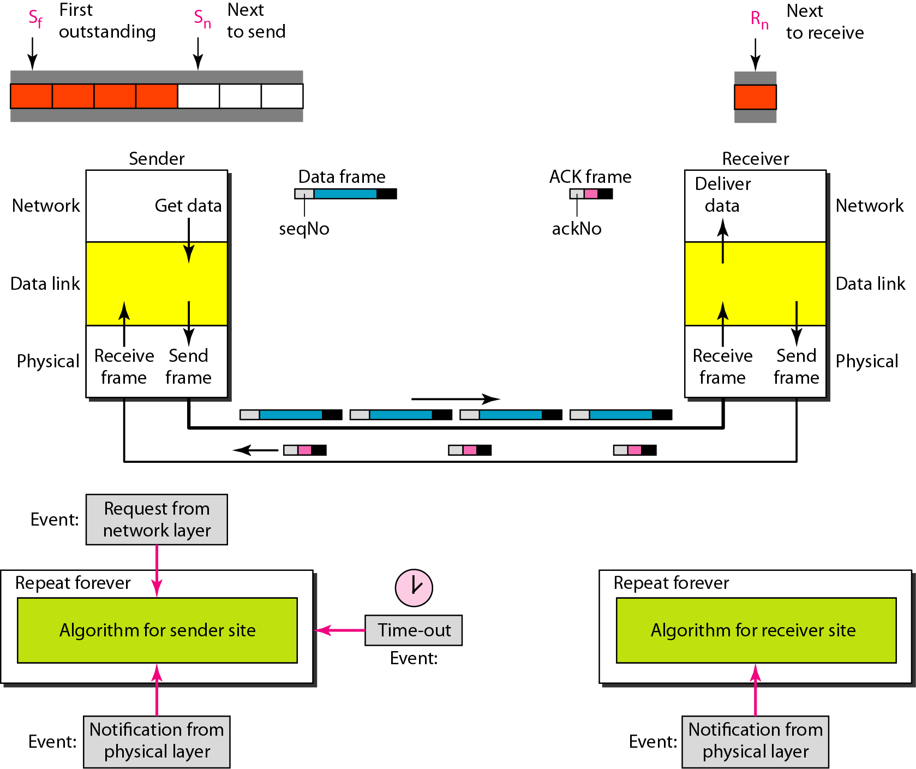
Figure 11.14 Design of Go-Back-N ARQ
11.<number>

Slide 21

Figure 11.15 Window size for Go-Back-N ARQ
11.<number>

Slide 22
Note
In Go-Back-N ARQ, the size of the send window must be less than 2^{m};
the size of the receiver window
is always 1.
11.<number>

Slide 23
Note
Stop-and-Wait ARQ is a special case of Go-Back-N ARQ in which the size of the send window is 1.
11.<number>

Slide 24

Figure 11.18 Send window for Selective Repeat ARQ
11.<number>

Slide 25

Figure 11.19 Receive window for Selective Repeat ARQ
11.<number>

Slide 26
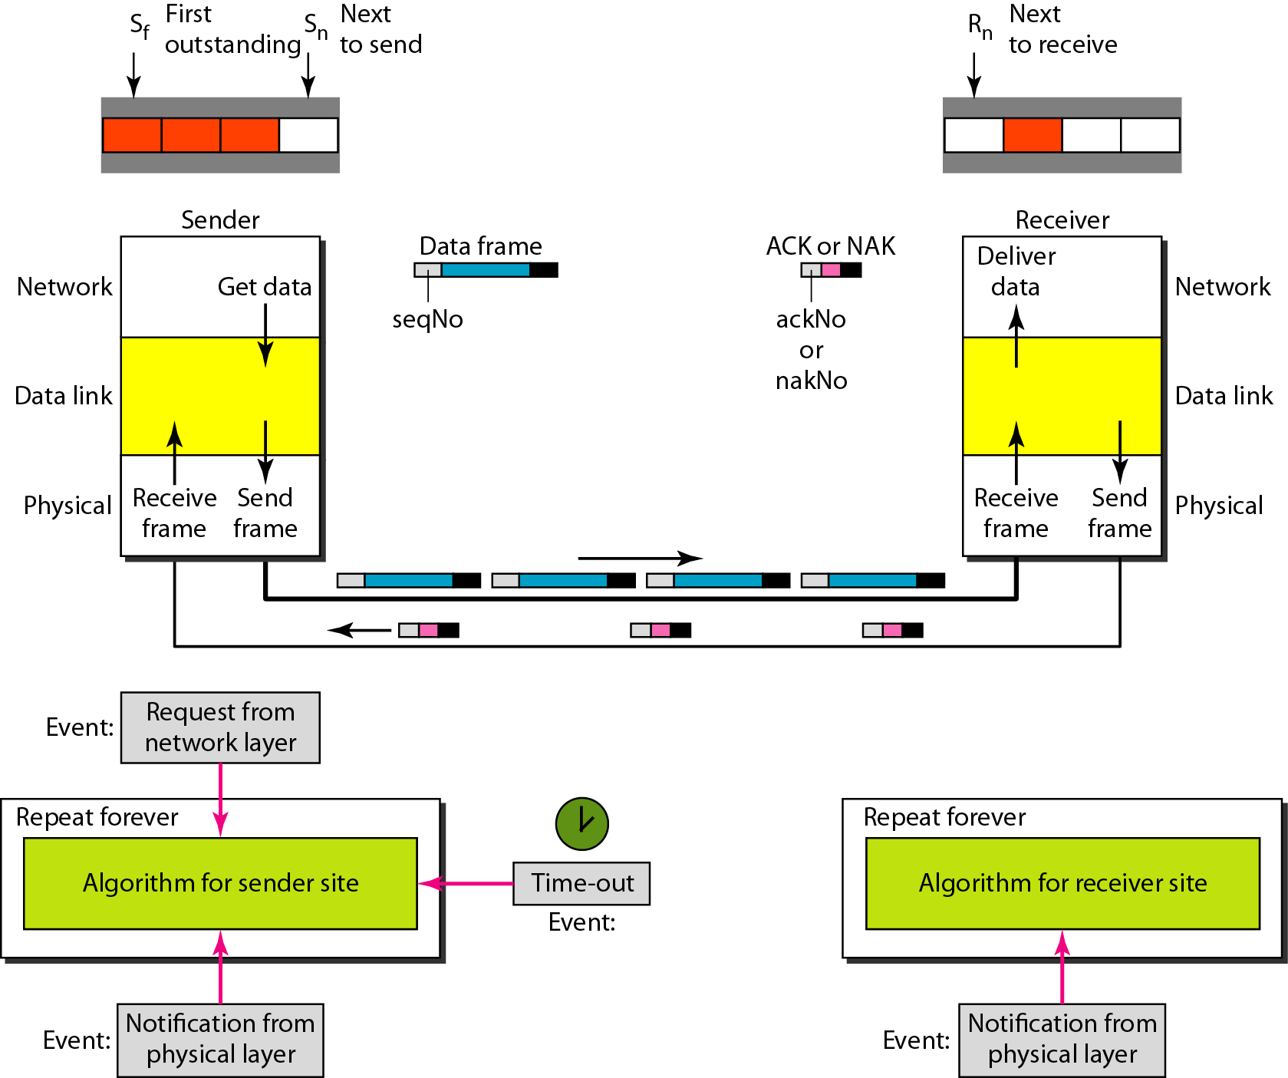
Figure 11.20 Design of Selective Repeat ARQ
11.<number>

Slide 27

Figure 11.21 Selective Repeat ARQ, window size
11.<number>

Slide 28
Note
In Selective Repeat ARQ, the size of the sender and receiver window
must be at most one-half of 2^{m}.
11.<number>

Slide 29

Figure 11.22 Delivery of data in Selective Repeat ARQ
11.<number>

Slide 30
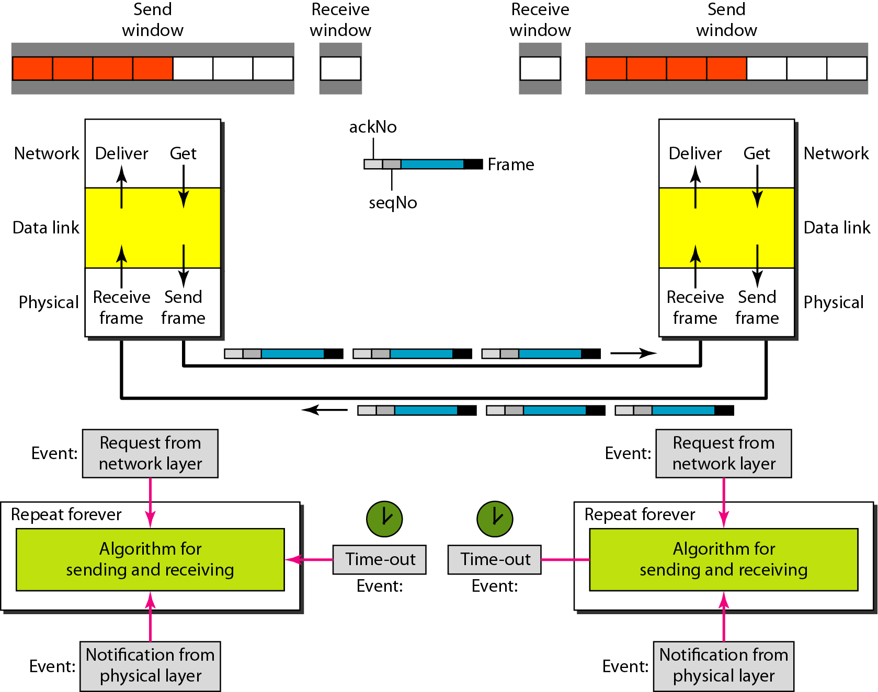
Figure 11.24 Design of piggybacking in Go-Back-N ARQ
11.<number>

Slide 31
11-6 HDLC
High-level Data Link Control (HDLC) is a bit-oriented protocol for communication over point-to-point and multipoint links. It implements the ARQ mechanisms we discussed in this chapter.
Topics discussed in this section:
Configurations and Transfer Modes
Frames
Control Field
11.<number>

Slide 32
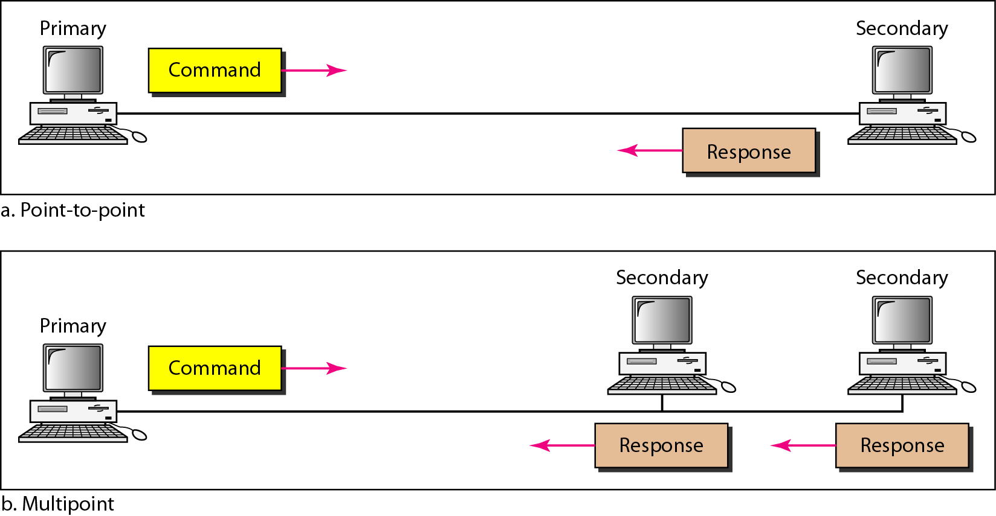
Figure 11.25 Normal response mode
11.<number>

Slide 33
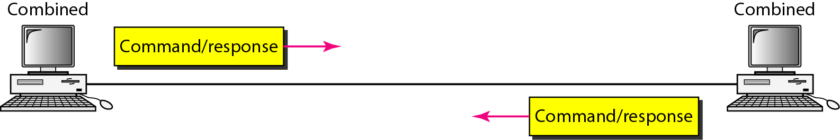
Figure 11.26 Asynchronous balanced mode
11.<number>

Slide 34
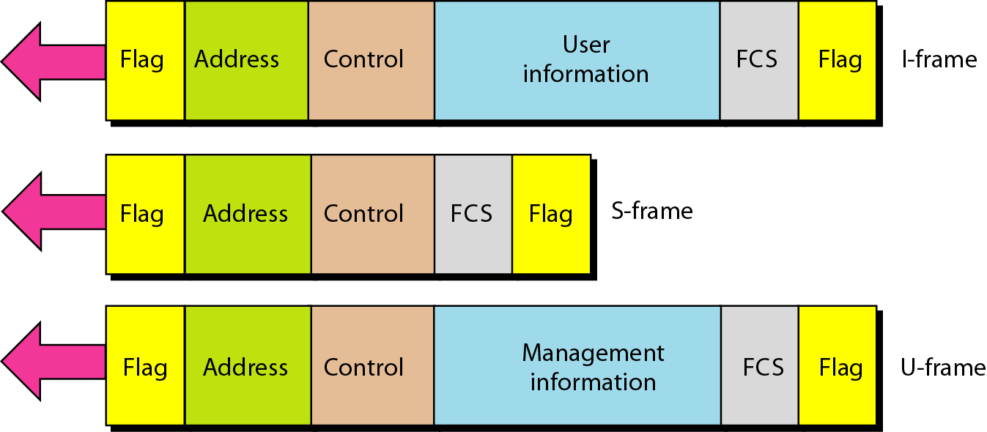
Figure 11.27 HDLC frames
11.<number>

Slide 35
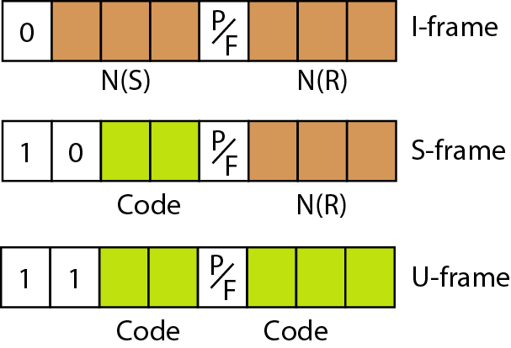
Figure 11.28 Control field format for the different frame types
11.<number>

Slide 36
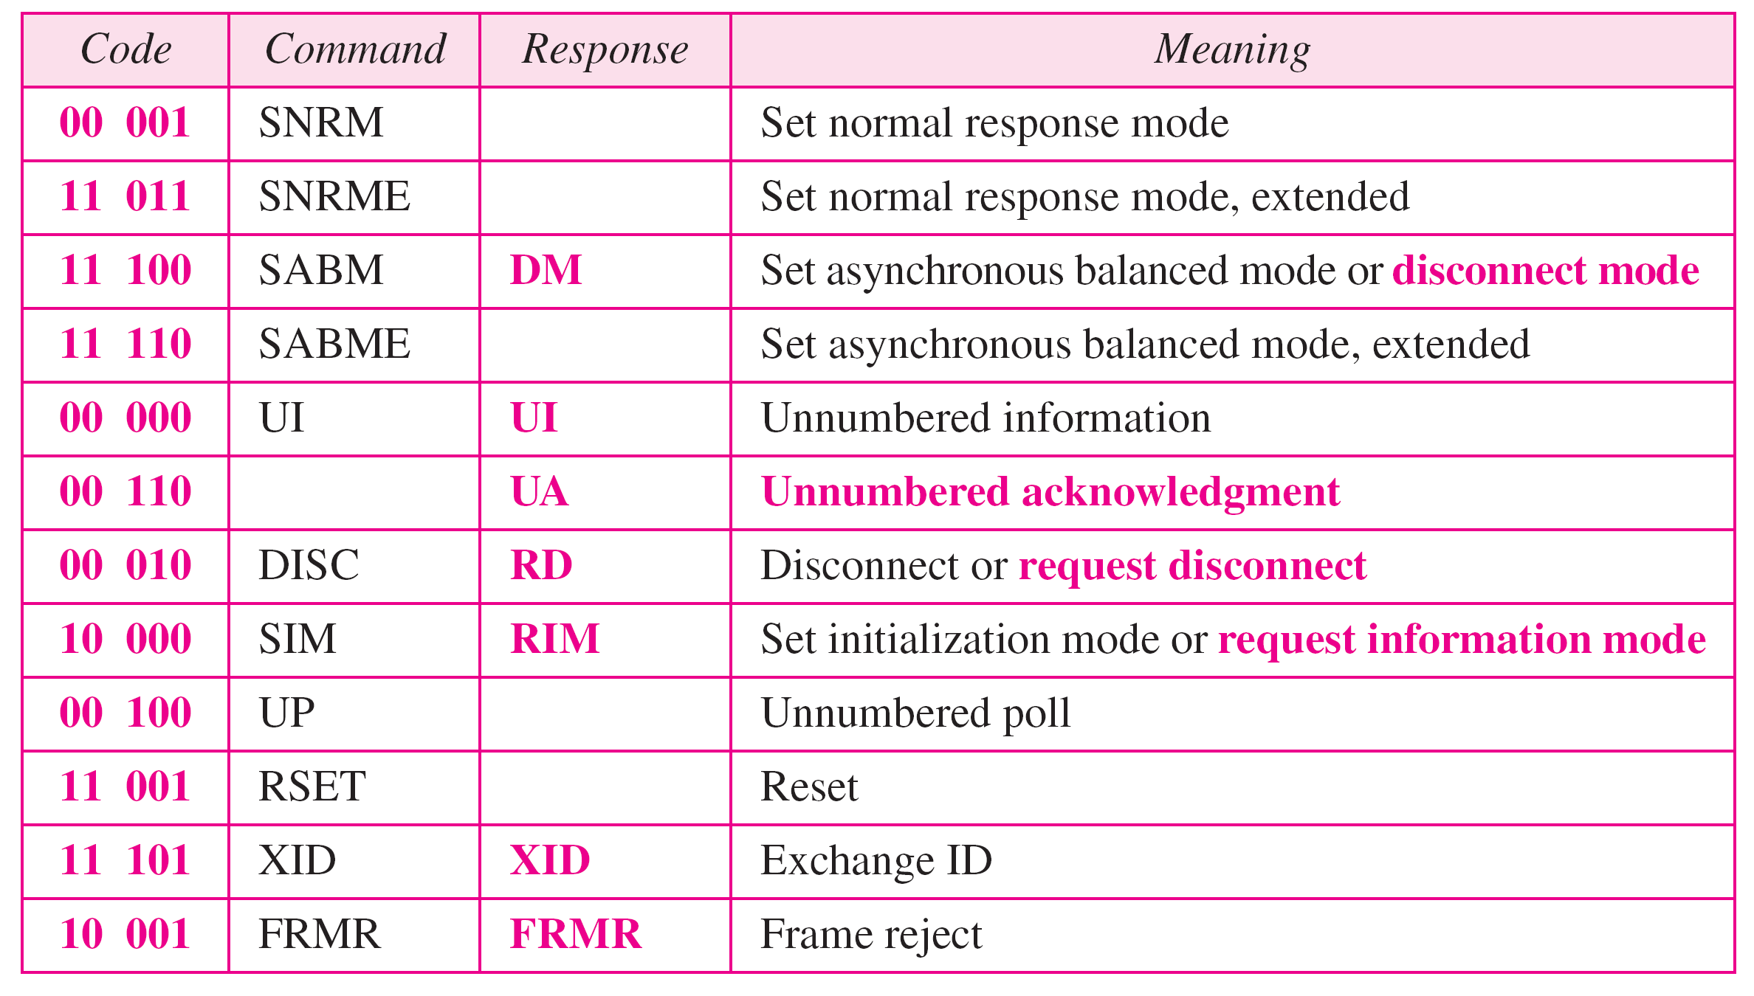
Table 11.1 U-frame control command and response
11.<number>

Slide 37
Example 11.9
Figure 11.29 shows how U-frames can be used for connection establishment and connection release. Node A asks for a connection with a set asynchronous balanced mode (SABM) frame; node B gives a positive response with an unnumbered acknowledgment (UA) frame. After these two exchanges, data can be transferred between the two nodes (not shown in the figure). After data transfer, node A sends a DISC (disconnect) frame to release the connection; it is confirmed by node B responding with a UA (unnumbered acknowledgment).
11.<number>

Slide 38
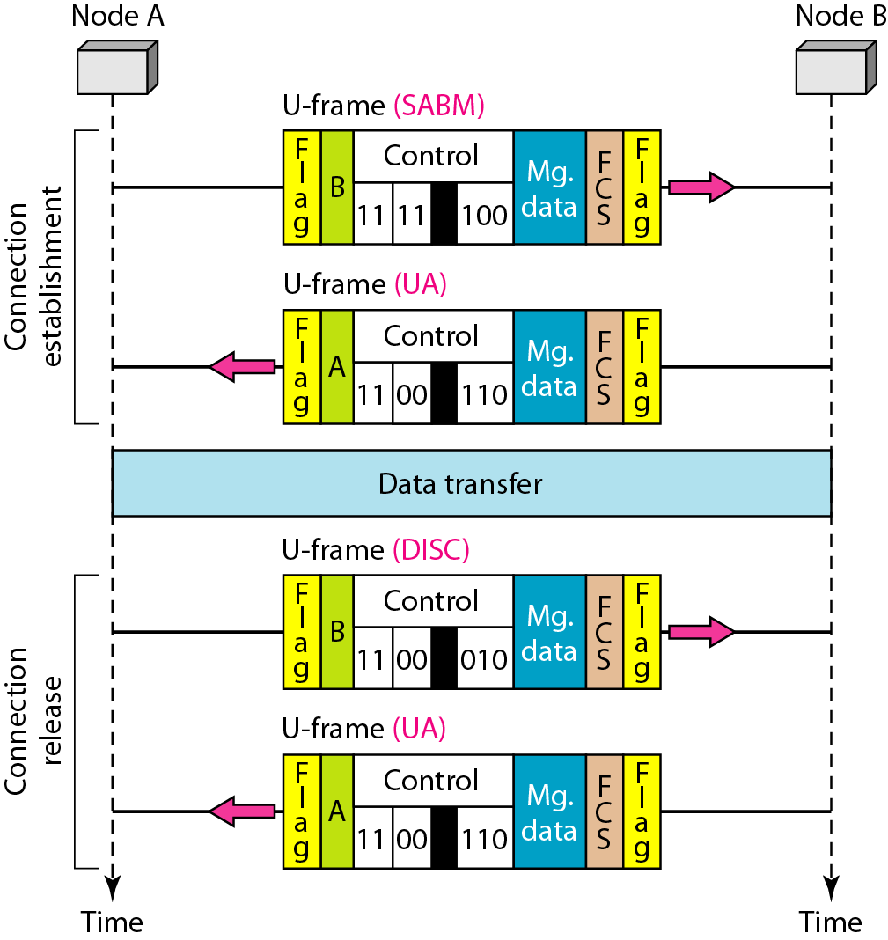
Figure 11.29 Example of connection and disconnection
11.<number>

Slide 39
Example 11.10
Figure 11.30 shows an exchange using piggybacking. Node A begins the exchange of information with an
I-frame numbered 0 followed by another I-frame numbered 1. Node B piggybacks its acknowledgment of both frames onto an I-frame of its own. Node B’s first
I-frame is also numbered 0 [N(S) field] and contains a 2 in its N(R) field, acknowledging the receipt of A’s frames 1 and 0 and indicating that it expects frame 2 to arrive next. Node B transmits its second and third I-frames (numbered 1 and 2) before accepting further frames from node A.
11.<number>

Slide 40
Example 11.10 (continued)
Its N(R) information, therefore, has not changed: B frames 1 and 2 indicate that node B is still expecting A’s frame 2 to arrive next. Node A has sent all its data. Therefore, it cannot piggyback an acknowledgment onto an I-frame and sends an S-frame instead. The RR code indicates that A is still ready to receive. The number 3 in the N(R) field tells B that frames 0, 1, and 2 have all been accepted and that A is now expecting frame number 3.
11.<number>

Slide 41
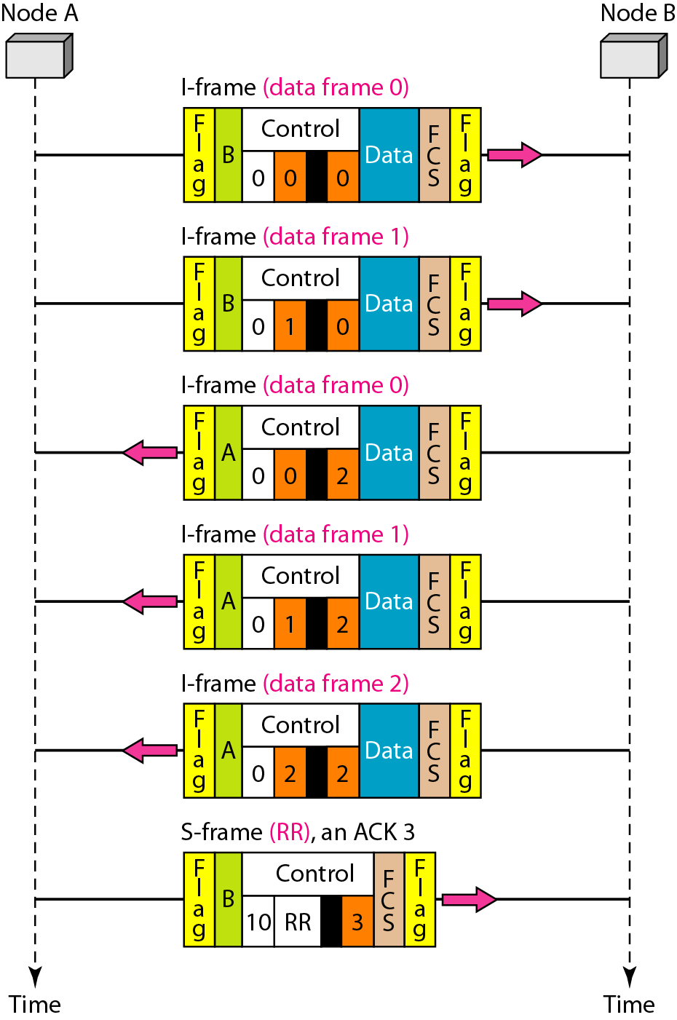
Figure 11.30 Example of piggybacking without error
11.<number>

