Slide 1
Multiple Access
12.<number>

Slide 2

Data link layer divided into two functionality-oriented sublayers
12.<number>

Slide 3
The Channel Allocation Problem
1. Static Channel Allocation
2. Dynamic Channel Allocation
2.1 Station Model
2.2 Single Channel Assumption
2.3 Collision Assumption
2.4.1 Continuous Time
2.4.2 Slotted time
2.5.1 Carrier Sense
2.5.2 No Carrier Sense

Slide 4
Dynamic Channel Allocation Parameters
Station Model.
  N independent stations, each acting as a Poisson Process for the purpose protocol analysis
Single Channel Assumption.
  A single channel is available for all communication.
Collision Assumption.
  If transmitted frames overlap in time, the resulting signal is garbled.
Transmission Discipline:
  Continuous time
    Frames can be transmitted at any time
  Slotted time
    Frames can be transmitted at particular time points
Sensing capability:
  Station cannot sense the channel before trying to use it.
  Stations can tell if the channel is in use before trying to use it

Slide 5

Taxonomy of multiple-access protocols discussed in this chapter
12.<number>

Slide 6
RANDOM ACCESS
In random access or contention methods, no station is superior to another station and none is assigned the control over another. No station permits, or does not permit, another station to send. At each instance, a station that has data to send uses a procedure defined by the protocol to make a decision on whether or not to send.
Topics discussed in this section:
ALOHA
Carrier Sense Multiple Access
Carrier Sense Multiple Access with Collision Detection
Carrier Sense Multiple Access with Collision Avoidance
12.<number>

Slide 7

Frames in a pure ALOHA network
In pure ALOHA, frames are transmitted at completely arbitrary times.
12.<number>

Slide 8

Figure 12.4 Procedure for pure ALOHA protocol
12.<number>

Slide 9
Example
The stations on a wireless ALOHA network are a maximum of 600 km apart. If we assume that signals propagate at 3 × 10⁸ m/s, we find
Tp = (600 × 10³ ) / (3 × 10⁸ ) = 2 ms.
Now we can find the value of T_{B} for different values of
K .
a. For K = 1, the range is {0, 1}. The station needs to|
generate a random number with a value of 0 or 1. This
means that T_{B} is either 0 ms (0 × 2) or 2 ms (1 × 2),
based on the outcome of the random variable.
12.<number>

Slide 10
Example (continued)
b. For K = 2, the range is {0, 1, 2, 3}. This means that T_{B}
can be 0, 2, 4, or 6 ms, based on the outcome of the
random variable.
c. For K = 3, the range is {0, 1, 2, 3, 4, 5, 6, 7}. This
means that T_{B} can be 0, 2, 4, . . . , 14 ms, based on the
outcome of the random variable.
d. We need to mention that if K > 10, it is normally set to
10.
12.<number>

Slide 11

Figure 12.5 Vulnerable time for pure ALOHA protocol
12.<number>

Slide 12
Example 12.2
A pure ALOHA network transmits 200-bit frames on a shared channel of 200 kbps. What is the requirement to make this frame collision-free?
Solution
Average frame transmission time T_{fr} is 200 bits/200 kbps or 1 ms. The vulnerable time is 2 × 1 ms = 2 ms. This means no station should send later than 1 ms before this station starts transmission and no station should start sending during the one 1-ms period that this station is sending.
12.<number>

Slide 13
The throughput for pure ALOHA is (Where G is average number of frames generated by the system during one frame transmission)
S = G × e ^{−2G} .
The maximum throughput
S_{max} = 0.184 when G= (1/2).
12.<number>

Slide 14
Example
A pure ALOHA network transmits 200-bit frames on a shared channel of 200 kbps. What is the throughput if the system (all stations together) produces
a. 1000 frames per second b. 500 frames per second
c. 250 frames per second.
Solution
The frame transmission time is 200/200 kbps or 1 ms.
a. If the system creates 1000 frames per second, this is 1
frame per millisecond. The load is 1. In this case
S = G× e^{−2 G} or S = 0.135 (13.5 percent). This means
that the throughput is 1000 × 0.135 = 135 frames. Only
135 frames out of 1000 will probably survive.
12.<number>

Slide 15
Example 12.3 (continued)
b. If the system creates 500 frames per second, this is
(1/2) frame per millisecond. The load is (1/2). In this
case S = G × e ^{−2G} or S = 0.184 (18.4 percent). This
means that the throughput is 500 × 0.184 = 92 and that
only 92 frames out of 500 will probably survive. Note
that this is the maximum throughput case,
percentagewise.
c. If the system creates 250 frames per second, this is (1/4)
frame per millisecond. The load is (1/4). In this case
S = G × e −^{2G} or S = 0.152 (15.2 percent). This means
that the throughput is 250 × 0.152 = 38. Only 38
frames out of 250 will probably survive.
12.<number>

Slide 16

Frames in a slotted ALOHA network
12.<number>

Slide 17

Note
The throughput for slotted ALOHA is
S = G × e^{−G} .
The maximum throughput
S_{max} = 0.368 when G = 1.
12.<number>

Slide 18

Figure 12.7 Vulnerable time for slotted ALOHA protocol
12.<number>

Slide 19
Example 12.4
A slotted ALOHA network transmits 200-bit frames on a shared channel of 200 kbps. What is the throughput if the system (all stations together) produces
a. 1000 frames per second b. 500 frames per second
c. 250 frames per second.
Solution
The frame transmission time is 200/200 kbps or 1 ms.
a. If the system creates 1000 frames per second, this is 1
frame per millisecond. The load is 1. In this case
S = G× e^{−G} or S = 0.368 (36.8 percent). This means
that the throughput is 1000 × 0.0368 = 368 frames.
Only 386 frames out of 1000 will probably survive.
12.<number>

Slide 20
Example 12.4 (continued)
b. If the system creates 500 frames per second, this is
(1/2) frame per millisecond. The load is (1/2). In this
case S = G × e^{−G} or S = 0.303 (30.3 percent). This
means that the throughput is 500 × 0.0303 = 151.
Only 151 frames out of 500 will probably survive.
c. If the system creates 250 frames per second, this is (1/4)
frame per millisecond. The load is (1/4). In this case
S = G × e ^{−G} or S = 0.195 (19.5 percent). This means
that the throughput is 250 × 0.195 = 49. Only 49
frames out of 250 will probably survive.
12.<number>

Slide 21
Carrier Sense Multiple Access (CSMA)
Additional assumption:
  Each station is capable of sensing the medium to determine if another transmission is underway

Slide 22

Figure 12.9 Vulnerable time in CSMA
12.<number>

Slide 23

Figure 12.10 Behavior of three persistence methods
12.<number>

Slide 24

Figure 12.11 Flow diagram for three persistence methods
12.<number>

Slide 25

Figure 12.14 Flow diagram for the CSMA/CD
12.<number>

Slide 26
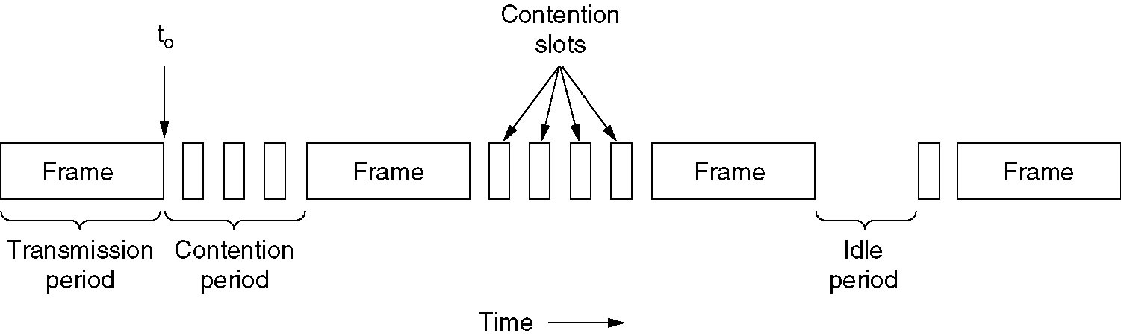
CSMA with Collision Detection
CSMA/CD can be in one of three states: contention, transmission, or idle.

Slide 27
Problem:
Consider building a CSMA/CD network running at 1 Gbps over a 1 km cable with no repeaters. The signal speed in the cable is 200000km/sec. What is the minimum frame size?
Answer:
We must keep in mind that in CSMA/CD , for a station to get some surety of successful transmission the contention interval (time during which the station is transmitting) should have at least 2t slot width where t is time for signal to propagate between two farthest stations ie there must be enough time for the front of the frame to reach the end of the cable and then for an error message to be sent back to the start before the entire frame is transmitted.
As a result for a 1 km cable the one way propagation time
= 1/200000 = 5 x 10 -6 = 5 μsec so for both ways it would be
= 2 x 5 μ sec = 10 μ sec
To make CSMA/CD work, it must be impossible to transmit an entire frame in this interval. so the minimum frame is
10⁹ bps x 10 x 10 ⁻⁶ sec = 10 ⁴ bits = 10 ⁴ bits / 8 = 1250 bytes

Slide 28
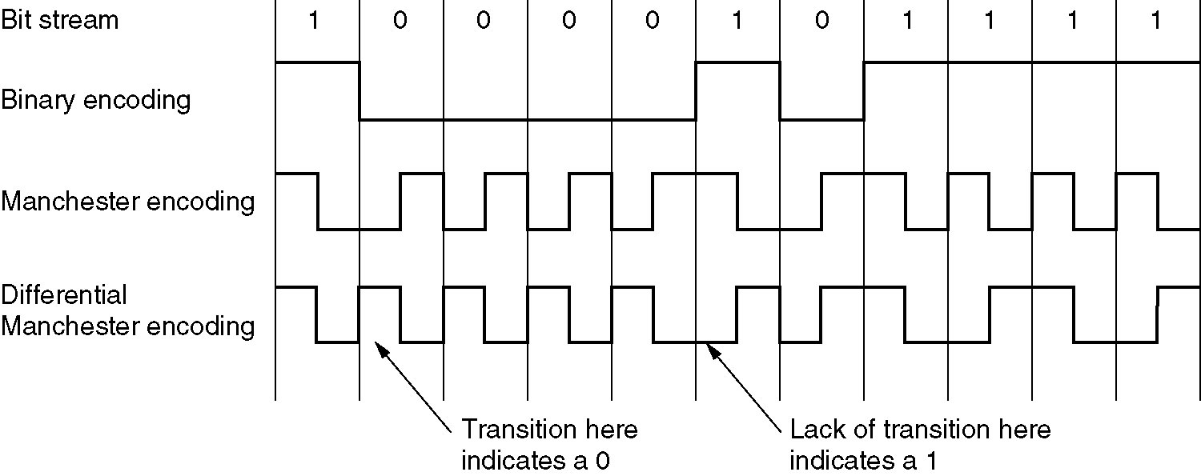
Ethernet Cabling
(a) Binary encoding, (b) Manchester encoding,
(c) Differential Manchester encoding.

