Slide 1
Introduction to Java
Presented By:
Pushpendra K. Rajput
Assistant Professor,
Department of Computer Science & Engineering

Slide 2
Outline
Inheritance

Slide 3
Inheritance
Inheritance is a fundamental Object Oriented concept
On the surface, inheritance is a code re-use issue.
we can extend code that is already written in a manageable manner.
Inheritance is more
it supports polymorphism at the language level

Slide 4
Inheritance Cont…
Take an existing object type (collection of fields and methods) and extend it.
create a special version of the code without re-writing any of the existing code (or even explicitly calling it!).
End result is a more specific object type, called the sub-class / derived class / child class.
The original code is called the superclass / parent class / base class.

Slide 5
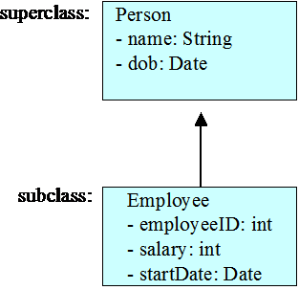
Inheritance Cont…
Inheritance uses subclasses:
A class can be defined as a "subclass" of another class.
The subclass inherits all data attributes of its superclass
The subclass inherits all methods of its superclass
The subclass inherits all associations of its superclass
The subclass can:
Add new functionality
Use inherited functionality
Override inherited functionality

Slide 6
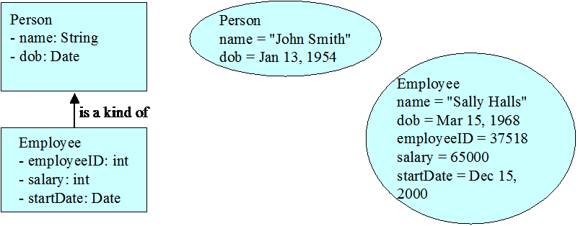
What really happens?
When an object is created using new, the system must allocate enough memory to hold all its instance variables.
This includes any inherited instance variables
In this example, we can say that an Employee "is a kind of" Person.
An Employee object inherits all of the attributes, methods and associations of Person

Slide 7
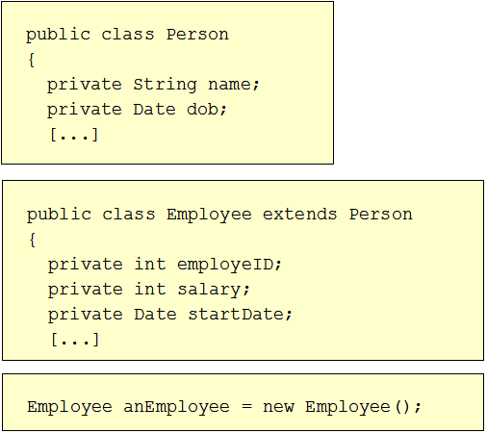
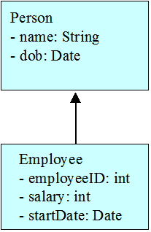
SCHOOL OF ENGINEERING & TECHNOLOGY
DEPARTMENT OF COMPUTER SCIENCE AND ENGINEERING
Inheritance in Java
Inheritance is declared using the "extends" keyword
If inheritance is not defined, the class extends a class called Object

Slide 8
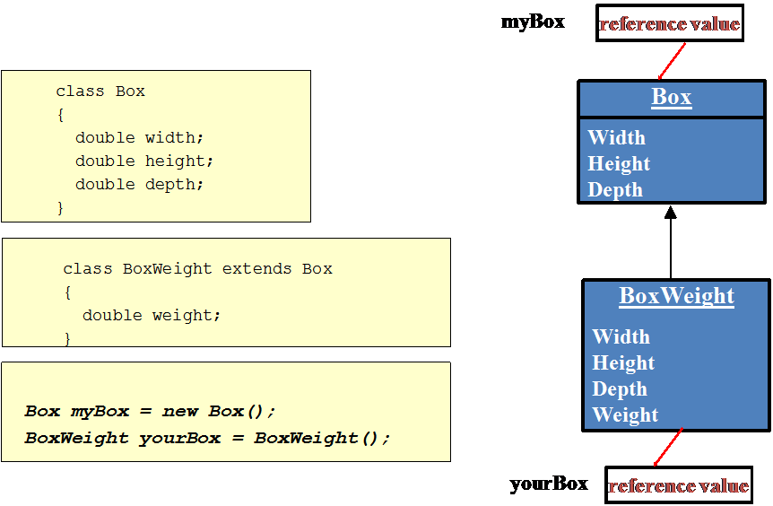
Inheritance in Java

Slide 9
SCHOOL OF ENGINEERING & TECHNOLOGY
DEPARTMENT OF COMPUTER SCIENCE AND ENGINEERING
Inheritance and Visibility Rules
Private variables and methods are not visible to subclasses or clients
Public variables and methods are visible to all subclasses and clients
Protected variables and methods can only be referenced by subclasses of the class and no other classes
Default variables and methods are only visible to subclasses and clients defined in the same package as the class
Notes:
If a superclass has some private variable then sub class has no access of them.
So to initialize these variables we have to call the specified constructor of superclass for which we use super method.

Slide 10
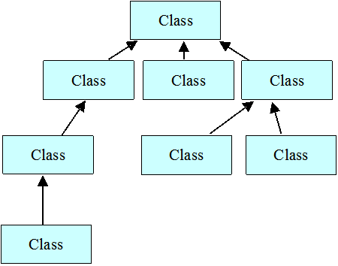
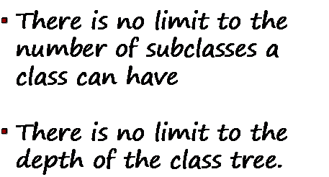
Inheritance Hierarchy
Each Java class has one (and only one) superclass.
C++ allows for multiple inheritance
Inheritance creates a class hierarchy
Classes higher in the hierarchy are more general and more abstract
Classes lower in the hierarchy are more specific and concrete

Slide 11
Constructors and Initialization using super
Classes use constructors to initialize instance variables
When a subclass object is created, its constructor is called.
It also invoke the appropriate superclass constructors so that the instance variables defined in the superclass are properly initialized.
Superclass constructors can be called using the "super" keyword.
It must be the first line of code in the constructor
If a call to super is not made, the system will automatically attempt to invoke the no-argument constructor (default) of the superclass.
Notes:
If a superclass has some private variable then sub class has no access of them.
So to initialize these variables we have to call the specified constructor of superclass for which we use super method.

Slide 12
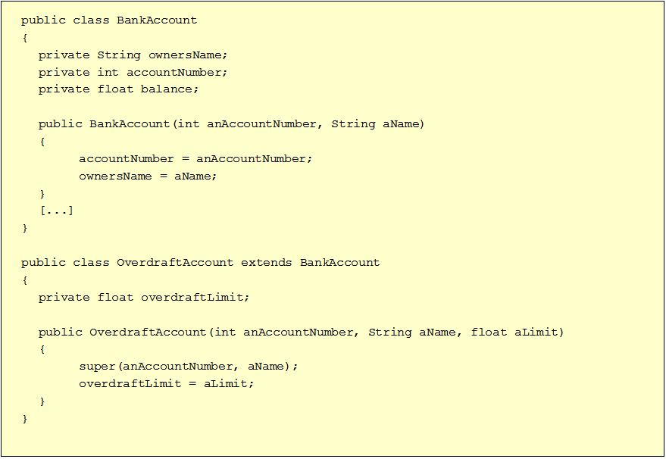
SCHOOL OF ENGINEERING & TECHNOLOGY
DEPARTMENT OF COMPUTER SCIENCE AND ENGINEERING
Initialization using super
Notes:
If a superclass has some private variable then sub class has no access of them.
So to initialize these variables we have to call the specified constructor of superclass for which we use super method.

Slide 13
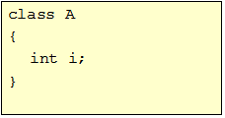
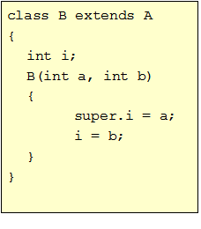
super as a member accessor
super is also used to access a member of the superclass.
Sometimes the member of superclass is hidden by the member of subclass.
The general form is:
super.member
(member = method or variable)

Slide 14
Method Overriding
Subclasses inherit all methods from their superclass
Sometimes, the implementation of the method in the superclass does not provide the functionality required by the subclass.
In these cases, the method must be overridden.
To override a method, provide an implementation in the subclass.
The method in the subclass MUST have the exact same signature as the method it is overriding.
If they are not, then the two methods are simply overloaded.

Slide 15
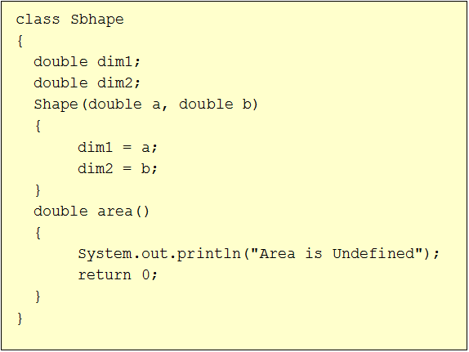
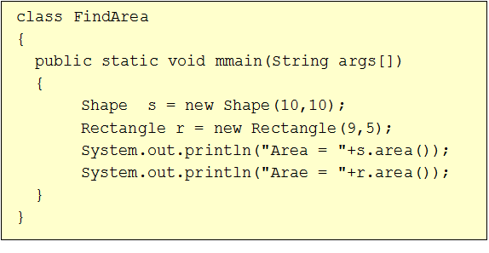
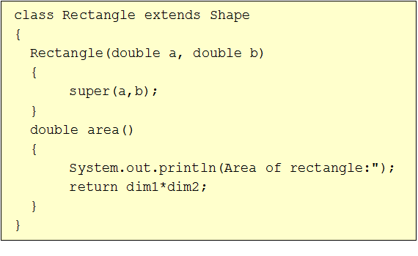
Method Overriding Example
Output:
Area is Undefined
Area = 0
Area of Rectangle:
Area = 45

Slide 16
Overriding vs Overloading
A method is overloaded if it has multiple definitions that are distinguished from one another by having different numbers or types of arguments
A method is overridden when a subclass gives a different definition of the method with the same number and types of arguments
Selection of overloaded methods is done at compile time.
Selection of overridden methods is done at run time.

Slide 17


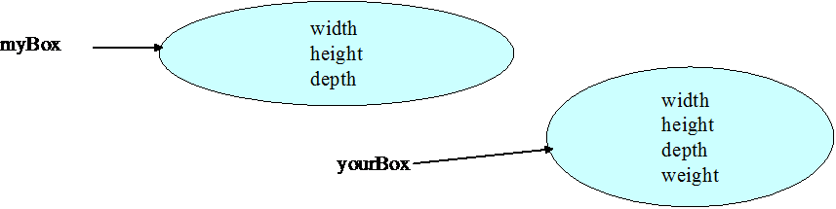
Object References and Inheritance
You can assign a subclass object reference to a variable of a superclass type.
Superclass object variable will only permit access to those items that are members of its own class.

Slide 18
Dynamic Method dispatch
(Runtime Polymorphism)
Mechanism by which a call to an overridden method is resolved at run time, rather than compile time.
A superclass reference variable can refer to a subclass object.
The version of the overridden method is selected based upon the type of the object being referred to superclass reference variable at the time the call occurs.

Slide 19
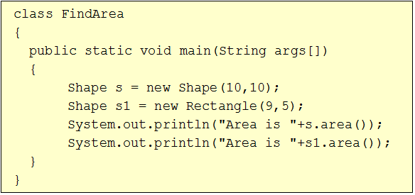
Dynamic Method dispatch Example
Output:
Area is Undefined
Area = 0
Area of Rectangle:
Area = 45

Slide 20
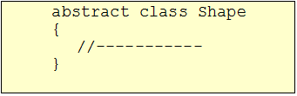
Abstract Classes
Abstract classes must contain one or more abstract methods
Abstract classes can not be instantiated
Classes are declared as abstract classes only if they will never be instantiated
Cannot declare abstract constructors, or abstract static methods
Any subclass of an abstract class must either implement all of the abstract methods in the superclass, or be itself declared abstract.
Abstract classes can be used to create object references that can be used to point to a subclass object.
Example:

Slide 21

Abstract Methods
Abstract methods have no body at all and just have their headers declared
The only way to use an abstract class is to create a subclass that implements each abstract method
Concrete classes are classes that implement each abstract method in their superclasses
Example:

Slide 22
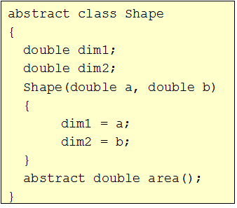
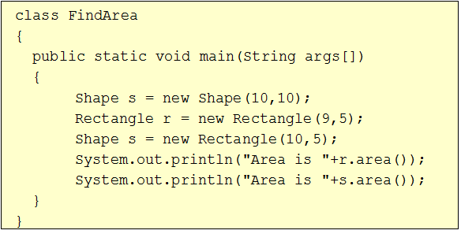
Abstract Class Example
Output:
Area of Rectangle:
Area = 45
Area of Rectangle:
Area = 50

Slide 23
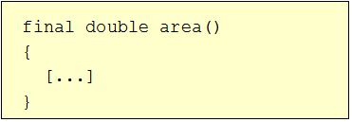

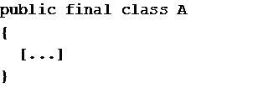
Final Methods and Final Classes
Methods can be qualified with the final modifier
Final methods cannot be overridden.
This can be useful for security purposes.
Compiler free to inline calls- improve performance
Classes can be qualified with the final modifier
The class cannot be extended
This can be used to improve performance. Because there will be no subclasses, there will be no polymorphic overhead at runtime.

Slide 24
Thank You!

