Slide 1
Introduction to Java
Presented By:
Pushpendra K. Rajput
Assistant Professor,
Department of Computer Science & Engineering

Slide 2
Outline
Packages

Slide 3
Packages-Introduction
The main feature of OOP is its ability to support the reuse of code:
Extending the classes (via inheritance)
Extending interfaces
The features in basic form limited to reusing the classes within a program.
What if we need to use classes from other programs without physically copying them into the program under development ?
In Java, this is achieved by using what is known as “packages”, a concept similar to “class libraries” in other languages.

Slide 4
Packages
Packages act as “containers” for classes.
The mechanism provided by Java for partitioning the class namespace into more manageable chunks. It is both a naming and a visibility control mechanism.
The benefits of organising classes into packages are:
The classes contained in the packages of other programs/applications can be reused.
In packages classes can be unique compared with classes in other packages. That two classes in two different packages can have the same name. If there is a naming clash, then classes can be accessed with their fully qualified name.
Classes in packages can be hidden if we don’t want other packages to access them.

Slide 5
Java Foundation Packages
Java provides a large number of classes groped into different packages based on their functionality.
The six foundation Java packages are:
java.lang
Contains classes for primitive types, strings, math functions, threads, and exception
java.util
Contains classes such as vectors, hash tables, date etc.
java.io
Stream classes for I/O
java.awt
Classes for implementing GUI – windows, buttons, menus etc.
java.net
Classes for networking
java.applet
Classes for creating and implementing applets

Slide 6
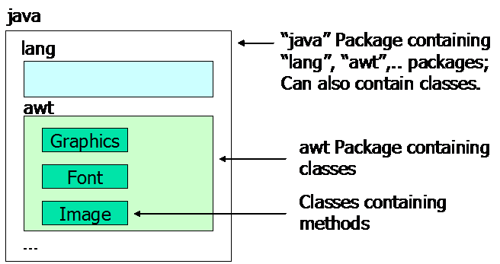
SCHOOL OF ENGINEERING & TECHNOLOGY
DEPARTMENT OF COMPUTER SCIENCE AND ENGINEERING
Using System Packages
The packages are organised in a hierarchical structure. For example, a package named “java” contains the package “awt”, which in turn contains various classes required for implementing GUI (graphical user interface).

Slide 7
Defining a Packages
Java supports a keyword called “package” for creating user-defined packages. The package statement must be the first statement in a Java source file (except comments and white spaces) followed by one or more classes.
The package statement defines a name space in which classes are stored.
General form – package packageName;
Example:
Package MyPackage;
Public class Example
{
//body of the class
}

Slide 8
Storage of Packages
Java uses file system directories to store packages.
Directory (folder) name in which the file is saved must match with package name.
For example, the .class files for any classes you declare to be part of MyPackage must be stored in a directory (folder) called MyPackage.
You can not rename a package without renaming the directory in which the classes are stored.
C:
Package MyPackage;
Public class Example
{
//body of the class
}
Save
MyPackage

Slide 9
Creating Sub Packages
Packages in Java are organised hierarchically, hence sub-packages can be created.
You can create a hierarchy of packages by separating them with a period.
To create sub package write the statement
General Form: package pkg1.pkg2 .pkg3;
Example:
→Store this file in a subdirectory named MyPackage\P1.
C:
MyPackage
Package MyPackage.P1;
Public class Example
{
//body of the class
}
Save
P1

Slide 10
Compiling a Package class
Can compile in two following ways:
Put source file into the same directory as the package name is declared and compile the program (resulting .class file is also in same directory).
Need to create the package directory manually.
If you want to put the sourcefile and .class file at different location then use the following command (suppose source file is stored in a directory named javaPrograms. Creates package directory automatically.
C:\MyPackage>javac Example.java
C:\>javac -d ./ ./javaPrograms/Example.java

Slide 11
Finding Packages and CLASSPATH
How does the java run-time system know where to look for packages that you create?
You can specify using two methods:
First, by default the Java run-time uses the current working directory as its starting point. Thus , if package is in a subdirectory of the current directory, it will be found.
Second, you can specify a directory path or paths by setting the CLASSPATH environmental variable. CLASSPATH must point to the package’s parent directory.
C:
C:\> set CLASSPATH = C:\;
If you want to point the current directory then use .(dot).
More than one location can be added into the CLASSPATH
C:\abc> set CLASSPATH = .; C:\;
Java will find our class file not only from C: directory but from the current directory as well i. e. abc
MyPackage
P1

Slide 12
Using Packages
There are three ways of using the resources in a package:
Inline Member Declarations: declare the package member with its fully qualified package name.
Importing a Single Package Member: Easily achieved using an import statement in which the import keyword is followed by the fully qualified name of the member you wish to use.
Importing an Entire Package: It may be that you use a number of members from a package and end up with a large number of import statements. . Put asterisk (*) in the place of member Name

Slide 13
Using Packages
Inline Member Declarations: declare the package member with its fully qualified package name.
Importing a Single Package Member: Easily achieved using an import statement in which the import keyword is followed by the fully qualified name of the member you wish to use.
Public class Test
{
MyPackage.Example example = new MyPackage.Example();
}
import MyPackage.Example;
Public class Test
{
Example example = new Example();
}

Slide 14
Using Packages
Importing an Entire Package: It may be that you use a number of members from a package and end up with a large number of import statements. . Put asterisk (*) in the place of member Name in import statement.
→ import statements occur immediately following the package statement (if it exists) and before any class definitions
import MyPackage.*;
Public class Test
{
Example1 example1 = new Example1();
Example2 example2 = new Example2();
}

Slide 15
Using Package
All of the standard Java classes included with Java are stored in a package called java.
The basic language functions are stored in a package inside of the java package called java.lang. Since Java is useless without much of the functionality in java.lang, it is implicitly imported by the compiler for all programs.
If a class with the same name exists in two different packages that you import using the star form, the compiler will remain silent, unless you try to use one of the classes.
You will get a compile time error and have to explicitly name the class specifying its package.

Slide 16
Protection and Packages
All classes (or interfaces) accessible to all others in the same package.
Class declared public in one package is accessible within another. Non-public class is not
Members of a class are accessible from a different class, as long as they are not private
protected members of a class in a package are accessible to subclasses in a different package

Slide 17
Visibility - Revisited
Public keyword applied to a class, makes it available/visible everywhere. Applied to a method or variable, completely visible.
Private fields or methods for a class only visible within that class. Private members are not visible within subclasses, and are not inherited.
Protected members of a class are visible within the class, subclasses and also within all classes that are in the same package as that class.

Slide 18
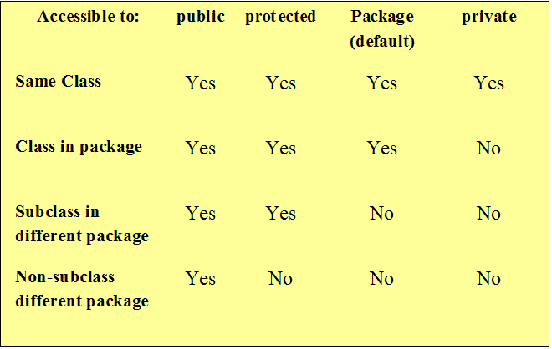
Visibility Modifiers

Slide 19
Package Example
package P1;
public abstract class Shape
{
public double PI = 3.14;
public double area();
}
package P2;
import P1.*;
public class Rectangle extends Shape
{
public double l,b;
public Rectangle(double l, double b)
{
this.l = l;
this.b = b;
}
public double area()
{
return l*b;
}
}
package P1;
public class Circle extends Shape
{
public double radius;
public Circle(double r)
{
}
public double area()
{
return PI*radius*radius;
}
}

Slide 20
Package Example
Save Shape and Circle class in P1 directory.
Save Rectangle in P2 directory.
import P1.*;
import P2.*;
public class Area
{
public static void main(String args[])
{
Circle c = new Circle(10);
Rectangle r = new Rectangle(15,10);
System.out.println(“Area : “+c.area());
System.out.println(“Area : “+r.area());
}
}

Slide 21
Thank You!

