Slide 1
SCHOOL OF ENGINEERING & TECHNOLOGY
DEPARTMENT OF COMPUTER SCIENCE AND ENGINEERING
Introduction to Java
Presented By:
Pushpendra K. Rajput
Assistant Professor,
Department of Computer Science & Engineering

Slide 2
SCHOOL OF ENGINEERING & TECHNOLOGY
DEPARTMENT OF COMPUTER SCIENCE AND ENGINEERING
Outline
Arrays
String

Slide 3
Arrays - Introduction
Array is a list of finite number n of homogeneous data elements such that:
The elements of the array are referenced respectively by an index set of n consecutive numbers.
The element of the array are stored respectively in successive memory location.
The number n of elements is called the length or size.

Slide 4
Graphical Representation
Position is called a index or superscript. Base index = 0.
Let DATA be a 6-element array of integers such that
DATA[0]=247, DATA[1]=56, DATA[2]=492,
DATA[3]=135, DATA[4]=87, DATA[5]=156
DATA
1
2
3
4
5
6
247
56
492
135
87
156
INDEX

Slide 5
SCHOOL OF ENGINEERING & TECHNOLOGY
DEPARTMENT OF COMPUTER SCIENCE AND ENGINEERING
Graphical Representation
Position is called a index or superscript. Base index = 0.
Let DATA be a 6-element array of integers such that
DATA[0]=247, DATA[1]=56, DATA[2]=492,
DATA[3]=135, DATA[4]=87, DATA[5]=156
DATA
0
1
2
3
4
5
247
56
492
135
87
156
VALUE

Slide 6
SCHOOL OF ENGINEERING & TECHNOLOGY
DEPARTMENT OF COMPUTER SCIENCE AND ENGINEERING
Declaration of Arrays
Like any other variables, arrays must declared and created before they can be used. Creation of arrays involve three steps:
Declare the array
Create storage area in primary memory.
Put values into the array (i.e., Memory location)
Declaration of Arrays:
Form 1:
Type arrayname[];
Form 2:
Type [] arrayname;
Examples:
int[] students;
int students[];
Note: we don’t specify the size of arrays in the declaration.

Slide 7
Creation of Arrays
After declaring arrays, we need to allocate memory for storage array items.
In Java, this is carried out by using “new” operator, as follows:
Arrayname = new type[size];
Examples:
students = new int[7];
students
0
1
2
3
4
5
6
Declaring and defining in the same statement:
int[] students=new students[10];

Slide 8
Initialisation of Arrays
Once arrays are created, they need to be initialised with some values before access their content. A general form of initialisation is:
Arrayname [index/subscript] = value;
Example:
students[0] = 50;
students[1] = 40;
Array index starts with 0 and ends with n-1
Trying to access an array beyond its
boundaries will generate an error message.
students[7] = 100;
students
0
1
2
3
4
5
6
50

Slide 9
SCHOOL OF ENGINEERING & TECHNOLOGY
DEPARTMENT OF COMPUTER SCIENCE AND ENGINEERING
Initialisation of Arrays
Once arrays are created, they need to be initialised with some values before access their content. A general form of initialisation is:
Arrayname [index/subscript] = value;
Example:
students[0] = 50;
students[1] = 40;
Array index starts with 0 and ends with n-1
Trying to access an array beyond its
boundaries will generate an error message.
students[7] = 100;
students
0
1
2
3
4
5
6
50
40

Slide 10
Explicit initialization
Arrays can also be initialised like standard variables at the time of their declaration.
Type arrayname[] = {list of values};
Example:
int[] students = {55, 69, 70, 30, 80, 90, 45};
Creates and initializes the array of integers of length 7.
In this case it is not necessary to use the new operator.
students
0
1
2
3
4
5
6
55
69
70
30
80
90
45

Slide 11
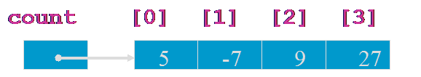
Processing Array Elements
Access individual elements of an array using:
the name (handle) of the array
a number (index or subscript) that tells which of the element of the array
What value is stored in count[2]?
count[2] = 9

Slide 12
Array Length
Refer to array length using length
A data member of array object
arrayname.length
for(int k=0; k<students.length;k++)
Example:
long[] primes = new long[20];
System.out.println(primes.length);
Output: 20
→ If number of elements in the array are changed, JAVA will automatically change the length attribute!

Slide 13
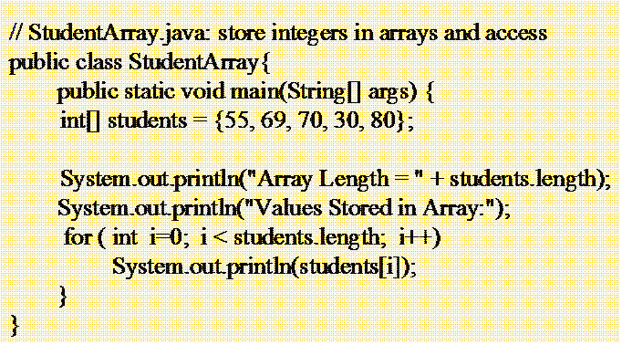
SCHOOL OF ENGINEERING & TECHNOLOGY
DEPARTMENT OF COMPUTER SCIENCE AND ENGINEERING
Processing Array Elements using loop
Often a for( ) loop is used to process each of the elements of the array in turn.
The loop control variable, i, is used as the index to access array components

Slide 14
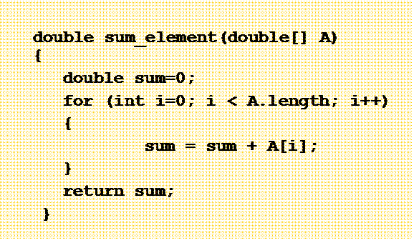
SCHOOL OF ENGINEERING & TECHNOLOGY
DEPARTMENT OF COMPUTER SCIENCE AND ENGINEERING
Array as Parameters
Methods can accept arrays via parameters
Use square brackets [ ] in the parameter declaration:

Slide 15

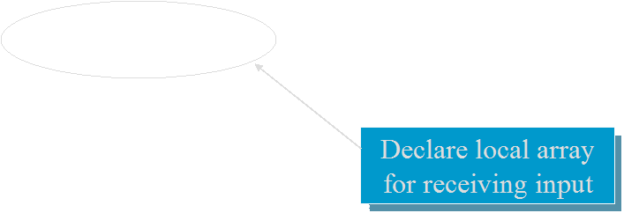

SCHOOL OF ENGINEERING & TECHNOLOGY
DEPARTMENT OF COMPUTER SCIENCE AND ENGINEERING
Returning Array
A method may return an array as its result
double [] readArray(int n)
{
double result[] = new double[n]; for (i = 0; i < n; i++) {
result[i] = i;
} return result;
}

Slide 16
SCHOOL OF ENGINEERING & TECHNOLOGY
DEPARTMENT OF COMPUTER SCIENCE AND ENGINEERING
Two Dimensional Arrays
Two dimensional arrays allows us to store data that are recorded in table.
int[][] student=new int[4][4];
4 arrays each having 4 elements
First index: specifies array (row)
Second Index: specifies element in that array (column)
0 | 1 | 2 | 3
0
1
2
3
10 | 20 | 85 | 45
56 | 58 | 25 | 58
45 | 85 | 65 | 78
65 | 14 | 28 | 56

Slide 17
Two Dimensional Arrays
Requires two indices
int[][] student=new int[4][4];
What is the value of student[2][3]?
student
Student[2][3] = 78
0 | 1 | 2 | 3
0
1
2
3
10 | 20 | 85 | 45
56 | 58 | 25 | 58
45 | 85 | 65 | 78
65 | 14 | 28 | 56

Slide 18
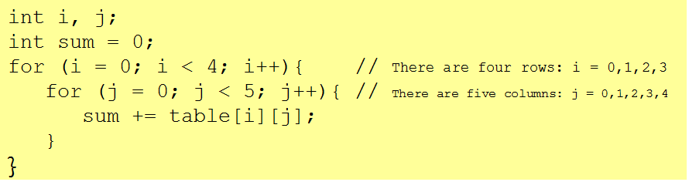
Accessing 2D Array Elements
Sum the Elements
Here is code that sums all the numbers in table.
The outer loop iterates four times and moves down the rows.
Each time through the outer loop, the inner loop iterates five times and moves across a different row.

Slide 19
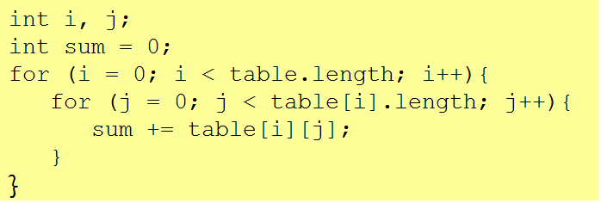
Accessing Rows and Columns
The previous code can be rewritten without using the numbers 4 and 5.
The value table.length equals the number of rows,
table[i].length is the number of columns in row i.
table[0].length = 5, table[1].length = 5,………..

Slide 20
Declaration and Instantiation of 2D Array
Declaring and instantiating two-dimensional arrays are accomplished by extending the processes used for one-dimensional arrays:
Declaration:
int myArray [][];
Creation or Instantiation:
myArray = new int[4][3]; // OR
int myArray [][] = new int[4][3];
Initialisation:
- Single Value;
myArray[0][0] = 10;
- Multiple values:
int table[2][3] = {{10, 15, 30}, {14, 30, 33}};
int table[][] = {{10, 15, 30}, {14, 30, 33}};

Slide 21
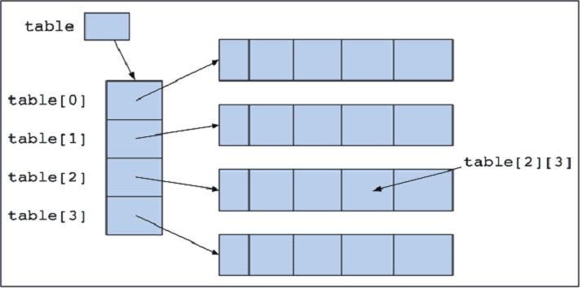
2D Array as “Array of Arrays”
int table [][] = new int[4][5];
The variable table references an array of four elements.
Each of these elements in turn references an array of five integers.
[0] | [1] | [2] | [3] | [4]

Slide 22
Variable Size Arrays
Java treats multidimensional arrays as “arrays of arrays”. It is possible to declare a 2D arrays as follows:
int a[][] = new int [3][];
[0]
[1]
[2]
a[0]= new int [2];
[0] | [1]
a[1]= new int [3];
[0] | [1] | [2]
a[2]= new int [4];
[0] | [1] | [1] | [3]

Slide 23
Multidimensional Arrays
Example: A farmer has 10 farms of beans each in 5 countries, and each farm has 30 fields!
Three-dimensional array:
long[][][] beans=new long[5][10][30];
//beans[country][farm][fields]

Slide 24
Varying length in Multidimensional Arrays
Same features apply to multi-dimensional arrays as those of 2 dimensional arrays
long beans=new long[3][][]; //3 countries
beans[0]=new long[4][]; //First country has 4 farms
beans[0][4]=new long[10];//Each farm in first country has 10 fields

Slide 25
Exercise-1
WAP in Java that create an array and simple print the element of the array. (Array Traversing).
WAP in Java that implements following three methods:
boolean Search( int [] A, int Key): it takes an array A and a Key as input and returns true if Key is in the array else return false.
int Position(int [] A, int Key): it takes an array A and a Key as input and returns the position of Key in the array.
int [] Sort(int [] A): it takes an array A and returns another array. The output array has same element as in input array but in ascending order.
WAP in Java that takes an two dimensional array as input parameter to a method and returns one dimensional array. Each element of the output array is the sum of the element of corresponding row in input array.
WAP in Java to add, multiply, and subtract two Matrices. The decision of operation should be made based on user’s choice.

Slide 26
SCHOOL OF ENGINEERING & TECHNOLOGY
DEPARTMENT OF COMPUTER SCIENCE AND ENGINEERING
Strings

Slide 27
Introduction
String manipulation is the most common operation performed in Java programs. The easiest way to represent a String (a sequence of characters) is by using an array of characters.
Example:
char place[] = new char[4];
place[0] = ‘J’; place[1] = ‘a’;
place[2] = ‘v’; place[3] = ‘a’;
Character arrays are too primitive and don’t support a range of common string operations. For example, copying a string, searching for specific pattern etc.
Recognising the importance and common usage of String manipulation in large software projects, Java supports String as one of the fundamental data type at the language level.

Slide 28
String Operations in Java
Following are some useful classes that Java provides for String operations.
String Class
StringBuffer Class
StringBuilder Class
StringTokenizer Class

Slide 29
String Class
String class provides many operations for manipulating strings.
String objects are read-only (immutable)
An object of the String class represents a string of characters.
The String class belongs to the java.lang package, which does not require an import statement.
Like other classes, String has constructors and methods.
Unlike other classes, String has two operators, + and += (used for concatenation).

Slide 30
Literal Strings
These are anonymous objects of the String class
These are defined by enclosing text in double quotes. “This is a literal String”
don’t have to be constructed.
can be assigned to String variables.
can be passed to methods and constructors as parameters.
have methods you can call.

Slide 31
String Object
Declaration : A String variable is simply a named object of the same class.
String stringName;
String Greeting;
Creation or Initialization : Can initialize a String variable with or without a String constructor
With the constructor
stringName = new String (“string value”);
Greeting = new String(“Hello”);
Without the constructor
stringName = “string value”;
Greeting = “Hello”;

Slide 32
String Constructors
public String() | String default constructor instantiates empty string
public String(String value) | Constructor copies String
public String(Char[] array) | Constructor copies character array
public String(Char [] array, int offset, int count) | Constructor copies character-array subset
public String(Byte [] array) | Constructor copies byte array
……………….

Slide 33
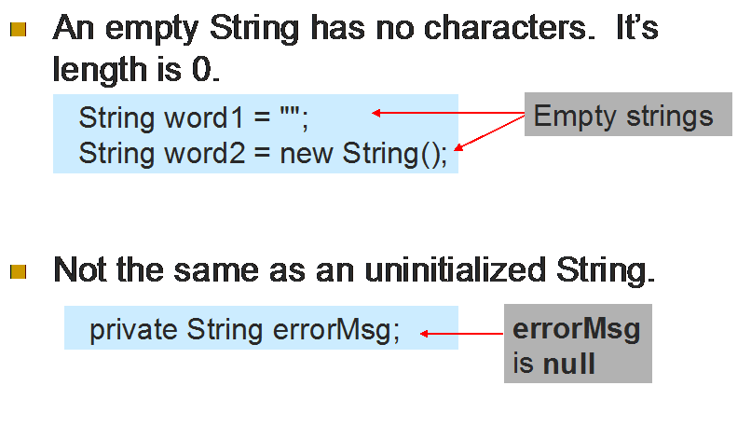
Empty Strings

Slide 34
String operations and Arrays
Java Strings can be concatenated using the + operator.
String city = “New” + “York”;
String city1 = “Delhi”;
String city2 = “New “+city1;
Strings Arrays
String city[] = new String[5];
city[0] = new String(“Melbourne”);
city[1] = new String(“Sydney”);
…
String megacities[] = {“Brisbane”, “Sydney”, “Melbourne”, “Adelaide”, “Perth”};

Slide 35
Immutability
Once created, a string cannot be changed: none of its methods changes the string. Such objects are called immutable.
Immutable objects are convenient because several references can point to the same object safely: there is no danger of changing an object through one reference without the others being aware of the change.

Slide 36
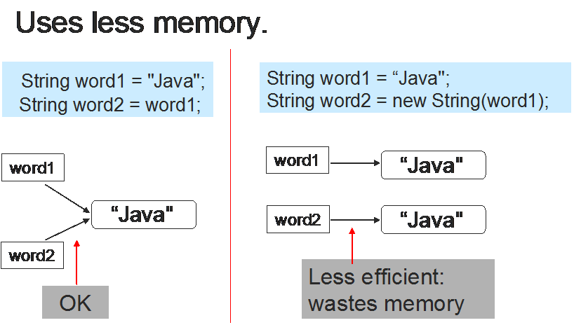
Advantages Of Immutability

Slide 37
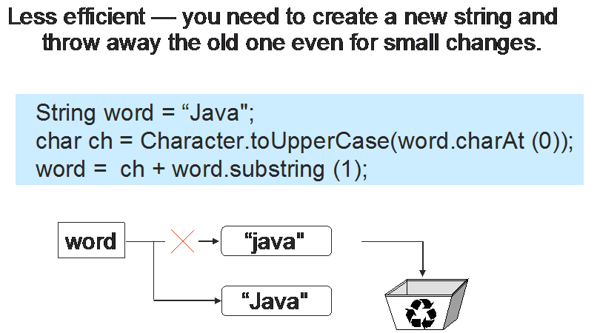
SCHOOL OF ENGINEERING & TECHNOLOGY
DEPARTMENT OF COMPUTER SCIENCE AND ENGINEERING
Disadvantages of Immutability

Slide 38
String Methods- length, charAt, getChars,
int length();
char charAt(i);
void getChars(int S, int E, char Target[], int Target_S)
char[] toCharArray()
Returns the number of characters in the string
Returns the character at position i.
Character positions in strings are numbered starting from 0 – just like arrays.
Used to extract more than one character.
Returns a character aaray that is created using the characters of invoking string
end of substring (E-1)
beginning of the substring
the array that receive the characters
index within Target at which substring will be copied
Example:- Statement Result
String example = “Java”; example(string object)
example.length() OR “Java”.length();
4
example.charAt(1) OR “Java”.charAt(1);
a
examle.getChars(1,3, ouput, 0);
output (char array) a v
char output[] = examle.toCharArray();
output (char array) J a v a

Slide 39
String Comparison Methods
boolean equals(Object str) | Returns true if two strings are equal . It consider the case.
boolean equalsIgnoreCase(String str) | Returns true if two strings are equal. It does not consider the case.
int compareTo(String str) | Returns the difference between two strings
boolean regionMatches(int S,String Str, int str_s, int num_char) | Compares a specific region inside a string with another specific region in another string
fg
Example:- Statement Result
String example = “Java”; example(string object)
example.equals(“Java”)
true
example.equals(“java”)
false
examle.equalsIgnoreCase(“java”)
true
example.regionMatches(0,“lava”,1,2)
true

Slide 40
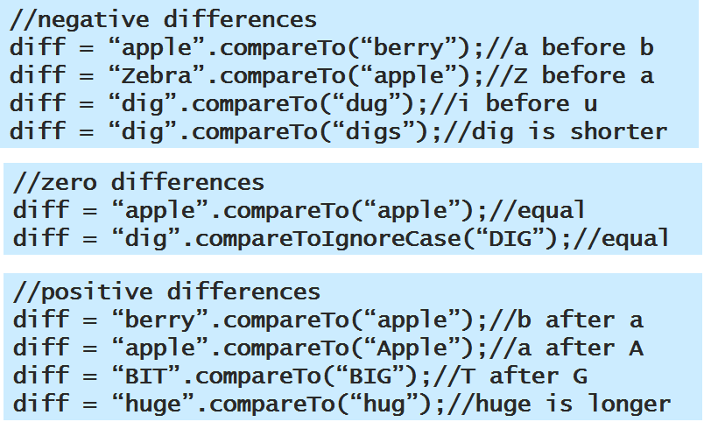
compareTo() Method Example
Invoking String is less than str
Invoking String is equals to str
Invoking String is greater than str

Slide 41
String Searching Methods
int indexOf(char ch) int indexOf(String str) | Searches of the first occurrence of a character or substring
int indexOf(char ch, int S) int indexOf(String str, int S) | Specify the starting point for the search
int lastIndexOf(char ch) int lastIndexOf(String str) | Searches of the last occurrence of a character or substring
int lastIndexOf(char ch, int S) int lastIndexOf(String str, int S) | Specify the starting point for the search
fg
Example:- Statement Result
String example = “Java”; example(string object)
example.indexOf(‘a’)
1
Example.lastIndexOf(‘a’)
3
Examle.indexOf(‘a’, 2)
3
example.indexOf(“av”)
1
If string or character is not present returns -1

Slide 42
String Modification Methods
String substring(int startIndex) | Returns a copy of the substring starts from startIndex upto the end.
String substring(int startIndex, int endIndex) | Returns a copy of the substring starts from startIndex upto the endIndex
String concat(String str) | Returns a string that is generated from invoking string appending the str.
String trim() | Removes the leading and trailing whitespace from invoking string
String replace(char original, char new) | Replaces all occurrence of a character with new character in invoking string
fg
Example:- Statement Result
String example = “Java”; example(string object)
example.substring(1)
ava
example.substring(0,2)
Jav
examle.concat (“ is secure”)
Java is secure
example.trim()
Java
example.replace(‘a’, ‘o’)
Jovo

Slide 43
String Methods — Changing Case
String toLowerCase() | Converts all the character in the invoking string from uppercase to lowercase.
String toUpperCase() | Converts all the character in the invoking string from lowercase to uppercase.
Example:- Statement Result
String example = “Java”; example(string object)
example.toLowerCase ()
java
example.toUpperCase()
JAVA

Slide 44
String Methods
String trim() | eliminates white spaces before and after string
String startsWith() String endsWith() | Matches prefix and postfix respectively
Example:- Statement Result
String example = “ Java ”; example(string object)
example.trim ()
Java
example.startsWith(“Ja”)
true
example.endsWith(“VA”)
false

Slide 45



Data Conversion– valueOf() Method
Data can be converted from one format to another format-
Example: from number to String
Three ways to convert a number into a string:
1. String s = "" + num;
2. String s = Integer.toString (i);
String s = Double.toString (d);
3. String s = String.valueOf (num);

Slide 46
valueOf() Method cont….
static String valueOf(double num)
static String valueOf(long num)
static String valueOf(Object ob)
static String valueOf(char char[])
static String valueOf(char char[], int startIndex, int numChars)
Any object that you pass to valueOf() will return the result of a call to the object’s toString() method

Slide 47
StringBuffer Class
String represents fixed length, immutable character sequence.
The StringBuffer class was invented to accommodate strings that are not immutable (constants)
Uses a buffer that is much larger than any one string; actual size of the buffer is the capacity
Provides methods that can change individual characters within a string
Must initialize StringBuffer objects as follows:
StringBuffer eventString = new StringBuffer(“Hello there”);
→Cannot use StringBuffer eventString = “Hello there”;

Slide 48
StringBuffer Class
Has three constructors:
public StringBuffer() constructs a StringBuffer with no characters and a default size of 16 characters
public StringBuffer(int Capacity) creates a StringBuffer with no characters and a capacity defined by the parameter
public StringBuffer(String s) contains the same characters as those stored in the String object s.
→Capacity or size is the number of characters that can be stored in a stringBuffer

Slide 49
StringBuffer Class---Methods
int length() | Return StringBuffer length
int capacity() | Return StringBuffer capacity
void ensureCapacity(int minimum_capacity) | Set StringBuffer capacity
void setLength(int len) | Increase or decrease StringBuffer length
fg
Example:- Statement Result
StringBuffer example = new StringBuffer(“Java is Secure”);
example.length()
14
example.ensureCapacity(25)
examle.capacity()
25
example.setLength(7)
Java is

Slide 50
StringBuffer Class---Methods
char charAt(int i) | Returns the character at position i.
void setChar( int Index, char ch) | Return StringBuffer capacity
void getChars(int S, int E, char Target[], int Target_S) | Used to extract more than one character.
StringBuffer reverse() | Returns the reverse object of the invoking StringBuffer
fg
Example:- Statement Result
StringBuffer example = new StringBuffer(“Java is Secure”);
example.charAt(8)
S
examle.setChar(4, ‘a’)
Javaais Secure
example.reverse()
eruceS si avaJ

Slide 51
StringBuffer Class---Methods
StringBuffer append(String str) StringBuffer append(String num) StringBuffer append(Object ob) | Concatenates the string representation of any other type of data to the end of the invoking StringBuffer
StringBuffer insert(int Index, String str) StringBuffer insert(int Index, char ch) StringBuffer insert(int Index, Object ob) | Inserts one string into another at specified Index
StringBuffer delete(int startIndex, int endIndex) | Deletes a sequence of characters from the invoking object. (from startIndex to endIndex-1)
StringBuffer deleteCharAt(int index) | Deletes the character at the index specified by index.
fg
Example:- Statement Result
StringBuffer example = new StringBuffer(“Java is Secure”);
example.append(!)
Java is Secure!
examle.insert(8, “too”)
Java is too Secure
example.delete(8,11)
Java is Secure
example.deleteCharAt(5)
Java s Secure

Slide 52
StringBuilder Class
Java StringBuilder class is used to create mutable (modifiable) string.
The Java StringBuilder class is same as StringBuffer class except that it is non-synchronized.

Slide 53
StringTokenizer Class
StringTokenizer class in Java is used to break a string into tokens.

Slide 54
StringTokenizer Class
Constructors
StringTokenizer(String str) : default delimiters like new line, space, tab, carriage return and form feed.
StringTokenizer(String str, String delim) : delim is set of delimiters that are used to tokenize the given string.
StringTokenizer(String str, String delim, boolean flag): If the flag is false, delimiter characters serve to separate tokens. If the flag is true, delimiter characters are considered to be tokens.

Slide 55
StringTokenizer Class
Methods
Public method | Description
boolean hasMoreTokens() | checks if there is more tokens available.
String nextToken() | returns the next token from the StringTokenizer object.
boolean hasMoreElements() | same as hasMoreTokens() method.
Object nextElement() | same as nextToken() but its return type is Object.
int countTokens() | returns the total number of tokens.

Slide 56
Exercise-2
WAP in Java that implements following four methods:
boolean isAnagram(String str1, String str2): It will take two string values and returns true if both strings are anagram of one another.
boolean palimdrome(String str): It will take a string and check if string is palindrome and returns true.
String reverseString(String str): Returns the reverse of the input String.
WAP in Java that prints all characteristics of java with the following implementation:
Create an StringBuffer object that has initail value “Java Is”
Create an String array that stores all the name of java characteristics.
Modify the initial stringBuffer using string array values and print in the following way:
Java Is Secure
-----------
--------

Slide 57
SCHOOL OF ENGINEERING & TECHNOLOGY
DEPARTMENT OF COMPUTER SCIENCE AND ENGINEERING
Thank You!

