Slide 1




Slide 2
Software Testing
What is Testing?
Many people understand many definitions of testing :
Testing is the process of demonstrating that errors are not present.
The purpose of testing is to show that a program performs its intended functions correctly.
Testing is the process of establishing confidence that a program does what it is supposed to do.
These definitions are incorrect.

Slide 3
Software Testing
A more appropriate definition is:
“Testing is the process of executing a program with the intent of finding errors.”

Slide 4
Software Testing
Why should We Test ?
Although software testing is itself an expensive activity, yet launching of software without testing may lead to cost potentially much higher than that of testing, specially in systems where human safety is involved.
In the software life cycle the earlier the errors are discovered and removed, the lower is the cost of their removal.

Slide 5
Software Testing
Who should Do the Testing ?
Testing requires the developers to find errors from their software.
It is difficult for software developer to point out errors from own creations.
Many organisations have made a distinction between development and testing phase by making different people responsible for each phase.

Slide 6
Software Testing
What should We Test ?
We should test the program’s responses to every possible input. It means, we should test for all valid and invalid inputs. Suppose a program requires two 8 bit integers as inputs. Total possible combinations are 2⁸x2⁸. If only one second it required to execute one set of inputs, it may take 18 hours to test all combinations. Practically, inputs are more than two and size is also more than 8 bits. We have also not considered invalid inputs where so many combinations are possible. Hence, complete testing is just not possible, although, we may wish to do so.

Slide 7
Software Testing
Some Terminologies
Error, Mistake, Bug, Fault and Failure
People make errors. A good synonym is mistake. This may be a syntax error or misunderstanding of specifications. Sometimes, there are logical errors.
When developers make mistakes while coding, we call these mistakes “bugs”.
A fault is the representation of an error, where representation is the mode of expression, such as narrative text, data flow diagrams, ER diagrams, source code etc. Defect is a good synonym for fault.
A failure occurs when a fault executes. A particular fault may cause different failures, depending on how it has been exercised.

Slide 8
Software Testing
Test, Test Case and Test Suite
Test and Test case terms are used interchangeably. In practice, both are same and are treated as synonyms. Test case describes an input description and an expected output description.
Test Case ID
Section-I (Before Execution) | Section-II (After Execution)
Purpose : | Execution History:
Pre condition: (If any) | Result:
Inputs: | If fails, any possible reason (Optional);
Expected Outputs: | Any other observation:
Post conditions: | Any suggestion:
Written by: | Run by:
Date: | Date:
Fig. 2: Test case template
The set of test cases is called a test suite. Hence any combination of test cases may generate a test suite.

Slide 9
Software Testing
Verification and Validation
Verification is the process of evaluating a system or component to determine whether the products of a given development phase satisfy the conditions imposed at the start of that phase.
Validation is the process of evaluating a system or component during or at
the end of development process specified requirements .
Testing= Verification+Validation
to determine whether it satisfies the

Slide 10
Black-Box Testing
Test cases are decided solely on the basis of the requirements or specifications of the program or module, and the internals of the module or the program are not considered for selection of test cases.
The tester only knows the inputs that can be give into the system and what output the system should give.
Also called functional testing, as it concern with the functionality of the program
In the black-box testing, test cases are designed from an examination of the input/output values only and no knowledge of design, or code is required.

Slide 11
Generating test cases
Randomly – not much optimal.
Optimal means detection of maximum errors with minimum test cases.
Some other techniques for designing test-cases are as follows :-

Slide 12
2.1 Equivalence Class Partitioning
divide the input domain into a set of equivalence classes.
so that if the program works correctly for a value then it will work correctly for all the other values in that class.
Difficult to find equivalence class without knowing the internal structure of program.
Equivalence class – inputs with same expected behavior.

Slide 13
If the input data values to a system can be specified by a range of values, then one valid and two invalid equivalence classes should be defined.
If the input data assumes values from a set of discrete members of some domain, then one equivalence class for valid input values and another equivalence class for invalid input values should be defined.

Slide 14
Software Testing
Invalid input
Valid inputs
System under test
Outputs
Input domain
Output domain
Fig. 7: Equivalence partitioning
Most of the time, equivalence class testing defines classes of the input domain. However, equivalence classes should also be defined for output domain. Hence, we should design equivalence classes based on input and output domain.

Slide 15
Software Testing
Example 8.7
Consider the program for the determination of nature of roots of a quadratic equation as explained in example 8.1. Identify the equivalence class test cases for output and input domains.

Slide 16
Software Testing
Solution
Output domain equivalence class test cases can be identified as follows: O₁={<a,b,c>:Not a quadratic equation if a = 0}
O₁={<a,b,c>:Real roots if (b²-4ac)>0}
O₁={<a,b,c>:Imaginary roots if (b²-4ac)<0} O₁={<a,b,c>:Equal roots if (b²-4ac)=0}`
The number of test cases can be derived form above relations and shown below:
Test case | a | b | c | Expected output
1 | 0 | 50 | 50 | Not a quadratic equation
2 | 1 | 50 | 50 | Real roots
3 | 50 | 50 | 50 | Imaginary roots
4 | 50 | 100 | 50 | Equal roots

Slide 17
Software Testing
We may have another set of test cases based on input domain.
I₁= {a: a = 0} I₂= {a: a < 0}
I₃= {a: 1 ≤ a ≤ 100} I₄= {a: a > 100}
I₅= {b: 0 ≤ b ≤ 100}
I₆= {b: b < 0}
I₇= {b: b > 100}
I₈= {c: 0 ≤ c ≤ 100} I₉= {c: c < 0}
I₁₀={c: c > 100}

Slide 18
Software Testing
Test Case | a | b | c | Expected output
1 | 0 | 50 | 50 | Not a quadratic equation
2 | -1 | 50 | 50 | Invalid input
3 | 50 | 50 | 50 | Imaginary Roots
4 | 101 | 50 | 50 | invalid input
5 | 50 | 50 | 50 | Imaginary Roots
6 | 50 | -1 | 50 | invalid input
7 | 50 | 101 | 50 | invalid input
8 | 50 | 50 | 50 | Imaginary Roots
9 | 50 | 50 | -1 | invalid input
10 | 50 | 50 | 101 | invalid input
Here test cases 5 and 8 are redundant test cases.

Slide 19
Software Testing
Example 8.8
Consider the program for determining the previous date in a calendar as explained in example 8.3. Identify the equivalence class test cases for output & input domains.

Slide 20
Software Testing
Solution
Output domain equivalence class are: O₁={<D,M,Y>: Previous date if all are valid inputs}
O₁={<D,M,Y>: Invalid date if any input makes the date invalid}
Test case | M | D | Y | Expected output
1 | 6 | 15 | 1962 | 14 June, 1962
2 | 6 | 31 | 1962 | Invalid date

Slide 21
Software Testing
We may have another set of test cases which are based on input domain.
I₁={month: 1 ≤ m ≤ 12} I₂={month: m < 1} I₃={month: m > 12} I₄={day: 1 ≤ D ≤ 31}
I₅={day: D < 1} I₆={day: D > 31}
I₇={year: 1900 ≤ Y ≤ 2025} I₈={year: Y < 1900}
I₉={year: Y > 2025}

Slide 22
Software Testing
Inputs domain test cases are :
Test Case | M | D | Y | Expected output
1 | 6 | 15 | 1962 | 14 June, 1962
2 | -1 | 15 | 1962 | Invalid input
3 | 13 | 15 | 1962 | invalid input
4 | 6 | 15 | 1962 | 14 June, 1962
5 | 6 | -1 | 1962 | invalid input
6 | 6 | 32 | 1962 | invalid input
7 | 6 | 15 | 1962 | 14 June, 1962
8 | 6 | 15 | 1899 | invalid input (Value out of range)
9 | 6 | 15 | 2026 | invalid input (Value out of range)

Slide 23
Software Testing
Example – 8.9
Consider the triangle problem specified in a example equivalence class test cases for output and input domain.
8.3.
Identify the

Slide 24
Software Testing
Solution
Output domain equivalence classes are:
O₁={<x,y,z>: Equilateral triangle with sides x,y,z} O₁={<x,y,z>: Isosceles triangle with sides x,y,z} O₁={<x,y,z>: Scalene triangle with sides x,y,z} O₁={<x,y,z>: Not a triangle with sides x,y,z}
The test cases are:
Test case | x | y | z | Expected Output
1 | 50 | 50 | 50 | Equilateral
2 | 50 | 50 | 99 | Isosceles
3 | 100 | 99 | 50 | Scalene
4 | 50 | 100 | 50 | Not a triangle

Slide 25
Software Testing
Input domain based classes are:
I₁={x: x < 1} I₂={x: x > 100}
I₃={x: 1 ≤ x ≤ 100} I₄={y: y < 1}
I₅={y: y > 100}
I₆={y: 1 ≤ y ≤ 100} I₇={z: z < 1}
I₈={z: z > 100} I₉={z: 1 ≤ z ≤ 100}

Slide 26
Software Testing
Some inputs domain test cases can be obtained using the relationship amongst x,y and z.
I₁₀={< x,y,z >: x = y = z} I₁₁={< x,y,z >: x = y, x ≠ z} I₁₂={< x,y,z >: x = z, x ≠ y} I₁₃={< x,y,z >: y = z, x ≠ y}
I₁₄={< x,y,z >: x ≠ y, x ≠ z, y ≠ z} I₁₅={< x,y,z >: x = y + z}
I₁₆={< x,y,z >: x > y +z} I₁₇={< x,y,z >: y = x +z}
I₁₈={< x,y,z >: y > x + z} I₁₉={< x,y,z >: z = x + y} I₂₀={< x,y,z >: z > x +y}

Slide 27

Software Testing
Test cases derived from input domain are:
Test case | x | y | z | Expected Output
1 | 0 | 50 | 50 | Invalid input
2 | 101 | 50 | 50 | Invalid input
3 | 50 | 50 | 50 | Equilateral
4 | 50 | 0 | 50 | Invalid input
5 | 50 | 101 | 50 | Invalid input
6 | 50 | 50 | 50 | Equilateral
7 | 50 | 50 | 0 | Invalid input
8 | 50 | 50 | 101 | Invalid input
9 | 50 | 50 | 50 | Equilateral
10 | 60 | 60 | 60 | Equilateral
11 | 50 | 50 | 60 | Isosceles
12 | 50 | 60 | 50 | Isosceles
13 | 60 | 50 | 50 | Isosceles

Slide 28
Software Testing
Test case | x | y | z | Expected Output
14 | 100 | 99 | 50 | Scalene
15 | 100 | 50 | 50 | Not a triangle
16 | 100 | 50 | 25 | Not a triangle
17 | 50 | 100 | 50 | Not a triangle
18 | 50 | 100 | 25 | Not a triangle
19 | 50 | 50 | 100 | Not a triangle
20 | 25 | 50 | 100 | Not a triangle

Slide 29
2.2 Boundary Value Analysis
Test cases that have values on the boundaries of equivalence classes.
Chose input lie at the edges of equivalence class.
So, if the range is 0.0 < x< 1.0, then the test cases are 0.0, 1.0 (valid inputs), and -0.1, and 1.1 (for invalid inputs).

Slide 30
Software Testing
Boundary Value Analysis
Consider a program with two input variables x and y. These input variables have specified boundaries as:
a ≤ x ≤ b c ≤ y ≤ d
Input domain
d
y
c
a
b
x
Fig.4: Input domain for program having two input variables

Slide 31
Software Testing
The boundary value analysis test cases for our program with two inputs variables (x and y) that may have any value from 100 to 300 are: (200,100), (200,101), (200,200), (200,299), (200,300), (100,200), (101,200), (299,200) and
(300,200). This input domain is shown in Fig. 8.5. Each dot represent a test case and inner rectangle is the domain of legitimate inputs. Thus, for a program of n variables, boundary value analysis yield 4n + 1 test cases.
Input domain
400
300
y 200
100
0 100 400
200 300
x
Fig. 5: Input domain of two variables x and y with boundaries [100,300] each

Slide 32
Software Testing
Example- 8.I
Consider a program for the determination of the nature of roots of a quadratic equation. Its input is a triple of positive integers (say a,b,c) and values may be from interval [0,100]. The program output may have one of the following words.
[Not a quadratic equation; Real roots; Imaginary roots; Equal roots] Design the boundary value test cases.

Slide 33
Software Testing
Solution
Quadratic equation will be of type:
ax²+bx+c=0 Roots are real if (b²-4ac)>0
Roots are imaginary if (b²-4ac)<0 Roots are equal if (b²-4ac)=0 Equation is not quadratic if a=0

Slide 34
Software Testing
The boundary value test cases are :
Test Case | a | b | c | Expected output
1 | 0 | 50 | 50 | Not Quadratic
2 | 1 | 50 | 50 | Real Roots
3 | 50 | 50 | 50 | Imaginary Roots
4 | 99 | 50 | 50 | Imaginary Roots
5 | 100 | 50 | 50 | Imaginary Roots
6 | 50 | 0 | 50 | Imaginary Roots
7 | 50 | 1 | 50 | Imaginary Roots
8 | 50 | 99 | 50 | Imaginary Roots
9 | 50 | 100 | 50 | Equal Roots
10 | 50 | 50 | 0 | Real Roots
11 | 50 | 50 | 1 | Real Roots
12 | 50 | 50 | 99 | Imaginary Roots
13 | 50 | 50 | 100 | Imaginary Roots

Slide 35
Software Testing
Example – 8.2
Consider a program for determining the Previous date. Its input is a triple of day, month and year with the values in the range
1 ≤ month ≤ 12
1 ≤ day ≤ 31
1900 ≤ year ≤ 2025
The possible outputs would be Previous date or invalid input date. Design the boundary value test cases.

Slide 36
Software Testing
Solution
The Previous date program takes a date as input and checks it for validity. If valid, it returns the previous date as its output.
With single fault assumption theory, 4n+1 test cases can be designed and which are equal to 13.

Slide 37
Software Testing
The boundary value test cases are:
Test Case | Month | Day | Year | Expected output
1 | 6 | 15 | 1900 | 14 June, 1900
2 | 6 | 15 | 1901 | 14 June, 1901
3 | 6 | 15 | 1962 | 14 June, 1962
4 | 6 | 15 | 2024 | 14 June, 2024
5 | 6 | 15 | 2025 | 14 June, 2025
6 | 6 | 1 | 1962 | 31 May, 1962
7 | 6 | 2 | 1962 | 1 June, 1962
8 | 6 | 30 | 1962 | 29 June, 1962
9 | 6 | 31 | 1962 | Invalid date
10 | 1 | 15 | 1962 | 14 January, 1962
11 | 2 | 15 | 1962 | 14 February, 1962
12 | 11 | 15 | 1962 | 14 November, 1962
13 | 12 | 15 | 1962 | 14 December, 1962

Slide 38
Software Testing
Example – 8.3
Consider a simple program to classify a triangle. Its inputs is a triple of positive integers (say x, y, z) and the date type for input parameters ensures that these will be integers greater than 0 and less than or equal to 100. The program output may be one of the following words:
[Scalene; Isosceles; Equilateral; Not a triangle] Design the boundary value test cases.

Slide 39
Software Testing
Solution
The boundary value test cases are shown below:
Test case | x | y | z | Expected Output
1 | 50 | 50 | 1 | Isosceles
2 | 50 | 50 | 2 | Isosceles
3 | 50 | 50 | 50 | Equilateral
4 | 50 | 50 | 99 | Isosceles
5 | 50 | 50 | 100 | Not a triangle
6 | 50 | 1 | 50 | Isosceles
7 | 50 | 2 | 50 | Isosceles
8 | 50 | 99 | 50 | Isosceles
9 | 50 | 100 | 50 | Not a triangle
10 | 1 | 50 | 50 | Isosceles
11 | 2 | 50 | 50 | Isosceles
12 | 99 | 50 | 50 | Isosceles
13 | 100 | 50 | 50 | Not a triangle

Slide 40
White Box Testing
Is concerned with testing the implementation of the program.
The intent of this testing is not to exercise all the different input or output conditions but to exercise the different programming structures and data structures used in the program.
also called structural testing

Slide 41
Approaches
control flow-based testing:- control flow graph (or simply flow graph) of a program P be G.
A node in this graph represents a block of statements that is always executed together.
An edge (i, j) represents a possible transfer of control after executing the last statement of the block represented by node i to the first statement of the block represented by node j .
A node corresponding to a block whose first statement is the start statement of P is called the start node of G, and a node corresponding to a block whose last statement is an exit statement is called an exit node.
A complete path is a path whose first node is the start node and the last node is an exit node.

Slide 42
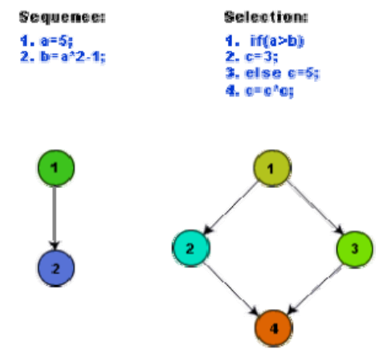

Slide 43
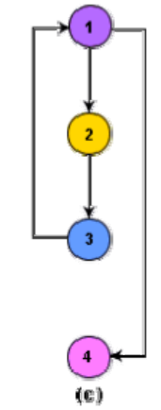
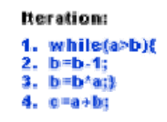

Slide 44
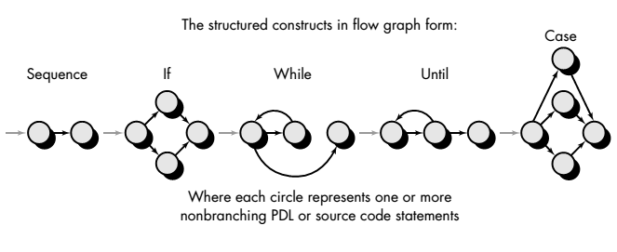

Slide 45
each circle, called a flow graph node, represents one or more procedural statements.
The arrows on the flow graph, called edges or links, represent flow of control.
Areas bounded by edges and nodes are called regions.
When counting regions, we include the area outside the graph as a region.
When compound conditions are encountered in a procedural design, the generation of a flow graph becomes slightly more complicated. A compound condition occurs when one or more Boolean operators (logical OR, AND, NAND, NOR) is present in a conditional statement.
Each node that contains a condition is called a predicate node and is characterized by two or more edges emanating from it.
Each compound condition in a conditional expression containing one or more Boolean operators (e.g., and, or) is represented by a separate predicate node
A predicate node has two edges leading out from it (True and False)

Slide 46
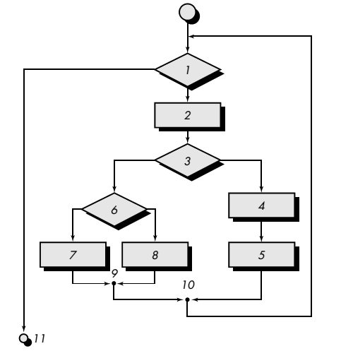
Consider flow-chart

Slide 47
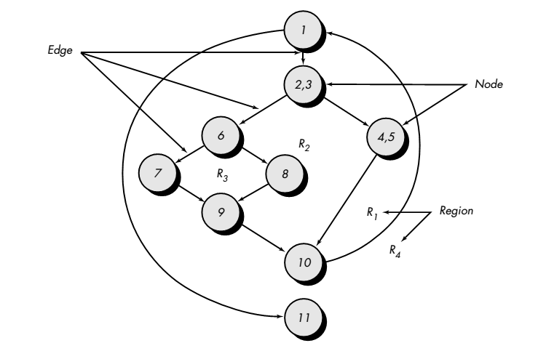
Corresponding Flow-Graph

Slide 48
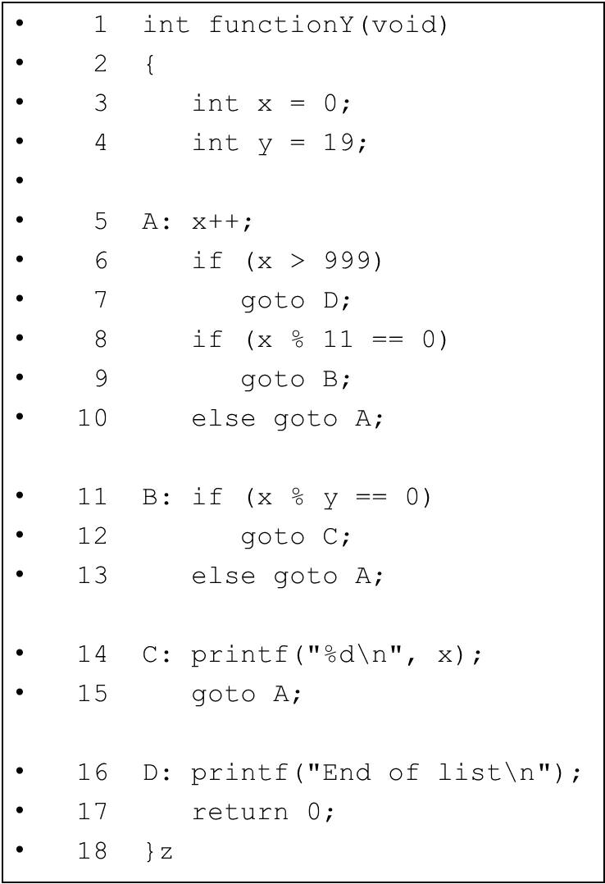

Slide 49
A Second Flow Graph Example
3
4
5
6
8
7
10
9
16
11
17
13
12
14
15

Slide 50
A Sample Function to Diagram and Analyze
1 int functionZ(int y)
2 {
3 int x = 0;
4 while (x <= (y * y))
5 {
6 if ((x % 11 == 0) &&
7 (x % y == 0))
8 {
9 printf(“%d”, x);
10 x++;
11 } // End if
12 else if ((x % 7 == 0) ||
13 (x % y == 1))
14 {
15 printf(“%d”, y);
16 x = x + 2;
} // End else
18 printf(“\n”);
19 } // End while
20 printf("End of list\n");
21 return 0;
22 } // End functionZ
3
4
6
7
9
12
13
10
15
16
18
20
21

Slide 51
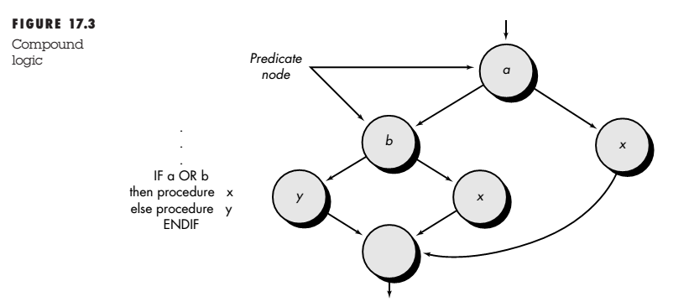
Compound logic

Slide 52
Cyclomatic Complexity
Cyclomatic complexity is a software metric that provides a quantitative measure of the logical complexity of a program.
When used in the context of the basis path testing method, the value computed for cyclomatic complexity defines the number of independent paths in the basis set of a program and provides us with an upper bound for the number of tests that must be conducted to ensure that all statements have been executed at least once.

Slide 53
Path
A path through a program is a node and edge sequence from the starting node to a terminal node of the control flow graph of a program. There can be more than one terminal node in a program.
Writing test cases to cover all the paths of a typical program is impractical. For this reason, the path-coverage testing does not require coverage of all paths but only coverage of linearly independent paths.

Slide 54
linearly independent path
A linearly independent path is any path through the program that introduces at least one new edge that is not included in any other linearly independent paths.
If a path has one new node compared to all other linearly independent paths.
For example, a set of independent paths for the flow graph illustrated in Figure

Slide 55
path 1: 1-11 path 2: 1-2-3-4-5-10-1-11 path 3: 1-2-3-6-8-9-10-1-11 path 4: 1-2-3-6-7-9-10-1-11

Slide 56
Methods
There are three different ways to compute the cyclomatic complexity.
The number of regions of the flow graph correspond to the cyclomatic complexity.
Cyclomatic complexity, V(G), for a flow graph, G, is defined as V(G) = E - N + 2 where E is the number of flow graph edges, N is the number of flow graph nodes.
Cyclomatic complexity, V(G), for a flow graph, G, is also defined as V(G) = P + 1 where P is the number of predicate nodes contained in the flow graph G.

Slide 57
Example
1. The flow graph has four regions. 2. V(G) = 11 edges 9 nodes + 2 = 4. 3. V(G) = 3 predicate nodes + 1 = 4.

Slide 58
Graph matrices
A graph matrix is a square matrix whose size (i.e., number of rows and columns) is equal to the number of nodes on the flow graph. Each row and column corresponds to an identified node, and matrix entries correspond to connections (an edge) between nodes.

Slide 59
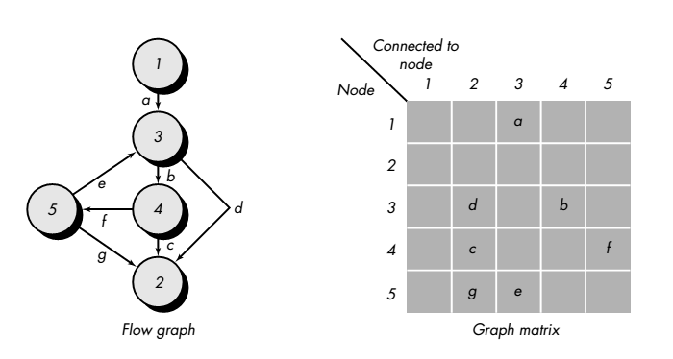

Slide 60
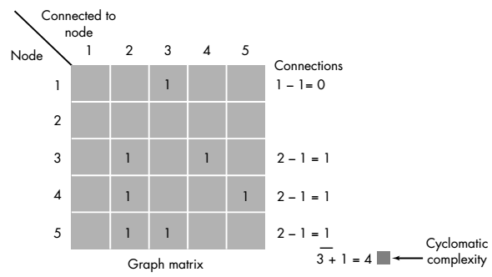
Each letter has been replaced with a 1, indicating that a connection exists (zeros have been excluded for clarity). Represented in this form, the graph matrix is called a connection matrix.
Each row with two or more entries represents a predicate node.

Slide 61
Loop Testing - General
A white-box testing technique that focuses exclusively on the validity of loop constructs
Four different classes of loops exist
Simple loops
Nested loops
Concatenated loops
Unstructured loops

Slide 62
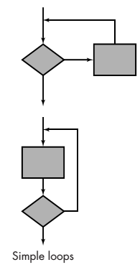
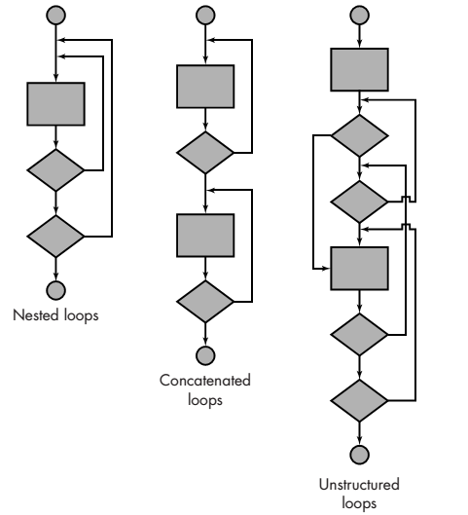

Slide 63
Testing of Simple Loops
Skip the loop entirely
Only one pass through the loop
Two passes through the loop
m passes through the loop, where m < n
n –1, n, n + 1 passes through the loop
‘n’ is the maximum number of allowable passes through the loop

Slide 64
Testing of Nested Loops
Start at the innermost loop; set all other loops to minimum values
Conduct simple loop tests for the innermost loop while holding the outer loops at their minimum iteration parameter values; add other tests for out-of-range or excluded values
Work outward, conducting tests for the next loop, but keeping all other outer loops at minimum values and other nested loops to “typical” values
Continue until all loops have been tested

Slide 65
Testing Concatenated Loop
Concatenated loops can be tested using the approach defined for simple loops, if each of the loops is independent of the other. However, if two loops are concatenated and the loop counter for loop 1 is used as the initial value for loop 2, then the loops are not independent. When the loops are not independent, the approach applied to nested loops is recommended.

Slide 66
Testing Unstructured Loops
Whenever possible, this class of loops should be redesigned to reflect the use of the structured programming constructs.

Slide 67
Black Box Testing
Black-box testing, also called behavioral testing, focuses on the functional requirements of the software.
Black-box testing enables the software engineer to derive sets of input conditions that will fully exercise all functional requirements for a program.

Slide 68
Black-box Testing Categories
Incorrect or missing functions
Interface errors
Errors in data structures or external data base access
Behavior or performance errors
Initialization and termination errors

Slide 69
Questions answered by Black-box Testing
How is functional validity tested?
How are system behavior and performance tested?
What classes of input will make good test cases?
Is the system particularly sensitive to certain input values?
How are the boundary values of a data class isolated?
What data rates and data volume can the system tolerate?
What effect will specific combinations of data have on system operation?

Slide 70
Equivalence Partitioning
Equivalence partitioning is a black-box testing method that divides the input domain of a program into classes of data from which test cases can be derived.
An ideal test case single-handedly uncovers a class of errors that might otherwise require many cases to be executed before the general error is observed.
Equivalence partitioning strives to define a test case that uncovers classes of errors, thereby reducing the total number of test cases that must be developed.
An equivalence class represents a set of valid or invalid states for input conditions.
Typically, an input condition is either a specific numeric value, a range of values, a set of related values, or a Boolean condition.

Slide 71
Equivalence Partitioning
Equivalence classes may be defined according to the following guidelines: 1. If an input condition specifies a range, one valid and two invalid equivalence classes are defined. 2. If an input condition requires a specific value, one valid and two invalid equivalence classes are defined. 3. If an input condition specifies a member of a set, one valid and one invalid equivalence class are defined. 4. If an input condition is Boolean, one valid and one invalid class are defined.

Slide 72
Guidelines for Defining Equivalence Classes
If an input condition specifies a range, one valid and two invalid equivalence classes are defined
Input range: 1 – 10 Eq classes: {1..10}, {x < 1}, {x > 10}
If an input condition requires a specific value, one valid and two invalid equivalence classes are defined
Input value: 250 Eq classes: {250}, {x < 250}, {x > 250}
If an input condition specifies a member of a set, one valid and one invalid equivalence class are defined
Input set: {-2.5, 7.3, 8.4} Eq classes: {-2.5, 7.3, 8.4}, {any other x}
If an input condition is a Boolean value, one valid and one invalid class are define
Input: {true condition} Eq classes: {true condition}, {false condition}

Slide 73
Boundary Value Analysis
A greater number of errors occur at the boundaries of the input domain rather than in the "center"
Boundary value analysis is a test case design method that complements equivalence partitioning
It selects test cases at the edges of a class
It derives test cases from both the input domain and output domain

Slide 74
Data flow based testing
Def (defined)
C-use (actual use)
P-use (predicate, use to transfer control)

Slide 75
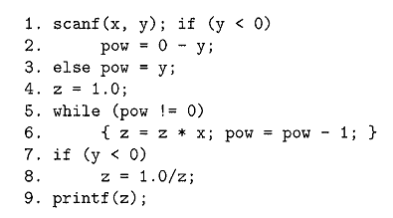
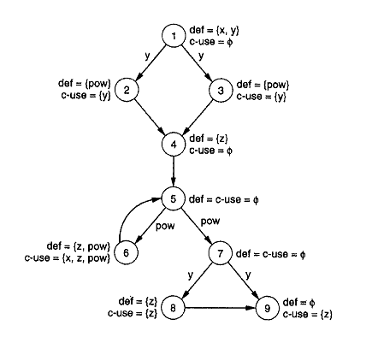
Data flow (def/use graph)

