Slide 1
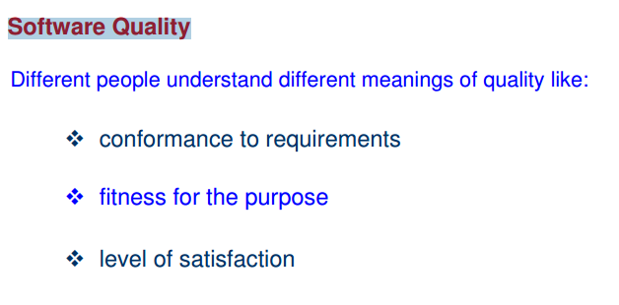
Quality

Slide 2
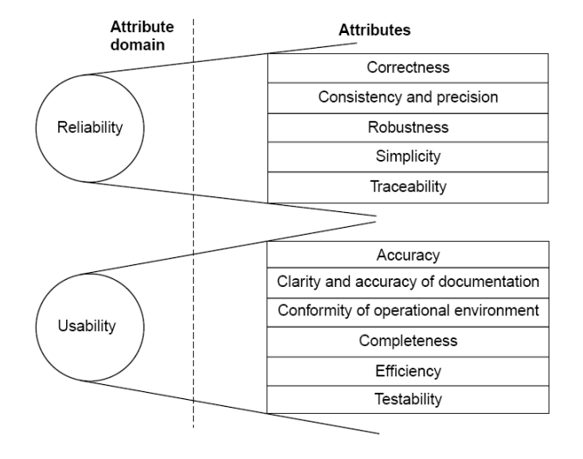
Software quality attributes

Slide 3
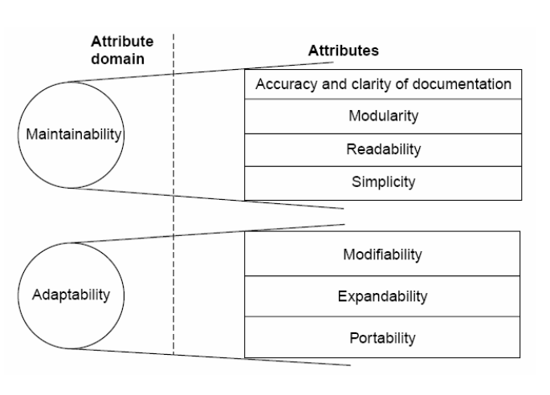
Software quality attributes

Slide 4
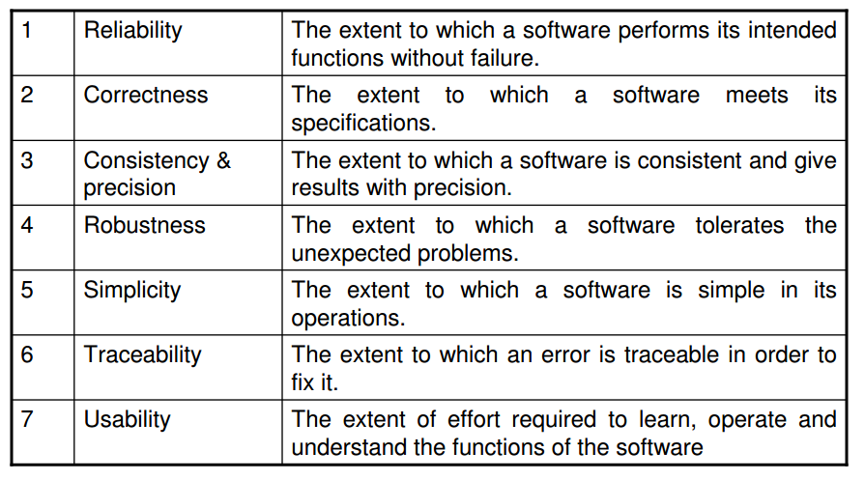
Understanding

Slide 5
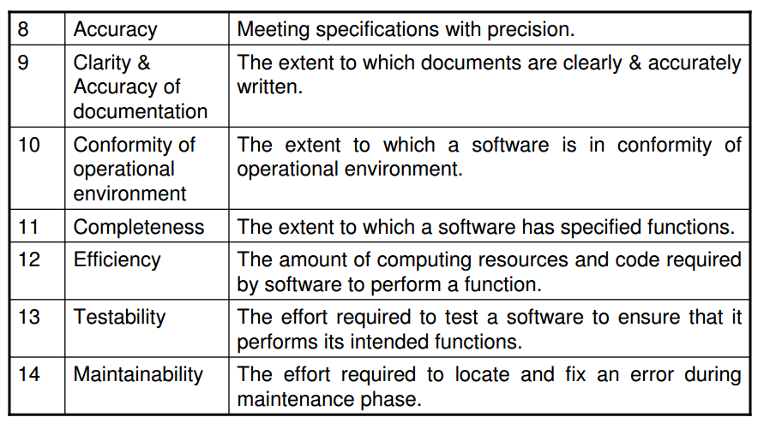
Understanding

Slide 6
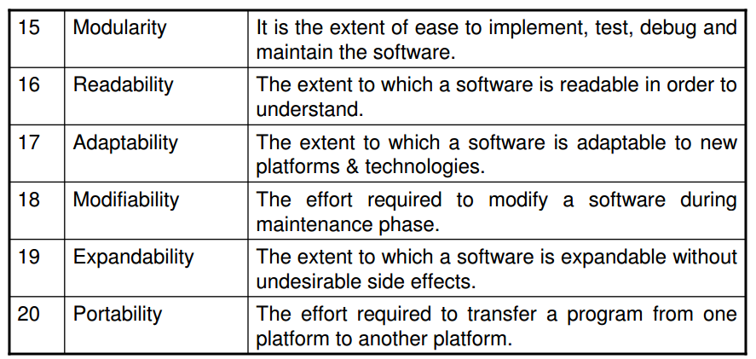
Understanding

Slide 7
McCall Software quality model
The model distinguishes between two levels of quality attributes. Higher level quality attributes are known as quality factors. These are external attributes and can be measured directly.
The second level attributes is named as quality criteria can be measured either subjectively or objectively.

Slide 8
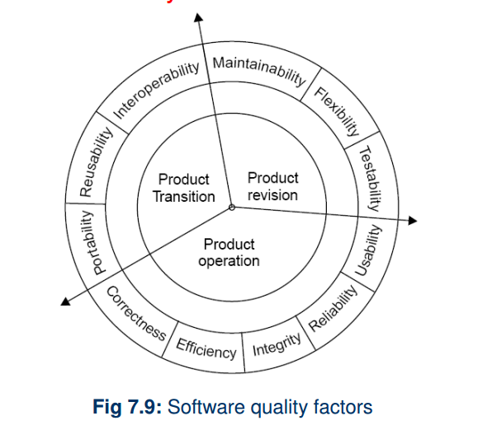
McCall Software quality model

Slide 9
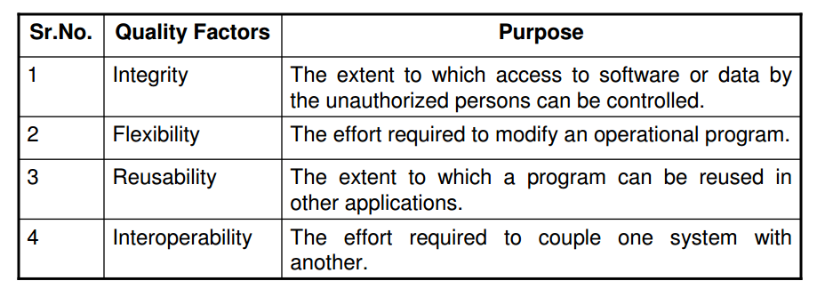
McCall Software quality model
Remaining quality attributes….

Slide 10
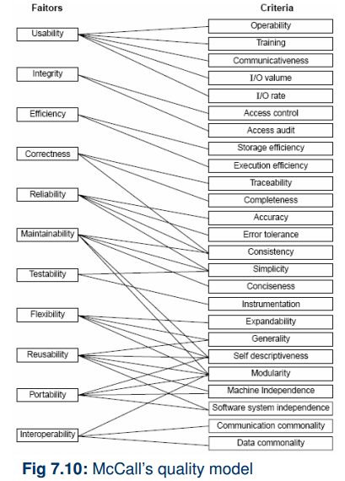

Slide 11
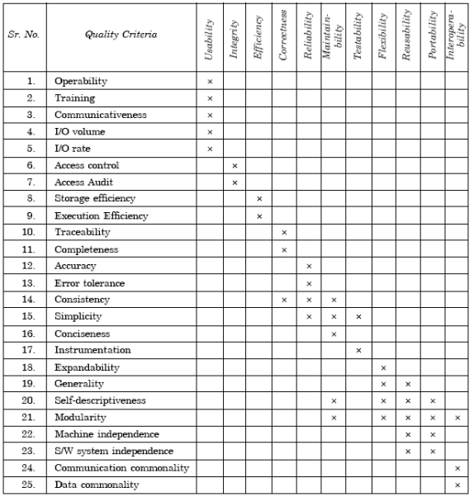

Slide 12
Risk Management
RM means dealing with the concern before it become a crisis.

Slide 13
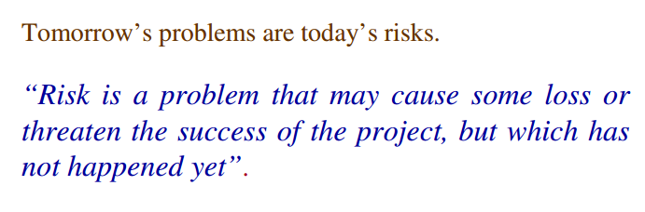
What is risk ?

Slide 14
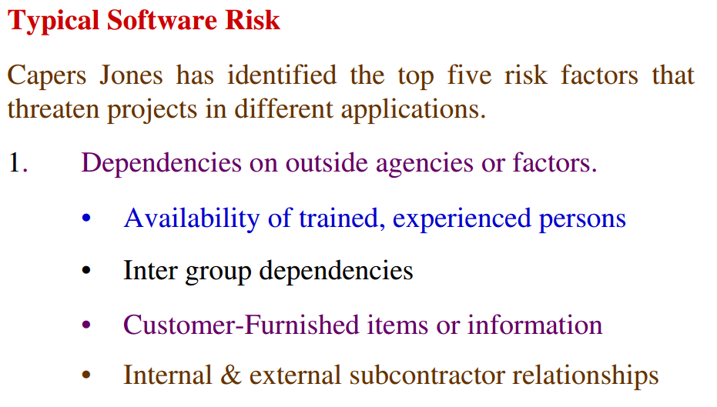
Typical software risks

Slide 15
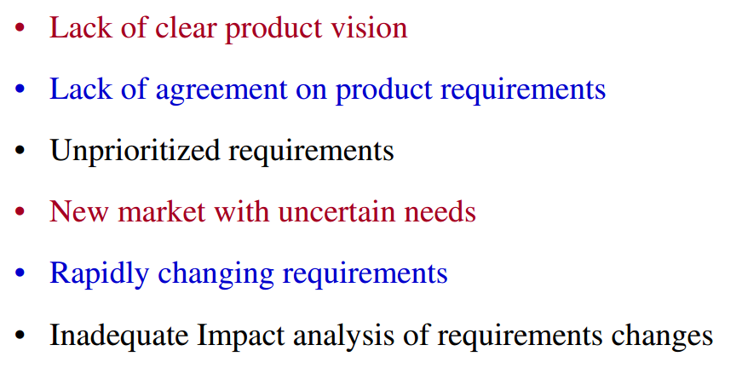
2. Requirements issues

Slide 16
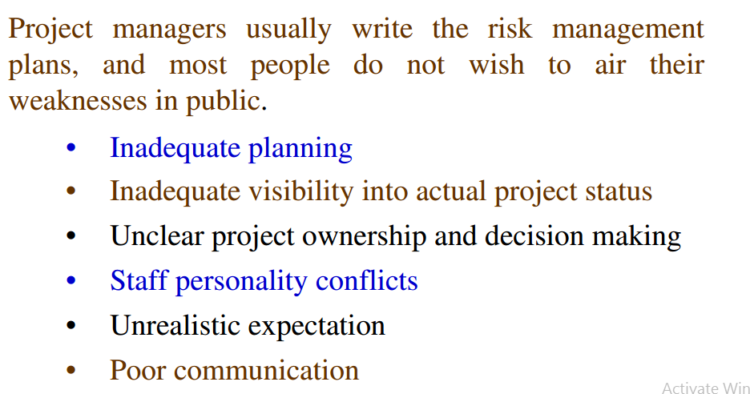
3. Management issues

Slide 17
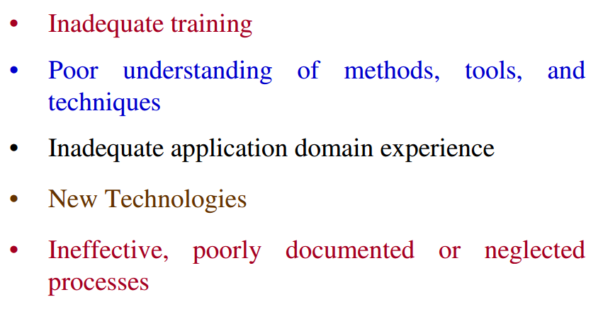
4. Lack of knowledge

Slide 18
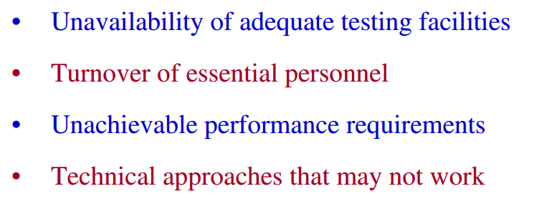
5. Other risk catagories

Slide 19
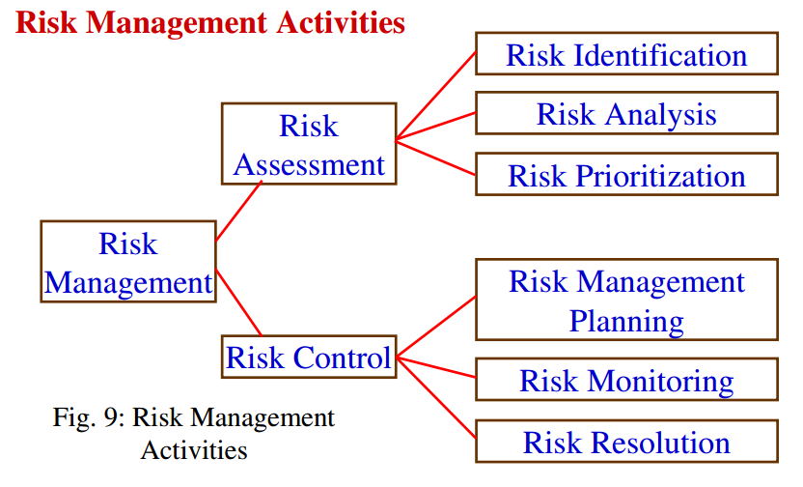
Risk management activities (KK Agarwal)

Slide 20
Risk Management Process
Risk Management is a five step process:
Step 1 – Establish the context
Step 2 – Identify the risks
Step 3 – Analyse the risks
Step 4 – Evaluate the risks
Step 5 – Treat the risks

Slide 21
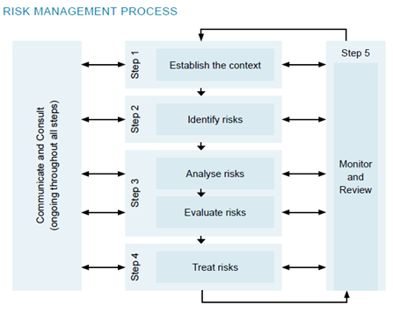

Slide 22
Step 1 – Establish the context
Before risk can be clearly understood and dealt with, it is important to understand the context in which it exists.

Slide 23
Step 2 – Identify the risks
The purpose of this step is to identify what could go wrong (likelihood) and what is the consequence (loss or damage) of it occurring.
Key questions to ask include:
What can happen?
How and why it can happen? List the possible causes and scenarios or description of the risk, incident or accident.
What is the likelihood of them happening?
What will be the consequences if they do happen?

Slide 24
Risks can be physical, financial, ethical or legal.
Physical risks are those involving personal injuries, environmental and weather conditions and the physical assets of the organisation such as property, buildings, equipment, vehicles, stock and grounds.
Financial risks are those that involve the assets of the organisation and include theft, fraud, loans, license fees, attendances, membership fees, insurance costs, lease payments, pay-out of damages claims or penalties and fines by the government.
Ethical risks involve actual or potential harm to the reputation or beliefs of your club, while legal risks consist of responsibilities imposed on providers, participants and consumers arising from laws made by federal, state and local government authorities.

Slide 25
Step 3 – Analyse the risks (& evaluate)
This involves analysing the likelihood and consequences of each identified risk and deciding which risk factors will potentially have the greatest effect and should, therefore, receive priority with regard to how they will be managed.
The level of risk is analysed by combining estimates of likelihood (table 1) and consequences (table 2), to determine the priority level of the risk (table 3).

Slide 26
Table 1– Likelihood scale
Question – what is the likelihood of the risk event occurring?
Rating | LIKELIHOOD The potential for problems to occur in a year
5 | ALMOST CERTAIN: will probably occur, could occur several times per year
4 | LIKELY: high probability, likely to arise once per year
3 | POSSIBLE: reasonable likelihood that it may arise over a five-year period
2 | UNLIKELY: plausible, could occur over a five to ten year period
1 | RARE: very unlikely but not impossible, unlikely over a ten year period

Slide 27
Table 2 – Loss or damage impact scale
Question: what is the loss or damage impact if the risk event occurred (severity?)
Rating | POTENTIAL IMPACT In terms of the objectives of the club
5 | CATASTROPHIC: most objectives may not be achieved, or several severely affected
4 | MAJOR: most objectives threatened, or one severely affected
3 | MODERATE: some objectives affected, considerable effort to rectify i.e. sport injury – requires medical attention and has some impact on participation in sport and/or other activity
2 | MINOR: easily remedied, with some effort the objectives can be achieved i.e. sport injury requires first aid treatment and prevents immediate participation in sport and/or other activity
1 | NEGLIGIBLE: very small impact, rectified by normal processes i.e. sport injury but does not prevent participation

Slide 28
Risk priority
The risk priority scale determines the nature of the risk and the action required. They are indicators to assist in the decision making of what action is warranted for the risks.
Question: what is the risk priority?
Table 3– Risk priority scale

Slide 29
 | 5 Catastrophic |  | 4 Major |  | 3 Moderate |  | 2 Minor |  | 1 Negligible
5 L I K E L I H O O D Almost certain |  | Extreme (1) |  | Extreme (1) |  | Major (2) |  | Major (2) |  | Medium (3)
4 Likely |  | Extreme (1) |  | Extreme (1) |  | Major (2) |  | Medium (3) |  | Minor (4)
3 Possible |  | Extreme (1) |  | Major (2) |  | Major (2) |  | Medium (3) |  | Minor (4)
2 Unlikely |  | Major (2) |  | Major (2) |  | Medium (3) |  | Minor (4) |  | Minor (4)
1 Rare |  | Medium (3) |  | Medium (3) |  | Minor (4) |  | Minor (4) |  | Minor (4)

Slide 30
Extreme | Extreme risks that are likely to arise and have potentially serious consequences requiring urgent attention
Major | Major risks that are likely to arise and have potentially serious consequences requiring urgent attention or investigation
Medium | Medium risks that are likely to arise or have serious consequences requiring attention
Minor | Minor risks and low consequences that may be managed by routine procedures

Slide 31
Step 4 – Treat the risks
Risk treatment involves identifying the range of options for treating the risk, evaluating those options, preparing the risk treatment plans and implementing those plans.
According to the standard, treatment options include:
Accepting the risk – for example most people would consider minor injuries in participating in the sporting activity as being an inherent risk.
Avoiding the risk is about your club deciding either not to proceed with an activity, or choosing an alternate activity with acceptable risk which meets the objects of your club. For example, a cricket club wishing to raise funds may decide that a rock climbing competition without a properly trained and accredited instructor, equipment etc may decide a safer way of raising funds.
Reducing the risk likelihood or consequences or both is commonly practiced treatment of a risk within sport, for example use of mouth guards for players in some sports i.e. contact sports.

Slide 32
Transferring the risk in full or in part, will generally occur through contracts or notices for example your insurance contract is perhaps the most commonly used risk transfer form used. Other examples include lease agreements, waivers, disclaimers, tickets, and warning signs.
Financing the risk means the club funding the consequences of risk i.e. providing funds to cover the costs of implementing the risk treatment. Most community non profit sport clubs would not consider this option.

Slide 33
Step 5 – Monitor and review
monitoring and review is an ongoing part of risk management that is integral to every step of the process.
Monitoring and review ensure that the important information generated by the risk management process is captured, used and maintained.

