Slide 1
The spiral model, Quadrants and it’s Scope
By :
Shelly
shelly@ddn.upes.ac.in

Slide 2
SPIRAL MODEL?
The spiral model, also known as the spiral lifecycle model, is a systems development method (SDM) used in information technology (IT).
This model of development combines the features of the prototyping model and the waterfall model. The spiral model is intended for large, expensive, and complicated projects.

Slide 3
HISTORY
The spiral model was defined by Barry Boehm in 1988
It was not the first model to discuss iterative development, but it was the first model to explain why the iteration matters.
The iterations were typically 6 months to 2 years
long.

Slide 4
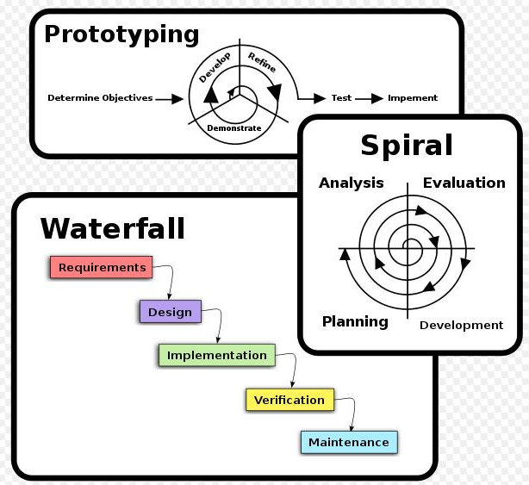

Slide 5
When to use The spiral Model?
-The user has experience to refine the requirements .
-Some parts of the implementation may depend on future technology
-New user requirements are anticipated but not yet known
-Some user requirements may be significantly more difficult to meet than others, and it is decided not to allow them to delay a usable delivery

Slide 6
Spiral Model VS Waterfall Model
Risk factor is considered in the Spiral Model but in water fall Model it is not considered.
In Waterfall the requirements are freezed but this does not happens in the Spiral Model.
Waterfall Model is linear sequential model where Spiral Model works in loop.
Spiral Model is costly as Risk factor is covered.
In spiral model there is a better communication between developer and customer.

Slide 7
Spiral Model VS prototype model
number of phases of spiral model is not fixed-whereas in prototype model number of phases is fixed .
Risk factor is considered in the Spiral Model but in water fall Model it is not considered
Spiral model includes many prototype models
Spiral model is used when requirement is not clear and needs conformation while in prototype model requirement is clear but complex
In spiral model customer interaction continous to move together. in other hand prototype model customer interaction needs till the prototype is app

Slide 8
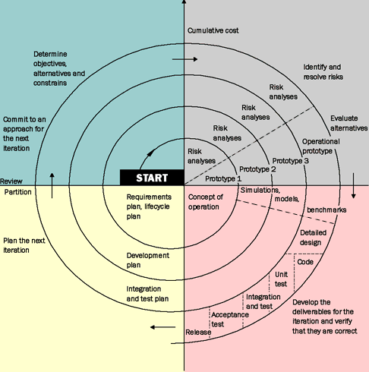

Slide 9
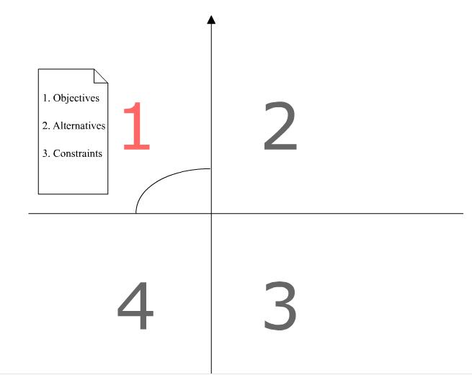
Spiral Model Description
Quadrant 1: Determine objectives, alternatives, and constraints:
Objectives: performance, hardware/software interface , functionality, etc.
Alternatives: design, reuse, buy, etc.
constraints : imposed on technology, cost, schedule, support, and risk.
Once the system‘s objectives, alternatives, and constraints are understood, Quadrant 2 (Evaluate alternatives, identify, and resolve risks) is performed

Slide 10
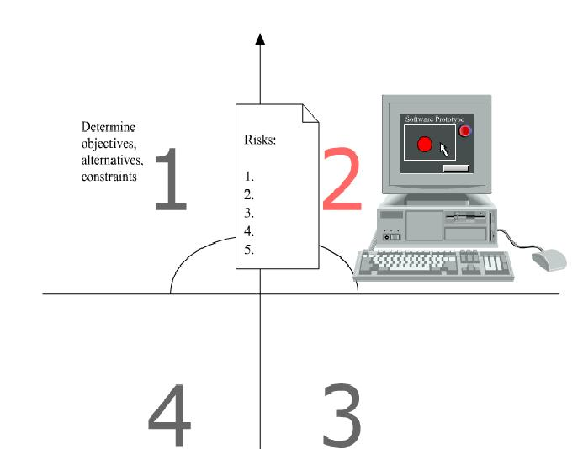
Quadrant 2: Evaluate alternatives, identify, resolve risks:
The focus here is on risk study. Each alternative is investigated and prototyped to reduce the risk associated with the development decisions
Study alternatives relative to objectives and constraints
Identify risks (lack of experience, new technology, tight schedules, poor process, etc.
Resolve risks (evaluate if money could be lost by continuing system development

Slide 11
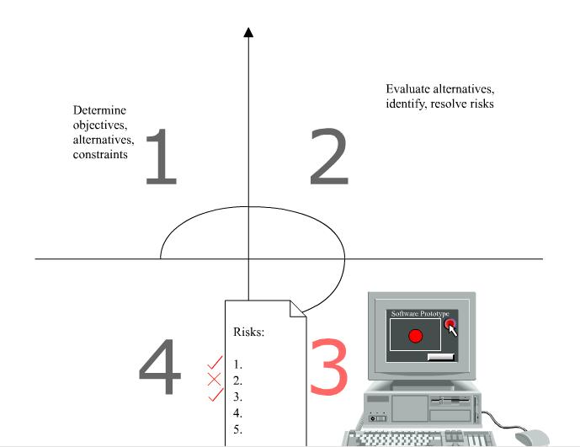
Quadrant 3: Develop, verify, next-level product.
Typical activities
Create a design
Review design
Develop code
Inspect code
Test product

Slide 12
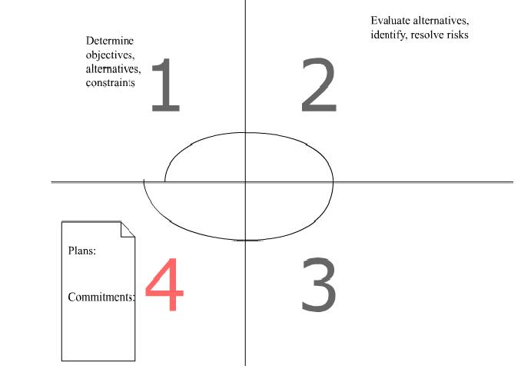
Quadrant 4: Plan next phases.
Typical activities
Develop project plan
Develop configuration management plan
Develop a test plan
Develop an installation plan

Slide 13
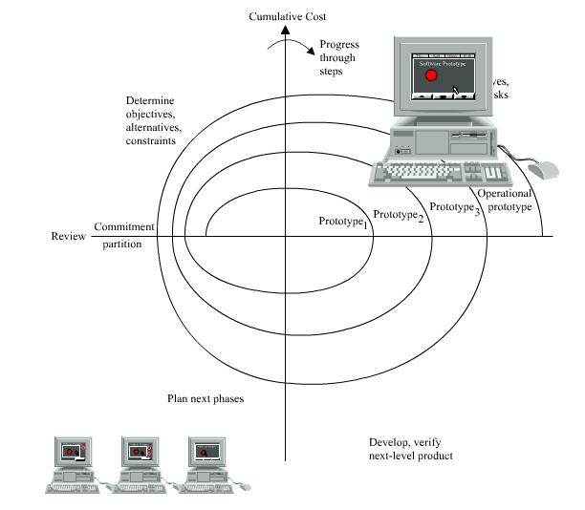

Slide 14
Summary of Spiral steps:
Each successive phase in the project as a new spiral includes a four steps or phases.
Software requirements in the design are gradually developed through a series of prototypes.
The exact number of spirals necessary for the project is flexible and depends on the number of prototypes needed to reach a satisfactory design.
Since each face requires a certain level of commitment a cumulative cost of the project represented by the width of the spiral
Once a satisfactory design is reached the software is constructed according the final three process of the waterfall model (Programming – Integration-Delivery)

Slide 15
ADVANTAGES
Provides early indication of insurmountable risks, without much cost
Users see the system early because of rapid prototyping tools
Critical high-risk functions are developed first
The design does not have to be perfect
Users can be closely tied to all lifecycle steps
Early and frequent feedback from users
Cumulative costs assessed frequently

Slide 16
DISADVANTAGES:
Time spent for evaluating risks too large for small or low-risk projects
Time spent planning, resetting objectives, doing risk analysis and prototyping may be excessive
The model is complex
Risk assessment expertise is required
Spiral may continue indefinitely
Developers must be reassigned during non-development phase activities
May be hard to define objective, verifiable milestones that indicate readiness to proceed through the next iteration

Slide 17
APPLICATIONS:
For a typical shrink-wrap application, the spiral model might mean that you have a rough-cut of user elements (without the polished / pretty graphics) as an operable application, add features in phases, and, at some point, add the final graphics.
The spiral model is used most often in large projects. For smaller projects, the concept of agile software development is becoming a viable alternative.
The US military has adopted the spiral model for its Future Combat Systems program.

