Slide 1
UNIT III: PHYSICAL AND NETWORK SECURITY

Slide 2
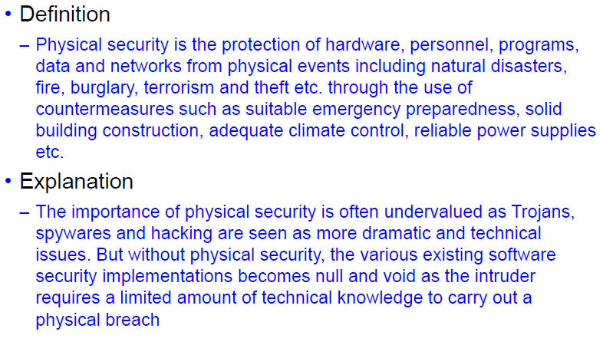
Introduction to Physical Security

Slide 3
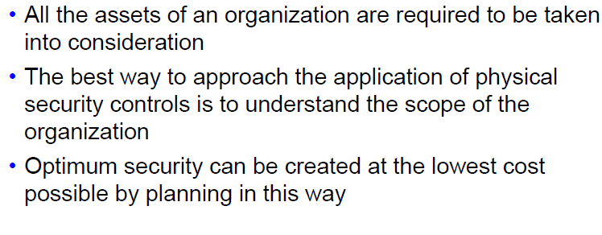
Scope of Physical Security 1

Slide 4
Scope of Physical Security 2
Grounds
Roads
Public roads
Private roads
Buildings

Slide 5
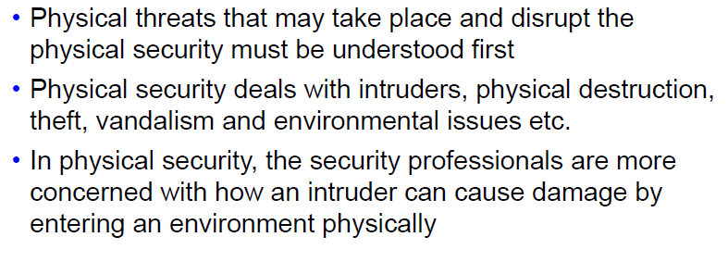
Physical Security Threats 1

Slide 6
Physical Security Threats 2
Threats due to natural environment
Threats due to supply systems
Threats which are man-made
Threats occurring because of political motivation

Slide 7
Physical Security Controls
Can be used to protect organization’s assets.
There is a need to understand the assets that need to be protected, where they are located, and what threats, vulnerabilities, and risks pertain to them.

Slide 8
Categories of Physical Security Controls
Security in layers
Technical Controls
Logging Controls
Perception as Physical Security

Slide 9
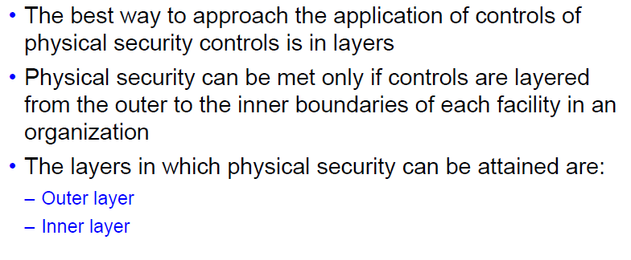
Security in Layers

Slide 10
Security in Layers – Inner Layer
Locks
Keys and Combinations
Patrol Force and Guards

Slide 11
Security in Layers – Outer Layer
Natural Barriers
Structural Barriers
Fences
Walls
Gates

Slide 12
Technical Controls 1
Mantraps
Turnstiles
Biometrics
CCTV Surveillance
Environmental Monitoring Controls
EMI Shielding Controls
Fire Suppression Controls
Power System Controls
Electronic and Electromagnetic Locks
Magnetic Locks

Slide 13
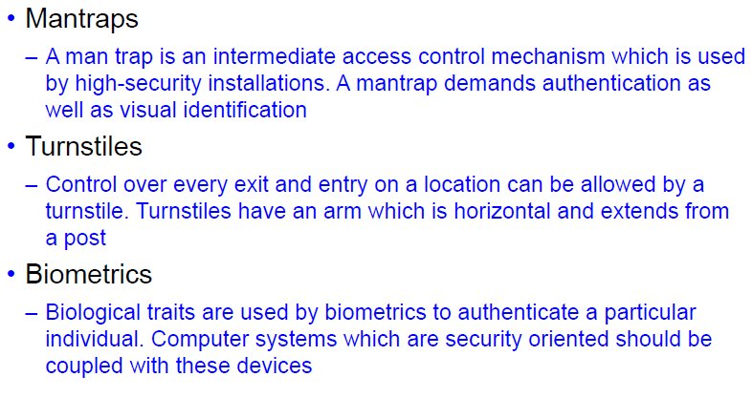
Technical Controls 2

Slide 14
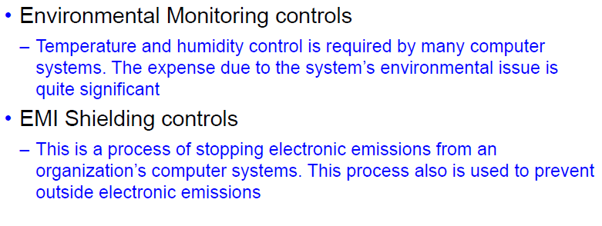
Technical Controls 3

Slide 15
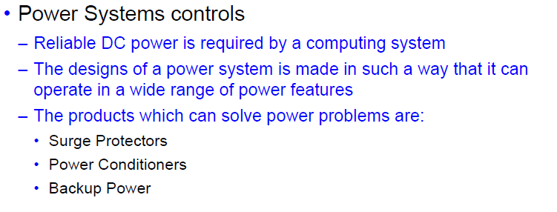
Technical Controls 4

Slide 16
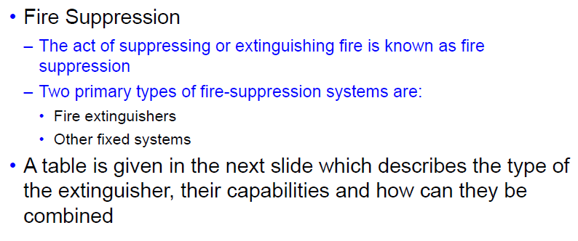
Technical Controls 5

Slide 17
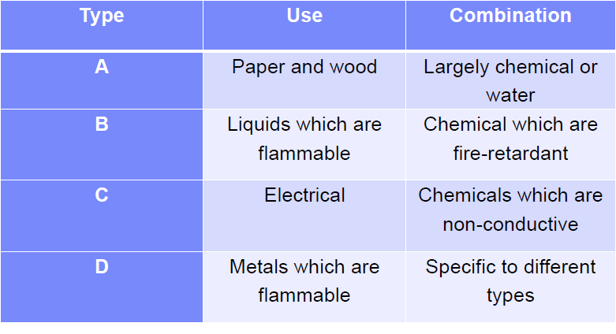
Types of Fire Extinguishers

Slide 18
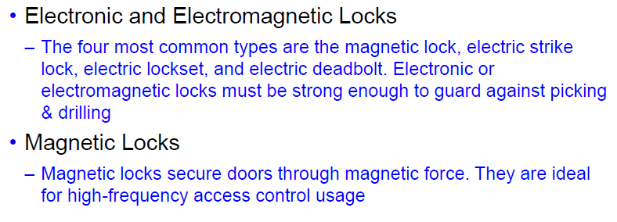
Technical Controls 6

Slide 19
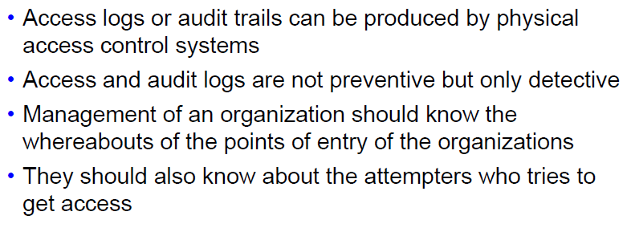
Logging Controls

Slide 20
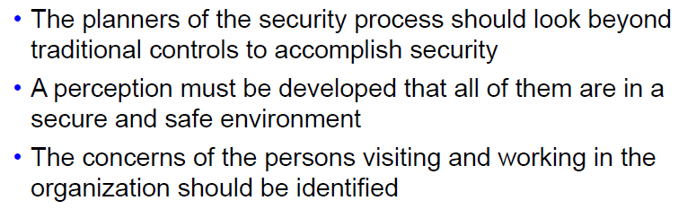
Perception as Protection

Slide 21
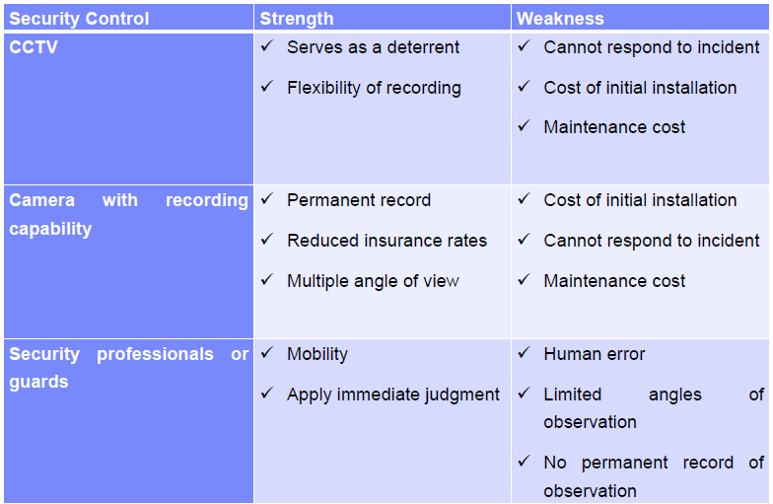
Weaknesses and Strengths of Security Controls

Slide 22
Benefits of Physical Security
Provides workplace security options
Multiple levels of identity verification
Improved response and awareness from combined solutions, improved event categorization
Event triggering between technology types for improved notification, assessment and response
Reduces threat for internal employees
Restricts unauthorized access

Slide 23
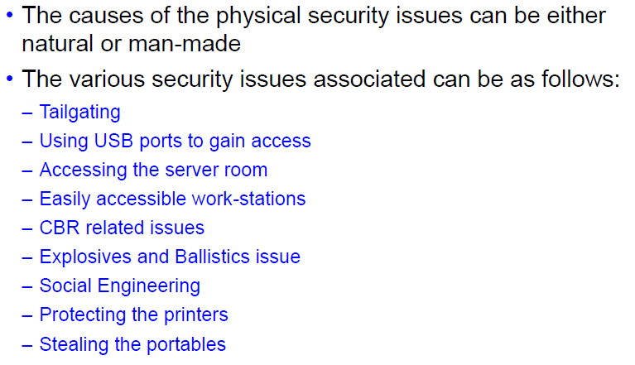
Security Issues Associated 1

Slide 24
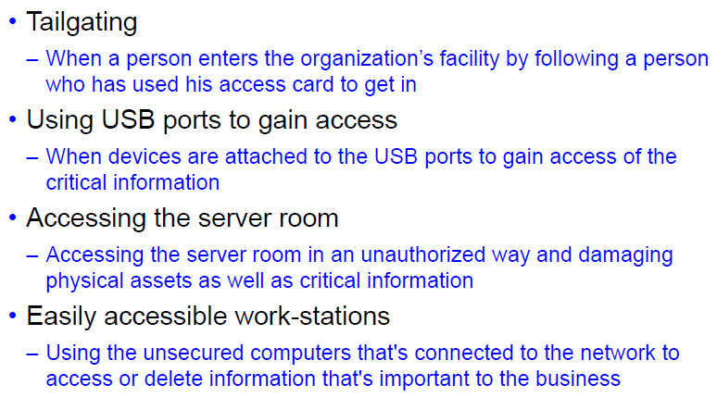
Security Issues Associated 2

Slide 25
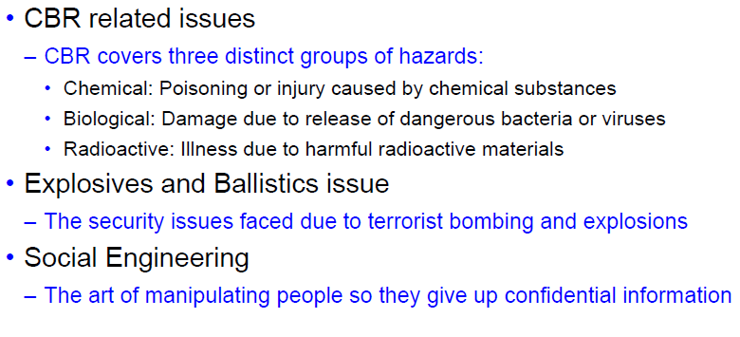
Security Issues Associated 3

Slide 26
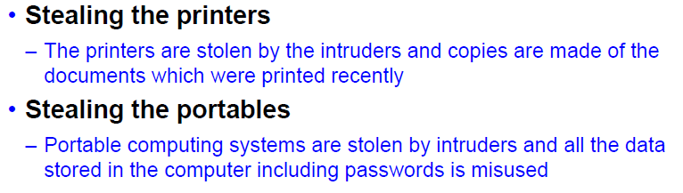
Security Issues Associated 4

Slide 27
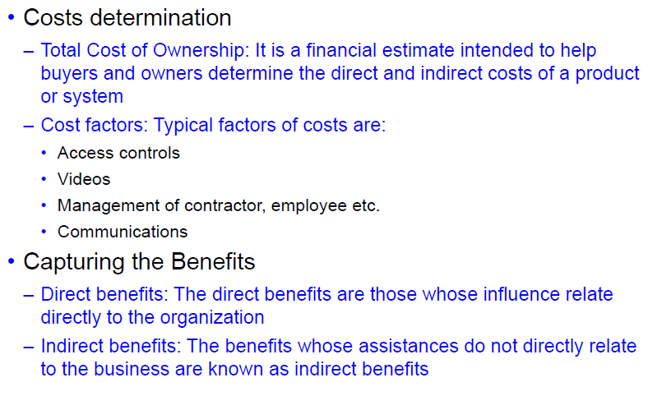
Cost vs. Benefit Analysis

Slide 28

Network Security

Slide 29
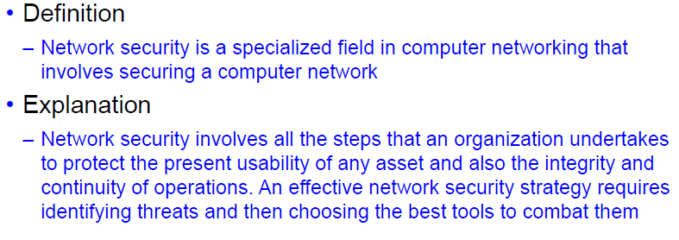
Introduction to Network Security

Slide 30
Scope of Network Security
Every organization has some critical information which needs to be protected.
Network Security deals with all this information whether they are present on the servers or on the network.
Network security can be applied at the perimeter level where the private network interfaces with the public network.
It ultimately protects the entire network architecture of the business.

Slide 31
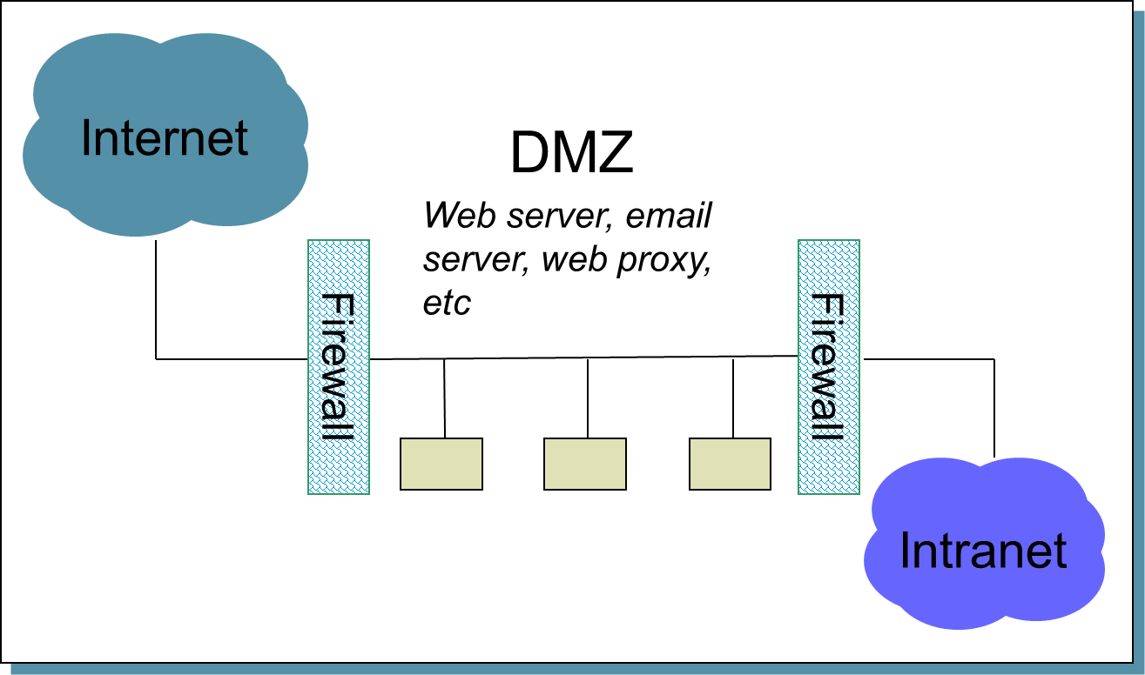
Example

Slide 32
Threats and Vulnerabilities 1
Vulnerability Scanning
Passively Testing Security Controls
Interpreting results
Identifying vulnerability
Identifying lack of security controls
Identifying common misconfigurations
Penetration Testing
Verify that a threat exists
Bypass security controls
Active test security
Exploit vulnerabilities

Slide 33
VAPT
You’ve just deployed an e-commerce site for your small business.
Now what?????

Slide 34
VAPT contd..
Don’t get hacked!!!!!

Slide 35
VAPT contd..
An often overlooked, but very important process in the development of any Internet-facing service is testing it for vulnerabilities, knowing if those vulnerabilities are actually exploitable in a particular environment and, lastly, knowing what the risks of those vulnerabilities are to your firm or product launch.
These three different processes are known as a vulnerability assessment, penetration test and a risk analysis.
Knowing the difference is critical when hiring an outside firm to test the security of your infrastructure or a particular component of your network.

Slide 36
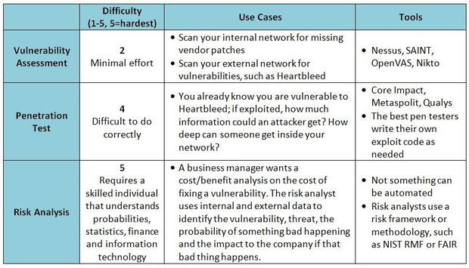
Differences between three:

Slide 37
Vulnerability Scanning
While public servers are important for communication and data transfer over the Internet, they open the door to potential security breaches by threat agents, such as malicious hackers.
Vulnerability scanning employs software that seeks out security flaws based on a database of known flaws, testing systems for the occurrence of these flaws and generating a report of the findings that an individual or an enterprise can use to tighten the network's security.

Slide 38
Vulnerability Scanning
Vulnerability scanning typically refers to the scanning of systems that are connected to the Internet.
But can also refer to system audits on internal networks that are not connected to the Internet in order to assess the threat of rogue software or malicious employees in an enterprise.
For example, the software has signatures for the missing Apache web server patches and will alert if found. The software then produces a report that lists out found vulnerabilities and (depending on the software and options selected) will give an indication of the severity of the vulnerability and basic remediation steps.

Slide 39
Penetration Testing
A penetration Test subjects a system to the real world attacks selected and conducted by the testing personnel.
The benefit of the penetration testing is to identify the extent to which a system can be compromised before the attack is identified and assess the response mechanism’s effectiveness.
Similar to a vulnerability scan, the results are usually ranked by severity and exploitability with remediation steps provided.

Slide 40
Penetration Testing
For example, let’s say a website is vulnerable to Heartbleed. Many websites still are. It’s one thing to run a scan and say “you are vulnerable to Heartbleed” and a completely different thing to exploit the bug and discover the depth of the problem and find out exactly what type of information could be revealed if it was exploited.
This is the main difference – the website or service is actually being penetrated, just like a hacker would do.

Slide 41

Heartbleed Bug!!!!
The Heartbleed Bug is a serious vulnerability in the popular OpenSSL cryptographic software library.
This weakness allows stealing the information protected, under normal conditions, by the SSL/TLS encryption used to secure the Internet. SSL/TLS provides communication security and privacy over the Internet for applications such as web, email, instant messaging (IM) and some virtual private networks (VPNs).
The Heartbleed bug allows anyone on the Internet to read the memory of the systems protected by the vulnerable versions of the OpenSSL software.
This compromises the secret keys used to identify the service providers and to encrypt the traffic, the names and passwords of the users and the actual content. This allows attackers to eavesdrop on communications, steal data directly from the services and users and to impersonate services and users.

Slide 42
Threats and Vulnerabilities 2
Ethical Hacking
Black Box
White Box
Grey Box
Assessment Types and Techniques
Baseline Reporting
Code Review
Determine Attack Surface
Architecture
Design Review

Slide 43
What constitutes Ethical Hacking?
For hacking to be deemed ethical, the hacker must obey the following rules:
Expressed (often written) permission to probe the network and attempt to identify potential security risks.
You respect the individual's or company's privacy.
You close out your work, not leaving anything open for you or someone else to exploit at a later time.
You let the software developer or hardware manufacturer know of any security vulnerabilities you locate in their software or hardware, if not already known by the company.

Slide 44
Black Box Model
This model presupposes that the Ethical Hacker has limited knowledge of the network.
This forces the ethical hacking team to gather a lot of information about the company from various sources prior to launching the penetration attack.

Slide 45
White Box Model
This model presupposes an expansive amount of knowledge about the company and its network.
Furthermore, indicates that the scope of the pre-attack information gathering might include interviews, access to internal network assets, physical security inspections and security policy evaluations.

Slide 46
Grey Box Model
This model combines elements of both the Black Box model and the White Box model providing a hybrid method of attack.
In other words, knowledge concerning some areas will be clearly defined, whereas, other areas will require detective work by the ethical hacking team.

Slide 47
Baseline Reporting
Network baselining is the act of measuring and rating the performance of a network in real-time situations.
Providing a network baseline requires testing and reporting of the physical connectivity, normal network utilization, protocol usage, peak network utilization, and average throughput of the network usage.
Once a network baseline has been established, this information is then used by companies and organizations to determine both present and future network upgrade needs as well as assist in making changes to ensure their current network is optimized for peak performance.

Slide 48
Code Review
Code review is probably the single-most effective technique for identifying security flaws.
When used together with automated tools and manual penetration testing, code review can significantly increase the cost effectiveness of an application security verification effort.

Slide 49
Determine Attack Surface
An attack surface is the total sum of the vulnerabilities in a given computing device or network that are accessible to a hacker.
Anyone trying to break into a system generally starts by scanning the target’s attack surface for possible attack vectors, whether for an active attack or passive attack, ethical hacking or a hacking competition.
An attack vector is a path or means by which a hacker ( or cracker) can gain access to a computer or network server in order to deliver a malicious outcome.

Slide 50
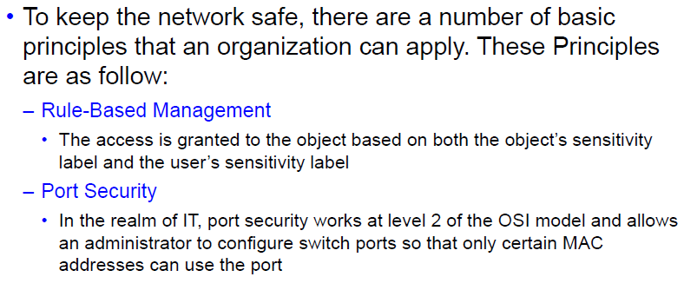
Secure Network Administration Principles and Tools 1

Slide 51
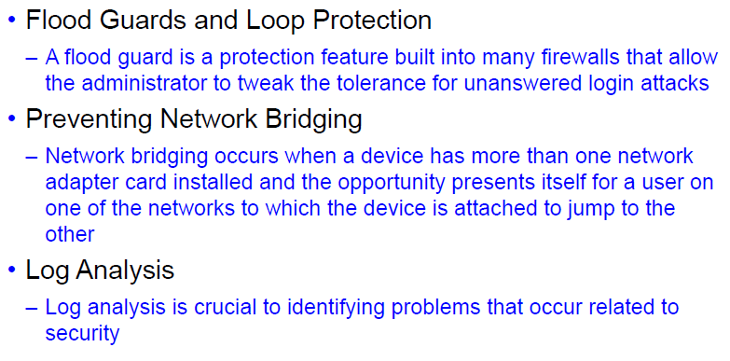
Secure Network Administration Principles and Tools 2

Slide 52
Flood Guards
A flood guard is a protection feature built into many firewalls that allow the administrator to tweak the tolerance for unanswered login attacks.
By reducing the tolerance, it is possible to reduce the likelihood of a successful DoS Attack..
If a resource – inbound or outbound – appears to be overused, then the flood guard kicks in.
With many Cisco firewalls, you can configure the same protection you apply at an upper level to be inherited by children as well in order to protect subgroup and devices.

Slide 53
Loop Protection
It is a similar feature that works in layer 2 switching configurations and is intended to prevent broadcast loops.
When configuring it in most systems, you can choose to disable broadcast forwarding and protect against duplicate ARP requests (those having the same target protocol address.

Slide 54
Network Bridging
It occurs when a device has more than one network adapter card installed and the opportunity presents itself for a user on one of the networks to which the device is attached to jump to the other.
While multiple cards have been used in servers for years, it is not uncommon today to find multiple cards in laptops (wired and wireless) and the bridging to occur without the user truly understanding what is happening.
To prevent network bridging, you can configure your network such that when bridging is detected, you shut off/disable that jack.
You can also create profiles that allow for only one interface.

Slide 55
Network Bridging contd.
In Windows 7, for example, this is accomplished by choosing:
Start → Control Panel → Network and Internet → Network Sharing Center and then clicking Change Adapter settings.
Right clicking a connection will allow you to choose to disable that connection.
It is not uncommon for a network bridge to appear in Network Sharing Center. If it does appear, you will want to delete it.
Windows Internet Connection is often pointed to as a cause of unintended bridging and should be disabled.

Slide 56
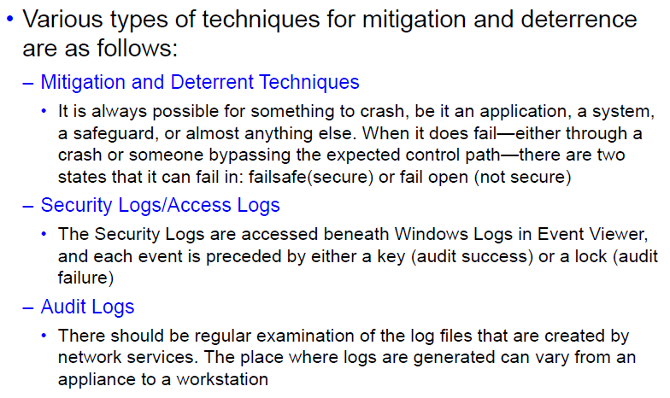
Mitigation and Deterrent Techniques 1

Slide 57
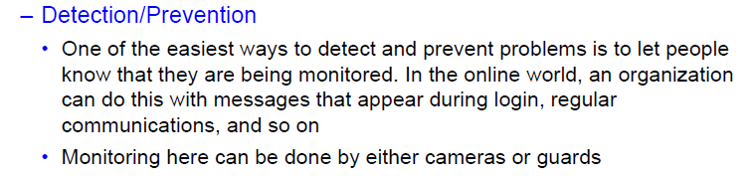
Mitigation and Deterrent Techniques 1

Slide 58
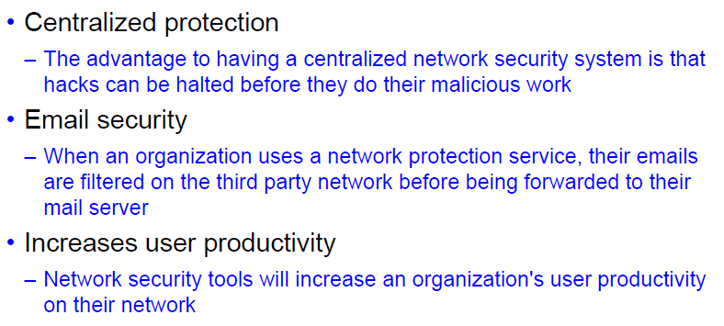
Benefits 1

Slide 59
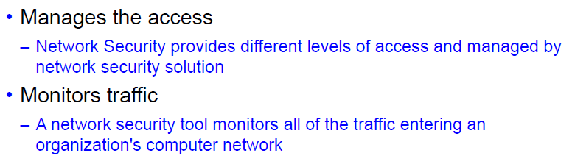
Benefits 2

Slide 60
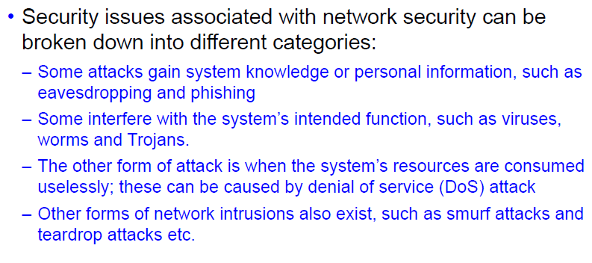
Associated Security Issues

Slide 61
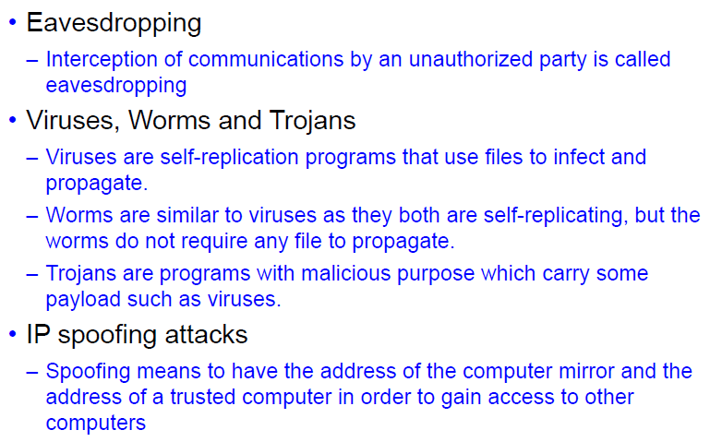
Types of Attacks 1

Slide 62
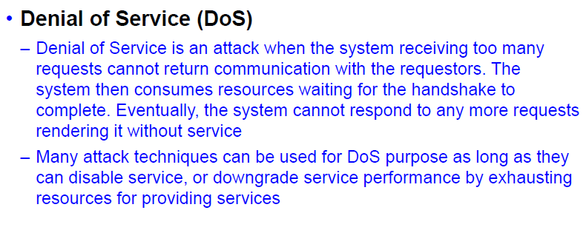
Types of Attacks 2

Slide 63
Viruses, Worms and Trojans
These all are malicious programs that can cause damage to your computer but there are differences amongst these three.
What is a Virus????

Slide 64
Viruses
A computer virus attaches itself to a program or a file enabling it to spread from one computer to another leaving infections as it travels.
Like a human virus, a computer virus can range in severity: some may cause only mildly annoying effects while others can damage your hardware, software or files.
Almost all viruses are attached to an executable file, which means the virus may exist on your computer but actually it cannot infect your computer unless you run or open the malicious program.
It is important to note that a virus cannot be spread without a human action (such as running the infected program.)

Slide 65
Worms
A worm is similar to a virus by design and is considered to be a sub class of virus.
Worms spread from computer to computer, but unlike a virus, it has the capability to travel without any human action.
The biggest danger with a worm is its capability to replicate itself on your system, so rather than your computer sending out a single worm, it could send out hundreds or thousands of copies of itself, creating a huge devastating effect.
One example would be for a worm to send a copy of itself to everyone listed in your e-mail address book. Then, the worm replicates and sends itself out to everyone listed in each of the receiver’s address book, and the manifest continues on down the line.
Due to the copying nature of a worm and its capability to travel across networks, the end result in most cases is that the worm consumes too much system memory (or network bandwidth), causing the web servers and individual computers to stop responding.

Slide 66
Trojans
A Trojan Horse, at first glance will appear to be a useful software but will actually do damage once installed or run on your computer.
Those on the receiving end of a Trojan Horse are actually tricked into opening them because they appear to be receiving legitimate software or files from a legitimate source.
Some Trojans are designed to be more annoying (like changing your desktop, adding silly active desktop icons) or they can cause serious damage by deleting files and destroying information on your system.
Trojans are also known to create a backdoor on your computer that gives malicious users access to your system, possibly allowing confidential or personal information to be compromised.
Unlike viruses and worms, Trojans do not reproduce by infecting other files, nor do they self- replicate.

Slide 67
Denial of Service (DoS)

Slide 68
DoS Attack Explained
The DOS attack makes resources unavailable for genuine users by sending a large number of service requests or exploiting vulnerabilities.
Techniques used by a hacker is sending malicious packets and exploiting already existing programming, logical and application vulnerabilities.
Organizations deploy IDS central logging servers exclusively to store IDS alert logs of all systems in a centralized manner.
If a hacker obtains the central log servers IP address then they could slow it down or even crash it with a DOS attack.
After the server is shut down, attacks could go unnoticed because the alert data is no longer being logged.
Using this technique, hacker can :
• Consume the device’s processing power which allows attacks to go unnoticed
• Cause the admin to take more time to investigate a large number of alarms
• Fill up disk space providing no space or disrupt logged processes
• Cause more alarms that are beyond handling capacity of the management systems, such as databases, ticketing systems etc.,
• Cause the device to lock up

Slide 69
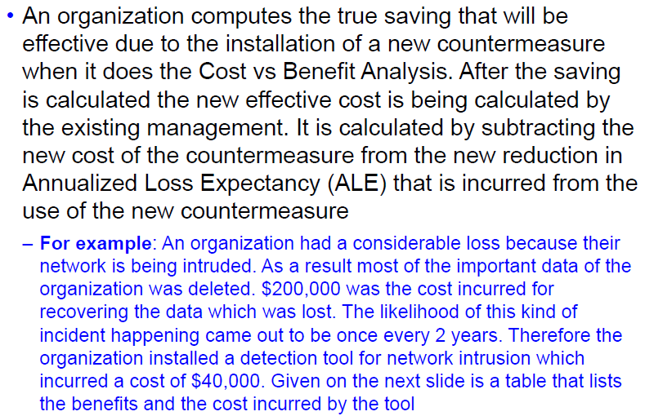
Cost vs. Benefit Analysis

Slide 70
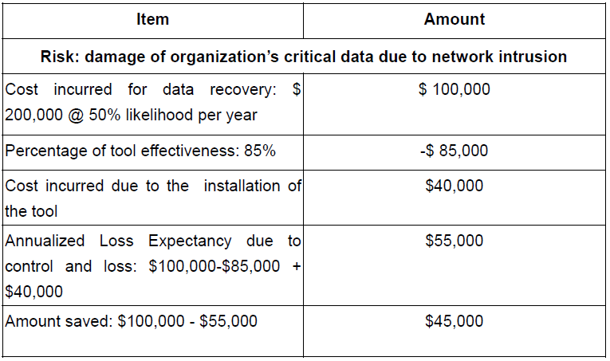
Cost vs. Benefit Table

Slide 71
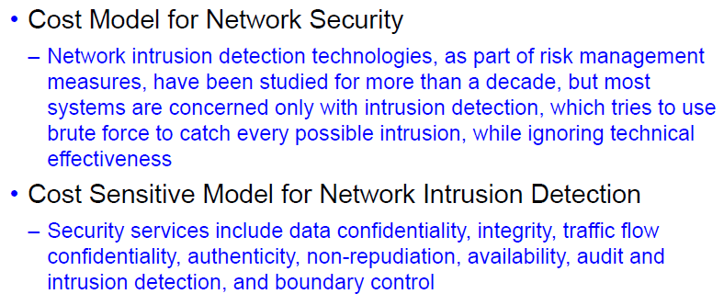
Cost Models

Slide 72
Thank You!!!

