Slide 1
Binary Search - Iterative
For a sorted array A, finds if x is in the array A[lo…hi]
Alg.: BINARY-SEARCH (A, lo, hi x)
{
while (lo ≤ hi)
{
mid ← ⎣(lo+hi)/2⎦
if ( x < A[mid] ) then
hi=mid-1;
else if ( x > A[mid] ) then
lo=mid+1;
else
return mid;
}
return false;
}

Slide 2
Binary Search - Recursive
For a sorted array A, finds if x is in the array A[lo…hi]
Alg.: BINARY-SEARCH (A, lo, hi, x)
{
if (lo > hi)
return FALSE
else
{
mid ← ⎣(lo+hi)/2⎦
if x ==A[mid]
return TRUE
if ( x < A[mid] )
BINARY-SEARCH (A, lo, mid-1, x)
if ( x > A[mid] )
BINARY-SEARCH (A, mid+1, hi, x)
}
}
1
2
3
4
5
6
7
8
2
3
5
7
9
10
11
12
mid
lo
hi

Slide 3
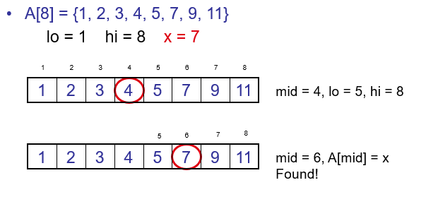
Binary Search - example

Slide 4
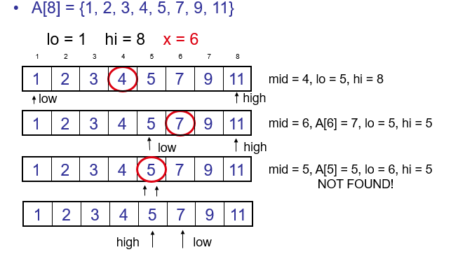
Binary Search - example

Slide 5
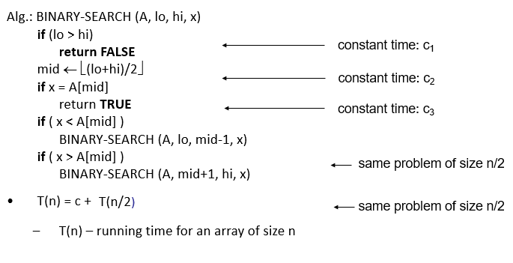
Binary Search - Analysis

Slide 6
Binary Search
Let m denotes the number of comparison required to search an element among the array of n elements.
No of elements(n) Maximum No of comparison (m)
1 1
2 2
3 2
4 3
5 3
6 3
7 3
8 4
9 4
10 4
12 4
14 4
15 4
2^{m-1} ≤ n
(m-1)log2 ≤ log(n)
(m-1) ≤ log(n)/log2
(m-1) ≤ lg(n)
m ≤ lg(n)+1
m=O(lgn)

