Slide 1

Shortest Path Problems
Dijkstra’s Algorithm
TAT ’01 Michelle Wang

Slide 2
Introduction
Many problems can be modeled using graphs with weights assigned to their edges:
  Airline flight times
  Telephone communication costs
  Computer networks response times

Slide 3

Where’s my motivation?
Fastest way to get to school by car
Finding the cheapest flight home
How much wood could a woodchuck chuck if a woodchuck could chuck wood?

Slide 4
Optimal driving time
UCLA
25
The Red Garter
19
5
9
the beach (dude)
16
21
31
In N’ Out
36
My cardboard box on Sunset

Slide 5
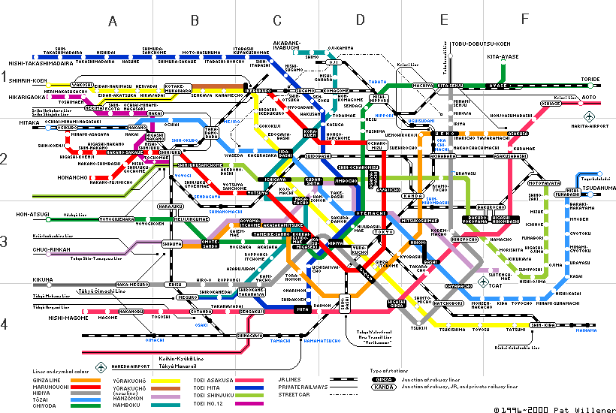
Tokyo Subway Map

Slide 6
Setup:
G = weighted graph
In our version, need POSITIVE weights.
G is a simple connected graph.
  A simple graph G = (V, E) consists of V, a nonempty set of vertices, and E, a set of unordered pairs of distinct elements of V called edges.
A labeling procedure is carried out at each iteration
  A vertex w is labeled with the length of the shortest path from a to w that contains only the vertices already in the distinguished set.

Slide 7
Outline of Algorithm
Label a with 0 and all others with ∞. L₀(a) = 0 and L₀(v) = ∞
Labels are shortest paths from a to vertices
S_{k} = the distinguished set of vertices after k iterations. S₀ = ∅. The set S_{k} is formed by adding a vertex u NOT in S_{k-1} with the smallest label.
Once u is added to S_{k} we update the labels of all the vertices not in S_{k}
To update labels:
L_{k}(a, v) = min{L_{k-1}(a, v),
L_{k-1}(a, u) + w(u, v)}

Slide 8
Using the previous example, we will find the shortest path from a to c.
a
25
r
19
9
5
b
16
21
i
31
36
c

Slide 9
Label a with 0 and all others with ∞. L₀(a) = 0 and L₀(v) = ∞
L₀(a) = 0
25
L₀(r) = ∞
19
9
5
L₀(b) = ∞
16
21
L₀(i) = ∞
31
36
L₀(c) = ∞

Slide 10
Labels are shortest paths from a to vertices.
S₁ = {a, i}
L₁(a) = 0
25
L₁(r) = ∞
19
9
5
L₁(b) = ∞
16
21
L₁(i) = 9
31
36
L₁(c) = ∞

Slide 11
L_{k}(a, v) = min{L_{k-1}(a, v), L_{k-1}(a, u) + w(u, v)}
S₂ = {a, i, b}
L₂(a) = 0
25
L₂(r) = ∞
19
9
5
L₂(b) = 19
16
21
L₂(i) = 9
31
36
L₂(c) = ∞

Slide 12
S₃ = {a, i, b, r}
L₃(a) = 0
25
L₃(r) = 24
19
9
5
L₃(b) = 19
16
21
L₃(i) = 9
31
36
L₃(c) = ∞

Slide 13
S₄ = {a, i, b, r, c}
L₄(a) = 0
25
L₄(r) = 24
19
9
5
L₄(b) = 19
16
21
L₄(i) = 9
31
36
L₄(c) = 45

Slide 14
Remarks
Implementing this algorithm as a computer program, it uses O(n²) operations [additions, comparisons]
Other algorithms exist that account for negative weights
Dijkstra’s algorithm is a single source one. Floyd’s algorithm solves for the shortest path among all pairs of vertices.

Slide 15
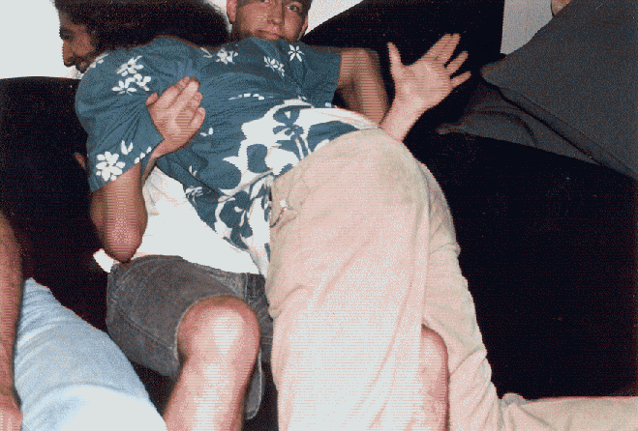
Endnotes 1

Slide 16
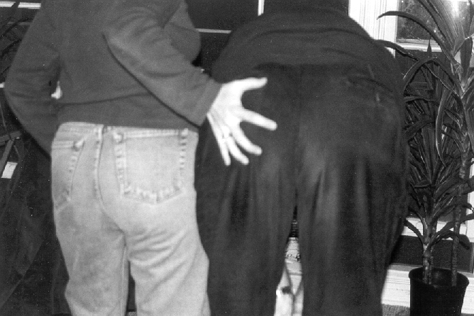
Endnotes 2

Slide 17
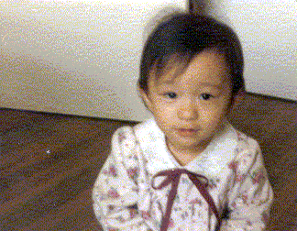
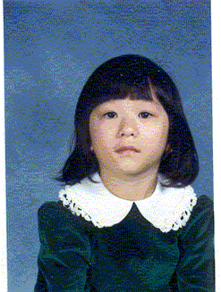
For Math 3975:

