Slide 1
Quicksort
Sort an array A[p…r] where p denotes the starting index and r denotes the ending index
Place the first element at its appropriate position so that all the elements which are smaller than the first element, they are placed on the left side of first element and all the elements which are larger than the first element they are placed on the right side of the first element.
Repeatedly apply the same procedure on the left subarray and right subarray of first elements location till all elements got sorted.

Slide 2
Quicksort Algorithm
Alg.: QUICKSORT(A, p, r)
{
//p denotes the starting index and r denotes the ending index
p=1, r =n
if (p < r)then
{
q ← PARTITION(A, p, r+1)
// q will hold the location where first element has been placed
QUICKSORT (A, p, q-1)
QUICKSORT (A, q+1, r)
// There is no need to combine the solutions.
}
}

Slide 3
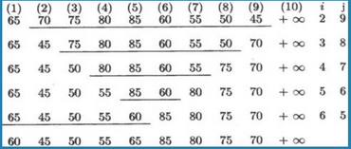
Quicksort- Example

Slide 4
Alg. PARTITION (A, p, r)
{
x ← A[p] // x will hold the value of first element
i ← p // i will hold the location index while moving from left to right
j ← r + 1 // j will hold the location index while moving from right to left
while
{
do repeat
{
i ← i + 1
} until (A[i] ≥ x)
do repeat
{
j ← j – 1
} until (A[j] ≤ x)
if (i < j) then Interchange A[i] ↔ A[j]
} until(i≥ j)
A[p]=A[j]; A[j]=x; return j;
}

Slide 5
Quicksort- Time Complexity –Worst Case Analysis
Worst Case Partitioning
One region has one element and the other has n – 1 elements
Maximally unbalanced
Recurrence: q=1
T(n) = T(1) + T(n – 1) + n,
T(1) = Θ(1)
T(n) = T(n – 1) + n
T(n)=
n
n
1
n - 1
n
1
n - 2
n - 1
n
1
n - 3
n - 2
1
2
3
1
1
2
Θ(n²)

Slide 6
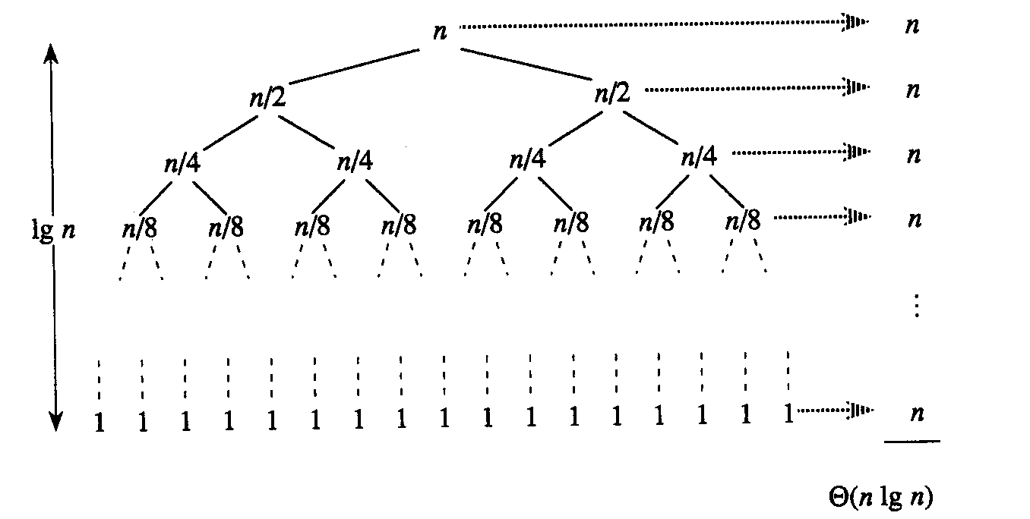
Quicksort- Time Complexity – Best Case Analysis
Best Case Partitioning
Partitioning produces two regions of size n/2
Recurrence: q=n/2
T(n) = 2T(n/2) + Θ(n)
T(n) = Θ(nlgn) (By master theorem)

Slide 7
Quicksort- Time Complexity – Average Case Analysis
Average Case Partitioning
All permutations of the input numbers are equally likely
On a random input array, we will have a mix of well balanced and unbalanced splits
Good and bad splits are randomly distributed across throughout the tree
Recurrence: q=n/2
T(n) = 2T(n/2) + Θ(n)
T(n) = Θ(nlgn) (By master theorem)

