Slide 1
UNIT IV: OPERATING SYSTEM & APPLICATION SECURITY

Slide 2
An Operating System is an intermediary between the user and the hardware of the computer.
The main purpose of an OS is to provide a suitable environment such that the programs can be executed effectively and conveniently.

Slide 3
Distributed Operating System
These are the systems in which data is stored and processed on many machines which are connected by some network. To make it more simple, distributed systems are a collection of several separate(individual) systems which communicate (through a LAN or WAN) and cooperate with each other (using some software) in order to provide the users, access to various resources that the system maintains.
One important point to note about distributed systems is that they are loosely-coupled i.e; hardware and software may communicate with each other but they need not depend upon each other.
Eg: Solaris Operating System

Slide 4
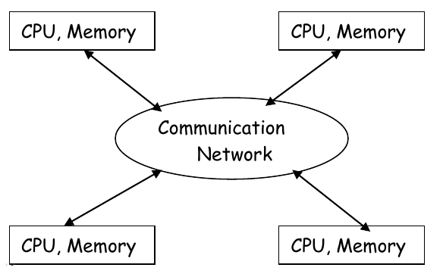

Slide 5
Objectives:
Making resources easily available.
Open & Scalable.
Distribution transparency i.e; the fact that the resources are distributed must be hidden.
Advantages:
Reduced load on the host computer.
Reduced delay in data processing.
Better service to the users.
Disadvantages:
Network Security.
Network complexity.
Unpredictability.

Slide 6
Batch Operating System
In this, jobs which are of similar type are grouped together and treated as a batch. Now, they are stored on the Punch card (a stiff paper in which digital data is stored and represented using some specific sequence of holes) which will be submitted to the system for processing.
The system will then perform all the required operations in a sequence. So, we consider this as a type of Serial processing.
Eg: Bank Statements

Slide 7
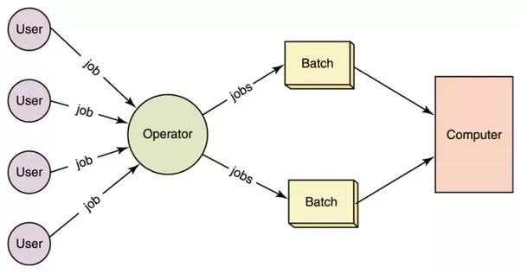

Slide 8
Advantages:
Suppose a job takes a very long time(1 day or so). Then, such processes can be performed even in the absence of humans.
They doesn't require any special hardware and system support to input data.
Disadvantages:
It is very difficult to debug batch systems.
Lack of interaction between user and operating system.
Suppose an error occurs in one of the jobs of a batch. Then, all the remaining jobs get affected i.e; they have to wait until the error is resolved.

Slide 9
Real Time Operating System
A real-time operating system (RTOS) is an operating system (OS) intended to serve real-time applications that process data as it comes in, typically without buffer delays.
Processing time requirements (including any OS delay) are measured in tenths of seconds or shorter increments of time.
Such applications include embedded systems, industrial robots, scientific research equipment and others.

Slide 10
The main task of an RTOS is to manage the resources of the computer such that a particular operation executes in precisely same amount of time every time it occurs.
A common example of an RTOS are the computers found on an aircraft, this is due to the critical moments when every command from the pilot must show a result immediately.

Slide 11
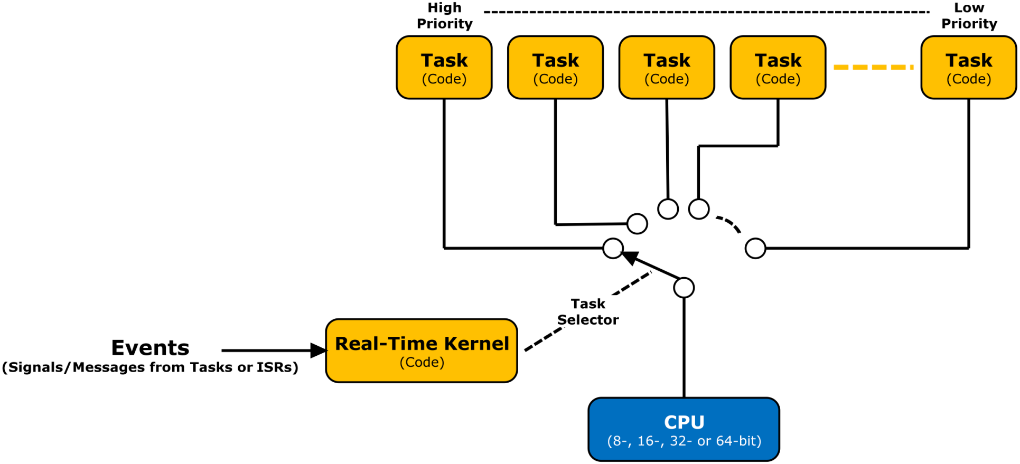

Slide 12
Advantages
Better throughput
Response Time is very less
Disadvantages
Very costly
Large memory required

Slide 13
Time Sharing Operating System
As the name itself suggests, in a time-sharing system or multi-tasking system, multiple jobs can be executed on a system at the same time by sharing the CPU time among them.
It is considered to be a logical extension of multiprogramming because both does simultaneous execution but differ in their prime objectives.
The main objective of time-sharing systems is to minimize response time but not maximizing the processor use (which is the objective of multiprogramming systems). Eg: Unix Systems

Slide 14
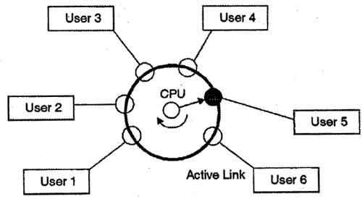

Slide 15
Advantages:
They minimize the response time i.e. greater the response time, lesser is the efficiency of the system.
They reduce CPU idle time.
Disadvantages:
Security and Synchronization must be given a greater importance.
Data communication must be enabled.

Slide 16
Network Operating System
Network Operating System(NOS) is similar to distributed systems but they differ in the way they access resources.
An NOS need special functions/protocols to facilitate connectivity & communication among the systems.
NOS employs a client-server model whereas a DOS employs a master-slave model.
In NOS, to process the data, it has to be transferred to the server.

Slide 17
Types of NOS
Peer-to-Peer Model
Client Server Model

Slide 18
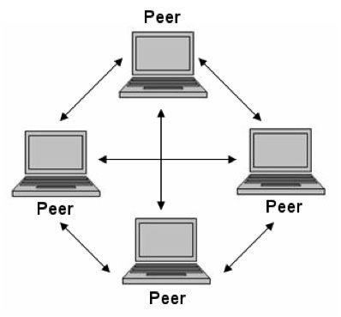
Peer-to-Peer Model

Slide 19
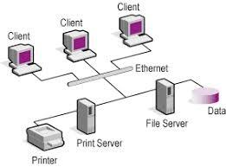
Client Server Model

Slide 20
Objectives:
Providing Security.
Facilitating user management i.e; logon & logoff.
Enabling remote access to servers.
Advantages:
Stabilized Servers.
Provides file, print, web & back-up services.
Authorized access & automatic hardware detection.
Disadvantages:
Expensive as they need to run servers continuously.
Need for regular maintenance & updates.
Depends on the center location (server) even for small operations.

Slide 21
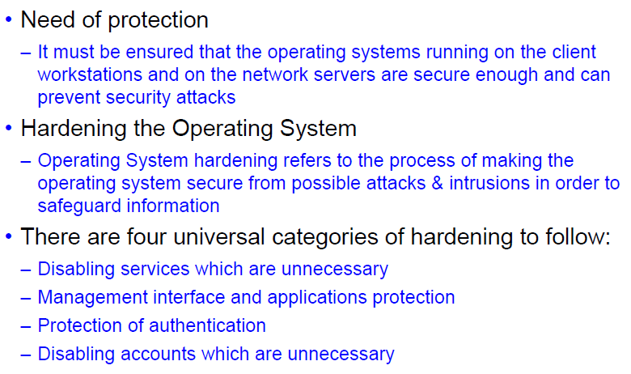
Operating System Protection Controls

Slide 22
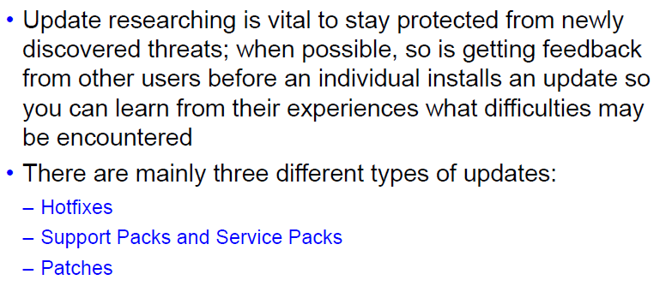
Updating OS for Hardening

Slide 23
Protecting against Malwares
The OS can be highly vulnerable to malwares, especially those which are connected to an internet network.
Malwares can cause any computing system to crash irrespective of what kind of OS is installed on it.
Some types of malware are:
Virus
Worm
Trojans

Slide 24
Solutions for Protection against Malwares
Hardware Firewall
A hardware firewall uses a PC-like appliance to run software that blocks unwanted outside traffic.
A firewall appliance may allow the firewall administrator to simply drag and drop various rules into place.
For example, if your business wishes to block all incoming traffic from particular top level domains (TLD’s), such as particular country codes, a few clicks will give the option of blocking incoming, outgoing or both types of traffic to/from those TLD’s.
Updating a firewall appliance with new rules to prevent evolving threats, hacks and malware is straightforward: a single update protects all machines connected on the network.

Slide 25
Solutions for Protection against Malwares
Software Firewall
Software firewalls use a combination of port filtering, stateful packet inspection and application level filtering.
Such firewalls are provided for each machine as part of the operating system – as in the case of Windows, for example – or as an application designed to run on a stand-alone PC that guards the entire network.
If the firewall software detects an attempted connection that is not contained in its rules database, it can be configured to prompt the user to accept or reject the connection.
Malicious traffic, whether it is outgoing as in the case of malware on a user’s PC attempting to send data outside the network – or incoming – can be blocked.

Slide 26
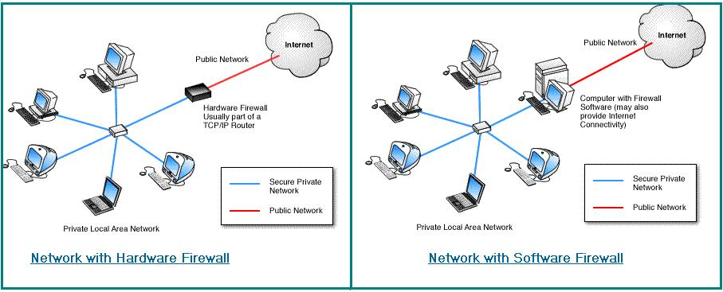
Network with Hardware and Software Firewall

Slide 27
Solutions for Protection against Malwares
Antivirus
It is an application that is installed on the system to protect it and to scan for viruses as well as worms and trojans.

Slide 28
Solutions for Protection against Malwares
Intrusion Detection Systems
An intrusion occurs when an attacker attempts to gain entry into or disrupt the normal operations of an information system, almost always with the intention to harm.
Even when such attacks are self-propagating, as in the case of viruses and denial-of-service attacks, they are almost always instigated by someone whose purpose is to harm an organization.
Intrusion detection consists of procedures and systems that identify system intrusions.

Slide 29
Types of IDSs
There are two types of IDS:
Host Based IDS (HIDS)
It resides on a particular computer or server, known as the host, and monitors activity only on that system.
These are also known as system integrity verifiers because they benchmark and monitor the status of key system files and detect when an intruder creates, modifies, or deletes monitored files.
Network Based IDS (NIDS)
It resides on a computer or appliance connected to a segment of an organization’s network and monitors network traffic on that network segment, looking for indications of ongoing or successful attacks.
When it identifies activity that it is programmed to recognize as an attack, it responds by sending notifications to administrators.

Slide 30
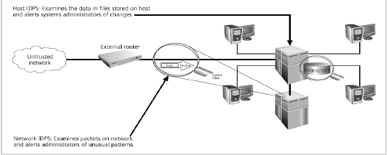

Slide 31
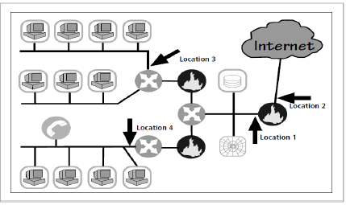
Task for you….??
Notes:
Identify the locations???

Slide 32
Solution:
Location 1: Behind each external firewall, in the network DMZ (location 1)
Location 2: Outside an external firewall (location 2)
Location 3: On major network backbones (location 3)
Location 4: On critical subnets (location 4)

Slide 33


Slide 34
What is Application Security?
The workstations and servers in an organization also run certain services and application. The services on the server such as, email, media servers and web services particularly are vulnerable to attack and exploitation.
So there is a need of hardening these applications as well, such that exploitation becomes almost impossible.
Application security encompasses measures taken to improve the security of an application often by finding, fixing and preventing security vulnerabilities.

Slide 35
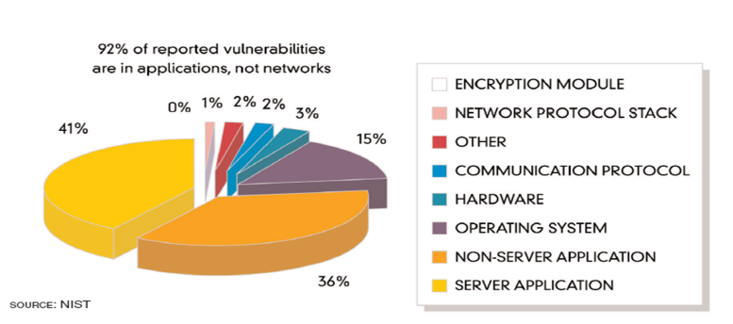
Vulnerabilities in Application

Slide 36
Application Security Technique 1
Fuzzing
Fuzz testing (fuzzing) is a technique used to discover coding errors and security loopholes in software, operating systems or networks.
It involves inputting large amounts of random data, called fuzz, to the test application in an attempt to make it crash.
If a vulnerability is found, a software tool called a fuzzer can be used to identify potential causes.
“Fuzzing is the process of sending intentionally invalid data to a product in the hopes of triggering an error condition or fault. These error conditions can lead to exploitable vulnerabilities.” –HD Moore

Slide 37
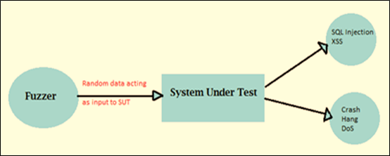

Slide 38
Application Security Technique 2
Cross Site Request Forgery (CSRF or XSRF)
A CSRF attack forces a logged-on victim’s browser to send a forged HTTP request, including the victim’s session cookie and any other automatically included authentication information, to a vulnerable website or web application.
This allows the attacker to force the victim’s browser to generate requests the vulnerable application thinks are legitimate requests from the victim.
Also known as XSRF, session riding and one-click attack, involves unauthorized commands coming from a trusted user to the website.

Slide 39
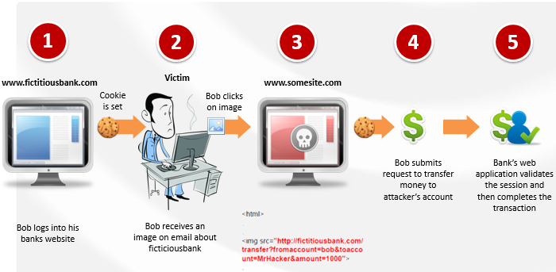

Slide 40
Application Security Technique 3
Application Configuration Baselining
Baselining is the act of measuring and rating the performance of a network in real-time situations.
Providing a baseline requires testing and reporting of the physical connectivity, normal network utilization, protocol usage, peak network utilization, and average throughput of the network usage as well as with applications.
Once a baseline has been established, this information is then used by companies and organizations to determine both present and future network upgrade needs as well as assist in making changes to ensure their current network is optimized for peak performance.

Slide 41
Application Security Technique 4
Application Patch Management
Just as one needs the Operating system patches up-to-date, because they often fix security problems that are discovered with the OS, you need to do the same with application patches for the same purpose.

Slide 42
Application Security Tools
Big-IP Application Security Manager
IBM Security AppScan Scanner
Cenzic Hailstorm Scanner
QualysGuard WAS
WhiteHat Sentinel

Slide 43
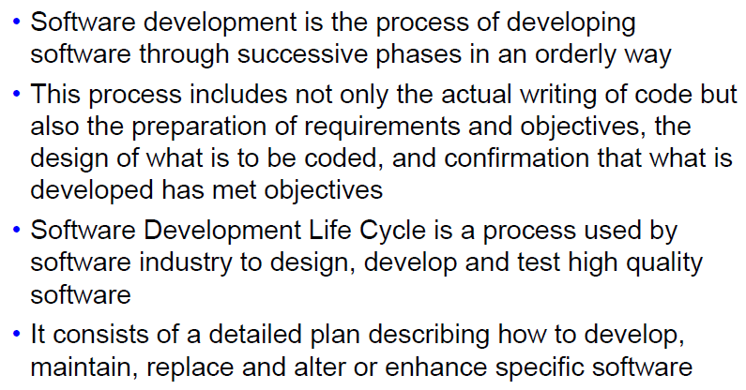
Secure Software Development

Slide 44
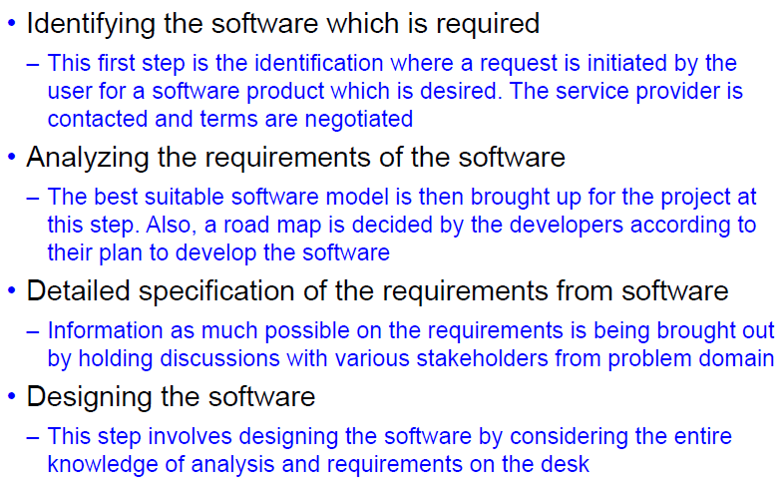
Secure Software development Phases 1

Slide 45
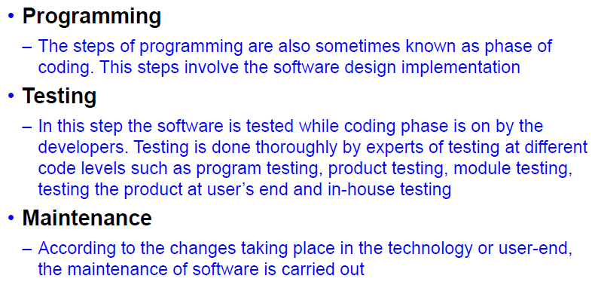
Secure Software development Phases 2

Slide 46
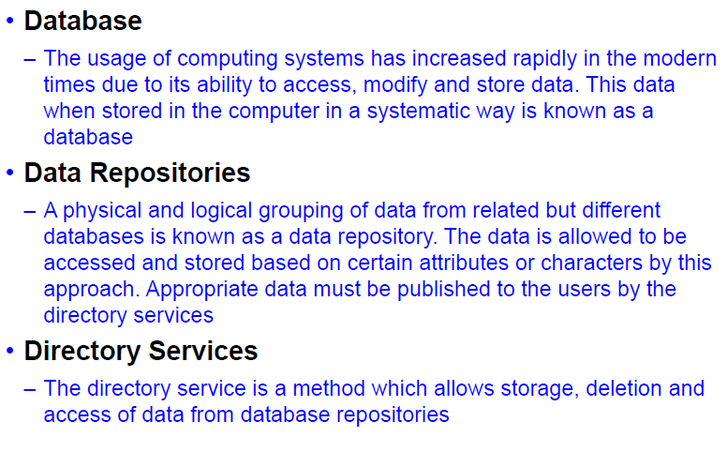
Introduction to Database

Slide 47
Directory Services
Provides file sharing
Authenticates users
Provides services such as Email, Access to the internet, print services, etc.
Control access to services and sharing.
Various Directory services are:
Lightweight Directory Access Protocol (LDAP) (open industry standard application protocol)
Active Directory (By Microsoft for windows domain networks)
eDirectory (by NetIQ)

Slide 48
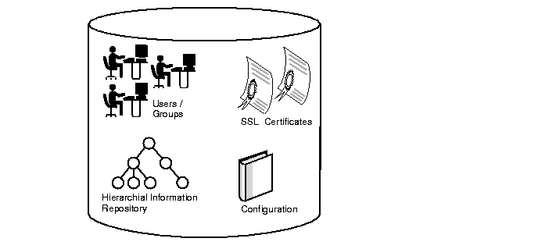
LDAP

Slide 49
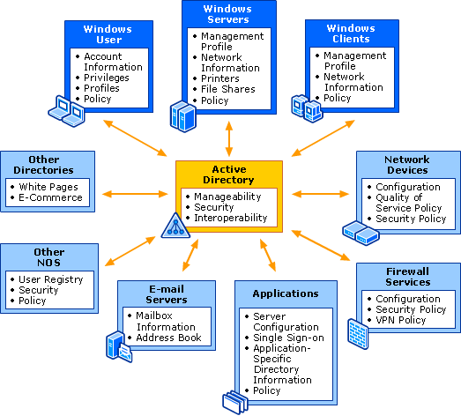
Active Directory

Slide 50
Vulnerabilities in Database
Failures due to deployment
Leakage of data
Database backup are stolen
Database abuse
Hopscotch
SQL Injections
Key Management

Slide 51
Deployment Failures
The most common cause of database vulnerabilities is a lack of due care at the moment they are deployed.
Although any given database is tested for functionality and to make sure it is doing what the databases is designed to do, very few checks are made to check the database is not doing things it should not be doing.

Slide 52
Data Leaks
Databases may be considered a "back end" part of the office and secure from Internet-based threats (and so data doesn't have to be encrypted), but this is not the case.
Databases also contain a networking interface, and so hackers are able to capture this type of traffic to exploit it. To avoid such a pitfall, administrators should use SSL- or TLS-encrypted communication platforms.

Slide 53
Stolen Database Backups
External attackers who infiltrate systems to steal data are one threat, but what about those inside the corporation?
The insiders are also likely to steal archives — including database backups — whether for money, profit or revenge.
This is a common problem for the modern enterprise, and businesses should consider encrypting archives to mitigate the insider-risk.

Slide 54
Abuse of database features
Every database exploit has been based on the misuse of a standard database feature.
For example, a hacker can gain access through legitimate credentials before forcing the service to run arbitrary code.
Although complex, in many cases, this access was gained through simple flaws that allow such systems to be taken advantage of or bypassed completely.
Future abuse can be limited by removing unnecessary tools — not by destroying the possibility of zero-day exploits, but by at least shrinking the surface area hackers can study to launch an attack.

Slide 55
Hopscotch
Rather than taking advantage of buffer overflow and gaining complete access to a database in the first stage, cybercriminals often play a game of Hopscotch: finding a weakness within the infrastructure that can be used as leverage for more serious attacks until they reach the back-end database system.
For example, a hacker may worm their way through your accounts department before hitting the credit card processing arena. Unless every department has the same standard of control, creating separate administrator accounts and segregating systems can help mitigate the risk.

Slide 56
SQL Injections
A popular method for hackers to take, SQL injections remain a critical problem in the protection of enterprise databases.
Applications are attacked by injections, and the database administrator is left to clean up the mess caused by unclean variables and malicious code which is inserted into strings, later passed to an instance of SQL server for parsing and execution.
The best ways to protect against these threats are to protect web-facing databases with firewalls and to test input variables for SQL injection during development.

Slide 57
Key Management
Key management systems are meant to keep keys safe, but the research team often found encryption keys stored on company disk drives.
Database administrators sometimes falsely believe these keys have to be left on the disk because of database failures, but this isn't true — and placing such keys in an unprotected state can leave systems vulnerable to attack.

Slide 58
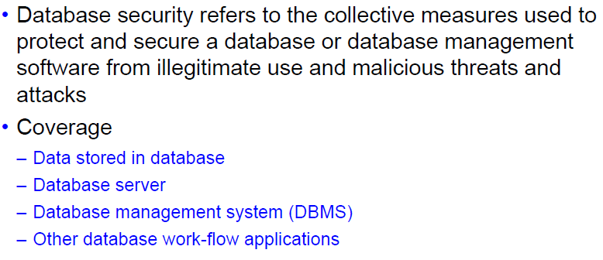
Securing the Database

Slide 59
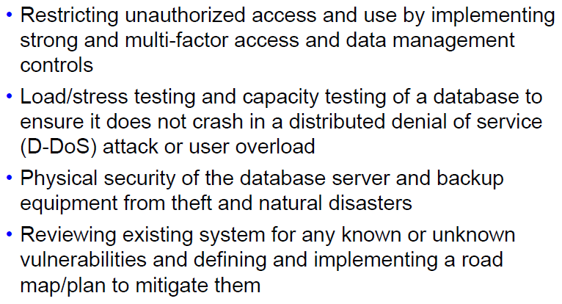
Database Security Techniques

Slide 60
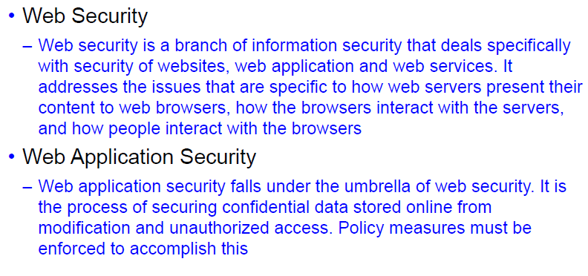
Web Application Security

Slide 61
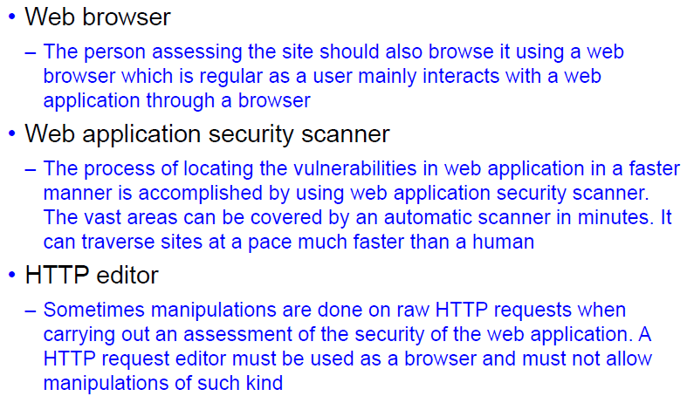
Web Application Security Assessment

Slide 62
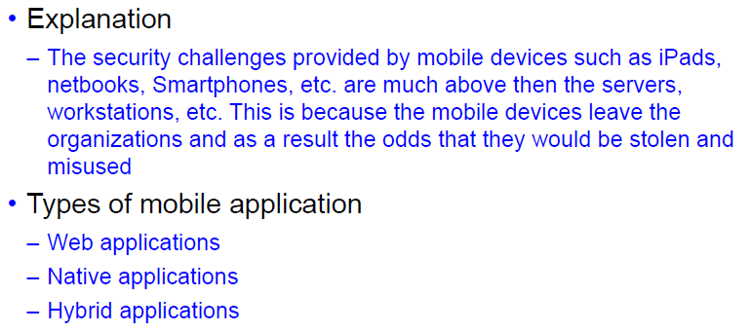
Mobile Application Security

Slide 63
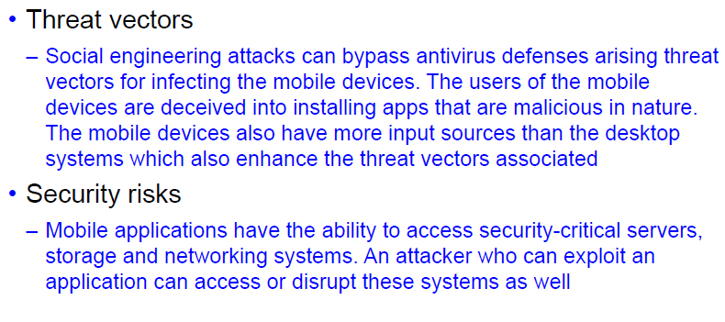
Threats and Risks on Mobile Applications

Slide 64
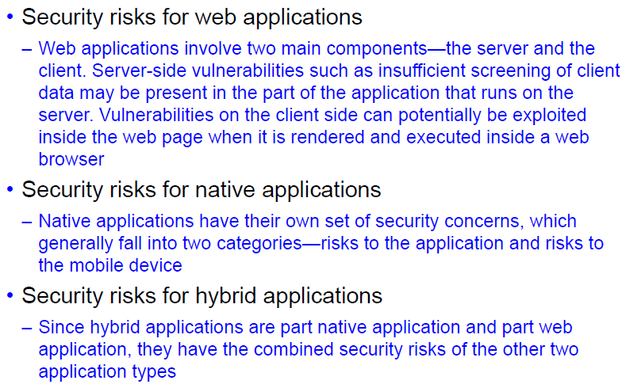
Potential security Risks

Slide 65
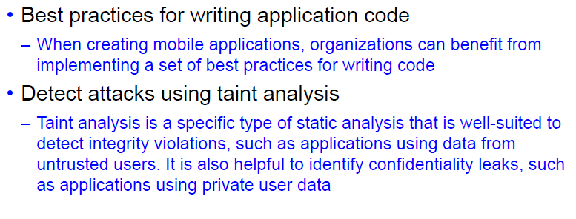
Preventing Vulnerabilities

Slide 66
Thank You!!!!

