Slide 1
Introduction, Instruction Interpretation & Execution
Anurag Tiwari
Assistant Professor
School of Computer Science and Engineering

Slide 2
Introduction of Instruction
In computer science, an instruction is a single operation of a processor defined by the processor instruction set.
The size or length of an instruction varies widely, from as little as 4-bits in some microcontrollers to many as multiples of a bytes in some very long instruction word (VLIW) systems.
Most modern processors used in personal computers, mainframes, and supercomputers have instruction sizes between 16 and 64 bits. In some architectures, especially Reduced instruction set computers, instructions are of fixed length, typically corresponding with that architecture's word size.

Slide 3
Introduction of Instruction
On traditional architectures, an instruction includes an opcode specifying the operation to be performed, such as "add contents of memory to register", and zero or more operand specifiers, which may specify registers, memory locations, or literal data.
The operand specifiers may have addressing modes determining their meaning or may be in fixed fields.

Slide 4
Instruction Interpretation
Instruction interpreter - a program that can imitate the functions of a CPU (fetch, examine, execute).
Hardware-software equivalence!
Design decision for a new language L:
– direct hardware implementation,
– implementation of a software interpreter,
– hybrid solutions.
Transition to complex instructions: sequence of simple instructions occurring frequently or special cases (floating point, array operations).

Slide 5
Instruction Interpretation
Hardware implementation of complex instructions → more powerful computers.
Economic factors: – hardware instructions - higher cost (Cray supercomputers). – solution: interpretation.

Slide 6
Micro-Operations
A computer executes a program
Fetch/execute cycle
Each cycle has a number of steps
see pipelining
Called micro-operations
Each step does very little
Atomic operation of CPU

Slide 7
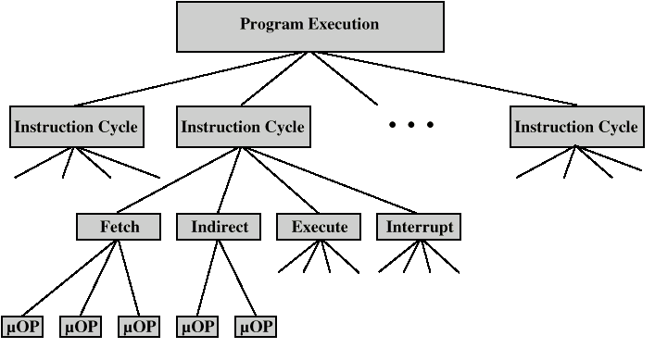
Constituent Elements of Program Execution

Slide 8
Registers
Memory Address Register (MAR)
Connected to address bus
Specifies address for read or write op
Memory Buffer Register (MBR)
Connected to data bus
Holds data to write or last data read
Program Counter (PC)
Holds address of next instruction to be fetched
Instruction Register (IR)
Holds last instruction fetched

Slide 9
Execution of Instruction
The main purpose of a CPU is to execute instructions.
CPU executes the binary representation of the instructions, i.e., machine code.
Since programs can be very large, and since CPUs have limited memory, programs are stored in memory (RAM). However, CPUs do its processing on the CPU.
So, the CPU must copy the instruction from memory to the CPU, and once it's in the CPU, it can execute it.

Slide 10
Execution of Instruction
The PC is used to determine which instruction is executed, and based on this execution, the PC is updated accordingly to the next instruction to be run.
Essentially, a CPU repeatedly fetches instructions and executes them

Slide 11
Instruction Execution Steps
Fetch instruction
Decode instruction and Fetch Operands
Perform ALU operation
Access memory
Write back result to register file
Update the PC

Slide 12
Step 1: Fetch instruction
To fetch an instruction involves the following steps:
CPU must place an address to the MAR.
CPU must activate the tristate buffer so MAR contents are placed on the address bus.
CPU sends R/\W = 1 and CE = 1 to memory, to indicate it wants to do a read.
Memory eventually puts instruction on the data bus. Memory sends ACK = 1.
CPU loads the instruction to the MDR.
CPU transfers instruction from MDR to IR. CPU sets CE = 0 to memory indicate it's done with fetching the instruction.

Slide 13
Decode instruction and Fetch Operands
Step 2 of the instruction Cycle is called the Decode Cycle.
The decoding process allows the CPU to determine what instruction is to be performed, so that the CPU can tell how many operands it needs to fetch in order to perform the instruction.
The opcode fetched from the memory is decoded for the next steps and moved to the appropriate registers. The decoding is done by the CPU's Control Unit.
During this cycle the encoded instruction present in the IR (instruction register) is interpreted by the decoder.

Slide 14
Perform ALU operation
The function of the instruction is performed. If the instruction involves arithmetic or logic, the Arithmetic Logic Unit is utilized.
This is the only stage of the instruction cycle that is useful from the perspective of the end user. Everything else is overhead required to make the execute phase happen.
The ALU has two 32-bit data inputs. It has a 32-bit output. The purpose of the ALU is to perform a computation on the two 32-bit data inputs, such as adding the two values. There are some control bits on the ALU. These control bits specify what the ALU should do.

Slide 15
Perform ALU operation…
Where do the input values of the ALU come from?
Recall that an instruction stores information about its operands. In particular, it encodes registers as 5-bit UB numbers. These register encodings are sent to the register file as inputs.
The register file then outputs the 32-bit values of these registers. These are the sent as inputs to the ALU

Slide 16
Access memory
There are only two kind of instructions that access memory: load and store.
load copies a value from memory to a register. store copies a register value to memory.
Any other instruction skips this step.

Slide 17
Write back result to register file
At this point, the output of the ALU is written back to the register file. For example, if the instruction was: add $r2, $r3, $r4 then the result of adding the contents of $r3 to the contents of $r4would be stored back into $r2.
The result could also be due to a load from memory.
Some instructions don't have results to store. For example, branch and jump instructions do not have any results to store.

Slide 18
Update the PC
Finally, we need to update the program counter. Typically, we perform the following update:
PC <- PC + 4 Recall that PC holds the current address of the instruction to be executed.
To update it means to set the value of this register to the next instruction to be executed. Unless the instruction is a branch or jump, the next instruction to execute is the next instruction in memory.
Since each instruction takes up 4 bytes of memory, then the next address in memory is PC + 4, which is the address of the current instruction plus 4
The PC might change to some other address if there is a branch or jump.

Slide 19
Six Steps, In Summary
Step | Description
1 | Fetch Instruction from Memory
2 | Decode Instruction and Fetch Operands
3 | Perform ALU Operations
4 | Memory Access (for load/store)
5 | Store ALU result to register file
6 | Update PC

