Slide 1
Control Transfer
Anurag Tiwari
Assistant Professor
School of Computer Science

Slide 2
Micro-Operations
A computer executes a program
Fetch/execute cycle
Each cycle has a number of steps
see pipelining
Called micro-operations
Each step does very little
Atomic operation of CPU

Slide 3
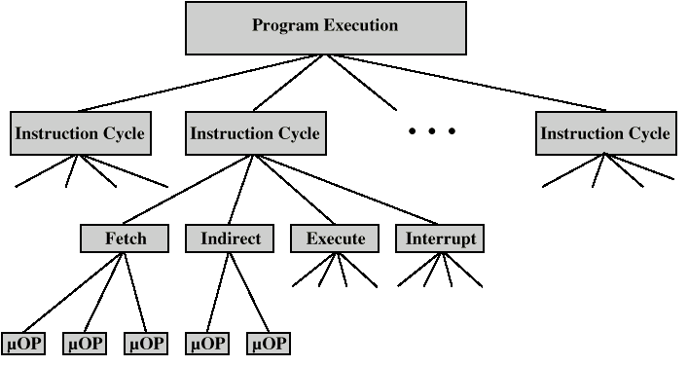
Constituent Elements of Program Execution

Slide 4
Registers
Memory Address Register (MAR)
Connected to address bus
Specifies address for read or write op
Memory Buffer Register (MBR)
Connected to data bus
Holds data to write or last data read
Program Counter (PC)
Holds address of next instruction to be fetched
Instruction Register (IR)
Holds last instruction fetched

Slide 5
Processing of control transfer instructions
Introduction
Basic approaches to branch handling
Delayed branching
Branch processing
Multiway branching
Guarded execution
CH01

Slide 6
Intro to Branch
Branches modify, conditionally or unconditionally, the value of the PC.
To transfer control
To alter the sequence of instructions

Slide 7
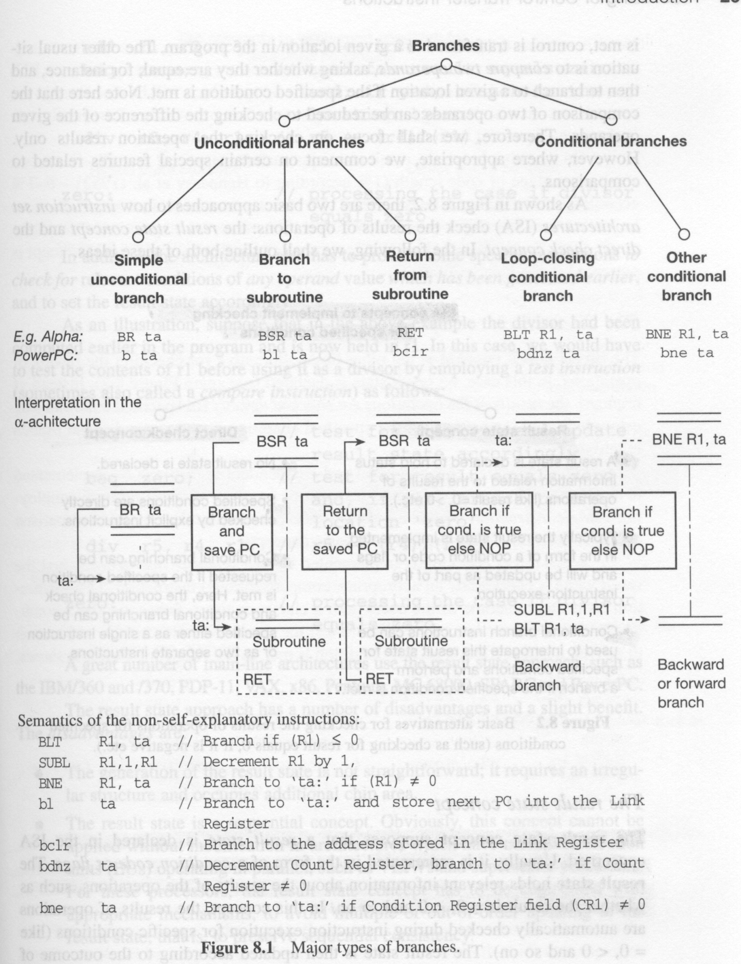
Major types of branches

Slide 8
Branch: To transfer control

Slide 9
Branch: e.g.

Slide 10
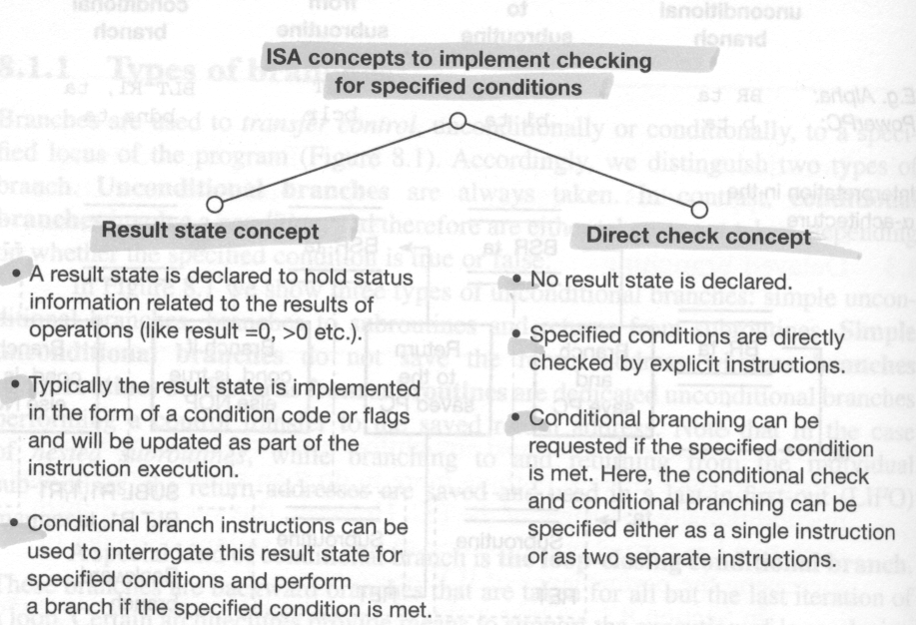
8.1.2 How to check the results of operations for specified conditions {branch} (e.g. equals 0, negative, and so on)

Slide 11
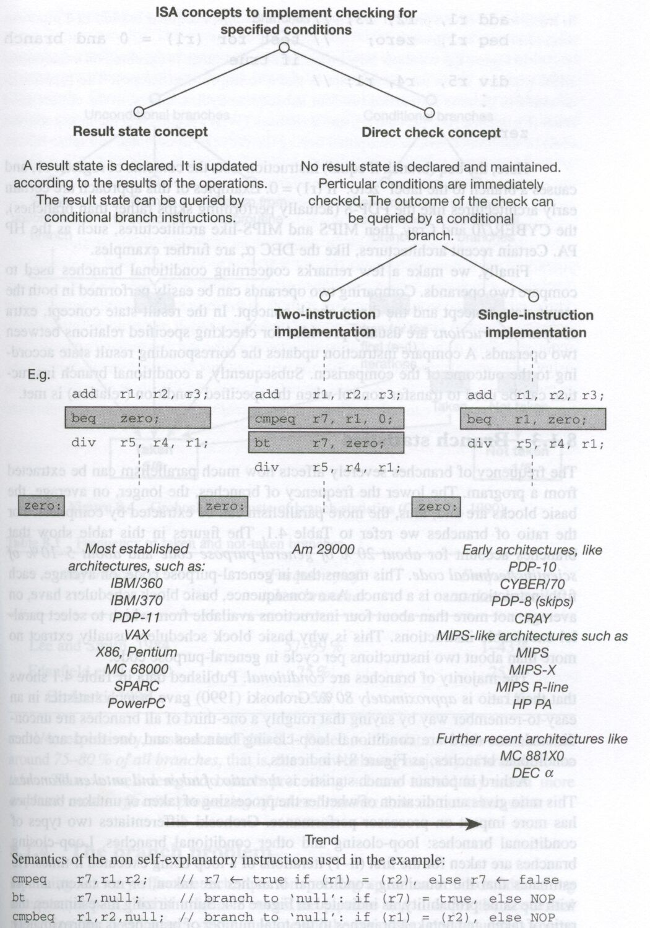
Alternatives for checking the operation results

Slide 12
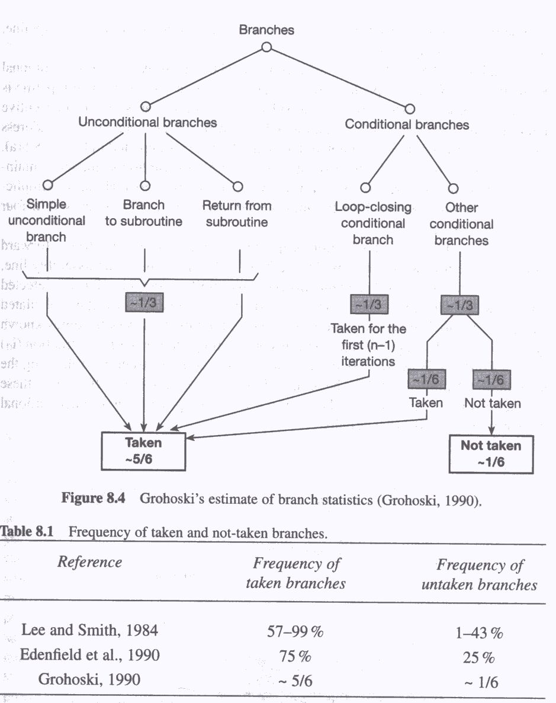
Frequency of taken and not-taken branches

