Slide 1
Microprogrammed Control Unit
• Control Memory
• Sequencing Microinstructions
• Microprogram Example
• Design of Control Unit
• Microinstruction Format

Slide 2
Control Unit
Initiate sequences of microoperations
Control signal (that specify microoperations)in a bus-organized system
groups of bits that select the paths in multiplexers, decoders, and arithmetic logic units
Two major types of Control Unit
»Hardwired Control : in Chap. 5
The control logic is implemented with gates, F/Fs, decoders, andother digital circuits
+ Fast operation.
-Wiring change(if the design has to be modified)
»Microprogrammed Control : in this Chapter
The control information is stored in a control memory, and the control memory is programmed to initiate the required sequence of microoperations
+Any required change can be done by updating the microprogram incontrol memory.
-Slow operation

Slide 3
Control Word
The control variables at any given time can be represented by a string of 1’s and 0’s.
Microprogrammed Control Unit
A control unit whose binary control variables are stored in memory (control memory).
Microinstruction
The microinstruction specifies one or more microoperations
Microprogram
A sequence of microinstruction
»Dynamic microprogramming :Control Memory =RAM
RAM can be used for writing (to change a writable control memory)
Microprogram is loaded initially from an auxiliary memory such as a magnetic disk
Control words in ROM are made permanent during the hardware production.
»Static microprogramming : Control Memory =ROM

Slide 4
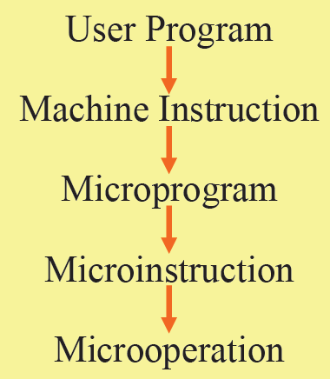
Microprogrammed Control Organization
External input
Control data register
Control word
Next-address generator (sequencer)
Control address register
Control memory (ROM)
Next-address information
Control Memory
»A memory is part of a control unit :
»Computer Memory (employs a microprogrammed control unit)
Main Memory : for storing user program (Machine instruction/data)
Control Memory : for storing microprogram (Microinstruction)

Slide 5
Control Address Register
»Specify the address of the microinstruction
Sequencer
»Determine the address sequence that is read from control memory
»Next address of the next microinstruction can be specified several way depending on the sequencer input.
Sequencing Capabilities Required in a Control Storage
Incrementing of the control address register
Unconditional and conditional branches
A mapping process from the bits of the machine instruction to an address for control memory
A facility for subroutine call and return
Control data register
»Hold the microinstruction read from control memory
»Allows the execution of the microoperations specified by the control word simultaneously with the generation of the next microinstruction

Slide 6
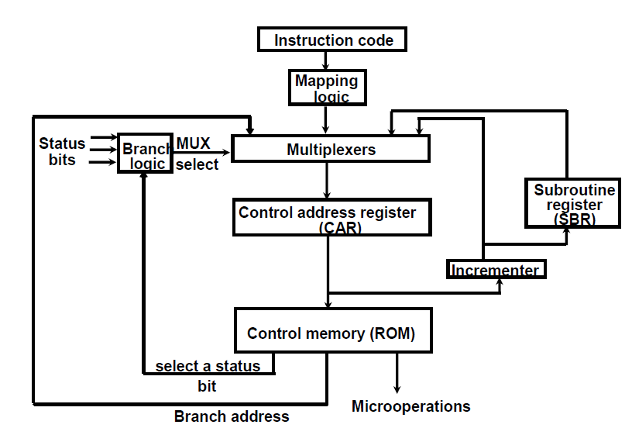
Selection of address for control memory

Slide 7
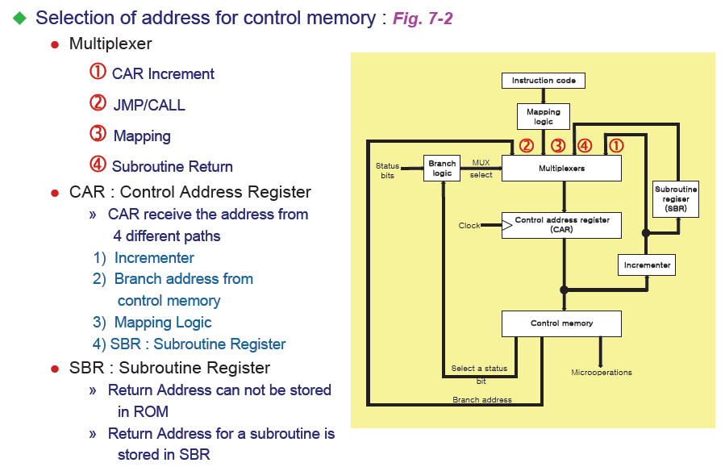

Slide 8
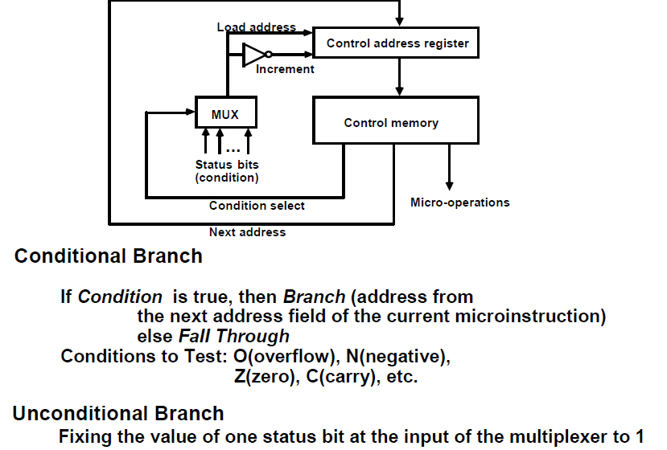
Conditional Branching

Slide 9
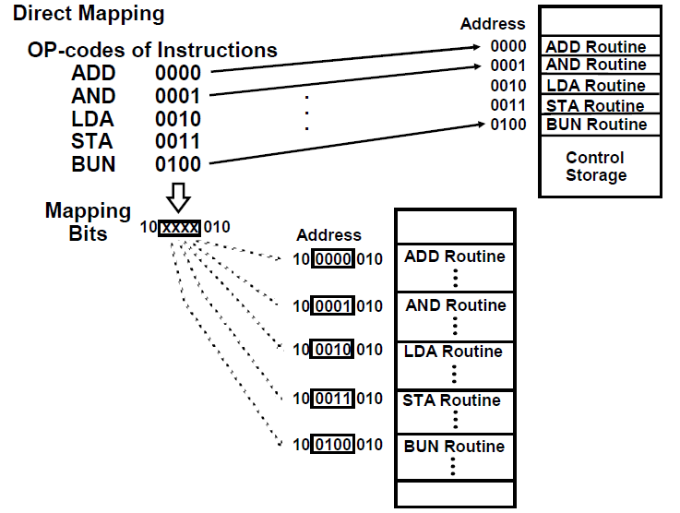
Mapping of Instructions

Slide 10
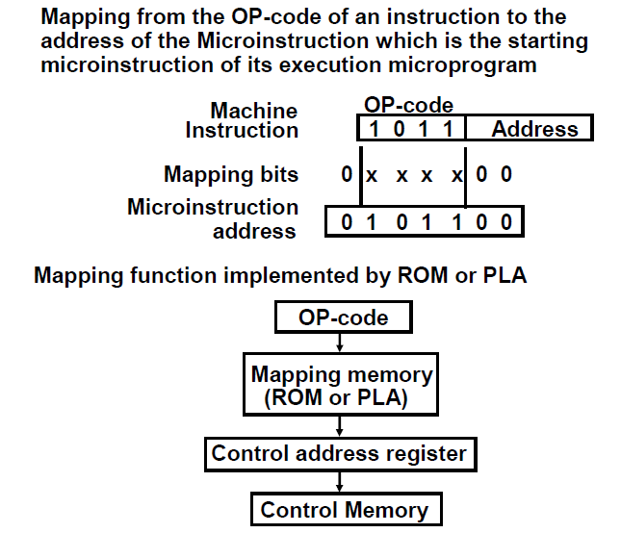
Mapping of Instructions to Microroutines

Slide 11
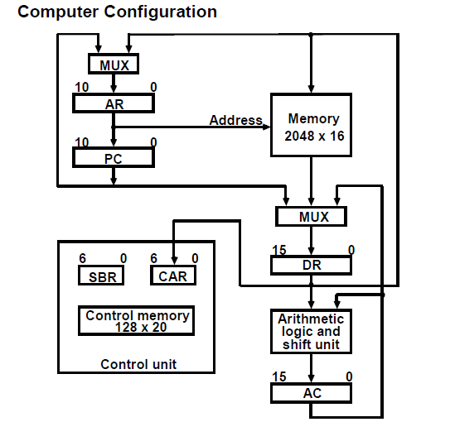
Microprogram Example

Slide 12
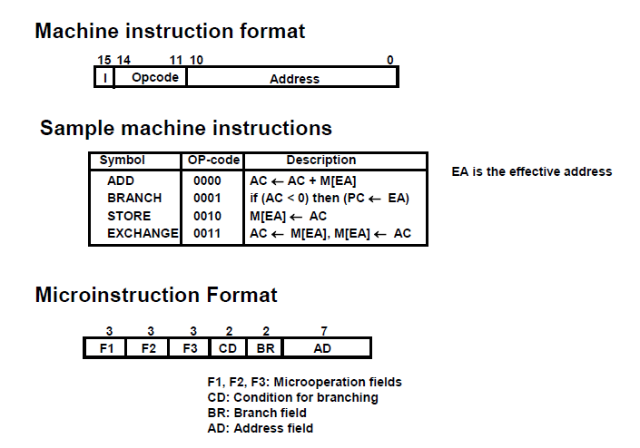
Machine Instruction Format

Slide 13
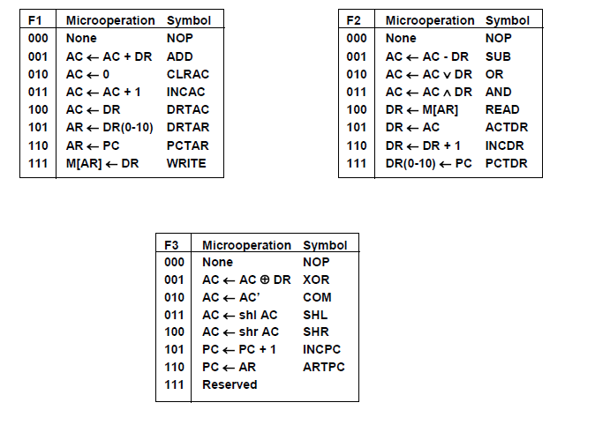

Slide 14
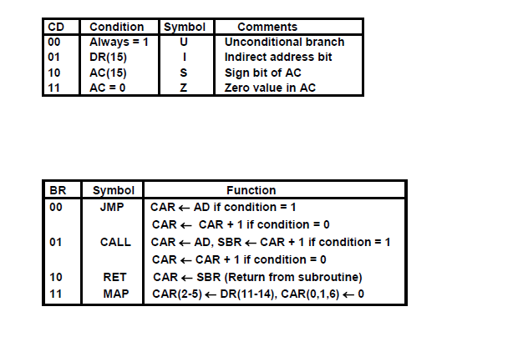

Slide 15
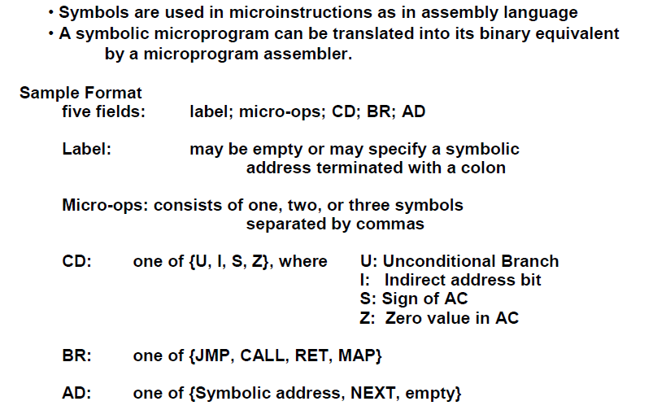
Symbolic Microinstructions

Slide 16
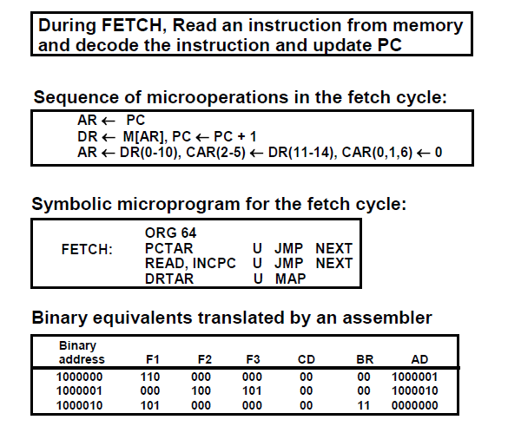
Symbolic Microprogram- Fetch routine

Slide 17
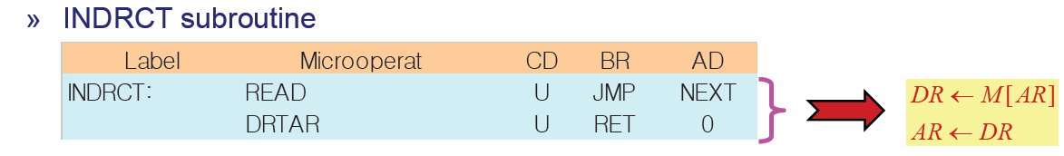
Symbolic Microprogram- Indirect routine

Slide 18
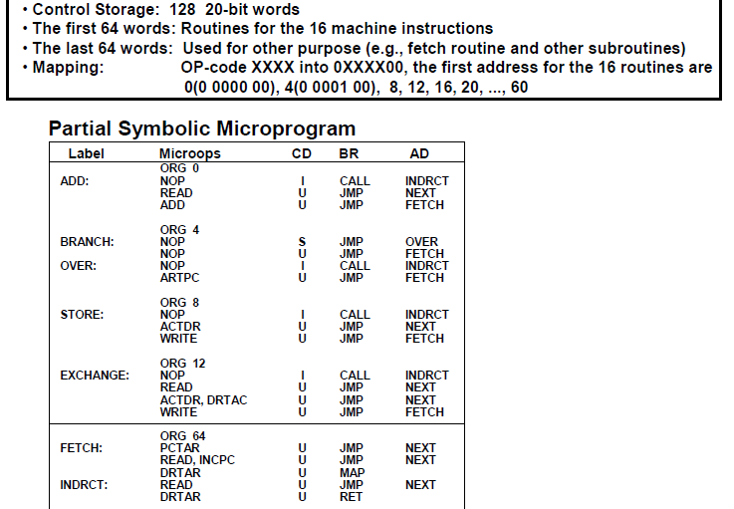
Symbolic Microprogram

Slide 19
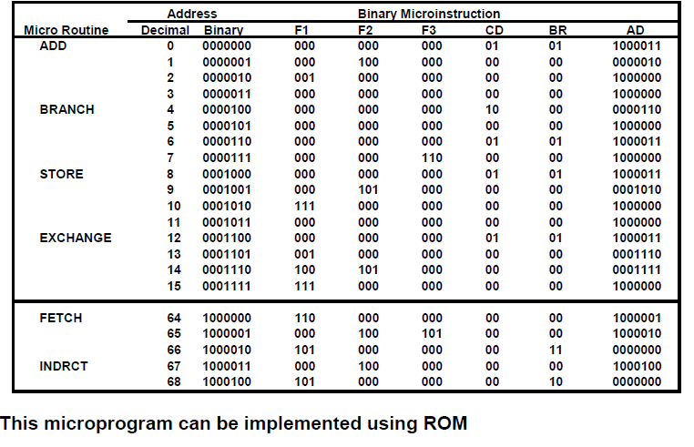
Binary Microprogram

Slide 20
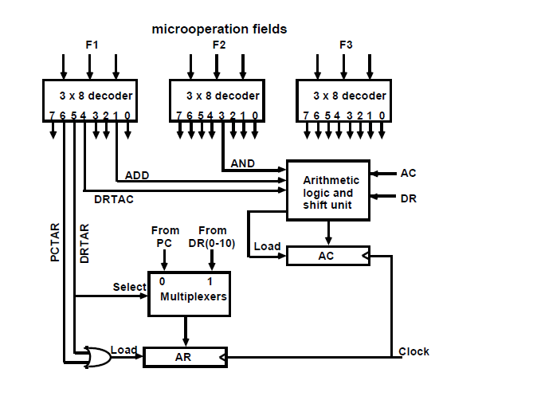
Design of control unit

Slide 21
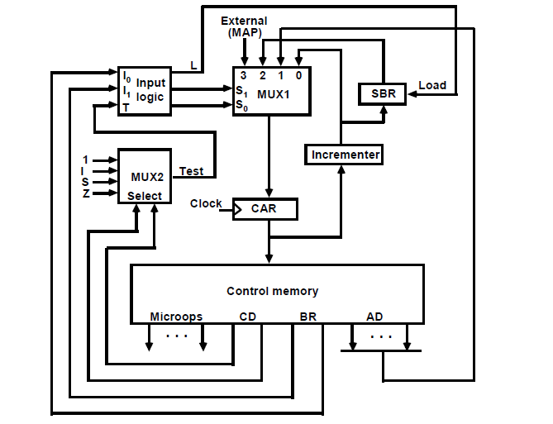
Microprogram Sequencer

Slide 22
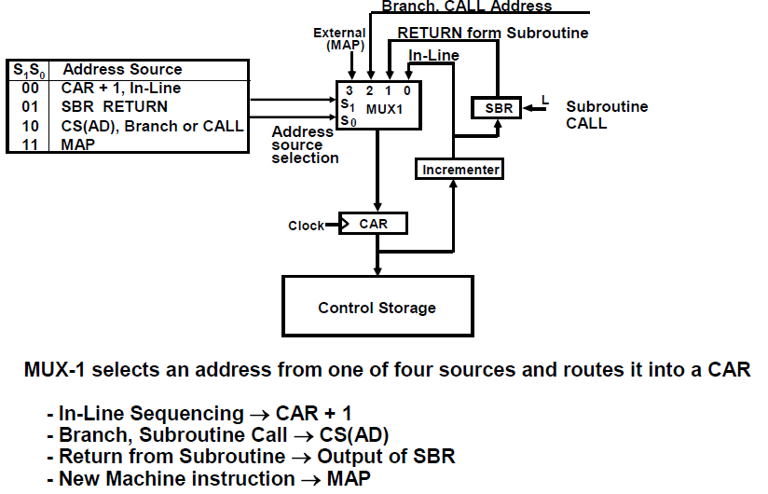

Slide 23
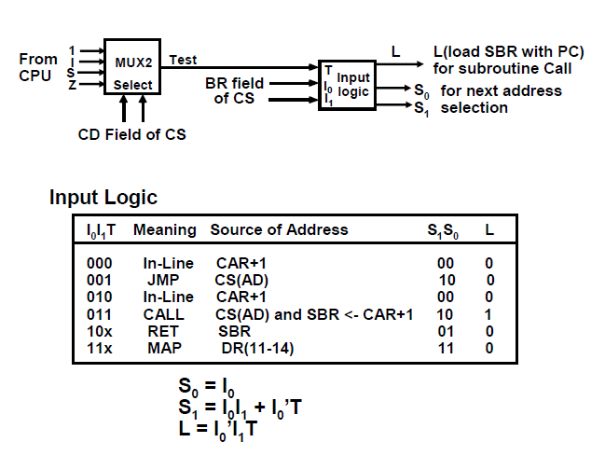

Slide 24
Microprogram Sequencer

Slide 25
