Slide 1
Lecture-1-2-3
Virtualization Technology

Slide 3
Learning Outcomes
At the end of the session you will be able to:
Comprehend virtualization
Explain need of compute virtualization
Understand virtual clusters
Apply various techniques used for computing virtualization
Describe various resource management tools
Describe application of virtual machine
Describe hypervisor taxonomy
Appreciate the concept of virtual machine
Explain data center virtualization

Slide 4
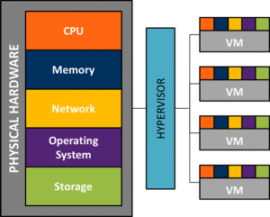
Concept of virtualization
Virtualization is the "creation of a virtual (rather than actual) version of something, such as a server, a desktop, a storage device, an operating system or network resources".
In other words, Virtualization is a technique, which allows to share a single physical instance of a resource or an application among multiple customers and organizations. It does by assigning a logical name to a physical storage and providing a pointer to that physical resource when demanded.

Slide 6
Introduction
Virtualization refers to a technology that is used to make physical
resources available as virtual resources.
Cloud computing technologies use a set of techniques to create virtual
servers, virtual storage, virtual networks, and perhaps virtual applications as
well.
Virtualization software is used to make a physical server like a virtual server.
Operating system-level virtualization can be achieved by installing
virtualization software on already installed operating systems.

Slide 7
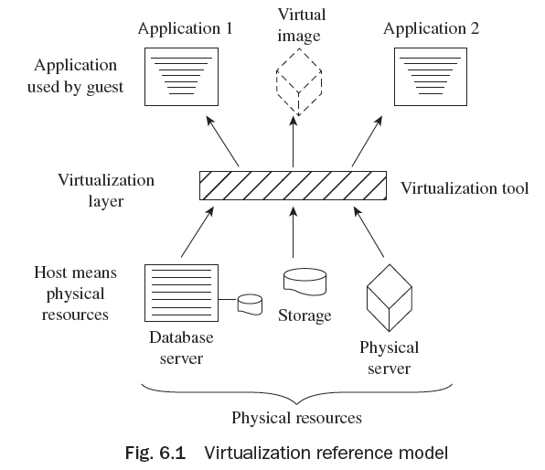
Virtualization Reference Model
The virtualization model consists of a host or physical resources in the first
layer, virtualization tool in the second layer,
and a guest in the third layer
(application as well as virtual image)
as shown in Fig. 6.1.

Slide 8
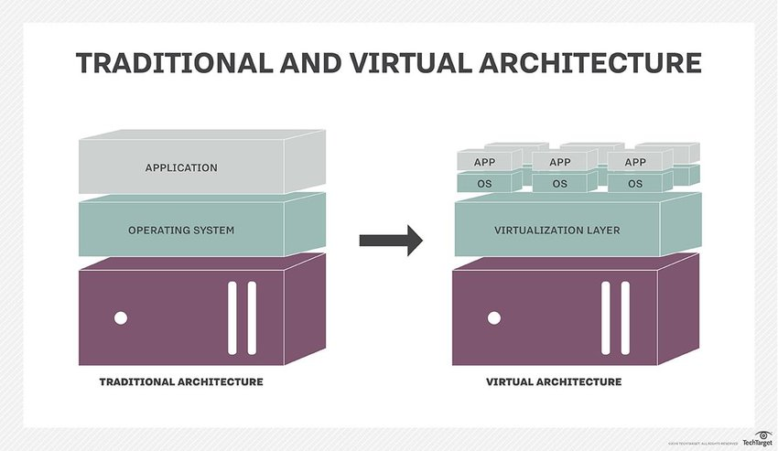
Traditional IT Infrastructure - Virtualization

Slide 12
Advantages of Virtualization
The advantages of virtualization include the following:
It allows any network-enabled device to access any network application over any network.
It maintains isolation of one workload from another application to enhance security in the environment.
Virtualization of an application allows users to be comfortable with different versions of the operating system.
It can support and allow application with multiple instances to run on various machines concurrently.
It optimizes the use of a single system.
It enhances the reliability or availability of an application through redundancy.

Slide 19
Server/Compute Virtualization
Server/Compute virtualization in cloud computing refers to making a virtual edition of a device or resource, such as a server, storage device, network, or an operating system where the structure splits the resources as one or more environments for execution.
The following are the advantages of server/compute virtualization:
1. Consistency
2. Energy efficiency
3. Enhanced disaster recovery
4. Cost savings
A virtual machine is a reasonable computing system like a physical machine which governs an application and operating system (OS). Some of the virtual components used in a virtual machine are as follows:

Slide 20
Server/Compute Virtualization
A virtual machine (VM) can be configured with the following virtual components:
Virtual central processing unit (vCPU)
Virtual random access memory (vRAM)
Virtual disk
Virtual network adaptor (vNIC)
Virtual DVD/CD-ROM and floppy drives
Virtual SCSI (Small Computer System Interface) controller
Virtual USB controllers
Virtual machine console

Slide 21
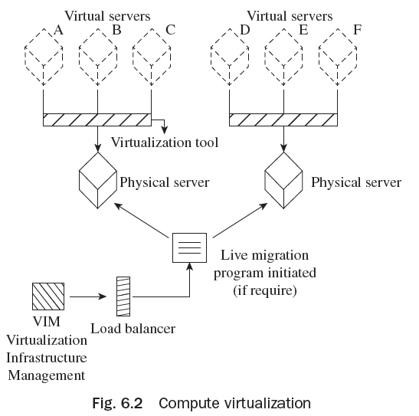
Server/Compute Virtualization

Slide 22
Area and technology based classification
Virtualization can be also be classified based on the technology or the area that is being virtualized
Server Virtualization
Network Virtualization
Storage Virtualization
Desktop Virtualization
Application Virtualization
Management Virtualization

Slide 23
Types of Virtualization
Virtualization is classified based on the extent of hardware emulation.
Full Emulation
Full/Native Virtualization
Para-Virtualization
OS Virtualization
Application Virtualization

Slide 24
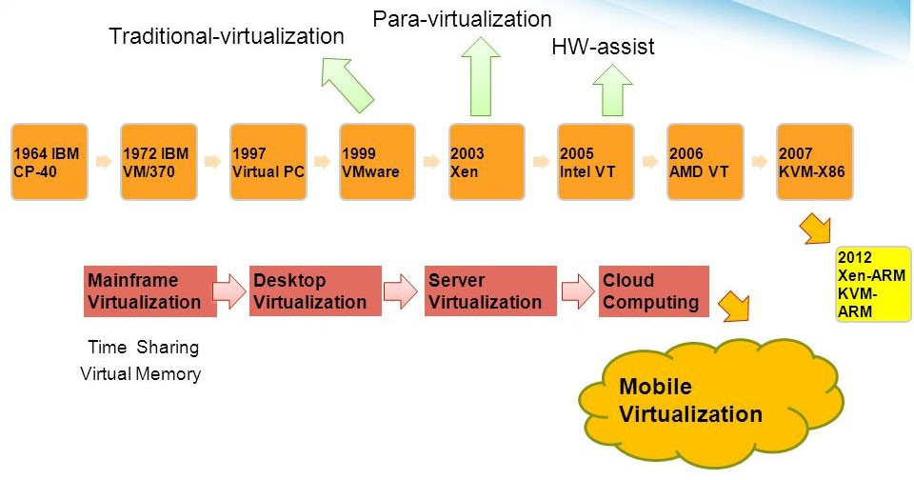
History of Virtualization
IBM ICE (Innovation Centre for Education)

Slide 25
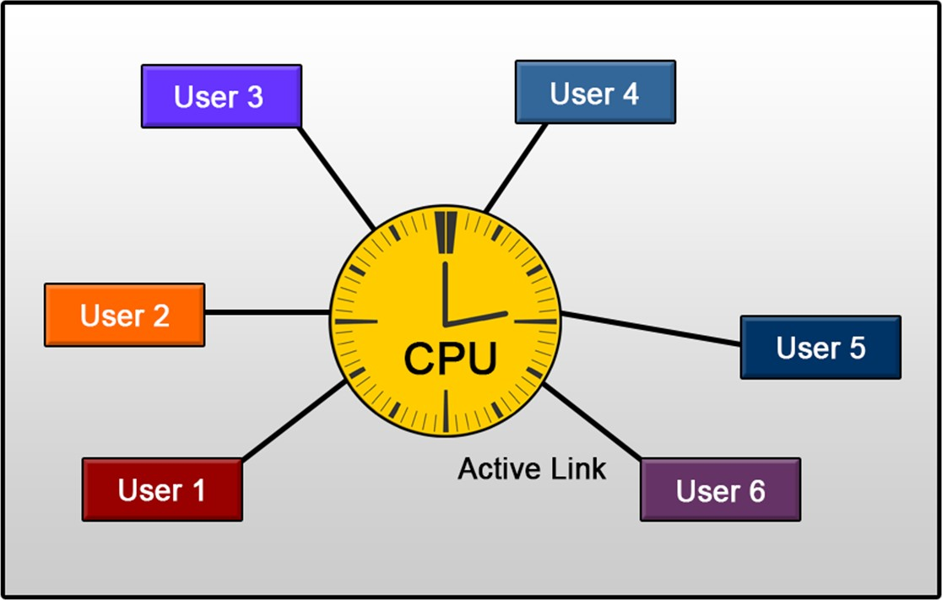
Time-sharing systems
IBM ICE (Innovation Centre for Education)

Slide 26


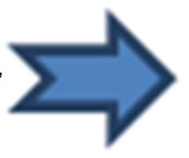
IBM Mainframe Virtualization
IBM ICE (Innovation Centre for Education)
The earliest pioneer of modern virtualization technology was IBM. IBM invented virtualization nearly 50 years ago.
CP-40
CP-67
S/360-67
S/370
In the late 1960s, IBM introduced the first successful virtual machine operating system, the CP-40 which was geared for the System/360 Mainframe. A revision of CP-40 was introduced by the name of CP-67 and was later implemented as S/360- 67 and finally as S/370.

Slide 27
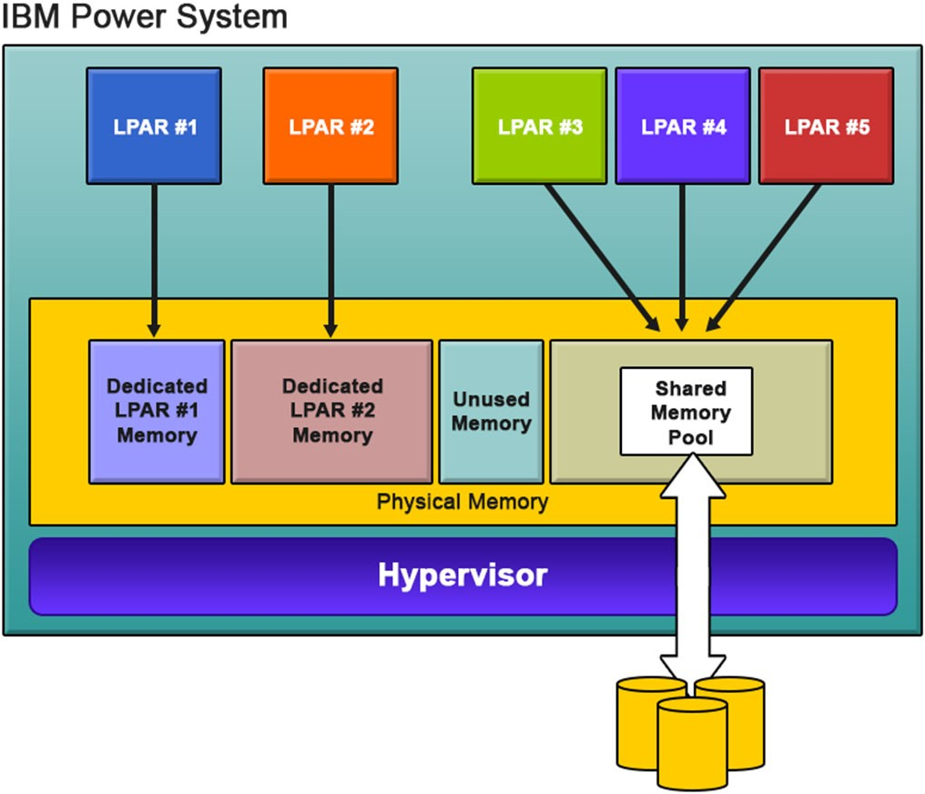
IBM PowerVM Virtualization
IBM ICE (Innovation Centre for Education)

Slide 28
Extending Virtualization to x86
IBM ICE (Innovation Centre for Education)
The virtualization on x86 Architecture was introduced in the year 1985.
In 1997, Connectix released the first version of “Virtual PC” for MAC platforms.
In 1998, VMware filed an US Patent 6,397,242 for virtualization techniques for x86 architecture and subsequently, a VMware Virtual Platform was introduced for IA32 architecture.
In 2000, FreeBSD introduced FreeBSD Jails for OS Virtualization.
In 2001, Connectix building on it initial success on Virtual PC launches the first version for Microsoft Windows.
Year 2003, marked the release of the first open source hypervisor for x86 machines called Xen Hypervisor. The company XenSource that developed the hypervisor was later acquired by Citrix. Citrix is currently one of the major virtualization solution provider in the x86 market.
In 2006/2007, Virtual Iron released Virtual- Iron, an x86 bare-metal hypervisor for enterprise customers. VirtualBox was also introduced as an open source alternative under the GPL license.

Slide 29
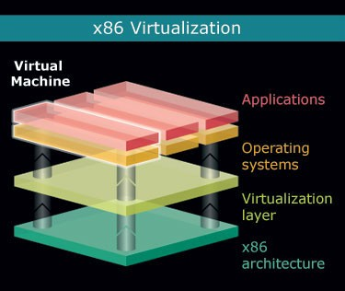
Hardware support for x86 Virtualization
IBM ICE (Innovation Centre for Education)
Source: https://www.desktop-virtualization.com

Slide 30
Impact of Virtualization
IBM ICE (Innovation Centre for Education)
The impact of virtualization can be classified under two major headings:
Cost
Manageability.

Slide 31
Cost Impact
IBM ICE (Innovation Centre for Education)
Security/Segregation of critical applications
Limited or No Monitoring
Ineffective Asset Management
Provisioning Turnaround

Slide 32
Thank You!

