Slide 1

LONG-TERM MEMORY CHATBOT
1
Aman Sharma(MT24013)
Anupma Pandey(MT23011)
Prajwal(MT24064)
Rahul Gupta(MT24017)
Sai Krishna kota(MT24078)
IIIT-Delhi 2024

Slide 2
PROBLEM STATEMENT
2
In traditional chatbot systems, interactions are often limited to isolated, short-term exchanges, lacking the ability to maintain context or adapt to a user's unique conversational history.
This limits the chatbot's effectiveness in providing personalized and meaningful responses over time.
The challenge lies in designing a system that enables long-term memory retention, efficient retrieval of past interactions, and adaptability to diverse conversational scenarios, all while using classical machine learning techniques without relying on pre trained or deep learning models.
IIIT-Delhi 2024

Slide 3
DATASET DESCRIPTION
2
1. Dataset Structure
Version: Dataset version (e.g., "1.0").
Source: Origin of the story (e.g., "mctest," "race").
ID: Unique identifier for each story.
Filename: File name containing the story.
Story: Main text passage (e.g., news or fiction).
2. Questions
Input Text: Question text.
Turn ID: Sequence identifier within a story.
3. Answers
Span Start/End: Character positions in the story.
Span Text: Exact answer text from the story.
Input Text: Short, direct answer text.
Turn ID: Matches respective question's turn ID.
4. Additional Answers
Optional answers from multiple annotators in the same format as primary answers.
This concise structure makes the dataset suitable for training and evaluating reading comprehension models.
IIIT-Delhi 2024

Slide 4
EDA
3
No of Stories : 500 Stories in JSON format having Story, Answers with SpanText and Additional Answers for every question.
No of questions per Story : 10-24 questions
Total Questions : 7983
Categories : 'What', 'Who','which', 'How', 'Yes/No', 'When', 'Where', 'Why', 'Other'
NA values for answers : Every question have corresponding answer, no NA values.
IIIT-Delhi 2024

Slide 5
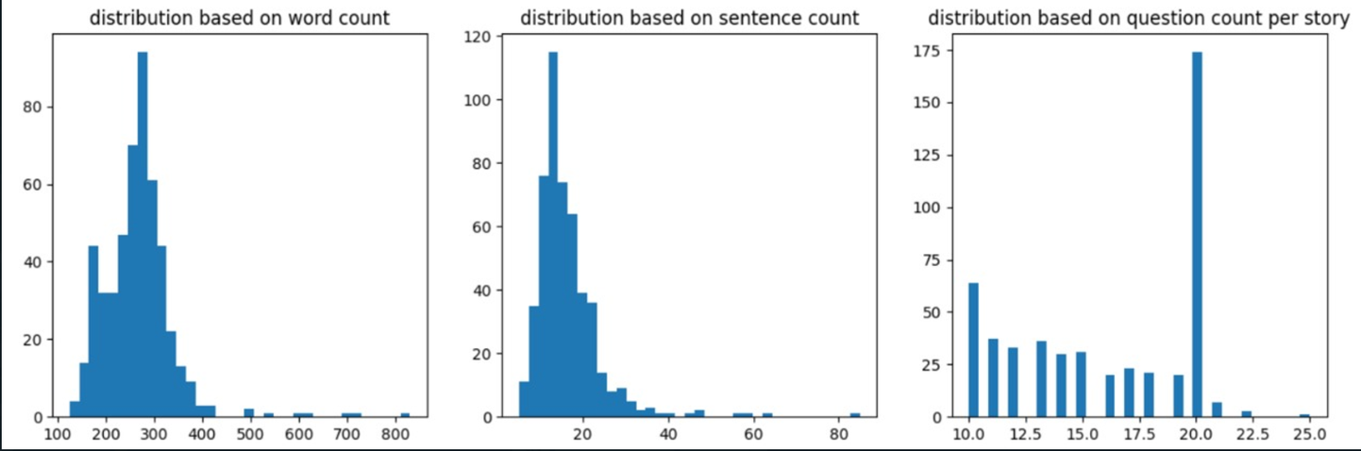
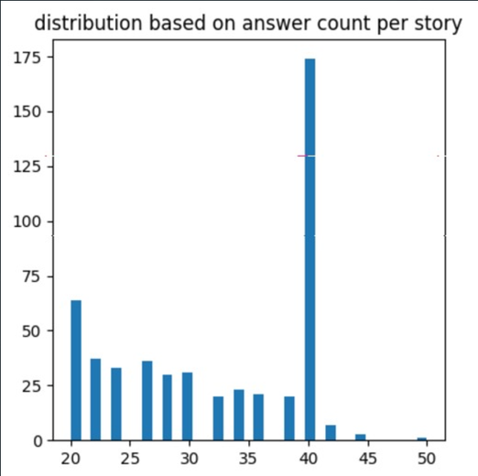
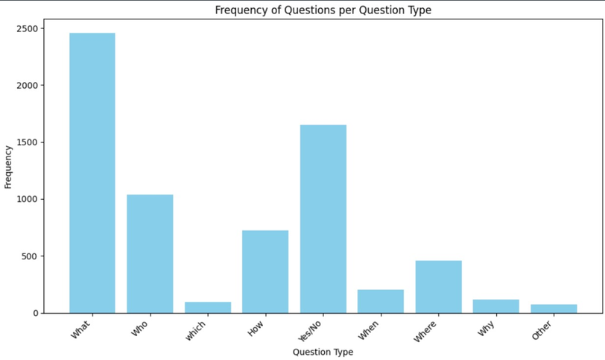
DISTRIBUTION
IIIT-Delhi 2024

Slide 6
METHODOLOGY
4
1. Data Preprocessing
Text Cleaning: Removed irrelevant characters and whitespace.
Tokenization: Split text into word tokens.
Normalization: Lowercased text; removed stop words.
Dataset Splitting: Training (80%), validation (20%), and test (20%).
2. Feature Engineering
Categorized Questions: Grouped into types ("who," "what," "why," etc.).
TF-IDF vectorization and cosine similarity between Question - Answer pair.
Category-Specific Features:
Example: has_location_context for "where" questions, has_time_context for "when."
Common Features:
Word overlap (shared words between question and answer).
Entity match (matching named entities).
Combined features improved context understanding and accuracy.
IIIT-Delhi | 2024

Slide 7
METHODOLOGY
5
3. Story Retrieval System
Database Setup: Populated SQLite with stories_id ,stories and entities from JSON.
Question Processing: Extracted key, entities from user input.
Search & Ranking:
Used TF-IDF and cosine similarity to rank relevant stories.
Retrieved and displayed the most contextually relevant story.
4. Answer Extraction
In our project, answer extraction is performed by identifying and selecting relevant sentences from the retrieved story using its unique story_id. After retrieving the story from the database, it is split into sentences. These sentences are analyzed to determine their relevance to the user's question. Relevance is assessed based on features like semantic similarity and contextual cues specific to the question type (e.g., "where," "when," "who").
The most relevant sentence is selected and return. This ensures that the response is given and directly addresses the user's query. In cases where no clear answer is found, fallback mechanisms are employed to provide a meaningful response or prompt the user for clarification.
IIIT-Delhi | 2024

Slide 8
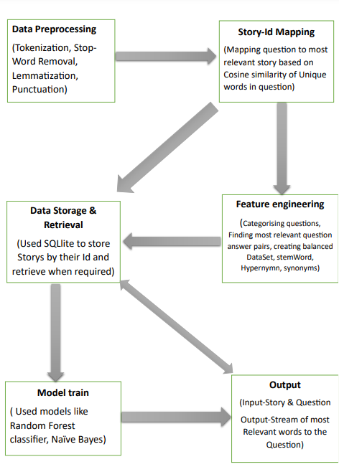
PIPELINE
6
IIIT-Delhi | 2024

Slide 9
MODELS
7
1. Naive Bayes Classifier
Purpose: Validates question-answer pairs as "valid" or "invalid."
Approach: Based on Bayes' theorem with feature independence assumption.
Features Used:
Category-Specific: E.g., has_location_context for "where" and has_time_context for "when."
Common Features: Word overlap (shared words) and entity match (e.g., names, locations).
Advantages: Simple, efficient, and effective for this classification task.
2. Random Forest Classifier (RFC)
Purpose: Validates user-submitted questions for relevance and context.
Approach: Trains on a labeled dataset of valid and invalid questions to classify new queries.
Benefits:
Ensures only meaningful questions are processed for story retrieval.
Enhances system accuracy and efficiency by filtering irrelevant inputs.
These models collectively improve the reliability of question validation and ensure accurate context-aware responses.
IIIT-Delhi | 2024

Slide 10
8
ANALYSIS AND RESULTS
Model | Accuracy
Random Forest Classifier | 60.57
Navie Bayes Classifier | 55.59
IIIT-Delhi | 2024

