Slide 1

SMART INDIA HACKATHON 2026
THE OUTLIERS
• Problem Statement ID – SIH26043
• Problem Statement Title – AI based Elephant attack alert system software
• Theme – Smart Automation / Wildlife Conservation & Disaster Management
• PS Category – Software
• Team ID – [KEEP EXISTING VALUE / PLACEHOLDER]
• Team Name – The Outliers
• Project Title – ELEPHANT GUARD
• Subtitle – Smart Elephant Early Warning & Human-Wildlife Conflict Mitigation System

Slide 2
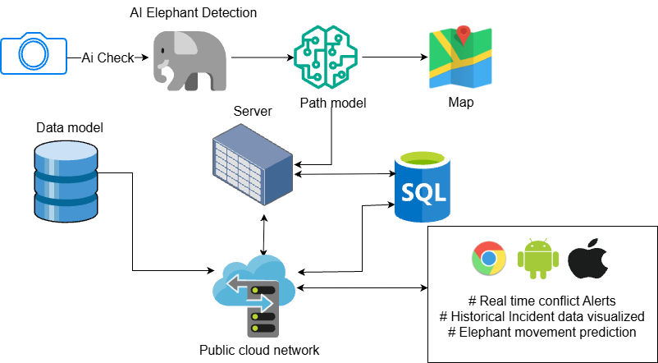
ElephantGuard AI
The Outlies
Proposed Solution
• 1. AI Early Warning: On-device CV detects elephants with estimated GPS location.
• 2. Temporal Validation: 3-of-5 frame queue validates detection to eliminate false alarms.
• 3. Dynamic Risk (DMRS): Multi-factor score: proximity, confidence, direction & time.
• 4. Proximity Alerts: 0–1 km: Siren + Critical alert | 1–2.5 km: Warning | >2.5 km: Safe.
• 5. Forest Dept Response: Real-time GIS map, live incident feed & rapid QRT dispatch.
• 6. Collaborative SIH Hub: Verified incidents converted to challenges for universities & industry.
END-TO-END WORKFLOW PIPELINE
CAMERA STREAM
Android CameraX / IR Feed
ON-DEVICE AI INFERENCE
EfficientDet-Lite0 TFLite Model
TEMPORAL VALIDATION
3-of-5 Multi-Frame Queue
GPS + DMRS RISK ENGINE
Distance, Direction & Night Weight
PROXIMITY ALERT ENGINE
0-1km Siren | 1-2.5km Warning
CITIZEN & FOREST DEPT QRT
Rapid Evacuation & Field Response
SIH COLLABORATIVE HUB
Universities + Industry Solutions

Slide 3
TECHNICAL APPROACH
The Outlies
Technology-
• Frontend / Mobile: Android Native (Kotlin, Jetpack Compose, CameraX, osmdroid).
• AI / ML Pipeline: TensorFlow Lite, EfficientDet-Lite0 on-device, Temporal Validation.
• Backend Engine: FastAPI (Python 3.11), REST APIs, Asynchronous WebSockets.
• API / Sync Bus: Telemetry intake, Incident sync, Offline queue via WorkManager.
• Database: SQLite relational schema: Users, Incidents, Alerts, Challenges, Logs.
SYSTEM ARCHITECTURE
ANDROID PATROL APP
Kotlin + Jetpack Compose | CameraX + GPS
ON-DEVICE AI INFERENCE
EfficientDet-Lite0 TFLite Model
VALIDATION & DMRS RISK
Confidence + Distance + Historical Risk
FASTAPI BACKEND & DB
REST APIs | SQLite Relational Database
ADMIN WEB DASHBOARD
Tactical GIS Map | QRT Dispatch | SIH Hub
MULTI-CHANNEL ALERTS
Local Audible Siren | SMS | Push Notifications

Slide 4
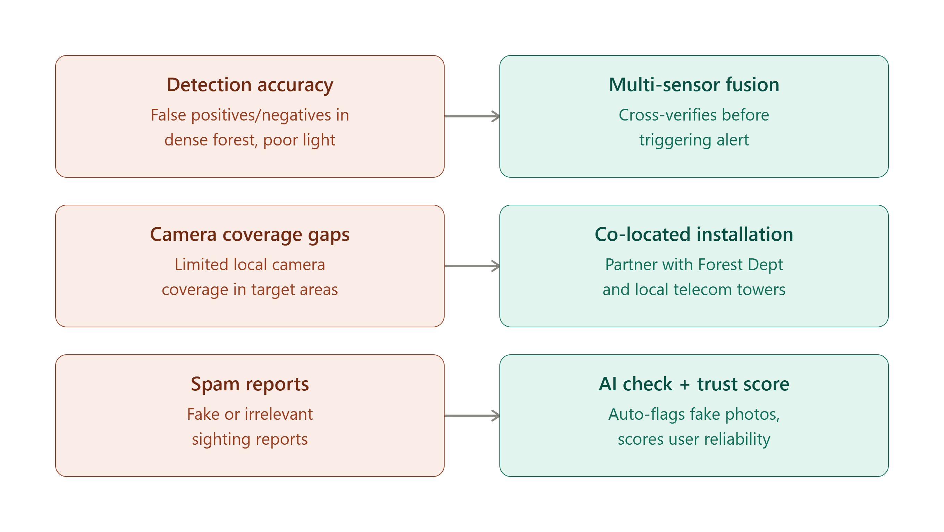
FEASIBILITY AND VIABILITY
The Outlies
Feasibility-
• Technical Feasibility: On-device lightweight AI removes continuous cloud dependence. Phone Camera + GPS provide primary sensing.
• Operational Feasibility: Designed for low-connectivity forest fringes. Multi-channel warnings (app, siren, SMS) ensure wide reach.
• Economic Feasibility: Built on open-source frameworks. Uses commodity smartphones rather than costly military hardware.
Viability-
• Social Viability: Early warnings reduce human encounters, protecting lives and crops. Connects communities directly with Forest Rangers.
• Environmental Viability: Non-invasive camera detection causes zero harm to wildlife. Helps eliminate retaliatory killings and supports Project Elephant.
Feasibility-
Technical Feasibility:
• On-device lightweight AI reduces dependence on continuous cloud inference. • Smartphone camera + GPS provide the primary sensing layer. • FastAPI provides a lightweight central integration layer. • Existing camera/telecom infrastructure can complement mobile nodes.
Operational Feasibility:
• Designed for forest-fringe and low-connectivity environments. • Multi-channel warning architecture (app, siren, SMS) ensures wide reach. • Forest Department dashboard supports centralized monitoring. • Pilot deployment can begin in selected high-risk zones (Dalma NH-33).
Economic Feasibility:
• Built on open-source software frameworks with zero licensing fees. • Uses commodity smartphones instead of specialized military hardware. • Existing infrastructure can be reused where available. • Modular architecture allows phased, cost-effective rollout.
Viability-
Social Viability:
• Early warnings reduce human-elephant encounters, protecting lives and crops. • Connects local communities with Forest Department response teams. • Builds trust through transparent, shared incident data and alerts.
Environmental Viability:
• Non-invasive camera monitoring does not disturb natural elephant movement. • Helps eliminate retaliatory killings, poisonings, and electrocutions. • Historical conflict data directly supports long-term conservation planning. • Contributes to India's national wildlife conservation commitments (Project Elephant).
KEY CHALLENGES & ENGINEERED MITIGATION STRATEGIES
KEY CHALLENGES & ENGINEERED SOLUTIONS
⚠ Detection Uncertainty
→ Temporal validation (3-of-5 queue) + confidence thresholding
⚠ Camera Coverage Gaps
→ Mobile sensing units + integration with existing infrastructure
⚠ Spam / Fake Reports
→ Incident verification + AI media checking + user trust scoring
⚠ Network Blackouts
→ On-device edge AI inference + offline-first sync architecture
⚠ Detection Uncertainty
→ Temporal validation (3-of-5 queue) + confidence filtering
⚠ Camera Coverage Gaps
→ Mobile sensing units + integration with public cameras
⚠ Spam / Fake Reports
→ Incident verification + AI media checking + trust scores
⚠ Network Blackouts
→ On-device edge AI + offline-first sync architecture

Slide 5
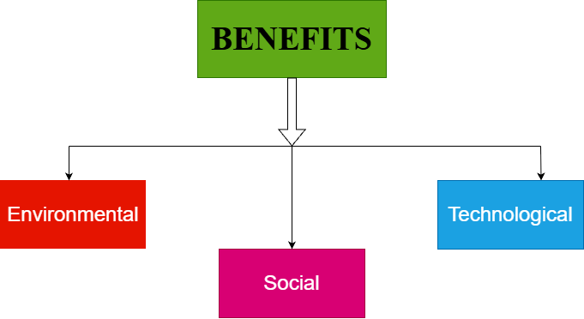
IMPACT AND BENEFITS
The Outlies
Benefits-
• Social Benefits: Faster early warning reduces human injuries & deaths. Protects crops and property. Multi-channel alerts (app, siren, SMS).
• Technical Benefits: Demonstrates practical on-device edge AI. Combines AI, GPS, DMRS risk & GIS. Reusable for tigers & leopards.
• Environmental Benefits: Non-invasive monitoring without disturbing elephants. Reduces retaliatory killing. Supports data-driven conservation.
Potential Impact-
1. IMPACT & INTERVENTION PIPELINE
1. IMPACT & INTERVENTION PIPELINE
EARLY DETECTION
EARLY WARNING
FASTER RESPONSE
LOWER CONFLICT
CONSERVATION
EARLY DETECTION
EARLY WARNING
FASTER RESPONSE
LOWER CONFLICT
CONSERVATION
2. SIH COLLABORATIVE PROBLEM-SOLVING CYCLE
2. SIH COLLABORATIVE PROBLEM-SOLVING CYCLE
1. CITIZEN / CAMERA REPORT
Sighting detected & geo-tagged
1. CITIZEN / CAMERA REPORT
Sighting detected & geo-tagged
2. INCIDENT VERIFICATION
Forest Dept validates threat
2. INCIDENT VERIFICATION
Forest Dept validates threat
3. CROWDSOURCED CHALLENGE
Recurring hotspot published
3. CROWDSOURCED CHALLENGE
Recurring hotspot published
4. UNIVERSITY / INDUSTRY
IITs, NITs & startups propose fixes
4. UNIVERSITY / INDUSTRY
IITs, NITs & startups propose fixes
5. FIELD TESTING & SOLUTION
Pilot deployment & conflict resolution
5. FIELD TESTING & SOLUTION
Pilot deployment & conflict resolution

Slide 6

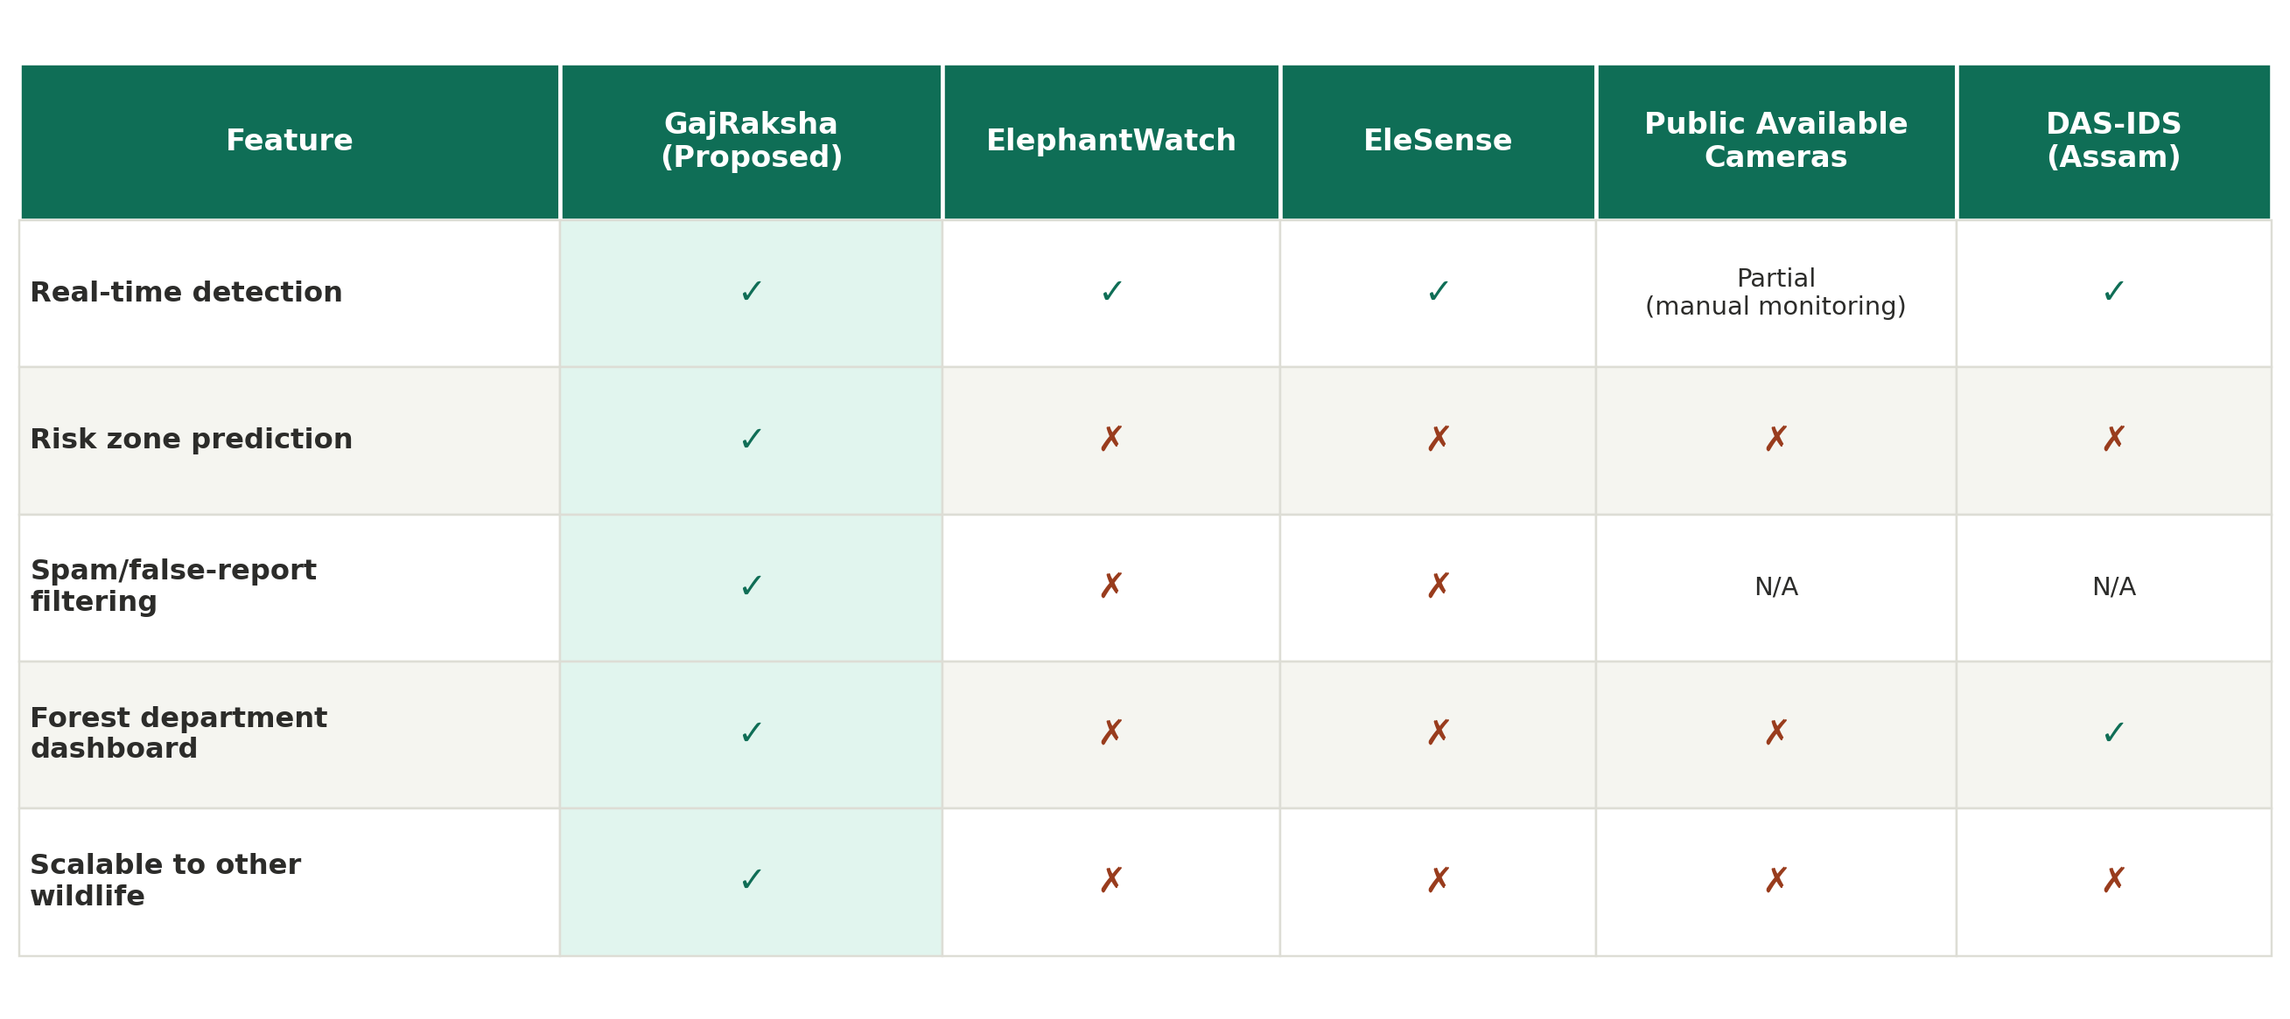
RESEARCH AND REFERENCES
The Outlies
Research & References:
• Down To Earth: State of India's Environment 2025 (conflict data & trends).
• PMC / PubMed: Human-elephant conflict studies (Jharkhand & Chhattisgarh).
• Nature (Reports): Scientific research on HEC fatality trends & mitigation.
• LILA BC: Open wildlife camera-trap datasets.
Existing AI / Wildlife Platforms:
• ElephantWatch: Amrita University (AI-enhanced detection).
• EleSense: Voice for Asian Elephants (Sensor corridor alert).
• MegaDetector: Microsoft AI for Earth (Open-source wildlife model).
Competitive Analysis
Competitive Analysis
Key Parameter | ElephantWatch | EleSense | Public Cams | ELEPHANT GUARD
Real-time detection | ✓ (Server) | ✓ (Sensor) | — (Manual) | ✓ (On-Device AI)
Risk-zone assessment | — (Basic) | — (Track) | — (None) | ✓ (DMRS Engine)
Temporal validation | — (Single) | — (Threshold) | — (None) | ✓ (3-of-5 Queue)
Proximity alerting | — (General) | ✓ (Local) | — (None) | ✓ (0-1km / 1-2.5km)
Forest Dept dashboard | ✓ (Monitor) | — (Hardware) | — (Feed only) | ✓ (Full Web GIS)
Crowdsourced reports | — (Sensor) | — (Sensor) | — (None) | ✓ (Citizen + QRT)
University / Industry hub | — (Internal) | — (NGO) | — (None) | ✓ (SIH Challenge)
Scalable to other wildlife | — (Elephant) | — (Elephant) | ✓ (Manual) | ✓ (Modular)

