Slide 1
Prototype Presentation
Aman Das, Raj Pratap Singh, Shreyansh Mukhopadhyay

Slide 2
In the morning

Slide 3
Getting up
Turn off alarm
Get out of bed

Slide 4
Breakfast
Eat eggs
Drink coffee

Slide 5
In the evening

Slide 6
Dinner
Eat spaghetti
Drink wine

Slide 7
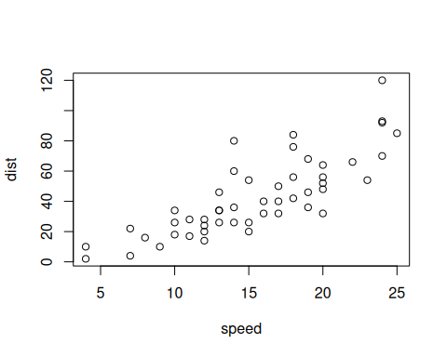
A scatterplot.

Slide 8
Going to sleep
Get in bed
Count sheep

