Slide 1
End-Semester Project
Bivariate Analysis on GDP per capita, Sanitation and Life Expectancy across Nations in 2010 Aman Das [BS2206] Raj Pratap Singh [BS2219] Shreyansh Mukhopadhyay [BS2147]

Slide 2
Introduction
country | lngdp | snt | lfx
Afghanistan | 6.265301 | 34.9 | 60.5
Albania | 8.183118 | 95.2 | 78.1
Algeria | 8.273847 | 87.0 | 74.5
Andorra | 10.454495 | 100.0 | 81.8
Angola | 8.291547 | 41.1 | 60.2
Antigua and Barbuda | 9.546813 | 86.3 | 75.9
Overview
This presentation demonstrates the capabilities of Bivariate Analysis on datasets, to infer relationship between various features of Nations.
log of GDP per capita: Logarithm (base $e$) of Gross Domestic Product (in $) per citizen. Adjusted for Inflation. [lngdp]
Sanitation Access %: Percentage of people using at least basic Sanitation facilities, not shared with other households. [snt]
Life Expectancy: The average number of years a newly born child would live, provided current mortality patterns hold. [lfx]
Data
script.dir <- getSrcDirectory(function(x) {x}) setwd(script.dir) numerise = function(x){ x[grepl("k$", x)] <- as.numeric(sub("k$", "", x[grepl("k$", x)]))*10^3 x <- as.numeric(x) return(x) } d1_raw = read.csv(file.path(".","Data","gdp.csv"), fileEncoding = 'UTF-8-BOM') d2_raw = read.csv(file.path(".","Data","sanitation.csv"), fileEncoding = 'UTF-8-BOM') d3_raw = read.csv(file.path(".","Data","life_expectancy.csv"), fileEncoding = 'UTF-8-BOM') yearname = "X2010" d1 = d1_raw[!is.na(numerise(d1_raw[, yearname])),][,c("country", yearname)] colnames(d1)[2] = "lngdp" d2 = d2_raw[!is.na(numerise(d2_raw[, yearname])),][,c("country", yearname)] colnames(d2)[2] = "snt" d3 = d3_raw[!is.na(numerise(d3_raw[, yearname])),][,c("country", yearname)] colnames(d3)[2] = "lfx" dtemp = merge(x = d1, y = d2, by = "country") d = merge(x = dtemp, y = d3, by = "country") d$lngdp = log(numerise(d$lngdp)) write.csv(d, "./Data/assembled.csv") kable(head(d, 6L))

Slide 3
FREE DATA FROM UN, WORLD BANK, WHO, IMHE VIA GAPMINDER.ORG, CC-BY LICENSE.

Slide 4
Univariate Statistics
 | $\overset{‾}{x}$ | $GM\left(x\right)$ | $HM\left(x\right)$ | $median\left(x\right)$ | $mode\left(x\right)$
ln(GDP) | 8.54124 | 8.42229 | 8.30248 | 8.48673 | 9.23014
Sanitation | 72.43857 | 62.58904 | 47.61862 | 85.60000 | 100.00000
Life Exp. | 70.54603 | 69.95538 | 69.28316 | 72.40000 | 73.20000
Measures of Central Tendency
Mean or Arithmetic Mean $\overset{‾}{x}$, Geometric Mean $GM\left(x\right)$, Harmonic Mean $HM\left(x\right)$, Median $median\left(x\right)$ and Mode $mode\left(x\right)$ are some measures of central tendency in the sample.
$$ \small \begin{aligned} \bar{x} = \frac{1}{n} \sum _{i=1}^{n}(x_{i}) && \operatorname{GM}(x) = \sqrt[n]{\prod_{i=1}^n} a_i && \operatorname{HM}(x)= n\sum_{i=1}^n x_i^{-1} \end{aligned} \normalsize $$
$$ \small \begin{aligned} \operatorname{median}(x)=\begin{cases} x_{(n + 1)/ 2} &: n = 1 \mod{2} \\ \frac{x_{(n/2)} + x_{((n/2)+1)}}{2} &:n = 0 \mod{2} \end{cases} && \operatorname{mode}(x) = x_{(n)} \end{aligned} \normalsize $$
getmode <- function(v) { uniqv <- unique(v) freq = max(tabulate(match(v, uniqv))) res = uniqv[which.max(tabulate(match(v, uniqv)))] if (freq == 1) res = NULL return(res) } d_central = data.frame( row.names = "Variable", Variable = c( "*ln(GDP)*", "*Sanitation*", "*Life Exp.*" ), Mean = c( mean(d$lngdp), mean(d$snt), mean(d$lfx) ), GM = c( geometric.mean(d$lngdp), geometric.mean(d$snt), geometric.mean(d$lfx) ), HM = c( harmonic.mean(d$lngdp), harmonic.mean(d$snt), harmonic.mean(d$lfx) ), Median = c( median(d$lngdp), median(d$snt), median(d$lfx) ), Mode = c( getmode(d$lngdp), getmode(d$snt), getmode(d$lfx) ) ) kable( d_central, col.names = c( "$\\bar{x}$", "$\\operatorname{GM}(x)$", "$\\operatorname{HM}(x)$", "$\\operatorname{median}(x)$", "$\\operatorname{mode}(x)$" ), digits=5 )

Slide 5
 | $Range\left(x\right)$ | $SIR\left(x\right)$ | ${MD}_{\left(\overset{‾}{x}\right)}\left(x\right)$ | $s_{x}^{2}$ | $s_{x}$
ln(GDP) | 6.04435 | 1.06914 | 1.17229 | 2.01791 | 1.42053
Sanitation | 94.03000 | 24.65000 | 25.50487 | 872.29346 | 29.53461
Life Exp. | 50.80000 | 6.00000 | 6.98712 | 75.33494 | 8.67957
Note: $x_{i}$ is the ith observation. $x_{\left(i\right)}$ is the ith largest observation.
Measures of Dispersion
Range(x), Semi-int.. SIR(x), Mean Deviation about x’ ${MD}_{\left(x′\right)}\left(x\right)$, Variance $s_{x}^{2}$, Standard Deviation $s_{x}$ are some measures of dispersion in the sample.
$$ \small \begin{aligned} \operatorname{Range}(x)=|x_{(n)} - x_{(1)}| && \ Q_1 = \operatorname{median}(x_{(1)}, \ldots ,x_{(\lfloor \frac{n+1}{2} \rfloor)}) && \ Q_3 = \operatorname{median}(x_{(\lfloor \frac{n+2}{2} \rfloor)}, \ldots , x_{(n)}) \end{aligned} \normalsize $$
$$ \small \begin{aligned} \operatorname{MD}_{(x')}(x) = \frac{\sum_{i=1}^n |x_i-x'|}{n} && \operatorname{SIR}(x)=\frac{|Q_1-Q_3|}{2} && s_x = \sqrt{\frac{\sum_{i=1}^{n} \left(x_i - \bar{x}\right)^2}{n}} && s^2_x= (s_x)^2 \end{aligned} \normalsize $$
getmd = function(x, center = mean(x)){ md = mean( abs( x - rep(center, length(x)) ) ) return(md) } d_disp = data.frame( row.names = "Variable", Variable = c( "*ln(GDP)*", "*Sanitation*", "*Life Exp.*" ), Range = c( max(d$lngdp) - min(d$lngdp), max(d$snt) - min(d$snt), max(d$lfx) - min(d$lfx) ), SIR = c( IQR(d$lngdp)/2, IQR(d$snt)/2, IQR(d$lfx)/2 ), MD = c( getmd(d$lngdp), getmd(d$snt), getmd(d$lfx) ), variance = c( (sd(d$lngdp))^2, (sd(d$snt))^2, (sd(d$lfx))^2 ), SD = c( sd(d$lngdp), sd(d$snt), sd(d$lfx) ) ) kable( d_disp, col.names = c( "$\\operatorname{Range}(x)$", "$\\operatorname{SIR}(x)$", "$\\operatorname{MD}_{(\\bar{x})}(x)$", "$\\quad \\quad \\quad \\quad s_x^2$", "$\\quad \\quad \\quad \\quad s_x$" ), digits=5 )

Slide 6
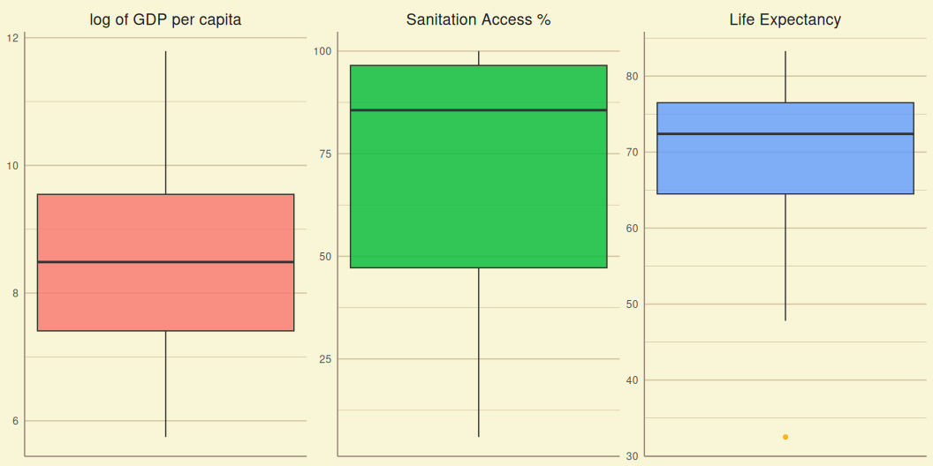
Box Plot
About?
labelfunction = function(val1){ return(list(c( "log of GDP per capita", "Sanitation Access %", "Life Expectancy" ))) } ggplot(stack(d[2:4]), mapping = aes(y = values))+ geom_boxplot(aes(fill=ind), alpha=0.8, outlier.color = "orange")+ labs( x=NULL, y=NULL )+ mytheme+ mycolor+ facet_wrap(~ind, scales="free", labeller = labelfunction)+ theme(axis.text.x=element_blank(), legend.position="none", strip.text.x = element_text(size = rel(1.5)), panel.grid.minor.x = element_blank(), panel.grid.major.x = element_blank() )

Slide 7
Inferences

Slide 8
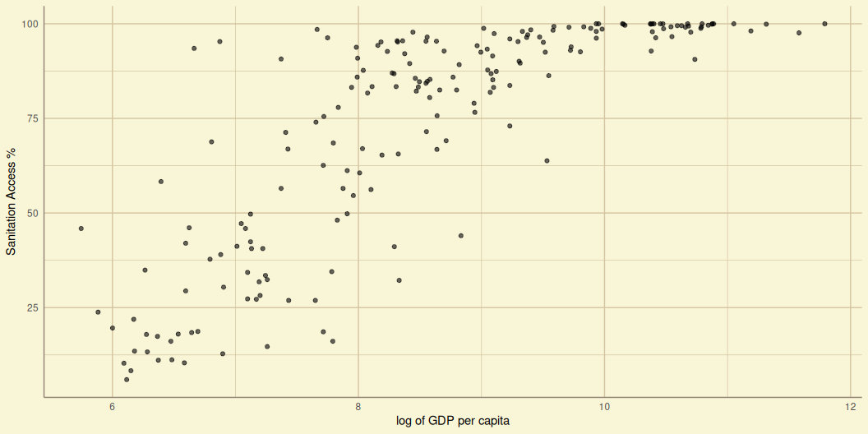
Scatter Plot
A Scatter plot is a type of Plot using Cartesian coordinate system to display values for two variables for a set of data. The data are displayed as a collection of points, each having one variable determining the abscissa and the other variable determining the ordinate. It helps us:
take a short glance at effect of two variables.
suggest kinds of correlations between variables.
estimate the direction of correlation.
sctrplot = function( d, x_map, y_map, x_lab=waiver(), y_lab=waiver(), title=waiver() ){ plot1 = ggplot(d, mapping = aes(x = x_map, y = y_map))+ geom_point( alpha=0.6 )+ mytheme+ labs( x=x_lab, y=y_lab, title=title ) return(plot1) }
Sanitation vs. GDP per Capita

Slide 9
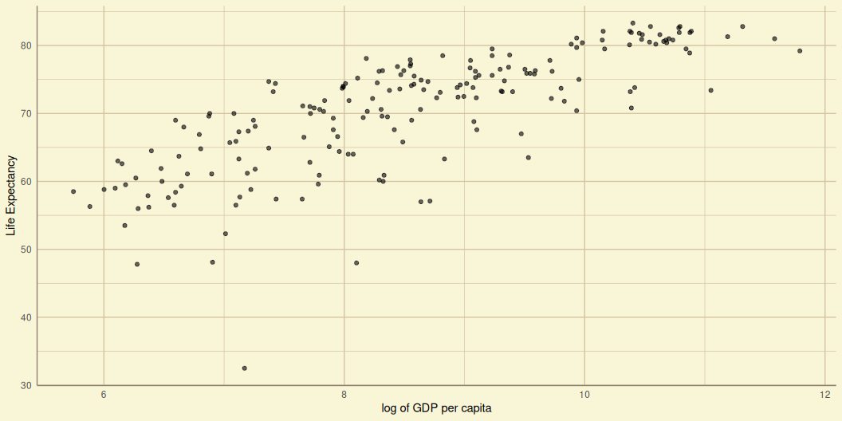
Life Expectancy vs. GDP per Capita

Slide 10
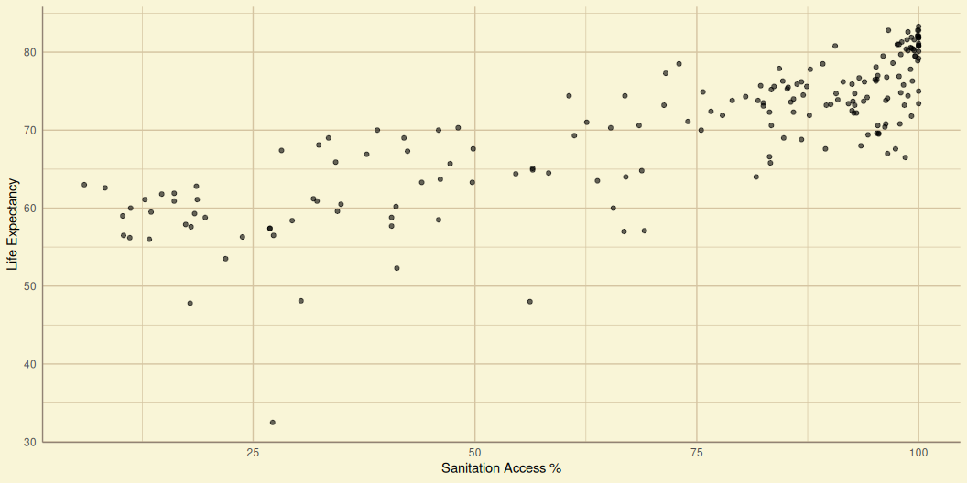
Life Expectation vs. Sanitation

Slide 11
Inferences
seems like Linear correlation

Slide 12
Bivariate Statistics
Covariance and Correlation Matrices
Covariance $cov\left(x,y\right)$ is a measure of the joint variability of two random variables $x$, $y$.
Correlation $r_{x,y}$ is any relationship, causal or spurious, between two random variables $x$, $y$. Pearson’s $r$ correlation coefficient is considered here.
$$\begin{matrix}cov\left(x,y\right)=\frac{\sum_{i=1}^{n}{\left(x_{i}−\overset{‾}{x}\right)}\left(y_{i}−\overset{‾}{y}\right)}{n} & & r_{x,y}=\frac{cov\left(x,y\right)}{s_{x}s_{x}}\end{matrix}$$

Slide 13
cov_mat = cov(d[, 2:4]) kable(cov_mat, digits=5)
 | lngdp | snt | lfx
lngdp | 2.01791 | 33.84045 | 9.52202
snt | 33.84045 | 872.29346 | 208.54155
lfx | 9.52202 | 208.54155 | 75.33494
$$A_{i,j}=cov\left(x_{i},x_{j}\right)$$

Slide 14
 | Pearson’s $r$ | Spearman’s $r_{s}$ | Kendall’s $τ$
Sanitation vs. ln(GDP) | 0.80659 | 0.85920 | 0.67458
Life Exp. vs. ln(GDP) | 0.77229 | 0.81639 | 0.62168
Life Exp. vs. Sanitation | 0.81351 | 0.83513 | 0.63744
Other Correlation Coefficients
Pearson, Spearman, Kendall #TODO
d_cor = data.frame( row.names = "Variable", Variable = c( "*Sanitation vs. ln(GDP)*", "*Life Exp. vs. ln(GDP)*", "*Life Exp. vs. Sanitation*" ), Pearson = c( cor(d$snt, d$lngdp, method="pearson"), cor(d$lfx, d$lngdp, method="pearson"), cor(d$lfx, d$snt, method="pearson") ), Spearman = c( cor(d$snt, d$lngdp, method="spearman"), cor(d$lfx, d$lngdp, method="spearman"), cor(d$lfx, d$snt, method="spearman") ), Kendall = c( cor(d$snt, d$lngdp, method="kendall"), cor(d$lfx, d$lngdp, method="kendall"), cor(d$lfx, d$snt, method="kendall") ) ) kable( d_cor, digit = 5, col.names = c( "*Pearson's* $r$", "*Spearman's* $r_s$", "*Kendall's* $\\tau$" ) )

Slide 15
 | Partial Correlation
Sanitation vs. ln(GDP) | 0.4826925
Life Exp. vs. ln(GDP) | 0.3377892
Life Exp. vs. Sanitation | 0.5075384
Partial Correlation
Partial

Slide 16
Inferences
Good linear correlation lets try to observe line of best fit.

Slide 17
Linear Regression
 | $\hat{a}$ | $\hat{b}$ | $R^{2}$
Sanitation vs. ln(GDP) | -70.79844 | 16.77006 | 0.65059
Life Exp. vs. ln(GDP) | 30.24203 | 4.71876 | 0.59643
Life Exp. vs. Sanitation | 53.22795 | 0.23907 | 0.66180
Simple Univariate Linear Regression is a method for estimating the relationship $y_{i}=f\left(x_{i}\right)$ of a response variable $y$ with a predictor variable $x$, as a line that closely fits the $y$ vs. $x$ scatter plot.
$$y_{i}=\hat{a}+\hat{b}x_{i}+e_{i}.$$
Where $\hat{a}$ is the intercept, $\hat{b}$ is the slope, and $e_{i}$ is the ith residual error. We aim to minimize $e_{i}$ for better fit.
Ordinary Least Squares
Ordinary Least squares method reduces $e_{i}$ by minimizing error sum of squares $∑e_{i}^{2}$.
olssmry = function( d, x_map, y_map, x_lab=waiver(), y_lab=waiver(), title=waiver() ){ model = lm(formula=y_map~x_map) smry = summary(model, signif.stars=TRUE) smryvec = c( as.numeric(model$coefficients["(Intercept)"]), as.numeric(model$coefficients["x_map"]), smry$r.squared ) return(smryvec) } olstab = t(data.frame( SvG = olssmry(d, d$lngdp, d$snt), LvG = olssmry(d, d$lngdp, d$lfx), LvS = olssmry(d, d$snt, d$lfx) )) row.names(olstab) = c( "*Sanitation vs. ln(GDP)*", "*Life Exp. vs. ln(GDP)*", "*Life Exp. vs. Sanitation*" ) kable( olstab, digit = 5, col.names=c( "$\\hat{a}$", "$\\hat{b}$", "$R^2$" ) )

Slide 18
 | $\hat{a}$ | $\hat{b}$
Sanitation vs. ln(GDP) | -71.23153 | 16.80472
Life Exp. vs. ln(GDP) | 31.99047 | 4.61340
Life Exp. vs. Sanitation | 53.73041 | 0.23963
$R^{2}$: Coefficient of Determination
Least Absolute Deviation
Least absolute Deviation method reduces $e_{i}$ by minimizing the sum of absolute deviations $∑\left|e_{i}\right|$.
ladsmry = function( d, x_map, y_map, x_lab=waiver(), y_lab=waiver(), title=waiver() ){ model = rq(formula=y_map~x_map) smry = summary(model) smryvec = c( as.numeric(model$coefficients[1]), as.numeric(model$coefficients[2]) ) return(smryvec) } olstab = t(data.frame( SvG = ladsmry(d, d$lngdp, d$snt), LvG = ladsmry(d, d$lngdp, d$lfx), LvS = ladsmry(d, d$snt, d$lfx) )) row.names(olstab) = c( "*Sanitation vs. ln(GDP)*", "*Life Exp. vs. ln(GDP)*", "*Life Exp. vs. Sanitation*" ) kable( olstab, digit = 5, col.names=c( "$\\hat{a}$", "$\\hat{b}$" ) )

Slide 19
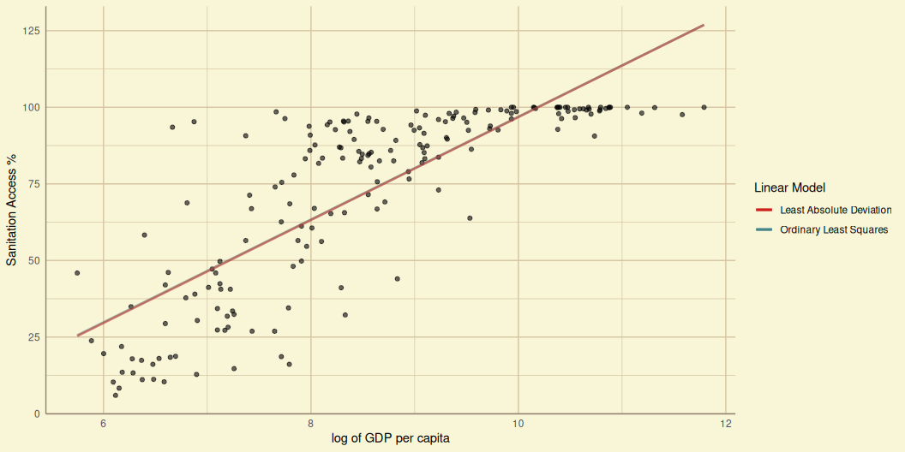
Line fitting
Plotting the estimated Linear Model on the Scatter Plot.
linearplot = function( d, x_map, y_map, x_lab=waiver(), y_lab=waiver(), title=waiver() ){ plot1 = ggplot(d, mapping = aes(x = x_map, y = y_map))+ geom_point( alpha=0.6 )+ mytheme+ labs( x=x_lab, y=y_lab, title=title )+ geom_smooth( method="lm", formula=y~x, se=FALSE, aes(color = "Ordinary Least Squares") )+ geom_smooth( method="rq", formula=y~x, se=FALSE, aes(color = "Least Absolute Deviation") )+ labs( color="Linear Model" )+ mycolor return(plot1) }
Sanitation vs. GDP per Capita

Slide 20
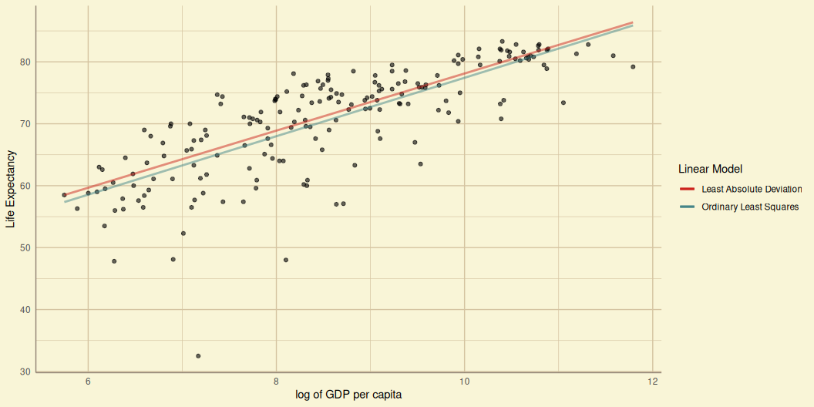
Life Expectancy vs. GDP per Capita

Slide 21
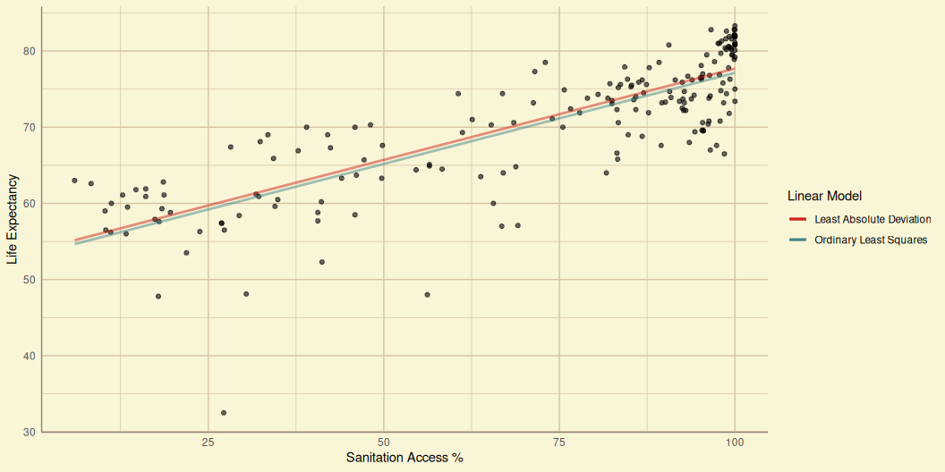
Life Expectancy vs. Sanitation

Slide 22
Inferences

Slide 23
Conclusion

