Slide 1


A Comparative Analysis of LSTM and TCN Models for Anomaly Detection in Healthcare Time Series Data
This presentation explores the comparative strengths and limitations of Long Short-Term Memory (LSTM) and Temporal Convolutional Network (TCN) models for anomaly detection in healthcare time series, focusing on chronic disease monitoring.
Aman Agrawal – 220962104
Dhimanth Kumar Singh – 220962230
Pranav Kumar Gupta – 220962250

Slide 2

Introduction and Challenges in Healthcare Time Series Anomaly Detection
Data Complexity
Key Challenges
Limitations of Traditional Methods
Continuous physiological data from chronic disease patients include heart rate, glucose, blood pressure, and respiratory rates, requiring advanced analysis for early anomaly detection.
Real-time processing, multi-modal data streams, noise from sensors, and the need for high accuracy with low false positives complicate anomaly detection.
Classical statistical techniques struggle with nonlinear patterns and long-term dependencies, necessitating deep learning approaches.

Slide 3
LSTM and TCN Architectures for Healthcare Anomaly Detection
Long Short-Term Memory (LSTM)
Temporal Convolutional Network (TCN)
Uses memory cells and gating to capture long-range dependencies, effective for gradual trends like slow glucose rises. Processes data sequentially, suitable for temporal patterns.
Employs dilated causal convolutions for multi-scale temporal pattern capture. Processes sequences in parallel, faster and better at detecting sudden shifts like blood pressure spikes.

Slide 4

Research Gaps and Objectives
1
Research Gaps
Challenges include balancing efficiency and accuracy, limited cross-series attention, lack of adaptive architectures, interpretability issues, and robustness to noise.
2
Research Objectives
Develop optimized LSTM and TCN models, compare performance, enhance interpretability, process multimodal data, and provide deployment guidelines for healthcare monitoring.

Slide 5



Proposed Methodology: Data and Model Architecture
Dataset Collection & Processing
MIMIC-IV and PhysioNet datasets with physiological parameters
Synthetic augmentation with noise and sensor dropout
Normalization, missing data imputation, denoising, and multi-modal alignment
Model Architecture
LSTM with bidirectional layers and attention gates
TCN with dilated and depthwise separable convolutions
Hybrid model combining LSTM and TCN outputs via attention fusion

Slide 6
Training Protocol and Evaluation Framework
Training Protocol
Evaluation Framework
Loss combines focal loss and mean absolute error to handle class imbalance and reconstruction errors. AdamW optimizer with FP16 training and gradient checkpointing improves efficiency.
Performance metrics focus on clinical relevance and computational efficiency. Robustness testing and validation on multiple datasets ensure practical applicability in resource-constrained environments.
Validation uses stratified 5-fold splits and early stopping to ensure robust model performance.

Slide 7
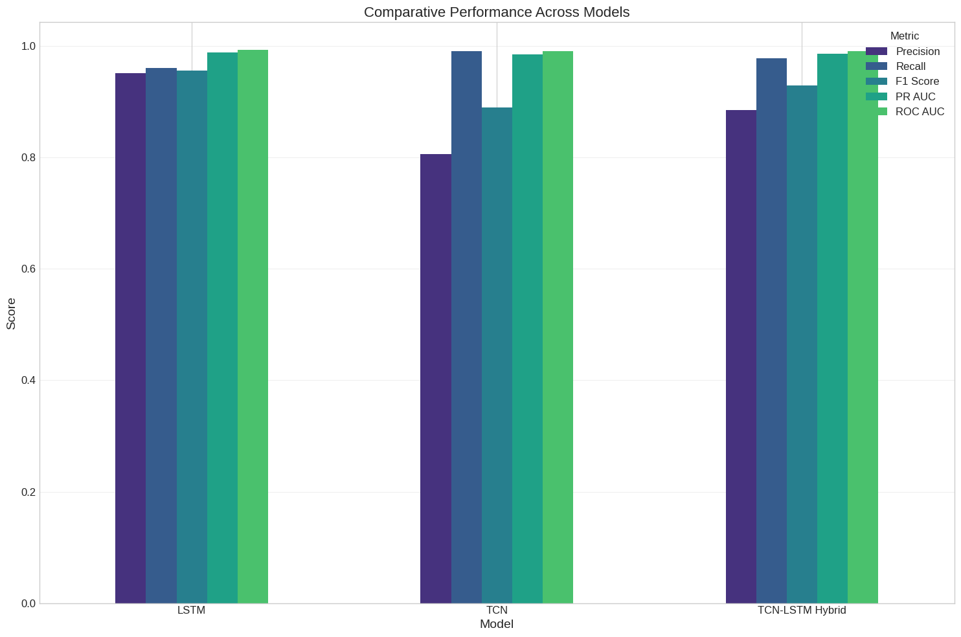
Experimental Results: Model Performance Comparison
Model
Precision
Recall
F1 Score
ROC AUC
LSTM
0.94
0.95
0.945
0.99
TCN
0.81
0.99
0.89
0.99
Hybrid (LSTM-TCN)
0.89
0.97
0.93
0.99
The hybrid model balances precision and recall, outperforming individual models in balanced accuracy and F1 score, demonstrating the complementary strengths of convolutional and recurrent architectures.

Slide 8

Conclusion and Future Directions
Summary
This study presents a thorough comparison of LSTM and TCN models for healthcare anomaly detection, addressing challenges like real-time processing, interpretability, and robustness.
Future Work
Plans include exploring real-time deployment, enhancing interpretability mechanisms, and integrating broader datasets to improve clinical applicability and patient outcomes.

Slide 9
Thank you !!!

