Slide 1
UNIT 1
OPERATING SYSTEMS

Slide 2
Course Code :24AM4ESOPS
Course Credits : 3-0-0
No. of Hrs./Week – 3 Hrs. (Direct Contact Hours)
CIE – 50M(Three tests + Quizzes + AAT)
SEE – (100 M) – 50% Weightage

Slide 3
UNIT 1
Introduction: Types of Operating System, Operating System Concepts, System Calls, Operating System Structure.
Processes and Threads: The Process Model, Process Creation, Process Termination, Process Hierarchies, Process States, Thread Usage, The Classical Thread Model, Implementing Threads in User Space, Implementing Threads in The Kernel.
UNIT 2
Inter-process Communication: Race Conditions, Critical Regions, Mutual Exclusion with Busy Waiting, Semaphores, Mutexes, Monitors, Message Passing, Avoiding Locks, Read- Copy-Update.
Pre-emptive, non-pre-emptive scheduling: First come first serve, Shortest Job First, Round-Robin, Priority.
Case study: The Dining Philosophers Problem, The Readers and Writers Problem.
UNIT 3
Memory Management: Memory management strategies, Background, Swapping, Contiguous memory allocation, Paging, Structure of page table, Segmentation.
Virtual Memory Management: Background, Demand paging, Copy-on-write, Page replacement, Allocation of frames; Thrashing.
UNIT 4
Deadlocks: Resources, Introduction to Deadlocks, The Ostrich Algorithm, Deadlock Detection and Recovery, Deadlock Avoidance, Deadlock Prevention, Other Issues.
Disk performance optimization: Disk Hardware, Disk Formatting, Disk Arm Scheduling Algorithms, Error Handling.
UNIT 5
File System: File concept, Access methods, Directory structure, File system mounting, File sharing.
Implementing File system: File system structure, File system implementation, Directory implementation, Allocation methods, Free space management

Slide 4
Text Books:
1. Modern operating systems, Tanenbaum, Andrew, 4th Edition, Pearson Education, 2015.
2. Operating System Concepts, Abraham Silberschatz, Peter Baer Galvin, Greg Gagne, 9th Edition, Wiley India, 2013.
Reference Books:
1. Operating Systems: Internals and Design Principles, William Stallings, 9th Edition, Pearson,2008.
2. Operating Systems: A Concept Based Approach, D.M Dhamdhere, 3rd Ed, McGraw- Hill, 2017.

Slide 5
What Is An Operating System?
Lots of hardware !!
One or more processors
Main memory
Disks
Printers
Various input/output devices
Managing all these components requires a layer of software – the operating system

Slide 6
Operating systems have two main functions: providing abstractions to user programs and managing the computer’s resources.
For the most part, the interaction between user programs and the operating system deals with the former; for example, creating, writing, reading, and deleting files.
The resource-management part is largely transparent to the users and done automatically.
Thus, the interface between user programs and the operating system is primarily about dealing with the abstractions.

Slide 7
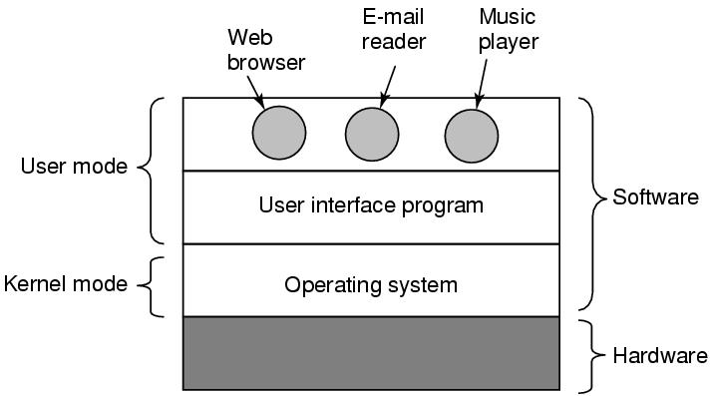
Where is the software?
The hardware consists of chips, boards, disks, a keyboard, a monitor, and similar physical objects.
On top of the hardware is the software. Most computers have two modes of operation: kernel mode and user mode.
The operating system, the most fundamental piece of software, runs in kernel mode (also called supervisor mode).
In this mode it has complete access to all the hardware and can execute any instruction the machine is capable of executing. The rest of the software runs in user mode, in which only a subset of the machine instructions is available.
The user interface program, shell or GUI, is the lowest level of user-mode software, and allows the user to start other programs, such as a Web browser, email reader, or music player.
Where the operating system fits in.

Slide 8
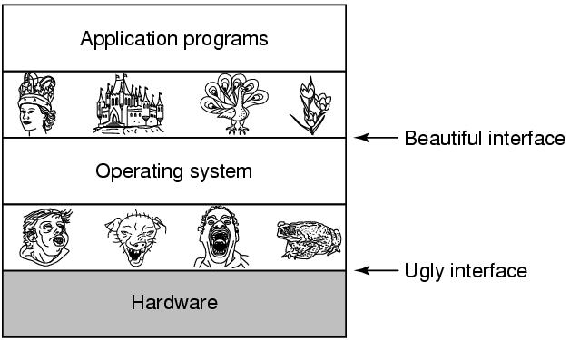
The Operating System as an Extended Machine

Slide 9
The Operating System as a Resource Manager
Allow multiple programs to run at the same time
Manage and protect memory, I/O devices, and other resources
Multiplexes (shares) resources in two different ways:
  In time- When a resource is time multiplexed, different programs or users take turns using it.
  With only one CPU and multiple programs that want to run on it, the operating system first allocates the CPU to one program, then, after it has run long enough, another program gets to use the CPU, then another, and then eventually the first one again. Example : sharing the printer.
  In space- main memory is normally divided up among several running programs, so each one can be resident at the same time (for example, in order to take turns using the CPU). Assuming there is enough memory to hold multiple programs, it is more efficient to hold several programs in memory at once rather than give one of them all of it, especially if it only needs a small fraction of the total.

Slide 10
History of Operating Systems
Generations:
(1945–55) Vacuum Tubes
(1955–65) Transistors and Batch Systems
(1965–1980) ICs and Multiprogramming
(1980–Present) Personal Computers, Tablets, Phones

Slide 11
The Operating System Zoo
Mainframe operating systems
Server operating systems
Multiprocessor operating systems
PC operating systems
Handheld Computer Operating Systems
Sensor-Node Operating Systems
Embedded operating systems
Real-time OS

Slide 12
The Operating System Zoo
Mainframe operating systems
  Big thousands of disks….
  Elderly-Unix, Linux replacing them
  Mainframes are also making some thing of a comeback as high-end Web servers, servers for large-scale electronic commerce sites, and servers for business-to-business transactions.
  They typically offer three kinds of services: batch, transaction processing, and timesharing.
  A batch system is one that processes routine jobs without any interactive user present.
  Claims processing in an insurance company or sales reporting for a chain of stores is typically done in batch mode.
  Transaction-processing systems handle large numbers of small requests, for example, check processing at a bank or airline reservations. Each unit of work is small, but the system must handle hundreds or thousands per second.
  Timesharing systems allow multiple remote users to run jobs on the computer at once, such as querying a big database.

Slide 13
The Operating System Zoo
Server operating systems
Serve multiple users at once over a network and allow the users to share hardware and software resources
Internet providers run many server machines to support their customers and Websites use servers to store the Web pages and handle the incoming requests.
  Workstations
  File, print, web servers
  BSD, Linux, Windows

Slide 14
Multiprocessor operating systems
Use multiple cores
Depending on precisely how they are connected and what is shared, these systems are called parallel computers, multi-computers, or multiprocessors.
They need special operating systems, but often these are variations on the server operating systems, with special features for communication, connectivity, and consistency.

Slide 15
The Operating System Zoo
PC operating systems-Linux, Mac, Windows
Their job is to provide good support to a single user. They are widely used for word processing, spreadsheets, games, and Internet access.
Smart phone operating systems- Android, iPhone, Blackberry
  No hard disk
  Handheld Computer Operating Systems
  A handheld computer, originally known as a PDA (Personal Digital Assistant), is a small computer that can be held in your hand during operation. Smartphones and tablets are the best-known examples.

Slide 16
The Operating System Zoo
Sensor-Node Operating Systems
Networks of tiny sensor nodes are tiny computers that communicate with each other and with a base station using wireless communication.
Sensor networks are used to protect the perimeters of buildings, guard national borders, detect fires in forests, measure temperature and precipitation for weather forecasting, glean information about enemy movements on battlefields, and much more.
Each sensor node is a real computer, with a CPU, RAM, ROM, and one or more environmental sensors. It runs a small, but real operating system, usually one that is event driven, responding to external events or making measurements periodically based on an internal clock.
The operating system has to be small and simple because the nodes have little RAM and battery lifetime is a major issue.

Slide 17
The Operating System Zoo
Embedded operating systems run on the computers that control devices that are not generally thought of as computers and which do not accept user-installed software.
The main property that distinguishes embedded systems from handhelds is the certainty that no untrusted software will ever run on it
-TV sets, cars, DVDs, MP3s
  Everything is in ROM (no apps can run on it)
  QNx, Vxworks

Slide 18
Real time operating systems
These systems are characterized by having time as a key parameter. For example, in industrial process-control systems, real-time computers have to collect data about the production process and use it to control machines in the factory.
Hard deadline (eg. factory) Ex: if a car is moving down an assembly line, certain actions must take place at certain instants of time. If, for example, a welding robot welds too early or too late, the car will be ruined. If the action absolutely must occur at a certain moment (or within a certain range), we have a hard real-time system. Many of these are found in industrial process control, avionics, military.
Soft deadline (eg. multi-media)
A soft real-time system, is one where missing an occasional deadline, while not desirable, is acceptable and does not cause any permanent damage.
Ex: Digital audio or multimedia systems, Smartphones.

Slide 19
Operating System Concepts
Processes
Address spaces
Files
Input/Output
Protection
The shell

Slide 20
Processes
Program in execution
Lives in address space- a list of memory locations from 0 to some maximum, which the process can read and write.
The address space contains the executable program, the program’s data, and its stack.
Also associated with each process is a set of resources, commonly including
Registers (including the program counter and stack pointer),
A list of open files, outstanding alarms,
lists of related processes.
Process table
  Keeps info about process
  Used to re-start process
Shell (command interpreter) reads commands from terminal

Slide 21

A Process Tree
A process tree. Process A created two child processes, B and C.
Process B created three child processes, D, E, and F.
Process can create one or more other processes (referred to as child processes) and these processes in turn can create child processes

Slide 22
Process
Can communicate with one another (IPC) Inter process communication.
Each person authorized to use a system is assigned a UID (User Identification) by the system administrator. Every process started has the UID of the person who started it.
A child process has the same UID as its parent.
Users can be members of groups, each of which has a GID (Group Identification).
One UID, called the superuser (in UNIX), or Administrator (in Windows),has special power and may override many of the protection rules.
Have UID’s and group ID’s (GID)

Slide 23
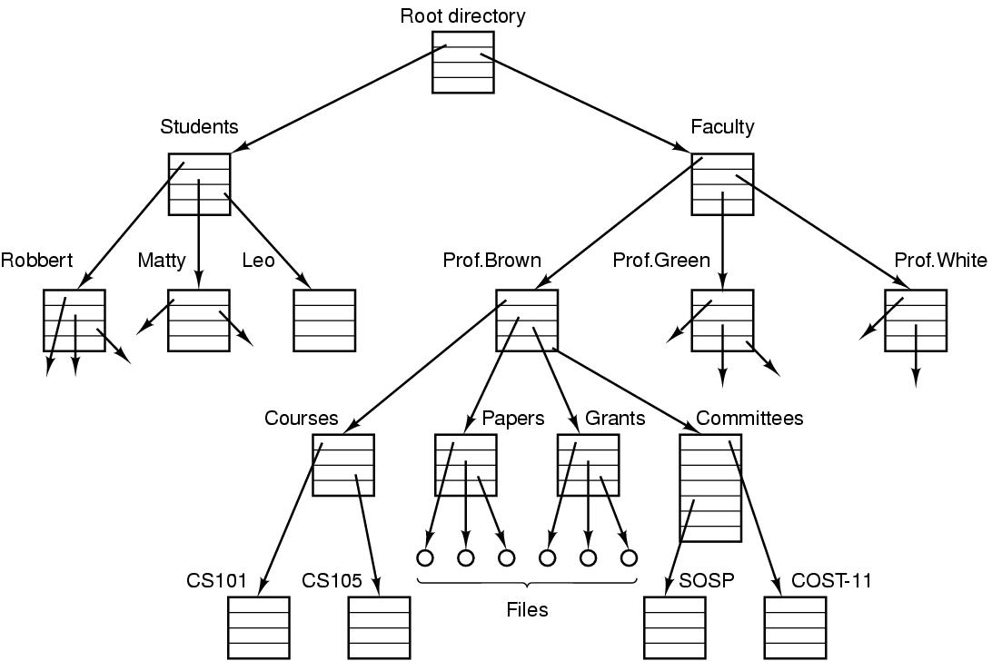
File directory
  The directory is organized as a tree
  Root directory at the top. Path proceeds from the root (e.g. faculty/prof brown/courses)

Slide 24
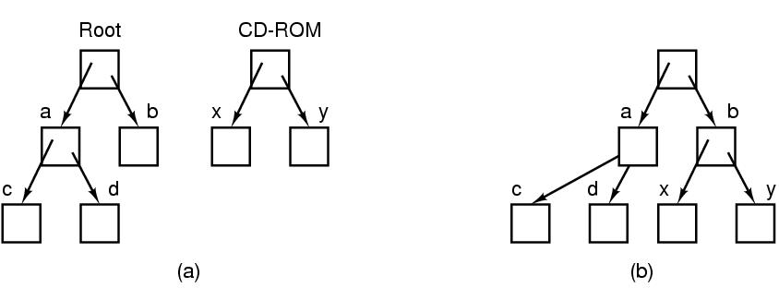
Mounting Files in UNIX
A CD-ROM is mounted on directory b.

Slide 25
Special files
Special files-can use same calls for I/O as for files. OS treats them as files.
  Block special files (disks)
  Character special files (line printers, modems)
  Kept in /dev directory, e.g. /dev/lp is line printer

Slide 26
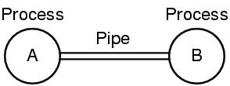
Unix Pipe
Processes communicate by writing into/reading from a file in Unix
A and B write into the pipe and read from the pipe.

Slide 27
I/O, Protection/Shell
I/O-big part of OS
Protection-UNIX uses rwx bits for each file
Each field has a bit for read access,a bit for write access, and a bit for execute access.
  3 bits for owner, 3 for group, 3 for everyone else
Shell (command interpreter)
  UNIX
  Has lots of flavors-sh,bash,csh,ssh…..
  Sort<file1>file2
  Cat file 1 file 2 file3 | sort > /dev/lp

Slide 28
System Calls
Interface between user programs and OS
Varies from OS to OS
System call issued by user program
Call uses a library call of the same name
Library routine puts machine into kernel modes (by issuing a special instruction)
Finds actual routine for system call in a table
Does the work involved in the call
Returns to user program

Slide 29
Unix Read System Call
Count=read(fd, buffer, nbytes)
  fd is a file descriptor. When a file is opened, permissions are checked. If access is allowed, a number (fd) is returned. Then file can be read/written
  nbytes is number of bytes in file
  buffer is where read deposits the bytes
If the system call cannot be carried out owing to an invalid parameter or a disk error, count is set to −1, and the error number is put in a global variable, errno.

Slide 30

System Calls
read(fd, buffer, nbytes).

Slide 31
In preparation for calling the read library procedure, which actually makes the read system call the calling program first pushes the parameters onto the stack, as shown in steps 1–3.
The first and third parameters are called by value, but the second parameter is passed by reference, meaning that the address of the buffer (indicated by &) is passed, not the contents of the buffer. Then comes the actual call to the library procedure (step 4). This instruction is the normal procedure-call instruction used to call all procedures.
The library procedure, possibly written in assembly language, typically puts the system-call number in a place where the operating system expects it, such as a register (step 5).

Slide 32
Then it executes a TRAP instruction to switch from user mode to kernel mode and start execution at a fixed address within the kernel (step 6).
The kernel code that starts following the TRAP examines the system-call number and then dispatches to the correct system-call handler, usually via a table of pointers to system-call handlers indexed on system-call number (step 7).
At that point the system-call handler runs (step 8).
Once it has completed its work, the control may be returned to the user-space library procedure at the instruction following the TRAP instruction (step 9). This procedure then returns to the user program in the usual way procedure calls return (step 10).
To finish the job, the user program has to clean up the stack, as it does after any procedure call (step 11). Assuming the stack grows downward, as it often does, the compiled code increments the stack pointer exactly enough to remove the parameters pushed before the call to read. The program is now free to do whatever it wants to do next.

Slide 33
System Calls for Process Management
Fork is the only way to create a new process in POSIX.
It creates an exact duplicate of the original process, including all the file descriptors, registers—everything.
After the fork, the original process and the copy(the parent and child) go their separate ways.
All the variables have identical values at the time of the fork, but since the parent’s data are copied to create the child, subsequent changes in one of them do not affect the other one.
The fork call returns a value, which is zero in the child and equal to the child’s PID (Process Identifier) in the parent. Using the returned PID, the two processes can see which one is the parent process and which one is the child process

Slide 34
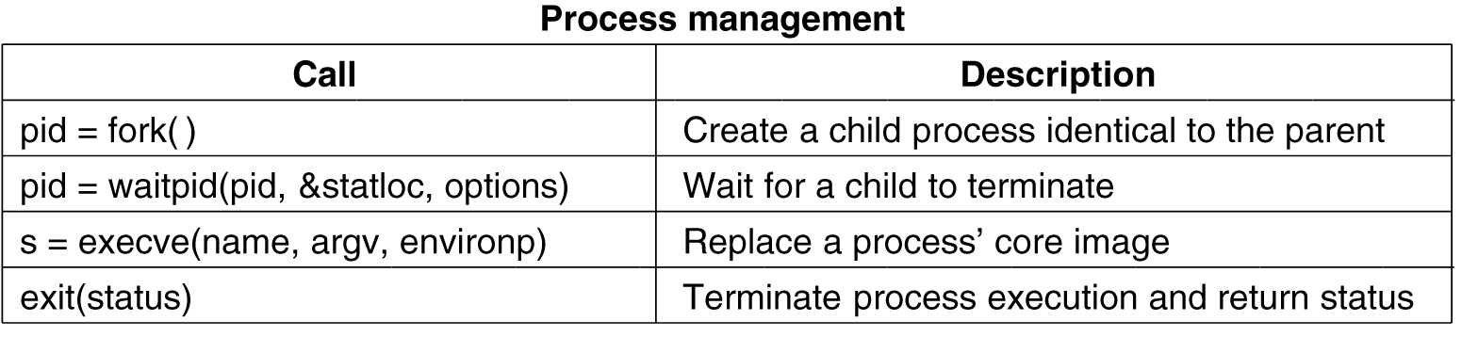
System Calls for Process Management
Waitpid can wait for a specific child, or for any old child by setting the first parameter to −1.
When waitpid completes, the address pointed to by the second parameter, statloc, will be set to the child process’ exit status (normal or abnormal termination and exit value).

Slide 35
Execve
Replaces process’ core image by the file named in its invocation
Execve(name,arg,environp) has 3 parameters
  Name of file (e.g. cp command)
  Arg-pointer to argument array
  Environp-pointer to environment array

Slide 36
consider how fork is used by the shell. When a command is typed, the shell forks off a new process. This child process must execute the user command.
It does this by using the execve system call, which causes its entire core image to be replaced by the file named in its first parameter.
execve has three parameters: the name of the file to be executed, a pointer to the argument array, and a pointer to the environment array.

Slide 37
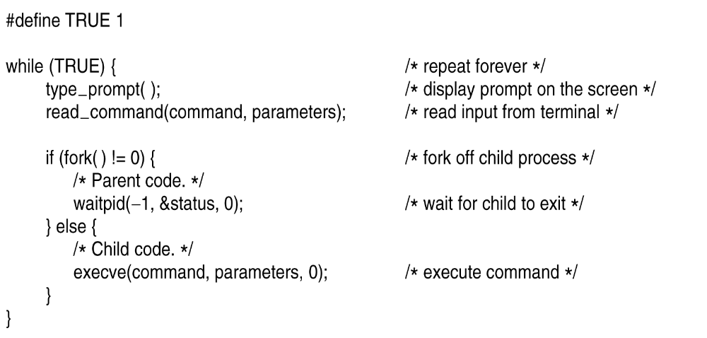
Shell
.

Slide 38
Excve (example)
Cp f1 f2 is located by execve and parameters are passed to it by execve
  Main(argc, argv, envp) is main prog in cp
    Argc is #items on command line (=3 in cp)
    Argv points to array (arg[0] points to cp, arg[1] points to f1,
    Envp points to environment, an array of name=value with info like terminal type

Slide 39
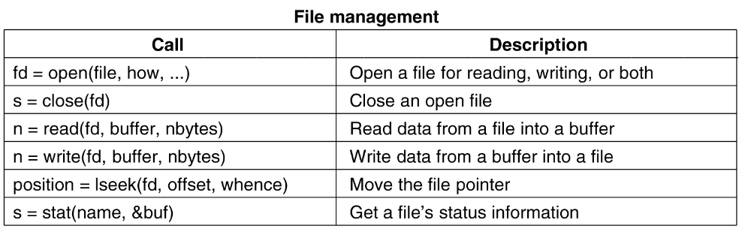
System Calls for File Management
.

Slide 40
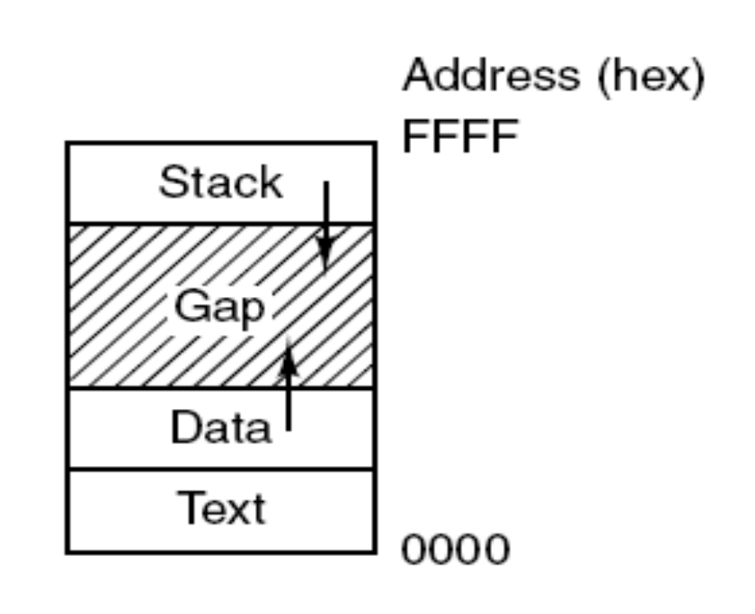
Memory Layout
Processes have three segments:
text, data, and stack.

Slide 41
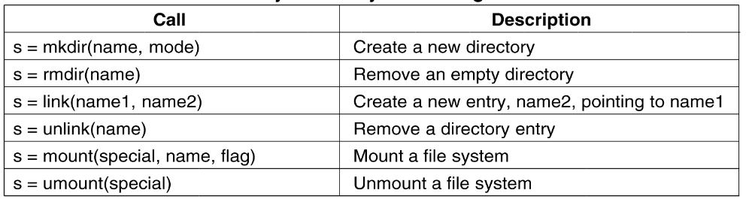
System Calls for Directory and File Management

Slide 42
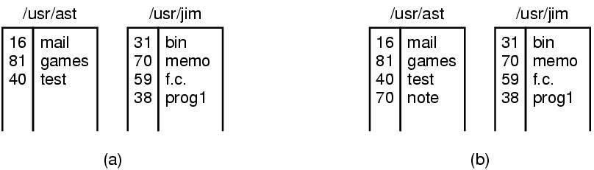
Linking
In Unix, each file is identified by an i-number
i-number indexes into i-node table
  Link creates a new directory entry with same i-number
  Has a new name (note instead of memo)

Slide 43
Mount System Call
mount(“/dev/fd0”, “/mnt”, 0) is system call
File comes from drive 0 and is mounted on binary file /mnt.
Third parameter tells if it is read or read-write
Result is that file on drive zero can be accessed from a directory
Saw this example before with CD-same mechanism for memory sticks and portions of hard drives

Slide 44
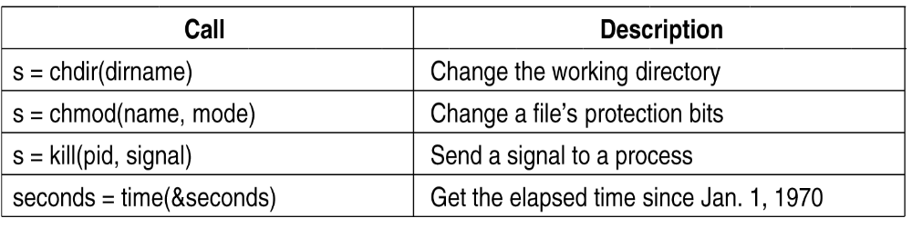
Other System Calls

Slide 45
Operating Systems Structure
Monolithic systems
A main program that invokes the requested service procedure.
A set of service procedures that carry out the system calls.
A set of utility procedures that help the service procedures.

Slide 46
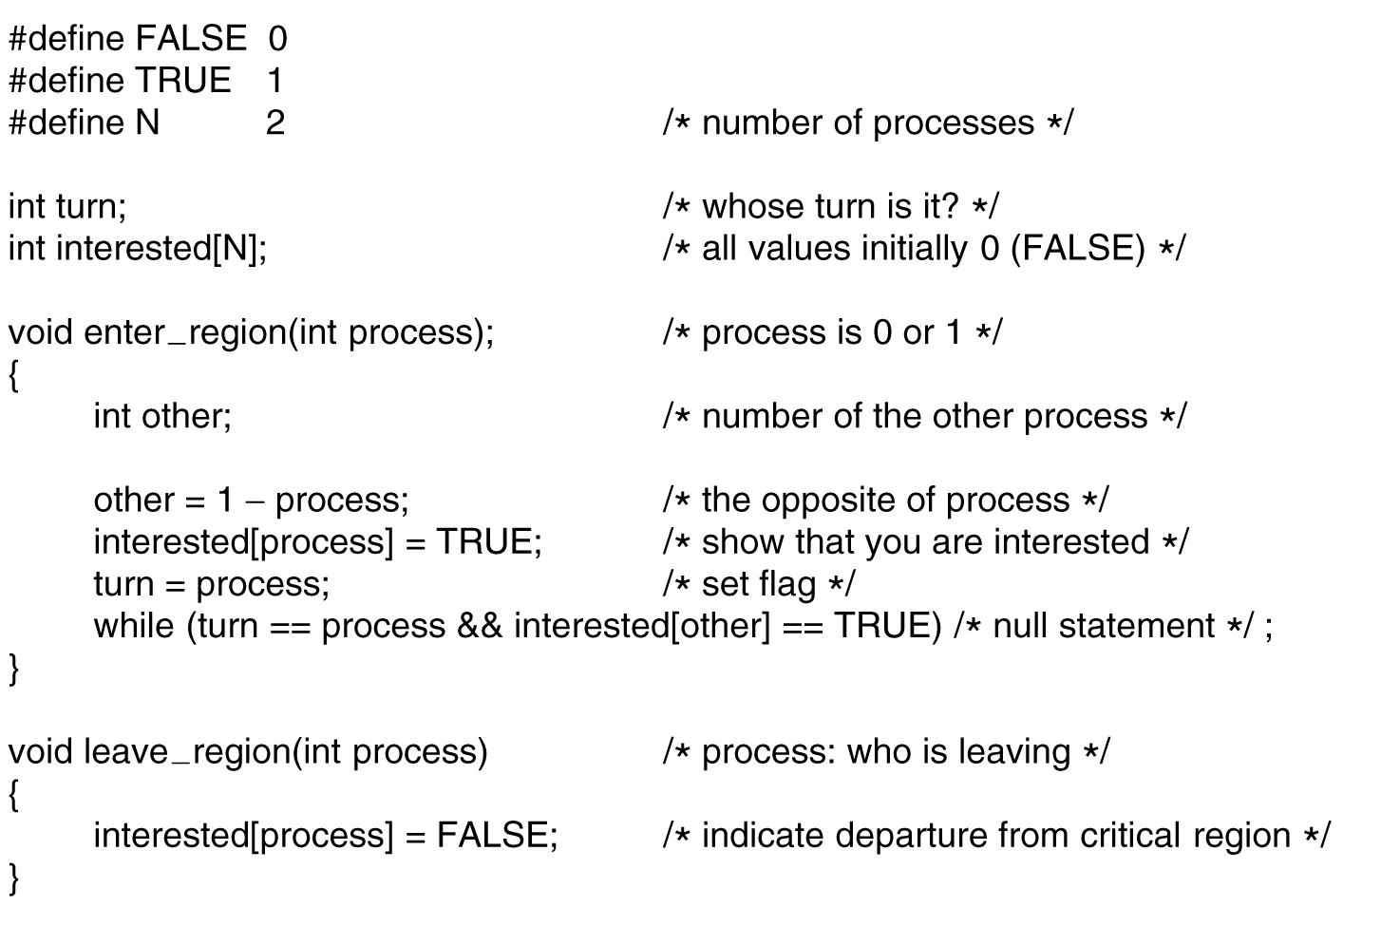
Monolithic Systems
A simple structuring model for a monolithic system.

Slide 47
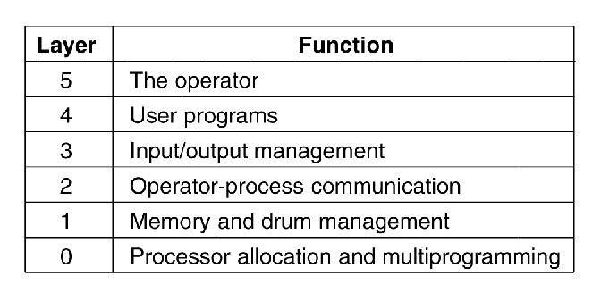
Layered Systems-THE operating system

Slide 48
Microkernels
Small number of processes are allowed in the kernel
Minimizes effects of bugs
  Don’t want bug in driver to crash system
Put mechanism in kernel and policy outside the kernel
  Mechanism- schedule processes by priority scheduling algorithm
  Policy-assign process priorities in user space

Slide 49
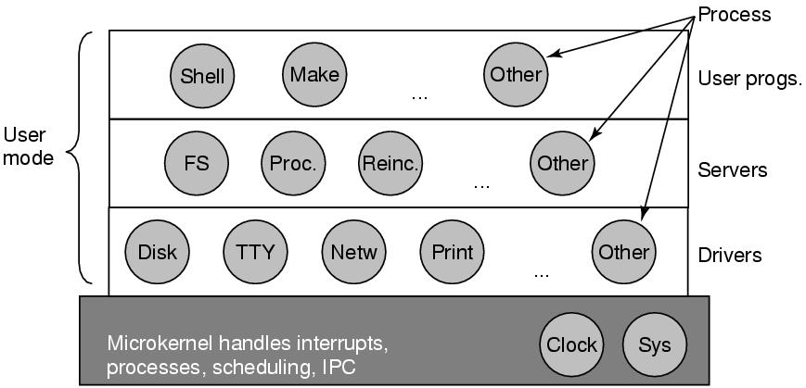
Microkernels
Structure of the MINIX 3 system.

Slide 50
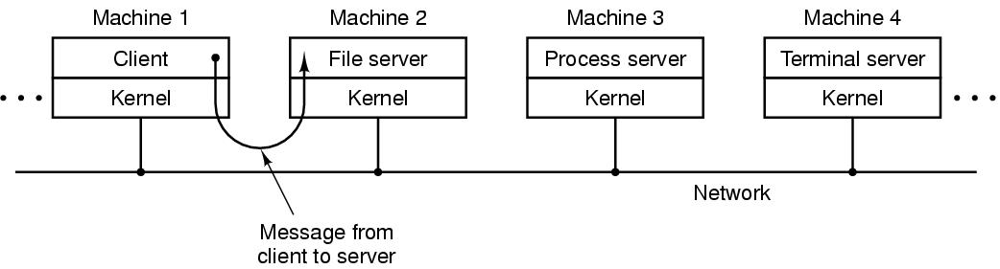
Client-Server Model
The servers, each of which provides some service, and the clients, which use these services.
Communication between clients and servers is often by message passing.
To obtain a service, a client process constructs a message saying what it wants and sends it to the appropriate service. The service then does the work and sends back the answer.
If the client and server happen to run on the same machine, certain optimizations are possible, but conceptually, we are still talking about message passing here.
The client-server model over a network.

Slide 51
What is a process?
An instance of a program, replete with registers, variables, and a program counter
It has a program, input, output and a state
Why is this idea necessary?
  A computer manages many computations concurrently-need an abstraction to describe how it does it
  In reality, of course, the real CPU switches back and forth from process to process, but to understand the system, it is much easier to think about a collection of processes running in (pseudo) parallel than to try to keep track of how the CPU switches from program to program. This rapid switching back and forth is called multiprogramming

Slide 52

Multiprogramming
(a) Multiprogramming of four programs. (b) Conceptual model of four independent, sequential processes. (c) Only one program is active at once.

Slide 53
Multiprogramming
(a) Multiprogramming of four programs. (b) Conceptual model of four independent, sequential processes. (c) Only one program is active at once.

Slide 54
Process creation
Four principal events cause processes to be created:
1. System initialization.
2. Execution of a process-creation system call by a running process.
3. A user request to create a new process.
4. Initiation of a batch job

Slide 55
Process states
Although each process is an independent entity, with its own program counter and internal state, processes often need to interact with other processes.
One process may generate some output that another process uses as input. In the shell command
cat chapter1 chapter2 chapter3 | grep tree
The first process, running cat, concatenates and outputs three files.
The second process, running grep, selects all lines containing the word ‘‘tree.’’
Depending on the relative speeds of the two processes (which depends on both the relative complexity of the programs and how much CPU time each one has had), it may happen that grep is ready to run, but there is no input waiting for it. It must then block until some input is available.

Slide 56
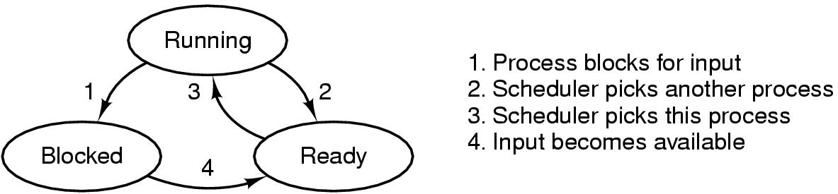
Process States
A process can be in running, blocked, or ready state. Transitions between these states are as shown.
1.Running (actually using the CPU at that instant).
2. Ready (runnable; temporarily stopped to let another process run).
3. Blocked (unable to run until some external event happens).

Slide 57
Process States
Transition 1 occurs when the operating system discovers that a process cannot continue right now.
Transition 2 occurs when the scheduler decides that the running process has run long enough, and it is time to let another process have some CPU time.
Transition 3 occurs when all the other processes have had their fair share and it is time for the first process to get the CPU to run again.
Transition 4 occurs when the external event for which a process was waiting (such as the arrival of some input) happens.

Slide 58
Process Termination
Events which cause process termination:
Normal exit (voluntary).
Error exit (voluntary).
Fatal error (involuntary).
Killed by another process (involuntary).

Slide 59
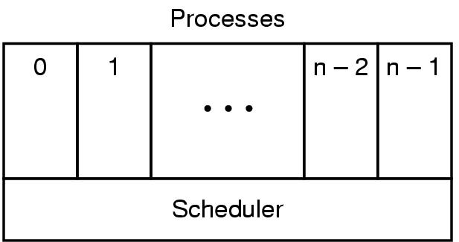
Implementation of Processes (1)
The lowest layer of a process-structured operating system handles interrupts and scheduling. Above that layer are sequential processes.

Slide 60
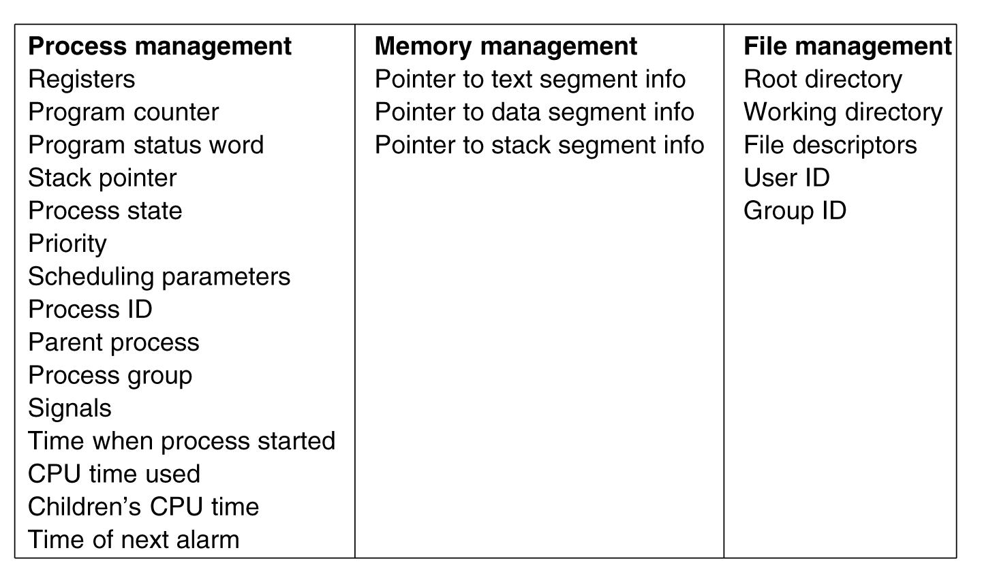
Implementation of Processes (2)
Some of the fields of a typical process table entry.

Slide 61
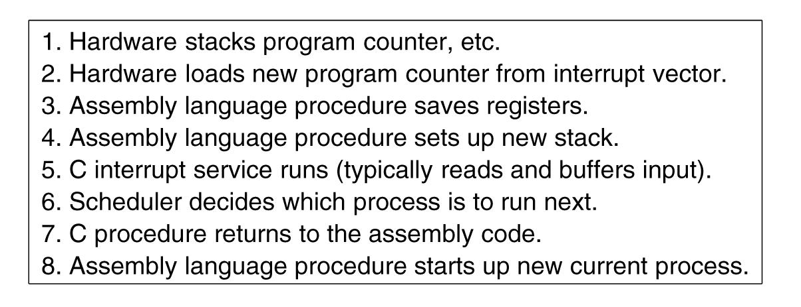
OS processes an interrupt
Skeleton of what the lowest level of the operating system does when an interrupt occurs.

Slide 62
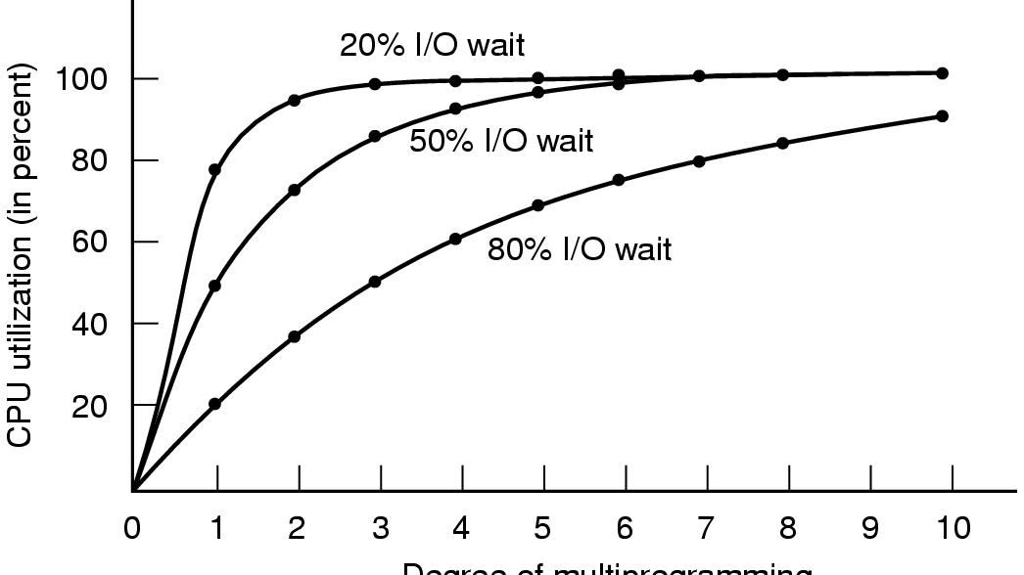

How multiprogramming performs
A better model is to look at CPU usage from a probabilistic viewpoint. Suppose that a process spends a fraction p of its time waiting for I/O to complete. With n processes in memory at once, the probability that all n processes are waiting for I/O (in which case the CPU will be idle) is pn. The CPU utilization is then given by the formula
From the figure it is clear that if processes spend 80% of their time waiting for I/O, at least 10 processes must be in memory at once to get the CPU waste below 10%. When you realize that an interactive process waiting for a user to type some thing at a terminal (or click on an icon) is in I/O wait state, it should be clear that I/O wait times of 80% and more are not unusual
CPU utilization as a function of the number of processes in memory.

Slide 63
Threads
The main reason for having threads is that in many applications, multiple activities are going on at once.
Some of these may block from time to time. By decomposing such an application into multiple sequential threads that run in quasi-parallel, the programming model becomes simpler.

Slide 64
Reasons to use threads
Enables parallelism (web server) with blocking system calls
lighter weight than processes, they are easier (i.e., faster) to create and destroy than processes. In many systems, creating a thread goes 10–100 times faster than creating a process.
Threads yield no performance gain when all of them are CPU bound, but when there is substantial computing and substantial I/O, having threads allows these activities to overlap, thus speeding up the application.
Natural for multiple cores
Easy programming model

Slide 65
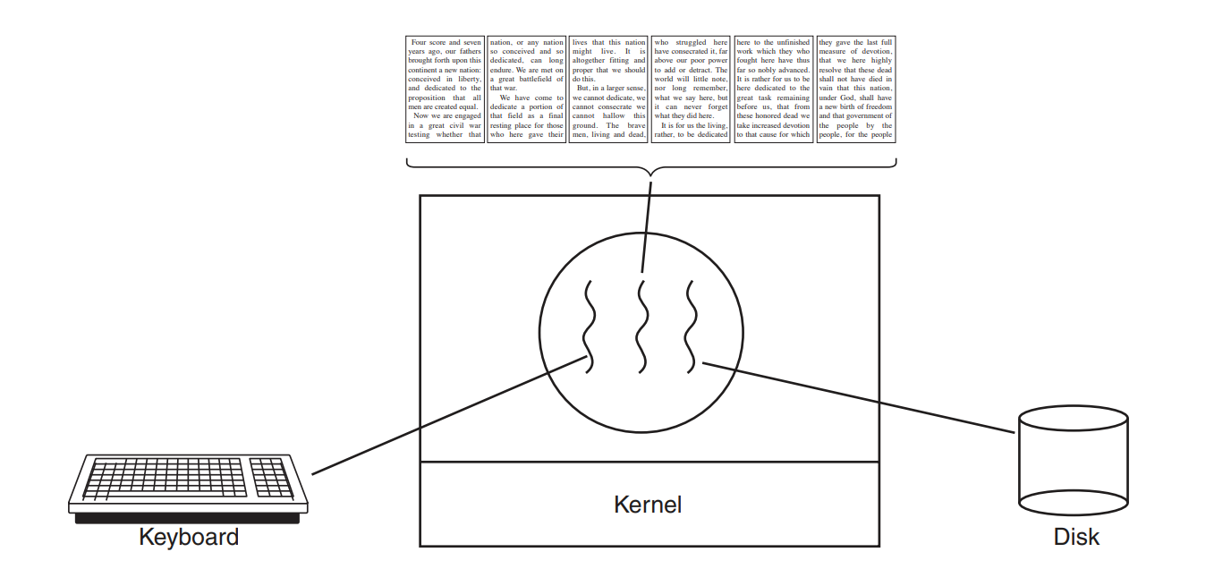
Managing a book as a single file simplifies tasks such as searching for topics and making global changes, but handling each chapter as a separate file can ease navigation.
However, when it comes to making global changes across numerous files, the single-file approach proves more efficient, as opposed to editing each file individually.
The challenge arises when a user deletes a sentence from one page of a multi-page book and then seeks to make another change elsewhere, triggering the need for the word processor to reformat the entire book up to the specified page before displaying it, causing delays.
To mitigate this, employing threads in the word processor can enhance performance. With one thread managing user interactions and another handling background reformatting tasks, changes can be processed simultaneously, potentially reducing delays and enhancing user experience.

Slide 66

Thread Example-web server
One thread, the dispatcher, reads incoming requests for work from the network.
After examining the request, it chooses an idle (i.e., blocked) worker thread and hands it the request, possibly by writing a pointer to the message into a special word associated with each thread.
The dispatcher then wakes up the sleeping worker, moving it from a blocked state to a ready state.
When the worker wakes up, it checks to see if the request can be satisfied from the Web page cache, to which all threads have access.
If not, it starts a read operation to get the page from the disk and blocks until the disk operation completes.
When the thread blocks on the disk operation, another thread is chosen to run, possibly the dispatcher, in order to acquire more work, or possibly another worker that is now ready to run.
.
.

Slide 67
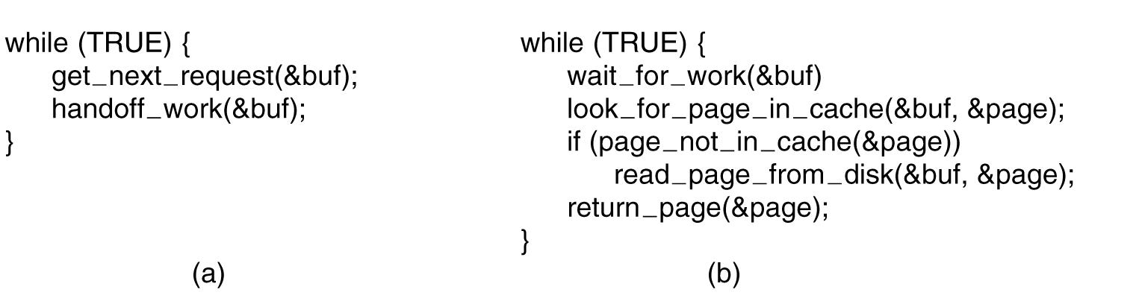
Web server code
The dispatcher’s program consists of an infinite loop for getting a work request and handing it off to a worker.
Each worker’s code consists of an infinite loop consisting of accepting a request from the dispatcher and checking the Web cache to see if the page is present.
If so, it is returned to the client, and the worker blocks waiting for a new request. If not, it gets the page from the disk, returns it to the client, and blocks waiting for a new request
(a) Dispatcher thread. (b) Worker thread.

Slide 68
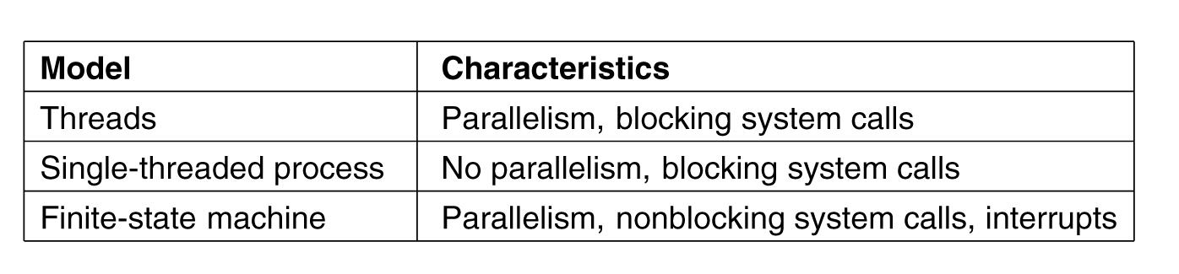
Three ways to build the server
Threads make it possible to retain the idea of sequential processes that make blocking calls (e.g., for disk I/O) and still achieve parallelism.
Blocking system calls make programming easier, and parallelism improves performance.
The single-threaded server retains the simplicity of blocking system calls but gives up performance.
The third approach achieves high performance through parallelism but uses nonblocking calls and interrupts and thus is hard to program.

Slide 69
Threads are like processes
Have same states
  Running
  Ready
  Blocked
Have their own stacks –same as processes
Stacks contain frames for (un-returned) procedure calls
  Local variables
  Return address to use when procedure comes back

Slide 70
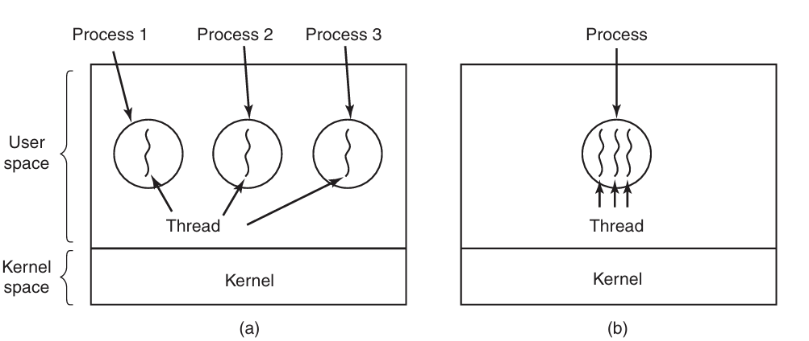
Classical thread model
(a) Three processes each with one thread. (a) we see three traditional processes. Each process has its own address space and a single thread of control (b) One process with three threads. (a) each of them operates in a different address space, whereas in (b) all three of them share the same address space.

Slide 71
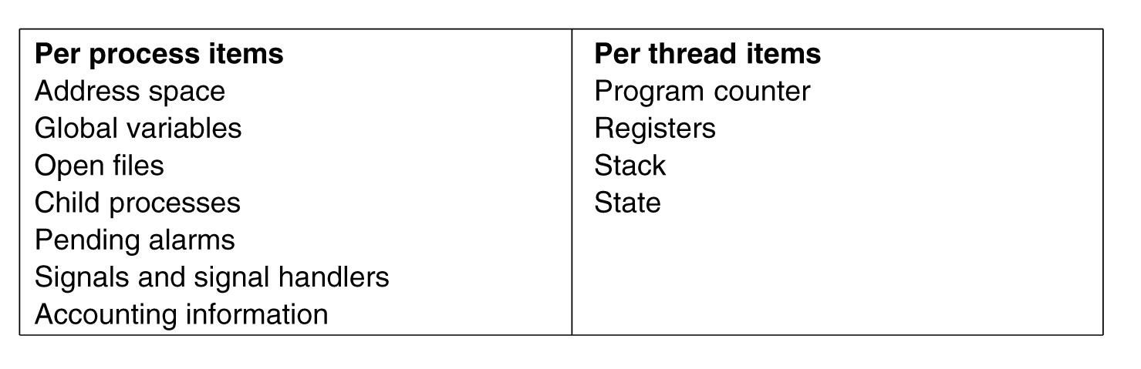
Threads are lightweight
The first column lists some items shared by all threads in a process. The second one lists some items private to each thread. For example, if one thread opens a file, that file is visible to the other threads in the process and they can read and write it.

Slide 72
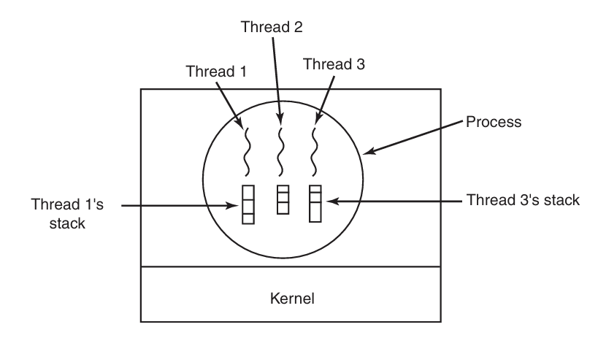

Slide 73
How do threads work?
Start with one thread in a process
Thread contains (id, registers, attributes)
Use library call to create new threads and to use threads
  Thread_create includes parameter indicating what procedure to run
  Thread_exit causes thread to exit and disappear (can’t schedule it)
  Thread_join Thread blocks until another thread finishes its work
  Thread_yield

Slide 74
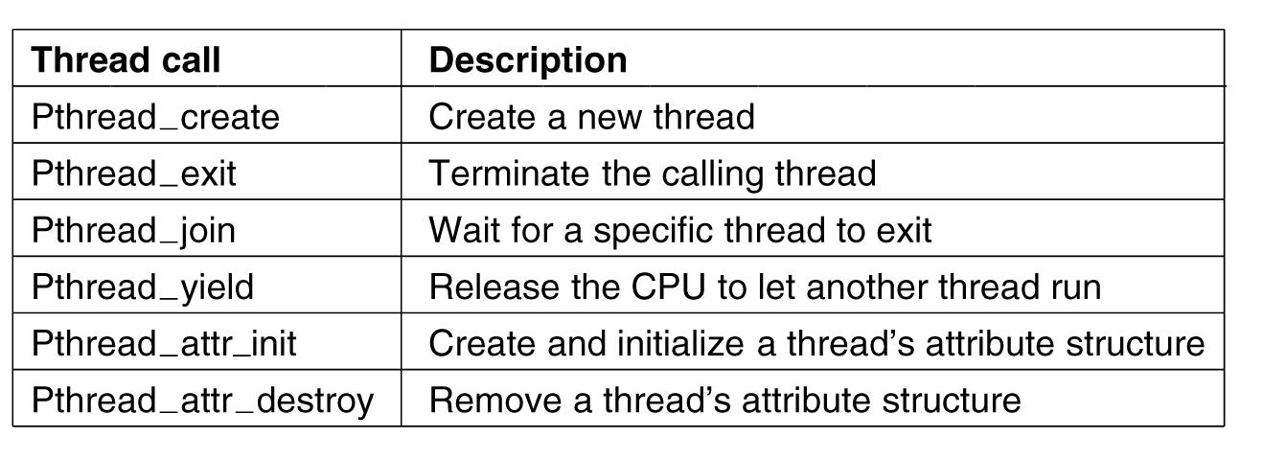
POSIX Threads (Pthreads)
Pthreads are IEEE Unix standard library calls

Slide 75
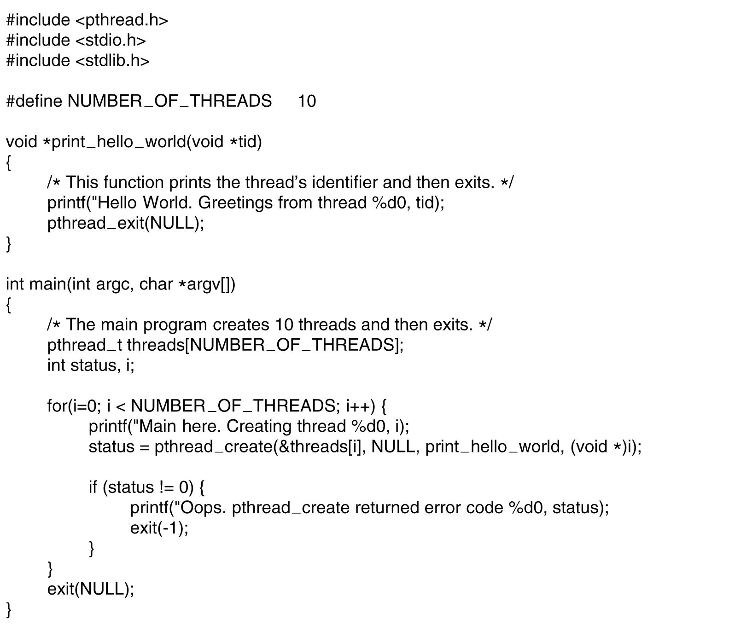
A Pthreads example-”Hello,world”
. . .
.

Slide 76
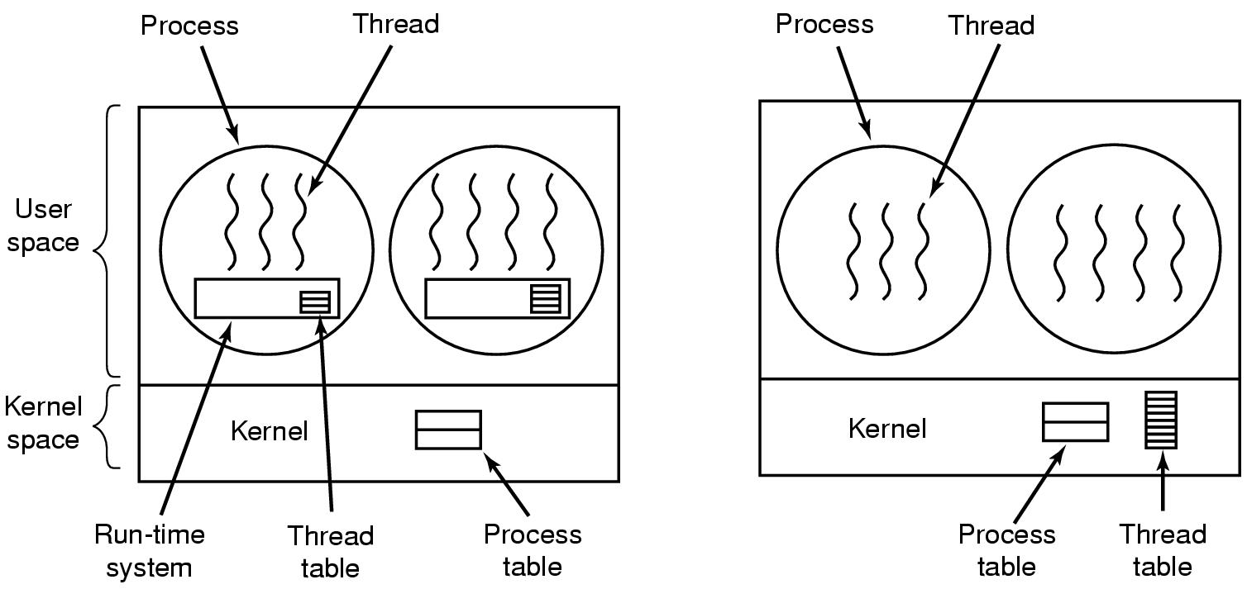
Implementing Threads in User Space
(a) A user-level threads package. (b) A threads package managed by the kernel.

Slide 77
Threads in user space-the good
Thread table contains info about threads (program counter, stack pointer...) so that run time system can manage them
If thread blocks, run time system stores thread info in table and finds new thread to run.
State save and scheduling are invoked faster then kernel call (no trap, no cache flush)

Slide 78
Threads in user space-the bad
Can’t let thread execute system call which blocks because it will block all of the other threads
No elegant solution
  Hack system library to avoid blocking calls
  Could use select system calls-in some versions of Unix which do same thing
Threads don’t voluntarily give up CPU
  Could interrupt periodically to give control to run time system
  Overhead of this solution is a problem…..

Slide 79
Threads in user space
The kernel knows nothing about them.
When threads are managed in user space, each process needs its own private thread table to keep track of the threads in that process.
When a thread is moved to ready state or blocked state, the information needed to restart it is stored in the thread table, exactly the same way as the kernel stores information about processes in the process table.
When a thread does something that may cause it to become blocked locally, for example, waiting for another thread in its process to complete some work, it calls a run-time system procedure. This procedure checks to see if the thread must be put into blocked state. If so, it stores the thread’s registers (i.e., its own) in the thread table, looks in the table for a ready thread to run, and reloads the machine registers with the new thread’s saved values.
As soon as the stack pointer and program counter have been switched, the new thread comes to life again automatically.

Slide 80
Threads in kernel space-the good
Kernel keeps same thread table as user table
If thread blocks, kernel just picks another one
  Not necessarily from same process!
The bad-expensive to manage the threads in the kernel and takes valuable kernel space

Slide 81
There is no thread table in each process.
Instead, the kernel has a thread table that keeps track of all the threads in the system.
When a thread wants to create a new thread or destroy an existing thread, it makes a kernel call, which then does the creation or destruction by updating the kernel thread table.
The kernel’s thread table holds each thread’s registers, state, and other information. The information is the same as with user-level threads, but now kept in the kernel instead of in user space (inside the run-time system). This information is a subset of the information that traditional kernels maintain about their single threaded processes, that is, the process state.
In addition, the kernel also maintains the traditional process table to keep track of processes. All calls that might block a thread are implemented as system calls, at considerably greater cost than a call to a run-time system procedure.
When a thread blocks, the kernel, at its option, can run either another thread from the same process (if one is ready) or a thread from a different process.
With user-level threads, the run-time system keeps running threads from its own process until the kernel takes the CPU away from it (or there are no ready threads left to run).

Slide 82
Due to the relatively greater cost of creating and destroying threads in the kernel, some systems take an environmentally correct approach and recycle their threads.
When a thread is destroyed, it is marked as not runnable, but its kernel data structures are not otherwise affected. Later, when a new thread must be created, an old thread is reactivated, saving some overhead.
Thread recycling is also possible for user-level threads, but since the thread-management overhead is much smaller, there is less incentive to do this.
Kernel threads do not require any new, nonblocking system calls. In addition, if one thread in a process causes a page fault, the kernel can easily check to see if the process has any other runnable threads, and if so, run one of them while waiting for the required page to be brought in from the disk.
Their main disadvantage is that the cost of a system call is substantial, so if thread operations (creation, termination, etc.) a common, much more overhead will be incurred.

