Slide 1
Discrete Math
Recurrence Relations

Slide 2
Recurrence Relation
A recurrence relation for the sequence {a_{n}} is an equation that expresses a_{n} in terms of one or more of the previous terms of the sequence, namely
a₁, … ,a_{n-1}, for all integers n with n ≥ n₀.
A sequence is called a solution of the recurrence relation if its terms satisfy the recurrence relation

Slide 3
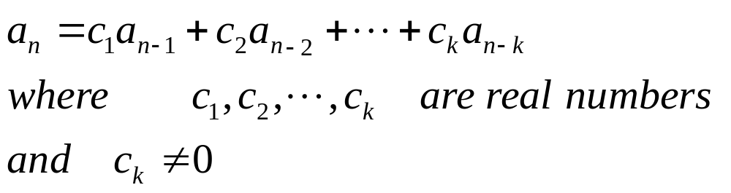
Linear homogeneous
A linear homogenous recurrence relation of degree k with constant coefficients is a recurrence relation of the form

Slide 4
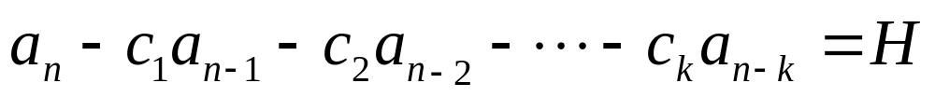
Linear Homogeneous
Homogeneous: The linear combination of a_{j}’s adds up to 0
is homogeneous only if H=0
Linear: RHS is a linear combination of a_{j}‘s (no a_{j}^{M} where M ≠ 1)
Degree: k, because each term is defined in terms of k previous terms

Slide 5
recurrence relations: degree 1
General form: A_{n} = CA_{n-1} n ≥ 1
Describe systems we wish to model terms of a geometric progression
  A geometric progression is an infinite sequence of numbers where the division of each term, except the first, by its immediate predecessor is a constant
To uniquely specify your recurrence relation also need an initial condition. You initial condition is a value for A₀,
  Depending on the value of A₀, you will obtain a different sequence

Slide 6
Example:
Compound interest: suppose that a person deposits $10,000 is a savings account that pays 5% interest annually.
The initial condition is P₀=10000
The amount in the account after n+1 years is the amount in the account after n years plus the interest for year n+1 (5% of the amount in year n)
P_{n+1} = P_{n} + 0.05*P_{n} = 1.05*P_{n}

Slide 7
Linear homogeneous recurrence relations: degree 2
General form: A_{n} = C₁A_{n-1} + C₂ A_{n-2} n ≥ 2
Describe systems we wish to model. Gives us a relation for the nth term, the solution to our problem for n, in terms of the solution for n-1 and n-2
To uniquely specify your recurrence relation also need an initial conditions. You initial condition is a value for A_{0,} and for A ₁,
  Depending on the values you will obtain a different sequence

Slide 8
Example
Suppose you have a game board with 2xN squares, for N ∈ Z⁺ . We wish to cover the board with identical (not distinguishable) 2x1 dominos. The dominos can be placed vertically 2x1 or horizontally 1x2). How many ways can we cover the surface of a 2xN game board with such dominos?

Slide 9


2xN Boards and dominos
2x1 2x2 2x3 2x4
Dominos for tiling

Slide 10
2xN Boards and dominos
2x1 Board
1 way to cover
initial condition b₁=1
2x2 Board
2 ways to cover
Initial condition b ₂=2

Slide 11
Recurrence Relation
To build a recurrence relation consider covering a 2xN game board
Can cover using one vertical domino to cover the Nth column. Then have b_{N-1} ways to cover the remaining N-1 columns
Can cover using two horizontal dominos to cover the Nth and (N-1)st columns. Then have b_{N-2} ways to cover the remaining N-2 columns

Slide 12


2xN Board N≥3: ways to cover
b_{N-1} ways to cover light
blue area (a 2x[N-1] board)
b_{N-2} ways to cover dark
blue area (a 2x[N-2] board)
b_{N} = b_{N-1} + b_{N-2} N ≥ 3 b₁=1 b ₂=2
…
…

Slide 13
Recurrence relations
Clearly the recurrence relation that models this system is the recurrence relation that generates the Fibonacci numbers.
Your text book gives another example modeling the breeding of rabbits that also leads to the same recurrence relation.
It is possible that many problems will be modeled by the same recurrence relation

Slide 14
Your turn
Suppose you have a game board with 2xN squares, for N ∈ Z⁺ . We wish to cover the board with identical (not distinguishable) dominos of two types. The first kind of domino is a 1x1 tile, the second type of domino is L shaped and covers 3 squares. The second type of domino can be rotated before being placed on the board. How many ways can we cover the surface of a 2xN game board with such dominos?

Slide 15


Your turn: Dominos and boards
Dominos for tiling

Slide 16


Your turn: tiling 2x1 board
2x1 Board
1 way to cover
initial condition b₁=1

Slide 17








Your turn: tiling 2x2 board
2x2 Board
5 ways to cover
Initial condition b ₂=5

Slide 18






























Your turn: tiling 2x3 board
1
2
4
3
11
2x3 Board
11 ways to cover
Initial condition b ₃=11
5
10
8
9
7
6

Slide 19


Recurrence Relation: b_{N-1} term
Can cover the Nth column using two 1x1 dominos.
Then have b_{N-1} ways to cover the remaining N-1 columns
b_{N-1} ways to cover light blue area (a 2x[N-1] board)
One way to cover the last column
…

Slide 20







Recurrence Relation : b_{N-2} term
Can cover the Nth and (N-1)st columns in 4 ways. Each of the four ways uses one 1x1 domino and one L shaped domino.
Then have b_{N-2} ways to cover the remaining N-2 columns for each of the four cases
…
…
…
…

Slide 21
Don’t count twice
What happened to the fifth way to cover the 2x2 board (4 1x1 tiles)?
The patterns for the 2x N board, with the last two columns filled with 1x1 dominos are the some of the patterns counted for the 2xN board with the Nth column filled with 1x1 dominos (the previous case).
We don’t want to count them a second time

Slide 22




Recurrence Relation : b_{N-3} term
Can cover the Nth, (N-1)st and (N-2)nd columns in 2 ways. Each of the 2 ways uses two L shaped dominos.
Then have b_{N-3} ways to cover the remaining N-3 columns for each of the two cases
…
…

Slide 23
Don’t count twice
What happened to other 9 ways to cover the 2x3 board?
The patterns for the 2x N board, with the last column filled with 1x1 dominos are the patterns already counted for the 2xN board with the last column filled with 1x1 dominos. (1, 2, 3, 4, 5)
The patterns for the 2xN board, with the last 2 columns fill with 1 1X1 domino and 1 L shaped domino are the patterns already counted for the last two rows filled with 2 dominos (8,9,10,11)
We don’t want to count any of these cases a second time

Slide 24
Recurrence relation
Example of recurrence relation of degree 3
b_{N} = b_{N-1} + 4b_{N-2} + 2b_{N-3} N ∈ Z⁺ N ≥ 4
b₁ = 1
b₂ = 5
b₃ = 11

Slide 25
Linear homogeneous recurrence relations: degree 3
General form: A_{n} = C₁A_{n-1} + C₂ A_{n-2} + C₃A_{n-3} n ≥ 3
Describe systems we wish to model. Gives us a relation for the nth term, the solution to our problem for n, in terms of the solution for n-1, n-2 and n-3
To uniquely specify your recurrence relation also need an initial conditions. You initial condition is a value for A₀, A_{1,} and A ₂, Depending on the values you will obtain a different sequence

Slide 26
Linear homogeneous recurrence relations: degree k
General form:
A_{n} = C₁A_{n-1} + C₂ A_{n-2} + … +C_{k}A_{n-k} n ≥ k n ∈ Z
Describe systems we wish to model. Gives us a relation for the nth term in terms of the solution for n-1, n-2 … n-k
To uniquely specify your recurrence relation also need an initial conditions. You initial condition is a value for A₀, A_{1,} … A _{k-1},
  Depending on the values you will obtain a different sequence

Slide 27
Linear homogeneous recurrence relations: degree k
General form:
A_{n} = C₁A_{n-1} + C₂ A_{n-2} + … +C₃A_{n-k} n ≥ k+1 n ∈ Z⁺
Describe systems we wish to model. Gives us a relation for the nth term in terms of the solution for n-1, n-2 … n-k
To uniquely specify your recurrence relation also need an initial conditions. You initial condition is a value for A₁, A_{2,} … A _{k},
  Depending on the values you will obtain a different sequence

Slide 28
Models
In each of our examples of constructing a recurrence relation we have made a careful argument describing why each term in the relation is a general description of the nth term in the recurrence relationship.
Be sure you make such arguments, observing a pattern and stating the relation you think you see is dangerous. The recurrence relation you end up with may not really describe your problem

Slide 29
Another example
Start with n identical pennies. Let b_{n} be the number of ways we can arrange these n pennies according to the following rules:
  Pennies must be placed in rows
  One row of pennies must be placed so that each penny fits between two pennies in the row below it
  Each row of pennies must be contiguous (no spaces between the pennies.

Slide 30
Penny arrangements n=1,…,4
n=1 n=2
n=3
n=4

Slide 31
Penny arrangements n=5,6
n=5
n=6

Slide 32
Can we see a pattern?
N 1 2 3 4 5 6
# 1 1 2 3 5 8
Looks like we have Fibonacci numbers again!
If we assume the recurrence relation in the recurrence relation for Fibonacci numbers we are making an error!

Slide 33
Penny arrangements n=7
n=7

Slide 34
No model: n to n+1
Clearly for n=7 the number of arrangements is not the next Fibonacci number!
We also need an explanation of how to go from n to n+1 that we can prove using induction before we can be sure we have a correct recurrence relation model

Slide 35
Linear recurrence relations: degree k
General form:
A_{n} = F(n) + C₁A_{n-1} + C₂ A_{n-2} + … +C₃A_{n-k} n ≥ k+1 n ∈ Z⁺
Describe systems we wish to model. Gives us a relation for the nth term in terms of the solution for n-1, n-2 … n-k
To uniquely specify your recurrence relation also need an initial conditions. You initial condition is a value for A₁, A_{2,} … A _{k},
  Depending on the values you will obtain a different sequence

Slide 36
Example: system with non-linear recurrence relation
A popular puzzle, the towers of Hanoi, is played using a board with three pegs. On one of the pegs a stack of n discs is placed. Each disc in the stack is smaller than the disc it is placed upon. The object of the game is to move the stack of discs from one peg to a second peg. Only one disc can be moved at a time, a larger disc can never be placed on top of a smaller disc.
How many moves does it take to solve the puzzle when n discs are used?

Slide 37
Starting position n=6

Slide 38
Induction: step 1
How do we find a method to solve the puzzle?
First let’s use inductive reasoning, lets assume we can figure out how to solve the puzzle for n-1 discs
If we know how to move n-1 discs from one peg to another let us do it, this will be our first step.
We also know it will take b_{n-1} moves to put those n-1 discs on the 3rd peg

Slide 39
After first step for n=6

Slide 40
Induction: step 2
Now we have n discs of our 3rd peg, 1 disc on our original peg, and no discs on the peg we are trying to move all our discs to.
Our second step is a single move
  Move the disc on our original peg to our final peg

Slide 41
After second step for n=6

Slide 42
Induction: step 3
We know how to move n-1 discs from one peg to another
We also know it will take b_{n-1} move those n-1 discs
Our third step will be moving the n-1 discs on the 3rd peg to the second peg.
After moving the n-1 discs the puzzle is solved

Slide 43
After second step for n=6

Slide 44
Recurrence relation
The towers of Hanoi can be represented by a simple recurrence relation
b_{n} = b_{n-1} + 1 + b_{n-1}
b_{n} = 2b_{n-1} + 1
This is a linear recurrence relation of degree 1. It is not Homogeneous.

