Slide 1
Interrupts in Computer Organization and Architecture
Title: Interrupts in Computer Organization and Architecture
Subtitle: Interrupt Hardware, Types of Interrupts, and Exceptions
Presenter Name: Aman ,Aditya ,Astha ,Ayush ,Ankit ,Dolly
Date: 23 / 01 /2025

Slide 2
Introduction to Interrupts
What is an Interrupt?
The interrupt is a signal emitted by hardware or software when a process or an event needs immediate attention. It alerts the processor to a high- priority process requiring interruption of the current working process. In I/O devices one of the bus control lines is dedicated for this purpose and is called the Interrupt Service Routine (ISR).
Purpose:
Efficient CPU Utilization: Interrupts allow the CPU to perform other tasks instead of waiting for I/O operations to complete, thereby improving overall system efficiency.
Asynchronous Event Handling: They enable the system to respond promptly to external events, such as user inputs or hardware signals, ensuring timely processing.
Multitasking Support: Interrupts facilitate the implementation of multitasking by allowing the CPU to switch between different tasks or processes efficiently.

Slide 3
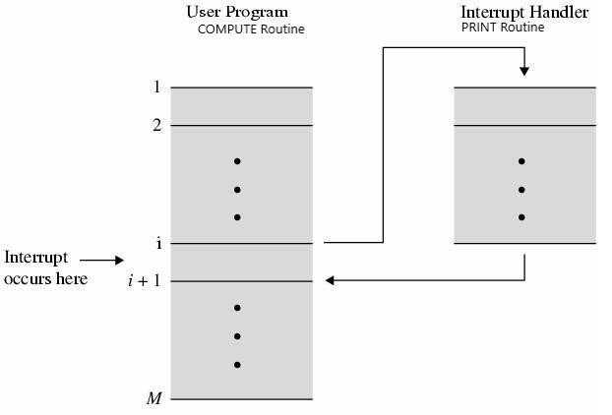
Interrupt service routine

Slide 4
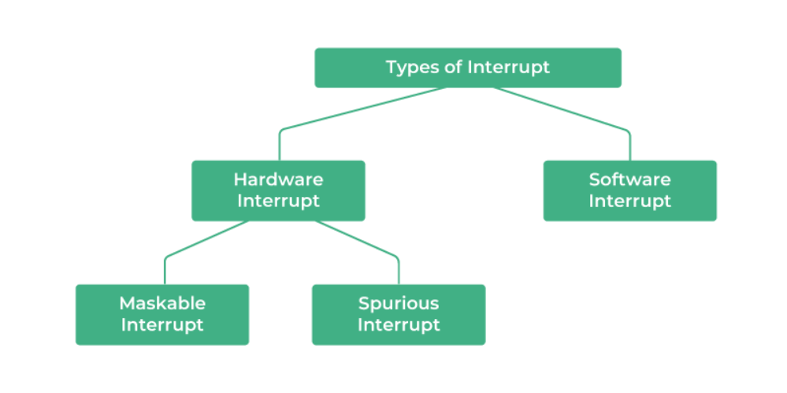
Types of Interrupt

Slide 5
Hardware Interrupts: If the signal for the processor is from external device or hardware is called hardware interrupts. Example: from keyboard we will press the key to do some action this pressing of key in keyboard will generate a signal which is given to the processor to do action, such interrupts are called hardware interrupts. Hardware interrupts can be classified into two types they are
Maskable Interrupt: The hardware interrupts which can be delayed when a much highest priority interrupt has occurred to the processor.
Non Maskable Interrupt: The hardware which cannot be delayed and should process by the processor immediately.
Software Interrupts: Software interrupt can also divided in to two types. They are
Normal Interrupts: the interrupts which are caused by the software instructions are called software instructions.
Exception: unplanned interrupts while executing a program is called Exception. For example: while executing a program if we got a value which should be divided by zero is called a exception.

Slide 6
Identifying the source of Interrupts
1.Polled Interrupt
Iterative checking of status or interrupt request lines of devices to identify pending interrupts.
Systematically polling devices to detect interrupt requests.
CPU periodically checks each device for interrupt status, determining if an interrupt is pending.
2. Vectored Interrupt
Each interrupt source is assigned a unique vector stored in an interrupt vector table.
The interrupting device sends a signal with its specific vector to the CPU.
CPU uses this vector to directly jump to the corresponding Interrupt Service Routine (ISR).
Fast and direct identification of interrupt sources.
Devices signal their interrupt through a unique vector, enabling direct access to specific ISRs

Slide 7
Resolving the Source of Interrupt
1.Polling Method:
Iterative checking of devices to determine the source of the interrupt.
CPU sequentially polls each device until the interrupting device is identified.
Systematically resolving the interrupt source by checking each device in sequence.
Devices are polled in a predetermined order until the interrupting device is found
2. Daisy Chaining:
Devices are connected in a chain, each with a unique priority level.
When an interrupt occurs, the CPU identifies the source based on the priority level of the interrupting device in the chain.
Efficiently resolving interrupt sources with a prioritized chaining mechanism.

Slide 8
Interrupt Processing Steps
Interrupt Signal Detection: Continuous monitoring of interrupt lines or flags for device or system requests.
Interrupt Request (IRQ): Device signals CPU with an interrupt request indicating an occurrence.
Save CPU State: CPU preserves its current state, including program counter and register contents.
Acknowledge Interrupt: CPU confirms interrupt receipt, potentially sending a signal back to the device.
Interrupt Vectoring : CPU uses interrupt vector to locate the ISR’s(Interrupt Service Routine) address for specific interrupt source .
Jump to ISR: CPU jumps to ISR’s address specified by interrupt vector or fixed location for a non vectored interrupts.
Execute ISR: ISR performs necessary operations e.g. data read /write, flag updates.
Restore CPU State: CPU restores, including program counter and register contents.
Return from Interrupt : CPU executives return from interrupt instruction resuming control at the interrupted point.
Continue Execution: Back to normal program ,task execution continues.

