Slide 1
Self-Explaining Neural Networks
Towards Robust Interpretability with
A review with extensions

Slide 2
Outline
Self Explaining Neural Network
Reproducibility
Improvements

Slide 3
The SENN Framework

Slide 4
Transparency by Design
Explicitness
Faithfulness
Stability

Slide 5




Neural Network
Architecture

Slide 6

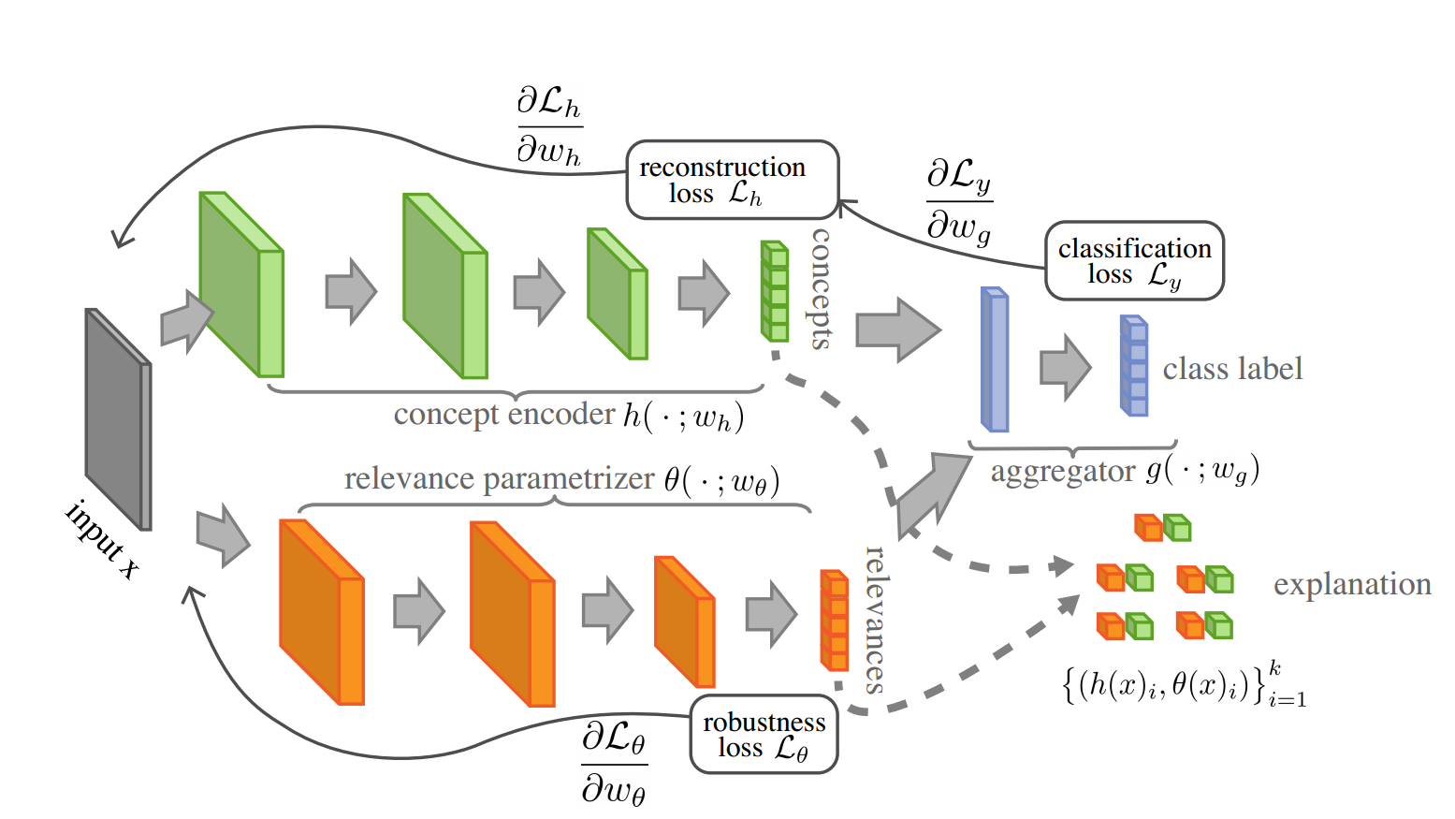
Neural Network
Architecture
Autoencoder as Concept Encoder
Fidelity (relevant representation): Reconstruction Loss
Diversity (non-overlapping concepts): Sparsity Loss
Grounding: Human Interpretable

Slide 7

Neural Network
Architecture
Autoencoder as Concept Encoder
Fidelity (relevant representation): Reconstruction Loss
Diversity (non-overlapping concepts): Sparsity Loss
Grounding: Human Interpretable
Regularized Parameterizer
Compute relevances for each concept
Similar relevances for similar concepts
Locally linear in concepts: Robustness Loss

Slide 8
Reproducibility
Notes:
Now that you know the basics I will continue with the reproducibility experiments

Slide 9
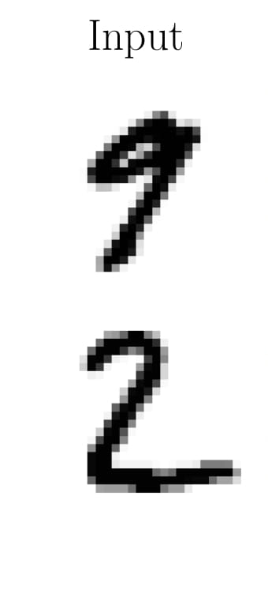
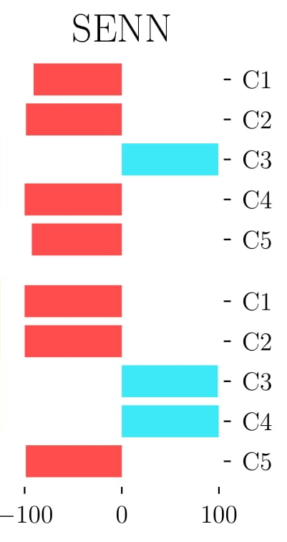
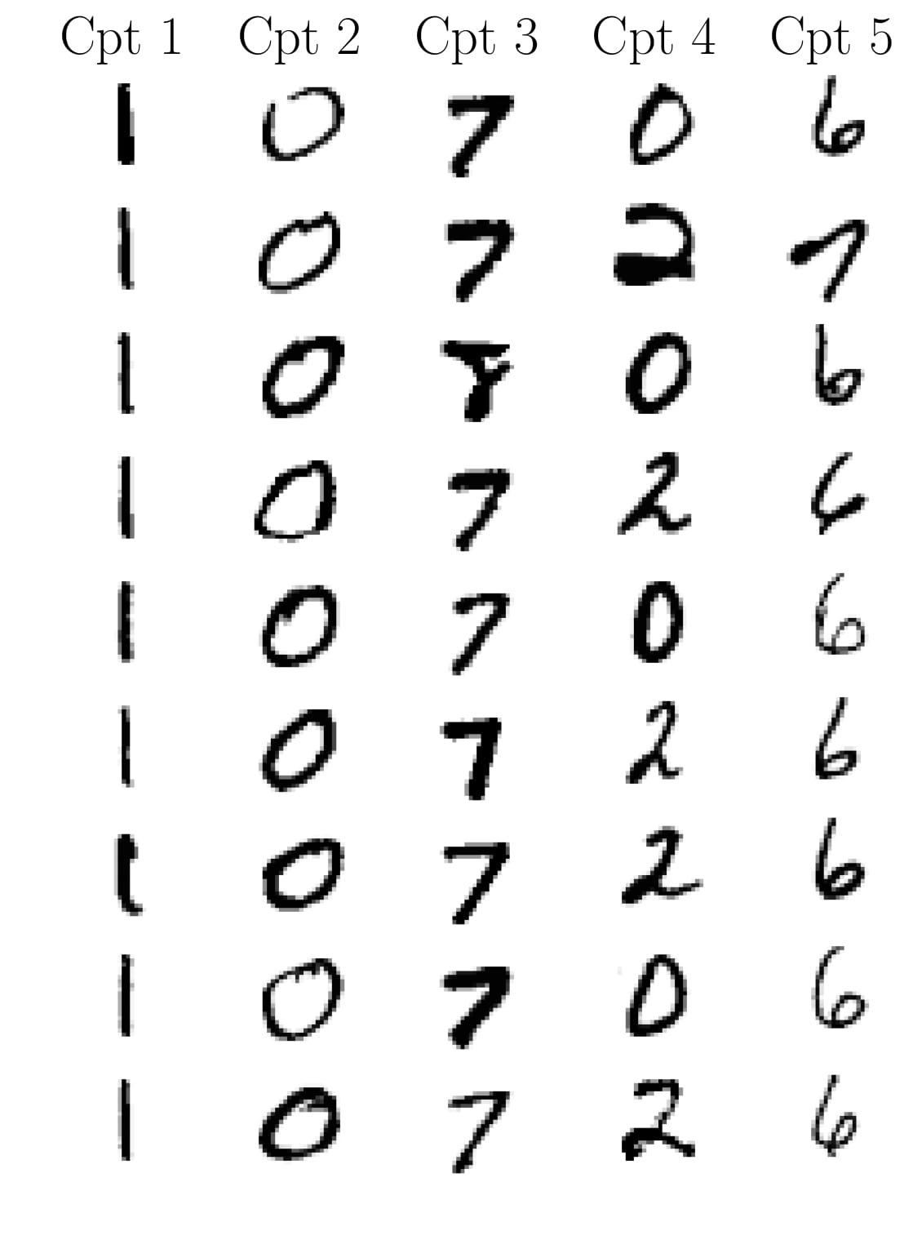
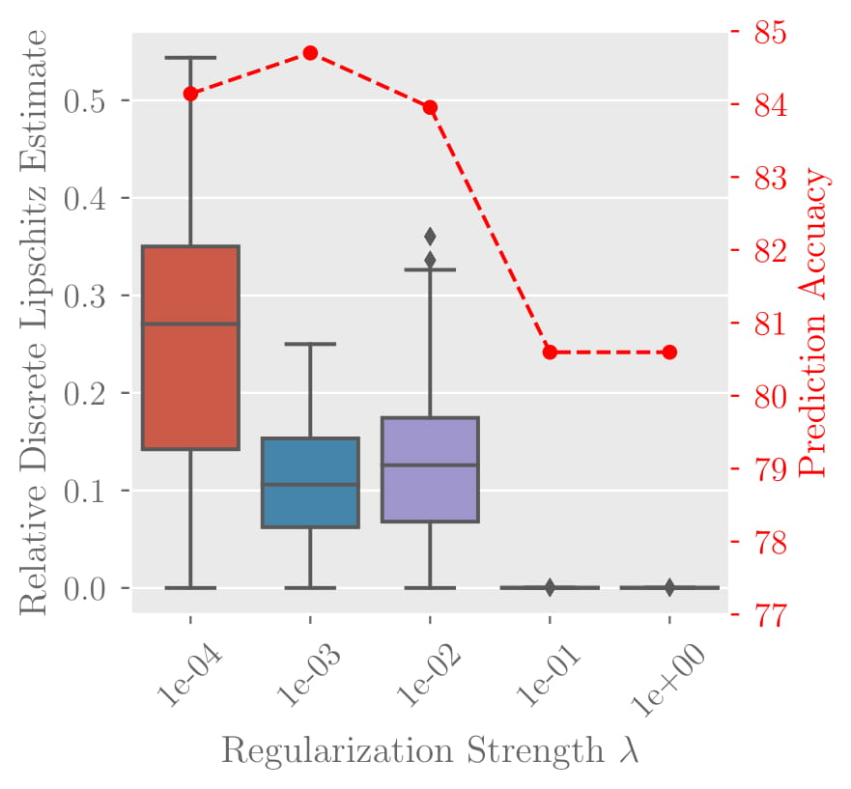
Original Experimental Results
Accuracy on MNIST (Image Data)
98.7%
Accuracy on COMPAS (Tabular Data)
82%
Interpretability of Explanations
Accuracy trade-off with Regularization
Notes:
On this slide we summarized the main results of the original paper
We focused on two datasets, one of them is the MNIST dataset which is a representative dataset for the image domain and the other one is the Compas (Recidivism Risk Score dataset) which is a nice example of tabular data which is especially interesting for the FACT community because it is a classification task on how likely a convicted person will commit a crime again and some features contain sensitive data like gender,age or race. So it is interesting to see on which features the model’s decision is based.
As you can see the achieved test accuracies are quite high, but to be honest both of these datasets are very simple
The main experiment is concerned about the interpretebility of the explanations. So looking at this first example of digit 9 the most relevant concept predicted by the model is concept number 3; looking at this concept the prototypes share the property of a diagonal dash and this is why the explanation makes sense as this stroke is also present in the digit 9. (The concept are here represented with some prototypes that activate the specific concept the most.)
The Robustness term in the loss that omar talked about is a kind of regularisation that enforces the model to have only small changes in the predicted relevances for small changes in the input. As the regularisation constrains the model there is a natural trade-off between the accuracy and the amount of robustnes regularisation. This effect is shown in this figure (on the right), please ignore the bars and only look at the red curve. The Y axis is the accuracy and on the x axis we have an increasing amount of regularisation, and the authors observed a downward trend of the accuracy with increasing regularizsation as was to expect
The authors used several different datasets. we decided on testing on two datasets, namely, MNIST and COMPAS to have a representative example for image data as well as tabular data
COMPAS contains data about whether or not a convicted criminal will commit a crime again or not (features contain race, age -> interesting how model decides because of fairnes)
We look at three different aspects, and this slide shows the results reported by the AUTHORS
1. Is the classification performance reproducible with the architecture and hyperparameters details provided
- 98.7% sounds high but is not hard to achieve for MNIST and also COMPAS is rather simple (only 11 input features)
2. The main contribution of the paper is to generate human interpretable explanations of the model’s prediction, this example is from the paper
-left: two MNIST test set examples, middle: relevances from parameterizer, right: representation of concepts via prototypes (examples from dataset that activate the concept the most)
-The authors argue that the positive contribution of concept 3 for digit 9 is because 7s look most similar to 9s and the rest is negative because they look dissimilar.
Same in the second example and concept 3 gets activated because of the diagonal dash
3. Ignore vertical bars! Robustness loss component which should enforce stability regularizes the model to be locally linear to make explanations similar for similar inputs BUT this comes at cost of reduced accuracy: Trade-off: in most cases not too bad and even in extreme cases it is still ok (from 84.5% to 80.5%)

Slide 10
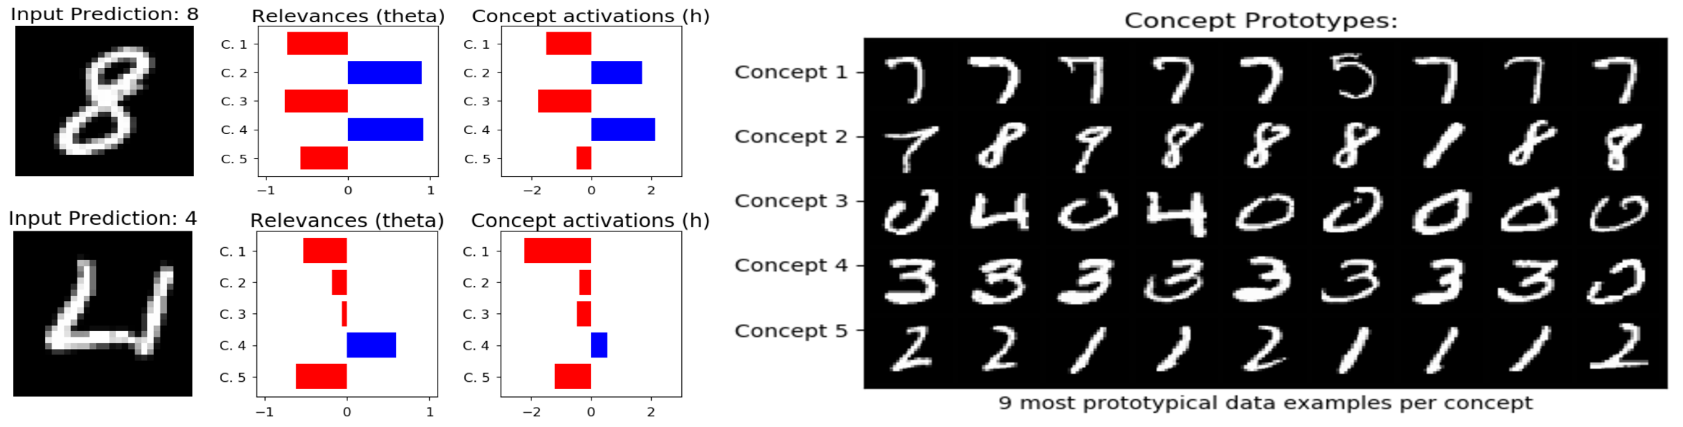
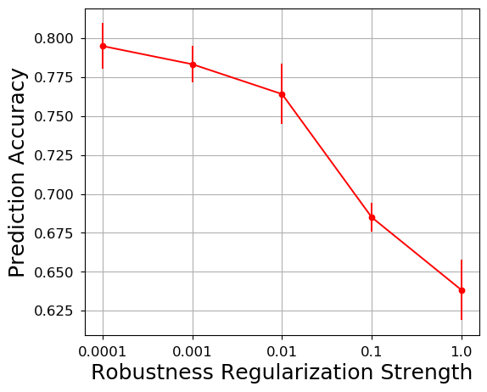
Reproduced Experimental Results
Accuracy on MNIST (Image Data)
98.9%
Accuracy on COMPAS (Tabular Data)
80.9%
Interpretability of Explanations
Accuracy trade-off with Regularization
Notes:
Now we move on to our own results on these experiments.
No code was officially released with the paper; We implemented the method from scratch using the architecture details provided by the authors
So we were able to get very similar test accuracies on both datasets, that is why we marked it in green which means this was reproducible
The next experiment has a red headline because the quality in terms of interpretebility of explanations was not reproducible. On top we have here an example of a good explanation that is similarly interpretable than the authors’ examples but the lower one is an example for a bad explanation which is not realy human interpretable (a human can not make sense out of it)
And we observed that the vast majority of the explanations actually looked more like the lower example. And we believe that the authors cherry-picked their results a lot.
For the study of the negative impact of the robustness regularisation on the accuracy we observed the same downward trend as the authors, however the drop in accuracy we experienced is a lot higher than reported by the authors. To compare: they reported a drop of about 4% points while we observed a drop of 15% point. So this is marked as dark orange because we observe the same tendency but the amount of the effect is not reproducible.
These are the results we produced with our own implementation:
The test accuracies match the ones presented by the authors pretty well, there is only a small difference (this is why it is marked as green because we consider it reproducible)
When it comes to the Interpretability of explanations we observed that in the general case the results in the paper are not reproducible:
We can show that our implementation is able to produce explanations that are on the same level of the ones in the paper (which shows out implementation works in general) BUT this example was selected by hand and the majority of explanations looks like the second example which is not really interpretable -> We believe that the authors cherry-picked the examples as they did not mention anything about how these examples were selected
The tendency of the downward trend of accuracy for increasing regularization we observe is similar to the one presented in the original paper, however the impact of this effect is a lot bigger than in the authors paper. To compare: ~84.5-80.5% is 4% points difference whereas for us it was from 79%-64% 15% points less
-> this implies that it might become an issue to use the framework if accuracy is important
The effect is reproducible the magnitude is NOT
Conclusion for reproducibility part: Reproducibility only very limited
Then we come to to our second part of the paper: The Extensions… mic-drop -> Ivan

Slide 11
Extensions

Slide 12
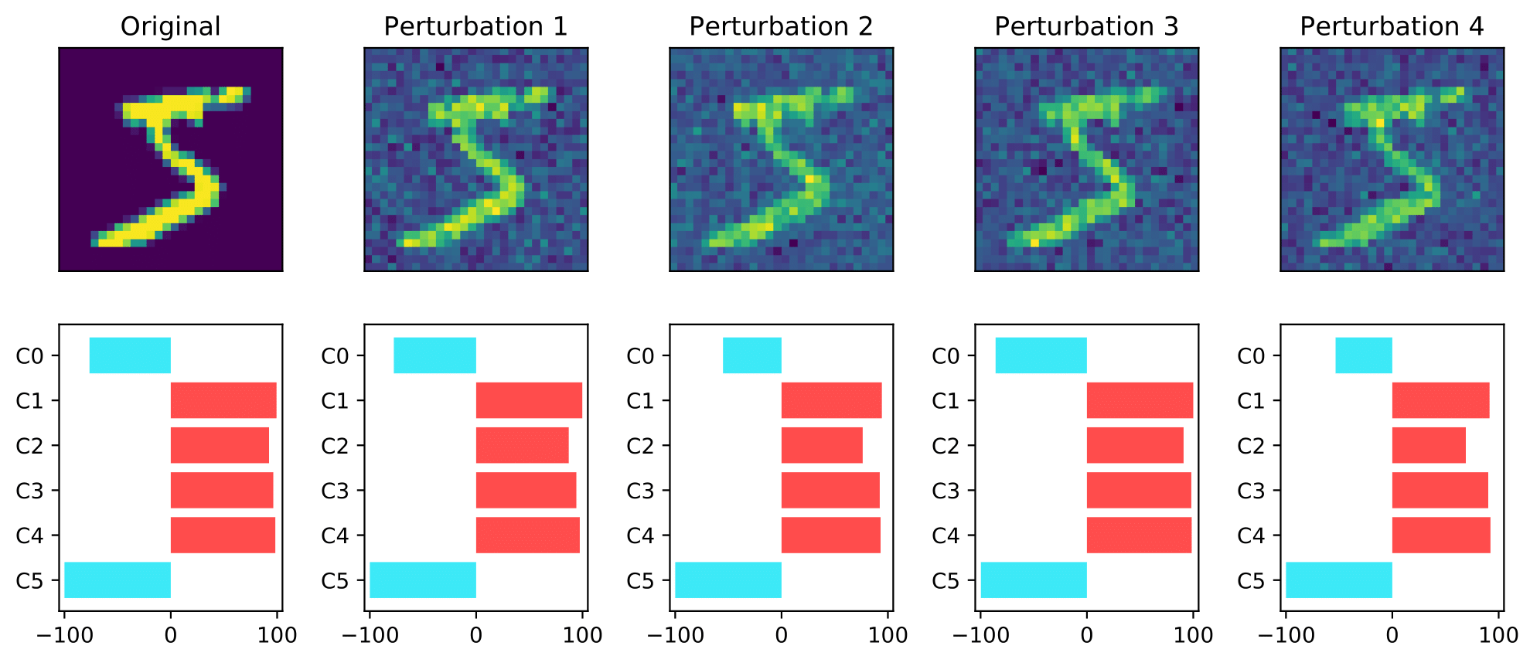
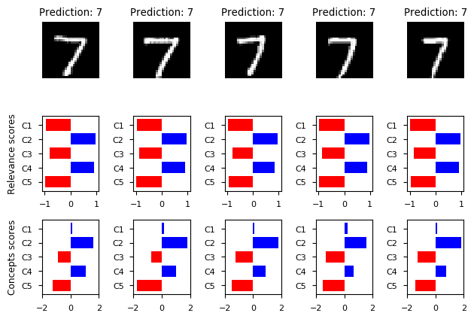
Study of
Robustness
Regularization
Original Experiment
Add Gaussian noise to input
Do relevance parameters vary?
Our Experiment
Find semantically similar inputs
Do relevance parameters vary?
Notes:
We enforce robustness so that similar inputs should give us similar explanations. One of the experiments the authors show in the paper is this kind of robustness study, where they alter an input image with Guassian noise and explore how the relevance scores change. We thought that Guassian noise is rather artificial and we need to find a way to test our model on semantically similar images. So we came up with a more natural way to find similar images from the dataset that we feed our model. As you can see from these plots the input is very much the same but not exactly and despite their differences the model is robust enough to depict similar concepts and similar relevance scores.

Slide 13
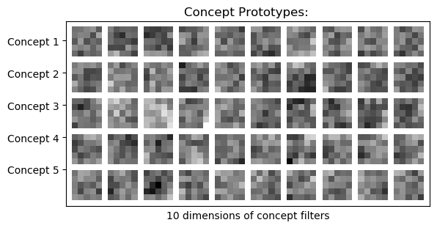
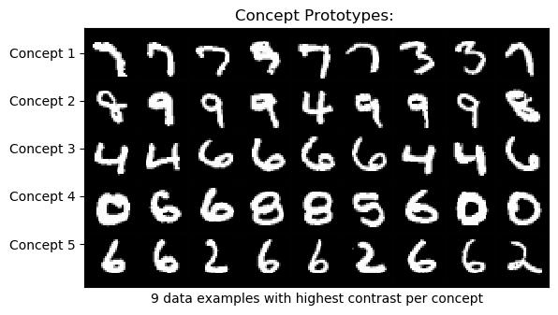
Interpretability
of Concepts
Different ways to interpret concepts:
Highest Activation
Highest Contrast
Filter Visualization
Highest Activation
Filter Visualization
Highest Contrast
Notes:
Now we come to the main problem - we want the concepts to be interpretable so that the explanations make sense. To give meaning to the concepts, the authors propose the highest activation method which takes images from the dataset which activate each concept maximally. However, they mention another possibilities for how to visualize the concepts and here we have the highest contrast which is very much similar to the highest activation but it also tries to ensure that the rest of the concepts are activated as little as possible, somehow trying to isolate each specific concept. By comparing these it can be seen that the results are pretty different which according to us is one of the major drawbacks of the framework as it is. For example, i would like to point your attention at concept 4 which produces completely different results in both cases, so it is very hard to reason about its exact meaning. Lastly, we tried another approach proposed by the authors, to visualize the filters of the last layer of the encoder part of the autoencoder. However, as it can be seen from the plot in the left corner, again it is hard to give any meaningful interpretation to what they represent.

Slide 14
Critical Issues
Arbitrarily many ways to visualize explanations
Leads to inconsistent explanations
Explanations hard to interpret
Autoencoder sparsity partially fulfils “Diversity”:
few & non-overlapping
Notes:
To sum up, in our opinion the current framework has some critical issues when it comes to the interpretation of concepts. Firstly, there isnt 1 systematic way to visualize the concept explanations which also leads to inconsistent explanations produced by the different techniques. That is a serious problem as it shows that the current model does not fulfil all the concept requirements and the concept interpretation might not be immediate to humans.
The explanations are hard to interpret because they are not non-overlapping so it is hard to reason about what a certain concept means. We believe this is caused by the way the authors generate their concepts - in other words using a sparse autoencoder. Although sparsity guarantees few activations in the concepts it does not guarantee that the concepts are actually going to be non-overlapping.

Slide 15
Disentangled SENN
Notes:
Now we propose an extension of the SENN framework.
Where we enforce disentanglement on the basis concepts.
What is disentanglement?
Where the each dimension of the representation is independently sensitive to single generative factors.
Like in the animation here.
We aim to disentangle all the factors that influence predictions.
Visualize them independently to have greater clarity and simplicity in the explanations.

Slide 16
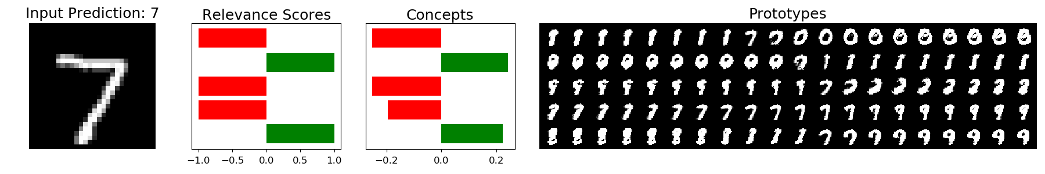
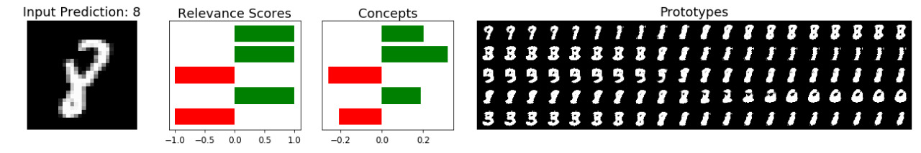
Results

Slide 17
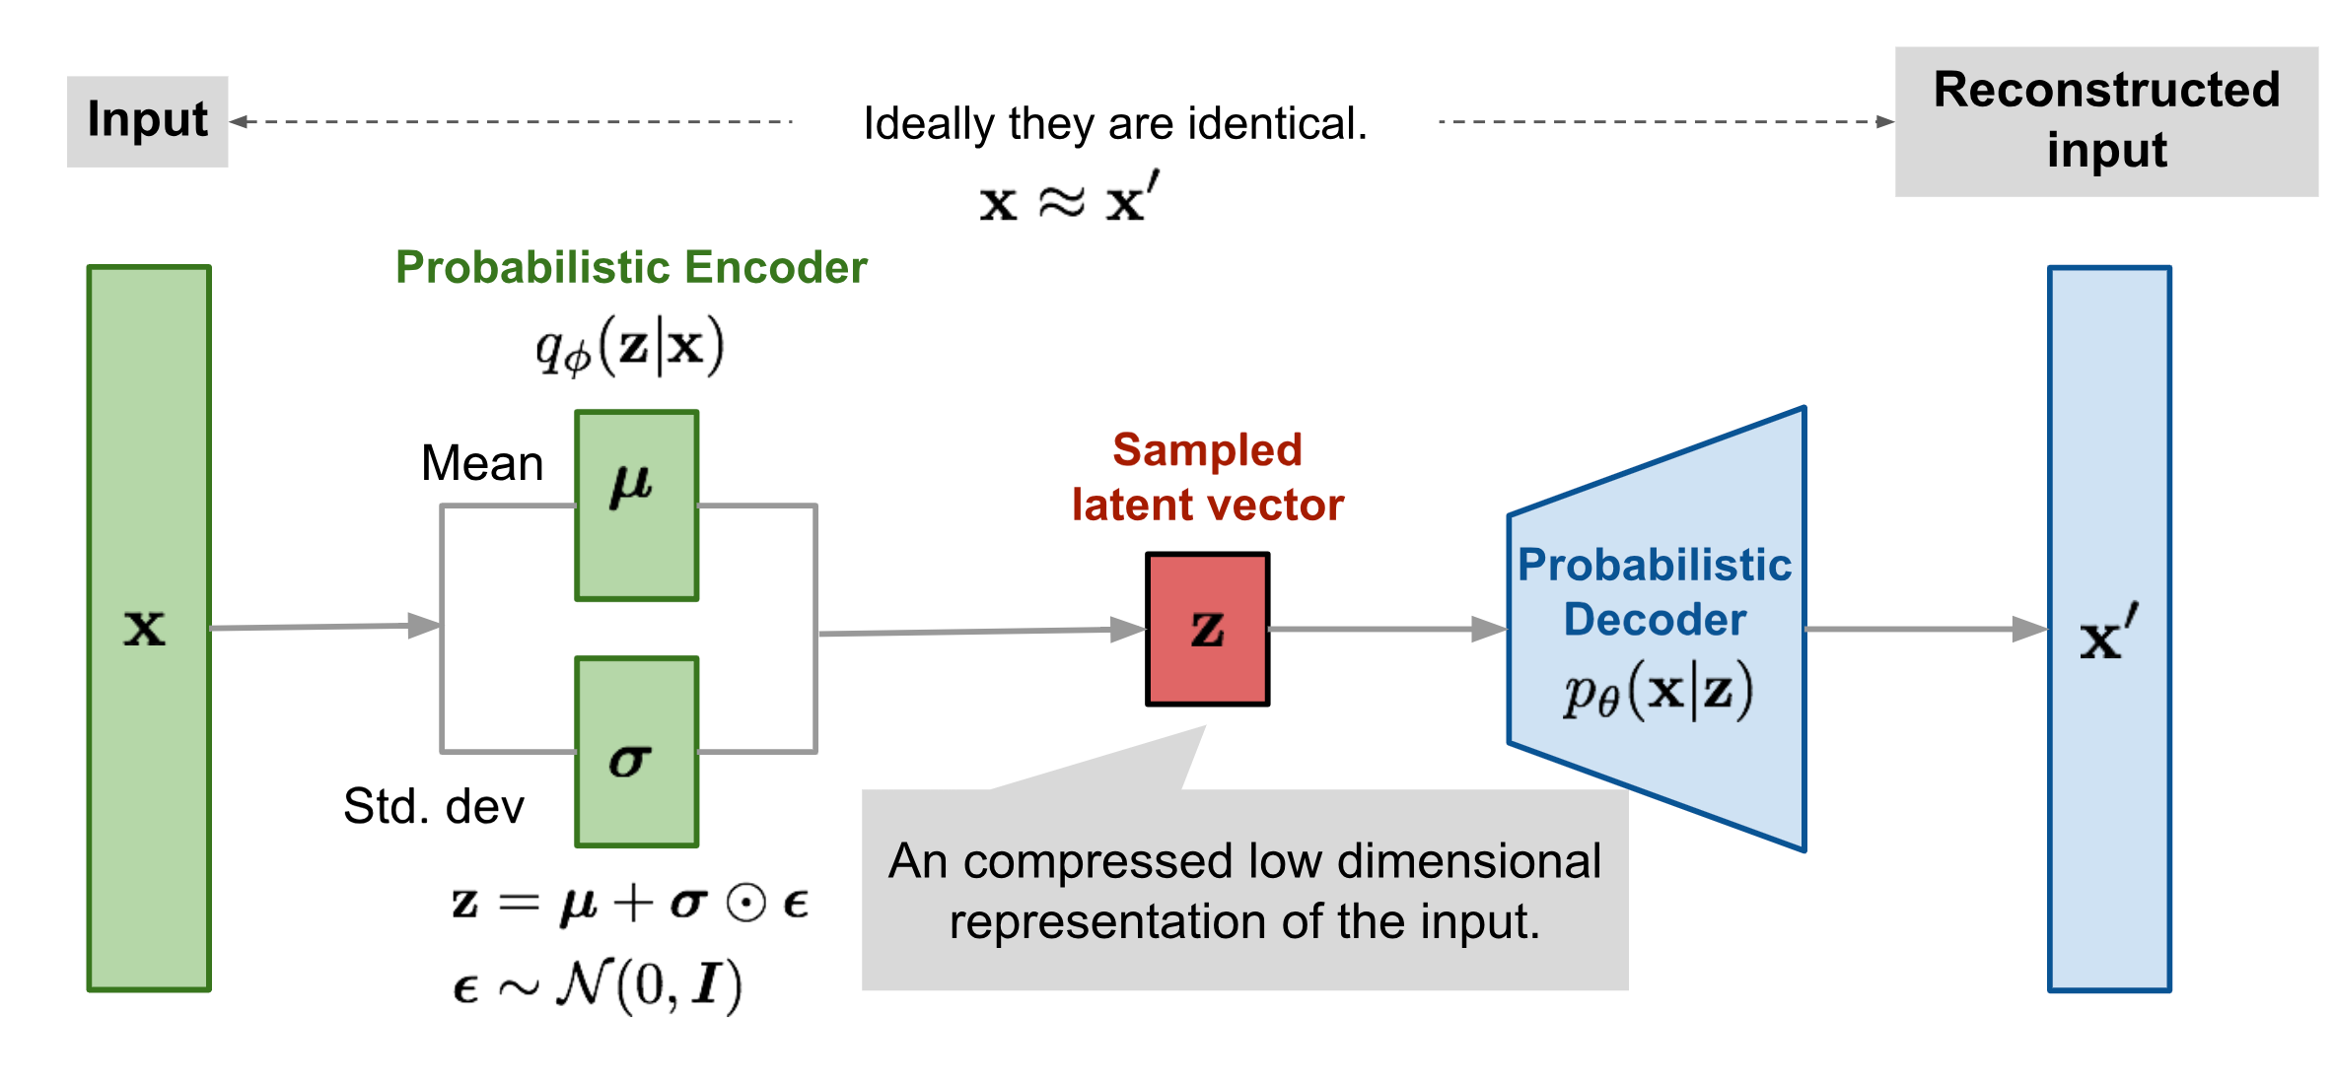
Disentangled Representation of Concepts
Independent sensitivity to single generative factors
Notes:
We use a Beta Variational Auto Encoder to generate disentangled concepts.
This is just a variation on the ELBO objective of a standard VAE.
So the VAE learns a prior distribution on the latent space.
And a beta VAE just enforces a stronger KL divergence loss on the latent space.
This forces the latent space to resemble a uncorrelated multivariate gaussian
Where the dimensions are independent.
We use this Beta VAE as our Concept Encoder

Slide 18
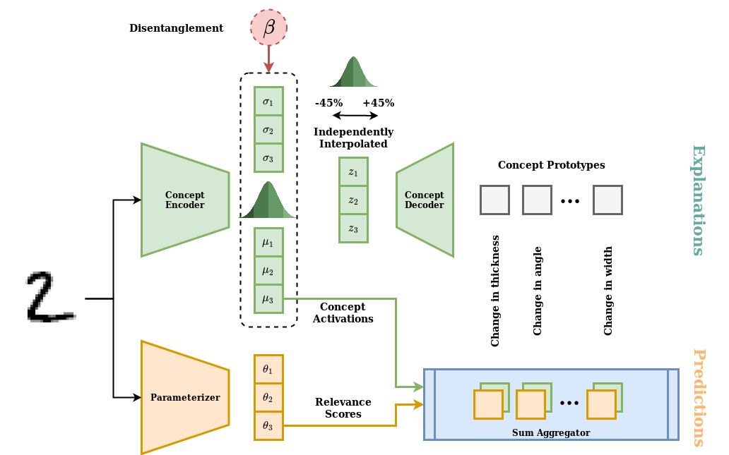
DiSENN
Notes:
BVAE used as a Concept Encoder
The decoder is used to generate prototypes
Variance of prototypes shows you the meaning of a concept

Slide 19
Conclusion
Transparent by design
Accuracy reproducible
Explanations not interpretable
Disentangle

Slide 20
References
Architecture and results slides 6,7,9,12: “Towards Robust Interpretability with Self-Explaining Neural Networks”, by David Alvarez-Melis, Tommi S. Jaakkola
Figure on slide 12: “From Autoencoder to Beta-VAE” by Lilian Weng
GIF on slide 11: “Evaluating the Unsupervised Learning of Disentangled Representations” by Olivier Bachem

