Slide 1

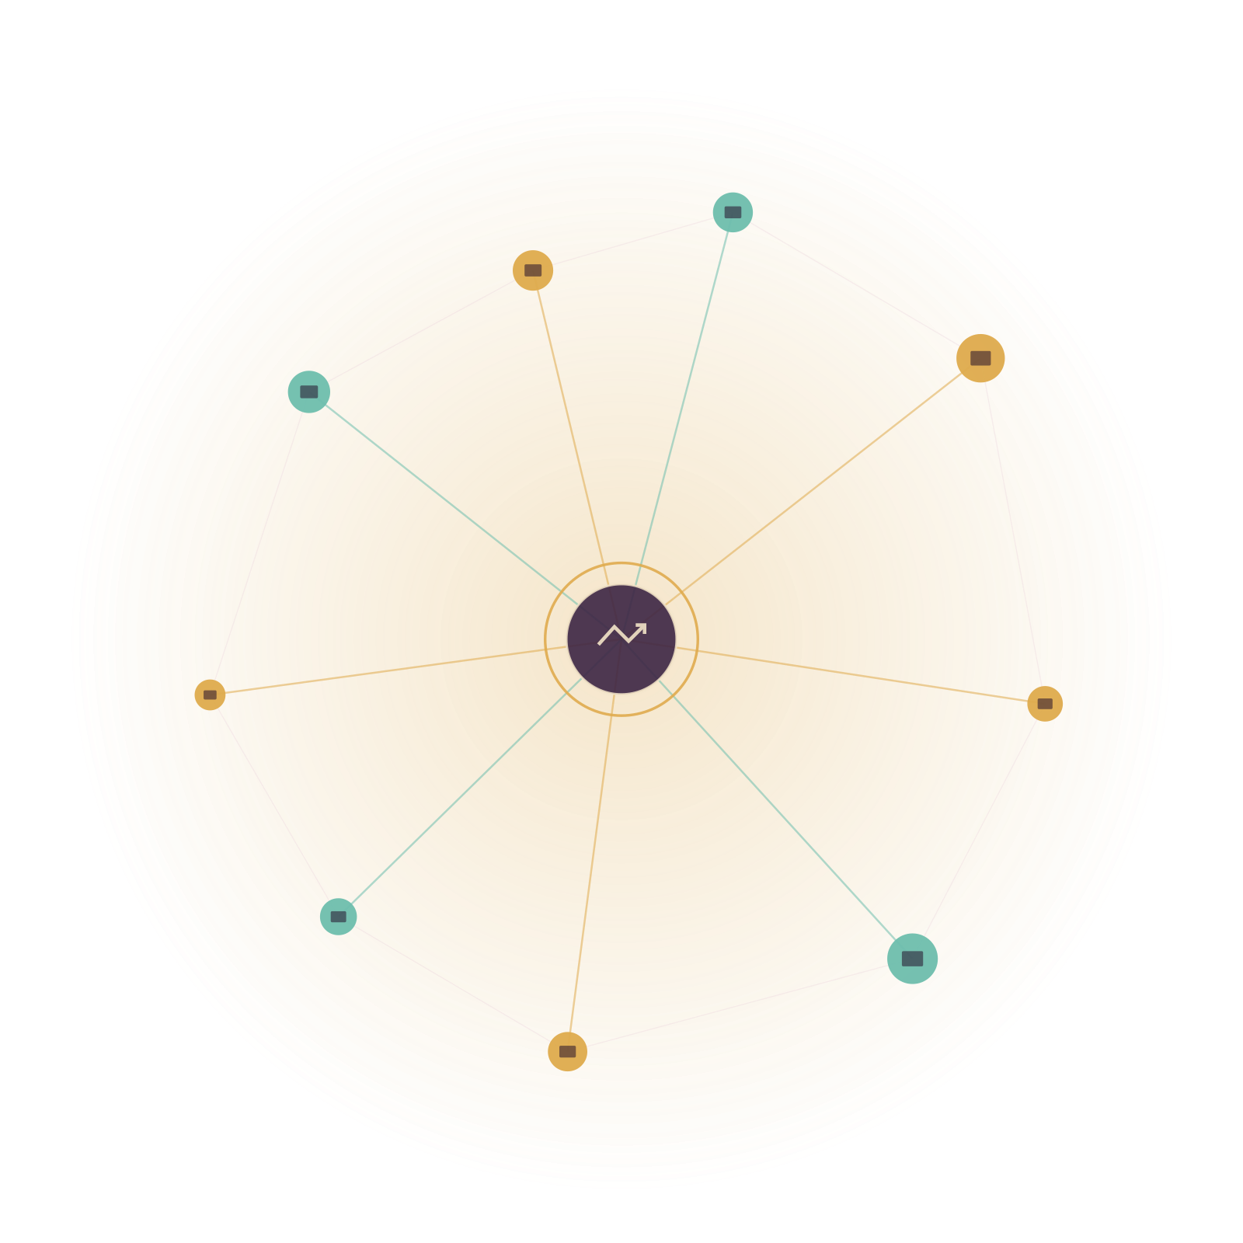
AJEENKYA D Y PATIL UNIVERSITY, PUNE
School of Engineering · Dept. of Computer Science & Engineering
Vendor360
A Zero-Logistics B2B Mediator for India’s Local Vendors
ALTERNATE TRACK · MINI-PROJECT
Presented by [Student Name 1] | [Student Name 2] | [Student Name 3] | [Student Name 4] Guide: [Guide Name] | [Date]

Slide 2












AGENDA
Outline
01
Introduction
07
Expected Outcomes
02
Literature Review
08
Societal Impact
03
Research Gap & Motivation
09
Research Timeline
04
Research Objectives
10
Conclusion
05
Research Methodology
11
References
06
Software & Hardware Requirements
[Date]
Department of Computer Science and Engineering
02 / 15

Slide 3
01 · GETTING STARTED
Introduction
Small stores pay retail prices for wholesale goods.
Kirana stores buy in small, fragmented quantities — so they pay far more per unit than big supermarkets, who negotiate massive bulk discounts. No individual vendor has the volume to negotiate on equal terms.
Vendor360 (Alternate Track) is a pure digital mediator — connecting vendors, wholesale distributors / mandis, and market intelligence. It owns zero logistics and makes zero deliveries; it only aggregates, matches, and builds trust.
10–15%
of India’s 6.3 crore MSMEs currently have access to formal credit.
40%
of MSMEs operate fully informally — with no documented sourcing or repayment history.
Zero
warehouses, vehicles or delivery staff owned — the platform is software-only, by design.
Source: Policy Circle; IDR — India Development Review, 2025
[Date]
Department of Computer Science and Engineering
03 / 15

Slide 4




02 · PRIOR ART
Literature Review / Survey
ONDC — Proof At Scale
Digital Khata Apps
Alternative Credit Scoring
India’s govt-backed Open Network for Digital Commerce now spans B2B wholesale, validating open “network mediator” models for small sellers.
Khatabook & OkCredit solve credit-ledger tracking — but not sourcing, pricing discovery, or procurement.
GST, utility & transaction data are already used to score MSMEs lacking formal history — validating a Vendor Reliability Score.
The gap this project targets: no platform aggregates hyperlocal demand, wholesale supply and a trust layer inside one zero-logistics mediator.
[Date]
Department of Computer Science and Engineering
04 / 15

Slide 5




03 · WHY THIS MATTERS
Research Gap & Motivation
No collective bargaining power
Invisible local demand
Vendors buy in small lots at retail-level wholesale prices — big chains negotiate bulk discounts alone.
No visibility into unmet hyperlocal consumer demand before a vendor decides what to stock.
Opaque distributor pricing
No shared trust layer
Sourcing relationships stay manual and word-of-mouth, with no structured price discovery.
Distributors have no consistent way to offer small vendors 15–30 day credit terms.
[Date]
Department of Computer Science and Engineering
05 / 15

Slide 6



04 · WHAT WE WILL BUILD
Research Objectives
Objective 1
Objective 2
Build a B2B Co-op Group-Buying engine that aggregates vendor demand into bulk tenders
Design a Hyperlocal Demand Heatmap dashboard with ROI-scored opportunity alerts
Objective 3
Objective 4
Build Smart Distributor Matching for real-time wholesale price discovery
Generate a Vendor Reliability / Credit Score from inventory & payment behaviour
Objective 5
Objective 6
Keep the platform strictly software-only — a broker layer, never fulfilment
Demonstrate measurable bulk-pricing gains vs. individual vendor purchasing
[Date]
Department of Computer Science and Engineering
06 / 15

Slide 7
05 · HOW WE WILL BUILD IT
Research Methodology / Data Collection
→
→
Vendor Demand Signals
Aggregation & Matching
Vendor + Distributor Apps
Simulated vendor order data
POS / transaction history
Local search-trend proxies
FastAPI tender aggregator
Distributor bid-matching
Reliability scoring model
Bulk-tender alerts
Price discovery dashboard
Credit-score visibility
Type of Research: Applied / experimental — platform prototype evaluated against simulated marketplace data.
Evaluation Metrics: bulk discount % achieved vs. solo pricing, distributor response time, score-to-repayment correlation.
[Date]
Department of Computer Science and Engineering
07 / 15

Slide 8



06a · WHAT IT RUNS ON
Software Requirements
Backend
Database
Python 3.11+, FastAPI — tender aggregation & distributor-matching engine
Supabase (PostgreSQL) — vendor, distributor & tender records
Frontend
External APIs
Flutter app + lightweight web dashboard for vendor & distributor portals
Local search/trend data proxy, GST / payment data connectors (simulated)
Dev Tooling
Operating System
Git / GitHub, Postman, VS Code
Windows 10/11 or Ubuntu 20.04+ (development environment)
[Date]
Department of Computer Science and Engineering
08 / 15

Slide 9

06b · WHAT IT RUNS ON
Hardware Requirements
Development Machine
Vendor / Distributor Device
Intel i5 / Ryzen 5 or higher, 8GB+ RAM (16GB recommended), 256GB SSD
Any smartphone or desktop browser — no special hardware required
Server / Cloud
Connectivity
Supabase managed cloud instance — zero warehousing or logistics infrastructure
Runs on standard mobile data — a lightweight dashboard, not a heavy app
[Date]
Department of Computer Science and Engineering
09 / 15

Slide 10
07 · WHAT WE EXPECT TO SHOW
Expected Outcomes / Results
Real bulk discounts
A live heatmap alert
An explainable score
Proven feasibility
30–50 vendor cohort
Aggregated tenders demonstrate wholesale-level pricing for small vendors.
Prototype surfaces at least one actionable, unserved-demand opportunity.
A transparent reliability score distributors can act on with confidence.
A zero-logistics mediator, demoed within a mini-project timeline.
Aggregation simulated at a realistic single-zip-code scale.
[Date]
Department of Computer Science and Engineering
10 / 15

Slide 11
08 · WHY IT MATTERS BEYOND TECH
Societal Impact
Levels The Playing Field
Financial Inclusion
Strengthens Local Mandis
ONDC-Aligned
Small kirana stores gain bulk-purchase economics once reserved for big-box retail.
Behaviour-based scoring for the ~85–90% of MSMEs excluded from formal credit.
Empowers distributor ecosystems instead of disintermediating them.
Supports India’s vision of open, interoperable digital commerce.
[Date]
Department of Computer Science and Engineering
11 / 15

Slide 12
09 · MINI-PROJECT PHASE I · SEM 3
Research Timeline
COMPLETED
UPCOMING
UPCOMING
01
02
03
30 July 2026
27 August 2026
18 November 2026
Project Title Finalization
Review 1
Final Presentation
Mini-project topic proposed
and finalized for Sem 3.
Project Title, Abstract,
Introduction, Literature Survey
& Block Diagram — presented
to the review panel.
Complete project presented
before an External Examiner
/ Industry Expert.
Standard report & poster formats are shared with the group and via email on an ongoing basis.
[Date]
Department of Computer Science and Engineering
12 / 15

Slide 13
10 · WRAPPING UP
Conclusion
Meaningful impact for local vendors doesn’t require owning logistics. A lean, pure-software mediator for group buying, market intelligence, and trust-scoring unlocks wholesale economics and formal credit — at near-zero operational complexity.
Mediator, not operator
Zero logistics footprint
Bulk power for small stores
[Date]
Department of Computer Science and Engineering
13 / 15

Slide 14
11 · SOURCES
References
1. GeeksforGeeks — "ONDC: Open Network for Digital Commerce," 2025.
2. Capgemini — "Demystifying the Indian Open Network for Digital Commerce," 2025.
3. India Development Review (IDR) — "Reimagining How India’s MSMEs Access Credit," 2025.
4. RiskSeal — "Alternative Credit Scoring in India: Lending Beyond Banks," 2025.
5. YuVerse.ai — "Using Alternative Data to Score MSME Borrowers Without Financial History," 2025.
6. CB Insights Research — "Digitizing the Kirana Store: India’s Retail Opportunity," 2025.
7. Invest India — "Modernization of Kirana Stores in India," 2025.
8. Policy Circle — "India’s MSMEs Face a ₹25 Lakh Crore Credit Gap," 2025.
[Date]
Department of Computer Science and Engineering
14 / 15

Slide 15
Thank You
Questions & Discussion
Vendor360 (Alternate Track) — A Zero-Logistics B2B Mediator
[Student Name 1] | [Student Name 2] | [Student Name 3] | [Student Name 4]
[team-email@example.com]
[Date]
Department of Computer Science and Engineering
15 / 15

