Slide 1

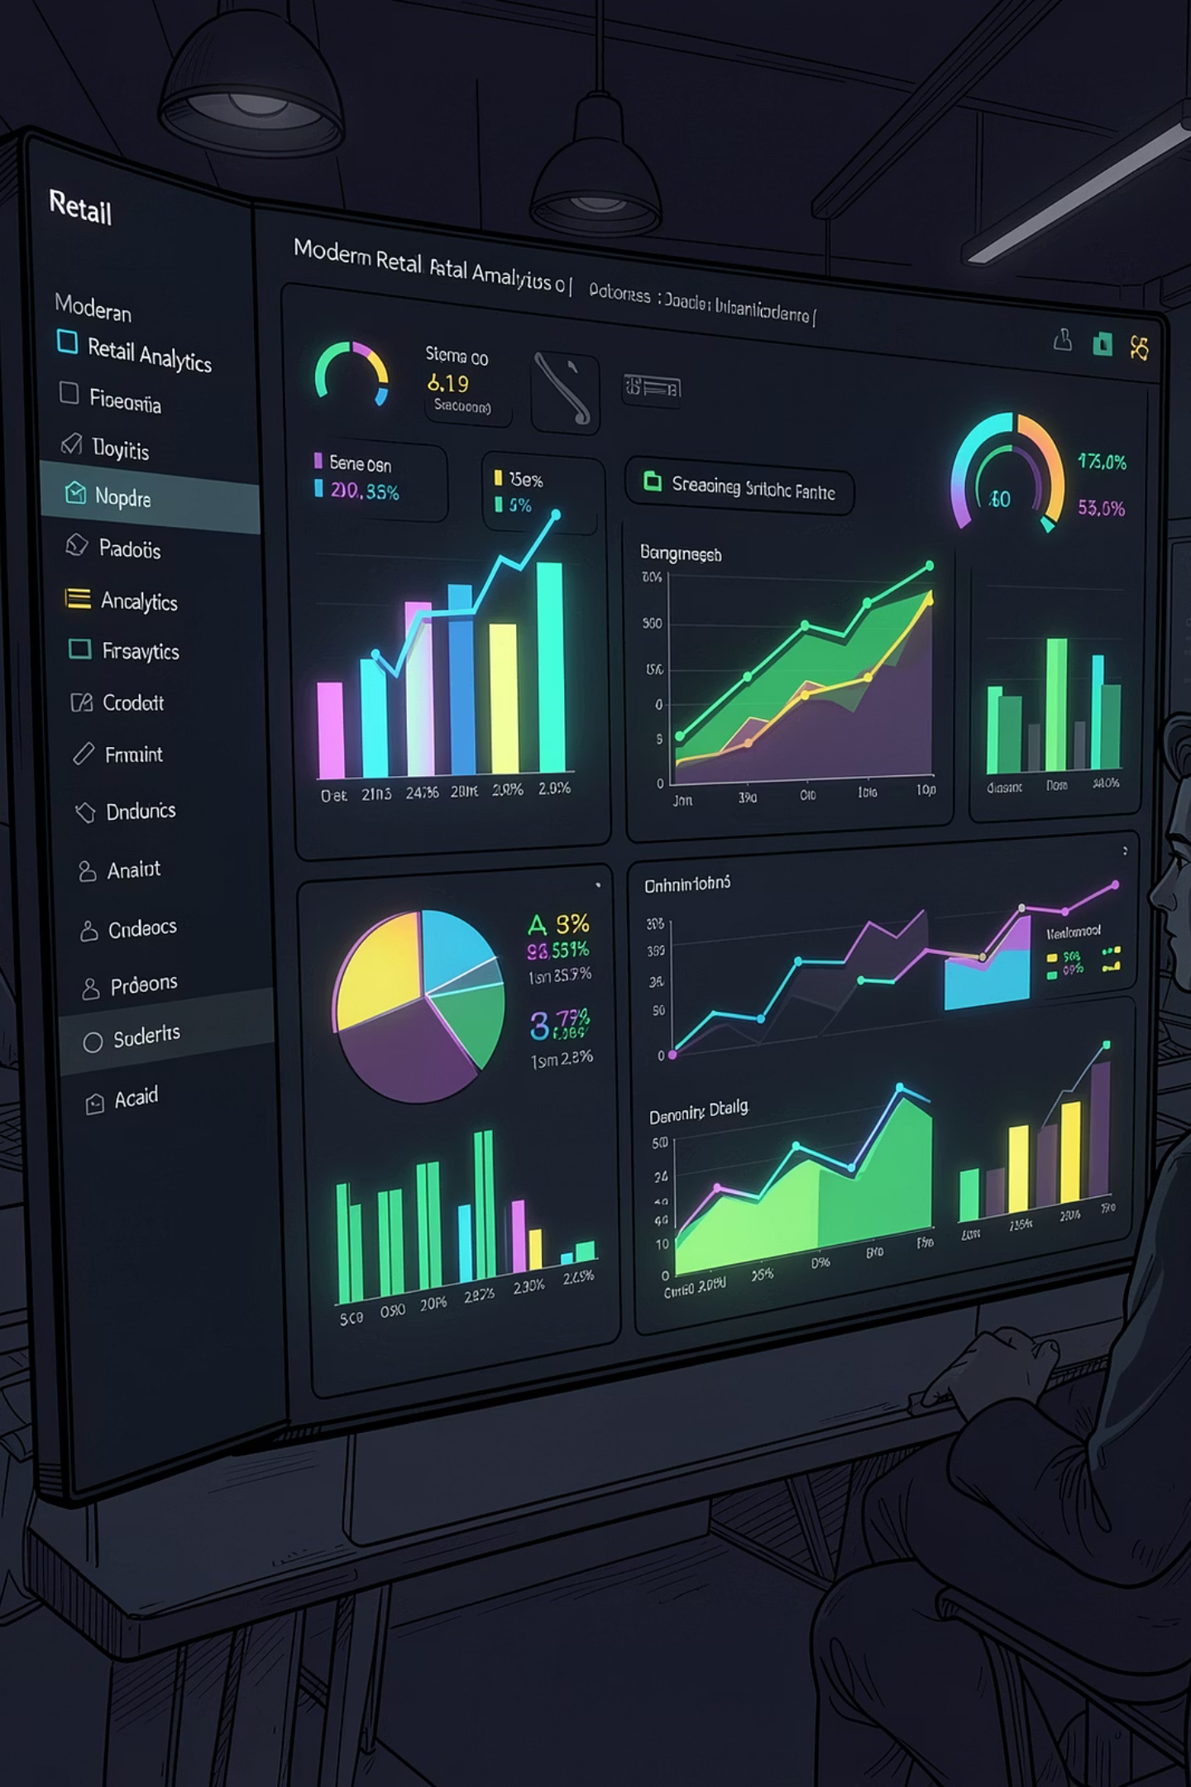
Customer Behavior & Retail Analytics
Transforming Retail Data into Actionable Business Insights
Prepared by: Aman | Stack: Python · Pandas · MySQL · Power BI

Slide 2


Why Customer Behavior Analytics Matters
Retail organizations generate massive transaction volumes daily — yet most struggle to extract meaningful signals from the noise. Analytics bridges that gap.
Personalization
Revenue Optimization
Data-driven insights enable tailored marketing and customer experiences at scale.
Identify high-value segments and spending triggers to maximize lifetime value.
Retention
Understand churn signals and subscription impact to improve customer loyalty.

Slide 3

The Business Challenge
The Problem
Retail organizations collect vast volumes of transactional data but rarely convert it into actionable strategy. Without structured analysis, opportunities for revenue growth and customer retention go undiscovered.
Project Goal
Analyze purchasing behavior and spending patterns
Identify revenue-driving customer segments
Evaluate subscription and shipping effectiveness
Build interactive BI dashboards for decision-makers

Slide 4
Project Objectives
Purchase Behavior
Spending Patterns
Analyze transaction frequency, basket size, and category preferences.
Uncover demographic and behavioral drivers of high-value purchases.
Subscription Performance
Customer Segmentation
Measure the revenue impact of subscription status on customer spend.
Classify customers by age, behavior, and loyalty for targeted strategy.
Shipping Preferences
BI Dashboards
Study how shipping type correlates with purchase value and satisfaction.
Deliver interactive Power BI reports for real-time business decisions.

Slide 5
Dataset at a Glance
3,900
18
37
Purchase Records
Features
Missing Values
Real-world retail transaction data
Demographics, behavior & transaction attributes
Identified and resolved during preprocessing
Key Attributes
Behavioral Features
Age & Gender
Product Category
Purchase Amount
Subscription Status
Shipping Type
Review Rating
Previous Purchases
Customer Tenure

Slide 6

End-to-End Analytics Workflow
Data Prep
Insights
Analytics
A structured, reproducible pipeline ensures data quality at every stage — from raw CSV to executive-ready dashboards. Each phase builds on the last, maintaining traceability and analytical rigor throughout the project.

Slide 7
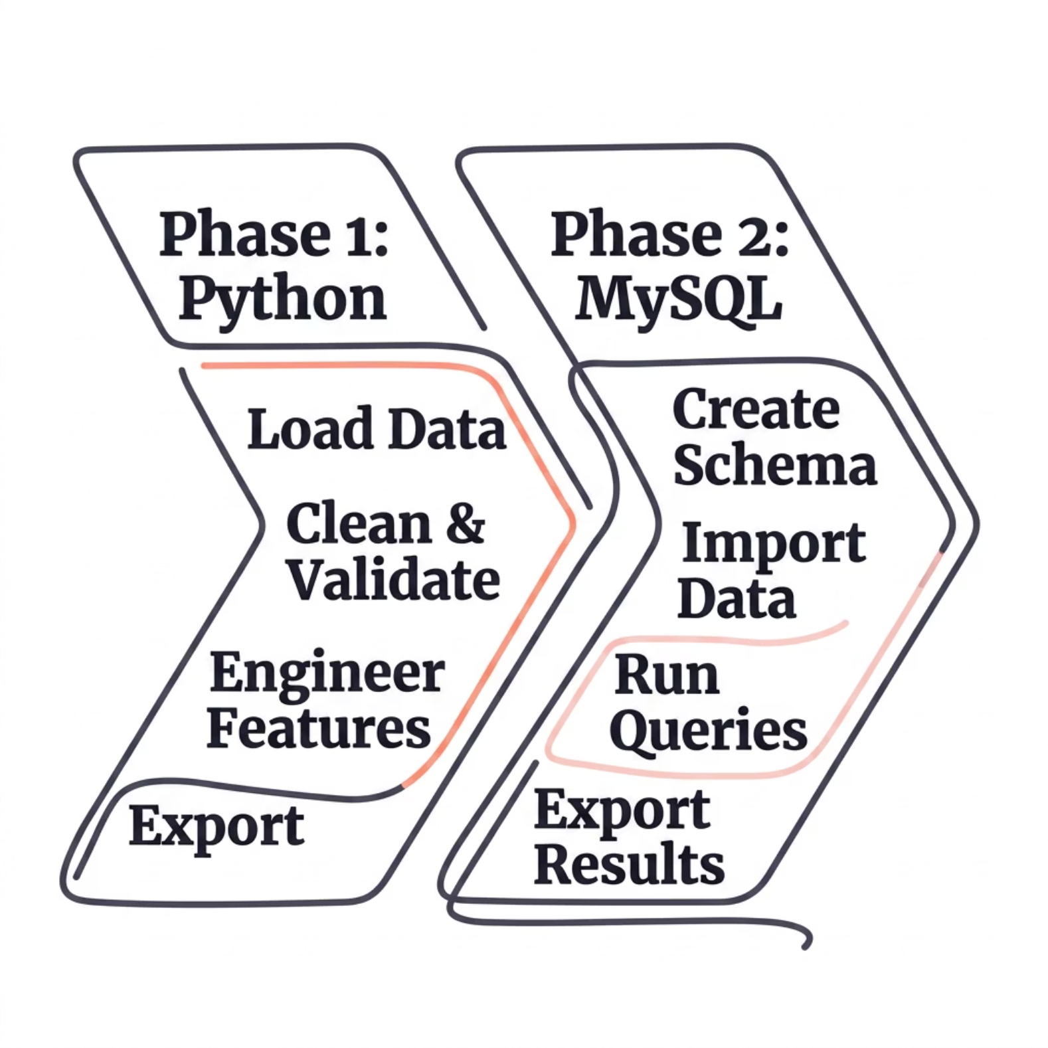
Data Engineering: Python & MySQL
Python Preprocessing
Loaded and profiled raw data using Pandas
Handled missing values and outliers systematically
Engineered features: Age Groups, Spending Tiers, Frequency Bands
Validated data types and enforced quality checks
MySQL Integration
Designed normalized table schema for retail data
Imported cleaned dataset via SQLAlchemy
Executed analytical queries for segmentation and revenue

Slide 8
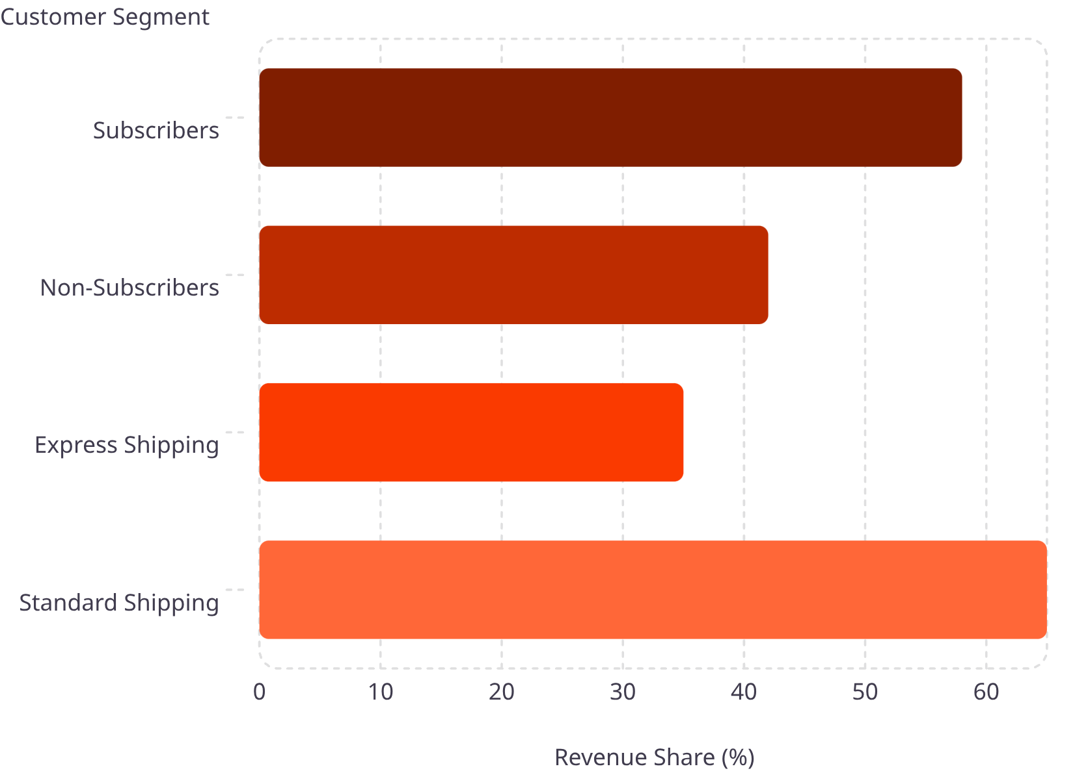

SQL Analytics: Key Analyses Performed
Analyses Conducted
Revenue by Gender — Female customers led in total spend
Revenue by Age Group — 35–44 segment drove highest value
Subscription Impact — Subscribers spent significantly more
Shipping Analysis — Express shipping correlated with higher AOV
Top-Rated Products — High ratings drove stronger engagement
All queries optimized for readability and reusable in production BI pipelines.

Slide 9
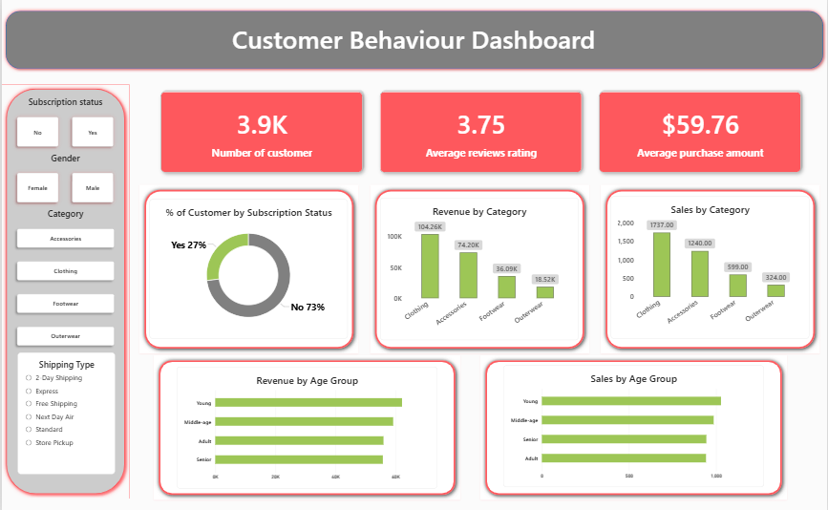
Interactive Power BI Dashboard
Revenue KPIs
Total sales, average order value, and revenue trends with dynamic period filters.
Customer Segmentation
Visual breakdown by age, gender, subscription status, and loyalty tier.
Product Performance
Category-level revenue, review ratings, and purchase frequency metrics.
Shipping & Subscription
Interactive filters to explore how shipping type and subscription drive spend.

Slide 10
Key Insights & Project Outcomes
Major Findings
Project Outcomes
Female customers generated slightly higher total revenue than male counterparts.
Cleaned and transformed 3,900+ records with Python
Built structured MySQL database with analytical schema
Delivered interactive Power BI dashboard with live filters
Generated actionable, data-backed business recommendations
Subscribers spent significantly more — validating subscription model ROI.
Express shipping customers showed higher average purchase values.
PYTHON
MYSQL
POWER BI
GITHUB
Loyal repeat customers contributed a major share of total revenue.

