Slide 1
Cross-Sell Propensity & Customer NPV
Who to target next, and what it's worth

Slide 2
The ask
Of our existing customers, which should we target for the next-product offer?
How sure are we the attributes we target on actually matter?
What is the long-term value of pursuing them?

Slide 3
Approach
45,211 customers, real UCI Bank Marketing data
Logistic regression (interpretable, odds ratios) vs. gradient boosting benchmark
Chi-square / t-tests + Benjamini-Hochberg correction to separate real drivers from noise
Calibration + cost-sensitive threshold so propensity x dollars is honest
Shallow decision tree segments customers into High/Med/Low target tiers

Slide 4
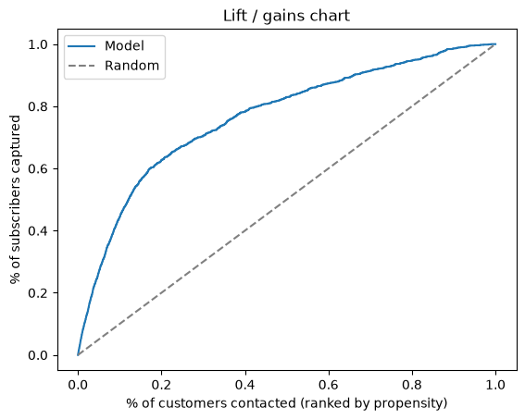
Key result
Logistic AUC 0.773 vs. GBM AUC 0.802
Logistic PR-AUC 0.419 vs. GBM PR-AUC 0.460
Real drivers (FDR-significant and practically important): poutcome, pdays, previous, campaign, month, contact, housing, job
Back-tested on held-out, out-of-time data: High-tier customers subscribed at a meaningfully higher rate

Slide 5
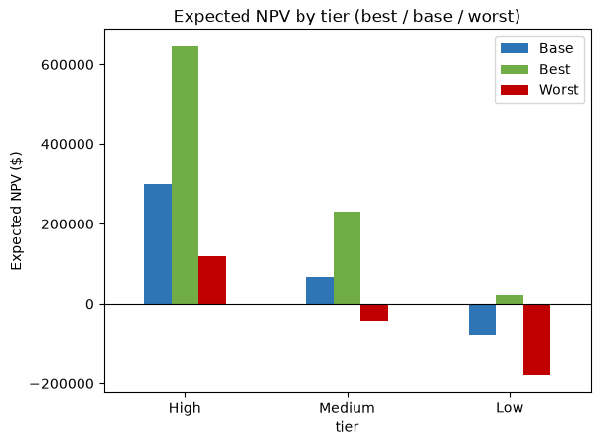
Recommendation
High tier: 300,278 expected NPV
Medium tier: 73,551 expected NPV
Low tier: -77,214 expected NPV
Target High + Medium tiers; full ranked list in target_list.csv
Assumptions (margin, retention, cost) are toggleable in npv_model.xlsx

