Slide 1

Agentic RAG Chatbot for Multi-Format Document QA using Model Context Protocol
Firm Name
Candidate Name & Email
SLRI Solutions, LLC
Aman Sharma
amansharma9605@gmail.com

Slide 2
Table of Contents
I
Problem Statement
3
II
Features and Objectives
4
III
System Architecture
5
IV
Tech Stack
6
V
Workflow
7
VI
Demo - Flow
8 - 11
VI
Challenges faced
12
VII
Errors and fixes
13
VIII
Conclusion
14
2

Slide 3

Problem Statement
Users often struggle to quickly extract relevant answers from large, multi-format documents.
There is a need for an intelligent system that can understand queries and return accurate, context-based responses—without manual searching.
Understand user queries,
Extract contextually relevant answers, and
Do so accurately and efficiently across multiple document formats.
3
2

Slide 4

Objectives
Features
Develop a modular chatbot capable of answering user queries using content from multi-format documents.
Leverage Retrieval-Augmented Generation (RAG) for accurate and context-driven responses.
Use a structured communication protocol (MCP) to coordinate between agents.
Ingestion of PDF, DOCX, PPTX, CSV, and TXT files.
Context-aware question answering.
Source-aware responses with traceable document chunks.
Web-based interface built using Streamlit.
4
2

Slide 5
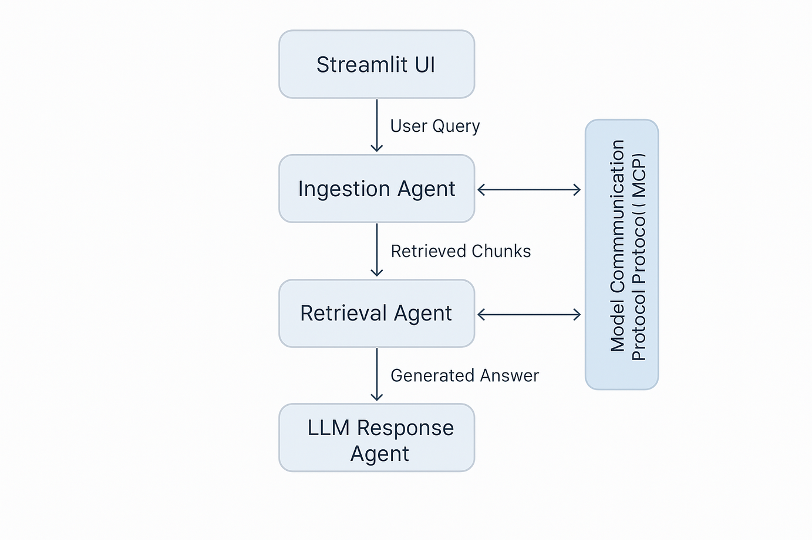
System Architecture
The Agentic RAG Chatbot follows a modular architecture comprising three agents:
Ingestion Agent: Processes and chunks uploaded documents.
Retrieval Agent: Indexes and retrieves relevant content using semantic search.
LLM Response Agent: Generates responses using a language model based on retrieved context.
5
2

Slide 6

Technology Stack
Technology Stack
Backend
Python – Core language for implementing agents and logic.
FAISS – Vector similarity search for efficient retrieval.
Sentence Transformers – Embedding generation for semantic search.
Groq / OpenAI API – Language model used for response generation.
Frontend
Streamlit – Web interface for document upload and user interaction.
Supporting Tools
PyMuPDF / python-docx / python-pptx – For parsing multi-format documents.
dotenv – For secure environment variable management.
Pickle – To persist document chunks.
6
2

Slide 7
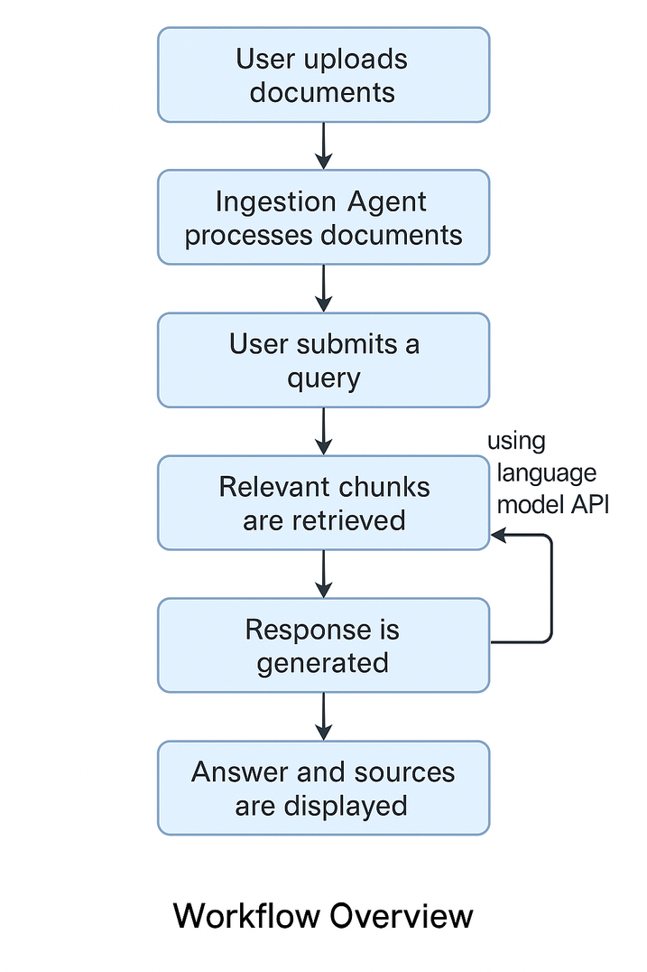
Workflow Overview
Document Upload
User uploads documents in various formats.
Document Ingestion
Ingested documents are chunked and embedded.
Vector Indexing
FAISS indexes document embeddings for fast retrieval.
Query Input
User submits a question related to the uploaded documents.
Context Retrieval
Top relevant chunks are retrieved from the index.
LLM Response Generation
Retrieved context is sent to LLM to generate an answer.
Answer Display
Final response and source chunks are shown to the user.
7
2

Slide 8
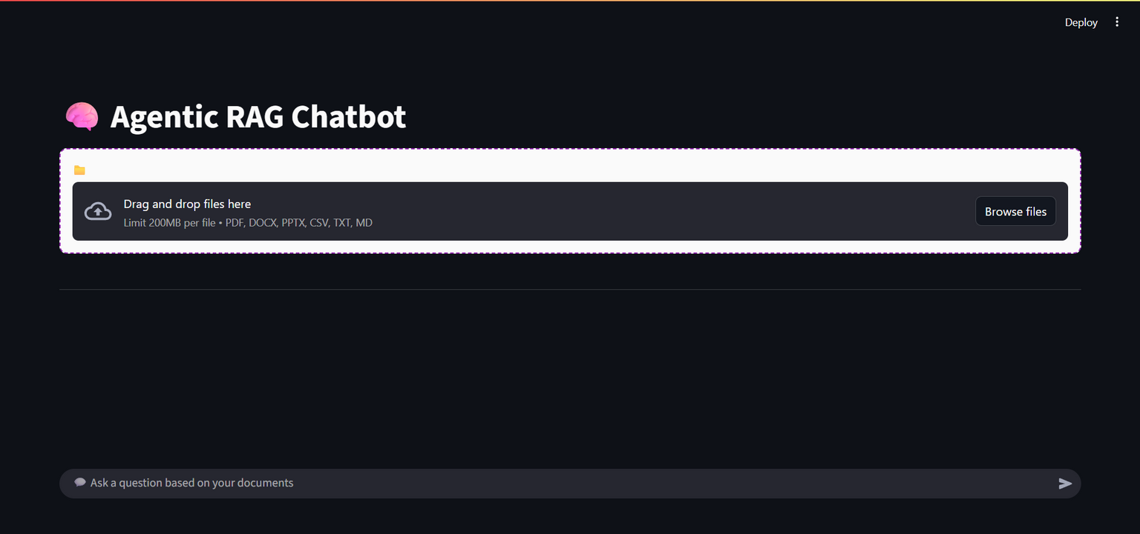
2025 August 24
Demo-flow
Launch : User opens the Streamlit-based web application.
8
2

Slide 9
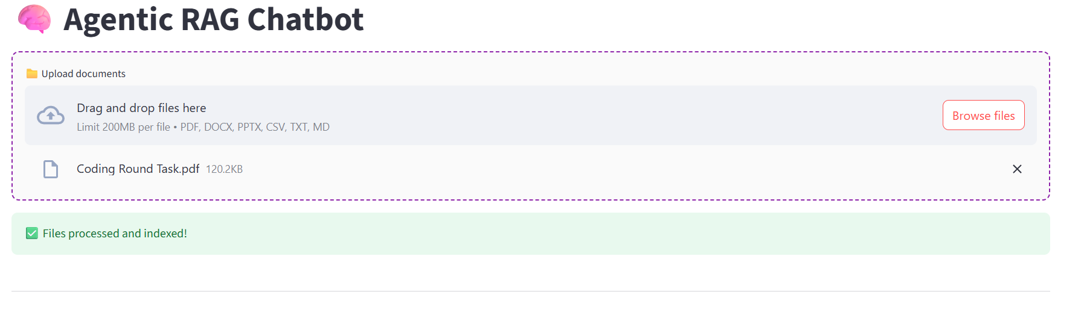
Demo-flow
Document Upload : User uploads one or more supported files (PDF, DOCX, PPTX, TXT, etc.).
9
2

Slide 10
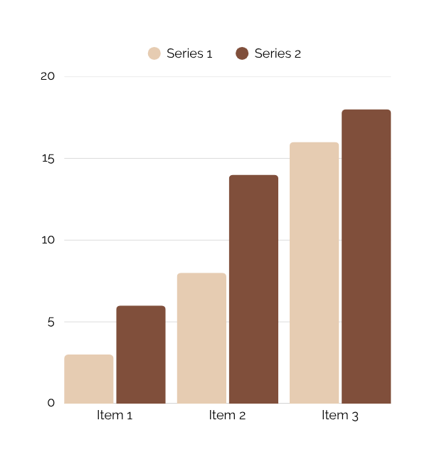
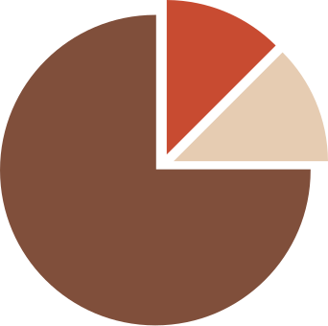
Demo-flow
Processing & Indexing : The system extracts text, generates embeddings, and indexes chunks.
10
2

Slide 11
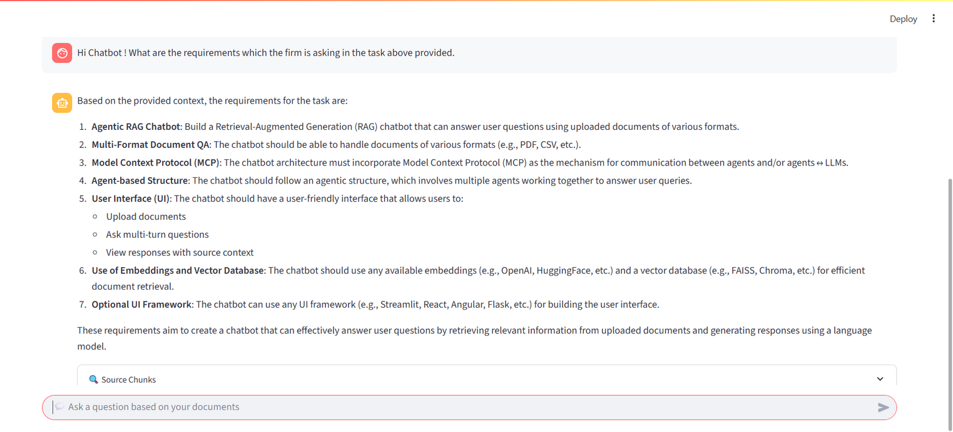
Demo-flow
Question & Response : User submits a question based on the uploaded documents. The system retrieves relevant content, generates an answer using the LLM, and displays it along with source references.
11
2

Slide 12
Challenges Faced
Multi-Format Parsing :
Ensuring reliable text extraction across varied file types (PDF, DOCX, PPTX, etc.).
Embedding Quality & Chunking :
Balancing chunk size and semantic clarity for accurate context retrieval.
LLM Integration Limits :
Managing API usage, rate limits, and deprecation of selected models.
Response Transparency :
Mapping generated answers back to precise source content.
UI Responsiveness :
Maintaining a smooth user experience within Streamlit's layout constraints.
12
2

Slide 13
Errors and fixes
1. Document Ingestion Failure
Issue: FileNotFoundError due to inconsistent file path handling during ingestion.
Resolution: Implemented robust file-saving logic using os.path.join and verified file presence before parsing.
2. Incomplete LLM API Response
Issue: KeyError: 'choices' when parsing the LLM response payload.
Resolution: Introduced structured error handling and added fallback checks for missing keys in API responses.
3. Hidden Environment Configuration
Issue: .env file not visible in development environment, affecting API key setup.
Resolution: Updated VS Code workspace settings to reveal hidden files and ensured .env inclusion in deployment configs.
4. Deprecated Model Usage
Issue: Groq API returned deprecation error for mixtral-8x7b-32768.
Resolution: Migrated to the supported llama3-8b-8192 model as per Groq’s official guidance and updated the .env accordingly.
13
2

Slide 14
Conclusion
Developed a modular Agentic RAG Chatbot for multi-format document QA.
Implemented using Model Context Protocol with agent-driven architecture.
Enabled source-aware responses for transparency and trust.
Ensured scalable retrieval and clean UI via FAISS and Streamlit.
Ready for further enhancements and enterprise integration.
14
2

Slide 15
Thank you
for the opportunity!
Firm Name
Candidate Name & Email
SLRI Solutions, LLC
Aman Sharma
amansharma9605@gmail.com
15

