Slide 1

Chat Summarization Bot with PEFT of LLM
By DeeP AMAN GANTa

Slide 2
Introduction
Project Goal:
To construct a conversation summarization bot by optimizing an existing large language model (LLM) using Parameter-Efficient Fine-Tuning (PEFT) approaches, such as Low-Rank Adaptation (LoRA).
Objectives:
Enhance the model's ability to provide quick, accurate overviews of chat discussions.
Apply Reinforcement Learning from Human Feedback (RLHF) to reduce toxicity in generated summaries and align the model better with human expectations.
Significance:
This project addresses the challenge of information overload in digital communication by developing a tool that can condense lengthy chat conversations into insightful summaries, making it highly relevant and intriguing.

Slide 3
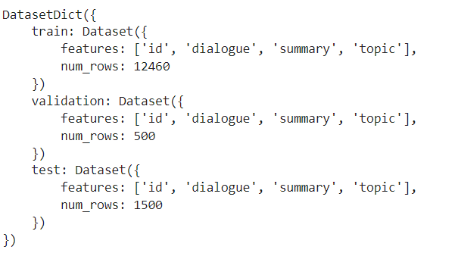
Dataset(DialogSum Corpus)
Our project's data comes from the DialogSum corpus in the Hugging Face datasets repository. A large-scale dialogue summarizing resource, this dataset was developed by Yulong Chen and colleagues and includes 13,460 talks with matching hand annotated summaries and themes. DialogSum offers a comprehensive and varied collection of task-oriented scenarios that address a wide range of everyday themes, including work, education, medicine, shopping, leisure, and travel. Language specialists analyze each interaction to make sure the summaries maintain significant named entities, are succinct, convey the most relevant information, and are presented in formal language from the viewpoint of an observer. With an extra 100 holdout conversations for topic creation, the dataset is divided into training (12,460 dialogues), validation (500 dialogues), and test sets (1,500 dialogues). A couple of the data snapshots are shown below.

Slide 4

Base Model
Google Research created the FLAN-T5 model, which stands for "Fine-tuned Language Net - T5".
Expands upon the T5 architecture by converting various NLP tasks into a common text-to-text format.
Instruction-based fine-tuning improves generalization and comprehension of task instructions.
Excels at tasks like chat summarization requiring sophisticated comprehension and generation.

Slide 5
Summarization Optimization with LoRA
Preprocessing Steps:
Removed the DialogSum dataset’s useless field "topic".
Experimented with several prompting strategies including one-shot, few-shot, and zero-shot procedures but the result is not good as expected.
Evaluation:
Assessed performance using ROUGE metrics on ten randomly selected conversations and their human-written summaries.

Slide 6
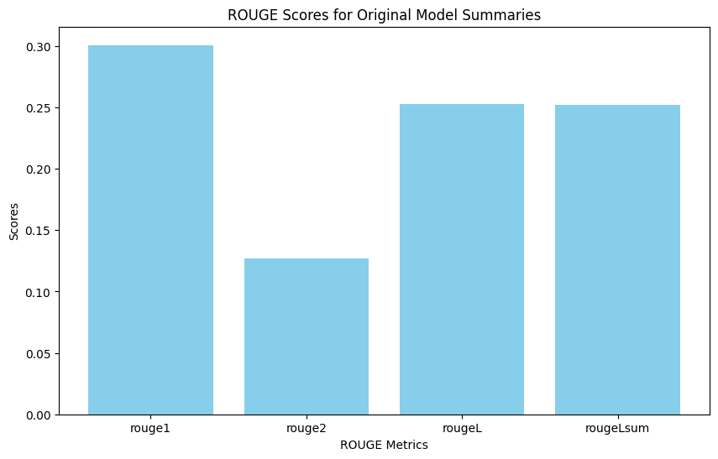
Initial Performance
Base FLAN-T5 Model Evaluation:
ROUGE-1: 0.300
ROUGE-2: 0.127
ROUGE-L: 0.253

Slide 7
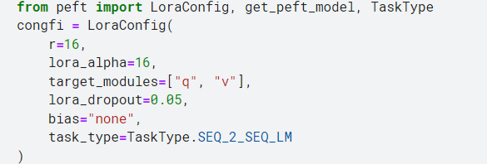
Training Setup
Approach:
Employed the PEFT (Parameter-Efficient Fine-Tuning) approach along with LoRA (Low-Rank Adaptation).
Environment:
Configured on PyTorch GPU 100, providing the necessary processing capacity for demanding training tasks.
LoRA Parameters:
r=16
lora_alpha=16
Targeted Modules: "q" and "v"
Bias-free dropout rate: 0.05
Trainable Parameters:
1,769,472 (0.7096414524241463% of the total parameter

Slide 8
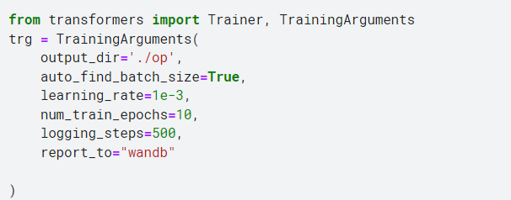
Training Arguments Setup
Learning rate: 1×10−3
Automatic batch size finder
Output directory for storing model checkpoints
Total training epochs: 10
Logging progress every 500 steps
Data sent to "wandb" for comprehensive tracking and metrics visualization

Slide 9
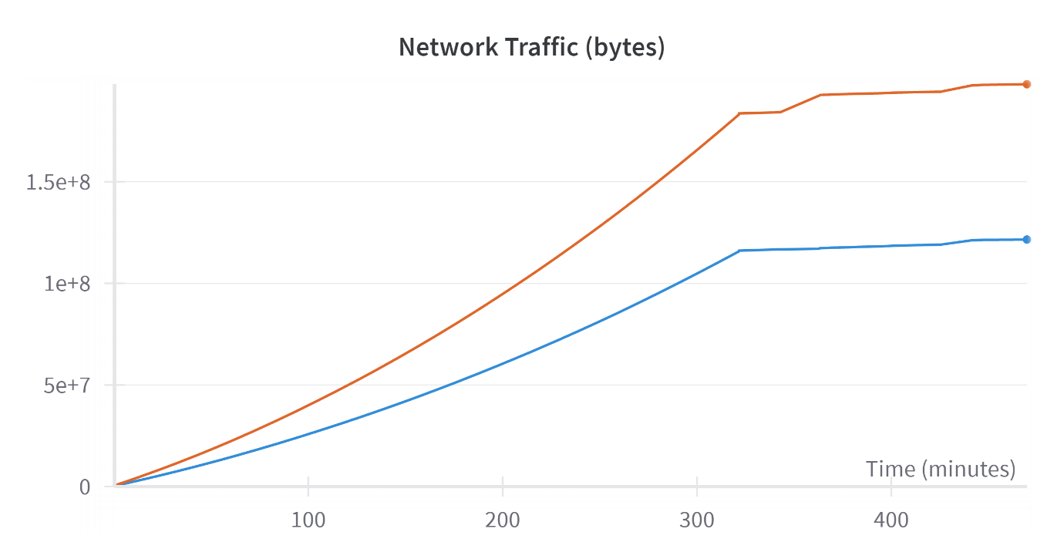
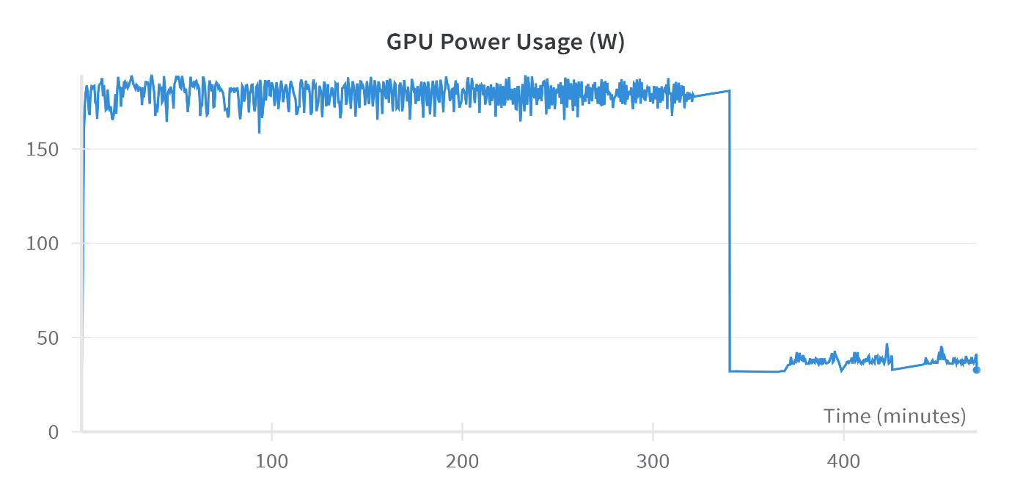
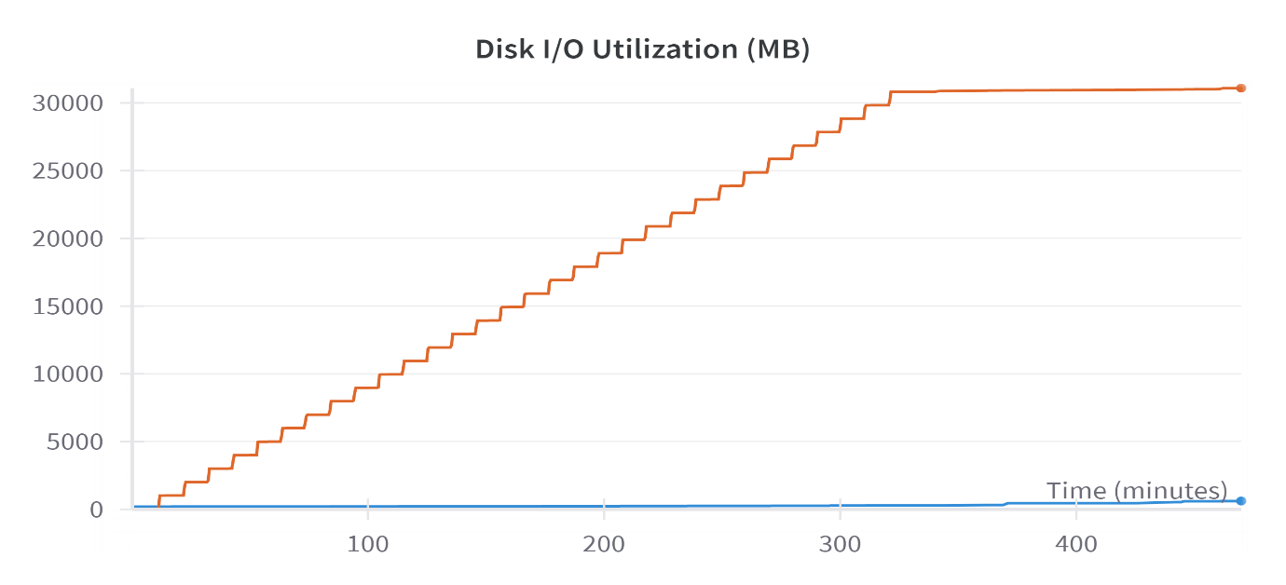
Resource Utilization
Network Traffic:
Steady increase in data sent between compute and storage units.
Disk I/O Use:
Periodic checkpointing and storing of model states.
GPU Power Usage:
High and stable power consumption during training.

Slide 10
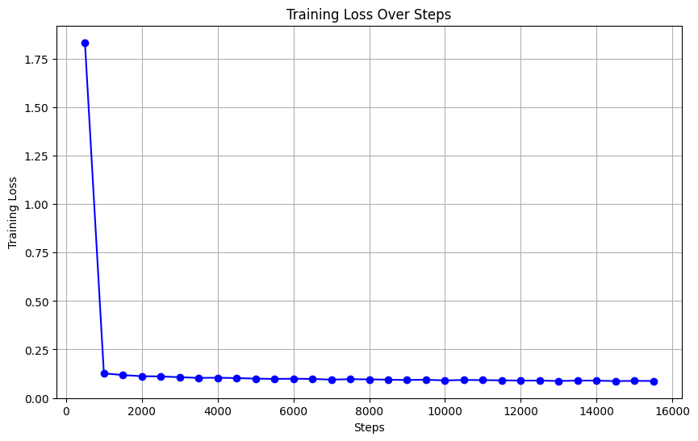
Training Loss
The training loss during the course of the training procedure is depicted in the chart. The training loss is much higher at start, but it rapidly decreases in the first few hundred steps and stabilizes at a much lower value for the duration of the training session. This quick decline shows that the model learned and converged effectively early in the training phase. Once the model has successfully learned the underlying patterns in the data, it is likely to sustain minimal error as training advances, as indicated by the continuously low training loss beyond the initial phase

Slide 11
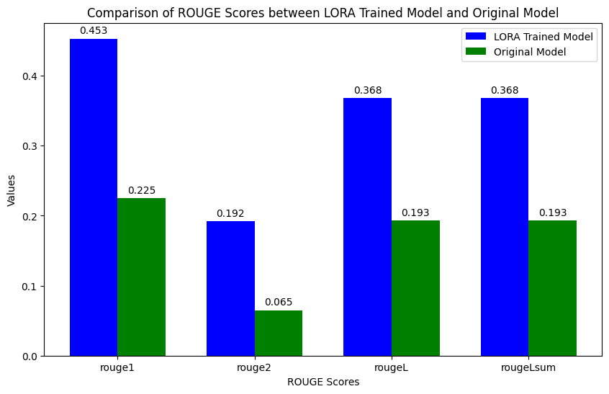
Comparison of Results
ROUGE Scores Comparison:
Significant improvements in all metrics with LoRA-trained model.
Metrics:
ROUGE-1: 0.453
ROUGE-2: 0.192
ROUGE-L: 0.368
ROUGE-Lsum: 0.368

Slide 12
Detailed Improvements
ROUGE-1:
LoRA trained model: 0.453
Improvement: 101.6%
ROUGE-2:
LoRA trained model: 0.192
Improvement: 195.7%
ROUGE-L:
LoRA trained model: 0.368
Improvement: 90.7%
ROUGE-Lsum:
LoRA trained model: 0.368
Improvement: 90.7%

Slide 13
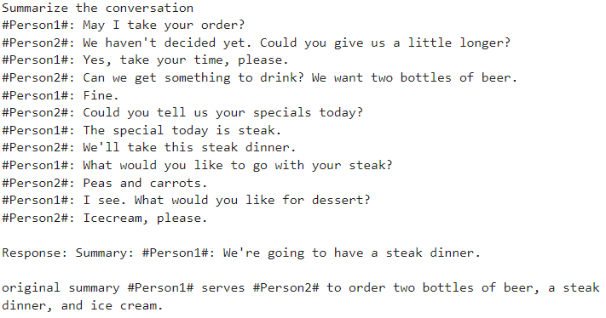
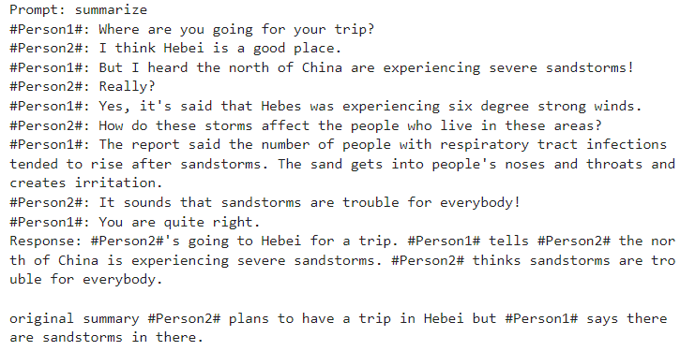
Qualitative Analysis
Before LoRA:
After LoRA:

Slide 14
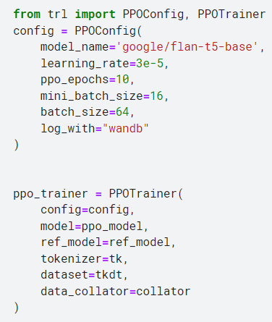
RLHF Training
Setup:
Built models and tokenizers using the transformers library and roberta-hate-speech-dynabench-r4.
Loaded a pre-trained FLAN-T5 model optimized for dialogue summarization.
Configured PEFT with LoRA for efficient fine-tuning and training.
Objective:
Generate non-toxic content aligned with human expectations.

Slide 15
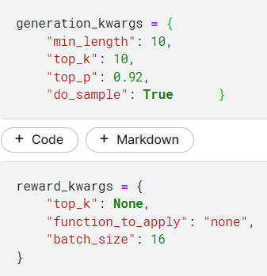
Training Process:
Reward Model:
Scored summaries based on human feedback by using
Facebook RoBERTa model.
Proximal Policy Optimization (PPO):
Maintained stable training with PPO.
Created a reference model for evaluation before PEFT
Trainable Parameters: 769
Total Parameters: 249,348,097
Percentage of Trainable Parameters: 0.0003%

Slide 16
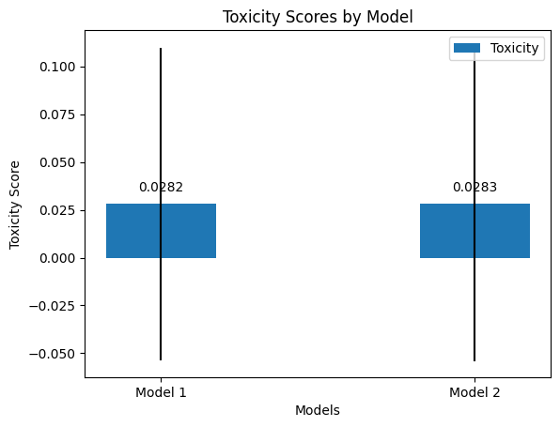
Evaluation:
Toxicity Measurement:
Baseline and post-training toxicity score: Mean: 0.028, Standard deviation: 0.082
No significant change, indicating effective control over toxicity.

Slide 17
Interface Design
User-Friendly Web Application:
Developed using Flask.
HTML and CSS
Pages:
Input page: Text area for input, "Summarize" button.
Result page: Displays summarized text.
Backend:
Powered by FLAN-T5 model fine-tuned for summarization tasks and avoiding toxicity.

Slide 18
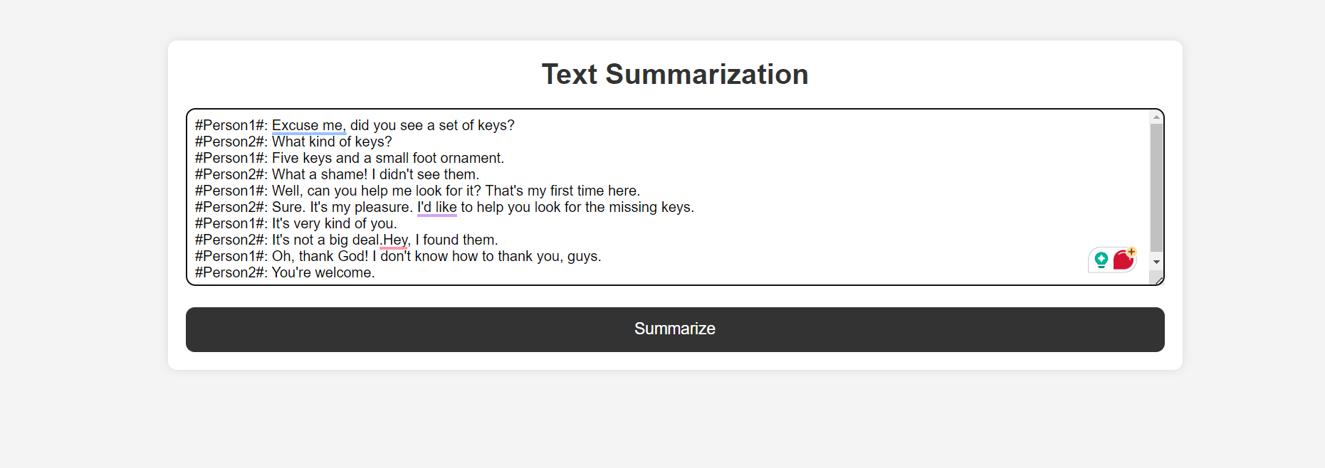
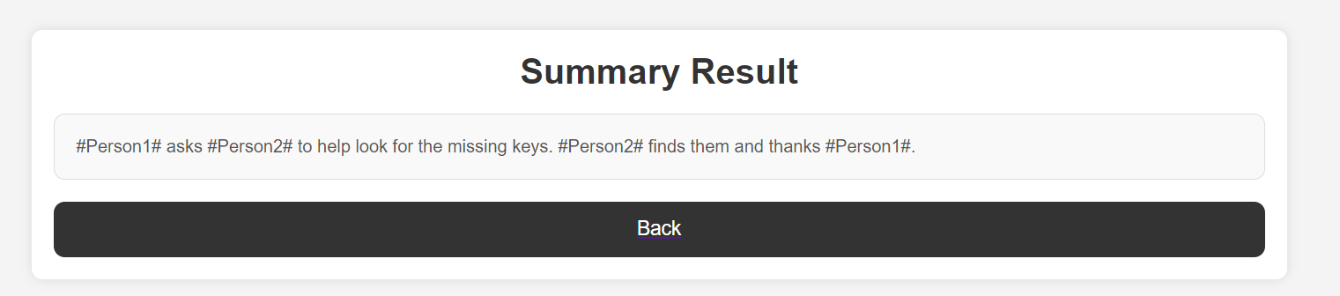
Interface
Input
output

Slide 19
Conclusion
Achievements:
Significant improvements in summarization quality, with ROUGE-1 increasing by 101.6% , ROUGE-2
by 195.7%, and ROUGE-L by 90.7% .
Efficient use of advanced NLP techniques, including PEFT and RLHF.
Future Work:
Explore further fine-tuning methods.
Implement additional evaluation metrics.

