Slide 1
Audio Noise Reduction Model
Team No.: 17
2242-CSE-6363-008 Machine Learning
Instructor: Prof. Farnaz Farahanipad
Team Members:
Aman Hogan Bailey
Karan Shah
Divya Shah

Slide 2
Overview
Introduction
Problem Statement
Project Approach
Project Flow
Demo
Current Methods
Limitations
Future Scope
Loading and Pre-processing
Feature Extraction
Learning Algorithms
Model Training
Model Evaluation
Audio Reconstruction

Slide 3
Introduction
Audio Noise Reduction Model is a machine learning model that will clear noisy audio input into clear audio output for better understanding.
We have taken opensource dataset of Columbia University to train our model.
We have used different machine learning models to train and test our dataset and to find best possible accuracy and outcome to denoise audio files.

Slide 4
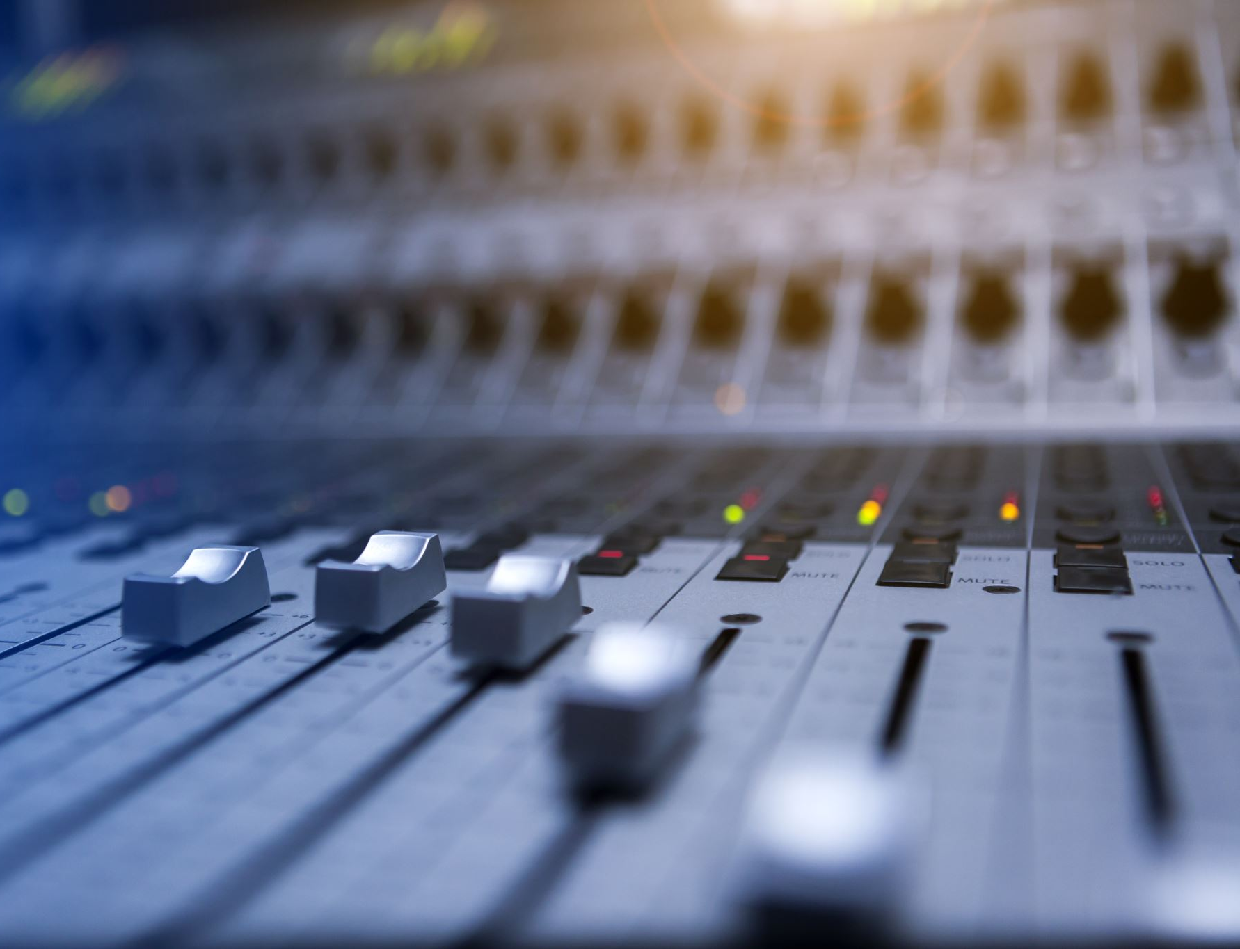
Problem Statement
Problem Statement: We aim to incorporate background noise reduction of audio to provide a clear audio output with the highest accuracy possible. We will also train the model with audio datasets to improve the efficiency of the model.
Challenge: Producing a clear audio file despite computational, space, and time limitations.

Slide 5
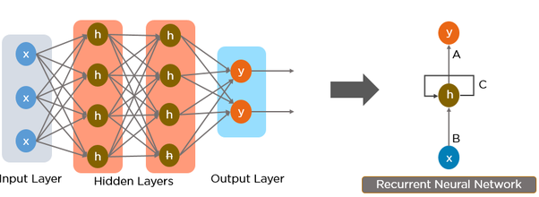
Project Approach
Typical Noise Reduction Methods
Wiener Filtering and Spectral Subtraction
‘Subtracts’ noisy audio signal from Clean audio. (Usually for real time data)
Downsides:
Assumes noise is stationary
Can cause speech distortions
Requires two audio signals
Strictly using CNN/RNNs
Trains a model on large datasets to learn complex, non-linear relationships between noisy inputs and clean outputs. (Usually for post processing)
Downsides:
Require significant amounts of labeled training data to perform well
Very computationally expensive
E = Y – N_k = estimate
Y = Signal + Noise
N = Noise
N_k = Filter

Slide 6
Project Approach
Our methodology
Our methodology combines both approaches to balance speed and accuracy:
Filter + a supervised or unsupervised learning algorithm
Model
Output
Training Data
Learning Algorithm
Input
Filter

Slide 7
Project Flow
Load Dataset
Machine Learning Model Training
Model Evaluation
Preprocess Data
Filter Method
Audio Reconstruction
Feature Extraction

Slide 8
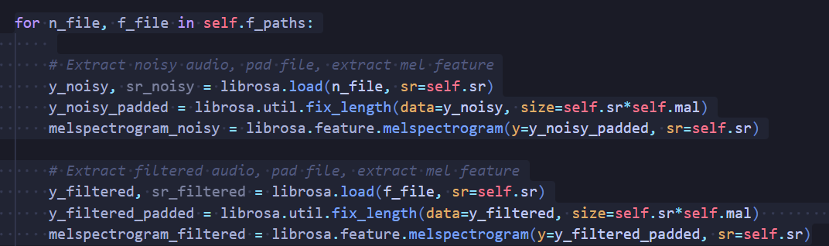
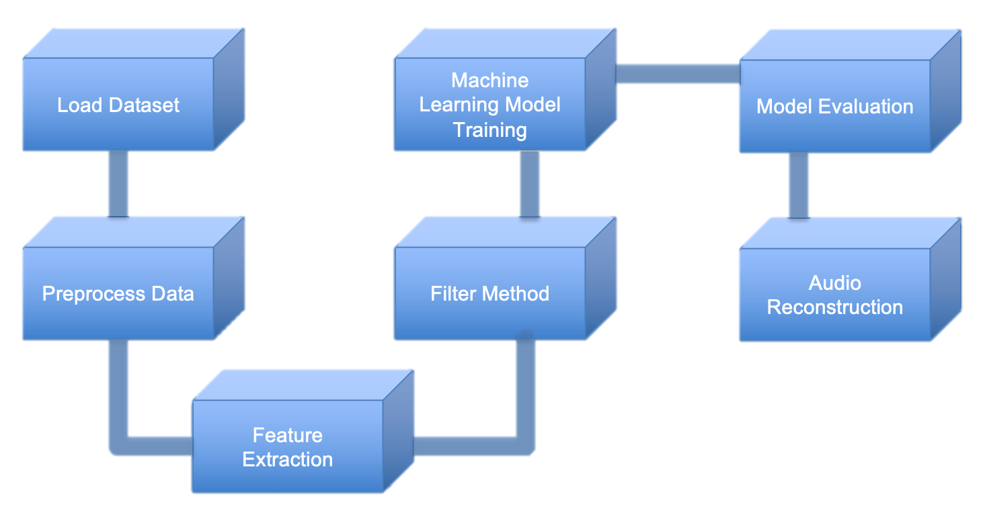
Loading and Pre-processing
Loading Dataset
Loading the dataset consisting of noisy and clean audio files which contains a mix of male and female voices and sentences, digits, and various noise types. (https://www.ee.columbia.edu/~dpwe/sounds/)
Data Pre-processing
We pad the audio files so to handle audio files of various lengths using their sample rate and max length of audio file.

Slide 9
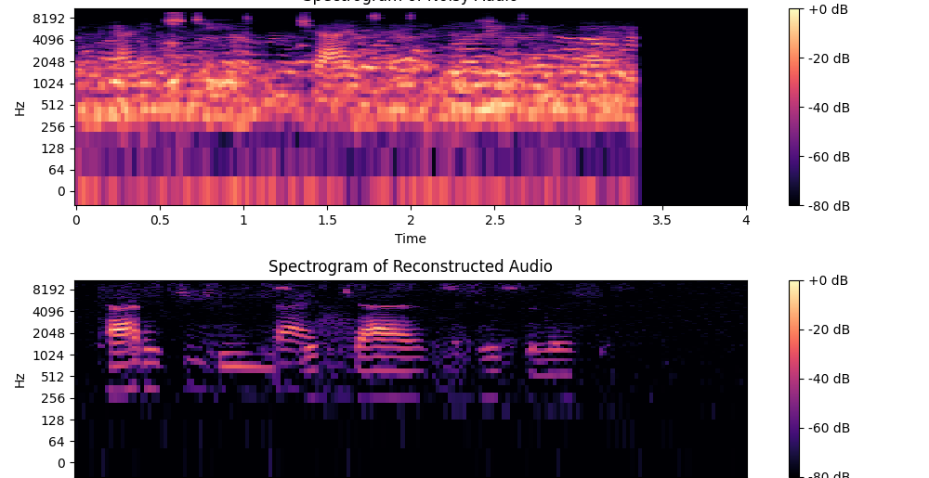
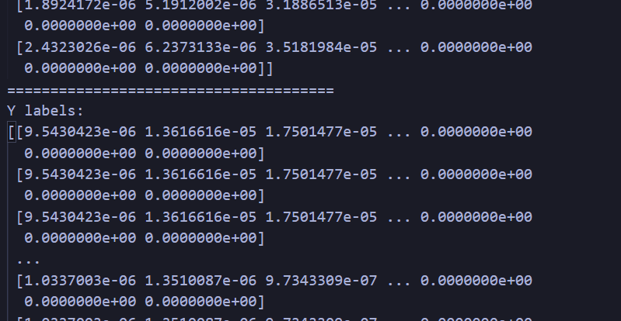
Feature Extraction
We extract a feature called the Mel spectrogram. This feature is essentially an array of magnitudes over time that stores meaningful audio data that we can visualize.
We extract the Mel Spectrogram for every sample to create our vectors.

Slide 10
Learning Algorithms
Random Forrest Bagging
Linear Regression
CNN Regression
KNN Regression
RNN Regression
Chosen Algorithms for our Model

Slide 11


Model Training
KNN Regression
Linear Regression
Random Forrest Bagging

Slide 12
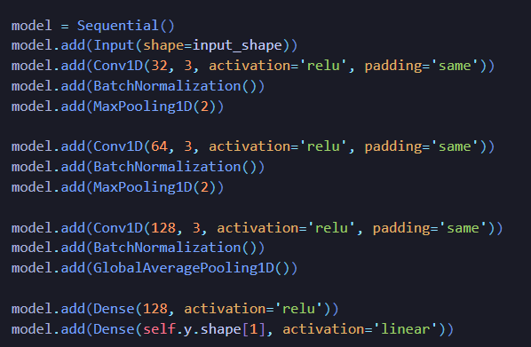
Model Training
CNN
RNN
RNN Architecture 3 x Bidirectional GRU's

Slide 13
Model Performance / Evaluation
NOTE: May have an extra slide explaining the model performance in detail if we need to hit a certain time.
NOTE: COMPARE KNN, LINEAR, RFB
USE: LOSS, MSE, R2
SHOW: ELBOW PLOT FOR KNN REGRESSION

Slide 14
Model Performance / Evaluation
NOTE: May have an extra slide explaining the model performance in detail if we need to hit a certain time.
NOTE: COMPARE KNN, LINEAR, RFB
USE: LOSS, MSE, R2
SHOW: ELBOW PLOT FOR KNN REGRESSION

Slide 15
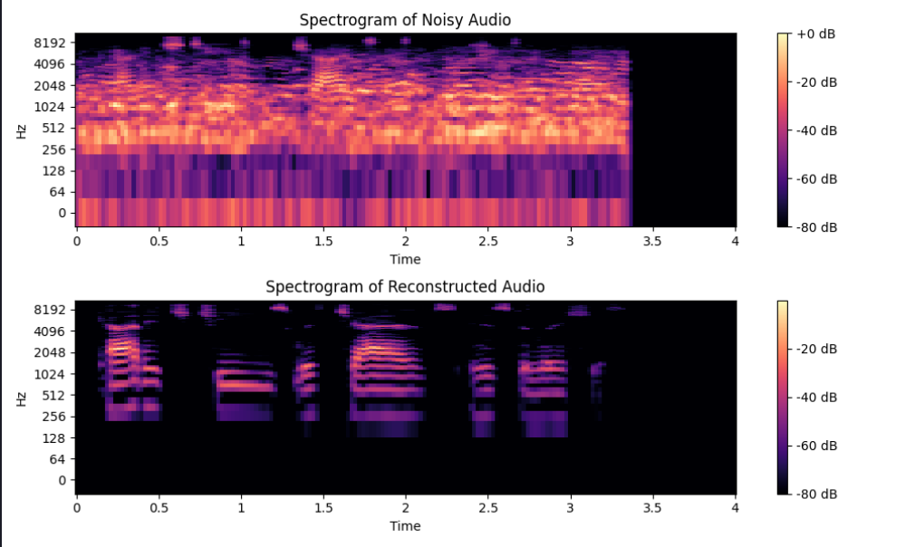
Audio Reconstruction
We convert our predicted vector achieved from our model from a Mel Spectrogram to a Short-Time Fourier Transform.
We convert our STFT back into a ‘.wav’ file

Slide 16
Demo

Slide 17
Model Comparison
Our Model v/s current methods / benchmarks
NOTE: Compare using a simple Weiner filter
NOTE: Compare current RNN’s and their runtime and dataset size with ours

Slide 18
Limitations
Space Limitation: Mozilla’s RNN model is trained using over 10,000 (100+ GB’s) hours of audio data. Ours only uses 30 minutes because we don’t have enough space.
Time Limitation: Our current CNN’s and RNN’s moved relatively slow because of the computational complexity.

Slide 19
Future Scope
To clear more complex and noisy data
To learn from real-time audio data
Apply to speech recognition software
To improve accuracy and efficiency by feeding large dataset

Slide 20
Thank You!!

